Slide 2
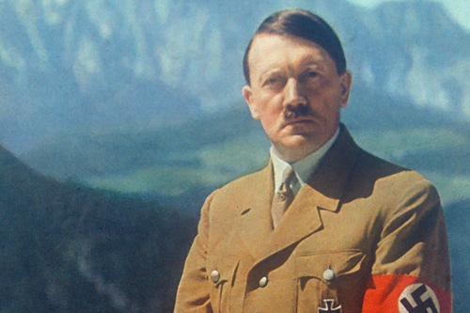
Sermons on the Psalms
Unjust Rulers
Psalm 58

Slide 3
There Always Have Been Wicked Rulers
“By me kings reign, And rulers decree justice. By me princes rule, and nobles, All the judges of the earth” (Prov. 8:15-16).
“For rulers are not a terror to good works, but to evil. Do you want to be unafraid of the authority? Do what is good, and you will have praise from the same. For he is God’s minister to you for good. But if you do evil, be afraid; for he does not bear the sword in vain; for he is God’s minister, an avenger to execute wrath on him who practices evil” (Rom. 13:3-4).
“Therefore submit yourselves to every ordinance of man for the Lord’s sake, whether to the king as supreme, or to governors, as to those who are sent by him for the punishment of evildoers and for the praise of those who do good” (1 Pet. 2:13-14).

Slide 4
Wickedness Undermines Government
“Righteousness exalts a nation, But sin is a reproach to any people” (Prov. 14:34).
“It is an abomination for kings to commit wickedness, For a throne is established by righteousness” (Prov. 16:12).
“Take away the wicked from before the king, And his throne will be established in righteousness” (Prov. 25:5).
Psalm 58 is a hymn that laments a country with unjust rulers and foretells the wicked’s certain demise.

Slide 5
The Challenge of Evil Rulers (58:1-2)
Do you indeed speak righteousness, you silent ones?
Do you judge uprightly, you sons of men?
No, in heart you work wickedness;
You weigh out the violence of your hands in the earth.
Psalm 58:1-2

Slide 6
Psalm 58:1
Three translations:
“Do ye indeed speak righteousness, O congregation? do ye judge uprightly, O ye sons of men?” (58:1, KJV).
“Do you indeed speak righteousness, you silent ones? Do you judge uprightly, you sons of men?” (58:1, NKJV).
“Do you indeed decree what is right, you gods? Do you judge the sons of men uprightly?” (58:1, RSV).

Slide 7
Who Is Intended?
The issue is how to translate the Hebrew word ’ēlām. Without going into a detailed examination of the Hebrew, the best conclusion is to understand the word as the plural form of ’ēl, meaning “gods.”
Evan Blackmore: “A similar plural is found in Psalm 82:6 where the meaning is beyond doubt because Jesus himself quoted and explained that ‘he called them gods unto whom the word of God came’ (John 10:34-36). Like that psalm this one is addressed to ‘children of the most High’ ( Psa. 82:6) who judge ‘unjustly’ (82:2). If those people can be called ‘gods,’ so could these” (Psalm 1-72: Truth Commentaries, 586).
See Exodus 22:8-9 where the translations “judges” (KJV,) or “God” (RSV) also appears.

Slide 8
The Situation
The opening word of Psalm 58:1-2 has hă interrogative, “Do you indeed (truly). . .?” The question expects the negative answer, “No!”
Rabbi Samson Raphael Hirsch: “It contains a reproach directed at those who, by virtue of their high position and station, should have deemed it their duty to intervene, both in word and in action, to put an end to the evil done in the land but who, instead, have kept complacently silent in the face of widespread lawlessness” (The Psalms, 306; cf. Keil and Delitzsch, Psalms 2:180).
The situation is that of wicked people who hold powerful positions distorting righteousness and uprightness in the nation.

Slide 9
Psalm 58:2
“No, in heart you work wickedness; You weigh out the violence of your hands in the earth” (58:2).
The crimes committed:
Wickedness (‘awlāh): “badness, malice, injustice” (HALOT, 798).
Violence (chāmās): “violence, wrong” (HALOT, 329).

Slide 10
Bible Examples: The House of Eli
Ignored the Bible’s regulation about the portion of the priests at sacrifices, causing the Lord’s worship to be abhorred (1 Sam. 2:13-17).
Eli’s sons lay with the women who assembled at the Tabernacle of the congregation (1 Sam. 2:22).
They ignored Eli’s rebuke (1 Sam. 2:25).
Eli was rebuked for honoring his sons more than God, to make yourselves fat with the chiefest of all the offering of Israel my people (1 Sam. 2:29).

Slide 11
Samuel’s House
Samuel’s house was no better than Eli’s house: “But his sons did not walk in his ways; they turned aside after dishonest gain, took bribes, and perverted justice” (1 Sam. 8:3).
Solomon wrote, “Moreover I saw under the sun: In the place of judgment, Wickedness was there; And in the place of righteousness, Iniquity was there. I said in my heart, God shall judge the righteous and the wicked, For there is a time there for every purpose and for every work” (Eccl. 3:16-17).

Slide 12
Examples of Unjust Rulers
Nine justices of the Supreme Court ruled in 1973 that the child in the womb of its mother is not human, with God-given inalienable rights.
Nine justices of the Supreme Court ruled on June 26, 2015 that homosexual marriages were legal.
Government decrees advocating the mutilation of teenaged children who may be (temporally) experiencing sexual dysphoria (perhaps influenced by government indoctrination classes that help create that dysphoria).
When the tools of government are used to suppress political dissent, to overlook the same crimes and/or worse crimes committed by one group of people, while lesser crimes committed by their opponents are prosecuted to the fullest extend of the law!

Slide 13
More Examples of Unjust Rulers
When threats against supreme court justices who are making an unpopular decision are ignored and unpunished.
When pro-choice protestors can burn down pro-life businesses but the least crimes against pro-abortion groups are punished to fullest extend of the hate crimes law.
When policemen are targeted and murdered, but not defended and protected.
When looting of stores across the country goes uninvestigated and unpunished.

Slide 14
The Influence of the Wicked (58:3-5)
The wicked are estranged from the womb;
They go astray as soon as they are born, speaking lies.
Their poison is like the poison of a serpent;
They are like the deaf cobra that stops its ear,
Which will not heed the voice of charmers,
Charming ever so skillfully.
Psalms 58:3-5

Slide 15
Psalm 58:3
“The wicked are estranged from the womb; They go astray as soon as they are born, speaking lies” (58:3).
This verse has long been misused by Calvinists to teach inherited depravity.
Notice that the ones being described are not new born infants.
They are able to “go astray” (tā’āh) ethically (HALOT, 1072) (cf. Ezek. 44:10; 48:11).
An infant is incapable of making ethical decisions.
He is unable to “go” anywhere; he lies on his back dependent upon others.
They “speak lies” (dōberê’ kāzāb). Newborns can not even speak, let alone to make a moral decision to tell lies.

Slide 16
What The Bible Says About Infants
A newborn is incapable of speaking either good or evil to even know good and evil.
“Moreover your little ones and your children, who you say will be victims, who today have no knowledge of good and evil, they shall go in there; to them I will give it, and they shall possess it” (Deut. 1:39).
“For before the Child shall know to refuse the evil and choose the good, the land that you dread will be forsaken by both her kings” (Isa. 7:16).
Whenever a person is old enough to make moral decisions and chooses to do evil, that child is “estranged” (zûr), “to turn aside from” (HALOT, 266).
How can a newborn who cannot even turn over in its bed, turn aside from following God’s way?

Slide 17
A Figure of Speech
The expression is a figure of speech called hyperbole, which is an exaggeration, in this case with the meaning “very early.”
To use this passage to teach that the guilt of Adam’s sin is imputed to babies born thousands of years later (or even a year later) is an abuse of the passage.
To use this passage to teach that a child inherits a corrupt, defiled nature from Adam is an abuse of this passage.
Whatever nature every other child receives at birth is the same kind of nature Jesus had, otherwise Jesus was not fully like us!

Slide 18
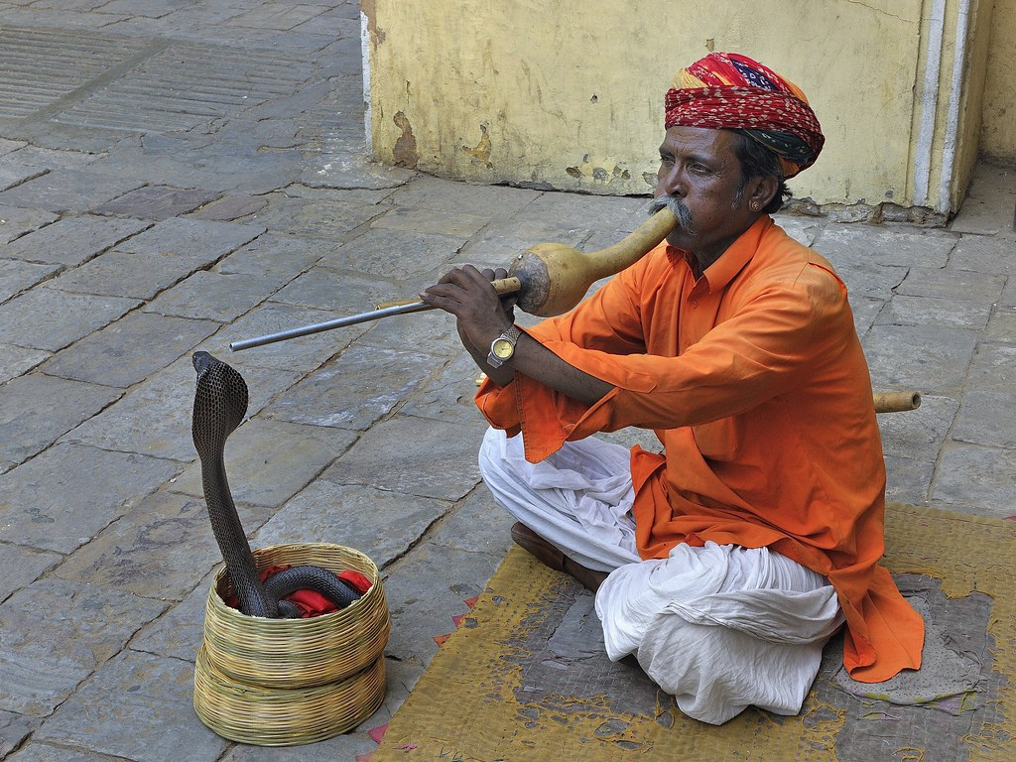
Psalm 58:4
“Their poison is like the poison of a serpent; They are like the deaf cobra that stops its ear” (58:4).

Slide 19
Their Poison
The wickedness of popular men is like the poison (chēmāh) of a serpent.
This picture recalls the serpent in the Garden of Eden.
Poison’s effect is life-threatening, and in this context, it threatens the entire nation.
“Their poison” is their deadly lies. “But no man can tame the tongue. It is an unruly evil, full of deadly poison” (James 3:8).

Slide 20
The Deaf Serpent
The reason for describing snakes as deaf is that they have no ears. Snakes can feel vibrations, but they have no ear drum.
A snake charmer tries to charm the snake by playing his pungi. Charming has nothing to do with the music and everything to do with the charmer waving a pungi, a reed instrument carved out of a gourd, in the snake’s face.
Snakes don’t have external ears and can perceive little more than low-frequency rumbles.
Derek Kidner: “G. S. Cansdale, who writes: ‘The cobra is the main subject of snake-charmers.… It is now agreed that all snakes are deaf, … and the charmer holds their attention by the movement of his pipe, not its music’” (Psalms 1–72: An Introduction and Commentary, 227).
Describing the serpent as “stops its ears” emphasizes that the charmer has no effect on the serpent and becomes a picture of one who refuses to hear and listen to God’s word (see v. 5).
Is there any better picture to describe unjust rulers?

Slide 21
Psalm 58:5
“Which will not heed the voice of charmers, Charming ever so skillfully” (Psa. 58:5).
This verse continues the picture of the cobra being charmed, which is deaf to the music its charmer is playing.
The word “charmers” is from the Pi’el participle of lāchaš being used as a noun.
The word means “whispering” and is used in this context with the meaning of “muttering incantations in a low voice” (HALOT, 527).
The phrase is an example of onomatopoeia, where the pronunciations imitate its meaning by the repeated use of Heth (ch sound), which occurs in each of the last four Hebrew words in the phrase “charmers, charming ever so skillfully.”

Slide 22
A Prayer for God to Destroy the Wicked Rulers (58:6-9)
Break their teeth in their mouth, O God!
Break out the fangs of the young lions, O Lord!
Let them flow away as waters which run continually;
When he bends his bow,
Let his arrows be as if cut in pieces.
Let them be like a snail which melts away as it goes,
Like a stillborn child of a woman, that they may not see the sun.
Before your pots can feel the burning thorns,
He shall take them away as with a whirlwind,
As in His living and burning wrath.
Psalms 58:6-8

Slide 23
Psalm 58:6
“Break their teeth in their mouth, O God! Break out the fangs of the young lions, O Lord!” (Psa. 58:6).
The Almighty is appealed to, first by the word’ĕlōhîm and then by YHWH, the personal name for God (Exod. 3:14).
The psalmist uses two words to ask for God to break the teeth and fangs of the wicked:
Hāras: “to break in pieces. . . 1. to tear down. . . to overthrow, ruin; 2. Metaphorically: to throw down a person from his position. . . 4. To break away the teeth” (HALOT, 256).
Nāthats: “to tear down, pull down. . . to smash (the teeth) of a young lion” (HALOT, 736).
Two words are used for teeth:
Shën: “the tooth of a person” (HALOT, 1594).
Maltā’ôth: “jaw-bone” (HALOT, 595). The English translations use “fangs,” meaning not the poisonous fangs of a serpent but “a large sharp tooth, especially a canine tooth of a dog or wolf.”

Slide 24
Why Is It Hard to Pray This Prayer?
It is difficult for me to pray for the destruction of another person because of Jesus’s instructions, “But I say to you, love your enemies, bless those who curse you, do good to those who hate you, and pray for those who spitefully use you and persecute you” (Matt. 5:44).
However, these Scriptures show that it is not God’s will that government be under the control of wickedness.
We see political favoritism, partiality shown in the judicial system, decisions made to obtain personal wealth stemming from an office holder’s greed, taking of bribes, the exaltation of those brazenly wicked and flaunting their wickedness in the face of those who have moral principles, etc.
We can and should pray for God to bring down and destroy those who abuse their positions and power for their own personal and political advantages.

Slide 25
Psalm 58:7
“Let them flow away as waters which run continually; When he bends his bow, Let his arrows be as if cut in pieces” (Psa. 58:7).
The Psalmist’s prayer for the destruction of the wicked in high places continues in this verse.
The first half of the verses prays that the wicked will be like flowing waters that quickly pass on downstream.
Mā’as in the Niphal is the secondary form of māsas which means “flow, run” (BDB, 549). Most all of the translations accept this translation.
The Hithpa’el form of hālak means “to part, disperse” referring to the flow of waters (HALOT, 249).

Slide 26
The Second Half of the Verse
The second half of the verse is more difficult.
The translations reflect some of the struggles to make sense of the Hebrew text.
“like grass let them be trodden down and wither” (58:7, RSV).
“when they draw the bow, let their arrows fall short” (58:7, NIV).
“when he aims his arrows, let them be blunted” (58:7, ESV).
Despite these differences, the sense is that the power of the wicked will end.

Slide 27
Psalm 58:8
“Let them be like a snail which melts away as it goes, Like a stillborn child of a woman, that they may not see the sun” (58:8).
The psalmist’s prayer continues to ask for the destruction of the wicked by comparing them to two things:
A snail (šabbĕlûl) that melts away (temes: “outflow, melting away,” HALOT, 1755) as it moves along a path on a hot day.
A stillborn child (nëphel: miscarriage, HALOT, 711) who never sees the sun, because it is born dead.
Again, the psalmist prays for the demise of the wicked, that their time of earth will quickly end.

Slide 28
Psalm 58:9
“Before your pots can feel the burning thorns, He shall take them away as with a whirlwind, As in His living and burning wrath” (58:9).
The first clause speaks of the suddenness of God’s judgment on the wicked.
“Pots” (sîr) were ceramic pots used for cooking.
“Thorns” (‘ātār) refers to brambles or buck-thorn bushes that were frequently used for heat in an oven or under a pot.
“Can feel” is translated from bîn, “to understand, see, to pay attention, to consider, to discern” (HALOT, 122). Usually it is used of sentient beings, but here is used of impersonal pots feeling the heat of the quick burning thorns.
God judgment against the wicked is compared to a whirlwind hitting the wicked.
The whirlwind is from a verb (śā’ar) that means “to carry off in the storm, blow away” (HALOT, 1343).
The “wrath” (chārôn) describes the burning anger of God (HALOT, 352) which is also said to be “living” (chay).

Slide 29
The Purge (58:10-11)
The righteous shall rejoice when he sees the vengeance;
He shall wash his feet in the blood of the wicked,
So that men will say,
“Surely there is a reward for the righteous;
Surely He is God who judges in the earth.”
Psalms 58:10-11

Slide 30
Psalm 58:10
“The righteous shall rejoice when he sees the vengeance; He shall wash his feet in the blood of the wicked” (58:10).
The divine destruction of the wicked causes the righteous to rejoice, much as the Allied troops rejoiced at the defeat of Hitler’s evil regime. It was not the joy of hatefulness of watching one’s enemies suffer, but rejoicing at the triumph of righteousness.
The “vengeance” (nāqām) is God’s “divine vengeance, retribution,” much as we expect to experience at the second coming of Jesus, and not one rejoicing in the taking of personal vengeance.
“When it goes well with the righteous, the city rejoices; And when the wicked perish, there is jubilation” (Prov. 11:10).

Slide 31
Psalm 58:11
“So that men will say, ‘Surely there is a reward for the righteous; Surely He is God who judges in the earth’” (58:11).
“Reward” (pĕrî) is literally “fruit,” and in this context “wages” (HALOT, 968).
There is reward for the righteous because there is a just God who judges the earth!

Slide 32
Conclusion

Slide 33
Take Aways
This psalm guides us in properly directing our emotions and spirit in the situation where wicked men control government and are taking it in directions contrary to God’s purpose and will.
We should pray for God’s will to be done in destroying these wicked leaders and we should rejoice when their administrations collapse.
This should not be the rejoicing of one political party winning over another, but the rejoicing that God’s will is done when wickedness is defeated and destroyed.

