Slide 2
Churches Come In All Sizes
Some are large, numbering in the thousands, even tens of thousands.
Some are small, with as few as two or more people meeting in a home.
The definition of church sizes is rather arbitrary, but here is one...
A small church is less than 200 members (80% of churches).
A medium church has 201-400 members (10% of churches).
A large church has 401+ members (10% of churches).
For most of us, even 200 members constitute a large church.
There is no scriptural size of a church.

Slide 3
Church at Jerusalem
The first day the gospel was preached, 3000 obeyed the gospel (Acts 2:41) and were added to the church (Acts 2:47).
This was the first church and it was a big church that continued to grow.
Soon it numbered 5000 (Acts 4:4).
The Bible does not reveal the number of members in any other New Testament church, but I suspect that the churches that Paul established and to which he wrote were mostly small congregations.

Slide 4
Planting Churches
When I first started preaching, a congregation which grew to 200-250 began to look for nearby communities where there was no church, locate several families going to the congregation who lived in the area, and encourage them to start a new congregation there.
Plainfield helped to start Mooresville, Danville, and Belleville.
Belmont Avenue started Lafayette Heights; 40th and Emerson started Eastside.
Sometimes congregations began as result of division in another congregation.
Today the trend is for the larger congregations to become small megachurches.

Slide 5
Advantages
Each size has its advantages.
The larger church . . .
Can do more things because of its increased resources.
Can do more things because it has more participants.
But there are benefits of small churches often lost in larger churches.
My purpose is not to encourage stagnation in church growth, but to remind us of the benefits (and obligations) of a small church lest we become discouraged.

Slide 6
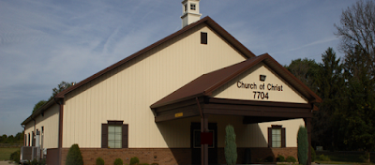
Benefits of A Small Church

Slide 7
A Large Number Is Not Necessary
It does not take a large number to have a church.
“For where two or three are gathered together in My name, I am there in the midst of them” (Matt. 18:20).
When persecution scattered the saints in Jerusalem, the result undoubtedly was the spawning of a number of small congregations.
“Therefore those who were scattered went everywhere preaching the word” (Acts 8:4).

Slide 8
House Churches
Priscilla and Acquila had a church meeting in their house while living in Ephesus (1 Cor. 16:19) and Rome (Rom. 16:3-5).
Nymphas in Laodicea had a church meeting in her house (Col. 4:15).
Philemon, who is thought to have lived at Colossae, had a church meeting in his house (Phile. 2).
In some countries where Christianity is banned, such as China and Iran, house churches are about the only option for a congregation.
As a child, I attended a church that met in a lady’s house and later in a barn-like building (that was later converted into a house) which Mom and Dad owned.
The largest congregation I was a member of before going away to college was about the size of Decatur Township. Even the largest church of which I have held membership is categorized by the word “small” in the listing cited at the beginning of this lesson.

Slide 9
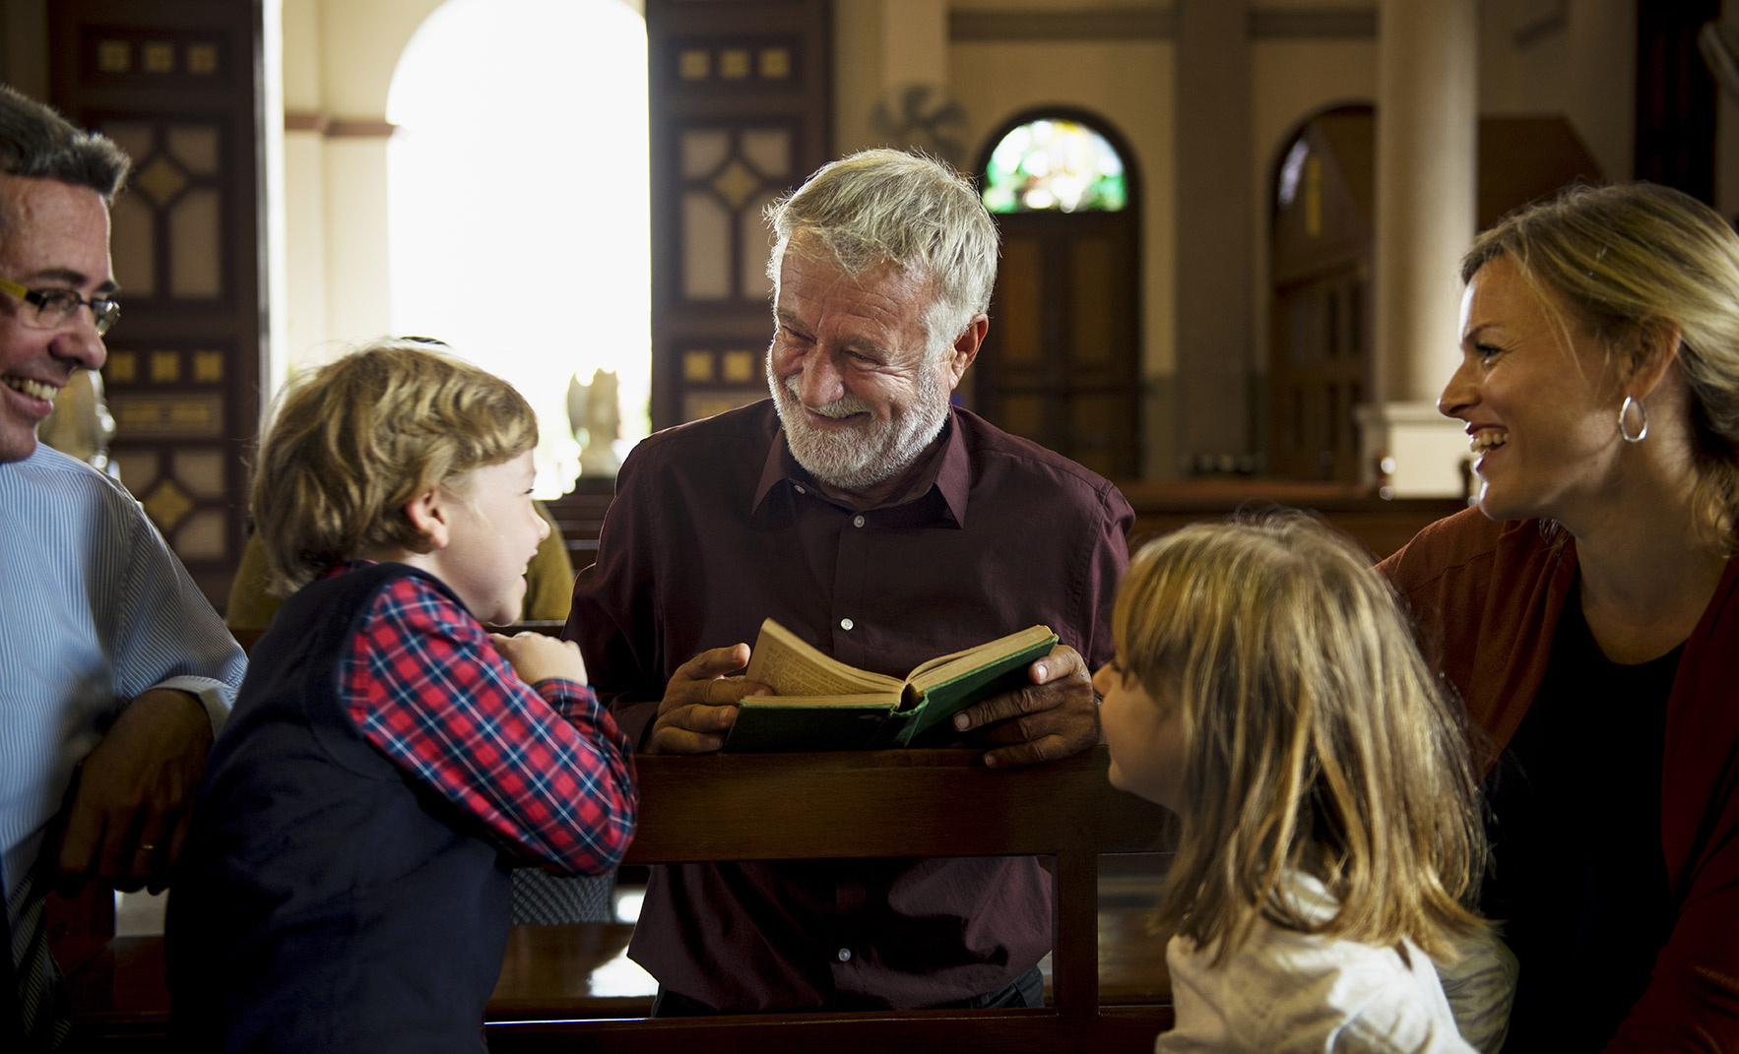
1. A Stronger Sense of Family

Slide 10
A Stronger Sense of Intimacy
A small church is one where almost everyone knows each another, allowing more intimacy among the entire membership.
Face-to-face interaction is much easier.
Even when we don’t remember a person’s name, we remember his “face.”
There is usually a more intimate knowledge of what is happening in the lives of each other.
One certainly does not tend to get lost in the crowd!

Slide 11
Family-Like Relationships
There is a true sense of family about a small congregation.
“Do not rebuke an older man, but exhort him as a father, younger men as brothers, older women as mothers, younger as sisters, with all purity” (1 Tim. 5:1-2).
“Then Peter began to say to Him, ‘See, we have left all and followed You.’ So Jesus answered and said, ‘Assuredly, I say to you, there is no one who has left house or brothers or sisters or father or mother or wife or children or lands, for My sake and the gospel’s, who shall not receive a hundredfold now in this time—houses and brothers and sisters and mothers and children and lands, with persecutions—and in the age to come, eternal life’” (Mark 10:28-30).
“Brother” and “sister” are not religious terms we use without meaning, they are terms that remind us that our spiritual bonds and closer than our blood bonds.

Slide 12
Cross-Generational Relationships
Even the young people interact with the elderly at a small congregation (e.g., Cale).
Young and old have opportunities to benefit from the strength of both age groups.
Young people have opportunity to relate to someone besides their peers.
Older people sometimes “adopt” the babies in a congregation, giving them gifts at different times of the year.
By contrast, a large church may allow little opportunity to know and visit older saints who have so much to share.

Slide 13
2. Greater Opportunities for Spiritual Growth
Everyone is needed in a small congregation.
The roles to fill are not that much different between large and small churches:
Roles such as serving in public worship, Bible classes, etc.
Whether large or small, the number of teachers, preachers, song leaders, etc. that are needed is about the same.
The ratio of roles to members is usually much greater in small churches.
Simply because we do not have a large pool of members to choose from, there are more numerous opportunities for you to be involved in public worship.

Slide 14
Large Churches Have Unused Talents
Larger churches often require a large rotation in its use of members.
Opportunities to preach, teach classes, serve in the public worship may be rare.
One may have the opportunity to be used only once in a long while.
In a large church of 300 or more, a person may have opportunity to lead in prayer only once a year, especially since some congregations have eliminated their evening worship services. My grandson has not had opportunity to lead in prayer or lead singing during his first year at Tampa.

Slide 15
Many More Opportunities to Serve
Smaller churches use those willing to serve much more frequently.
Both young and old Christians are by necessity used in public worship at times, whether out of filling in for someone else or by design.
Small churches are often the training ground where leaders for large churches develop their skills.

Slide 16
2. Absent Members Are Missed
One’s absence is more keenly felt in a small church.
Especially is this true when someone is needed to fulfill a certain role (e.g., Bible class teacher, song leader, preacher, etc.).
One’s absence can be overlooked for several weeks in a larger church, but almost always his absence is hardly felt.
For those needing encouragement, this is important.
It is too easy to get lost in a crowd, but this never occurs in a small congregation.
As members, we need people who watch out for our spiritual well being.

Slide 17
Watching For Each Other
“Brethren, if a man is overtaken in any trespass, you who are spiritual restore such a one in a spirit of gentleness, considering yourself lest you also be tempted. Bear one another’s burdens, and so fulfill the law of Christ” (Gal. 6:1-2).
“Brethren, if anyone among you wanders from the truth, and someone turns him back, let him know that he who turns a sinner from the error of his way will save a soul from death and cover a multitude of sins” (James 5:19-20).

Slide 18
Overlooked
Sometimes a person might miss for several weeks before he is even missed, despite the best efforts of those overseeing the larger congregation.
We need brethren who will take notice when we begin to show signs of weakness.

Slide 19
3. Smaller Churches Produce Leaders
Members of large congregations may feel superior to the small congregations, but proportionally speaking, more preachers, teachers, elders, and average members have been developed by small churches than large churches.

Slide 20
Conclusion

Slide 21
Take Advantages of Your Opportunities
What would it be worth to you to have the opportunity to sit down and talk one on one with a parent who has raised his children to be faithful to the Lord, to a husband/wife who have lived together for 50-60 years so that you could ask them how they did it?
You have that opportunity in a smaller church.

