Slide 2
Favorite Texts from . . .

Slide 3
Historical Context
The historical context in which this letter from Paul to the Philippians is that Paul was under house arrest in Rome (Acts 28:30-31).
The brethren at Philippi had heard about Paul’s circumstances and had inquired about how he was doing.
Therefore, verse 12 begins a section in which Paul is answering their inquiry: “But I want you to know, brethren. . . .”

Slide 4
What I Would Want Brethren to Know
I probably would complain that I cannot do much of anything because I am handcuffed to a guard.
I might have complained about my shackles, the food that I have to eat, and my other physical circumstances. We recognize that all of us are pretty good complainers.
Let’s learn from Paul.

Slide 5
Philippians 1:12-17
“But I want you to know, brethren, that the things which happened to me have actually turned out for the furtherance of the gospel, so that it has become evident to the whole palace guard, and to all the rest, that my chains are in Christ; and most of the brethren in the Lord, having become confident by my chains, are much more bold to speak the word without fear. Some indeed preach Christ even from envy and strife, and some also from good will: The former preach Christ from selfish ambition, not sincerely, supposing to add affliction to my chains; but the latter out of love, knowing that I am appointed for the defense of the gospel. “

Slide 6
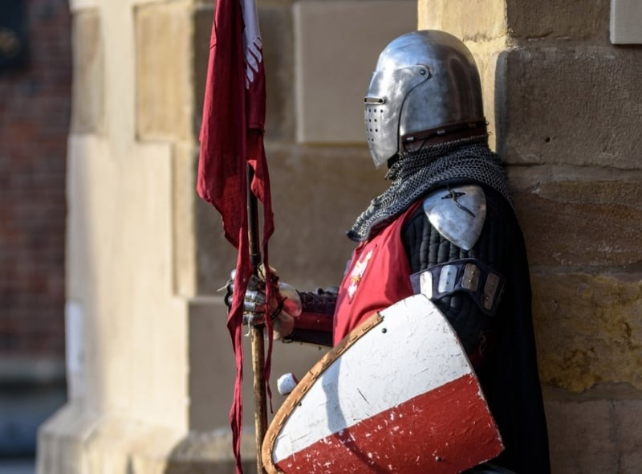
“I Am Appointed for the Defense of the Gospel”
Phil. 1:17

Slide 7
1. What Paul Wants the Philippians to Know

Slide 8
For the Furtherance of the Gospel
While the Philippians were concerned about Paul’s welfare, he wanted them to know that the things that befell him had actually helped to advance the gospel.
The word proskopē (furtherance) means “a movement forward to an improved state, progress, advancement, furtherance” (BDAG, 871).
Ralph P. Martin commented that this word describes “advancement in spite of obstructions and dangers which would block the path of the traveller” (Philippians: An Introduction and Commentary, 75).
Paul had long desired to preach in Rome (Rom. 1:10-13; 15:22-24).

Slide 9
Paul’s Circumstances
That his suffering for the gospel had become known among the soldiers bound to him and also to many others (1:13).
It must have seemed strange to the Roman soldiers that. . .
One would be willing to suffer for his faith in someone who had been crucified.
He was not a political threat to the administration in power nor a civil wrongdoer guilty of some kind of crime.
He bore the punishment with such grace. Martin commented, “For Christ (lit. ‘in Christ’) may also be taken to mean that it was Paul’s example of the way in which he bore his suffering in Christ, i.e. as a Christian in union with his Lord, that gave point and power to his witness” (ibid., 75).

Slide 10
Word Spread
Word of this prisoner spread throughout the ranks. “In the whole paretorian (or imperial) guard” (BDAG, 859) word about Paul spread.
In Philippians 4:22, Paul wrote, “All the saints greet you, but especially those who are of Caesar’s household” (Phil. 4:22).
This may be the advancement of the gospel to which Paul was referring.

Slide 11
A Second Effect
A second effect of his imprisonment is also described: “and most of the brethren in the Lord, having become confident by my chains, are much more bold to speak the word without fear” (Phil. 1:14).
His suffering for Christ emboldened others to preach the gospel!
They saw the fortitude of Paul and were encouraged to give more and bolder testimony about the Lord.
Rather than Paul’s chains intimidating others so that they would give up their faith, it fostered their resolve to more boldly speak the word without fear.

Slide 12
Same as Jerusalem Saints
It had the same effect when the Jewish leaders tried to stamp out early Christianity when Peter and John were arrested after the miracle at the Beautiful Gate in Jerusalem:
“Now when they saw the boldness of Peter and John, and perceived that they were uneducated and untrained men, they marveled. And they realized that they had been with Jesus” (Acts 4:13).

Slide 13
Peter and John in Acts 4:23-30
And being let go, they went to their own companions and reported all that the chief priests and elders had said to them. So when they heard that, they raised their voice to God with one accord and said: “Lord, You are God, who made heaven and earth and the sea, and all that is in them, who by the mouth of Your servant David have said: ‘Why did the nations rage, And the people plot vain things? The kings of the earth took their stand, And the rulers were gathered together Against the Lord and against His Christ.’ For truly against Your holy Servant Jesus, whom You anointed, both Herod and Pontius Pilate, with the Gentiles and the people of Israel, were gathered together to do whatever Your hand and Your purpose determined before to be done. Now, Lord, look on their threats, and grant to Your servants that with all boldness they may speak Your word, by stretching out Your hand to heal, and that signs and wonders may be done through the name of Your holy Servant Jesus.”

Slide 14
God’s Answer to the Prayer
The prayer of these early brethren is inspiring to others.
Its effect was powerful: “And when they had prayed, the place where they were assembled together was shaken; and they were all filled with the Holy Spirit, and they spoke the word of God with boldness” (Acts 4:31).

Slide 15
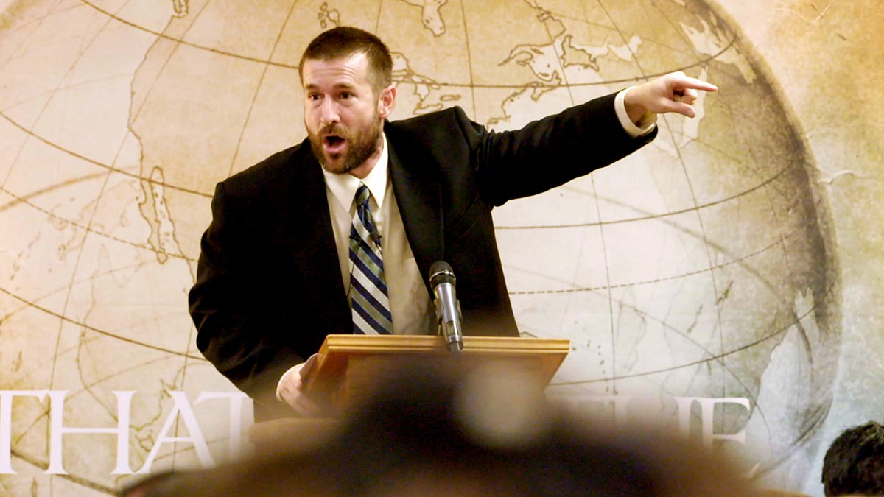
2. Some Preachers Have Evil Motives

Slide 16
Base Motives
“Envy” (phthonos): the Greek word means “envy, jealousy” (BDAG, 1054). Louw-Nida commented, “a state of ill will toward someone because of some real or presumed advantage experienced by such a person—‘envy, jealousy’” (Greek-English Lexicon of the New Testament: Based on Semantic Domains, 759).
“Strife” (eris): “engagement in rivalry, especially with reference to positions taken in a matter, strife, discord, contention” (BDAG, 392).
“Selfish ambition” (eritheia): the word describes “a self-seeking pursuit of political office by unfair means.” The suggested meaning in this context is “strife, contentiousness” (BDAG, 393).
“Not sincerely” (ouch hagnōs): the word hagnōs means “purely, sincerely.” The negative emphasizes that their motives were not sincere.
Notice that there is nothing spoken about the content of what is preached; the problem was their seeking to advance themselves at Paul’s expense.

Slide 17
Proper Motives
“Goodwill” (eudokia): “state or condition of being kindly disposed, good will of humans” (BDAG, 404).
“Love” (agapē): “the quality of warm regard for and interest in another, esteem, affection, regard, love” (BDAG, 6).

Slide 18
Who Were These Men?
The goal of those condemned by Paul was to “add affliction to my chains” (1:16).
This group is hard define.
There is nothing to indicate that they were teaching false doctrine.
There purpose was simply to increase Paul’s affliction through their preaching.
Yet, Paul was satisfied that the gospel was being preached and that it could lead to others being saved: “What then? Only that in every way, whether in pretense or in truth, Christ is preached; and in this I rejoice, yes, and will rejoice” (1:18).

Slide 19
3. I Am Set for the Defense of the Gospel

Slide 20
Definitions
“Set” (keimai): “be appointed, set, destined” (BDAG, 537). Ralph Martin wrote that keimai “is a military term, emphasizing the point that in prison he is enduring hardness as a good soldier of Jesus Christ (cf. 2 Tim. 2:3–4), and as much ‘on duty’ as the guards posted to watch over him are on duty in the service of Rome” (ibid., 80).
“Defense” (apologia): “a speech of defense, defense, reply; . . . the act of making a defense” (BDAG, 117). This word appears eight times in the New Testament (Acts 22:1; 25:16; 1 Cor. 9:3; 2 Cor. 7:11; Phil. 1:7, 16; 2 Tim. 4:16; 1 Pet. 3:15). It compares the defense of the gospel with the defense an attorney makes for his client in a trial.
Whereas the English word “apology” means “a regretful acknowledgment of an offense or failure,” the Greek word describes an ordered argument to defend one’s actions or beliefs.
“Apologetics” is “reasoned arguments in justification of something” (in Christianity the facts of the faith).
Peter wrote, “But sanctify the Lord God in your hearts, and always be ready to give a defense to everyone who asks you a reason for the hope that is in you, with meekness and fear” (1 Pet. 3:15).
Like Paul, each of us should be ready to defend his conduct and beliefs.

Slide 21
Issues to Defend
Regarding belief in God: atheism, agnosticism, and skepticism
There was a time when “defense of the faith” meant showing what was wrong with denominationalism.
Regarding belief in Jesus in contrast to these modern beliefs:
He is not a historical person
He is an historical person whom the third and fourth century church deified
He was a faith healer and exorcist of the first century—a charlatan and deceiver, like modern faith healers
He was not raised from the dead
He is a good moral teacher, with some good points

Slide 22
Sexual Issues
Pornography
Fornication, sex outside the bonds of wedlock
Homosexuality, sex with someone of the same gender
Transgender issues
Sexual assault and rape

Slide 23
Filthy Language
Blasphemy
Taking God’s name in vain
Crude and vulgar language
Divisive lack of civility in political differences

Slide 24
Other Issues
Crime:
Violent crimes: murder (or attempted murder), robbery, stealing, assault, breaking and entering, etc.
White collar crimes of embezzlement.
Defunding the police and otherwise not supporting their efforts to maintain law and order.
With regard to the conditions of salvation.
With regard to Christ’s church.

Slide 25
Are You Prepared?
You and I need to be prepared and set for the defense of any Bible doctrine that is under attack.
We must defend the existence of God and the deity of Christ.
We must defend objective morality—that there is a moral standard of right and wrong.

Slide 26
With Empathy
In our preaching and teaching of the gospel, we must never lose our empathy for those who are suffering under Satan’s cruel dominion.
We must meet those who need salvation where they are hurting and minister to their needs.

Slide 27
Conclusion

Slide 28
Are We “Set”?
Like Paul faced in the first century, there will be times when we face difficulties in our lives brought on by brethren whose motives are, to say the least, tainted, if not altogether malicious.
We must never give up!
Rather, like a good soldier of Christ, we must look at ourselves to be sure our own motives are pure.
Are you and I set for the defense of the gospel?
Are we active in preaching and defending the gospel?

