Slide 2
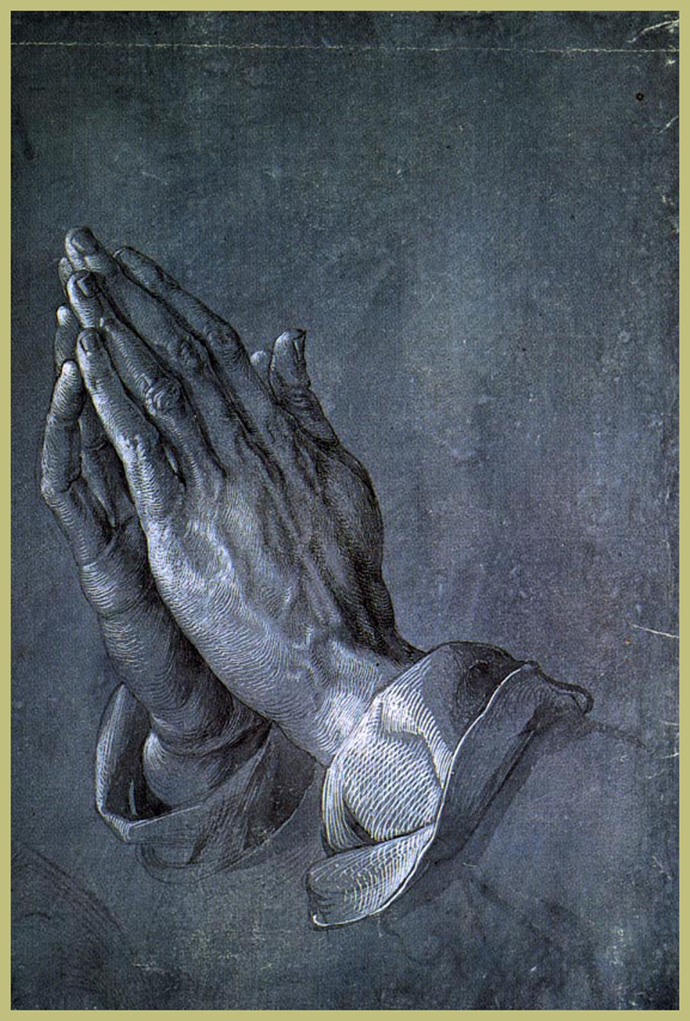
Teach Us to Pray
Luke 11:1-13

Slide 3
Pray Often and Persistently
Without ceasing. 11:1; 3:21; 5:16; 6:12
Because God gives to His children. 11:9-13
He desires persistence on our part. 11:5-8; 18:1-8

Slide 4
How to Pray
As to a Father.
With reverent simplicity.
Have a spiritual emphasis.
For the kingdom.
Ask for the things of this life.
Forgiveness is our greatest need.
Are we seeking to avoid sin?

Slide 5
Conclusion
Pray often, persistently, and with confidence.
Pray for this world’s needs, but never forget what is most important.

Slide 6
Conclusion
Pray often, persistently, and with confidence.
Pray for this world’s needs, but never forget what is most important.
But if you have never come to Christ, you can’t do that through prayer.

