Slide 2
The Feeling of Emptiness
By-Product of a Life without God

Slide 3
Howard Hughes
Marilyn Monroe
Robin Williams
Elvis Presley

Slide 4
Bible Characters Who Felt Empty
Naomi
King Solomon
Haman

Slide 5
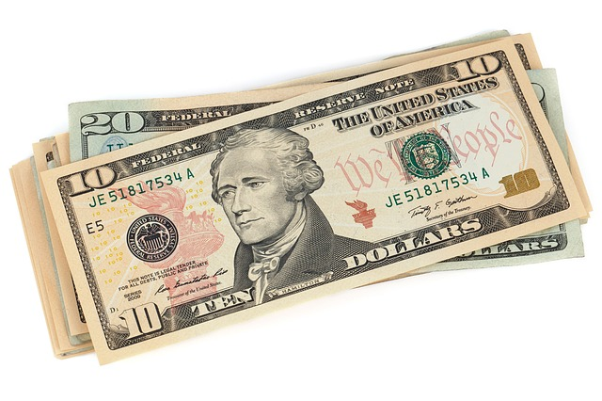
The Search For Gratification

Slide 6
Man Yearns for a Relationship with God
Psalm 42:1-3
Psalm 63:1-3
Psalm 84

Slide 7
Jesus’s Gospel
Satisfies the hungering and thirsting heart (Matt. 5:6)
Provides water that leaves one never thirsting again (John 4:13-14)
Provides the bread of life that satisfies one’s hunger (John 6:35)
Gives abundant life (John 10:10)

Slide 8
“…knowing that you were not redeemed with corruptible things, like silver or gold, from your aimless conduct received by tradition from your fathers” (1 Peter 1:18).

Slide 9
“…and you are complete in Him, who is the head of all principality and power” (Col. 2:10).

Slide 10
Proverbs 3:13-18
Happy is the man who finds wisdom,
And the man who gains understanding;
For her proceeds are better than the profits of silver,
And her gain than fine gold.
She is more precious than rubies,
And all the things you may desire cannot compare with her.
Length of days is in her right hand,
In her left hand riches and honor.
Her ways are ways of pleasantness,
And all her paths are peace.
She is a tree of life to those who take hold of her,
And happy are all who retain her.

Slide 11
Conclusion

Slide 12
When I Feel Empty
Usually it is caused by getting caught up in the daily activities and missing my relationship with God.
I spend more time reading my Bible, praying, and trying to reach out to my brethren.
I reset my priorities.

Slide 13
God Wants A Relationship With You
“Or do you suppose it is in vain that the scripture says, ‘He yearns jealously over the spirit which he has made to dwell in us’?” (James 4:5, RSV).
“Or do you suppose it is to no purpose that the Scripture says, ‘He yearns jealously over the spirit that he has made to dwell in us’?” (ESV).

Slide 14
Which Best Pictures You?

