Slide 3
A Familiar Text
Most of us can quote the Golden Rule by heart: “Therefore, whatever you want men to do to you, do also to them, for this is the Law and the Prophets” (Matt. 7:12).
The words Jesus spoke are not difficult to understand, even though they are supremely profound. How can one come up with a one-sentence statement that covers all aspects of moral ethics? But, Jesus did.
This lesson will focus on learning the implications of the Golden Rule.

Slide 4
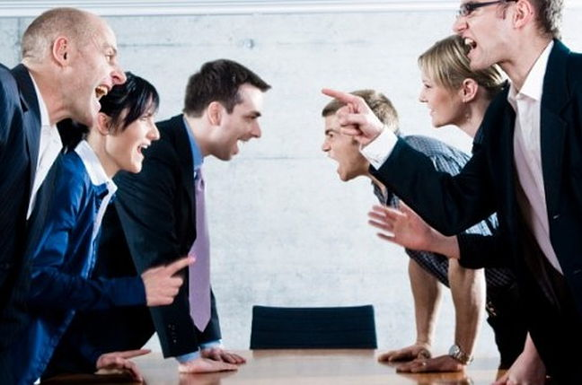
God Cares How We Treat Others

Slide 5
The Old Testament
“And if a stranger dwells with you in your land, you shall not mistreat him. The stranger who dwells among you shall be to you as one born among you, and you shall love him as yourself; for you were strangers in the land of Egypt: I am the Lord your God” (Lev. 19:33-34).
Similar instruction is given in these passages as well:
“You shall neither mistreat a stranger nor oppress him, for you were strangers in the land of Egypt” (Exod. 22:21).
“Also you shall not oppress a stranger, for you know the heart of a stranger, because you were strangers in the land of Egypt” (Exod. 23:9).
“Therefore love the stranger, for you were strangers in the land of Egypt” (Deut. 10:19).
“You shall not pervert justice due the stranger or the fatherless, nor take a widow’s garment as a pledge. But you shall remember that you were a slave in Egypt, and the Lord your God redeemed you from there; therefore I command you to do this thing” (Deut. 24:17-18).

Slide 6
The Sermon on the Mount
From the Sermon on the Mount, consider these verses previously given:
“Blessed are the merciful, For they shall obtain mercy” (Matt. 5:7).
“And forgive us our debts, As we forgive our debtors” (Matt. 6:12).
“Judge not, that you be not judged. For with what judgment you judge, you will be judged; and with the measure you use, it will be measured back to you” (Matt. 7:1-2).

Slide 7
Many Follow the Golden Rule When . . .
It’s their friend or family.
It’s convenient for them.
They’re in a good mood.
They expect something in return.

Slide 8
The Golden Rule Does Not Say . . .
“Treat the people close to you how you would want to be treated…”
Treat people how they have treated you.
Do unto others before they do unto you! Hit first!
The Golden Rule is clear—love others as yourself. Treat others as you would want to be treated.

Slide 9
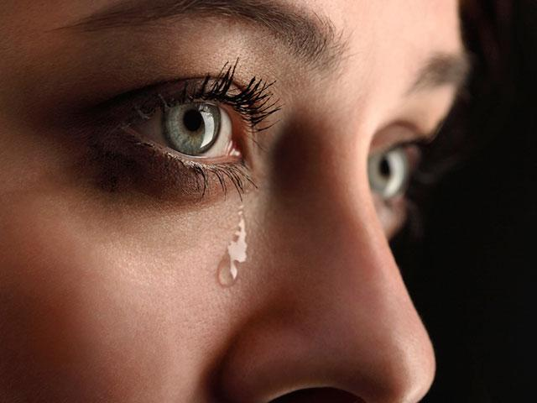
We All Hurt Others!

Slide 10
Hurt People Hurt People
And everyone is hurt or has been hurt in some way in this world; nobody has the perfect life.
The hurts of life can harden us and make us cautious, maybe even bitter, causing us to only look out for ourselves.
It is easy for hurt people to continue the cycle of hurting other people, whether they realize it or not.
But if everyone hurts in some way, how do we stop this cycle of hurting others?

Slide 11
Does Motive Count?
Sometimes our hurting others is premeditated and intentional; at other times, it is thoughtless and unintended.
Stating that one’s action was thoughtless and unintended to hurt is not said to minimize the pain the victim is suffering.
I once was rear-ended by a car that could not stop quickly enough. I knew it was unintentional, because I barely avoided rear-ending the driver in front of me.
But, the next morning I still had whiplash.
Sometimes our conduct causes suffering and occasionally even death, even though it was unintended to hurt.

Slide 12
Learning to Love Like God Loves

Slide 13
Romans 5:5-8
“Now hope does not disappoint, because the love of God has been poured out in our hearts by the Holy Spirit who was given to us. For when we were still without strength, in due time Christ died for the ungodly. For scarcely for a righteous man will one die; yet perhaps for a good man someone would even dare to die. But God demonstrates His own love toward us, in that while we were still sinners, Christ died for us” (Rom. 5:5-8).

Slide 14
God Acted First
God did not wait for us to do kind things for Him before He acted kindly toward us.
“For God so loved the world that He gave His only begotten Son, that whoever believes in Him should not perish but have everlasting life” (John 3:16).
He planned our salvation before any man was ever created.
“Now to Him who is able to establish you according to my gospel and the preaching of Jesus Christ, according to the revelation of the mystery kept secret since the world began” (Rom. 16:25).
Do we wait for others to act kindly toward us before we show them love?

Slide 15
God’s Love Is Not Deserved
God acted in kindness toward mankind, despite man’s rebellious disobedience to His commandments.
Adam and Eve in the Garden (Gen. 3).
Cain’s murder of his brother Abel (Gen. 4).
The wickedness calling forth the flood (Gen. 6).
Nevertheless, God did not change His mind and walk away from the kindness He intended toward those created in His image. I stand in awe of God’s AMAZING GRACE!

Slide 16
The Greatest Commanded
Love of God: “‘Teacher, which is the great commandment in the law?’ Jesus said to him, ‘You shall love the Lord your God with all your heart, with all your soul, and with all your mind. This is the first and great commandment’” (Matt. 22:36-37).
This commandment is taken from the Old Testament (Deut. 6:5).
The God of the Old Testament is a loving God!
Our love for God is the most important, foundational commandment in Christianity.

Slide 17
The Second Greatest Commandment
Love for our neighbor: “And the second is like it: ‘You shall love your neighbor as yourself’” (Matt. 22:39).
This teaching was also from the Old Testament, from Leviticus 19:18—“You shall not take vengeance, nor bear any grudge against the children of your people, but you shall love your neighbor as yourself: I am the Lord.”
The Jews of the first century limited its application to other Jewish people, asking “Who is my neighbor?” (Luke 10:29).
The implications of this instruction is the Golden Rule.

Slide 18
A Debt That Is Never Paid Off
“Owe no one anything except to love one another, for he who loves another has fulfilled the law. For the commandments, ‘You shall not commit adultery,’ ‘You shall not murder,’ ‘You shall not steal,’ ‘You shall not bear false witness,’ ‘You shall not covet,’ and if there is any other commandment, are all summed up in this saying, namely, ‘You shall love your neighbor as yourself.’ Love does no harm to a neighbor; therefore love is the fulfillment of the law” (Rom. 13:8-10).
Love is a debt that is never fully paid. It is always owed.
You can pay off your mortgage, pay off your cars, and get all of your credit cards to a zero balance.
But, you can never fully pay the debt of love.

Slide 19
The Golden Rule Restrains Us
The Golden Rule restrains one from committing sins against others.
The Parable of the Good Samaritan shows three levels of human conduct: The level of the thieves:
Beat the man.
Took his clothing.
Robbed him.
Left him for dead.
The evening newscast tells about those who live on this level and, unfortunately, more Americans have chosen to live at this level in this period of my life than were living that way in my youth.

Slide 20
The Golden Rule Constrains Us
The level of the priest and Levite. These men lived a life far better than the thieves.
If you do not want someone to commit adultery with your mate, do not commit adultery with his/her mate.
If you do not want someone to murder you, do not murder him.
If you do not want someone to steal from you, do not steal from him
If you do not want someone to bear false witness against you, do not bear false witness against him.
If you and I have learned this truth, congratulations! We have reached the love degree that makes you like the priest and Levite!
But, if we stop here, Jesus said you have not yet learned to love your neighbor as yourself.

Slide 21
Is This What We Do?
Sometimes that is what we do.
We see someone who is hurting and we pass by without doing anything.
We did not injure him, nor do we add to his injuries. We just walk on by, perhaps making some comment to our friend about the poor person who is suffering.
I commend us from not living like the thieves, but we are not yet loving our neighbors as ourselves.
We are loving our neighbor like the priest and Levite.

Slide 22
God’s Love Changes Us
It makes us love our neighbor as ourselves, to do unto others as we wish one to do to us.
Do you want compassion? Give compassion.
Do you want mercy? Show mercy.
Do you want to be respected? Show respect.

Slide 23
Treat Others Like You Want to Be Treated!
Step outside ourselves and consider others’ point of view, situation, or life circumstances.
We are all self-serving creatures, and no one wishes for a life of hardship or difficulty.
No one wishes to be disrespected at work, insulted on social media, or excluded at a dinner.
Therefore, Matthew 7:12 provides a way to interact with people in healthy and ethical ways.
So… when in doubt about how to respond to a situation or how to react to a person, simply consider how you would like to be treated—and then do that.

Slide 24
Begin at Home
Your marriage is having real troubles… you don’t particularly enjoy spending time with each other because you just seem to argue.
There is always a list you both seem to have of hurts and wrongs done to each other.
On top of that, you are tired, you are busy and you sometimes wonder if it would just be easier to call it a day and go your separate ways.
But you remember the golden rule. That Jesus guy said something about love your neighbour as yourself. He said do to others as you would have done to you.
So you stop… you think how do I want to be treated in this marriage? What would I want to receive from my partner?… and then you begin to treat them as you yourself would want to be treated.
What are some of the things you would begin to do?

Slide 25
Conclusion

Slide 26
Take Aways
We should constantly be looking out for those who are hurting and asking how we can improve their circumstances. Let’s begin at home, but not stop there.
As we meet their needs, our lights will shine in our communities and they will see the influence of Jesus in our lives and say, like they did of Peter and John, that they had been with Jesus (Acts 4:13).

