Slide 3
Be Ready to Give a Defense
You and I need to be qualified to talk to unbelievers in a convincing manner.
“But sanctify the Lord God in your hearts, and always be ready to give a defense to everyone who asks you a reason for the hope that is in you, with meekness and fear” (1 Pet. 3:15).
A mere subjective “I believe in Jesus” will be inadequate to cause an unbeliever to become a believer.
In this lesson, I want to show you how to use your Bible as historical evidence to convince unbelievers to believe in Jesus.

Slide 4
Belief in the Deity of Jesus Was Not Anticipated
The Old Testament commands that men should only worship God.
“Hear, O Israel: The Lord our God, the Lord is one! You shall love the Lord your God with all your heart, with all your soul, and with all your strength” (Deut. 6:4-5).
“You shall fear the Lord your God and serve Him, and shall take oaths in His name. You shall not go after other gods, the gods of the peoples who are all around you” (Deut. 6:13-14).
When the Devil asked Jesus to worship him, Jesus replied, “Away with you, Satan! For it is written, ‘You shall worship the LORD your God, and Him only you shall serve’” (Matt. 4:10).

Slide 5
Worship Jesus Caused a Reaction
The New Testament records the reaction of the Pharisees to Jesus portraying Himself as deity:
By forgiving sins (Matt. 8:6)
By accepting worship (Matt. 2:2; 8:2; 9:18; 14:33; 15:25; 18:26; 20:20; 28:9, 17)
First century Jews were not expecting their Messiah to be God with us!

Slide 6
Though a Man, He Is Worshiped
Christians believe “that at the name of Jesus every knee should bow, of those in heaven, and of those on earth, and of those under the earth, and that every tongue should confess that Jesus Christ is Lord, to the glory of God the Father” (Phil. 2:10-11).
Indeed, Jesus Himself stated that one’s salvation depends upon what that person believed about Him.
“Therefore I said to you that you will die in your sins; for if you do not believe that I am He, you will die in your sins” (John 8:24).
“I am the door. If anyone enters by Me, he will be saved, and will go in and out and find pasture” (John 10:9).
“Jesus said to him, ‘I am the way, the truth, and the life. No one comes to the Father except through Me’” (John 14:6).

Slide 7
An Early Christian Hymn
Who, being in very nature God,
did not consider equality with God something to be grasped,
but made himself nothing
taking the very nature of a servant,
being made in human likeness.
And being found in appearance as a man,
he humbled himself
and became obedient to death—
even death on a cross!
Therefore God exalted him to the highest place
and gave him the name that is above every name,
that at the name of Jesus every knee should bow,
in heaven and on earth and under the earth,
and every tongue confess that Jesus Christ is Lord
to the glory of God the Father.

Slide 8
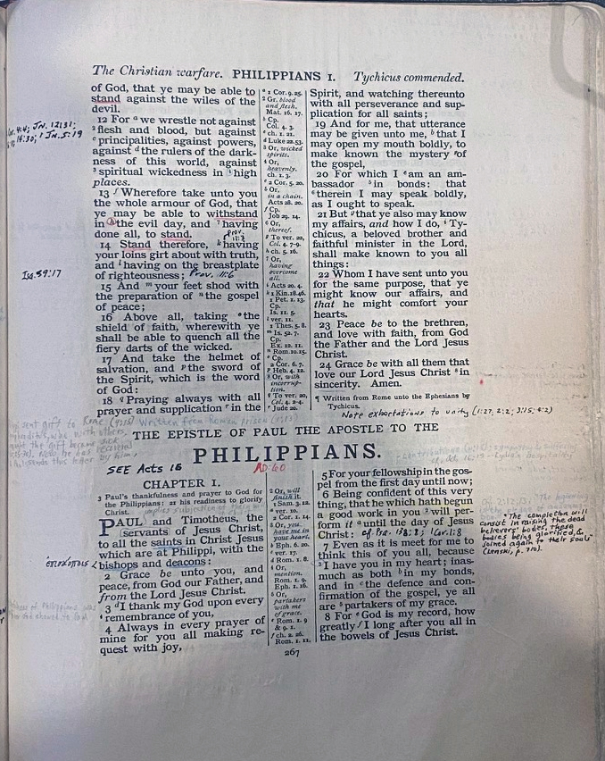
The Book of Philippians

Slide 9
An Argument from the Bible
The book of Philippians gives strong historical evidence that Jesus lived among men, was crucified, and risen from the dead.
The book of Philippians is an historical document that survived from the first century.
Whether or not one believes that the Bible and book of Philippians in particular is inspired in irrelevant for how I want to use the book in this lesson.
All scholars, from rabid atheist to Fundamentalist, admit that the book is written by a Christian named Paul. The document is dated about AD 60 and was written from Rome (some suggest Caesarea) while Paul was in prison. It was written to a church that Paul had established at Philippi, in the province of Macedonia (northern Greece). That cannot be successfully denied.
I suggest using this evidence because:
It is powerful.
You are already familiar with the document you will be citing.

Slide 10
The Pauline Letters
The book of Philippians is not Paul’s earliest letter.
It is preceded by 1 Thessalonians (AD 50-51), 2 Thessalonians (AD 52), and Galatians (AD 53).
However, it was written no later than AD 60-61. (Paul was in Rome 58-60, before being released.)
This means that everything that is said about Jesus in the book of Philippians was believed by Christians within thirty years of Jesus’s crucifixion.
There is no time for legend and myth to have developed around Jesus, giving early believers time to deify Jesus through fabricated tales.

Slide 11
Jesus Is the Central Figure
Confining ourselves to Philippians, look how often Jesus is mentioned in Philippians:
Jesus (21).
Christ (36).
Lord (15).
Lord Jesus Christ (3).
Lord Jesus (1).
Christ Jesus my Lord (1).
Jesus Christ is Lord (2:11).
Savior (3:20).

Slide 12
What Paul Said About Jesus The Core Facts

Slide 13
1. The Pre-existence of Jesus
“Let this mind be in you which was also in Christ Jesus, who, being in the form of God, did not consider it robbery to be equal with God” (Phil. 2:5-6).
“In the beginning was the Word, and the Word was with God, and the Word was God. He was in the beginning with God. All things were made through Him, and without Him nothing was made that was made” (John 1:1-3).

Slide 14
2. The Incarnation of Jesus
“. . . but made Himself of no reputation, taking the form of a bondservant, and coming in the likeness of men” (Phil. 2:7).
“And the Word became flesh and dwelt among us, and we beheld His glory, the glory as of the only begotten of the Father, full of grace and truth” (John 1:14).
The birth narratives of Luke 1-2 and Matthew 1-2 assert that Jesus is “Immanuel,” God with us (Matt. 1:23).

Slide 15
3. The Sufferings of Jesus
“that I may know Him and the power of His resurrection, and the fellowship of His sufferings, being conformed to His death” (Phil. 3:10).
The gospel accounts:
His arrest as a common criminal
He was slapped by the officers
They spat in His face, beat him, slapped again
He was mocked
Mocked, arrayed in a gorgeous robe
Scourged, mocked, spat upon, took a reed and smote Him on the head

Slide 16
4. The Crucifixion
“And being found in appearance as a man, He humbled Himself and became obedient to the point of death, even the death of the cross” (Phil. 2:8).
“. . .that I may know Him and the power of His resurrection, and the fellowship of His sufferings, being conformed to His death” (Phil. 3:10).
“For many walk, of whom I have told you often, and now tell you even weeping, that they are the enemies of the cross of Christ” (Phil. 3:18).

Slide 17
5. The Resurrection of Jesus
“. . .that I may know Him and the power of His resurrection, and the fellowship of His sufferings, being conformed to His death, if, by any means, I may attain to the resurrection from the dead” (Phil. 3:10-11).

Slide 18
6. The Exaltation of Jesus
“Therefore God also has highly exalted Him and given Him the name which is above every name” (Phil. 2:9).
Without a doubt, what is included in the exaltation of the Jesus is . . .
His ascension into heaven (Acts 1:9-11)
His being seated at the right hand of God (Acts 2:24-36).

Slide 19
7. Early Saints Believed That Jesus Is Coming Again
The second coming is spoken of as the “day of the Christ”:
“. . . being confident of this very thing, that He who has begun a good work in you will complete it until the day of Jesus Christ” (Phil. 1:6).
“. . . that you may approve the things that are excellent, that you may be sincere and without offense till the day of Christ” (Phil. 1:10).
“. . . holding fast the word of life, so that I may rejoice in the day of Christ that I have not run in vain or labored in vain” (Phil. 2:16).

Slide 20
8. Early Saints Believed That They Will Be Raised from the Dead
“. . . that I may know Him and the power of His resurrection, and the fellowship of His sufferings, being conformed to His death, if, by any means, I may attain to the resurrection from the dead” (Phil. 3:10-11).

Slide 21
9. Jesus Appeared to Paul
“I press toward the goal for the prize of the upward call of God in Christ Jesus” (Phil. 3:14).
“Not that I have already attained, or am already perfected; but I press on, that I may lay hold of that for which Christ Jesus has also laid hold of me” (Phil. 3:12).
How can one read this and not think of the miraculous appearance of Jesus to Paul on the road to Damascus?

Slide 22
10. Philippians 2:6-11 Is An Early Hymn
This means that what we read in these verses was being sung as a hymn around the Mediterranean before AD 60.
What is expressed in this hymn was believed even earlier than AD 60. How much earlier? AD 50? AD 40? We do not know when this hymn was originally written!
However, notice how near to AD 30 these dates are!

Slide 23
Conclusion

Slide 24
The Power of the Argument
Why do I believe that Jesus in the Christ, the Son of the Living God? Because it is substantiated by reliable historical documents.
If you meet someone who does not believe in Jesus, open your Bible and go over these facts with him. For it to be effective, He does not have to believe in. . .
The existence of God
The inspiration of Scripture
In Jesus
What you have shown is that, within 30 years of Jesus’s death, men believed the things listed about Him were true and that faith was the inspiration for the undeniable rapid rise of Christianity in the first century.

