Slide 2
Difficult Circumstances
Sometimes a person is torn between two difficult outcomes for his life over which he has little control.
Sometimes one has to accept what he does not want and try to put the best face on a bad situation.
Paul was in prison against his will, obviously. The plans he had for his life and those that Rome had were in conflict, and unfortunately they controlled the outcome.
So, how does one cope with such circumstances?
Perhaps some of you are facing such life choices at this time.

Slide 3
Philippians 1:18-24
“What then? Only that in every way, whether in pretense or in truth, Christ is preached; and in this I rejoice, yes, and will rejoice. For I know that this will turn out for my deliverance through your prayer and the supply of the Spirit of Jesus Christ, according to my earnest expectation and hope that in nothing I shall be ashamed, but with all boldness, as always, so now also Christ will be magnified in my body, whether by life or by death. For to me, to live is Christ, and to die is gain. But if I live on in the flesh, this will mean fruit from my labor; yet what I shall choose I cannot tell. For I am hard pressed between the two, having a desire to depart and be with Christ, which is far better. Nevertheless to remain in the flesh is more needful for you.”

Slide 4
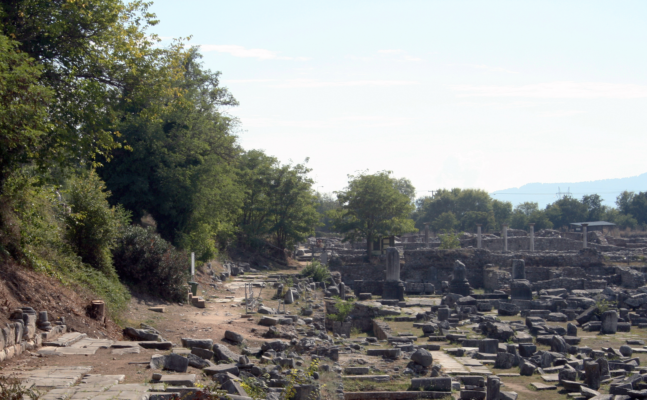
Favorite Texts from Philippians

Slide 5
I. Paul’s Single Purpose in Life
“. . . according to my earnest expectation and hope that in nothing I shall be ashamed, but with all boldness, as always, so now also Christ will be magnified in my body, whether by life or by death” (1:20).

Slide 6
Being Single-Minded
Jesus taught His disciples to be single-minded.
“For where your treasure is, there your heart will be also. The lamp of the body is the eye. If therefore your eye is good, your whole body will be full of light. But if your eye is bad, your whole body will be full of darkness. If therefore the light that is in you is darkness, how great is that darkness!” (Matt. 6:21-23).
What Jesus expressed is not just for super-Christians; it is for all Christians. Our purpose in life is to serve Jesus.

Slide 7
Luke 9:57-62
“Now it happened as they journeyed on the road, that someone said to Him, ‘Lord, I will follow You wherever You go.’ And Jesus said to him, ‘Foxes have holes and birds of the air have nests, but the Son of Man has nowhere to lay His head.’ Then He said to another, ‘Follow Me.’ But he said, ‘Lord, let me first go and bury my father.’ Jesus said to him, ‘Let the dead bury their own dead, but you go and preach the kingdom of God.’ And another also said, ‘Lord, I will follow You, but let me first go and bid them farewell who are at my house.’ But Jesus said to him, ‘No one, having put his hand to the plow, and looking back, is fit for the kingdom of God’” (Luke 9:57-62).

Slide 8
To the Rich Young Ruler
“If you want to be perfect, go, sell what you have and give to the poor, and you will have treasure in heaven; and come, follow Me.” (Matt 19:21).
Unfortunately, the young man heard that saying and chose not to follow Jesus. He went away sorrowful, for he had great possessions (Matt. 19:22).
Just a few verses later Jesus said, “And everyone who has left houses or brothers or sisters or father or mother or wife or children or lands, for My name’s sake, shall receive a hundredfold, and inherit eternal life” (Matt. 19:29).

Slide 9
Paul Had Made His Choice
Long before his arrest and imprisonment in a Roman prison, Paul had made the choice to make Jesus the Lord of His life.
“But when it pleased God, who separated me from my mother’s womb and called me through His grace, to reveal His Son in me, that I might preach Him among the Gentiles, I did not immediately confer with flesh and blood, nor did I go up to Jerusalem to those who were apostles before me. . .” (Gal. 1:15-17).
He told the Galatians, “I have been crucified with Christ; it is no longer I who live, but Christ lives in me; and the life which I now live in the flesh I live by faith in the Son of God, who loved me and gave Himself for me” (Gal. 2:20).
What Paul had determined—that Christ was going to be magnified in his body, whether by life or by death—is the same commitment God expects of each of us.

Slide 10
II. For Me to Live Is Christ
“For to me, to live is Christ, and to die is gain” (Phil. 1:21).

Slide 11
Two Choices
There were only two possibilities facing Paul and he had no control over which occurred.
“For me to live is Christ”—Paul could be released from prison.
“For me to die is gain”—Paul could be put to death for his faith in Jesus, in which case he would go to be with His Lord.
We know Paul well enough to know what it meant for him “to live” for Christ. He would continue devoting his life to the service of God.
What does it mean for you and me to live for Christ?

Slide 12
A. Accept the Lordship of Jesus over my life.
Jesus’s example is our model for life:
“I can of Myself do nothing. As I hear, I judge; and My judgment is righteous, because I do not seek My own will but the will of the Father who sent Me” (John 5:30).
“For I have come down from heaven, not to do My own will, but the will of Him who sent Me” (John 6:38).
“Now My soul is troubled, and what shall I say? ‘Father, save Me from this hour’? But for this purpose I came to this hour” (John 12:27).

Slide 13
What Jesus Expects of Me
“But why do you call Me ‘Lord, Lord,’ and do not do the things which I say?” (Luke 6:46.).
“Not everyone who says to Me, ‘Lord, Lord,’ shall enter the kingdom of heaven, but he who does the will of My Father in heaven” (Matt. 7:21).
When my will conflicts with the will of the Lord, my obligation is to submit to the Lord’s will. Remember the example of our Lord Jesus in the Garden of Gethsemane?
“Then He said to them, ‘My soul is exceedingly sorrowful, even to death. Stay here and watch with Me.’ He went a little farther and fell on His face, and prayed, saying, ‘O My Father, if it is possible, let this cup pass from Me; nevertheless, not as I will, but as You will’” (Matt. 26:38-39).

Slide 14
B. My Moral Choices Have Been Made
“Now the works of the flesh are evident, which are: adultery, fornication, uncleanness, lewdness, idolatry, sorcery, hatred, contentions, jealousies, outbursts of wrath, selfish ambitions, dissensions, heresies, envy, murders, drunkenness, revelries, and the like; of which I tell you beforehand, just as I also told you in time past, that those who practice such things will not inherit the kingdom of God” (Gal. 5:19-21).
“For we have spent enough of our past lifetime in doing the will of the Gentiles—when we walked in lewdness, lusts, drunkenness, revelries, drinking parties, and abominable idolatries” (1 Pet. 4:3).
“Do you not know that the unrighteous will not inherit the kingdom of God? Do not be deceived. Neither fornicators, nor idolaters, nor adulterers, nor homosexuals, nor sodomites, nor thieves, nor covetous, nor drunkards, nor revilers, nor extortioners will inherit the kingdom of God” (1 Cor. 6:9-10).

Slide 15
C. My Conduct toward Others – Love Each Other
“Love one another” appears twelve times in our New Testaments (John 13:34; 15:12, 17; Rom. 13:8; 1 Thess. 4:9; 1 Pet. 1:22; 1 John 3:23; 4:7, 11, 12; 2 John 5).
“Love suffers long and is kind; love does not envy; love does not parade itself, is not puffed up; does not behave rudely, does not seek its own, is not provoked, thinks no evil; does not rejoice in iniquity, but rejoices in the truth; bears all things, believes all things, hopes all things, endures all things. Love never fails.” (1 Cor. 13:4-8).

Slide 16
D. My Choices for Worship
My attendance at worship: “And let us consider one another in order to stir up love and good works, not forsaking the assembling of ourselves together, as is the manner of some, but exhorting one another, and so much the more as you see the Day approaching” (Heb. 10:24-25).
What we will do in worship: “And they continued steadfastly in the apostles’ doctrine and fellowship, in the breaking of bread, and in prayers” (Acts 2:42).
Singing (1 Cor. 14:15)
Praying (Acts 2:42)
Preaching (Acts 2:42)
Fellowship (Acts 2:42), jointly participating in the work through my contribution (1 Cor. 16:1-2)
Observing the Lord’s supper (Acts 20:7; 1 Cor. 11:23ff.)

Slide 17
III. For Me to Die Is Gain
“For to me, . . . to die is gain” (Phil. 1:21).

Slide 18
He Knew That His Death Might Be Required
“Yes, and if I am being poured out as a drink offering on the sacrifice and service of your faith, I am glad and rejoice with you all” (Phil. 2:17).
“For I am already being poured out as a drink offering, and the time of my departure is at hand. I have fought the good fight, I have finished the race, I have kept the faith. Finally, there is laid up for me the crown of righteousness, which the Lord, the righteous Judge, will give to me on that Day, and not to me only but also to all who have loved His appearing” (2 Tim. 4:6-8).

Slide 19
He Knew What Lay Ahead for Christians
“But I do not want you to be ignorant, brethren, concerning those who have fallen asleep, lest you sorrow as others who have no hope. For if we believe that Jesus died and rose again, even so God will bring with Him those who sleep in Jesus. For this we say to you by the word of the Lord, that we who are alive and remain until the coming of the Lord will by no means precede those who are asleep. For the Lord Himself will descend from heaven with a shout, with the voice of an archangel, and with the trumpet of God. And the dead in Christ will rise first. Then we who are alive and remain shall be caught up together with them in the clouds to meet the Lord in the air. And thus we shall always be with the Lord” (1 Thess. 4:13-17).

Slide 20
He Knew What Lay Ahead for Christians
“Now this I say, brethren, that flesh and blood cannot inherit the kingdom of God; nor does corruption inherit incorruption. Behold, I tell you a mystery: We shall not all sleep, but we shall all be changed—in a moment, in the twinkling of an eye, at the last trumpet. For the trumpet will sound, and the dead will be raised incorruptible, and we shall be changed. For this corruptible must put on incorruption, and this mortal must put on immortality. So when this corruptible has put on incorruption, and this mortal has put on immortality, then shall be brought to pass the saying that is written: ‘Death is swallowed up in victory.’ ‘O Death, where is your sting? O Hades, where is your victory?’ The sting of death is sin, and the strength of sin is the law. But thanks be to God, who gives us the victory through our Lord Jesus Christ” (1 Cor. 15:50-57).

Slide 21
The White-Robed Saints
John described white-robed saints still alive after their death awaiting the second coming of Jesus (Rev. 6:11). When he asked who these people were, the angel said:
“These are the ones who come out of the great tribulation, and washed their robes and made them white in the blood of the Lamb. Therefore they are before the throne of God, and serve Him day and night in His temple. And He who sits on the throne will dwell among them. They shall neither hunger anymore nor thirst anymore; the sun shall not strike them, nor any heat; for the Lamb who is in the midst of the throne will shepherd them and lead them to living fountains of waters. And God will wipe away every tear from their eyes” (Rev. 7:14-17).
They live and reign with Christ: “Blessed and holy is he who has part in the first resurrection. Over such the second death has no power, but they shall be priests of God and of Christ, and shall reign with Him a thousand years” (Rev. 20:6).

Slide 22
After Judgment: Heaven
“And God will wipe away every tear from their eyes; there shall be no more death, nor sorrow, nor crying. There shall be no more pain, for the former things have passed away” (Rev. 21:4).
Joe South wrote a song expressing our yearning to be with God:
Don’t it make you wanna go home, now?
Don’t it make you wanna go home?
All God’s children get weary when they roam
Don’t it make you wanna go home?

Slide 23
Conclusion

Slide 24
Paul’s Dilemma
“For I am hard pressed between the two, having a desire to depart and be with Christ, which is far better. Nevertheless to remain in the flesh is more needful for you” (Phil. 1:23-24).
What a precious passage to guide us through the life and death choices each of us eventually has to make!
This is why it is included among my favorite passages from Philippians!

