Slide 2
The Work of the Church
Ephesians 3:8-11

Slide 3
The Church Manifests God’s Wisdom
Ephesians 3:8-11

Slide 4
Ephesians 3:8-11
To me, who am less than the least of all the saints, this grace was given, that I should preach among the Gentiles the unsearchable riches of Christ, and to make all see what is the fellowship of the mystery, which from the beginning of the ages has been hidden in God who created all things through Jesus Christ; to the intent that now the manifold wisdom of God might be made known by the church to the principalities and powers in the heavenly places, according to the eternal purpose which He accomplished in Christ Jesus our Lord…

Slide 5
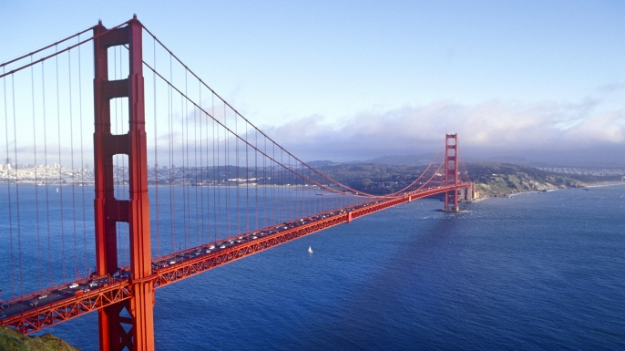
Golden Gate Bridge, San Francisco, CA

Slide 6
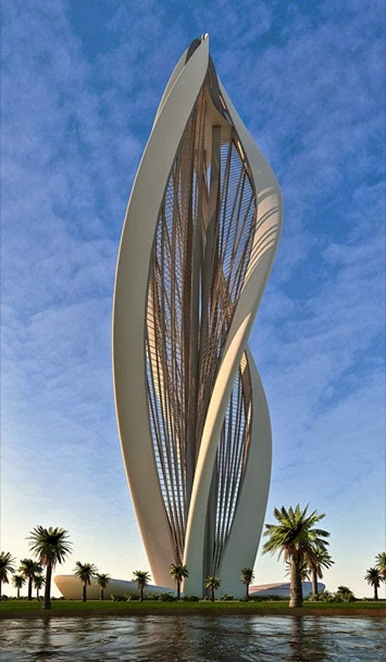
Blossoming Tower in Dubai

Slide 7
God: The Architect
Planned the church from all eternity (Eph. 3:10-11)
A perfect architect
Was built by Christ Himself (Matt. 16:18)
A perfect builder
God’s church, as revealed in the Bible, is just exactly what God wanted.

Slide 8
God Gave Noah a Pattern
The ark (Gen. 6):
Made out of gopher wood (6:14)
Pitch it within and without (6:14)
Size: 300 x 50 x 30 cubits (6:15)
A window (6:16)
A door (6:16)
Three floors
“Thus Noah did; according to all that God commanded him, so he did” (Gen. 6:22).

Slide 9
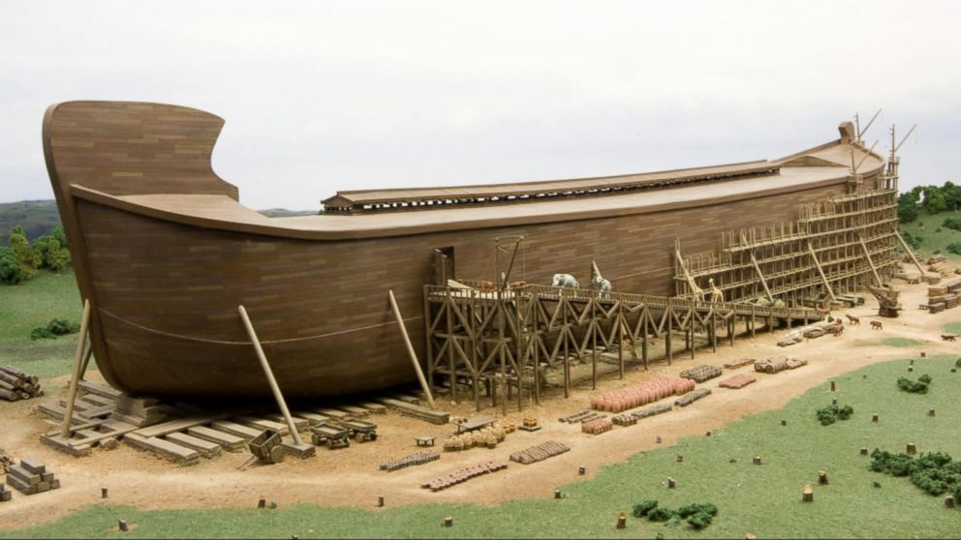
Full-scale Noah’s Ark, Williamstown, KY

Slide 10
The Tabernacle
The construction of the Tabernacle (Exod. 25-40)
The tent
The ark of the covenant
The mercy seat
The altar of incense
Table of shewbread
The candlestick (Menorah)
Curtains for the tabernacle
Boards for the tabernacle
Altar of burnt offering
Etc.

Slide 11
According to the Pattern
“According to all that I show you, that is, the pattern of the tabernacle and the pattern of all its furnishings, just so you shall make it” (Exod. 25:9, 40; 26:30).
“According to all that the Lord had commanded Moses, so the children of Israel did all the work. Then Moses looked over all the work, and indeed they had done it; as the Lord had commanded, just so they had done it. And Moses blessed them” (Exod. 39:42-43).

Slide 12
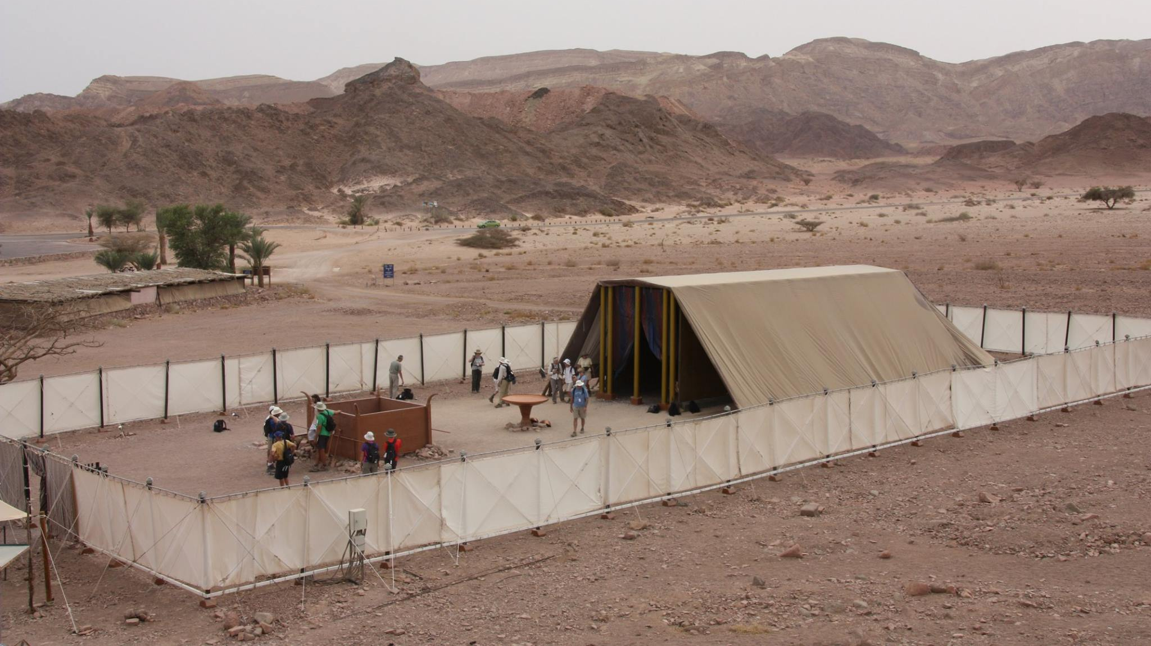
Model of Tabernacle erected in Timnah, Israel

Slide 13
Hebrews 8:1-5
Now this is the main point of the things we are saying: We have such a High Priest, who is seated at the right hand of the throne of the Majesty in the heavens, a Minister of the sanctuary and of the true tabernacle which the Lord erected, and not man. For every high priest is appointed to offer both gifts and sacrifices. Therefore it is necessary that this One also have something to offer. For if He were on earth, He would not be a priest, since there are priests who offer the gifts according to the law; who serve the copy and shadow of the heavenly things, as Moses was divinely instructed when he was about to make the tabernacle. For He said, “See that you make all things according to the pattern shown you on the mountain” (Heb. 8:1-5).

Slide 14
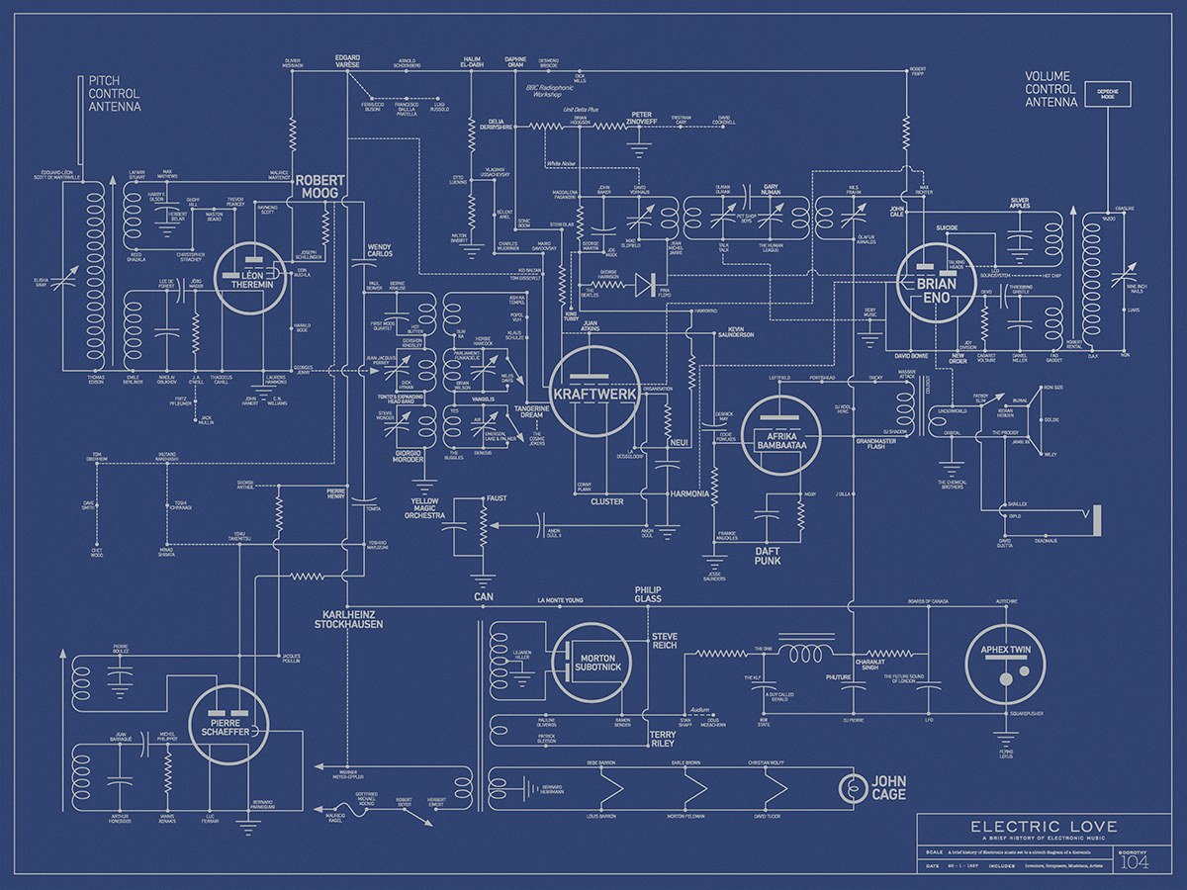
The Electrician
cannot decide to wire the building like he wants to; he is obligated to follow the blueprints!

Slide 15
Follow the Blueprint
“Whoever transgresses and does not abide in the doctrine of Christ does not have God. He who abides in the doctrine of Christ has both the Father and the Son. If anyone comes to you and does not bring this doctrine, do not receive him into your house nor greet him; for he who greets him shares in his evil deeds” (2 John 9-11).

Slide 16
Follow the Blueprint
“For I testify to everyone who hears the words of the prophecy of this book: If anyone adds to these things, God will add to him the plagues that are written in this book; and if anyone takes away from the words of the book of this prophecy, God shall take away his part from the Book of Life, from the holy city, and from the things which are written in this book” (Rev. 22:18-19).

Slide 17
Romans 4:15
“… because the law brings about wrath; for where there is no law there is no transgression.”
Illustrate: The Autobahn in Germany has no speed limit.

Slide 18
The Alternatives
Alternative 1
God has given us a pattern for the church
We are obligated to build all things according to the pattern
It is sinful to depart from the blueprint
Alternative 2
God has not given us a pattern for the church
Man can build the church any way he pleases
There are no right and wrong ways to build a church

Slide 19
The Work of the Church
What Is God’s Pattern?

Slide 20
Ephesians 4:11-12
“And He Himself gave some to be apostles, some prophets, some evangelists, and some pastors and teachers, for the equipping of the saints for the work of ministry, for the edifying of the body of Christ….”
Equipping the saints to serve: Edification
Work of Ministry: Benevolence
Edifying (building up) the body: Evangelism

Slide 21
1. Edification
Each Christian is commanded to grow (1 Pet. 2:1-2; 5:11-14; 2 Pet. 3:18).
The work of the church in edification is to give the right spiritual diet for its members (1 Tim. 4:6; 6:3; 2 Tim. 2:14-16; Tit. 2:1; Tit. 1:5).
Avenues through which the church might do this work.
Classes
Sermons
Special Gospel meetings
Oversight of the elders has this as one of their works (Acts 20:28; 1 Pet. 5:1-3).

Slide 22
2. Benevolence
The mission of the early church was in this area (Acts 11:27; 4:34-37).
They did not scurry across the country looking for someone to help.
The church is not in competition with the Salvation Army or the Medicaid program.
The method through which the church operated.
Each cared for its own (Acts 4:34-37).
When an emergency arose that the local church would not relieve the suffering of all of its members, sister congregations aided (Rom. 15:26-27; 1 Cor. 16:1-2; 2 Cor. 8-9; Acts 11:27-30).

Slide 23
3. Evangelism
The Great Commission (cf. Matt. 28:18-20; Mark 16:15-16)
This is the primary mission of the church (1 Tim. 3:15).
The method through which this was done.
Sending out preachers (2 Cor. 11:8; Phil. 4:15-16).
Each individual doing his own share of the work (Acts 8:1-5; 2 Tim. 2:2).
These men taught publicly and from house to house (Acts 20:20).

Slide 24
The Appeal of the Gospel
“And I, if I am lifted up from the earth, will draw all peoples to Myself” (John 12:32).
The appeal of the Gospel is…
God’s love for us (John 3:16)
Christ’s love for us (Rom. 5:8-9)
The blessings in Christ (Eph. 1:3)
The blessed hope of heaven (1 Pet. 1:3-5)
The fear of hell (2 Cor. 5:11)

Slide 25
The Gospel Vs. Gimmicks
“Most assuredly, I say to you, you seek Me, not because you saw the signs, but because you ate of the loaves and were filled” (John 6:26).
Men have used all kinds of physical rewards and attractions to lure men to Jesus
A hot meal and a bed
A reward for bringing the most visitors
$50 under the chair of the person sitting in the selected seat
Recreational activities (especially to draw the young)

Slide 26
Mistaken Views of the Work of the Church

Slide 27
Bible Authority
When a work for the church is suggested, one should ask:
Where is the Bible authority for the church to do this work?
Command?
Example?
Necessary inference?
If there is no Bible authority for the church to do that work, it should not be involved in it!

Slide 28
1. The Social Gospel
From where it came:
Men lost confidence in the inspiration of Scripture, miracles, etc.
Men quit believing in heaven and hell
Decided that man must create his own heaven on earth
Medical care
Clean out ghettos
Get rid of child labor
Rid ourselves of slavery

Slide 29
Social Change through Christ
The individual is converted and brings forth fruits of repentance (Matt. 3:9)
Become a better employer or employee (Eph. 6:5-6)
A business built on Christian principles
Do all of the good we can (James 1:27; Gal. 6:10; Luke 10:25-37)
Christians doing what they can to change the world (building colleges, hospitals, nursing homes, etc.)
We can change ourselves and then work to change the world

Slide 30
Confusing the Church and Individual
There are things we do as individuals that the church is not to do
We enter businesses as individuals, but the churches does not build businesses to make money
It raises its funds from the free-will contributions of the saints (1 Cor. 16:1-2)
The church does not have…
A fish fry
Pie supper
Casino nights

Slide 31
2. Medical Care
Many denominations have built hospitals
St. Frances
St. Vincent
Methodist Hospital
Baptist Hospital

Slide 32
3. Recreation
Events
Church basketball teams
Church sponsored skating parties
Swimming parties,
Facilities for ping-pong games
It isn’t the business of the church to furnish entertainment or recreation for either young or old.
Churches spend great sums of money to erect a basketball court and other recreational facilities. They are constantly sponsoring baseball leagues, basketball leagues, soccer teams, etc.
During the summer many churches sponsor church camps.

Slide 33
4. Pastoral Counselling
Family counselling
Divorce recovery
Financial management courses
Grief counselling

Slide 34
5. Education
The Great Commission does not charge the church with teaching the following:
Math
Science
Grammar and literature
History
Music
Churches spend resources and sell services for “Christian Education”
Pre-school classes
Elementary education
Middle school classes
High schools

Slide 35
Church Sponsored Colleges
Catholic:
Notre Dame, Loyola, Georgetown, St. John’s
Methodist:
Southern Methodist University, Duke, Emory
Baptist
Baylor, Cedarville College, Howard-Payne, Southern Baptist Theological Seminary
Christian Church
Texas Christian University, Butler, Cincinnati Bible Seminary, Bethany College
Mormon
Brigham Young

Slide 36
Churches of Christ
Pepperdine
Abilene
David Lipscomb
Freed Hardeman
Harding
Oklahoma Christian
Faulkner
Lubbock Christian
Ohio Valley
York

Slide 37
Disastrous Influences
The pattern of apostasy
Bible believers start colleges to give their children a good education from the Christian point of view
Teachers are hired with proven skills in their fields
Teachers want to be accepted by their educational peers
Soon they compromise Bible beliefs to conform with academically accepted beliefs
Evolution: age of earth, six-day creation
A universal flood is denied
Historical miracles are literary forms (serpent in Eden)
The graduates take this tainted gospel to churches all over the U.S.

Slide 38
6. Politics
The church wants to flex its voting leverage
The Moral Majority
Evangelicals tried to organize to influence the national and state elections
Candidates invited to speak at churches
Especially common among Afro-American churches
Spreading to more Evangelical groups
Shaping politics is not the work of the church
The first century church did not become a social institution or the center of social activity. It did not wage a campaign for social reformation or social equality.

Slide 39
Summary Points
Diverting the church from its divinely given missions to other activities results in…
Taking funds from their intended use
Taking energies from their intended use
Reshaping the mindset of the people about what the work of the church is

Slide 40
Let the Church Be the Church
We have plenty of organizations that sponsor and support:
Education
Recreation
Politics
Medicine
Helping the poor
There is one organization for doing Christ’s work – the church! Let the church be the church and let other organizations fulfill their selected missions!

Slide 41
Conclusion

Slide 42
Unintended Consequences
It looks like a good work – to man!
It looks like it will make the church more effective in its work – to man!
But, man cannot see the unintended ill consequences of his judgments!
What has happened to churches that have become involved in these activities to make themselves relevant?

