Slide 2
Philippians 2:12-13
“Therefore, my beloved, as you have always obeyed, not as in my presence only, but now much more in my absence, work out your own salvation with fear and trembling; for it is God who works in you both to will and to do for His good pleasure.”

Slide 3
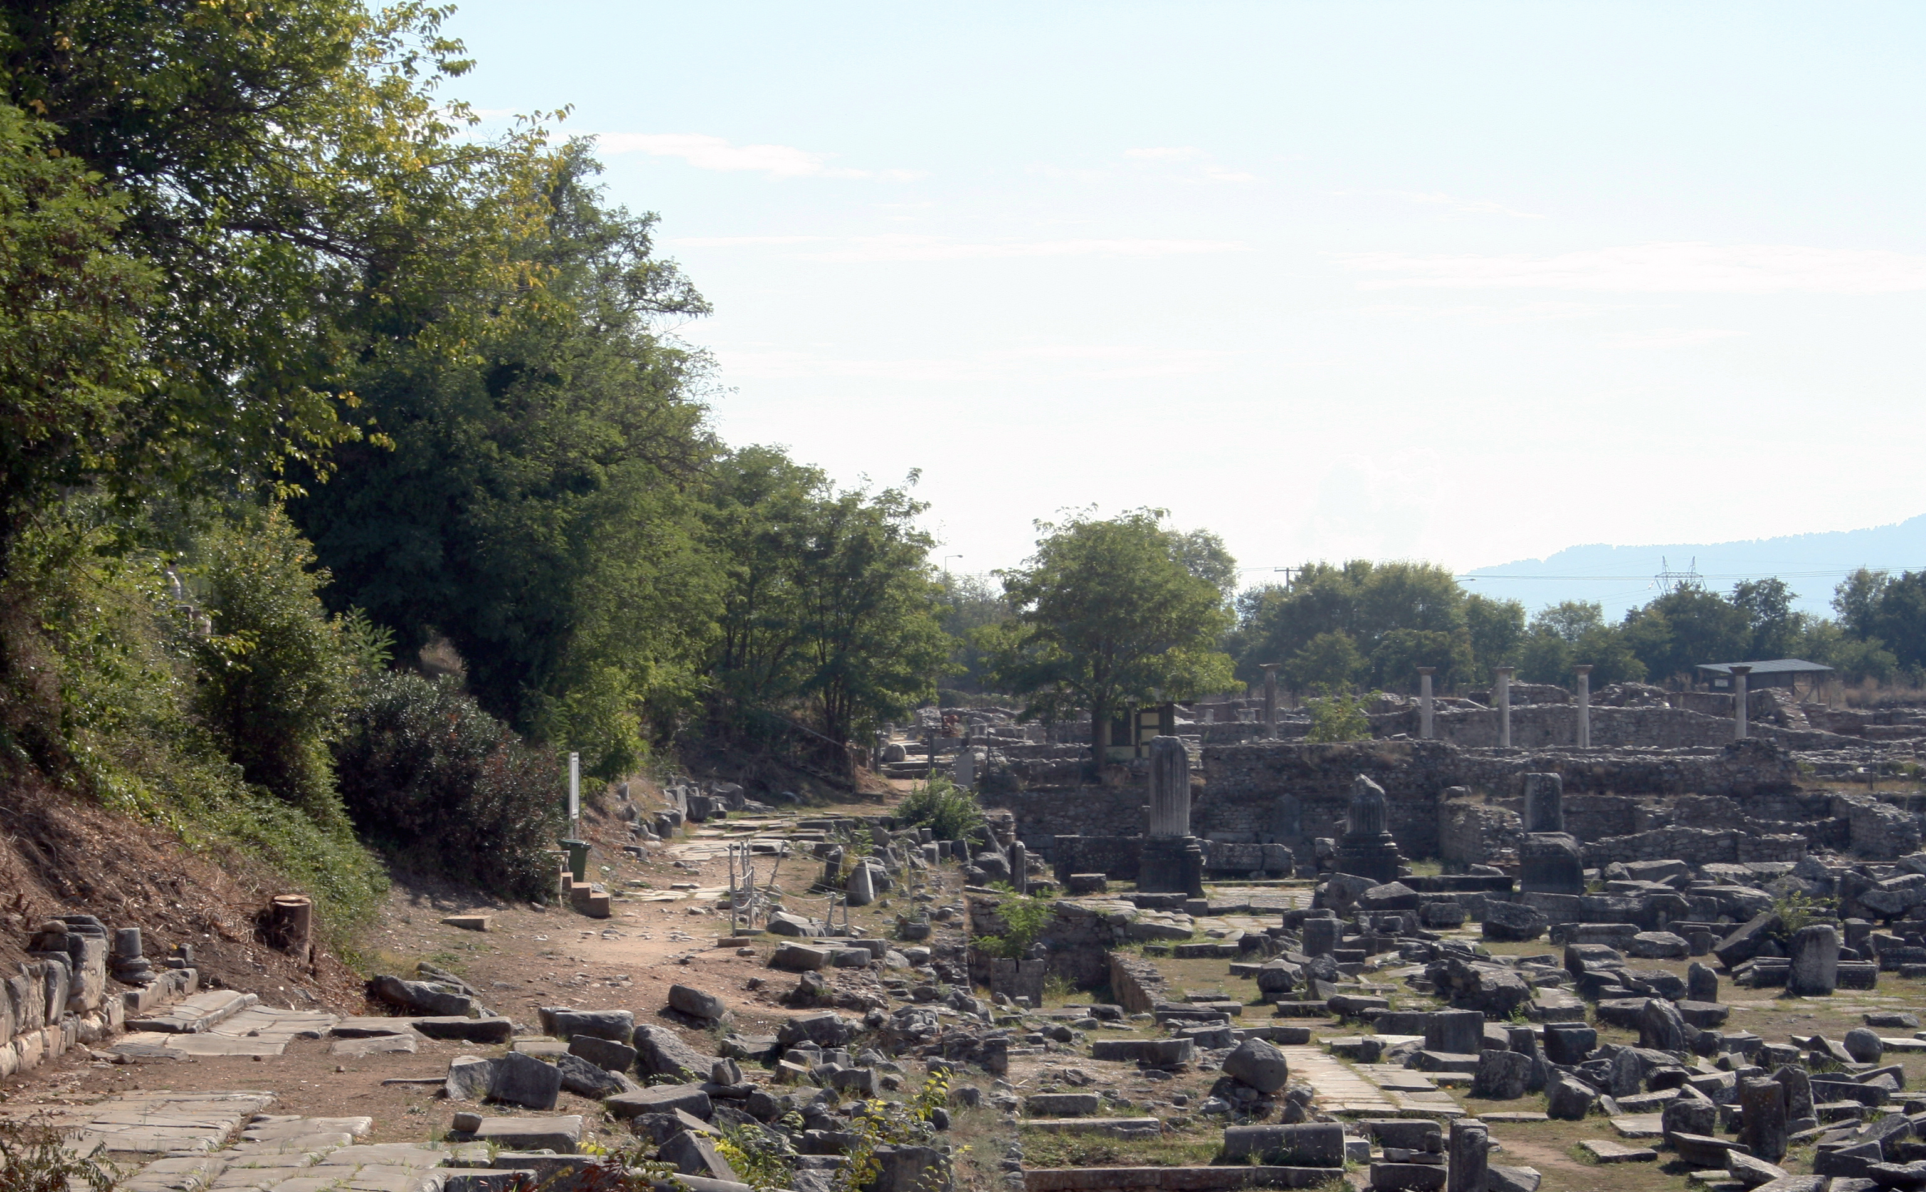
Favorite Texts from Philippians

Slide 4
The Context
These two verses follow such a glorious description of what God did for mankind through Jesus Christ, that no one reading the book of Philippians could have gotten the impression that man earns his salvation by his own good works.

Slide 5
Paul Did Not Teach Salvation by Works
“For by grace you have been saved through faith, and that not of yourselves; it is the gift of God, not of works, lest anyone should boast” (Eph. 2:8-9).
“Therefore by the deeds of the law no flesh will be justified in His sight, for by the law is the knowledge of sin” (Rom. 3:20; cf. 3:27-28; 4:2; 9:11; 11:6)
“But when the kindness and the love of God our Savior toward man appeared, not by works of righteousness which we have done, but according to His mercy He saved us, through the washing of regeneration and renewing of the Holy Spirit, whom He poured out on us abundantly through Jesus Christ our Savior” (Tit. 3:4-6).
We owe our salvation to God’s love for mankind and Jesus’s self-sacrificing death on Calvary.

Slide 6
I. As You Have Always Obeyed (2:12)

Slide 7
Complimentary Words
Paul speaks approvingly of the faithful obedience of the Philippian saints.
Like a good servant who obeys his master not only when the master is watching, but also when he is not looking (Eph. 6:5-6; Col. 3:21-22), so also the Philippians obeyed God when Paul was with them or away.
“Therefore, my beloved, as you have always obeyed, not as in my presence only, but now much more in my absence, . . .” (Phil. 2:12).

Slide 8
Obedience: Evidence of Recognition of Jesus As Lord
“But why do you call Me ‘Lord, Lord,’ and do not do the things which I say?” (Luke 6:46).
“Not everyone who says to Me, ‘Lord, Lord,’ shall enter the kingdom of heaven, but he who does the will of My Father in heaven” (Matt. 7:21).
“If you love Me, keep My commandments . . . .He who has My commandments and keeps them, it is he who loves Me. And he who loves Me will be loved by My Father, and I will love him and manifest Myself to him. . . .If anyone loves Me, he will keep My word; and My Father will love him, and We will come to him and make Our home with him” (John 14:15, 21, 23)

Slide 9
II. Work Out Your Own Salvation (2:12)

Slide 10
“Work Out”
One shows his obedience to Jesus by “work(ing) out your own salvation.”
Work out (katergazomai) is used in the sense of “to cause a state or condition, bring about, produce, create” (BDAG, 531).
The word is an imperative, the language of commandment.
This is not optional to those who profess allegiance to Jesus.

Slide 11
With Fear
The verb is modified by a compound prepositional phrase: “with fear and trembling.”
Fear (phobos): The word phobos can mean “intimidation,” “fear, alarm, fright,” but in this context it is used of “reverence, respect” (BDAG, 1062).
It recalls passages such as:
“Let us hear the conclusion of the whole matter: Fear God and keep His commandments, For this is man’s all. For God will bring every work into judgment, Including every secret thing, Whether good or evil” (Eccl. 12:13-14).
“. . .that you may fear the Lord your God, to keep all His statutes and His commandments which I command you, you and your son and your grandson, all the days of your life, and that your days may be prolonged” (Deut. 6:2).
“And now, Israel, what does the Lord your God require of you, but to fear the Lord your God, to walk in all His ways and to love Him, to serve the Lord your God with all your heart and with all your soul” (Deut. 10:12).

Slide 12
With . . . Trembling
Trembling (tromos): “trembling, quivering” (BDAG, 1016). The same phrase is used in the following passages:
“And his affections are greater for you as he remembers the obedience of you all, how with fear and trembling you received him” (2 Cor. 7:15).
“Bondservants, be obedient to those who are your masters according to the flesh, with fear and trembling, in sincerity of heart, as to Christ” (Eph. 6:5).

Slide 13
Gordon Fee
“The phrase with fear and trembling indicates how important this matter is for Paul. One does not live out the gospel casually or lightly, especially in light of verses 6–11, but as those who know what it means to stand in awe of the living God. Nothing of cringing or lack of confidence is implied. . . . Thus working out the salvation that God has given them should be done with a sense of “holy awe and wonder” before the God with whom they—and we—have to do” (Philippians, The IVP New Testament Commentary Series (Westmont, IL: IVP Academic, 1999), 104–105.

Slide 14
Who Are We Pleasing?
Too frequently, Christians manifest an attitude of pleasing themselves in what they offer to God rather than approaching God with reverent awe in hope that our service might be acceptable to Him.
Remember Uzzah.
In David’s first attempt to move the ark of the covenant to the city of Jerusalem, he moved it in a way that pleased himself (2 Sam. 6:1-11).
In his second effort, he followed the instructions of the Law in how to move the ark (2 Sam. 6:12-19).

Slide 15
Salvation
Salvation (sōtēria): the word is not used in a corporate sense.
Paul is not discussing congregational well-being, using the word “salvation” to aim at correcting the disunity described in 2:1-4.
We are not saved as a local church, but individually.
This verse is speaking about personal salvation.
Group problems will be resolved to the degree that every individual is determined to work out his own salvation.
If we are willing to live in keeping with our call to salvation, group problems will begin to disappear.

Slide 16
God Initiated Salvation
God has done His part in salvation by showing His love for mankind by sending His Son.
Jesus did His part in dying on Calvary.
The Holy Spirit has done His part in guiding the Apostles in all truth and inspiring their writings to make the New Testament.
Preachers do their part by preaching and teaching the gospel to men.
Yet, every man has free will and must choose for himself whether or not to obey God and the gospel.

Slide 17
God’s Work in Mankind
“. . . for it is God who works in you both to will and to do for His good pleasure” (Phil. 2:13).
This passage reminds us of what was said in the first chapter, “being confident of this very thing, that He who has begun a good work in you will complete it until the day of Jesus Christ” (Phil. 1:6).

Slide 18
The Calvinist Idea
Through the centuries, men have had trouble understanding God’s part and man’s part in salvation.
The Calvinist puts everything on God, logically compelled by their mistaken belief that the guilt of Adam’s sin is imputed to all of mankind and passes down a sinful nature through procreation.
Mankind is thought to be utterly incapable of responding to the gospel until God sends His Holy Spirit to enable him to believe.
God only sends the Holy Spirit to the elect.
Once in grace, always in grace!
It all depends upon God.

Slide 19
Let’s Look at Pentecost
Let’s look at how salvation occurs in mankind.
God works in you to will.
On the day of Pentecost, the Holy Spirit inspired apostles preached the first gospel sermon.
The effect of hearing that sermon was to create in receptive men the desire to do something about their sin: “Men and brethren, what shall we do?” (Acts 2:37).

Slide 20
God Works in Us To Do His Will
God works in us to do His good pleasure.
Let’s look again at Pentecost:
Peter told the men what to do: “Repent, and let every one of you be baptized in the name of Jesus Christ for the remission of sins; and you shall receive the gift of the Holy Spirit” (Acts 2:38).
From hearing the word of God, men chose to obey that word: “Then those who gladly received his word were baptized; and that day about three thousand souls were added to them” (Acts 2:41).

Slide 21
God’s Work Continues After Baptism
God does not quit working with us once we are baptized. Through the same process that brought us to conversion, God continues to purify His children:
“Do you not know that to whom you present yourselves slaves to obey, you are that one's slaves whom you obey, whether of sin leading to death, or of obedience leading to righteousness? But God be thanked that though you were slaves of sin, yet you obeyed from the heart that form of doctrine to which you were delivered. And having been set free from sin, you became slaves of righteousness” (Rom. 6:16-18).
He moves His saints to desire to change their lives.
He energizes us to do His good will.

Slide 22
God Doesn’t Quit
What a wonderful promise appears in chapter 1:
“. . . being confident of this very thing, that He who has begun a good work in you will complete it until the day of Jesus Christ” (Phil. 1:6).

Slide 23
Conclusion

Slide 24
Take Aways
This exhortation encourages God’s saints to keep on working out their own salvation with fear and trembling.
We do not cringe before our God.
We stand in reverent fear and trembling because we have the privilege of entering His presence.
His word continues to work in our lives and our yielding spirit bows before Him and resolves to bring our wills and lives into compliance with His Word.

