Slide 2
“Therefore, my beloved, as you have always obeyed, not as in my presence only, but now much more in my absence, work out your own salvation with fear and trembling; for it is God who works in you both to will and to do for His good pleasure” (Phil. 2:12-13).
How to
Work Out Your Own Salvation

Slide 3
Leaving Us An Example, That Ye Should Follow His Steps
“. . . God anointed Jesus of Nazareth with the Holy Spirit and with power, who went about doing good and healing all who were oppressed by the devil, for God was with Him” (Acts 10:38).

Slide 4
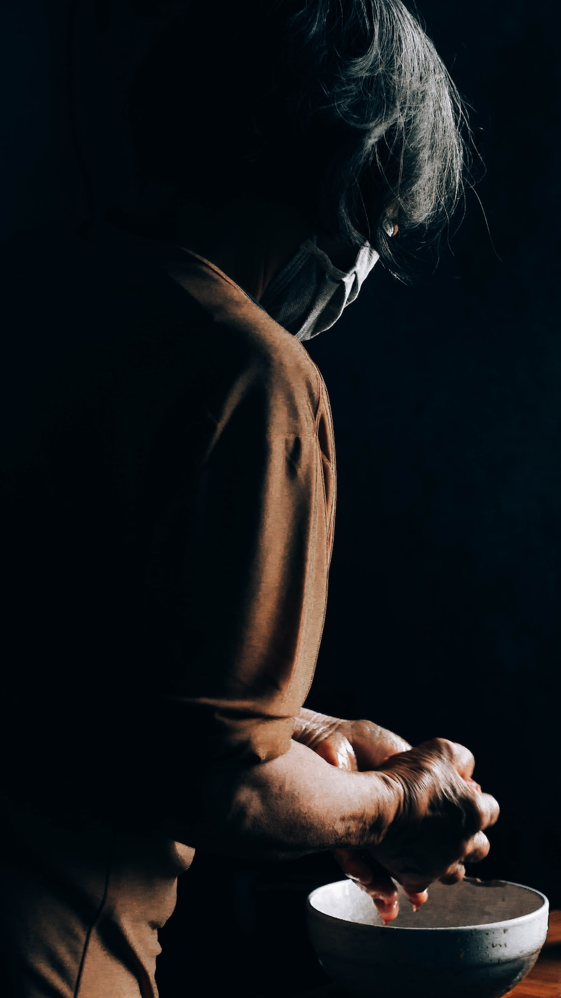
Jesus “rose from supper and laid aside His garments, took a towel and girded Himself. After that, He poured water into a basin and began to wash the disciples’ feet, and to wipe them with the towel with which He was girded” (John 13:4-5).
This was a job usually done by oneself or by servants.

Slide 5
Mark 10:41-45
“And when the ten heard it, they began to be greatly displeased with James and John. But Jesus called them to Himself and said to them, ‘You know that those who are considered rulers over the Gentiles lord it over them, and their great ones exercise authority over them. Yet it shall not be so among you; but whoever desires to become great among you shall be your servant. And whoever of you desires to be first shall be slave of all. For even the Son of Man did not come to be served, but to serve, and to give His life a ransom for many.’”

Slide 6
Matthew 25:34-36
“Then the King will say to those on His right hand, ‘Come, you blessed of My Father, inherit the kingdom prepared for you from the foundation of the world: for I was hungry and you gave Me food; I was thirsty and you gave Me drink; I was a stranger and you took Me in; I was naked and you clothed Me; I was sick and you visited Me; I was in prison and you came to Me.”
Give someone food and drink.
Receive a stranger into your home.
Clothe the naked. James 2:14-15 reminds one to clothe the naked and feed the hungry.
Visit (take care of the needs) of the sick.
Visit those in prison (particularly for Christ’s sake).

Slide 7
The Good Samaritan (Luke 10:25-37)
We could focus on what the Levite and Priest did not do:
The priest saw the injured man and passed by (v. 31).
The Levite “came and looked on him, and passed by on the other side” (v. 32).
The Samaritan:
Had compassion on him (v. 33).
He took time from his busy day, whatever his plans and expectations were.
He bound up his wounds, pouring in oil and wine.
He set him on his own beast, leaving the Samaritan to walk.
He brought him to an inn, and took care of him.
He hired someone else to care for him: “he took out two pence (denarius: a day’s wages)” to pay the innkeeper to care for him and committed himself to whatever else he needed.

Slide 8
Sometimes It Costs Nothing to Help
“If you meet your enemy’s ox or his donkey going astray, you shall surely bring it back to him again. If you see the donkey of one who hates you lying under its burden, and you would refrain from helping it, you shall surely help him with it” (Exod. 23:4-5).
Sometimes we see someone in need and there is absolutely no threat of danger by stopping to help.
Are we like the priest and Levite, or like the Samaritan?

Slide 9
Proverbs 3:27-28
“Do not withhold good from those to whom it is due, When it is in the power of your hand to do so. Do not say to your neighbor, ‘Go, and come back, And tomorrow I will give it,’ When you have it with you.”

Slide 10
Dorcas
“At Joppa there was a certain disciple named Tabitha, which is translated Dorcas. This woman was full of good works and charitable deeds which she did. . . . Then Peter arose and went with them. When he had come, they brought him to the upper room. And all the widows stood by him weeping, showing the tunics and garments which Dorcas had made while she was with them.”

Slide 11
Ephesians 4:28
“Let him who stole steal no longer, but rather let him labor, working with his hands what is good, that he may have something to give him who has need.”
We labor hard for a new car, a bigger house, better clothes, etc.
How many times have you said, “I got a raise! Now we can give more to help those who are in need?”

Slide 12
James 1:27
“Pure and undefiled religion before God and the Father is this: to visit orphans and widows in their trouble, and to keep oneself unspotted from the world.”
Our widows in this congregation sometimes have needs. Do we make ourselves available to help or are we too busy to be bothered?
We appreciate those who have adopted children so that they might have a better life.

Slide 13
The Shunammite Woman and Elisha
“Now it happened one day that Elisha went to Shunem, where there was a notable woman, and she persuaded him to eat some food. So it was, as often as he passed by, he would turn in there to eat some food” (2 Kings 4:8).
“Please, let us make a small upper room on the wall; and let us put a bed for him there, and a table and a chair and a lampstand; so it will be, whenever he comes to us, he can turn in there” (2 Kings 4:10).

Slide 14
Other Workers
Barnabas stands out: “having land, sold it, and brought the money and laid it at the apostles’ feet” (Acts 4:37).
Priscilla and Aquila opened their home to have worship services (Rom. 16:5).
Phebe had a reputation of being “a helper of many, including myself also” (Rom. 16:2).
Epaphroditus risked his life to bring financial help to Paul while he was in a Roman prison (Phil. 2:30).

Slide 15
Other Workers
Rahab: “By faith the harlot Rahab did not perish with those who did not believe, when she had received the spies with peace” (Heb. 11:31).
Hid the spies.
Gave them advice to keep from being found.
Let them down by a cord from her window.
Instructions to Timothy: “Let them do good, that they be rich in good works, ready to give, willing to share” (1 Tim. 6:18).

Slide 16
Galatians 6:1-10
“Brethren, if a man is overtaken in any trespass, you who are spiritual restore such a one in a spirit of gentleness, considering yourself lest you also be tempted. Bear one another’s burdens, and so fulfill the law of Christ” (6:1-2).
“For each one shall bear his own load” (6:5).
“And let us not grow weary while doing good, for in due season we shall reap if we do not lose heart” (6:9).
“Therefore, as we have opportunity, let us do good to all, especially to those who are of the household of faith” (6:10).

Slide 17
Spiritual Helpers
“. . . bearing with one another, and forgiving one another, if anyone has a complaint against another; even as Christ forgave you, so you also must do” (Col. 3:13).
“Depart from evil and do good; Seek peace and pursue it” (Psa. 34:14).
“The Lord grant mercy to the household of Onesiphorus, for he often refreshed me, and was not ashamed of my chain” (2 Tim. 1:16).

Slide 18
Spiritual Helpers
“Is anyone among you suffering? Let him pray. Is anyone cheerful? Let him sing psalms. Is anyone among you sick? Let him call for the elders of the church, and let them pray over him, anointing him with oil in the name of the Lord. And the prayer of faith will save the sick, and the Lord will raise him up. And if he has committed sins, he will be forgiven. Confess your trespasses to one another, and pray for one another, that you may be healed. The effective, fervent prayer of a righteous man avails much” (James 5:13-16).

Slide 19
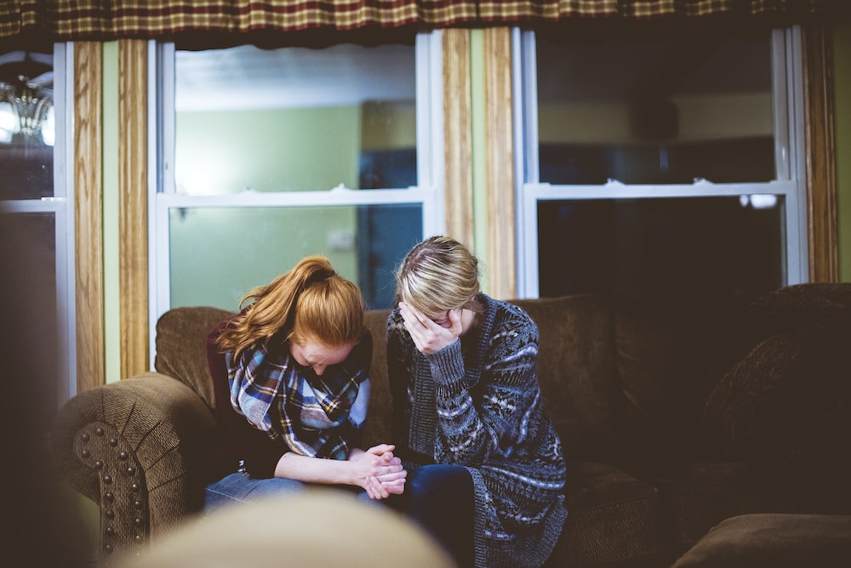
It Costs Nothing to Pray for Someone

Slide 20
Accept the Challenge

Slide 21
I Challenge You . . .
Do one good deed for someone else in the coming week!
Can you call someone confined to their home and check on them?
Can you go to one’s home and provide company to them?
Can you pray with someone about his troubles?
. . . Whatever you are capable of doing.

Slide 22
“Therefore, my beloved, as you have always obeyed, not as in my presence only, but now much more in my absence, work out your own salvation with fear and trembling; for it is God who works in you both to will and to do for His good pleasure” (Phil. 2:12-13).
How to
Work Out Your Own Salvation
“Do all things without complaining and disputing, that you may become blameless and harmless, children of God without fault in the midst of a crooked and perverse generation, among whom you shine as lights in the world, holding fast the word of life, so that I may rejoice in the day of Christ that I have not run in vain or labored in vain” (Phil. 2:14-16).

