Slide 2
Religion Definition
A personal set or institutionalized system of religious attitudes, beliefs, and practices
2a
(1): the service and worship of God or the supernatural
(2): commitment or devotion to religious faith or observance
2b: . . .
3: a cause, principle, or system of beliefs held to with ardor and faith

Slide 3
Jesus: Some Religions Are Vain
“And in vain they worship Me, Teaching as doctrines the commandments of men” (Matt. 15:9).
“If anyone among you thinks he is religious, and does not bridle his tongue but deceives his own heart, this one’s religion is useless. Pure and undefiled religion before God and the Father is this: to visit orphans and widows in their trouble, and to keep oneself unspotted from the world” (James 1:26-27).

Slide 4
The Real Test of Your Religion
What difference does it make in your life?
The blind man (John 9:24-38): it got him thrown out of the synagogue and then led him to praise Jesus.
The eunuch “went...rejoicing” (Acts 8:39).
The Jews were “praising God” (Acts 2:47).
Paul was “ready...to die” (Acts 21:13).
What does your religion mean to you? Has it made a difference in your life?

Slide 5
What Religion Means to Some People
Some go to church three times in their lives:
When they are born: infant baptism
When they get married
When they have their funeral
Going to church on Easter Sunday, Christmas, Mother’s Day, etc.
Church is a fashion show.
Attending only when it is convenient to them.

Slide 6
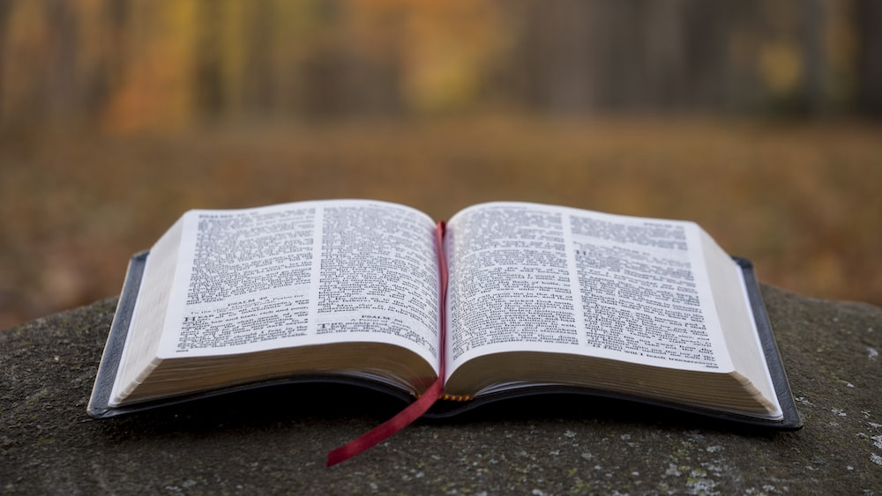
What Does Religion Mean to You?

Slide 7
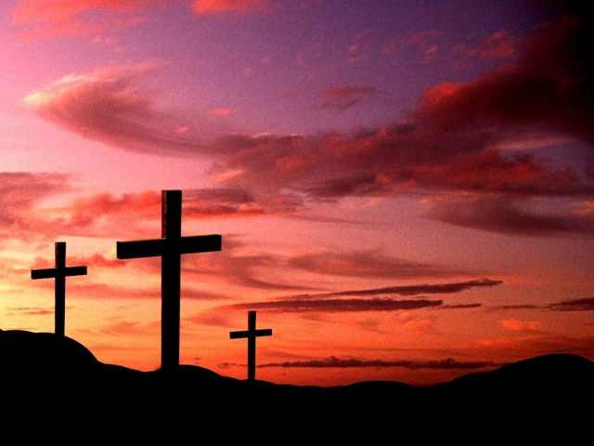
1. Purity of Life
“I beseech you therefore, brethren, by the mercies of God, that you present your bodies a living sacrifice, holy, acceptable to God, which is your reasonable service. And do not be conformed to this world, but be transformed by the renewing of your mind, that you may prove what is that good and acceptable and perfect will of God” (Rom. 12:1-2).

Slide 8
Mary Magdalene
“Now it came to pass, afterward, that He went through every city and village, preaching and bringing the glad tidings of the kingdom of God. And the twelve were with Him, and certain women who had been healed of evil spirits and infirmities—Mary called Magdalene, out of whom had come seven demons” (Luke 8:1-2).
She ministered to Jesus during His life (Luke 8:3).
She was present at the crucifixion (Matt. 27:56).
She anointed the dead body of Jesus (Matt. 27:61).
She was the first to see the risen Lord (Mark 16:9).

Slide 9
Zacchaeus
“But when they saw it, they all complained, saying, ‘He has gone to be a guest with a man who is a sinner.’ Then Zacchaeus stood and said to the Lord, ‘Look, Lord, I give half of my goods to the poor; and if I have taken anything from anyone by false accusation, I restore fourfold.’ And Jesus said to him, ‘Today salvation has come to this house, because he also is a son of Abraham; for the Son of Man has come to seek and to save that which was lost’” (Luke 19:7-10).

Slide 10
Zacchaeus
“But when they saw it, they all complained, saying, ‘He has gone to be a guest with a man who is a sinner.’ Then Zacchaeus stood and said to the Lord, ‘Look, Lord, I give half of my goods to the poor; and if I have taken anything from anyone by false accusation, I restore fourfold.’ And Jesus said to him, ‘Today salvation has come to this house, because he also is a son of Abraham; for the Son of Man has come to seek and to save that which was lost’” (Luke 19:7-10).

Slide 11
Christ Calls Us to Purity
“For the grace of God that brings salvation has appeared to all men, teaching us that, denying ungodliness and worldly lusts, we should live soberly, righteously, and godly in the present age, looking for the blessed hope and glorious appearing of our great God and Savior Jesus Christ, who gave Himself for us, that He might redeem us from every lawless deed and purify for Himself His own special people, zealous for good works” (Tit. 2:11-14).
“Blessed are the pure in heart, For they shall see God” (Matt. 5:8).

Slide 12
Other Verses
“Do all things without complaining and disputing, that you may become blameless and harmless, children of God without fault in the midst of a crooked and perverse generation, among whom you shine as lights in the world” (Phil. 2:14-15).
“Finally, brethren, whatever things are true, whatever things are noble, whatever things are just, whatever things are pure, whatever things are lovely, whatever things are of good report, if there is any virtue and if there is anything praiseworthy—meditate on these things” (Phil. 4:8).
“Let no corrupt word proceed out of your mouth, but what is good for necessary edification, that it may impart grace to the hearers” (Eph. 4:29).

Slide 13
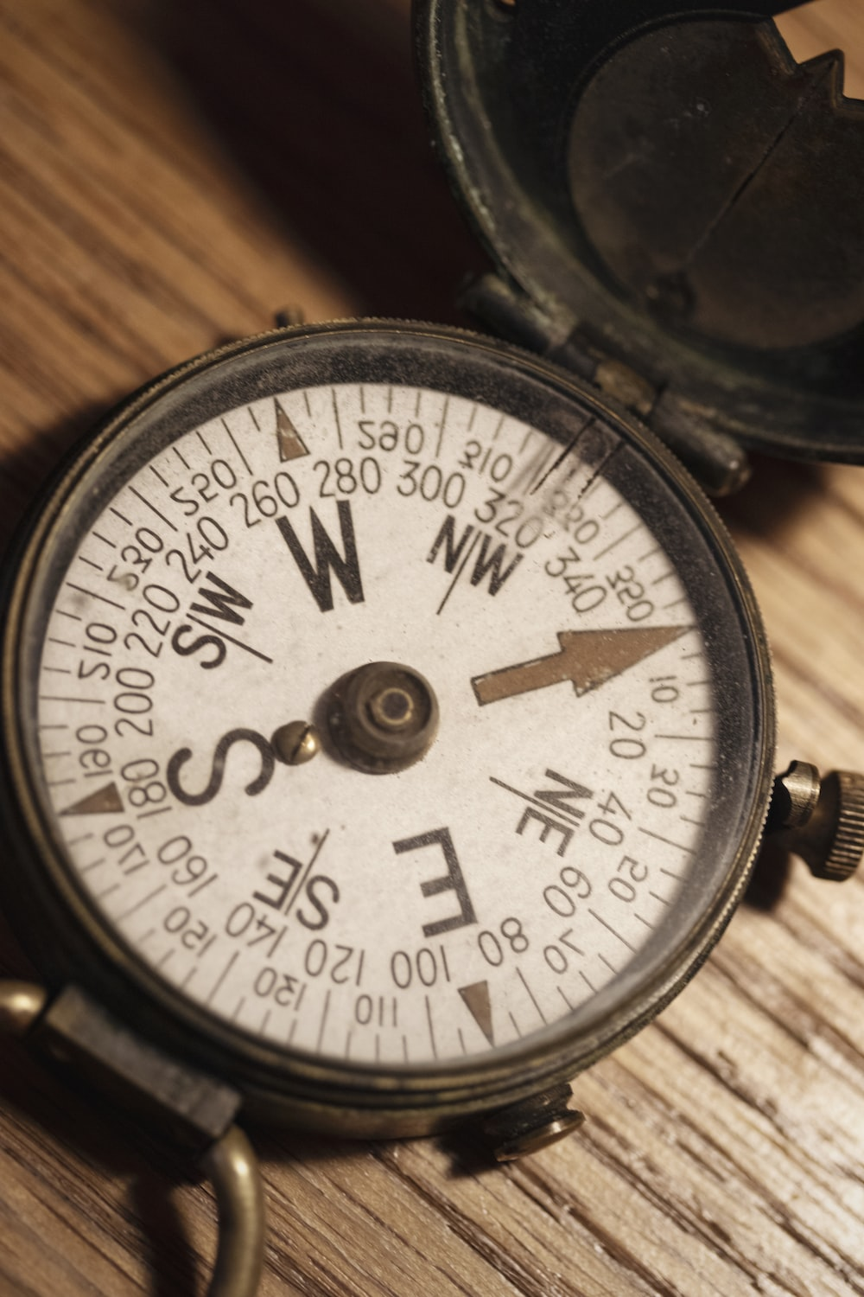
2. A Sense of Direction

Slide 14
We Need Direction
What do I want to do in my life?
What kind of husband/wife do you want to be?
What do I want my friends to think when they think of me?
What is most important in my life?

Slide 15
Are You Off Course?
“If you were of the world, the world would love its own. Yet because you are not of the world, but I chose you out of the world, therefore the world hates you” (John 15:19).
“Adulterers and adulteresses! Do you not know that friendship with the world is enmity with God? Whoever therefore wants to be a friend of the world makes himself an enemy of God” (James 4:4).
“Do not love the world or the things in the world. If anyone loves the world, the love of the Father is not in him. For all that is in the world—the lust of the flesh, the lust of the eyes, and the pride of life—is not of the Father but is of the world. And the world is passing away, and the lust of it; but he who does the will of God abides forever” (1 John 2:15-17).

Slide 16
Some People Who Lost Their Way
The rich young ruler (Matt. 19:16-22)
The rich farmer who built bigger barns (Luke 12:16-21)
Judas Iscariot (Matt. 26:24)

Slide 17
3. Gaining the Victor’s Crown

Slide 18
The Paradox
You find rest from your weariness by taking Jesus’ yoke upon you (Matt. 11:28-30).
One lives by dying. “I have been crucified with Christ; it is no longer I who live, but Christ lives in me; and the life which I now live in the flesh I live by faith in the Son of God, who loved me and gave Himself for me (Gal. 2:20).
One loses his life in order to find it: “For whoever desires to save his life will lose it, but whoever loses his life for My sake will find it” (Matt. 16:25).

Slide 19
The Need for Guidance
“O Lord, I know the way of man is not in himself; It is not in man who walks to direct his own steps” (Jer. 10:23).
“Trust in the Lord with all your heart, And lean not on your own understanding” (Prov. 3:5).
“But seek first the kingdom of God and His righteousness, and all these things shall be added to you” (Matt. 6:33).

Slide 20
Devoting One’s Life to God
Jesus: “Not my will but thine be done” (Matt. 26:39).
Paul considered his life a sacrifice (cf. 2 Tim. 4:7-8).
We can be victors over all sin and evil and overcome the world.
“I can do all things through Christ who strengthens me” (Phil. 4:13).
“For whatever is born of God overcomes the world. And this is the victory that has overcome the world—our faith” (1 John 5:4).
We can be more useful in the kingdom, and win a victory over death.
“But thanks be to God, who gives us the victory through our Lord Jesus Christ” (1 Cor. 15:57).

Slide 21
4. A Challenge

Slide 22
Some Start But Do Not Finish
The parable of the sower (Luke 8:4-15)
Judas
Demas: “for Demas has forsaken me, having loved this present world, and has departed for Thessalonica” (2 Tim. 4:10).
“For many walk, of whom I have told you often, and now tell you even weeping, that they are the enemies of the cross of Christ: whose end is destruction, whose god is their belly, and whose glory is in their shame—who set their mind on earthly things” (Phil. 3:18-19).

Slide 23
The Challenge
“For you were bought at a price; therefore glorify God in your body and in your spirit, which are God’s” (1 Cor. 6:20).
“I beseech you therefore, brethren, by the mercies of God, that you present your bodies a living sacrifice, holy, acceptable to God, which is your reasonable service. And do not be conformed to this world, but be transformed by the renewing of your mind, that you may prove what is that good and acceptable and perfect will of God” (Rom. 12:1-2).
Aim toward perfection (Phil. 3:13-14).

Slide 24
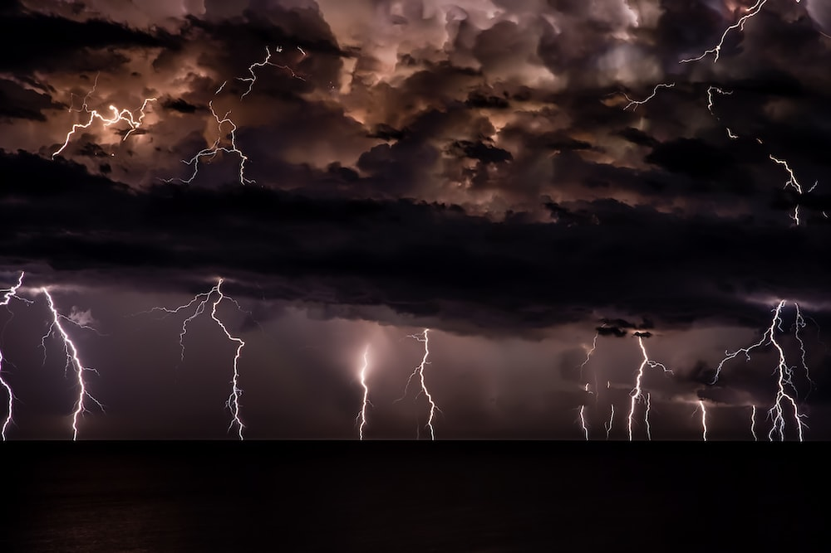
5. Refuge and Security
God is our refuge and strength,
A very present help in trouble.
Therefore we will not fear,
Even though the earth be removed,
And though the mountains be carried into the midst of the sea;
Though its waters roar and be troubled,
Though the mountains shake with its swelling (Psa. 46:1-3).

Slide 25
God Is Our Refuge
“. . .that by two immutable things, in which it is impossible for God to lie, we might have strong consolation, who have fled for refuge to lay hold of the hope set before us” (Heb. 6:18).

Slide 26
Trust in Jesus
“There is therefore now no condemnation to those who are in Christ Jesus, who do not walk according to the flesh, but according to the Spirit. For the law of the Spirit of life in Christ Jesus has made me free from the law of sin and death” (Rom. 8:1-2).
“For this reason I also suffer these things; nevertheless I am not ashamed, for I know whom I have believed and am persuaded that He is able to keep what I have committed to Him until that Day” (2 Tim. 1:12).
Lend Jesus a boat, it comes back full of fishes; give him water, it comes back wine; give him a boy’s lunch, he feeds 5,000 men and has left overs.

Slide 27
Conclusion

Slide 28
Does Your Religion Mean This to You?
Purity of life
A sense of direction
Gaining the Victor’s crown
A challenge
Refuge and Security

