Slide 2
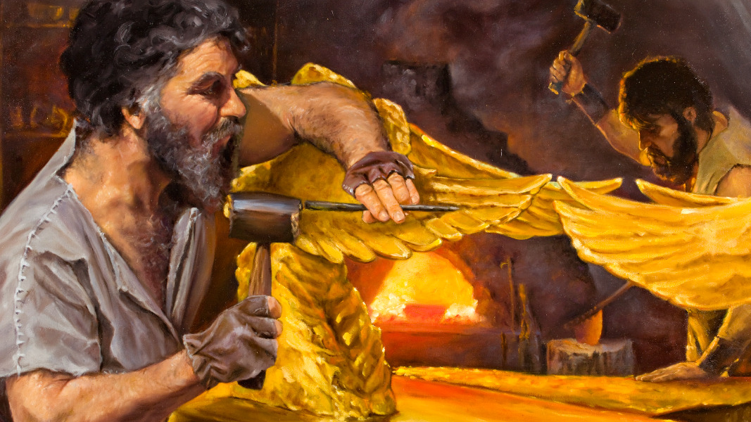
What Do You Know about Bezalel?

Slide 3
Introduction
Most of us will not know much about Bezalel, the Bible character studied in this lesson.
We are familiar with the Noah, the Patriarchs (Abraham, Isaac, Jacob), Joseph, Moses, Joshua, Saul, David, and Solomon, the prophets, and other Old and New Testament characters.
But perhaps many of you know nothing about Bezalel (NKJV; Bezaleel, KJV).
In the church, we emphasize those who can teach and preach and serve as elders. There is not much emphasis given to those who serve in other capacities.

Slide 4
Why Talk about Bezalel?
To emphasize the contributions of those who may not serve in a public capacity in the church.
To teach our children that God also creates men and women for skilled trades to serve the needs of our society. It is honorable work and pays wages sufficient to support one’s family.

Slide 5
I. Appreciating Skilled Craftsmen

Slide 6
Going to College
American culture encourages young adults to enroll in college and train to become someone with specialized skills:
Teaching
Medicine: Doctors, nurses (RN, LPN, etc.). The medical field has so many specialists for every part of the body
Engineers: mechanical, electronic, architectural, etc.
Scientists: Biologists and chemists
Mathematicians
Computer specialists (writing coding, cyber security, software development, etc.)
Counseling
Lawyers
You can’t do these jobs without a college degree!

Slide 7
Bezalel and Aholiab Were Skilled Tradesmen
“And with him was Aholiab the son of Ahisamach, of the tribe of Dan, an engraver and designer, a weaver of blue, purple, and scarlet thread, and of fine linen” (Exod. 38:23).
Engraver
Cunning workman
Embroider in purple, scarlet and fine linen
Their assigned duties required:
Masonry, stoneworking
Carpentry
Cloth work

Slide 8
Their Skills
“And Moses said to the children of Israel, ‘See, the Lord has called by name Bezalel the son of Uri, the son of Hur, of the tribe of Judah; and He has filled him with the Spirit of God, in wisdom and understanding, in knowledge and all manner of workmanship’” (Exod. 35:30-31).
“And He has put in his heart the ability to teach, in him and Aholiab the son of Ahisamach, of the tribe of Dan. He has filled them with skill to do all manner of work of the engraver and the designer and the tapestry maker, in blue, purple, and scarlet thread, and fine linen, and of the weaver—those who do every work and those who design artistic works” (Exod. 35:34-35).
Note that Bezalel is capable of teaching others to do the same crafts.

Slide 9
Their Skills
“And Bezalel and Aholiab, and every gifted artisan in whom the Lord has put wisdom and understanding, to know how to do all manner of work for the service of the sanctuary, shall do according to all that the Lord has commanded” (Exod. 36:1).

Slide 10
Used His Skills for God
“Belazel has been gifted by God so that he is a man capable of bringing artistic ideals to life with his own hands, and leading others to join him in constructing a suitable dwelling place for God. This is not just learning, but a supernatural gifting. He has been filled with the Spirit of God, gifted in craftsmanship, and given the ability to teach others and to do the same. And by using his gift, he is going to create a dwelling place for God” (Eric Stillman, “The Power of One Life: Bezalel: You Are Gifted by God,” https://www.newlife-ct.org/sermons/sermon/2013-06-30/bezalel:-you-are-gifted-by-god).

Slide 11
God Does Not Give All of Us the Same Gifts
Do not be hard on yourself if your skills are not in books. God did not give those skills to everyone.
Think of skills so desperately needed that make our world function

Slide 12
America’s Skilled Workforces
Carpentry (framing, trim, remodeling, dry wall, painting)
Steelworkers
Electricians
Some of the men who work on the poles maintaining our electric grid are very well paid.
Plumbing
Landscaping
Surveying
Automobile mechanics and body work
Small engine repair
Transportation (truck drivers, bus drivers, etc.)
Cooks and other restaurant personnel (waiters)
Tree removal
Unskilled labor (garbage men, road crews
Military services can teach you hundreds of different skills
Policemen (forensic, detective, speed enforcement, etc.)

Slide 13
II. Essential Character Traits

Slide 14
A. Honesty
He had gold and silver entrusted him that had been donated by the people for the construction of the Tabernacle. He had to be trustworthy.
Exodus 38:21-31 lists the materials used in the construction of the tabernacle, necessarily entrusted to the hands of Bezalel and Aholiab:
Gold: 29 talents, 730 shekels.
Silver: 100 talents, 1775 shekels.
“This is the inventory of the tabernacle, the tabernacle of the Testimony, which was counted according to the commandment of Moses, for the service of the Levites, by the hand of Ithamar, son of Aaron the priest. Bezalel the son of Uri, the son of Hur, of the tribe of Judah, made all that the Lord had commanded Moses” (Exod. 38:21-22).
Men who work in skilled trades are also required to be honest. Embezzlement and other forms of stealing lead to imprisonment.

Slide 15
B. Self-Discipline
“Go to the ant, you sluggard! Consider her ways and be wise, Which, having no captain, Overseer or ruler, Provides her supplies in the summer, And gathers her food in the harvest” (Prov. 6:6-8).
To be a skilled craftsman working on the job requires self-discipline. I do not want to have to stand and watch every worker who builds my house to be sure he arrives on time and does his work in a timely fashion. Instead, we pay him by the job and if he can get it done faster than other contractors, he can make more money.
Parents who allow their children to stay up till the wee hours of the morning playing games and watching TV and then allow them to sleep till noon are hurting their children. I don’t know any companies looking for this kind of laborer.

Slide 16
No Room for a Procrastinator
Bezalel had to build the Tabernacle in six months.
Israzel left Egypt on the 14th day of the first month.
Bezalel got his assignment in the sixth month and the job had to be completed by the 14th day of the first month of the second year (Num. 10:11).
Scott and James were talking about the construction project of adding of new lanes to interstate highway I-635 and I-35 in downtown Dallas, Texas. The constructor was promised somewhere between $500,000 and $1,000,000 dollars a day for completing the project ahead of schedule.
Such incentives are frequently added to contracts and emphasize the need for such character traits as self-discipline. One worker not getting his work done in a timely fashion can cost the contractor big bucks!

Slide 17
C. Diligence
Bezalel could not sleep till noon, get up and work two or three hours and call it a day.
“How long will you slumber, O sluggard? When will you rise from your sleep? A little sleep, a little slumber, A little folding of the hands to sleep— So shall your poverty come on you like a prowler, And your need like an armed man” (Prov. 6:9-11).
“The person who labors, labors for himself, For his hungry mouth drives him on” (Prov. 16:26).

Slide 18
D. Aspiration for Excellence
“A lazy man buries his hand in the bowl, And will not so much as bring it to his mouth again” (Prov. 19:24; cf. 26:15).
No one wants a product that is not well built, that is sloppy.

Slide 19
III. Appreciate America’s Skilled Tradesmen

Slide 20
It Takes All of Us Working Together
Paul compared the local church to a physical body and emphasized the different contributions each part of the body made to the functioning of the body (1 Cor. 12:14-31).
There are men and women who make great contributions to our local work who may never (or rarely) stand before a class to teach. I speak of . . .
Project managers
Carpenters
Electricians
Plumbers
Men with computer skills
Audio/video technicians
Those who cook and prepare the communion
Those who work so hard to have an annual VBS
Your service to the Lord is just as vital as that of any other worker.

Slide 21
Conclusion

Slide 22
Love Your Work
This lesson is designed to encourage our young men and women who may not be interested in pursing a college career to find a skill that they enjoy doing and is able to provide a living for one’s family.
Keith Bradbury is a fan of Doctor Who, a British science-fiction television program that began broadcasting in 1963. He supports himself by starting a business in Mooresville called “WHO North America.” My guess is that he enjoys his work so much that he does not have to go to work a day in his life.
Find something you enjoy doing and make it your life’s career. Your avocation can become your vocation!

