Slide 2
Philippians 3:12-14
Not that I have already attained, or am already perfected; but I press on, that I may lay hold of that for which Christ Jesus has also laid hold of me. Brethren, I do not count myself to have apprehended; but one thing I do, forgetting those things which are behind and reaching forward to those things which are ahead, I press toward the goal for the prize of the upward call of God in Christ Jesus.

Slide 3
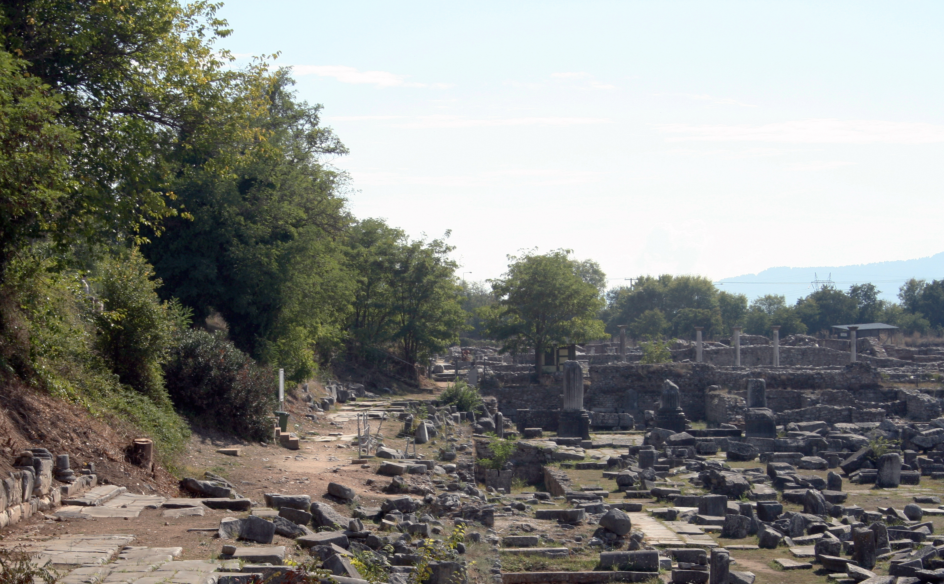
Favorite Texts from Philippians

Slide 4
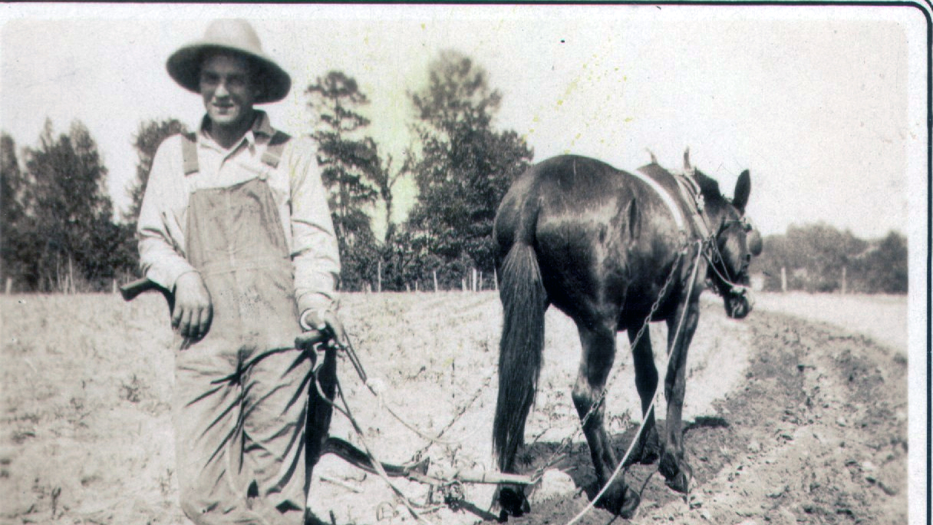
Keep Your Eye
on the Post

Slide 5
A Personal Relationship with Jesus

Slide 6
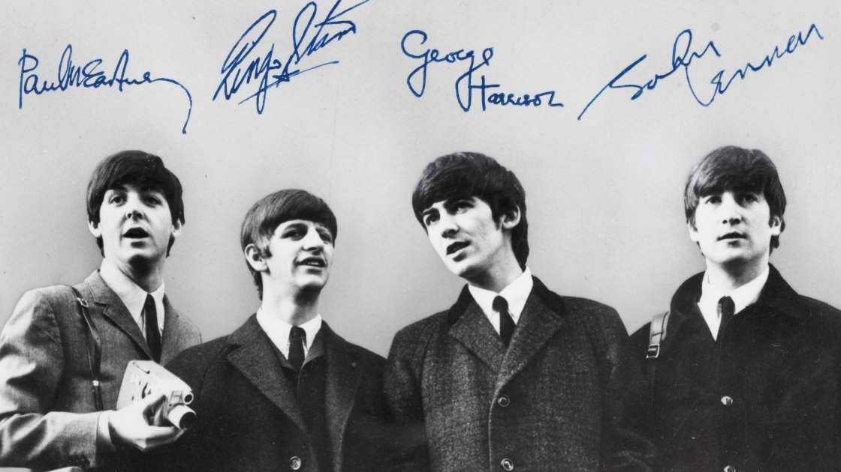

Slide 7
Philippians 3:8
“Yet indeed I also count all things loss for the excellence of the knowledge of Christ Jesus my Lord, for whom I have suffered the loss of all things, and count them as rubbish, that I may gain Christ” (3:8).
Paul recognized what a privilege it was to know Christ Jesus. All other things else in his life were “loss” (zēmia) in comparison thereto. Everything else was “rubbish” (skubalon: “useless or undesirable material that is subject to disposal, refuse, garbage [in various senses, ‘excrement, manure, garbage, kitchen scraps’],” BDAG, 932).
What a high honor it is to know Jesus!

Slide 8
Philippians 3:9
“. . . and be found in Him, not having my own righteousness, which is from the law, but that which is through faith in Christ, the righteousness which is from God by faith” (3:9).
Two systems of salvation are contrasted in this passage:
That taught by the Judaizers logically led to salvation by perfect obedience to the Law of Moses (remember the Judaizers of v.2).
Salvation “through the faith of Christ” (the gospel) and attained conditionally upon one’s personal faith in Jesus.
Paul’s renounces any ability for man to save himself by perfect obedience to the Law and shows a dependence upon Jesus for his salvation.

Slide 9
Philippians 3:10
“. . .that I may know Him and the power of His resurrection, and the fellowship of His sufferings, being conformed to His death” (3:10).
Paul wanted to know God’s Son, not some intermediate angel.
He wanted to experience the power of Jesus’s resurrection himself.
He was willing to have fellowship with Christ in His sufferings by suffering because of His faith.
He was willing to be conformed to Jesus’s death, in which act he submits his own will to the will of the heavenly Father. He was crucified with Christ so that he may live to God (Gal. 2:20).

Slide 10
Philippians 3:11
“. . . if, by any means, I may attain to the resurrection from the dead” (3:11).
The word exanastasis only appears here in the Greek New Testament; “resurrection” is usually translated from anastasis. The word exanastasis means “the state or condition of coming up from among the dead, resurrection” with the compound word connoting “a coming to fullness of life” (BDAG, 345).
“Resurrection from the dead” is literally “the resurrection from among the corpses.”

Slide 11
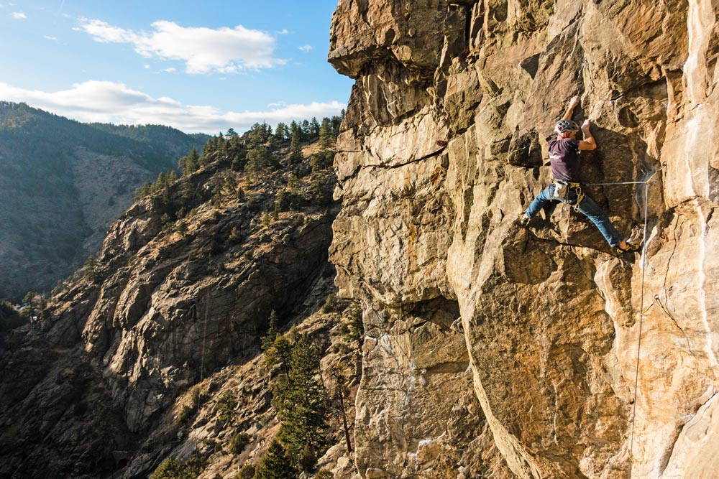
I Press On

Slide 12
Philippians 3:12
“Not that I have already attained, or am already perfected; but I press on, that I may lay hold of that for which Christ Jesus has also laid hold of me” (3:12). Paul realized he had not yet been perfected.
The word perfected (teleioō) does not bear the sense of sinlessness. The root meaning is “to complete an activity, complete, bring to an end, finish, accomplish, . . . bring to an end, bring to its goal/accomplishment.”
Sometimes the word was used in the mystery religions of an initiate who was privileged to know the secret mysteries of the religion. Here the word is used of the “perfection which will be his only at the resurrection . . . . The apostle denies, then, any sense of final perfection as a present experience” (Ralph P. Martin, Philippians: An Introduction and Commentary, 159).
All of us should constantly keep in our consciousness that we are not yet all that we should be.

Slide 13
Paul Recalls His Conversion
Jesus “lay hold” of Paul at his conversion
“I am Jesus, whom you are persecuting. But rise and stand on your feet; for I have appeared to you for this purpose, to make you a minister and a witness both of the things which you have seen and of the things which I will yet reveal to you. I will deliver you from the Jewish people, as well as from the Gentiles, to whom I now send you, to open their eyes, in order to turn them from darkness to light, and from the power of Satan to God, that they may receive forgiveness of sins and an inheritance among those who are sanctified by faith in Me” (Acts 26:16-18).
Paul yearned to “lay hold on” (to attain, to grain control of something through pursuit) the inheritance for which Jesus “lay hold” on him.

Slide 14
“I Press On” Implies Progression
Ralph P. Martin: “By his allusion to the future resurrection he makes it clear that the work of sanctifying grace is progressive, that the believer lives within the tension of salvation begun now but not yet final, and that the summum bonum of Christian experience will be reached only at the parousia or coming of Christ. Final perfection cannot be expected in this life and there will always be room for progress while the church is God’s pilgrim people” (Philippians, An Introduction and Commentary, 159).

Slide 15
Not One and Done!
Christianity is not a “one and done” activity—I heard the gospel, believed in Jesus, repented of my sins, and was baptized.” I am done! I have a ticket to heaven!
Paul is pressing forward in his pursuit of eternal life with Jesus.
He recognizes that he is not now and never will reach perfection in this life.
He is straining every nerve to reach the prize which lies before him.

Slide 16
Forgetting the Past
“Brethren, I do not count myself to have apprehended; but one thing I do, forgetting those things which are behind and reaching forward to those things which are ahead” (3:13).
We do not need to have a Humpty Dumpty approach to Christianity.
Humpty Dumpty sat on a wall.
Humpty Dumpty had a great fall.
All the king’s horses and all the King’s men
Could not put Humpty together again.
One cannot unscramble eggs! However, he can repent of his sins, confess them, and ask God’s forgiveness of them. Then, he needs to move forward to walk in newness of life.

Slide 17
Thanks to Calvary
Bill Gaither
Today, I went down to the place where I used to go;
Today, I saw the same old crowd I knew before.
And when they asked me what had happened, I tried to tell them—
Thanks to Calvary, I don’t come here anymore!
Refrain
Thanks to Calvary I am not the man I used to be;
Thanks to Calvary things are different than before.
And as the tears ran down my face I tried to tell them him,
Thanks to Calvary, I don’t come here anymore!
Then we went down to the house where we used to live.
My little boy ran behind the door, like so many times before;
And I said, “Son you don’t need to be afraid, you’ve got a new Daddy now;
Thanks to Calvary we don’t live here anymore!

Slide 18
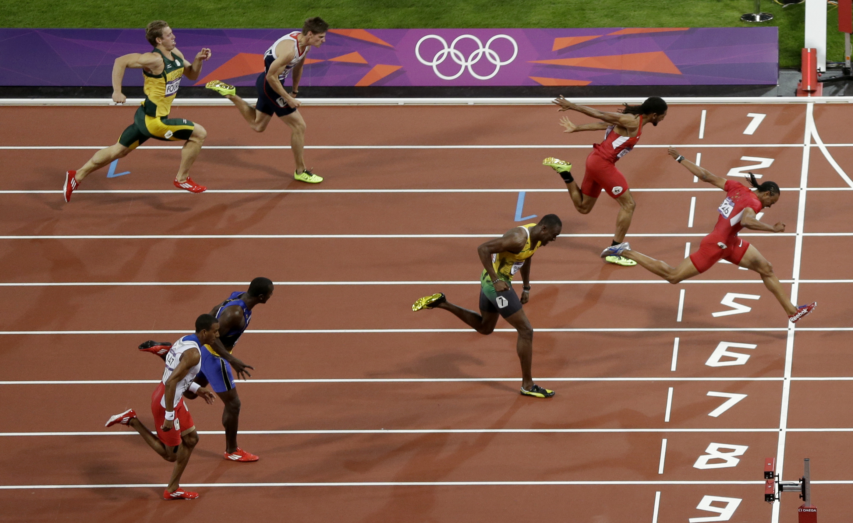
“Reaching Forward”

Slide 19
Here Am I, Send Me! M.W. Spencer (1893)
There is much to do, there’s work on every hand.
Hark! the cry for help comes ringing thru the land,
Jesus calls for reapers, I must active be.
What wilt Thou, O Master? Here am I, send me.
There are hung’ring souls who cry aloud for bread;
With the bread of life they’re longing to be fed.
Shall they starve and famish while a feast is free?
I must be more faithful! Here am I, send me.
There are souls who linger on the brink of woe;
Lord, I must not, cannot bear to let them go.
Let me go and tell them, “Brother, turn and flee!”
Master, I would save them! Here am I, send me.
Chorus:
Here am I, send me,
Lord, send me,
Here am I, send me,
Lord, send me.

Slide 20
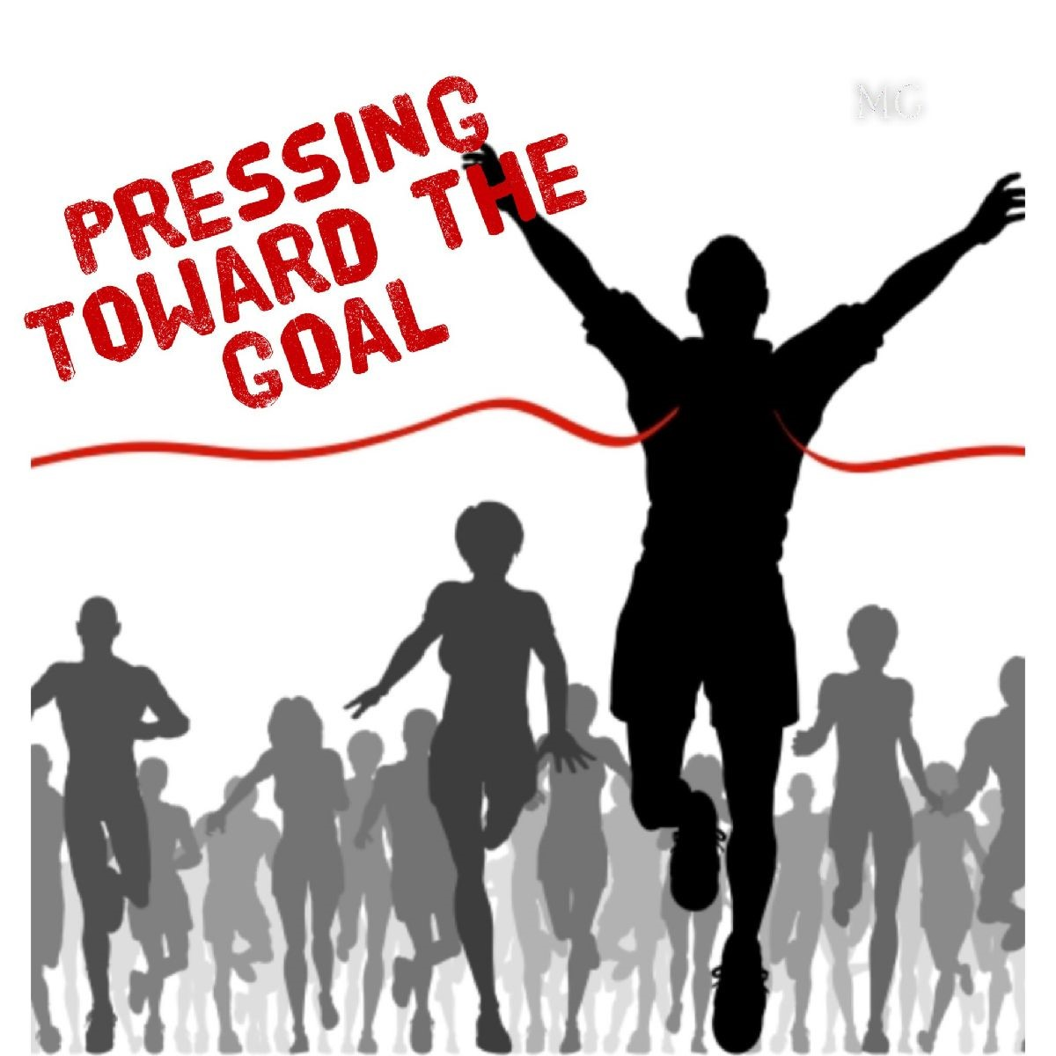
“I press toward the goal for the prize of the upward call of God in Christ Jesus” (Phil. 3:14).

Slide 21
Descriptions of Our Goal
A crown of life (2 Tim. 4:8)
An eternal home (Eccl. 12:5)
An everlasting dwelling place (John 14:2). The KJV/NKJV uses “mansion,” but the RSV “rooms” is closer. It should be contrasted with the temporary dwelling place of our earthly house (2 Cor. 5:1-2).
Paradise (Rev. 2:7)
A heavenly city described as the New Jerusalem (Rev. 21)

Slide 22
Conclusion

Slide 23
Philippians 3:12-14
Not that I have already attained, or am already perfected; but I press on, that I may lay hold of that for which Christ Jesus has also laid hold of me. Brethren, I do not count myself to have apprehended; but one thing I do, forgetting those things which are behind and reaching forward to those things which are ahead, I press toward the goal for the prize of the upward call of God in Christ Jesus.

