Slide 2
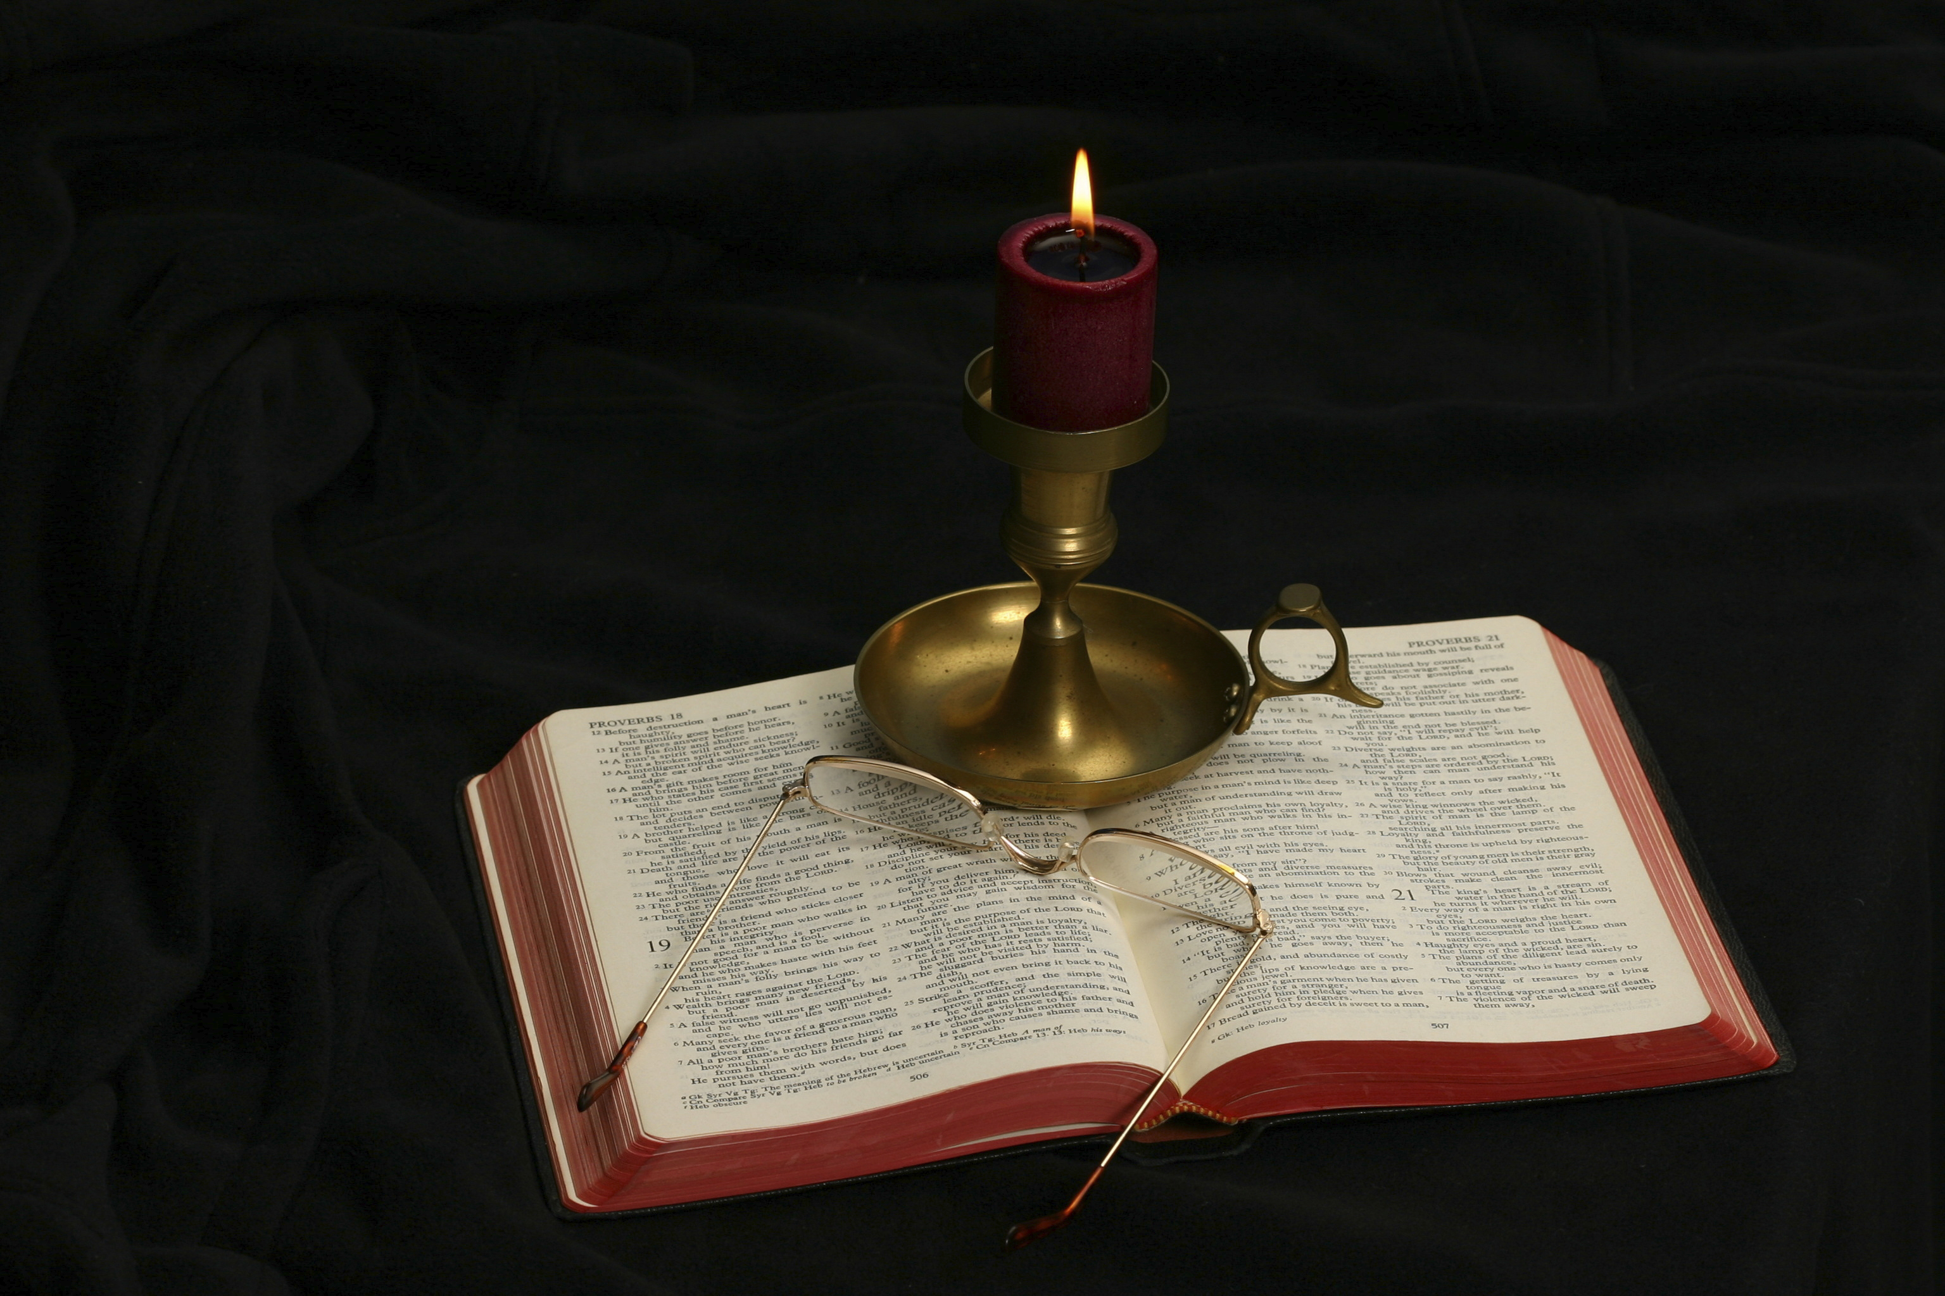
The Gospel of Matthew
Chapter 12

Slide 3
Public Opposition to Jesus Matthew 12:1-50
The Son of Man Is Lord of the Sabbath (12:1-8)
Another Sabbath Controversy (12:9-14)
The Servant of Yahweh (12:15-21)
The Beelzebul Controversy (12:22-37)
Request for a Sign (12:38-45)
Jesus’s True Family (12:46-50)

Slide 4
Rising Opposition
Matthew’s record of the early part of Jesus’s ministry shows that it was widely accepted and received.
In the course of time the Pharisees began to see that Jesus’s teachings were incompatible with their oral traditions, so they began to oppose Him.
Matthew has grouped together a number of incidents that show this growing conflict between the Jewish leaders and Jesus, ultimately ending in Jesus’s crucifixion.

Slide 5
The Son of Man Is Lord of the Sabbath Matthew 12:1-8
“At that time Jesus went through the grainfields on the Sabbath. And His disciples were hungry, and began to pluck heads of grain and to eat. And when the Pharisees saw it, they said to Him, ‘Look, Your disciples are doing what is not lawful to do on the Sabbath!’ But He said to them, ‘Have you not read what David did when he was hungry, he and those who were with him: how he entered the house of God and ate the showbread which was not lawful for him to eat, nor for those who were with him, but only for the priests? Or have you not read in the law that on the Sabbath the priests in the temple profane the Sabbath, and are blameless? Yet I say to you that in this place there is One greater than the temple. But if you had known what this means, “I desire mercy and not sacrifice,” you would not have condemned the guiltless. For the Son of Man is Lord even of the Sabbath.’”

Slide 6
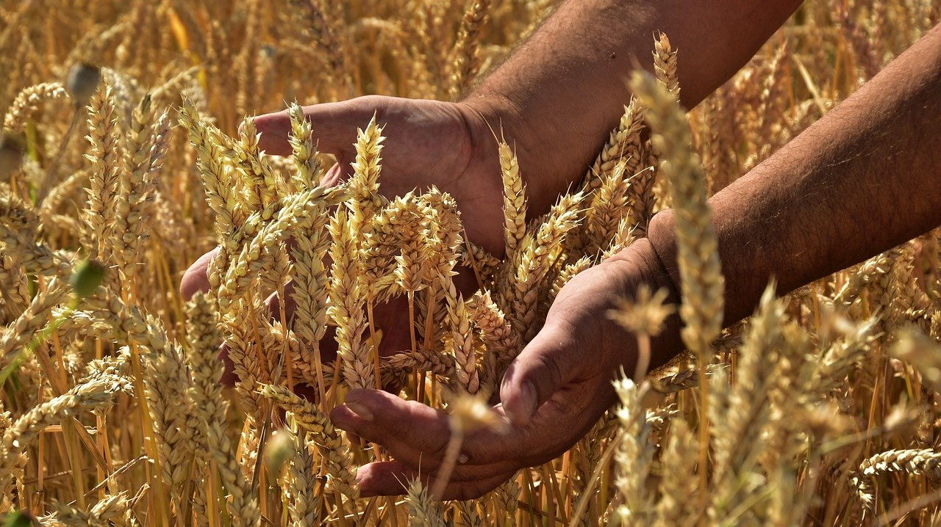

Slide 7
Sabbath Regulations
During the intertestamental period, the Jews developed oral laws that began to be as binding as the Torah. Both the Mishnah and Talmud have extensive sections entitled Shabbat, providing regulations for observing the Sabbath.
Their regulations became extremely burdensome.
One should note the connection between the “heavy burdens” of Matthew 11:28-30 and the conflict over the observance of the Sabbath in chapter 12.
Sabbath observance, circumcision, and the dietary laws were distinguishing characteristics of Jewish people.

Slide 8
Matthew 12:1
At that time Jesus went through the grainfields on the Sabbath. And His disciples were hungry, and began to pluck heads of grain and to eat.
At that time is not so much a chronological notation as it is to link the “heavy burdens” of 11:28-30 to the conflict with the Pharisees (Davies and Allison, 2:305). Both Mark and Luke have “and it came to pass” (egeneto).
The fact that the grain was ripened suggests that this event came around the time of Pentecost, which celebrated the first fruits of harvest (late May/early June).
The significant reference to time was that it was the Sabbath Day.
What the disciples did in plucking and eating grain from someone’s field as they traveled was not a violation of the law.
“When you come into your neighbor’s standing grain, you may pluck the heads with your hand, but you shall not use a sickle on your neighbor’s standing grain” (Deut. 23:25).

Slide 9
Shabbat 7:2
In the Mishnah, “reaping” and “threshing” are two works specifically forbidden for the Sabbath day.
We grew peanuts a few times in East Texas. There is quite a difference between harvesting the peanuts and an individual shelling and eating a few peanuts for food. This same distinction should have been apparent to any first century Pharisee.

Slide 10
Matthew 12:2
“And when the Pharisees saw it, they said to Him, ‘Look, Your disciples are doing what is not lawful to do on the Sabbath!’”
It is obvious that the disciples are present with Jesus, making this text refer to a time before or after the Limited Commission.
The Pharisees, who happened to witness the event, interpreted both the plucking and rubbing of the grain to be work, a violation of the Sabbath.
The charge is made against Jesus, even though it was the disciples who did this (probably without His rebuke).
Does this incident portray the Pharisees as enemies of Jesus just looking for a reason to accuse Him ( cf. Matt. 9:11, 34)?

Slide 11
Matthew 12:3-4
“But He said to them, ‘Have you not read what David did when he was hungry, he and those who were with him: how he entered the house of God and ate the showbread which was not lawful for him to eat, nor for those who were with him, but only for the priests?’”
The incident referred in recorded in 1 Samuel 21:1-6, when David was fleeing from King Saul and stopped at the Tabernacle in Nob.
The showbread was replaced each Sabbath and was to be eaten by priests in the Holy Place (Lev. 24:8-9).
Jesus condemned what David and his men did: “how he entered the house of God and ate the showbread which was not lawful for him to eat.”

Slide 12
What Did Jesus Say about David?
Jesus acknowledges:
The Showbread should have been eaten only by the priests in the Holy Place (Lev. 24:8-9).
David and his men were not priests.
The argument appears to expose an inconsistency in the Pharisees, who honored David and his men, even though they were guilty of a sin, but dishonored the Son of David’s disciples who did not violate the Law of Moses.
Jesus attacks the Pharisees’ role as legitimate law givers by teaching oral laws not given by God.

Slide 13
Matthew 12:5
“Or have you not read in the law that on the Sabbath the priests in the temple profane the Sabbath, and are blameless?”
This second example of work on the Sabbath appears only in Matthew.
The purpose of this is not to charge the Law with being inconsistent, but to call attention to the inconsistency of the Pharisees’ application of the law.
The priests “work” on the Sabbath in sacrificing animals (Num. 28:9-10). “Profane the Sabbath” is intentionally provocative.
Their work is specifically required by the Law of Moses, and is not an exception to what the Law allows. Therefore, they are blameless or innocent.
The legislating of additions to the law forbidding work on the Sabbath day on God’s people is unauthorized. The prohibition of “work” was never intended to forbid what Jesus’s disciples did.

Slide 14
Matthew 12:6
“Yet I say to you that in this place there is One greater than the temple.”
To flush out the argument, Jesus cited the work that priests do in the service of the Temple/Tabernacle on the Sabbath as authorized, even though it is “work.”
A strong argument about who Jesus is—One greater than the temple—legitimates the conduct of His disciples.
The I say unto you adds emphasis to what Jesus said.
How would the Pharisees have reacted to what Jesus said?

Slide 15
Matthew 12:7
“But if you had known what this means, ‘I desire mercy and not sacrifice,’ you would not have condemned the guiltless.”
Jesus quotes Hosea 6:6 for the second time in Matthew (see 9:13).
The passage in Hosea condemns those Jews who keep the sacrifices but were full of all kinds of wickedness (see Hos. 6:7-8).
The same emphasis on the externals of Temple rituals in contrast to purity and holiness was present in the Pharisees who were so concerned about defining “work” on the Sabbath but thought it lawful to hold a council on the Sabbath to plot the execution of their Messiah (Matt. 12:14).
Who are “the guiltless” in this verse?

Slide 16
Matthew 12:8
“For the Son of Man is Lord even of the Sabbath.”
How is “Son of Man” used in this verse?
What is Jesus claiming for Himself by calling Himself “Lord even of the Sabbath”?
R. T. France: “As Son of man Jesus does not abrogate the sabbath law, but claims the right to interpret it in a way which effectively undercuts Pharisaic legalism” (Matthew: An Introduction and Commentary, 208).
He destroys the foundation rock upon which oral law was based. Who gave the Pharisees the right to issue oral law?
How would you expect the Pharisees to react to Jesus’s claim that He is Lord even of the Sabbath?

Slide 17
Another Sabbath Controversy Matthew 12:9-14
“Now when He had departed from there, He went into their synagogue. And behold, there was a man who had a withered hand. And they asked Him, saying, ‘Is it lawful to heal on the Sabbath?’—that they might accuse Him. Then He said to them, ‘What man is there among you who has one sheep, and if it falls into a pit on the Sabbath, will not lay hold of it and lift it out? Of how much more value then is a man than a sheep? Therefore it is lawful to do good on the Sabbath.’ Then He said to the man, ‘Stretch out your hand.’ And he stretched it out, and it was restored as whole as the other. Then the Pharisees went out and plotted against Him, how they might destroy Him.”

Slide 18
Matthew 12:9
Now when He had departed from there, He went into their synagogue.
Matthew is obviously linking together conflicts between Jesus and the Pharisees on Sabbath observance.
The first conflict was outside; this one occurred inside the synagogue.

Slide 19
Matthew 12:10
“And behold, there was a man who had a withered hand. And they asked Him, saying, ‘Is it lawful to heal on the Sabbath?’ —that they might accuse Him.”
And behold (kai idou) is a frequent Matthean expression that makes the scene vivid for the reader.
The Pharisees raise the question about healing on the Sabbath in order to have something with which to accuse Jesus.
They are not seeking information but are lobbing the first shots in a battle. They ask so that they might accuse Him.
That they might accuse Him: Matthew gives us the Pharisees’ motivation behind their question, displaying the radical alienation already present toward Jesus.

Slide 20
The Mishnah Regulations
In the case of one who is seized with the life-threatening illness bulmos, causing him unbearable hunger pangs and impaired vision, one may feed him even impure foods on Yom Kippur or any other day until his eyes recover, as the return of his sight indicates that he is recovering. In the case of one whom a mad dog bit, one may not feed him from the lobe of the dog’s liver. This was thought to be a remedy for the bite, but the Rabbis deem it ineffective. And Rabbi Matya ben Ḥarash permits feeding it to him, as he deems it effective. And furthermore, Rabbi Matya ben Ḥarash said: With regard to one who suffers pain in his throat, one may place medicine inside his mouth on Shabbat, although administering a remedy is prohibited on Shabbat. This is because there is uncertainty whether or not it is a life-threatening situation for him, as it is difficult to ascertain the severity of internal pain. And a case of uncertainty concerning a life-threatening situation overrides Shabbat (Yoma 8:6).

Slide 21
What Is Jesus Doing?
How would you assess the man’s condition? Was his physical condition life threatening, requiring immediate action?
The hand was “withered” (xēros), “pertaining to being shrunken or withered, and therefore immobile because of disease, withered, shrunken, paralyzed” (BDAG, 685).
The physician Luke adds that this was his right hand (Luke 6:5).
How might Jesus’s conduct relate to what He said in 12:7?
How could Jesus have handled this situation without conflict?
Why didn’t He?

Slide 22
Is It Lawful?
How does one determine the answer to the “Is it lawful” question?
What did the Pharisees use to determine what is lawful?
The issue continues in Matthew and will be addressed again in Matthew 15:1-9.
Jesus is not running from a fight started by the Pharisees.
He challenges them head-on.

Slide 23
Matthew 12:11
“Then He said to them, ‘What man is there among you who has one sheep, and if it falls into a pit on the Sabbath, will not lay hold of it and lift it out?’”
Note what Jesus does not use:
A quotation from the Old Testament to provide an example that would allow the healing.
He does not assert His own authority as being greater than the Law.
What is the basis of the argument Jesus used in this verse?
The Talmud Shabbat 128b contains discussion about what can or cannot be done on the Sabbath for an animal that fell into a pit.
The negative (will not, ouchi) that Matthew uses expects a positive answer.

Slide 24
Matthew 12:12
“Of how much more value then is a man than a sheep? Therefore it is lawful to do good on the Sabbath.”
What part does Jesus’s statement “of how much more value then is a man than a sheep” play in His argument with the Pharisees?
What answer does Jesus’s question presuppose?
This is the third time Matthew has recorded that Jesus made this argument (see 6:26; 10:31).
How would 21st century members of the animal rights movements answer the same question?
What conclusion does Jesus draw from the expected answer that a man is of more value than a sheep?
How does this answer tie in with 12:7?

Slide 25
Matthew 12:13
“Then He said to the man, ‘Stretch out your hand.’ And he stretched it out, and it was restored as whole as the other.”
The word “restore” (apokathistēmi) is used in Greek literature as a technical term meaning “cure”; it means “to change to an earlier good state or condition, restore, reestablish” (BDAG, 131).
Would the audience be able to see with their eyes whether or not a miracle had occurred?
How do you think the Pharisees would have reacted had the man tried to stretch out his hand and been unable to move it?
How does their reaction confirm the miracle?
What “work” did Jesus do in healing the man?

Slide 26
Matthew 12:14
Then the Pharisees went out and plotted against Him, how they might destroy Him.
How does this verse relate to Jesus’s statement in v. 12: “It is lawful to do good on the Sabbath”?
What two things are contrasted?
Plotted is translated from sumboulion elabon, “to take council.” A council is “an official deliberative assembly as a body, council” (BDAG, 957).
What did “destroy Him” mean?
The Pharisees’ position: It is authorized on the Sabbath to meet in council to plot and plan the murder of Jesus, but it is wrong to heal a man on the Sabbath.

Slide 27
The Servant of Yahweh (12:15-21) Matthew 12:15-21
“But when Jesus knew it, He withdrew from there. And great multitudes followed Him, and He healed them all. Yet He warned them not to make Him known, that it might be fulfilled which was spoken by Isaiah the prophet, saying: ‘Behold! My Servant whom I have chosen, My Beloved in whom My soul is well pleased! I will put My Spirit upon Him, And He will declare justice to the Gentiles. He will not quarrel nor cry out, Nor will anyone hear His voice in the streets. A bruised reed He will not break, And smoking flax He will not quench, Till He sends forth justice to victory; And in His name Gentiles will trust.’”

Slide 28
Matthew 12:15-21
Contains the longest quotation from the OT in the book of Matthew—Isaiah 42:1-4.
The passage should be linked with Matthew 12:14—“Then the Pharisees went out and plotted against Him, how they might destroy Him.”
Jesus’s withdrawal is based on His knowledge of the plotting against Him.

Slide 29
Matthew 12:15
“But when Jesus knew it, He withdrew from there. And great multitudes followed Him, and He healed them all.”
This passage is similar to other summary statements about Jesus (cf. Matt. 4:25; 8:1).
The Scriptures do not tell us how Jesus knew of the plotting of the Pharisees, whether through observation, here-say, or omniscience.

Slide 30
Matthew 12:16
“Yet He warned them not to make Him known. . . .”
Obviously, the opposition to Jesus could provoke a premature confrontation with Jewish leadership.
Warned (epitimaō): “to express strong disapproval of someone, rebuke, reprove, censure also speak seriously, warn in order to prevent an action or bring one to an end” (BDAG, 384).
This passage helps explain the command in Matt. 8:4 not to tell others of the miraculous healing Jesus had performed.
Jesus’s conduct on this occasion fits the prophetic description of the coming Messiah.
It was not Jesus’s manner to wrangle and quarrel with His opponents.

Slide 31
Matthew 12:17
“. . . that it might be fulfilled which was spoken by Isaiah the prophet, saying: . . .”
This is the sixth time “that it might be fulfilled” occurs in Matthew (1:22; 2:15, 23; 4:14; 8:17) and follows the Isaiah passage quoted in chapter 11:5 (Isa. 35:4-6).
Rabbinic Judaism generally teaches that the servant of Isaiah 42:1-4 is the nation of Israel and not the Messiah. Rashi, for example, rendered verse 1a as “Behold My servant Jacob is not like you, for I will support him.” However, the Targum Jonathan on Isaiah, an Aramaic translation of the Hebrew Scriptures, understood the verse differently and translated it as “Behold, my servant, the Messiah.”
Jonathan Ben Uziel is thought to have lived 30 years before the birth of Jesus, so his understanding that the “servant” of Isaiah 42 was the Messiah is contemporary evidence of how Isaiah was understood.

Slide 32
Isaiah 42:1-4
“Behold! My Servant whom I uphold,
My Elect One in whom My soul delights!
I have put My Spirit upon Him;
He will bring forth justice to the Gentiles.
He will not cry out, nor raise His voice,
Nor cause His voice to be heard in the street.
A bruised reed He will not break,
And smoking flax He will not quench;
He will bring forth justice for truth.
He will not fail nor be discouraged,
Till He has established justice in the earth;
And the coastlands shall wait for His law.”

Slide 33
Matthew 12:18
“Behold! My Servant whom I have chosen, My Beloved in whom My soul is well pleased! I will put My Spirit upon Him, And He will declare justice to the Gentiles.”
Matthew links the events of Matthew 12 to the fulfillment of Isaiah 42:1-4. He presents to us a novel interpretation of “Messiah” in so doing.
The Messiah was popularly expected to exercise His authority by crushing political opposition—to be a conquering military leader.
Isaiah foretold the Messiah as being:
God’s Chosen Servant (pais). Remember “taking the form of a servant” (Phil. 2:5-6).
God’s Beloved (agapētos): used three times of Jesus in Matthew (3:17; 12:18; 17:5), the word means “one who is in a very special relationship with another, only, only beloved” (BDAG, 7).
In Whom God is well pleased (eudokeō): “to take pleasure or find satisfaction in something, be well pleased, take delight” (BDAG, 404).

Slide 34
Character Traits of the Messiah
Humility is seen from His taking the form of a servant.
But, Jesus is God’s chosen servant (cf. to Moses, Num. 12:3)!
Loved by God (“beloved”; in whom my soul delights). Cf. Matt. 3:17.
Empowered by God (“I will put My Spirit upon Him”).
Just. The word krisis can refer to the legal act of judging (usually of condemnation), the activity of God as judge in the final judgment, and here of “administration of what is right and fair.”
Leon Morris: “among the Jews the nations generally were despised since the people of God saw themselves as specially favored. But the prophet regarded all the world’s peoples as having worth before God, and it will be the function of the servant of whom he writes to make sure that justice is done for them. This was not a conspicuous feature of Jesus’ ministry here on earth, but the salvation he brought about was available to people of all nations and by the time Matthew wrote something of a fulfilment of this part of the prophecy was evident” (The Gospel according to Matthew, 310–311).
Justice to the Gentiles. Describes Jesus’s work of bringing salvation to all men.

Slide 35
Matthew 12:19
He will not quarrel nor cry out, Nor will anyone hear His voice in the streets.
Verses 19-21 are the reason for Matthew quoting Isaiah 42:1-4.
The descriptions are of what Jesus would not do, most of which were expected of a political contender.
Instead of quarreling with the Pharisees or protesting in the streets, Jesus withdrew to avoid such conflict.
Quarrel (erizō): “quarrel, wrangle” (BDAG, 392).
Cry out (kraugazō): “to utter a loud sound, ordinarily of harsh texture, cry out . . . Of the human voice, cry out, cry for help, scream excitedly” (BDAG, 565).
Jesus’s word were not heard in the streets. The “streets” are the “wide streets” where restless political crowds usually assembled.

Slide 36
Matthew 12:20
“A bruised reed He will not break, And smoking flax He will not quench, Till He sends forth justice to victory; . . .”
The Isaiah passage uses two figures of brokenness:
A bent reed: “A reed might be used as a flute, a measuring rod, a pen, and in many other ways. But for whatever purpose it was wanted, a whole reed was desirable. Reeds grew plentifully and were cheap. ‘The reed, growing by millions in every marsh and riverside, was a type of commonplace insignificance’ (Glover). The natural thing was to discard an imperfect reed and replace it with a better one” (Leon Morris, The Gospel according to Matthew, 311).
A smoking flax lamp wick: “A wick that functioned imperfectly was a nuisance: it would not give out good light and its smoldering released a certain amount of smoke. The simple thing was to snuff it out and throw it away. A little bit of flax did not cost much, so replacing it was the normal procedure” (Ibid.).

Slide 37
Jesus and the Broken Hearted
“It took time and patience and the willingness to take pains to make anything useful out of a bruised reed or a smoking wick. People in general would not take the trouble. In a similar fashion most of us regard the world’s down-and-outs as not worth troubling ourselves over; we do not see how anything can be made of them. But love and care and patience can do wonders, and that is what the prophet is talking about” (Morris, 311-312).
“Implicit is the idea that there is always hope for human beings, however wretched or unremarkable they may seem” (Davies and Allison, 2:326).

Slide 38
Matthew 12:21
“And in His name Gentiles will trust.”
This is the second time the passage from Isaiah 42:1-4 has spoken of the Gentiles (see 12:18—“He will declare justice to the Gentiles”).
Trust (elpizō): “to look forward to something, with implication of confidence about something coming to pass, hope, hope for. . .with indication of the person or thing on whom (which) hope is based, put one’s confidence in someone or something” (BDAG, 319).
The Gentiles will be trusting in the name of the Lord’s Servant Messiah!

Slide 39
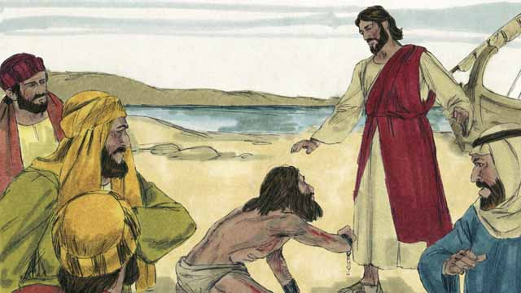
The Beelzebul Controversy (12:22-37)

Slide 40
Matthew 12:22-29
“Then one was brought to Him who was demon-possessed, blind and mute; and He healed him, so that the blind and mute man both spoke and saw. And all the multitudes were amazed and said, ‘Could this be the Son of David?’ Now when the Pharisees heard it they said, ‘This fellow does not cast out demons except by Beelzebub, the ruler of the demons.’ But Jesus knew their thoughts, and said to them: ‘Every kingdom divided against itself is brought to desolation, and every city or house divided against itself will not stand. If Satan casts out Satan, he is divided against himself. How then will his kingdom stand? And if I cast out demons by Beelzebub, by whom do your sons cast them out? Therefore they shall be your judges. But if I cast out demons by the Spirit of God, surely the kingdom of God has come upon you. Or how can one enter a strong man’s house and plunder his goods, unless he first binds the strong man? And then he will plunder his house.”

Slide 41
Matthew 12:30-37
“He who is not with Me is against Me, and he who does not gather with Me scatters abroad. Therefore I say to you, every sin and blasphemy will be forgiven men, but the blasphemy against the Spirit will not be forgiven men. Anyone who speaks a word against the Son of Man, it will be forgiven him; but whoever speaks against the Holy Spirit, it will not be forgiven him, either in this age or in the age to come. Either make the tree good and its fruit good, or else make the tree bad and its fruit bad; for a tree is known by its fruit. Brood of vipers! How can you, being evil, speak good things? For out of the abundance of the heart the mouth speaks. A good man out of the good treasure of his heart brings forth good things, and an evil man out of the evil treasure brings forth evil things. But I say to you that for every idle word men may speak, they will give account of it in the day of judgment. For by your words you will be justified, and by your words you will be condemned.”

Slide 42
The Beelzebul Controversy
The length of the exchange is surprising.
The conflict shows the rise of opposition to Jesus.
The Pharisees use a different argument than they previously used:
Healing on the Sabbath (12:1-8, 9-14)
It charges that Jesus heals people by an alliance with the Devil.

Slide 43
Matthew 12:22
“Then one was brought to Him who was demon-possessed, blind and mute; and He healed him, so that the blind and mute man both spoke and saw.”
The two conditions of the man:
Blind.
Mute (kōphos): BDAG (580) gives two definitions of the Greek word:
“Pertaining to lack of speech capability, mute”
“Pertaining to lack of hearing capability, deaf”
The determinative factor is the healing—he spoke and saw.
Jesus healed (therapeuō) the demon-possessed man by casting out the demon, as the charge brought against Jesus indicates.

Slide 44
Matthew 12:23
“And all the multitudes were amazed and said, ‘Could this be the Son of David?’”
Matthew pays little attention to the miracle; its significance is that it introduces the conflict with the Pharisees.
Amazed (existēmi): Used in this text to mean “be amazed, be astonished, of the feeling of astonishment mingled with fear, caused by events which are miraculous, extraordinary, or difficult to understand” (BDAG, 350).
What does “Could this be the Son of David” mean?
The mēti introduces a question expecting a negative response: “This can’t be the Son of David, can it?”
Why is attention given to “all the multitudes”?

Slide 45
Matthew 12:24
“Now when the Pharisees heard it they said, ‘This fellow does not cast out demons except by Beelzebub, the ruler of the demons.’”
The Pharisees cannot deny the reality of Jesus’s healing power. Beelzebub is used as a synonym for the Devil.
Craig Blomberg: “Interestingly, this charge persisted as a common view of Jesus among Jews in the early centuries of the Christian era. They did not deny the genuineness of his miracles but ascribed his power to the devil, so that he was branded a sorcerer (e.g., b. Sanh. 107b; b. Sabb. 104b) and worthy of death (m. Sanh. 7:4)” (Matthew, The New American Commentary, 201).
Several commentaries think that describing Jesus as “this fellow” is either dismissive or contemptuous.

Slide 46
Matthew 12:25
“But Jesus knew their thoughts, and said to them: ‘Every kingdom divided against itself is brought to desolation, and every city or house divided against itself will not stand.’”
Jesus responds to the argument of the Pharisees by showing its utter ridiculousness. A kingdom divided against itself is self-destructive.
The argument presumes that the Kingdom of God and the kingdom of Satan are locked in conflict with each other.
“Every kingdom” is general, meaning any and every kingdom.
A side note: A church engaged in bitter conflict will not stand, for the same reason!

Slide 47
Matthew 12:26
“If Satan casts out Satan, he is divided against himself. How then will his kingdom stand?”
As another name for the Devil, Satan has the meaning of “the enemy.” The word is used three times in Matthew (4:10; 12:26; 16:23).
The argument of this verse heightens the ridiculousness of the Pharisee’s argument by picturing Satan in a battle against himself!

Slide 48
Matthew 12:27
“And if I cast out demons by Beelzebub, by whom do your sons cast them out? Therefore they shall be your judges.”
This is an argument based on inconsistency. There were others in Judaism who were trying to cast out demons and were accepted by the Pharisees.
For the sake of the argument, Jesus assumes as true the Pharisees’ statement that he casts out demons by Beelzebub to prove them wrong. If that is the case, then “your sons,” who were also casting out demons, must be casting them out by the power of Beelzebub. How well would that sit with Jewish exorcists?
The Jews were in the same position as a Catholic who might accuse Jesus of casting out demons by the Devil. The question would then seem logical: By who do your priests cast out demons? By Beelzebub? A Catholic would be caught in the same position at the Pharisees.

Slide 49
Jews Casting Out Demons
“Then some of the itinerant Jewish exorcists took it upon themselves to call the name of the Lord Jesus over those who had evil spirits, saying, ‘We exorcise you by the Jesus whom Paul preaches’” (Acts 19:13).
“Now John answered Him, saying, ‘Teacher, we saw someone who does not follow us casting out demons in Your name, and we forbade him because he does not follow us’” (Mark 9:38).
Josephus tells of Jews using a root from a tree in casting out demons, which he describes as the spirits of wicked men who have passed on before (Wars of the Jews, 7.6.3).
Jesus is not defending the exorcists, but showing the inconsistency of the Pharisees.

Slide 50
Matthew 12:28
“But if I cast out demons by the Spirit of God, surely the kingdom of God has come upon you.”
Here is the key point of Jesus’s argument. Luke uses “the finger of God” rather than “by the Spirit of God” (11:20). Both emphasize Jesus’s divine power in His victory over Satan.
Note Matthew’s rare use of “kingdom of God,” instead of the more familiar “kingdom of Heaven.”
Jesus uses His miracles to affirm the inauguration of the kingdom of God.
Jesus’s work inaugurated (began or introduced; phthanō, to arrive) the kingdom, which did not fully come into being until Pentecost.
The Pharisees needed to come to grips with the fact that the Messiah was among them, working signs to demonstrated that He was their Christ. They refused to acknowledge the arrival of the Messiah.

Slide 51
Matthew 12:29
“Or how can one enter a strong man’s house and plunder his goods, unless he first binds the strong man? And then he will plunder his house.”
Who is the strong man? The one who binds the strong man?
What is this example teaching?
What do the exorcism show?
What should we learn from Jesus’s casting out demons?

Slide 52
Matthew 12:30
“He who is not with Me is against Me, and he who does not gather with Me scatters abroad.”
In the conflict between the kingdom of God and the kingdom of Satan, neutrality is impossible.
William Barclay: “We may take this saying and apply it to ourselves and to the Church. If our presence does not strengthen the Church, then our absence is weakening it” (The Daily Study Bible: Matthew, 2:44).

Slide 53
Matthew 12:31
“Therefore I say to you, every sin and blasphemy will be forgiven men, but the blasphemy against the Spirit will not be forgiven men.”
Therefore (dia touto) ties this statement to the preceding events.
Blasphemy (blasphēmia): “speech that denigrates or defames, reviling, denigration, disrespect, slander” (BDAG, 178). The verb form explains blaspheming deity: “slander, revile, defame, speak irreverently/impiously/ disrespectfully of or about.”
Any sin can be forgiven on the conditions spelled out in the gospel: “But if we walk in the light as He is in the light, we have fellowship with one another, and the blood of Jesus Christ His Son cleanses us from all sin” (1 John 1:7).

Slide 54
Blasphemy Against the Spirit
The passage illustrates what blasphemy against the Spirit is: it is a deliberate refusal to acknowledge God’s power.
Cf. Isaiah 5:20—“Woe to those who call evil good, and good evil; Who put darkness for light, and light for darkness; Who put bitter for sweet, and sweet for bitter!”
The Pharisees saw the miraculous works that Jesus was doing and attributed them to Jesus working through Satan.
Theirs was a flagrant, willful, and persistent rejection of God and His commands as revealed by Jesus.
The point is that those who refuse heaven’s call, rejecting what God has revealed in the gospel and calling it evil, cannot access God’s forgiveness.

Slide 55
Blasphemy Against the Holy Spirit
“Come to Me, all you who labor and are heavy laden, and I will give you rest. Take My yoke upon you and learn from Me, for I am gentle and lowly in heart, and you will find rest for your souls. For My yoke is easy and My burden is light” (Matt. 11:28-30).
Forgiveness is available for everyone.
The Pharisees rejected the light of the gospel, calling Jesus’s healing of the demon possessed man a miracle done by the power of Satan. By so doing, they rejected the only means God has provided for man’s forgiveness and salvation!

Slide 56
John Nolland
“Presumably what makes the blasphemy of attributing to Beezeboul the work of the Spirit in Jesus unforgivable is that it excludes people from participating in what God is doing in Jesus, and thus from the ‘forgiveness project’. No doubt such blasphemy remains unforgivable only as long as it is sustained. It too may be repented of” (The Gospel of Matthew: A Commentary on the Greek Text, New International Greek Testament, 505).
Think about the conversion of Saul, who at first thought Christianity was a heresy, but saw the evidence of the deity of Jesus and was converted.
“And I thank Christ Jesus our Lord who has enabled me, because He counted me faithful, putting me into the ministry, although I was formerly a blasphemer, a persecutor, and an insolent man; but I obtained mercy because I did it ignorantly in unbelief” (1 Tim. 1:12-13).

Slide 57
Matthew 12:32
“Anyone who speaks a word against the Son of Man, it will be forgiven him; but whoever speaks against the Holy Spirit, it will not be forgiven him, either in this age or in the age to come.”
Have you experienced someone fearful that he had committed the unforgiveable sin?
“For it is impossible for those who were once enlightened, and have tasted the heavenly gift, and have become partakers of the Holy Spirit, and have tasted the good word of God and the powers of the age to come, if they fall away, to renew them again to repentance, since they crucify again for themselves the Son of God, and put Him to an open shame” (Heb. 6:4-6).
What makes this sin unforgiveable?
What is meant by “this age” and “the age to come”?

Slide 58
Matthew 12:33-35
“Either make the tree good and its fruit good, or else make the tree bad and its fruit bad; for a tree is known by its fruit. Brood of vipers! How can you, being evil, speak good things? For out of the abundance of the heart the mouth speaks. A good man out of the good treasure of his heart brings forth good things, and an evil man out of the evil treasure brings forth evil things.”
Compare Matthew 7:16-20.
What is the point of these verses? Are they proverbs (general truths) or aimed at the audience to whom Jesus is speaking?
Who are intended by the bad tree/fruit, “brood of vipers,” and evil man?
What does Jesus say about the connection of the heart and the mouth?

Slide 59
Matthew 12:36
“But I say to you that for every idle word men may speak, they will give account of it in the day of judgment.”
Idle (argos): the word is used of one who is unemployed, idle, or lazy. It is defined as “pertaining to being unproductive, useless, worthless.” With specific reference to this verse, an idle world is “a careless utterance which, because of its worthlessness, had better been left unspoken” (BDAG, 128).
R. T. France: “. . . the point is that what might appear an idle quip, and therefore quite innocuous, may, because of what it reveals about the person who says it, be the basis for a severe condemnation” (Matthew: An Introduction and Commentary, 215).
In the context, the Pharisees’ charge that Jesus worked miracles by the power of Beelzebul is what is intended. It may have been a half-thought out answer to what they witnessed, but it exposed their heart.

Slide 60
Matthew 12:37
“For by your words you will be justified, and by your words you will be condemned.”
This statement emphasizes that you and I will be held accountable for the words that we speak.
Think of sins we commit with the tongue: gossip, lying, false witnessing, cursing men and God, filthy speech, etc. Indeed, the tongue tells who we are (cf. James 3:1-12).

Slide 61
Request for a Sign (12:38-45)
“Then some of the scribes and Pharisees answered, saying, ‘Teacher, we want to see a sign from You.’ But He answered and said to them, ‘An evil and adulterous generation seeks after a sign, and no sign will be given to it except the sign of the prophet Jonah. For as Jonah was three days and three nights in the belly of the great fish, so will the Son of Man be three days and three nights in the heart of the earth. The men of Nineveh will rise up in the judgment with this generation and condemn it, because they repented at the preaching of Jonah; and indeed a greater than Jonah is here. The queen of the South will rise up in the judgment with this generation and condemn it, for she came from the ends of the earth to hear the wisdom of Solomon; and indeed a greater than Solomon is here. When an unclean spirit goes out of a man, he goes through dry places, seeking rest, and finds none. Then he says, “I will return to my house from which I came.” And when he comes, he finds it empty, swept, and put in order. Then he goes and takes with him seven other spirits more wicked than himself, and they enter and dwell there; and the last state of that man is worse than the first. So shall it also be with this wicked generation.’”

