Slide 1
Do You Know My Jesus?

Slide 2
Do You Know My Jesus?
“Behold, The Lamb of God!”
“For the grace of God has appeared, bringing salvation for all people,” Titus 2:11
The “grown up” Jesus isn’t as celebrated as the baby Jesus.
We must face the adult Jesus!

Slide 3
My Jesus?
The Transfiguration (Luke 9:27-36)
Do You Know:

Slide 4
My Jesus?
The Transfiguration (Luke 9:27-36)
Feeding The 5,000 (John 6:1-14)
Do You Know:

Slide 5
My Jesus?
The Transfiguration (Luke 9:27-36)
Feeding The 5,000 (John 6:1-14)
Walked On Water (John 6:15-21)
Do You Know:

Slide 6
My Jesus?
The Transfiguration (Luke 9:27-36)
Feeding The 5,000 (John 6:1-14)
Walked On Water (John 6:15-21)
Raised Lazarus (John 11:38-44)
Do You Know:

Slide 7
My Jesus?
The Transfiguration (Luke 9:27-36)
Feeding The 5,000 (John 6:1-14)
Walked On Water (John 6:15-21)
Raised Lazarus (John 11:38-44)
Arose From The Dead (John 20:1-10; 19-29)
Do You Know:
Ascended Into Heaven (Acts 1:9-11)

Slide 8
And truly Jesus did many other signs in the presence of His disciples, which are not written in this book; 31 but these are written that you may believe that Jesus is the Christ, the Son of God, and that believing you may have life in His name.
John 20:30-31

Slide 9
"Truly, these times of ignorance God overlooked, but now commands all men everywhere to repent, 31 "because He has appointed a day on which He will judge the world in righteousness by the Man whom He has ordained. He has given assurance of this to all by raising Him from the dead."
Acts 17:30-31

Slide 10
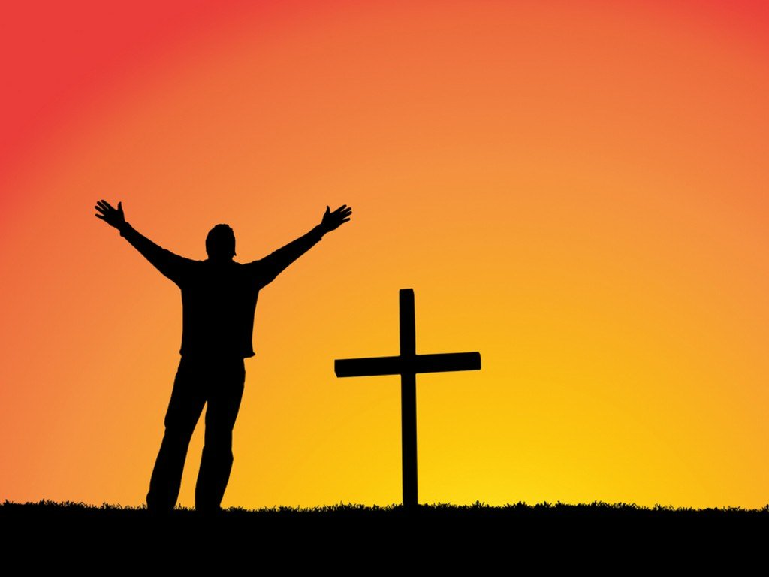
God’s Plan for Your Salvation
Based on God’s GRACE-- Eph. 2:8
Hear the Word of God --John 20:30-31
Believe In Your Heart -- Acts 8:37
Repent Of Your Sins --Luke 13:3, 5
Confess faith in Jesus -- Matt. 10:32-33
Be Baptized Into Christ -- Acts 22:16
Be Faithful Until Death --Rev. 2:10

