Slide 2
Saul of Tarsus
Not counting the Lord Jesus Himself, only a few people, if any, have exercised any greater influence on Christianity than Saul of Tarsus. I want to present this lesson on his conversion.
“Truly I understand that God shows no partiality, but in every nation anyone who fears him and does what is right is acceptable to him” (Acts 10:34-35).
Since God is no respecter of persons, anything God required Saul to do in order to be saved, he required of all men.
A study of this case of conversion should instruct us in what to do to be saved.

Slide 3
Why Saul?
We know considerably more about Saul’s conversion than most of the New Testament examples.
Luke, the author of the book of Acts, gives three accounts of Paul’s conversion.
The first is Luke’s account of his conversion, in the context of Saul’s persecution of the church (Acts 7:58; 8:1-3; 9:1-19).
The second is Saul himself telling of his conversion after the Roman soldiers stationed in the Tower of Antonia arrested him but allowed him to speak to the Jews who wished to harm him (Acts 22:1-21).
The third time is before Procurator Festus and Herod Agrippa II (Acts 26:12-29).
In addition, Paul’s letters include pertinent pieces of information to supplement what is found in Acts.

Slide 4
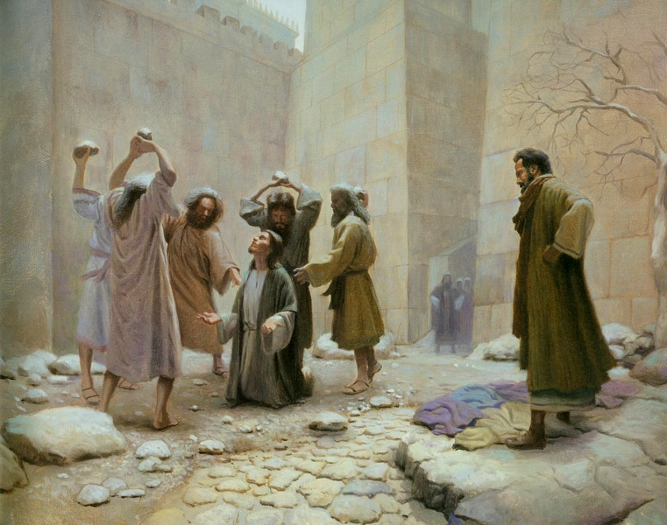
An Unlikely Convert
“And Saul approved of his execution” (Acts 8:1)

Slide 5
Chronology
Depending upon the chronology one follows, scholars either date the death of Jesus about AD 27 or AD 30.
Both systems put the death of Stephen about three years later, which is immediately followed by Saul’s persecution of the church.
Jesus’s appearance to Saul on the road to Damascus occurs about AD 30 or AD 33, depending upon which chronology one follows.

Slide 6
Saul’s Early Life
“For you have heard of my former life in Judaism, how I persecuted the church of God violently and tried to destroy it. And I was advancing in Judaism beyond many of my own age among my people, so extremely zealous was I for the traditions of my fathers” (Gal. 1:13-14).

Slide 7
The Stoning of Stephen
“Now when they heard these things they were enraged, and they ground their teeth at him. But he, full of the Holy Spirit, gazed into heaven and saw the glory of God, and Jesus standing at the right hand of God. And he said, ‘Behold, I see the heavens opened, and the Son of Man standing at the right hand of God.’ But they cried out with a loud voice and stopped their ears and rushed together at him. Then they cast him out of the city and stoned him. And the witnesses laid down their garments at the feet of a young man named Saul. And as they were stoning Stephen, he called out, “Lord Jesus, receive my spirit.” And falling to his knees he cried out with a loud voice, ‘Lord, do not hold this sin against them.’ And when he had said this, he fell asleep” (Acts 8:54-60).

Slide 8
An Outbreak of Jewish Persecution
“And Saul approved of his execution. And there arose on that day a great persecution against the church in Jerusalem, and they were all scattered throughout the regions of Judea and Samaria, except the apostles. Devout men buried Stephen and made great lamentation over him. But Saul was ravaging the church, and entering house after house, he dragged off men and women and committed them to prison” (Acts 8:1-3).
“Now those who were scattered went about preaching the word” (Acts 8:4).

Slide 9
Saul’s Involvement in the Persecution
“But Saul, still breathing threats and murder against the disciples of the Lord, went to the high priest and asked him for letters to the synagogues at Damascus, so that if he found any belonging to the Way, men or women, he might bring them bound to Jerusalem” (Acts 9:1-2).

Slide 10
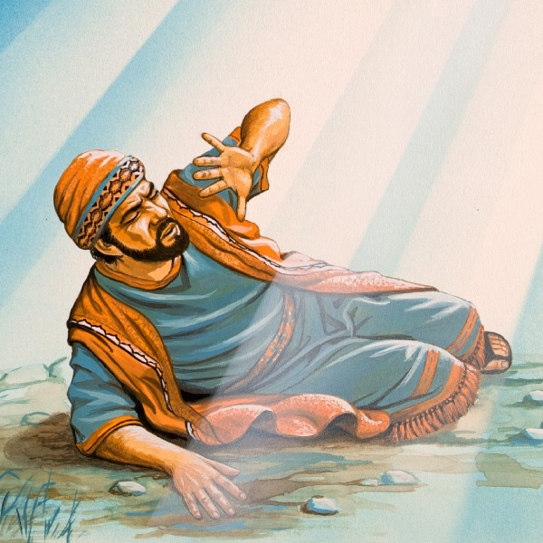
Jesus Appeared to Saul

Slide 11
Jesus Appeared to Saul
“Now as he went on his way, he approached Damascus, and suddenly a light from heaven shone around him. And falling to the ground, he heard a voice saying to him, ‘Saul, Saul, why are you persecuting me?’ And he said, ‘Who are you, Lord?’ And he said, ‘I am Jesus, whom you are persecuting. But rise and enter the city, and you will be told what you are to do.’ The men who were traveling with him stood speechless, hearing the voice but seeing no one. Saul rose from the ground, and although his eyes were opened, he saw nothing. So they led him by the hand and brought him into Damascus. And for three days he was without sight, and neither ate nor drank” (Acts 9:3-9).

Slide 12
Results of the Lord’s Appearance
Saul’s attitude toward Jesus was changed.
Today our faith comes from God’s revealed word: “So faith comes from hearing, and hearing through the word of Christ” (Rom. 10:17).
Saul, along with Thomas (John 20:24-29), should convince all doubters about who Jesus is.
He became remorseful for his past life.
“For godly grief produces a repentance that leads to salvation without regret, whereas worldly grief produces death” (2 Cor. 7:10).

Slide 13
Jesus’s Appearance Did Not Make Saul a Christian
It did not save him. He did not show the signs of salvation.
“And for three days he was without sight, and neither ate nor drank” (Acts 9:9).
Contrast this with the Ethiopian nobleman: “And when they came up out of the water, the Spirit of the Lord carried Philip away, and the eunuch saw him no more, and went on his way rejoicing” (Acts 8:39).
The vision forced Saul to make a decision about Jesus.
In his account of his conversion to King Herod Agrippa II, Saul said, “Therefore, O King Agrippa, I was not disobedient to the heavenly vision” (Acts 26:19).

Slide 14
Galatians 1:12-16
“For I would have you know, brothers, that the gospel that was preached by me is not man’s gospel. For I did not receive it from any man, nor was I taught it, but I received it through a revelation of Jesus Christ. For you have heard of my former life in Judaism, how I persecuted the church of God violently and tried to destroy it. And I was advancing in Judaism beyond many of my own age among my people, so extremely zealous was I for the traditions of my fathers. But when he who had set me apart before I was born, and who called me by his grace, was pleased to reveal his Son to me, in order that I might preach him among the Gentiles, I did not immediately consult with anyone. . . .”

Slide 15
Saul’s Conversion
The Lord instructed a reluctant preacher named Ananias to tell Saul what to do to be saved. Ananias had heard about Saul and had to be persuaded to go teach him.
“So Ananias departed and entered the house. And laying his hands on him he said, ‘Brother Saul, the Lord Jesus who appeared to you on the road by which you came has sent me so that you may regain your sight and be filled with the Holy Spirit.’ And immediately something like scales fell from his eyes, and he regained his sight. Then he rose and was baptized; and taking food, he was strengthened” (Acts 9:17-19).

Slide 16
Saul’s Own Account
“And one Ananias, a devout man according to the law, well spoken of by all the Jews who lived there, came to me, and standing by me said to me, ‘Brother Saul, receive your sight.’ And at that very hour I received my sight and saw him. And he said, ‘The God of our fathers appointed you to know his will, to see the Righteous One and to hear a voice from his mouth; for you will be a witness for him to everyone of what you have seen and heard. And now why do you wait? Rise and be baptized and wash away your sins, calling on his name’” (Acts 22:12-16).
This is when and how Saul was saved.

Slide 17
Saul Was A Religious Man
Saul had a pure conscience.
“And looking intently at the council, Paul said, ‘Brothers, I have lived my life before God in all good conscience up to this day’” (Acts 23:1; 26:9).

Slide 18
A Clear Conscience Is Not Evidence of Salvation
“A clear conscience makes a soft pillow” (African proverb), but it is no proof of one’s salvation!

Slide 19
Conscience Is Not A Safe Guide
“There is a way that seems right to a man, but its end is the way to death” (Prov. 14:12).
“I know, O Lord, that the way of man is not in himself, that it is not in man who walks to direct his steps” (Jer. 10:23).

Slide 20
Saul Was A Religious Man
Saul had a pure conscience.
“And looking intently at the council, Paul said, ‘Brothers, I have lived my life before God in all good conscience up to this day’” (Acts 23:1; 26:9).
Saul was active in his religion.
“And I was advancing in Judaism beyond many of my own age among my people, so extremely zealous was I for the traditions of my fathers” (Gal. 1:13-14).
Saul prayed to God. “. . . For behold, he is praying” (Acts 9:11).
But, Saul was not yet saved from his sins!

Slide 21
His Parents’ Religion Was Not Enough
Paul accepted his father’s religion (Acts 26:5). Yet, his father’s religion was inadequate to save him.
“Brothers, my heart’s desire and prayer to God for them is that they may be saved. For I bear them witness that they have a zeal for God, but not according to knowledge. For, being ignorant of the righteousness of God, and seeking to establish their own, they did not submit to God’s righteousness. For Christ is the end of the law for righteousness to everyone who believes” (Rom. 10:1-4).
Many live and die in their father’s religion without ever asking if this is the religion revealed in the Bible. Had Paul done the same thing, he would have died outside of Christ.

Slide 22
Becoming a Christian Sometimes Separates Families
“Do you think that I have come to give peace on earth? No, I tell you, but rather division. For from now on in one house there will be five divided, three against two and two against three. They will be divided, father against son and son against father, mother against daughter and daughter against mother, mother-in-law against her daughter-in-law and daughter-in-law against mother-in-law” (Luke 12:51-53).
“If anyone comes to me and does not hate his own father and mother and wife and children and brothers and sisters, yes, and even his own life, he cannot be my disciple. Whoever does not bear his own cross and come after me cannot be my disciple” (Luke 14:26-27).

Slide 23
Paul Could Not Be Saved in Judaism
“Let it be known to you therefore, brothers, that through this man forgiveness of sins is proclaimed to you, and by him everyone who believes is freed from everything from which you could not be freed by the law of Moses” (Acts 13:38-39).
“. . . let it be known to all of you and to all the people of Israel that by the name of Jesus Christ of Nazareth, whom you crucified, whom God raised from the dead—by him this man is standing before you well. This Jesus is the stone that was rejected by you, the builders, which has become the cornerstone. And there is salvation in no one else, for there is no other name under heaven given among men by which we must be saved” (Acts 4:10-12).

Slide 24
1 Timothy 1:12-16
“I thank him who has given me strength, Christ Jesus our Lord, because he judged me faithful, appointing me to his service, though formerly I was a blasphemer, persecutor, and insolent opponent. But I received mercy because I had acted ignorantly in unbelief, and the grace of our Lord overflowed for me with the faith and love that are in Christ Jesus. The saying is trustworthy and deserving of full acceptance, that Christ Jesus came into the world to save sinners, of whom I am the foremost. But I received mercy for this reason, that in me, as the foremost, Jesus Christ might display his perfect patience as an example to those who were to believe in him for eternal life.”

Slide 25
Let’s Sum It All Up
Here was a conscientious, religious man, extremely active in the religion of his parents. But, he was a lost man.
What Saul had to do to be saved:
He had to hear the gospel and believe it (Mark 16:15).
He had to repent (as evidenced by his ceasing to persecute Christians and his beginning to preach the gospel of Jesus).
He had to confess his faith in Jesus. “. . .because, if you confess with your mouth that Jesus is Lord and believe in your heart that God raised him from the dead, you will be saved. For with the heart one believes and is justified, and with the mouth one confesses and is saved” (Rom. 10:9-10).
He had to be baptized to wash away his sins (Acts 22:16).

Slide 26
Conclusion

Slide 27
Take Aways
Jesus saves!
“I thank him who has given me strength, Christ Jesus our Lord, because he judged me faithful, appointing me to his service, though formerly I was a blasphemer, persecutor, and insolent opponent. But I received mercy because I had acted ignorantly in unbelief, and the grace of our Lord overflowed for me with the faith and love that are in Christ Jesus. The saying is trustworthy and deserving of full acceptance, that Christ Jesus came into the world to save sinners, of whom I am the foremost. But I received mercy for this reason, that in me, as the foremost, Jesus Christ might display his perfect patience as an example to those who were to believe in him for eternal life” (1 Tim. 1:12-16).
If Jesus could save Saul, He can save me and you!

Slide 28
Take Aways
We see the conditions for salvation:
Faith in Jesus
Repentance of one’s sins
Confession that Jesus is the Christ, the Son of God
Baptism in water to wash away one’s sins (Acts 22:16)

Slide 29
Take Aways
Salvation requires a decision.
A decision for Jesus to become Lord over your life. “Let all the house of Israel therefore know for certain that God has made him both Lord and Christ, this Jesus whom you crucified” (Acts 2:36).
The question is still here for me and you: “What will you do with Jesus?”

