Slide 2
A Secular View of Jesus
A secular culture belittles the idea of the virgin birth of Jesus, reducing the story of the incarnation to the level of belief in Santa Claus and the Easter Bunny.
This lesson is designed to provide evidence that the New Testament record of the birth of Jesus is intended to be read as a historical account of Jesus’s birth.

Slide 3
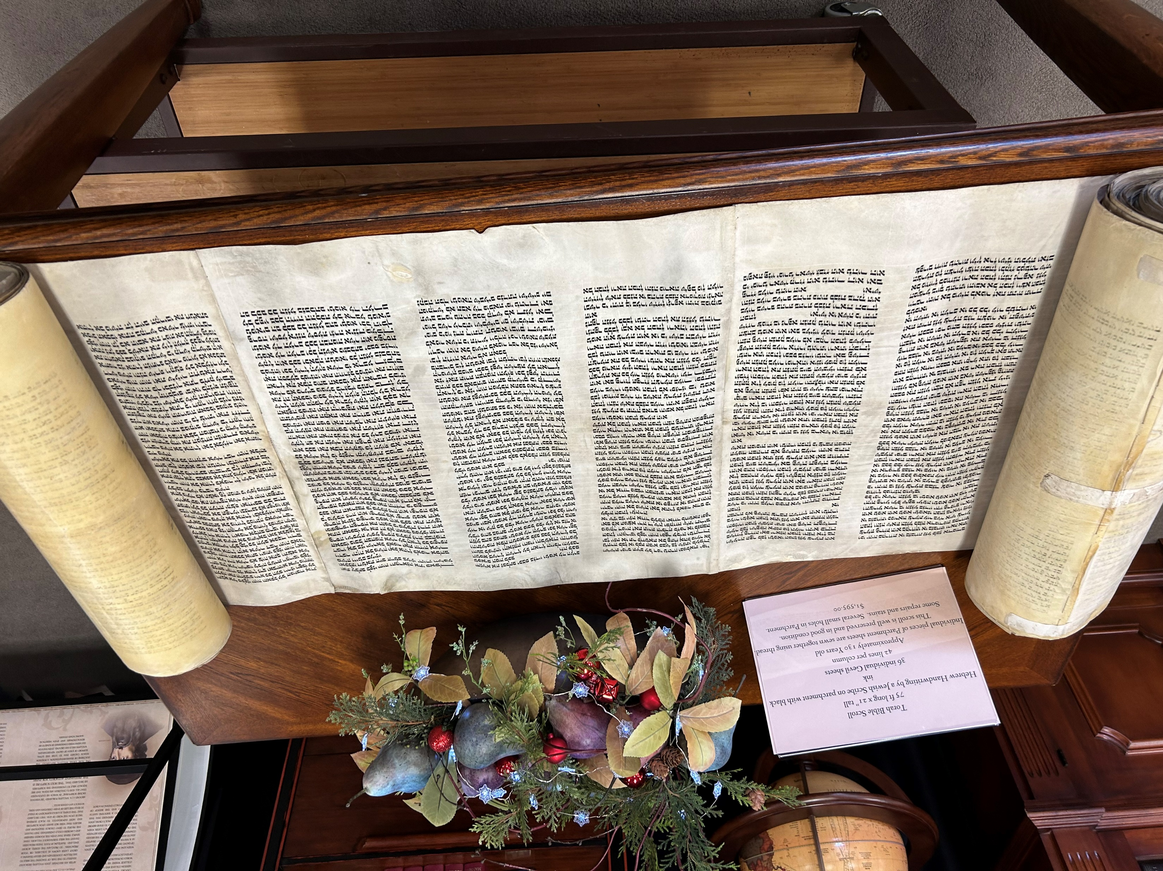
Old Testament Prophecies Foretold the Coming of the Messiah

Slide 4
An Historical Event
The Birth of the Lamb

Slide 5
The Witnesses
Mark (AD 50s or 60s)
Matthew (AD 50s or 60s)
Luke (early AD 60s)
John (ca. AD 85)
“One witness shall not rise against a man concerning any iniquity or any sin that he commits; by the mouth of two or three witnesses the matter shall be established” (Deut. 19:15).

Slide 6
What We Know About The Gospel of Luke
Part of a two-volume set, Luke-Acts.
The second volume ends with Paul in prison in Rome for two years. He was released from prison in AD 60.
Acts was probably completed shortly after Paul’s release, within 30-35 years of the crucifixion.
Luke was completed before Acts, probably around AD 58.

Slide 7
Luke 1:1-4
“Inasmuch as many have undertaken to compile a narrative of the things that have been accomplished among us, just as those who from the beginning were eyewitnesses and ministers of the word have delivered them to us, it seemed good to me also, having followed all things closely for some time past, to write an orderly account for you, most excellent Theophilus, that you may have certainty concerning the things you have been taught.”
First century historians frequently introduced their books with such a statement (2 Macc. 2:19-31; Josephus, “Against Apion, 1:1-4; etc.).

Slide 8
Luke 1:1-4
“Inasmuch as many have undertaken to compile a narrative of the things that have been accomplished among us, just as those who from the beginning were eyewitnesses and ministers of the word have delivered them to us, it seemed good to me also, having followed all things closely for some time past, to write an orderly account for you, most excellent Theophilus, that you may have certainty concerning the things you have been taught.”
First century historians frequently introduced their books with such a statement (2 Macc. 2:19-31; Josephus, “Against Apion, 1:1-4; etc.).

Slide 9
Luke 1:1-4
“Inasmuch as many have undertaken to compile a narrative of the things that have been accomplished among us, just as those who from the beginning were eyewitnesses and ministers of the word have delivered them to us, it seemed good to me also, having followed all things closely for some time past, to write an orderly account for you, most excellent Theophilus, that you may have certainty concerning the things you have been taught.”
First century historians frequently introduced their books with such a statement (2 Macc. 2:19-31; Josephus, “Against Apion, 1:1-4; etc.).

Slide 10
Luke 1:1-4
“Inasmuch as many have undertaken to compile a narrative of the things that have been accomplished among us, just as those who from the beginning were eyewitnesses and ministers of the word have delivered them to us, it seemed good to me also, having followed all things closely for some time past, to write an orderly account for you, most excellent Theophilus, that you may have certainty concerning the things you have been taught.”
First century historians frequently introduced their books with such a statement (2 Macc. 2:19-31; Josephus, “Against Apion,” 1:1-4; etc.).

Slide 11
Luke Was Writing History
There is no question that the author of this document meant for it to be understood as conveying historical information.
He was not writing fables.
He was not writing parables.
He was writing what he understood to be historical facts based on his own independent research. These evidences give proof of authorial intent—what the author intended to say.
Darrell L. Bock wrote, “Luke is a first-class ancient historian, and most good ancient historians understood their task well” (Luke 1:1–9:50, 13).

Slide 12
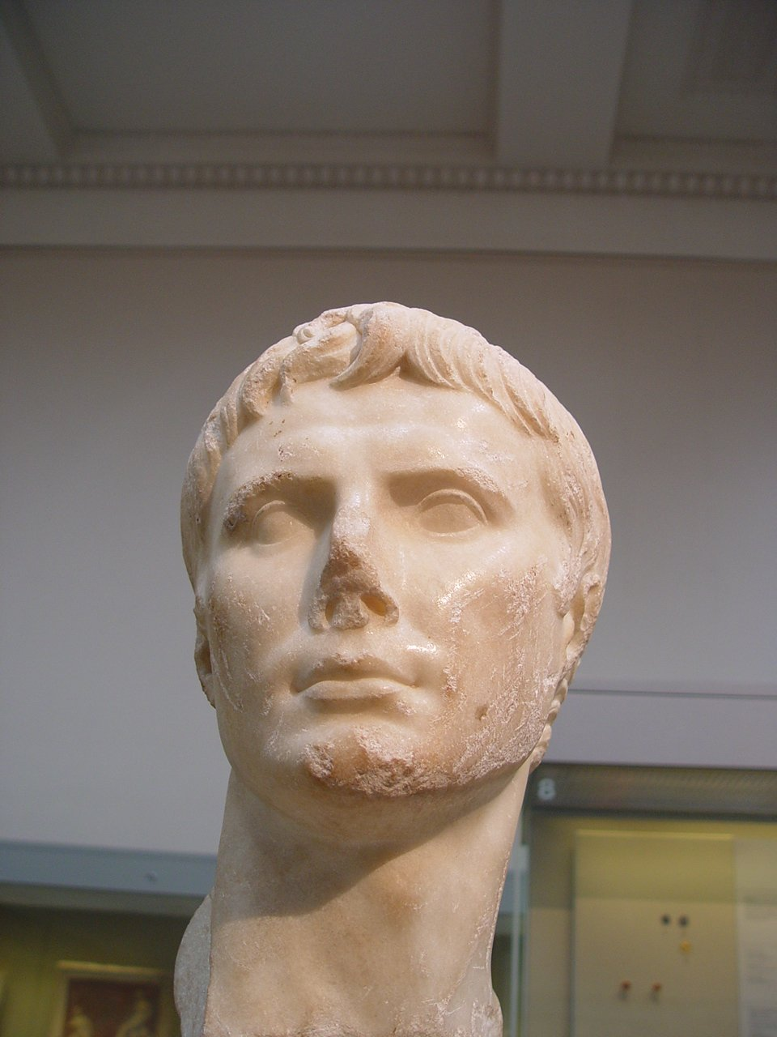
The Bible Speaks of Historical People
Caesar Augustus, also known as Octavian, was the second Roman emperor; he reigned from 27 BC until his death in AD 14.

Slide 13
Caesar Augustus
Caesar Augustus occupied the throne of Rome when Jesus was born (Luke 2:1).
Following the death of Julius Caesar, who ruled Rome from 64-44 BC until he was assassinated, Octavius Caesar became Caesar.
At Julius Caesar’s death, Octavius joined Mark Antony and Marcus Lepidus to form the Second Triumvirate. The Triumvirate fell apart by the competing ambitions of the three members and Octavius came out the winner.
He was named Augustus Caesar in 27 BC.
Augustus (Octavian) Caesar ruled the Roman Empire from 27 BC to 14 AD.

Slide 14
“In the Days of Herod the Great. . .”
The text begins by placing the birth of Jesus within the reign of Herod the Great (“there was in the days of Herod, the king of Judea,” Luke 1:5).
Herod the Great ruled from 37-4 BC.
He is well known from his colossal building projects:
Began the remodeling of the Jewish Temple in 19 BC.
His palace at Masada.
His palace at Caesarea on the coast.
Herodium.
New Testament Jericho along Wadi Qelt.
His tomb has been excavated and his sarcophagus is in the Israel Museum.

Slide 15
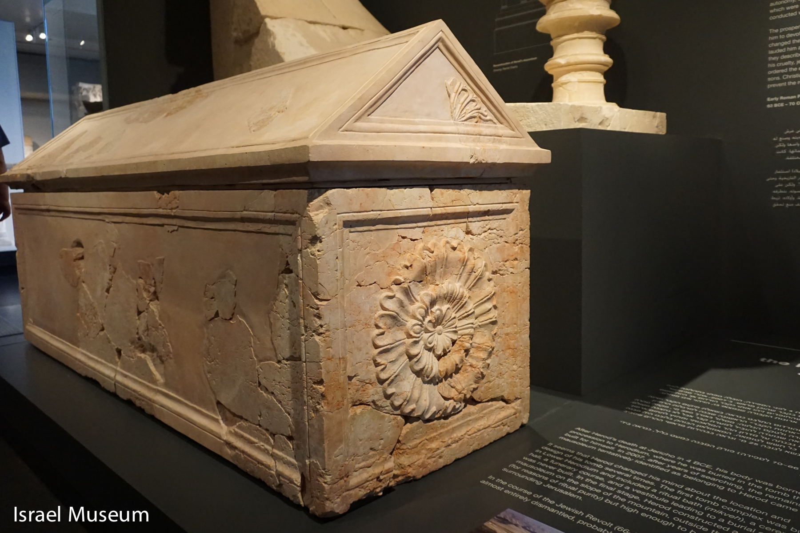
Herod the Great’s Sarcophagus
On display at the Israel Museum in Jerusalem

Slide 16
Luke 2:1-7
“In those days a decree went out from Caesar Augustus that all the world should be registered. 2 This was the first registration when Quirinius was governor of Syria. 3 And all went to be registered, each to his own town. 4 And Joseph also went up from Galilee, from the town of Nazareth, to Judea, to the city of David, which is called Bethlehem, because he was of the house and lineage of David, 5 to be registered with Mary, his betrothed, who was with child. 6 And while they were there, the time came for her to give birth. 7 And she gave birth to her firstborn son and wrapped him in swaddling cloths and laid him in a manger, because there was no place for them in the inn.”

Slide 17
Quirinius
Quirinius was governor of Syria (Luke 2:1).
Both Quirinius and the census that he issued which required Joseph to go from Nazareth to Bethlehem to pay his taxes are mentioned, describing that decree as the “first census” that took place while he was governor.
Quirinus (51 BC – AD 21) and a census he administered in AD 6 are known from history (Josephus, Antiquities, 8:1).
Luke’s statement that this was the “first” census leaves an impression that Luke was aware of others at later dates.

Slide 18
John the Baptist
John the Baptist is also mentioned in the birth narrative, as the child born to Zacharias and Elizabeth. The record of the death of John is given in Josephus (Antiquities 18.5.2).

Slide 19
Summation
These persons cited by Luke, are well known from history, and they place Luke’s account of the birth of Jesus in a specific period of time: 6-4 BC!
Note that this places Jesus in a definite chronological period.
It is not “long, long ago,” but “in 6-4 BC when Herod the Great was ruling Judaea, when Caesar Augustus was ruler over Rome, and Quirinius was governor of Syria.

Slide 20
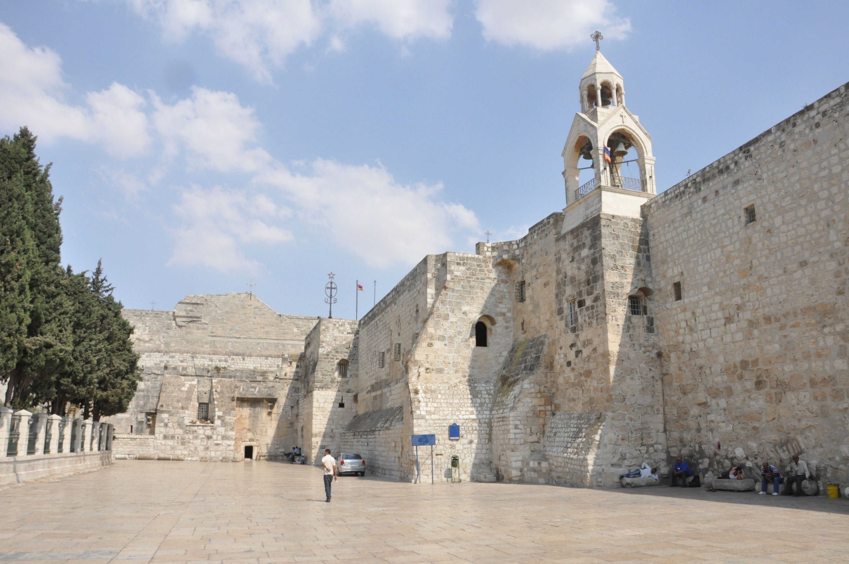
Jesus Was Born in Bethlehem
Church of the Nativity in Bethlehem, Israel

Slide 21
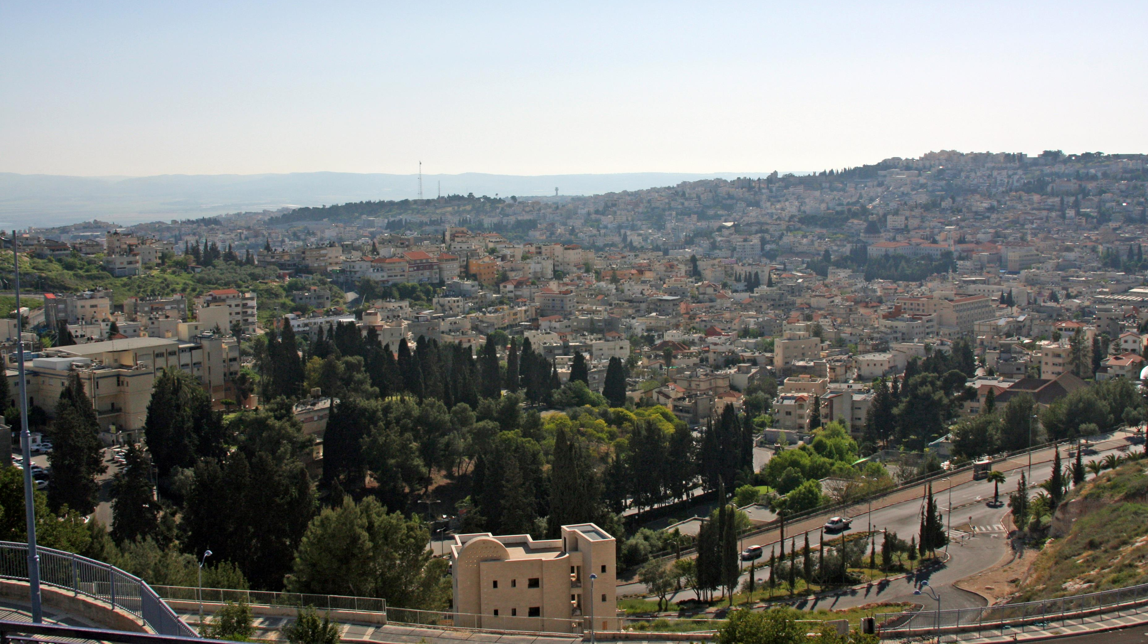
Nazareth, Israel

Slide 22
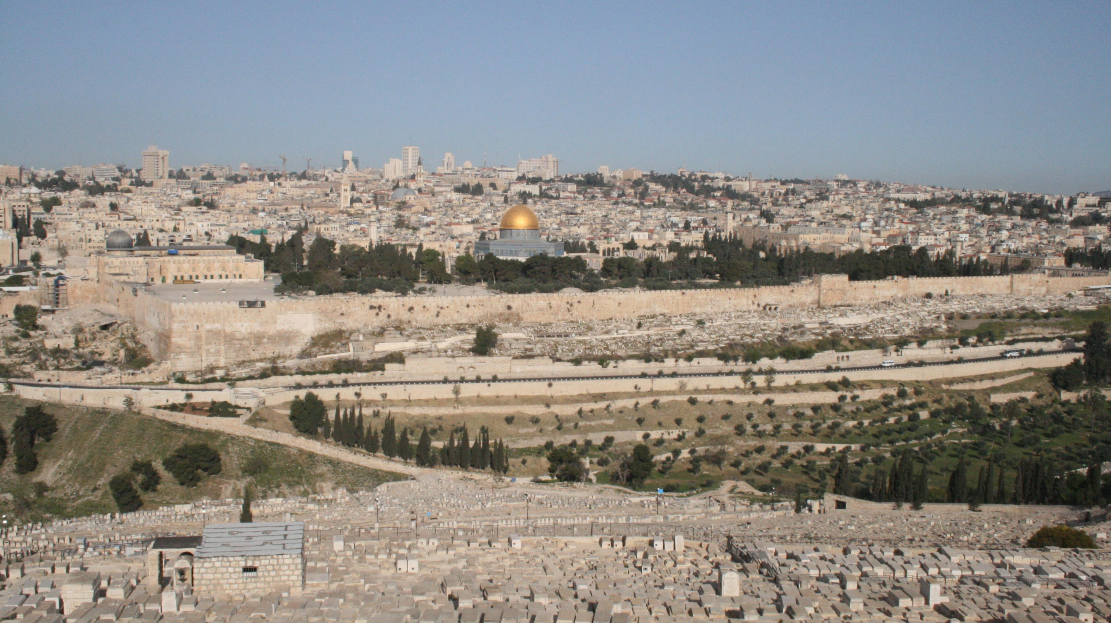
View of Jerusalem from Mount of Olives

Slide 23
Known Geographical Places
The places in the birth narrative of Jesus are geographically located.
Jerusalem was the capital city of Judaea and a palace where Herod the Great was there, although his main palace was a Caesarea. Jerusalem was also where the Temple where Zacharias was serving as a priest when the announcement of the birth of John was made.
Nazareth is the home of Joseph and Mary.
Bethlehem is the place where Jesus was born.
No one can successfully challenge the birth narrative on the basis of its geography.
These facts place the birth of Jesus in a specific place.
It is not “far, far away,” but in Bethlehem, Judaea.

Slide 24
Ancient Customs
An Ossuary

Slide 25
Contemporary Customs Fit the Social Context of First Century Judaism
The mother of John the Baptist is described as being barren (Luke 1:7).
It is known that barrenness was an embarrassment to a woman.
Jesus was circumcised on the eighth day of His life (Luke 2:21).
It is the known law of the Old Testament that male infants were to be circumcised on the eighth day (Gen. 17:9-12).
Mary was in the Temple for her purification on the 40th day after Jesus’s birth (Luke 2:22-23).
It is known that the Mosaical Law required that women giving birth to a male child should be purified on the 40th day (Lev. 12:2-6).

Slide 26
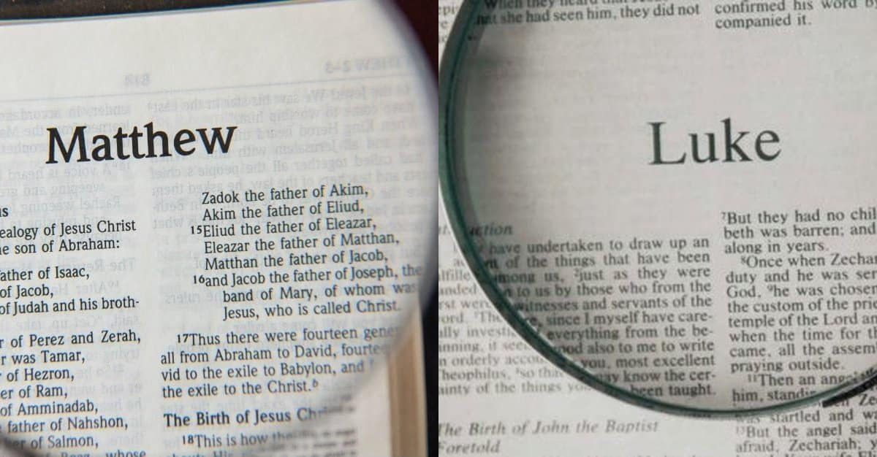
Confirmed by Eyewitnesses

Slide 27
Dating the Records
Mark was written first as shown by Matthew and Luke’s use of Mark.
Luke finished Acts with Paul still in prison. The most likely reason not to mention the outcome of Paul’s imprisonment was that it had not been decided when Luke finished Acts. Paul was martyred in ca. AD 67 or 68 by Nero (37-68). My ESV Bible says Luke was written in the early 60s.
All of the three synoptic gospels speak prophetically of the fall of Jerusalem in AD 70, not in the past tense.
Matthew was probably the third gospel written and that it was completed ca. AD 67. The introductory note in my ESV Bible says that Matthew was written in the 50s or 60s which would make it before Luke.
Those who deny that prophecy can occur place all of the synoptics after the fall of Jerusalem in AD 70 and usually date the book in the late 80’s.
Written about thirty years after the death of Jesus on the cross!

Slide 28
Luke: From Mary’s Viewpoint
Mary was the espoused wife (fiancé) of Joseph.
An angel appeared to Mary who announced that she would have a child conceived by the Holy Spirit.
Read the narrative of this appearance.

Slide 29
Luke 1:28-35
In the sixth month the angel Gabriel was sent from God to a city of Galilee named Nazareth, 27 to a virgin betrothed to a man whose name was Joseph, of the house of David. And the virgin’s name was Mary. 28 And he came to her and said, “Greetings, O favored one, the Lord is with you!” 29 But she was greatly troubled at the saying, and tried to discern what sort of greeting this might be. 30 And the angel said to her, “Do not be afraid, Mary, for you have found favor with God. 31 And behold, you will conceive in your womb and bear a son, and you shall call his name Jesus. 32 He will be great and will be called the Son of the Most High. And the Lord God will give to him the throne of his father David, 33 and he will reign over the house of Jacob forever, and of his kingdom there will be no end.”
34 And Mary said to the angel, “How will this be, since I am a virgin?”
35 And the angel answered her, “The Holy Spirit will come upon you, and the power of the Most High will overshadow you; therefore the child to be born will be called holy—the Son of God.

Slide 30
Luke 1:28-35
In the sixth month the angel Gabriel was sent from God to a city of Galilee named Nazareth, 27 to a virgin betrothed to a man whose name was Joseph, of the house of David. And the virgin’s name was Mary. 28 And he came to her and said, “Greetings, O favored one, the Lord is with you!” 29 But she was greatly troubled at the saying, and tried to discern what sort of greeting this might be. 30 And the angel said to her, “Do not be afraid, Mary, for you have found favor with God. 31 And behold, you will conceive in your womb and bear a son, and you shall call his name Jesus. 32 He will be great and will be called the Son of the Most High. And the Lord God will give to him the throne of his father David, 33 and he will reign over the house of Jacob forever, and of his kingdom there will be no end.”
34 And Mary said to the angel, “How will this be, since I am a virgin?”
35 And the angel answered her, “The Holy Spirit will come upon you, and the power of the Most High will overshadow you; therefore the child to be born will be called holy—the Son of God.

Slide 31
Luke 1:28-35
In the sixth month the angel Gabriel was sent from God to a city of Galilee named Nazareth, 27 to a virgin betrothed to a man whose name was Joseph, of the house of David. And the virgin’s name was Mary. 28 And he came to her and said, “Greetings, O favored one, the Lord is with you!” 29 But she was greatly troubled at the saying, and tried to discern what sort of greeting this might be. 30 And the angel said to her, “Do not be afraid, Mary, for you have found favor with God. 31 And behold, you will conceive in your womb and bear a son, and you shall call his name Jesus. 32 He will be great and will be called the Son of the Most High. And the Lord God will give to him the throne of his father David, 33 and he will reign over the house of Jacob forever, and of his kingdom there will be no end.”
34 And Mary said to the angel, “How will this be, since I am a virgin?”
35 And the angel answered her, “The Holy Spirit will come upon you, and the power of the Most High will overshadow you; therefore the child to be born will be called holy—the Son of God.

Slide 32
Luke 1:28-35
In the sixth month the angel Gabriel was sent from God to a city of Galilee named Nazareth, 27 to a virgin betrothed to a man whose name was Joseph, of the house of David. And the virgin’s name was Mary. 28 And he came to her and said, “Greetings, O favored one, the Lord is with you!” 29 But she was greatly troubled at the saying, and tried to discern what sort of greeting this might be. 30 And the angel said to her, “Do not be afraid, Mary, for you have found favor with God. 31 And behold, you will conceive in your womb and bear a son, and you shall call his name Jesus. 32 He will be great and will be called the Son of the Most High. And the Lord God will give to him the throne of his father David, 33 and he will reign over the house of Jacob forever, and of his kingdom there will be no end.”
34 And Mary said to the angel, “How will this be, since I am a virgin?”
35 And the angel answered her, “The Holy Spirit will come upon you, and the power of the Most High will overshadow you; therefore the child to be born will be called holy—the Son of God.

Slide 33
Matthew: From Joseph’s Viewpoint
Mary had made a trip from Nazareth to view Elizabeth because the angel reported to her the pregnancy of Elizabeth as evidence that Mary would conceive by the power of the Holy Spirit.
Mary was away about three months and returned to Nazareth pregnant.
Joseph knew for a fact that he was not the father of the child!
Joseph was considering privately divorcing Mary because he knew the child was not his own.
Joseph had a dream in which the angel of the Lord instructed him to take Mary as his wife.
Read the account of what happened.

Slide 34
Matthew 1:18-25
18 Now the birth of Jesus Christ took place in this way. When his mother Mary had been betrothed to Joseph, before they came together she was found to be with child from the Holy Spirit. 19 And her husband Joseph, being a just man and unwilling to put her to shame, resolved to divorce her quietly. 20 But as he considered these things, behold, an angel of the Lord appeared to him in a dream, saying, “Joseph, son of David, do not fear to take Mary as your wife, for that which is conceived in her is from the Holy Spirit. 21 She will bear a son, and you shall call his name Jesus, for he will save his people from their sins.” 22 All this took place to fulfill what the Lord had spoken by the prophet:
23 “Behold, the virgin shall conceive and bear a son,
and they shall call his name Immanuel”
(which means, God with us). 24 When Joseph woke from sleep, he did as the angel of the Lord commanded him: he took his wife, 25 but knew her not until she had given birth to a son. And he called his name Jesus.

Slide 35
Matthew 1:18-25
18 Now the birth of Jesus Christ took place in this way. When his mother Mary had been betrothed to Joseph, before they came together she was found to be with child from the Holy Spirit. 19 And her husband Joseph, being a just man and unwilling to put her to shame, resolved to divorce her quietly. 20 But as he considered these things, behold, an angel of the Lord appeared to him in a dream, saying, “Joseph, son of David, do not fear to take Mary as your wife, for that which is conceived in her is from the Holy Spirit. 21 She will bear a son, and you shall call his name Jesus, for he will save his people from their sins.” 22 All this took place to fulfill what the Lord had spoken by the prophet:
23 “Behold, the virgin shall conceive and bear a son,
and they shall call his name Immanuel”
(which means, God with us). 24 When Joseph woke from sleep, he did as the angel of the Lord commanded him: he took his wife, 25 but knew her not until she had given birth to a son. And he called his name Jesus.

Slide 36
Matthew 1:18-25
18 Now the birth of Jesus Christ took place in this way. When his mother Mary had been betrothed to Joseph, before they came together she was found to be with child from the Holy Spirit. 19 And her husband Joseph, being a just man and unwilling to put her to shame, resolved to divorce her quietly. 20 But as he considered these things, behold, an angel of the Lord appeared to him in a dream, saying, “Joseph, son of David, do not fear to take Mary as your wife, for that which is conceived in her is from the Holy Spirit. 21 She will bear a son, and you shall call his name Jesus, for he will save his people from their sins.” 22 All this took place to fulfill what the Lord had spoken by the prophet:
23 “Behold, the virgin shall conceive and bear a son,
and they shall call his name Immanuel”
(which means, God with us). 24 When Joseph woke from sleep, he did as the angel of the Lord commanded him: he took his wife, 25 but knew her not until she had given birth to a son. And he called his name Jesus.

Slide 37
Matthew 1:18-25
18 Now the birth of Jesus Christ took place in this way. When his mother Mary had been betrothed to Joseph, before they came together she was found to be with child from the Holy Spirit. 19 And her husband Joseph, being a just man and unwilling to put her to shame, resolved to divorce her quietly. 20 But as he considered these things, behold, an angel of the Lord appeared to him in a dream, saying, “Joseph, son of David, do not fear to take Mary as your wife, for that which is conceived in her is from the Holy Spirit. 21 She will bear a son, and you shall call his name Jesus, for he will save his people from their sins.” 22 All this took place to fulfill what the Lord had spoken by the prophet:
23 “Behold, the virgin shall conceive and bear a son,
and they shall call his name Immanuel”
(which means, God with us). 24 When Joseph woke from sleep, he did as the angel of the Lord commanded him: he took his wife, 25 but knew her not until she had given birth to a son. And he called his name Jesus.

Slide 38
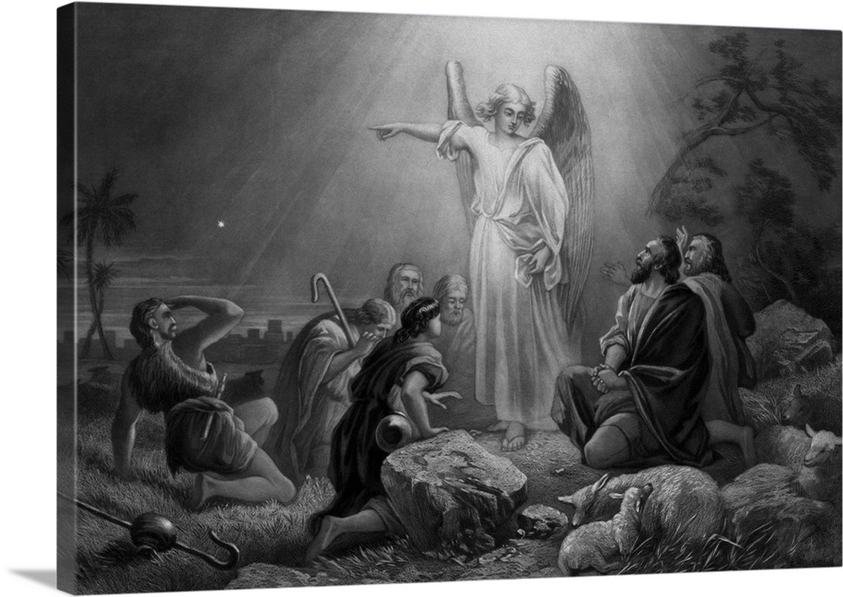
The Shepherd’s Testimony

Slide 39
Luke 2:8-14
8 And in the same region there were shepherds out in the field, keeping watch over their flock by night. 9 And an angel of the Lord appeared to them, and the glory of the Lord shone around them, and they were filled with great fear. 10 And the angel said to them, “Fear not, for behold, I bring you good news of great joy that will be for all the people. 11 For unto you is born this day in the city of David a Savior, who is Christ the Lord. 12 And this will be a sign for you: you will find a baby wrapped in swaddling cloths and lying in a manger.” 13 And suddenly there was with the angel a multitude of the heavenly host praising God and saying,
14 “Glory to God in the highest,
and on earth peace among those with whom he is pleased!”

Slide 40
Luke 2:15-18
When the angels went away from them into heaven, the shepherds said to one another, “Let us go over to Bethlehem and see this thing that has happened, which the Lord has made known to us.” 16 And they went with haste and found Mary and Joseph, and the baby lying in a manger. 17 And when they saw it, they made known the saying that had been told them concerning this child. 18 And all who heard it wondered at what the shepherds told them.

Slide 41
The Shepherd’s View
Shepherds came from the fields around Bethlehem looking for a newborn baby.
The angels announced the birth of the Jews’ Messiah, the Christ!
Undoubtedly, the shepherds would have understood the Messiah to be a political savior who would overthrow the Romans and drive them from Palestine.
They announced where the child was born—in Bethlehem, the city of David.
The announcement included where to find the child: “wrapped in swaddling clothes lying in a manger” (Luke 2:11).

Slide 42
The Magi from the East

Slide 43
The Wisemen’s Viewpoint
Sometime later, wise men from the East (region Tigris-Euphrates delta) arrived in Jerusalem telling that they had seen a star and had come to offer homage to the new born king of the Jews (Matt. 2:1-12).
The event caused the paranoid King Herod the Great to feel threatened and resulted in him putting to death children under two years old living in Bethlehem.

Slide 44
Matthew 2:1-6
Now after Jesus was born in Bethlehem of Judea in the days of Herod the king, behold, wise men from the east came to Jerusalem, 2 saying, “Where is he who has been born king of the Jews? For we saw his star when it rose and have come to worship him.” 3 When Herod the king heard this, he was troubled, and all Jerusalem with him; 4 and assembling all the chief priests and scribes of the people, he inquired of them where the Christ was to be born. 5 They told him, “In Bethlehem of Judea, for so it is written by the prophet:
6 “‘And you, O Bethlehem, in the land of Judah,
are by no means least among the rulers of Judah;
for from you shall come a ruler
who will shepherd my people Israel.’ ”

Slide 45
Matthew 2:1-6
Now after Jesus was born in Bethlehem of Judea in the days of Herod the king, behold, wise men from the east came to Jerusalem, 2 saying, “Where is he who has been born king of the Jews? For we saw his star when it rose and have come to worship him.” 3 When Herod the king heard this, he was troubled, and all Jerusalem with him; 4 and assembling all the chief priests and scribes of the people, he inquired of them where the Christ was to be born. 5 They told him, “In Bethlehem of Judea, for so it is written by the prophet:
6 “‘And you, O Bethlehem, in the land of Judah,
are by no means least among the rulers of Judah;
for from you shall come a ruler
who will shepherd my people Israel.’ ”

Slide 46
Matthew 2:7-12
7 Then Herod summoned the wise men secretly and ascertained from them what time the star had appeared. 8 And he sent them to Bethlehem, saying, “Go and search diligently for the child, and when you have found him, bring me word, that I too may come and worship him.” 9 After listening to the king, they went on their way. And behold, the star that they had seen when it rose went before them until it came to rest over the place where the child was. 10 When they saw the star, they rejoiced exceedingly with great joy. 11 And going into the house, they saw the child with Mary his mother, and they fell down and worshiped him. Then, opening their treasures, they offered him gifts, gold and frankincense and myrrh. 12 And being warned in a dream not to return to Herod, they departed to their own country by another way.

Slide 47
Summation: Who Can Deny These Witnesses?
Denying the narrative of the virgin birth of Jesus requires that one show that these witnesses were liars.
Mary
Joseph
The shepherds: What is their motive?
The wise men: What is their motive?

Slide 48
Defaming Mary
The character of Mary would be tarnished by a denial of the virgin birth.
Instead of being a paragon of virtue, she is reduced to fornicator with someone other than her fiancé.
Then years later, she may have been able to stop the crucifixion if she had stepped forward during Jesus’s trial and told Him the truth about who He was and who His real father was.
Instead, she sat with her mouth shut, to preserve her reputation, still clinging to her unbelievable tale that she had never had sex with a man before the birth of Jesus.
What kind of mother would do such things?

Slide 49
Unbelief Grounded in Atheism
Those with philosophical presuppositions that deny the existence of God will deny the evidences cited above that support the Bible narrative of the virgin birth of Jesus.
They deny the virgin birth because it was a miracle and miracles are impossible for one denying the existence of God.

Slide 50
The Virgin Birth Essential to the Incarnation
The virgin birth of Jesus is the means whereby God became incarnate.
“In the beginning was the Word, and the Word was with God, and the Word was God. He was in the beginning with God. All things were made through Him, and without Him nothing was made that was made. . . . And the Word became flesh and dwelt among us, and we beheld His glory, the glory as of the only begotten of the Father, full of grace and truth” (John 1:1-3, 14).
“Let this mind be in you which was also in Christ Jesus, who, being in the form of God, did not consider it robbery to be equal with God, but made Himself of no reputation, taking the form of a bondservant, and coming in the likeness of men. And being found in appearance as a man, He humbled Himself and became obedient to the point of death, even the death of the cross” (Phil. 2:5-8).
Denial of the virgin birth attacks Christianity in one of its core beliefs: Who Jesus is!

