Slide 2
Paul Is Wrapping Up
Paul is coming to the end of his letter to the Philippians.
Already he has taught that Christians should face the conflicts of the world with a spirit of joy, rejoicing in the Lord.
The appeal is not a “regardless of how you feel, put on a smile” approach to life, but an appeal to their faith—“rejoice in the Lord.”
To this he adds other Christian virtues that will enable and empower one to serve the Lord.

Slide 3
Philippians 4:5-7
“Let your reasonableness be known to everyone. The Lord is at hand; do not be anxious about anything, but in everything by prayer and supplication with thanksgiving let your requests be made known to God. And the peace of God, which surpasses all understanding, will guard your hearts and your minds in Christ Jesus.”

Slide 4
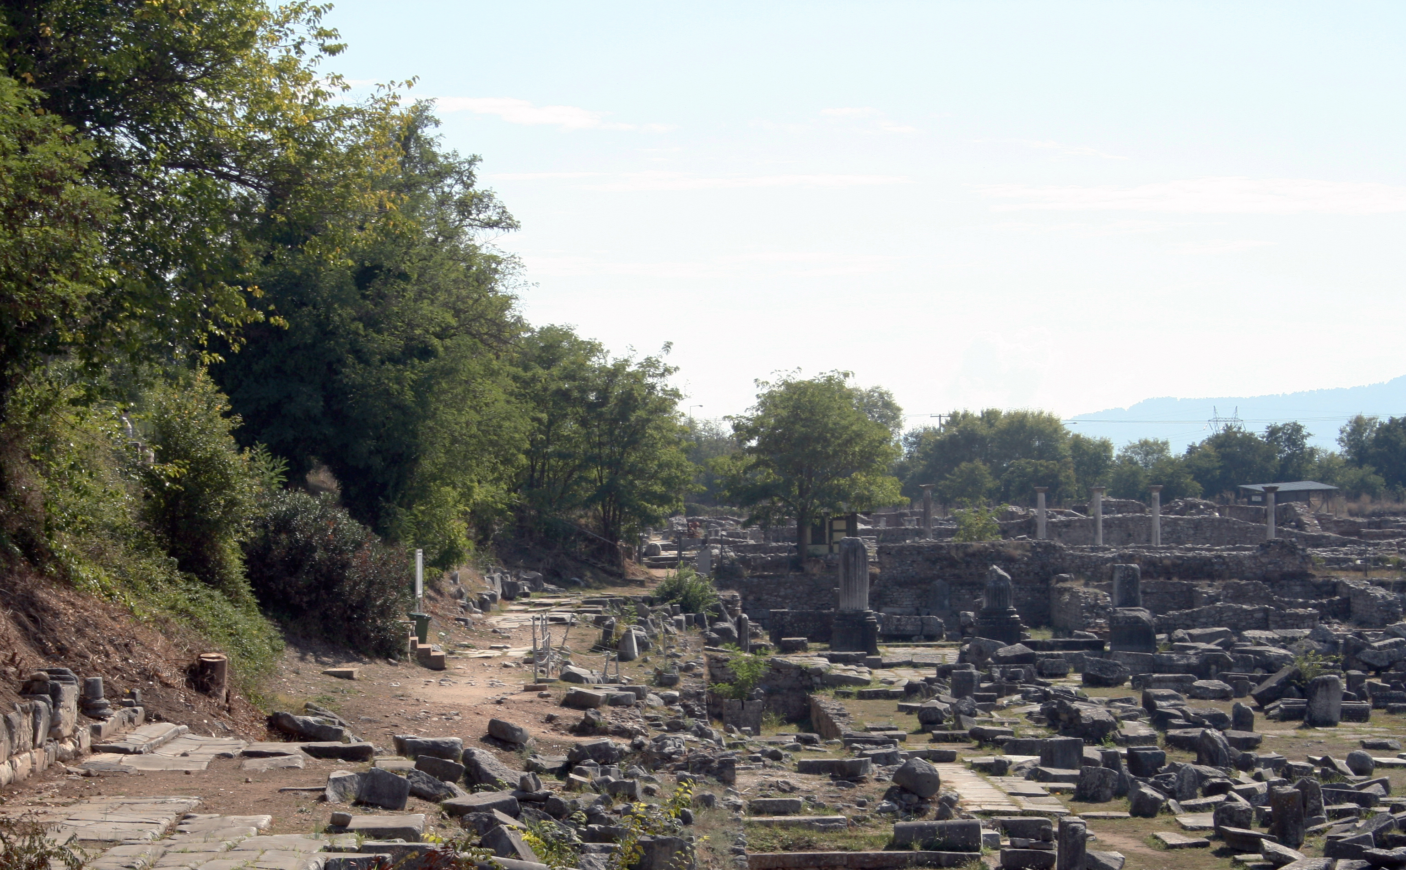
Favorite Texts from Philippians

Slide 5
1. Let Your Reasonableness Be Known to Everyone
Rea•son•a•ble•ness
Noun
Sound judgment, fairness
The quality of being as much as is appropriate or fair, moderateness

Slide 6
Defining the Word
The Greek word epieikēs is defined as “not insisting on every right of letter or law or custom, yielding, gentle, kind, courteous tolerant” (BDAG, 371). Regarding v. 5, BDAG suggests the translation “your forebearing spirit.”
Ralph P. Martin: “I. H. Marshall gives a full description of its meaning as ‘fairmindedness, the attitude of a man who is charitable towards men’s faults and merciful in his judgment of their failings because he takes their whole situation into his reckoning’. Perhaps ‘graciousness’ is the best English equivalent; and, in the context here, it is to be the spirit of willingness to yield under trial which will show itself in a refusal to retaliate when attacked” (Philippians: An Introduction and Commentary, Tyndale New Testament Commentaries, 174).

Slide 7
Richard R. Melick, Jr.
“No single word translates epieikēs well, and commentators consistently insist that the word contains an element of selflessness. The gentle person does not insist on his rights. ‘It is that considerate courtesy and respect for the integrity of others which prompts a man not to be for ever standing on his rights; and it is preeminently the character of Jesus (2 Cor 10:1).’ The word occurs in Paul’s writing as a characteristic of Christian leaders (1 Tim 3:3, of bishops; Titus 3:2). Fairness and magnanimity were to be developed so that they were visible to all” (Philippians, Colossians, Philemon, The New American Commentary, 149).

Slide 8
A Note I Wrote in My Bible
The Greek word epieikēs means “reasonableness in judging. The word signifies an humble steadfastness, which is able to submit to injustice, disgrace, and maltreatment without hatred and malice, trusting in God in spite of it all” (Linguistic Key to the Greek New Testament, 214).

Slide 9
Learning From Its Opposites
By looking at the opposites of some of the choice definitions may help us understand how to live with one another:
Always demanding that one meet the letter of the law
Always demanding one’s rights
Being contentious
Being legalistic rather than charitable
Being unmerciful rather than showing mercy

Slide 10
The World’s View: Beat Them While They Are Down
The world looks down upon one who does not bleed the last drop of blood from his enemy.
It considers this a sign of weakness that is likely to come back to haunt one.
If one kills his enemy, he better kill the children also, lest they grow up and take revenge.

Slide 11
A Better Way!
There is much to be said for that personality trait that tries to work with people to find a way to settle their differences so that both can be happy and content—a win-win solution.
Peter described Jesus’s conduct as follows: “who, when He was reviled, did not revile in return; when He suffered, He did not threaten, but committed Himself to Him who judges righteously” (1 Pet. 2:23).

Slide 12
The Lord Is At Hand!
Paul uses this reason for why one should show sweet reasonableness in his conduct toward others.
“At hand” is translated from the Greek word eggus which is used in two appropriate ways, both of which would fit this text:
Close proximity spatially, near, close to.
Being close in the point of time, near (BDAG, 271).
Let’s consider both options.

Slide 13
A. The Lord Is Coming Soon
The fact that the second coming of Jesus has not occurred, even though almost 2000 years have passed since He was on earth, make clear that the text is not saying to saints in the first century, “Jesus is coming soon.”
Yet, the next impending event in Bible chronology is the second coming and Paul frequently used this fact to exhort men to Christian behavior (1 Thess. 4:13-18; Phil. 3:20-21).

Slide 14
1 Thessalonians 4:13-18
“But we do not want you to be uninformed, brothers, about those who are asleep, that you may not grieve as others do who have no hope. For since we believe that Jesus died and rose again, even so, through Jesus, God will bring with him those who have fallen asleep. For this we declare to you by a word from the Lord, that we who are alive, who are left until the coming of the Lord, will not precede those who have fallen asleep. For the Lord himself will descend from heaven with a cry of command, with the voice of an archangel, and with the sound of the trumpet of God. And the dead in Christ will rise first. Then we who are alive, who are left, will be caught up together with them in the clouds to meet the Lord in the air, and so we will always be with the Lord. Therefore encourage one another with these words.”

Slide 15
Philippians 3:20-21
“But our citizenship is in heaven, and from it we await a Savior, the Lord Jesus Christ, who will transform our lowly body to be like his glorious body, by the power that enables him even to subject all things to himself.”

Slide 16
B. The Lord Is Ever Present
“The Lord is near to those who have a broken heart, And saves such as have a contrite spirit” (Psa. 34:18).
“You are near, O Lord , And all Your commandments are truth” (Psa. 119:151).
“The Lord is near to all who call upon Him, To all who call upon Him in truth” (Psa. 145:18).
“‘. . .teaching them to observe all things that I have commanded you; and lo, I am with you always, even to the end of the age.’ Amen” (Matt. 28:20).
“Let your conduct be without covetousness; be content with such things as you have. For He Himself has said, ‘I will never leave you nor forsake you’” (Heb. 13:5).
“For the eyes of the Lord are on the righteous, And His ears are open to their prayers; But the face of the Lord is against those who do evil” (1 Pet. 3:12).

Slide 17
Walton Weaver
“In view of both the Lord’s closeness to us and the unexpected suddenness of his coming, all Christian should always live as to be pleasing unto him and be prepared for his coming” (Philippians, Colossians, 214).
Both (a) Jesus’s coming is near and (b) Jesus is ever present (near) to us are reasons for us to let our own “sweet reasonableness” be known to all men!

Slide 18
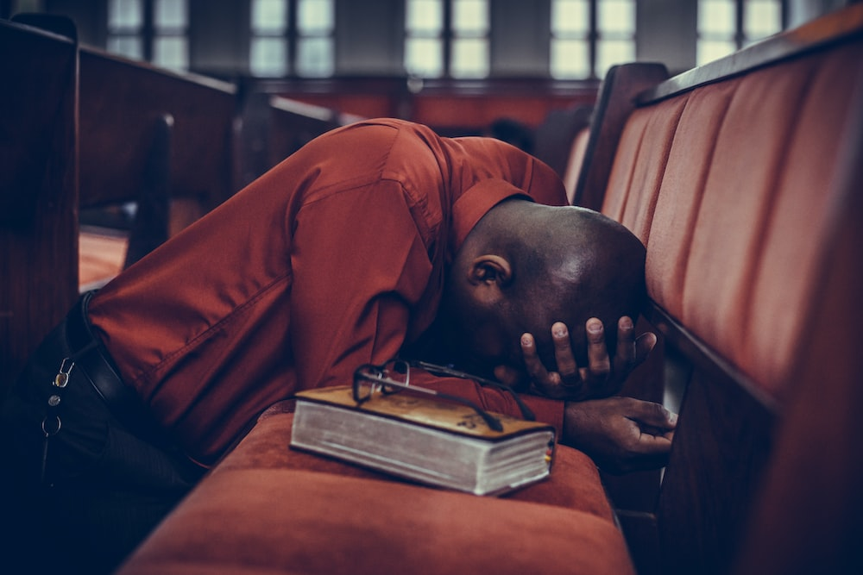
2. Be Anxious for Nothing, but in Everything by Prayer and Supplication, with Thanksgiving, Let Your Requests Be Made Known to God (4:6).

Slide 19
Anxiety Is Lack of Trust in God
“Therefore I tell you, do not be anxious about your life, what you will eat or what you will drink, nor about your body, what you will put on. Is not life more than food, and the body more than clothing? Look at the birds of the air: they neither sow nor reap nor gather into barns, and yet your heavenly Father feeds them. Are you not of more value than they? And which of you by being anxious can add a single hour to his span of life? And why are you anxious about clothing? Consider the lilies of the field, how they grow: they neither toil nor spin, yet I tell you, even Solomon in all his glory was not arrayed like one of these. But if God so clothes the grass of the field, which today is alive and tomorrow is thrown into the oven, will he not much more clothe you, O you of little faith? Therefore do not be anxious, saying, ‘What shall we eat?’ or ‘What shall we drink?’ or ‘What shall we wear?’ For the Gentiles seek after all these things, and your heavenly Father knows that you need them all. But seek first the kingdom of God and his righteousness, and all these things will be added to you. Therefore do not be anxious about tomorrow, for tomorrow will be anxious for itself. Sufficient for the day is its own trouble” (Matt. 6:25-34).

Slide 20
Anxiety
Anxiety sometimes betrays a lack of acceptance of one’s circumstances in life.
Anxiety accomplishes nothing: “Which of you by worrying can add one cubit to his stature?” (Matt. 6:27).
Anxiety about tomorrow can cripple one today.

Slide 21
Prayer Is the Cure for Anxiety
Paul uses three words for prayer to overcome one’s anxiety:
Proseuchē: “petition addressed to deity, prayer” (BDAG, 878).
Deēsis: “urgent request to meet a need, exclusively address to God, prayer” (BDAG, 213).
Eucharistia: “the expression or content of gratitude, the rendering of thanks, thanksgiving” (BDAG, 416).
“The recalling of God’s goodness and mercy will save us from the many pitfalls which await the ungrateful soul, e.g. over-concern with our immediate problems, forgetfulness of God’s gracious dealings with us in the past, disregard of the needs of others who are less fortunate than we are” (Ralph P. Martin, 176).

Slide 22
Talk to God About It
One should take his requests (aitēma) to the Lord.
God instructs and encourages His children to bring their needs before His throne (Matt. 7:7-11).
“Ask, and it will be given to you; seek, and you will find; knock, and it will be opened to you. For everyone who asks receives, and the one who seeks finds, and to the one who knocks it will be opened. Or which one of you, if his son asks him for bread, will give him a stone? Or if he asks for a fish, will give him a serpent? If you then, who are evil, know how to give good gifts to your children, how much more will your Father who is in heaven give good things to those who ask him!”
“. . .for your Father knows what you need before you ask him” (Matt. 6:8, cf. v 32).
The point is that prayer is the cure to anxiety.

Slide 23
3. The Peace of God, Which Surpasses All Understanding, Will Guard Your Hearts and Minds Through Christ Jesus (4:7).

Slide 24
A Relationship With God Creates Peace
God created us and knows us like no one else can.
God sustains us through His providential care.
God gives us the good things of life that we need (Matt. 7:7-11).
Even those things He does not choose to give us are for our own good always.
He loved us enough to give His beloved Son for our salvation (John 3:16) and right relationship with God.
Jesus has gone away to prepare us an eternal dwelling place (John 14:1-3).

Slide 25
Peace of God = God Is Origin of My Peace
The peace He provides transcends human thought, surpassing (huperechō) all of our dreams and therefore beyond our comprehension.
These thoughts will guard us.
The word phroureō means “to provide security, guard, protect, keep” (BDAG, 1067).
“‘Guard’ is a military term, implying that peace stands on duty to keep out anything that brings care and anxiety. For these reasons, prayerful people are peaceful people” (Richard R. Melick, Philippians, Colossians, Philemon, The New American Commentary, 150).
No wonder Paul would write, “being confident of this very thing, that He who has begun a good work in you will complete it until the day of Jesus Christ” (Phil. 1:6).

Slide 26
Conclusion

Slide 27
Calm in the Storm
We live in a world that has lost its way and knows nothing of God’s peace.
There are “wars and rumors of war.”
Even though we live in one of the most prosperous nations on earth, there is strife between different segments of our population (Blacks/whites, male/female, liberals/conservatives, Democrats/Republicans).
In the middle of this situation, we still can have peace, the peace of God that surpasses all understanding, the peace of God that keeps our hearts and minds in Christ.

