Slide 2
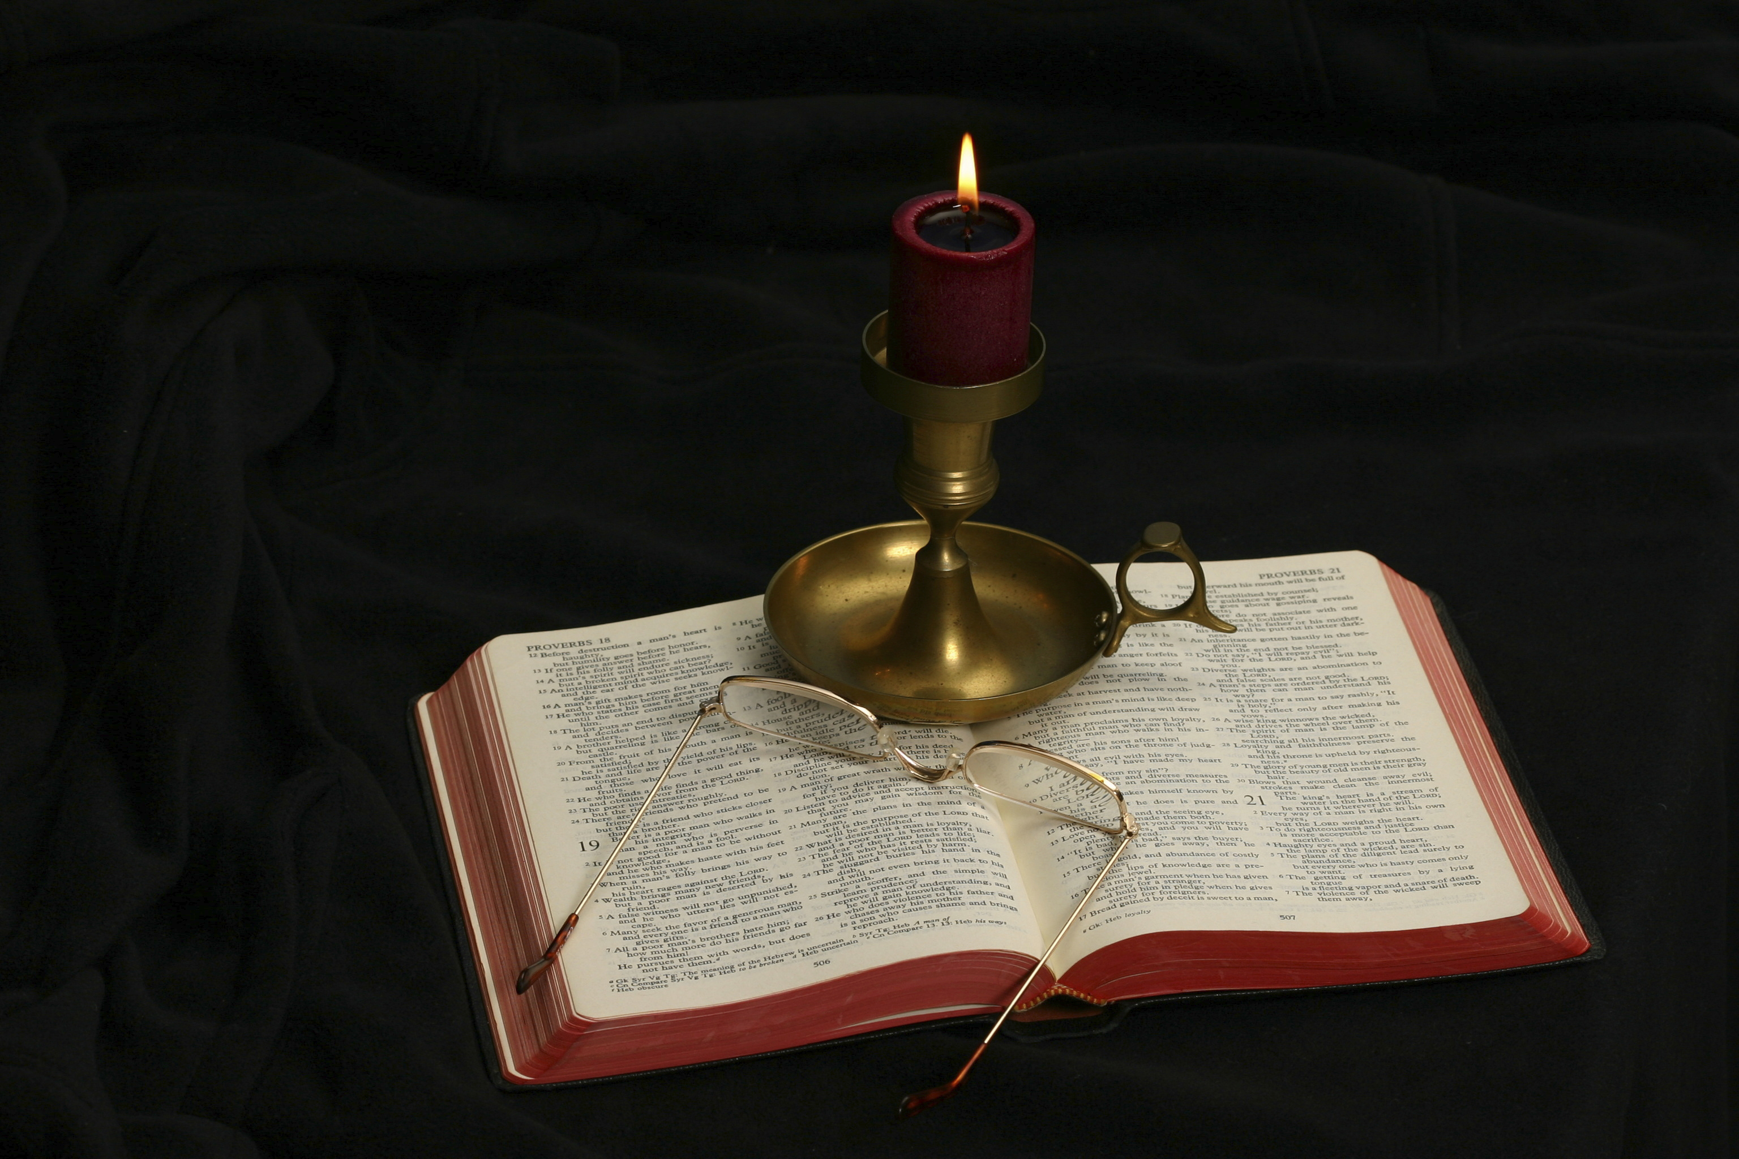
The Gospel of Matthew
Chapter 15

Slide 3
Outline of Chapter 15
Matthew is mostly following the same order of events as Mark 7:1–8:10.
Controversy with the Pharisees over Traditions (15:1-20)
The Faith of a Canaanite Woman (15:21-28)
Summary statement about healing (15:29-31)
Miraculous Feeding of the 4000 (15:32-39)

Slide 4
Controversy with the Pharisees over Tradition Matthew 15:1-20
Jesus with the scribes and Pharisees (15:1-9)
Jesus with the crowds (15:10-11)
Jesus with His disciples (15:12-20)

Slide 5
Matthew 15:1-9 Jesus with the Scribes and Pharisees
“Then Pharisees and scribes came to Jesus from Jerusalem and said, ‘Why do your disciples break the tradition of the elders? For they do not wash their hands when they eat.’ He answered them, ‘And why do you break the commandment of God for the sake of your tradition? For God commanded, “Honor your father and your mother,” and, “Whoever reviles father or mother must surely die.” But you say, “If anyone tells his father or his mother, ‘What you would have gained from me is given to God,’ he need not honor his father.” So for the sake of your tradition you have made void the word of God. You hypocrites! Well did Isaiah prophesy of you, when he said: “This people honors me with their lips, but their heart is far from me; in vain do they worship me, teaching as doctrines the commandments of men.”’”

Slide 6
Matthew 15:1-2
“Then Pharisees and scribes came to Jesus from Jerusalem and said, ‘Why do your disciples break the tradition of the elders? For they do not wash their hands when they eat.’”
The Pharisees are to be distinguished from the Sadducees on two important points:
The Sadducees rejected the doctrine of the resurrection and angels (Matt. 22:23; Mark 12:18; Luke 20:27; Acts 23:8).
The Pharisees bound on themselves and others the keeping of an oral law (the tradition of the elders), which the Sadducees rejected.
The oral law was codified in the second century into the Mishnah.
Hand washing was not for hygiene, but for ceremonial cleanness or purity.
A group had come from Jerusalem to see whether or not Jesus was orthodox.
The setting of Jesus intermingling with those with diseases in 14:34-36 provided a fitting introduction to this controversy.

Slide 7
Defining Some Words
Transgress (parabainō): “go aside, deviate from the way; “transgress, break” (BADG, 758).
Tradition (paradosis): “the content of instruction that has been handed down” (BDAG, 763).
Human traditions of whatever origin (Col. 2:8)
Jewish traditions (Gal. 1:14).
Apostolic tradition (1 Cor. 11:2; 2 Thess. 2:15; 3:6).

Slide 8
The Reasoning of the Pharisees
“The contact made the hands unclean, and if unclean hands touched food, that, too, became unclean. When it was eaten the whole person was made unclean. To avoid such a dreadful happening the strict upholders of the traditions had evolved a ritual washing that removed defilement, and they practiced it scrupulously before eating. So important was this that a whole tractate of the Mishnah is devoted to it (called Yadaim, ‘Hands’)” (Leon Morris, The Gospel according to Matthew, The Pillar New Testament Commentary, 391).

Slide 9
Matthew 15:3
“He answered them, ‘And why do you break the commandment of God for the sake of your tradition?’”
The Pharisees accused Jesus and His disciples of transgressing (parabainō) the traditions of the elders; Jesus accused them of transgressing (breaking; parabainō) commandment of God.
Note the contrast: Jesus’s disciples/“you” (Pharisees and scribes)
Note the contrasts:
“traditions”/“commandment”
This is a question of authority: of men/of God
The commandments of God have higher authority than human tradition!
They break God’s commandment “for the sake” (because of) of their traditions!

Slide 10
Human Traditions
Note how honored traditions still violate the commandment of God:
The action of baptism: those who defend sprinkling or pouring for baptism, immerse very few people
The weekly observance of the Lord’s supper vs. monthly, quarterly, yearly
The feminist traditions: the right to choose vs. the right to life
The homosexual traditions about sexuality displace the commandments of God about homosexual conduct

Slide 11
Matthew 15:4
“For God commanded, ‘Honor your father and your mother,’ and, ‘Whoever reviles father or mother must surely die.’”
Jesus quoted two passages spoken by God:
“Honor your father and your mother, that your days may be long in the land that the LORD your God is giving you” (Exod. 20:12).
“Honor” includes the child’s financial responsibility to provide for his parents in their old age.
“Whoever curses his father or his mother shall be put to death” (Exod. 21:17).

Slide 12
Matthew 15:5
“But you say, ‘If anyone tells his father or his mother, “What you would have gained from me is given to God. . . .”’”
Note the contrast: God commanded/but you say
Craig Blomberg: “The Corban practice in view was that of pledging money or other material resources to the temple to be paid upon one’s death. These funds could therefore not be transferred to anyone else but could still be used for one’s own benefit while one was still alive (v. 5)” (Matthew, The New American Commentary, 238).

Slide 13
Matthew 15:6
“‘. . . he need not honor his father.’ So for the sake of your tradition you have made void the word of God.”
Made void (akuroō): the word appears only three times in the Bible.
This human tradition nullified the word of God.
It is probably fair to say that the outcome of their human tradition (i.e., to nullify the word of God) was an unintended consequence, but it was nonetheless its effect.
One should not ignore the consequencies of what he believes.

Slide 14
Matthew 15:7
“You hypocrites! Well did Isaiah prophesy of you, when he said. . .”
Of the 17 times where hupokritēs occurs in the NT, 13 occur in Matthew (6x in chapter 23).
The word originally meant “play-actor, role-player” and evolved in its meaning to a metaphorical meaning of “actor, in the sense pretender, dissembler” (BDAG, 1038). It is a strong indictment of their character.
Craig Blomberg: “The inconsistencies of those who enforce the ‘tradition of the elders’ make them ‘hypocrites’” (238).
The Lord cites Isaiah 29:13 as applying to the scribes and Pharisees.

Slide 15
Matthew 15:8-9
“‘This people honors me with their lips, but their heart is far from me; in vain do they worship me, teaching as doctrines the commandments of men.’”
The Lord calls attention to expressing honor to God, while in reality their heart is far away from God.
I think of the pageantry of religious leaders around Christmas and Easter. Their humanly devised worship is more nearly like those of the Pharisees than like Jesus. They speak words that honor our Lord, but their heart is radically different from the teachings of the Lord.
It is not merely that their heart is not in what they doing; it is that their heart is moving further and further away from God.

Slide 16
Vain Worship
Vain (matēn): “in vain, to no end” (BDAG, 621).
James uses a different word (mataios), from the same word family, to describe the religion that thinks it is religious without bridling the tongue. It means “this person’s worship is worthless” (BDAG, 621).
What does Jesus explain to be “vain religion”?
Why is it important that one have Bible authority for his practices?
What does the world think about the need for Bible authority for one’s worship?

Slide 17
Leon Morris
“People who genuinely worship God will proceed to teach what God has commanded; the fact that these people teach what is of human origin demonstrates that their worship is a sham. Jesus’ charge against the Jewish scholars was that in the last resort they were substituting manmade regulations for the divine commands. Their motives may possibly have been excellent, but the results were deplorable” (The Gospel according to Matthew, The Pillar New Testament Commentary, 394).

Slide 18
An Example: The UMC
The United Methodist Church is going through a split at this present time over the issue of homosexuality.
About 1/3 of their churches have already left the denomination and others are trying to get out by the end of 2023, in order that the local church can keep control of its property (otherwise the UMC denomination will have control of the property).
The churches which are leaving are the ones who believe what the Bible teaches about homosexuality; the 2/3 who are staying approve of homosexuality.
What do you think that Jesus thinks about the UMC?

Slide 19
Matthew 15:10-11 Jesus with the Crowds
“And he called the people to him and said to them, ‘Hear and understand: it is not what goes into the mouth that defiles a person, but what comes out of the mouth; this defiles a person.’”
Jesus turned from a discussion with the scribes and Pharisees to address the crowds following Him.
What does Jesus want the people to understand?
Jesus emphasizes that the food that one eats does not defile the person, but the words that come out of the mouth are what defile (cf. Matt. 12:33-37).
This was a radical statement that overturned a central point of Pharisaic religion.
Can one exalt human traditions above the word of God and still please God?

Slide 20
Mark’s Comment on Jesus’s Words
“And when he had entered the house and left the people, his disciples asked him about the parable. And he said to them, “Then are you also without understanding? Do you not see that whatever goes into a person from outside cannot defile him, since it enters not his heart but his stomach, and is expelled?” (Thus he declared all foods clean.)” (Mark 7:17-19).
Craig L. Blomberg says that Mark “spells out the radical implications of Jesus’ statement in v. 11, even if these implications were not fully understood until after the events of Acts 10” (Matthew, The New American Commentary, 239).

Slide 21
Jesus with His Disciples Matthew 15:12-20
“Then the disciples came and said to him, ‘Do you know that the Pharisees were offended when they heard this saying?’ He answered, ‘Every plant that my heavenly Father has not planted will be rooted up. Let them alone; they are blind guides. And if the blind lead the blind, both will fall into a pit.’ But Peter said to him, ‘Explain the parable to us.’ And he said, ‘Are you also still without understanding? Do you not see that whatever goes into the mouth passes into the stomach and is expelled? But what comes out of the mouth proceeds from the heart, and this defiles a person. For out of the heart come evil thoughts, murder, adultery, sexual immorality, theft, false witness, slander. These are what defile a person. But to eat with unwashed hands does not defile anyone.’”

Slide 22
Matthew 15:12
“Then the disciples came and said to him, ‘Do you know that the Pharisees were offended when they heard this saying?’”
This verse explains that Jesus had a private conversation with His disciples away from the Pharisees and from the crowd.
Matthew alone records this conversation.
What is the meaning and significance of the disciples’ question?
Were they correct?
Was this a case of Jesus not showing love and kindness to the Pharisees?
When is it needed and necessary to speak words that offends peoples’ religious beliefs?

Slide 23
To Be Offended
TDNT comments on the meaning of “offended” (skandalizō): “σκανδαλίζομαι is more than just ‘feeling hurt.’ Naturally this is part of it in view of Jesus’ personal attack on them, v. 8f. But the primary meaning is ‘deep religious offence’ at the preaching of Jesus, and this both causes and includes denial and rejection of Jesus. One may see this from the reply of Jesus. By their σκανδαλίζεσθαι the Pharisees show that they are a devilish plant which is to be rooted up” (Gustav Stählin, 7:350–351).

Slide 24
Matthew 15:13
“He answered, ‘Every plant that my heavenly Father has not planted will be rooted up.’”
Is Jesus’s reply a retraction or apology for what He had said?
What are the implications of what Jesus said in this verse?
The Pharisees are scattering seed that will produce weeds among the wheat.
How does one identify plants that will be rooted up?
John the Baptist had preached before, “Even now the axe is laid to the root of the trees. Every tree therefore that does not bear good fruit is cut down and thrown into the fire” (Matt. 3:10).

Slide 25
Matthew 15:14
“Let them alone; they are blind guides. And if the blind lead the blind, both will fall into a pit.”
Compare Romans 2:19 for how Jewish leaders thought of themselves and leaders of the blind.
Let. . .alone (aphiēmi): “to convey a sense of distancing through an allowable margin of freedom, leave it to someone to do something, let, let go, allow, tolerate” (BDAG, 157).
It is useless to try to teach those who refuse to listen to what God’s word teaches.
One must leave them to reap the harvest of their own ways.

Slide 26
Blind Guides
What will become of the blind guides?
What will become of those who follow blind guides?
It is not a question of “if” but “when” they will fall into the ditch.
What is represented by the “ditch”?

Slide 27
Matthew 15:15-16
“But Peter said to him, ‘Explain the parable to us.’ And he said, ‘Are you also still without understanding?’”
The parable Jesus will explain is the teaching in v. 11, as indicated by Jesus’s reply.
Jesus’s reply conveys a bit of surprise and perhaps disappointment that the Twelve still do not understand what He taught.

Slide 28
Matthew 15:17
“Do you not see that whatever goes into the mouth passes into the stomach and is expelled?”
Jesus describes the physical processing of food: the things we eat go in the mouth, down the digestive tract, into the stomach, through the colon, and are expelled into the latrine.
Blomberg commented, “Ritually impure food harms no one. What the body doesn’t use is eliminated through the digestive tract (v. 17). Jesus is obviously not talking about ingesting that which does bodily damage, such as the abuse of alcohol or drugs” (Matthew, The New American Commentary, 241–242).
Unclean foods do not corrupt the heart of man.

Slide 29
Matthew 15:18
“But what comes out of the mouth proceeds from the heart, and this defiles a person.”
The heart is used here, not of the physical blood pump, but of the fullness of the true person himself, who he really is.
What defiles the man is morally sinful behavior and speech that are offensive to God.
Most of us have spoken of someone’s sinful behavior and then added, “but he is a good person at heart.” Jesus’s words contradict that notion. One’s speech and action tell us what kind of person a man is.
Note the opposite directions: going in the mouth/coming out of the mouth.
Also note the contrast between mouth/heart.
Earlier Jesus had said, “For out of the abundance of the heart the mouth speaks” (Matt. 12:34).

Slide 30
Matthew 15:19
“For out of the heart come evil thoughts, murder, adultery, sexual immorality, theft, false witness, slander.”
Jesus is not giving an all-inclusive comprehensive list of the things that defile. Compare this vice list with those in Rom. 1:29-31; 1 Cor. 6:9-10; Gal. 5:19-21; etc. and see other things that alienate a person from God.
Nevertheless, where these vice lists occur, you can profitably learn what is required in one’s own life for him to be a righteous person.
The point is that all of these sinful thoughts and conduct proceed from an evil heart. This is the true source of man’s sin problems.
Four of the Ten Commandments are included in Jesus’s list.

Slide 31
Seven Sins (1)
Evil thoughts (dialogogismoi ponēroi):
The noun means “the process of reasoning,” and then the “content of reasoning or conclusion reached through use of reason, thought, opinion, reasoning, design” (BDAG, 232).
The adjective “evil” means “pertaining to being morally or socially worthless, wicked, evil, bad, base, worthless, vicious, degenerate” (BDAG, 851).
Some understand “evil thoughts” as descriptive of the evil in the heart from which the other six things derive, emphasizing again that sin comes from the heart.
Murders (phonoi): Like the Old Testament (“You shall not murder”), the New Testament condemns the sinful taking of another’s life.
We note that accidentally killing is not murder, nor is capital punishment, killing in war, or self-defense included in the meaning of “murder.”

Slide 32
Seven Sins (2)
Adulteries (moicheiai): The word “adultery” means “voluntary sexual intercourse between a married person and a person who is not his or her spouse.”
“Let marriage be held in honor among all, and let the marriage bed be undefiled, for God will judge the sexually immoral and adulterous” (Heb. 13:4).
Sexual immoralities (porneiai): “unlawful sexual intercourse, prostitution, unchastity, fornication” (BDAG, 854).
Fornication: consensual sex outside the bond of marriage.
Homosexuality
Oral sex
Prostitution
Bestiality

Slide 33
Seven Sins (3)
Thefts (klopai): Like “sexual immorality,” “thefts” includes many kinds of sin:
Shoplifting
Burglary
Robbery
Embezzling
Car jacking
Identity theft
And any other kind of taking things that do not belong to you against the will of its owner.

Slide 34
Seven Sins (4)
False witness (pseudomarturia):
One wishes to harm his fellowman by destroying his reputation, causing his incarceration or death by lying about him.
The legal name of this sin is “perjury.”
Giving a false report about another causes him harm, although the body may be left intact.
Slander (blasphēmia): “speech that denigrates or defames, reviling, denigration, disrespect, slander” (BDAG, 178).
The legal distinction between slander and libel: “Libel and slander are types of defamatory statements. Libel is a defamatory statement that is written.”
The Greek word blasphēmia includes offenses against God.

Slide 35
Matthew 15:20
“These are what defile a person. But to eat with unwashed hands does not defile anyone.”
Jesus takes the disciples back to the initial charge made against the disciples by the Pharisees, “Why do your disciples break the tradition of the elders? For they do not wash their hands when they eat” (15:2).
Defile (koinoō): “make common or impure, defile in the cultic sense” (BDAG, 552).
Jesus explicitly said that eating without going through the ceremonial process of washing one’s hands did not defile.

Slide 36
The Faith of a Canaanite Woman Matthew 15:21-28
And Jesus went away from there and withdrew to the district of Tyre and Sidon. And behold, a Canaanite woman from that region came out and was crying, “Have mercy on me, O Lord, Son of David; my daughter is severely oppressed by a demon.” But he did not answer her a word. And his disciples came and begged him, saying, “Send her away, for she is crying out after us.” He answered, “I was sent only to the lost sheep of the house of Israel.” But she came and knelt before him, saying, “Lord, help me.” And he answered, “It is not right to take the children’s bread and throw it to the dogs.” She said, “Yes, Lord, yet even the dogs eat the crumbs that fall from their masters’ table.” Then Jesus answered her, “O woman, great is your faith! Be it done for you as you desire.” And her daughter was healed instantly.

Slide 37
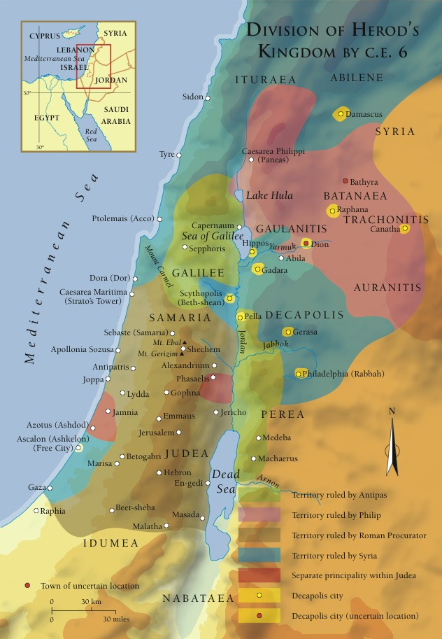
Matthew 15:21
And Jesus went away from there and withdrew to the district of Tyre and Sidon.
How might the events of 15:1-20 have influenced Jesus to withdraw to the district of Tyre and Sidon?
This territory is outside of Israel and would be inhabited mostly by Gentiles.

Slide 38
Matthew 15:22
“And behold, a Canaanite woman from that region came out and was crying, ‘Have mercy on me, O Lord, Son of David; my daughter is severely oppressed by a demon.’”
In Mark’s account, the woman is identified as a Gentile, a Syro-Phonecian by birth (7:26). What is the significance of and behold?
What does her coming to Jesus to request a healing tell us about Jesus?
Was crying (ekrazen) is in the imperfect tense, indicating the continuous appeal that she was making.
What was wrong with her daughter?
What do the two titles she used to describe Jesus tell the reader?
What is mercy?
What does this woman ask from Jesus?

Slide 39
Matthew 15:23
“But he did not answer her a word. And his disciples came and begged him, saying, ‘Send her away, for she is crying out after us.’”
What is unusual about Jesus’s action in this verse?
What are the disciples asking (the imperfect tense of “begged” emphasizes continuous asking) Jesus to do?
The text is ambiguous about whether they were asking that Jesus heal her daughter (“give her what she wants”) and send her away or send her away without healing the daughter.
Has Jesus ever turned away anyone before?

Slide 40
Matthew 15:24
“He answered, ‘I was sent only to the lost sheep of the house of Israel.’”
This reminds us of the instructions to the Twelve when He sent them on the limited commission: “Go nowhere among the Gentiles and enter no town of the Samaritans, but go rather to the lost sheep of the house of Israel” (10:5-6).
This is Jesus’s response to the disciples’ request to send the woman away.

Slide 41
Matthew 15:25
“But she came and knelt before him, saying, ‘Lord, help me.’”
Hearing the discussion between Jesus and His disciples, the woman ignores the disciples’ suggestion and again begs Jesus to help her.
What do we learn about the woman from what she did (knelt before him) and said (“Lord, help me!”)?

Slide 42
Matthew 15:26
“And he answered, ‘It is not right to take the children’s bread and throw it to the dogs.’”
What is your emotional reaction to what Jesus said to her?
R. T. France: “So Jesus is expressing the contemptuous Jewish attitude to Gentiles in order to explain why her request does not fit into his mission to Israel. But written words cannot convey a twinkle in the eye, and it may be that Jesus was almost jocularly presenting her with the sort of language she might expect from a Jew in order to see how she would react” (Matthew: An Introduction and Commentary, 250; cf. William Barclay, Matthew, 122).
Craig Blomberg: “Even at best, Jesus’ remarks still strike the modern reader as condescending. Jesus apparently wants to demonstrate and stretch this woman’s faith” (Matthew, 244).

Slide 43
Matthew 15:27
“She said, ‘Yes, Lord, yet even the dogs eat the crumbs that fall from their masters’ table.’”
The woman’s reply seems to be tongue-in-cheek (ironic). The woman’s argument is this: Given your illustration of the children’s bread being too important to be thrown to the dogs, yet even the dogs get the crumbs that fall from their master’s table.
“If I am a dog, give me my share!”
Her reply supports the idea that Jesus’s initial statement was somewhat light hearted or half-serious bantering between Jesus and the woman.

Slide 44
Matthew 15:28
“Then Jesus answered her, ‘O woman, great is your faith! Be it done for you as you desire.’ And her daughter was healed instantly.”
The word “O” in an emotional interjection.
Jesus’s reply changes the tone of the previous exchange and pays this woman a compliment: “great is your faith!” No other person receives this compliment in the Gospels.
Then, Jesus grants her request.
Her daughter was instantly healed (elsewhere, the demon is cast out).

Slide 45
Two Gentiles with Faith
Matthew 8:5-13 | Matthew 15:21-28
When he had entered Capernaum, a centurion came forward to him, appealing to him, “Lord, my servant is lying paralyzed at home, suffering terribly.” And he said to him, “I will come and heal him.” But the centurion replied, “Lord, I am not worthy to have you come under my roof, but only say the word, and my servant will be healed. For I too am a man under authority, with soldiers under me. And I say to one, ‘Go,’ and he goes, and to another, ‘Come,’ and he comes, and to my servant, ‘Do this,’ and he does it.” When Jesus heard this, he marveled and said to those who followed him, “Truly, I tell you, with no one in Israel have I found such faith. I tell you, many will come from east and west and recline at table with Abraham, Isaac, and Jacob in the kingdom of heaven, while the sons of the kingdom will be thrown into the outer darkness. In that place there will be weeping and gnashing of teeth.” And to the centurion Jesus said, “Go; let it be done for you as you have believed.” And the servant was healed at that very moment. | And Jesus went away from there and withdrew to the district of Tyre and Sidon. And behold, a Canaanite woman from that region came out and was crying, “Have mercy on me, O Lord, Son of David; my daughter is severely oppressed by a demon.” But he did not answer her a word. And his disciples came and begged him, saying, “Send her away, for she is crying out after us.” He answered, “I was sent only to the lost sheep of the house of Israel.” But she came and knelt before him, saying, “Lord, help me.” And he answered, “It is not right to take the children’s bread and throw it to the dogs.” She said, “Yes, Lord, yet even the dogs eat the crumbs that fall from their masters’ table.” Then Jesus answered her, “O woman, great is your faith! Be it done for you as you desire.” And her daughter was healed instantly. The chart on the following slide is prepared based on information in W.D.Davies and D.C. Allison’s Matthew, 2:558.

Slide 46
Parallels Between the Two Gentiles’ Faith
The Centurion (8:5-13) | The Canaanite Woman (15:21-28)
A despised Gentile: a military officer (8:5, 9) | A despised Gentile: a Canaanite woman (15:22)
Asks a favor from Jesus: healing of servant (8:6) | Asks a favor of Jesus: healing of daughter (15:22)
Calls Jesus “Lord” (8:6, 8) | Calls Jesus “Lord” (15:22, 25, 27)
Text focuses on the conversation, not the miracle (8:8-9) | Text focuses on the conversation, not the miracle (15:26-27)
Initial hesitation by Jesus (8:7) | Initial hesitation by Jesus (15:23-24)
Gentile makes an astounding statement of faith (8:8-9) | Gentile makes an astounding statement of faith (15:22, 25, 27)
Jesus compliments his faith (8:10) | Jesus compliments her faith (15:28)
Jesus agrees to heal the servant (8:13) | Jesus agrees to heal the servant (15:28)
Servant immediately healed (8:13) | Daughter Immediately healed (15:28

Slide 47
What Is Going On?
Why would Matthew include these two cases of Jesus’s interaction with Gentiles?
What are these texts saying?

Slide 48
Summary Statement about Healing Matthew 15:29-31
Jesus went on from there and walked beside the Sea of Galilee. And he went up on the mountain and sat down there. And great crowds came to him, bringing with them the lame, the blind, the crippled, the mute, and many others, and they put them at his feet, and he healed them, so that the crowd wondered, when they saw the mute speaking, the crippled healthy, the lame walking, and the blind seeing. And they glorified the God of Israel.

Slide 49
Matthew 15:29
“Jesus went on from there and walked beside the Sea of Galilee. And he went up on the mountain and sat down there.”
Mark states that Jesus went to the region of the Decapolis, which is also Gentile area (7:31).
Mark recounts the healing of a deaf mute (7:32-37), but Matthew mentions that many others were healed.

Slide 50
Matthew 15:30
“And great crowds came to him, bringing with them the lame, the blind, the crippled, the mute, and many others, and they put them at his feet, and he healed them, . . .”
The ones healed (the lame, the blind, the crippled, the mute, etc.) reminds one of Isaiah 35:5-6 and Matthew 11:5.
The response of the Gentiles contrasts with the reception Jesus received at Nazareth when not many were healed (Matt. 13:53-58).
The reference to the people being with Jesus for three days (v. 32), not only allows for many miracles but presumes Jesus taught there as well.
Crippled (kullos): “of a limb of the human body that is in any way abnormal or incapable of being used” (BDAG, 575). Cf. Matt. 12:13.
Put (riptō): “1. to propel something with a forceful motion, throw. . . 2. with no connotation of violence, but context may indicate some degree of rapidity, put/lay something down” (BDAG, 906).

Slide 51
Matthew 15:31
“. . . so that the crowd wondered, when they saw the mute speaking, the crippled healthy, the lame walking, and the blind seeing. And they glorified the God of Israel.”
What was the result of Jesus’s miracles?
What does the phrase “glorified the God of Israel” tell us about those whom Jesus is teaching?
What does it tell us about God’s relationship with Israel?

Slide 52
The Parallel Narrative in Mark
“Then he returned from the region of Tyre and went through Sidon to the Sea of Galilee, in the region of the Decapolis. And they brought to him a man who was deaf and had a speech impediment, and they begged him to lay his hand on him. And taking him aside from the crowd privately, he put his fingers into his ears, and after spitting touched his tongue. And looking up to heaven, he sighed and said to him, ‘Ephphatha,’ that is, ‘Be opened.’ And his ears were opened, his tongue was released, and he spoke plainly. And Jesus charged them to tell no one. But the more he charged them, the more zealously they proclaimed it. And they were astonished beyond measure, saying, ‘He has done all things well. He even makes the deaf hear and the mute speak’” (7:31-37).

Slide 53
Miraculous Feeding of the 4000 Matthew 15:32-39
Then Jesus called his disciples to him and said, “I have compassion on the crowd because they have been with me now three days and have nothing to eat. And I am unwilling to send them away hungry, lest they faint on the way.” And the disciples said to him, “Where are we to get enough bread in such a desolate place to feed so great a crowd?” And Jesus said to them, “How many loaves do you have?” They said, “Seven, and a few small fish.” And directing the crowd to sit down on the ground, he took the seven loaves and the fish, and having given thanks he broke them and gave them to the disciples, and the disciples gave them to the crowds. And they all ate and were satisfied. And they took up seven baskets full of the broken pieces left over. Those who ate were four thousand men, besides women and children. And after sending away the crowds, he got into the boat and went to the region of Magadan.

Slide 54
Matthew 15:32
“Then Jesus called his disciples to him and said, ‘I have compassion on the crowd because they have been with me now three days and have nothing to eat. And I am unwilling to send them away hungry, lest they faint on the way.’”
Both Matthew (cf. 14:13-21) and Mark (6:32-44) treat the feeding of the 5000 and 4000 as separate events.
Matthew later mentions both miracles: “And they began discussing it among themselves, saying, ‘We brought no bread.’ But Jesus, aware of this, said, ‘O you of little faith, why are you discussing among yourselves the fact that you have no bread? Do you not yet perceive? Do you not remember the five loaves for the five thousand, and how many baskets you gathered? Or the seven loaves for the four thousand, and how many baskets you gathered? How is it that you fail to understand that I did not speak about bread? Beware of the leaven of the Pharisees and Sadducees’” (Matt. 16:7-11).

Slide 55
Differences in the Two Events
Difference | Feeding of the 5000 | Feeding of the 4000
Number fed | 5000 | 4000
Location | Bethsaida (Luke 9:10) | Region of Decapolis
People who were fed | Jewish | Gentile
Need | Missing an evening meal | Danger of fainting on the way home because they had been with Jesus three days
Dialogue | Disciples initiate the need for food | Jesus initiates the need for food
Number of baskets of leftovers | Twelve | Seven

Slide 56
Compassion
The Greek word splagchnizomai means “have pity, feel sympathy” (BDAG, 938). It appears 12 times, only in the gospels.
The word is derived from the noun splagchnon, “the inwards of the body. . . . As often in the ancient world, inner body parts served as referents for psychological effects” (ibid.). Think of “bowels of compassion,” the seat and source of love, sympathy, mercy, affection, much as we use the word “heart.”
The use of splagchnizomai in the New Testament:
It is used of what Jesus felt (Matt. 9:36; 14:14; 15:32; 20:34; Mark 1:41; 6:34; 8:2; Luke 7:13).
Jesus used it in parables to portray divine love and forgiveness (Matt. 18:27; Luke 15:20).
Sometimes people begged Jesus to show compassion (Mark 9:22).
Jesus used it to describe what the Good Samaritan did (Luke 10:33).
What is the opposite of having compassion?
How well do you rate yourself in having compassion?

Slide 57
Matthew 15:33
“And the disciples said to him, ‘Where are we to get enough bread in such a desolate place to feed so great a crowd?’”
The disciples see no way to meet the needs of such a great crowd.
Was Jesus implying that the disciples should do something to take care of the need?
Their thinking is limited to the natural means of supplying food; they knew that Jesus did not miraculously feed large crowds regularly.

Slide 58
Matthew 15:34
“And Jesus said to them, ‘How many loaves do you have?’ They said, ‘Seven, and a few small fish.’”
The point is to emphasize the impossibility of feeding such a large crowd with so few resources.
One might think of other miracles Jesus performed with fish:
Two miracle of the catching large quantities of fish after unsuccessfully fishing all night.
Peter’s finding a coin in a fish’s mouth.

Slide 59
Matthew 15:35-36
“And directing the crowd to sit down on the ground, he took the seven loaves and the fish, and having given thanks he broke them and gave them to the disciples, and the disciples gave them to the crowds.”
The phrase “having given thanks he broke them and gave them to the disciples” reminds us of similar words spoken at the institution of the Lord’s supper.

Slide 60
Matthew 15:37
“And they all ate and were satisfied. And they took up seven baskets full of the broken pieces left over.”
The need was fully met: All ate and were satisfied!
Seven baskets:
A different word is used for “basket” than appeared in the feeding of the 5000.
Some attribute the difference to the audience (Jews vs. Greek) and some make a point about the different sizes of the two baskets. But both words are general words for “basket” without reference to the size of the basket.
The point is this: The meal was more than adequate! Jesus provide sufficient food for all who were present.
Contrast to the host of the wedding in Cana who ran out of wine!

Slide 61
Matthew 15:38
“Those who ate were four thousand men, besides women and children.”
As was the case of the counting of the size of the crowd of 5000 (see 14:21), the number does not include women and children. The total number fed could easily be as high as 10,000 in either instance.

Slide 62
Matthew 15:39
“And after sending away the crowds, he got into the boat and went to the region of Magadan.”
The parallel in Mark reads as follows: “And immediately he got into the boat with his disciples and went to the district of Dalmanutha.”
Neither Magadan nor Dalmanutha are known places. Because of this, textual variant readings occur in the ancient manuscripts. Many commentaries associate this with Magdala, where Mary Magdalene lived.
We will have to wait for more archaeological excavations to solve the mystery.
However, most commentaries believe that Jesus left the Decapolis and journeyed to the northwest side of the Sea of Galilee, based on the comment in 16:5—“When the disciples reached the other side, they had forgotten to bring any bread” (which presupposes a trip to the west side of the Sea of Galilee).

