Slide 2
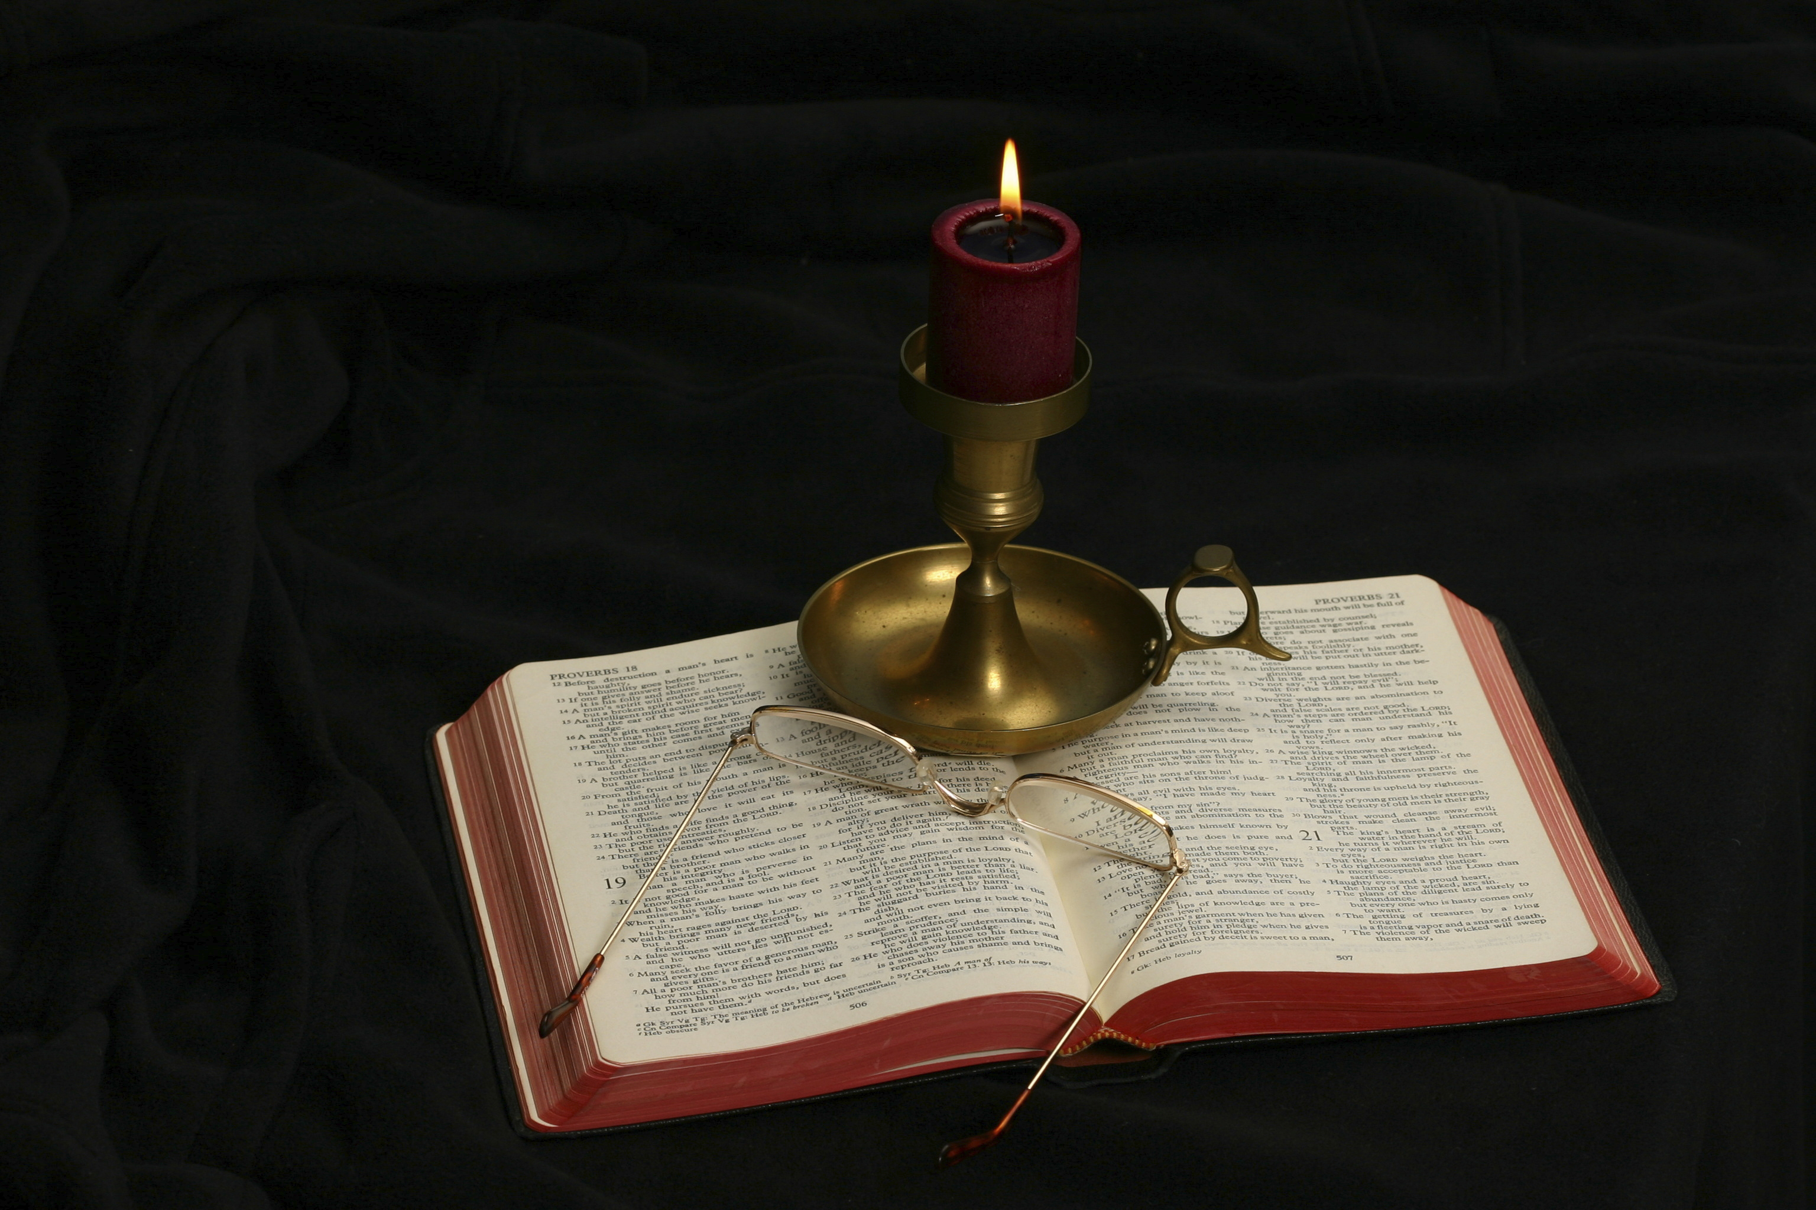
The Gospel of Matthew
Chapter 16

Slide 3
Outline of the Chapter
The demand for a sign (16:1-4)
Warning against the influence of Jewish leaders (16:5-12)
Jesus Is the Messiah (16:13-20)
Ministry in Galilee: Preparing the Disciples (16:21-18:35)
First announcement of Jesus’s suffering and death (16:21-23)
The cost discipleship (16:24-28)

Slide 4
The Demand for a Sign Matthew 16:1-4
And the Pharisees and Sadducees came, and to test him they asked him to show them a sign from heaven. He answered them, “When it is evening, you say, ‘It will be fair weather, for the sky is red.’ And in the morning, ‘It will be stormy today, for the sky is red and threatening.’ You know how to interpret the appearance of the sky, but you cannot interpret the signs of the times. An evil and adulterous generation seeks for a sign, but no sign will be given to it except the sign of Jonah.” So he left them and departed.

Slide 5
Matthew 16:1
“And the Pharisees and Sadducees came, and to test him they asked him to show them a sign from heaven.”
It is quite unusual for the Pharisees and Sadducees to cooperate on any mission, but common enemies make strange bedfellows!
It is an indication of the growing hostility toward Jesus.
To test (peirazō): “to attempt to entrap through a process of inquiry, test” (BDAG, 793). This is the same word as appears in 4:3, of the Devil tempting Jesus.
To show (epideixō): “to cause to be seen, show, point out” (BDAG, 370). The second definition “to demonstrate that something is true, demonstrate, show” (ibid.) seems to be the best definition in this context.
A sign from heaven: a miraculous display that would show God was with Jesus. Elsewhere, sign is used of the miracles Jesus has already been performing.
It could be either a sign emerging from the heavens (an extraordinary event coming from the sky) or a sign coming from the realm of God.

Slide 6
Matthew 16:2-3
“He answered them, ‘When it is evening, you say, “It will be fair weather, for the sky is red.” And in the morning, “It will be stormy today, for the sky is red and threatening.” You know how to interpret the appearance of the sky, but you cannot interpret the signs of the times.’”
Jesus is referring to the ordinary weather patterns in Palestine (not everywhere in the world).
If the western sky is red in the evening, the next day will be a fair day (rain and storms come for the Mediterranean).
If the sky is red and threatening in the morning, the storm will come that day.
Cf. sailor’s saying, “Red sky at morning, sailors take warning. Red sky at night, sailors delight.”
These verses are omitted in some important manuscripts, perhaps because the weather patterns of these verses may not have fitted the places where the manuscripts were written.

Slide 7
The Point?
What is the point of vv. 2-3?
We have weather forecasters who have studied the heavens (wind currents and weather patterns) enough to rather accurately predict weather for the next day.
However, the religious leaders seemed altogether ignorant of the significant signs that God was giving through the ministry of Jesus that the prophesied Messiah and kingdom of God was at hand!

Slide 8
Matthew 16:4
“An evil and adulterous generation seeks for a sign, but no sign will be given to it except the sign of Jonah.” So he left them and departed.”
This verse is virtually the same as 12:39 (“But he answered them, ‘An evil and adulterous generation seeks for a sign, but no sign will be given to it except the sign of the prophet Jonah.’”).
What is the significance of “evil and adulterous generation”?
What is the sign of Jonah and what does it mean?
What is the significance of “so he left them and departed”?

Slide 9
Warning Against the Influence of Jewish Leaders Matthew 16:5-12
When the disciples reached the other side, they had forgotten to bring any bread. Jesus said to them, “Watch and beware of the leaven of the Pharisees and Sadducees.” And they began discussing it among themselves, saying, “We brought no bread.” But Jesus, aware of this, said, “O you of little faith, why are you discussing among yourselves the fact that you have no bread? Do you not yet perceive? Do you not remember the five loaves for the five thousand, and how many baskets you gathered? Or the seven loaves for the four thousand, and how many baskets you gathered? How is it that you fail to understand that I did not speak about bread? Beware of the leaven of the Pharisees and Sadducees.” Then they understood that he did not tell them to beware of the leaven of bread, but of the teaching of the Pharisees and Sadducees.

Slide 10
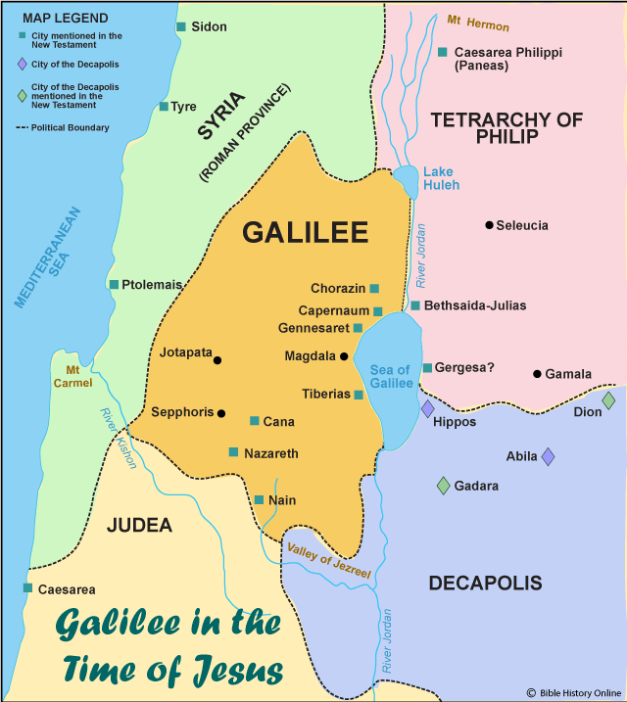

Slide 11
Matthew 16:5
“When the disciples reached the other side, they had forgotten to bring any bread.”
What does “the other side” mean?
Jesus is headed for the eastern side of the Sea of Galilee (as indicated by their arrival at Bethsaida, Mark 8:22).
Matthew’s explanation of the concern for physical bread provides the background for the comments on the leavening of the Jewish leaders.

Slide 12
Matthew 16:6
“Jesus said to them, ‘Watch and beware of the leaven of the Pharisees and Sadducees.’”
The reference to the “Pharisees and Sadducees” ties these verses to 16:1-4, where the two groups united to test Jesus.
Leaven (zumē): “1. fermented dough, leaven . . . . 2. that which negatively permeates attitude and behavior” (BDAG, 429). It was a piece of last week’s dough used to make this week’s dough rise.
Jesus is obviously using “leaven” in a figurative sense; the disciples are pre-occupied with physical bread.
Jesus requires vigilance on the part of His disciples.
Watch (horaō): used here to mean “to be alert or on guard, pay attention, see to it” (BDAG, 720).
Beware (prosechō): “to be in a state of alert, be concerned about, care for, take care” (BDAG, 879). The addition of this verb gives emphasis to the command.
What does Jesus require of us regarding the harmful influences of our day?

Slide 13
Matthew 16:7
“And they began discussing it among themselves, saying, ‘We brought no bread.’”
The thoughts of the Twelve were on physical bread or food.
They were talking among themselves about what they had done.
This is a good example of noting the dangers of miscommunication—using words you intend to be understood one way but are taken with a different meaning.

Slide 14
Matthew 16:8
“But Jesus, aware of this, said, ‘O you of little faith, why are you discussing among yourselves the fact that you have no bread?’”
How is their misunderstanding connected to littleness of faith?
John Nolland: “He makes of this another ‘[you people of] little faith’ statement by adding ὀλιγόπιστοι, thus providing links back to the (doubted) promise of God’s provision of clothing in 6:31, to the cowardice of the disciples when they lost sight in the storm of the reality of the power and presence of their Lord in 8:26, and to the doubting of Peter that caused him to sink into the waves in 14:31. The focus here on lack of bread belongs with this set of inappropriate responses precisely because it also evidences a lack of confidence in God’s provision and care, as now focused in Jesus” (The Gospel of Matthew: A Commentary on the Greek Text, New International Greek Testament Commentary, 653).

Slide 15
Matthew 16:9-10
“Do you not yet perceive? Do you not remember the five loaves for the five thousand, and how many baskets you gathered? Or the seven loaves for the four thousand, and how many baskets you gathered?”
The allusion to the separate feedings of the 5000 and 4000 is confirmation that these were two separate miracles, not two different accounts of one miracle.
What message should the disciples have learned from the two feedings?
What is the significance of “not yet”?
Why should the disciples worry about feeding 13 people when Jesus was with them?

Slide 16
What Jesus Wanted Them So Understand
“The thought is: ‘The feedings of the five thousand and four thousand are symbolic of my teaching which is all-sufficient for you. You do not need the teaching of my enemies, and you must beware of it.’” But there is no mention of the “leaven” of Jesus, nor any reference to his teaching. We may agree that the two miraculous feedings teach important spiritual lessons, but at this point it is rather the fact of their showing Jesus’ capacity to supply bread than these lessons that is to the fore” (quoted by Leon Morris in The Gospel according to Matthew, The Pillar New Testament, 417).

Slide 17
Matthew 16:11
“How is it that you fail to understand that I did not speak about bread? Beware of the leaven of the Pharisees and Sadducees.”
What does Jesus mean by “the leaven of the Pharisees and Sadducees”?
What difference existed in their teachings?
Characteristic doctrines of the Pharisees (Matt. 15:1-9).
Characteristic doctrines of the Sadducees (Acts 23:8).
Mark has “the leaven of the Pharisees and the leaven of Herod” (8:15). What is the leaven of Herod?
What did the Pharisees and Sadducees agree upon that enabled them to work together against Jesus?
What leavens do you and I have to beware?

Slide 18
Matthew 16:12
“Then they understood that he did not tell them to beware of the leaven of bread, but of the teaching of the Pharisees and Sadducees.”
A “eureka” moment!

Slide 19
Jesus Is the Messiah Matthew 16:13-20
Now when Jesus came into the district of Caesarea Philippi, he asked his disciples, “Who do people say that the Son of Man is?” And they said, “Some say John the Baptist, others say Elijah, and others Jeremiah or one of the prophets.” He said to them, “But who do you say that I am?” Simon Peter replied, “You are the Christ, the Son of the living God.” And Jesus answered him, “Blessed are you, Simon Bar-Jonah! For flesh and blood has not revealed this to you, but my Father who is in heaven. And I tell you, you are Peter, and on this rock I will build my church, and the gates of hell shall not prevail against it. I will give you the keys of the kingdom of heaven, and whatever you bind on earth shall be bound in heaven, and whatever you loose on earth shall be loosed in heaven.” Then he strictly charged the disciples to tell no one that he was the Christ.

Slide 20
Introduction to Matthew 16:13-20
Matthew made clear at the outset that Jesus was the Son of David who was the Messiah (1:1–4:16).
At Jesus’s baptism, God identified who Jesus was (3:17).
The demons that Jesus cast out recognized Jesus (8:29).
Yet, Jesus has not made a specific declaration that He is the Messiah to His disciples. The prediction of Jesus’s death, burial, and resurrection, followed by Peter’s comment, shows the disciples’ inaccurate understanding of what it meant to be the Messiah.

Slide 21
Matthew 16:13
“Now when Jesus came into the district of Caesarea Philippi, he asked his disciples, ‘Who do people say that the Son of Man is?’”
Jesus has traveled about 25 miles north to Caesarea Philippi, at the foot of Mount Hermon.
The place was formerly known as Banias and Paneas, a place where the Greek fertility god Pan (generally represented as a vigorous and lustful figure having the horns, legs, and ears of a goat) was worshiped. Philip the tetrarch had recently changed the name of the city to honor Augustus Caesar and himself.
The springs located there are one of the headwaters of the Jordan River.
Jesus and the Twelve are in Gentile country without crowds coming to Him for teaching and healing.
Jesus would be crucified in less than a year; this retreat allowed Jesus to prepare them for what lay ahead.

Slide 22
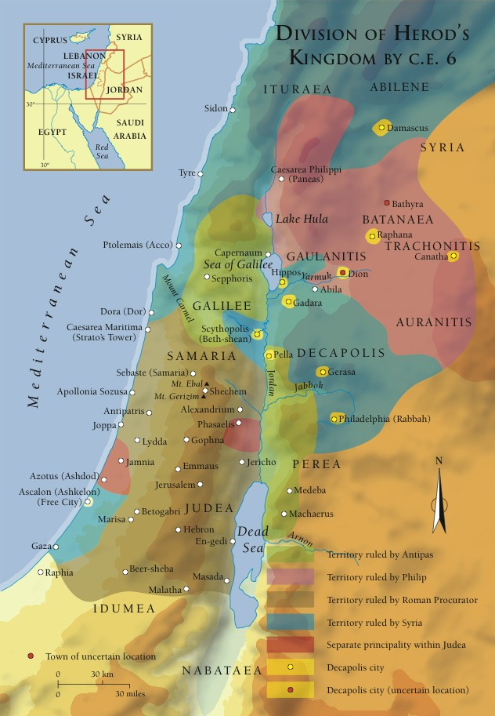
Caesarea

Slide 23
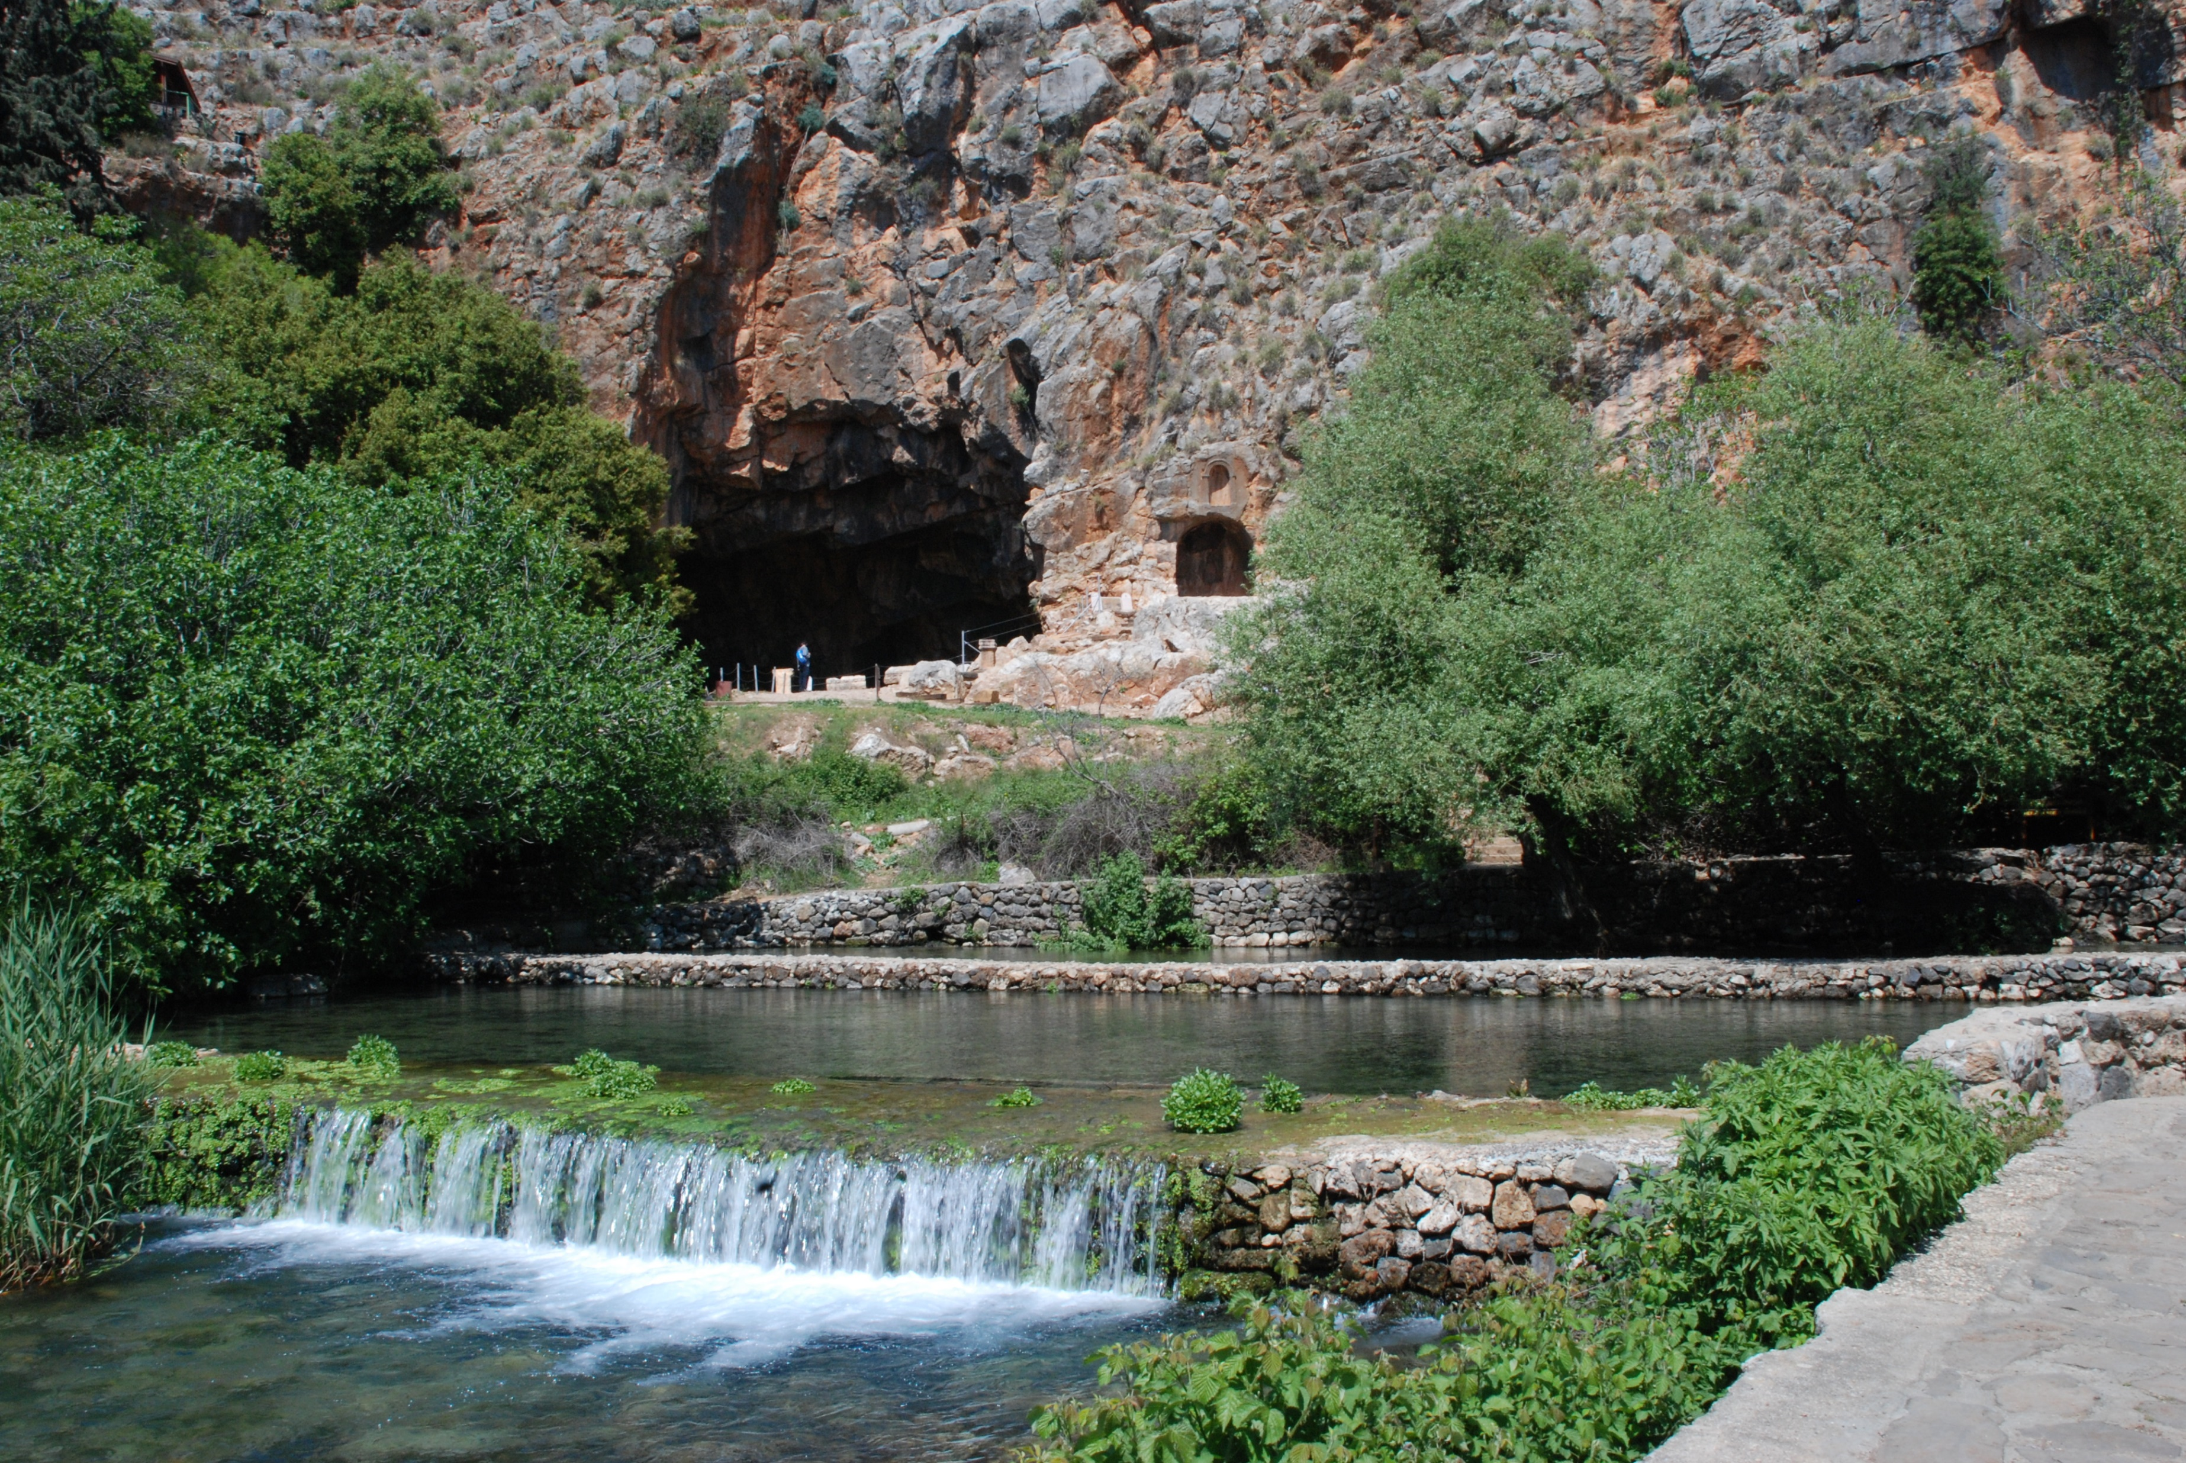
Caesarea Philippi

Slide 24
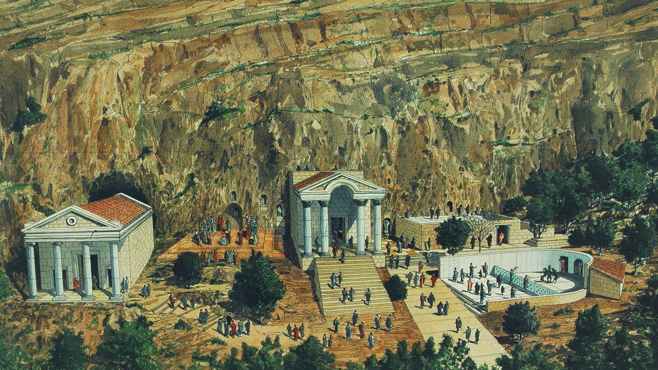
Artist Drawing of Ancient Caesarea Philippi

Slide 25
Jesus’s Question for His Disciples
“Who do people say that the Son of Man is?”
Already we know. . .
The family of Jesus think Jesus has lost His mind.
The village of Nazareth would not accept Jesus.
Herod Antipas thought Jesus was John the Baptist risen from the dead.
Jesus asked His disciples what people were saying about the “Son of Man.”
This is one of the self-designations Jesus used.

Slide 26
Matthew 16:14
And they said, “Some say John the Baptist, others say Elijah, and others Jeremiah or one of the prophets.”
The common feature of John, Elijah, and Jeremiah is that all of them were prophets. Jesus had said that John was “more than a prophet” (11:9).
A prophet is a spokesman for God.
The Jews were expecting a prophet like Moses:
“The Lord your God will raise up for you a prophet like me from among you, from your brothers—it is to him you shall listen. . . .And the Lord said to me, ‘They are right in what they have spoken. I will raise up for them a prophet like you from among their brothers. And I will put my words in his mouth, and he shall speak to them all that I command him. And whoever will not listen to my words that he shall speak in my name, I myself will require it of him” (Deut. 18:15, 18).
All of these opinions are complimentary of Jesus.

Slide 27
Matthew 16:15
“He said to them, ‘But who do you say that I am?’”
The previous question was about the thoughts of the general populace. This question is about the disciples.
Jesus equates “Son of Man” (v. 13) with Himself (“I”).
Already the disciples had made significant statement about who Jesus is.
“And the men marveled, saying, ‘What sort of man is this, that even winds and sea obey him?’” (Matt. 8:27).
“And those in the boat worshiped him, saying, ‘Truly you are the Son of God’” (Matt. 14:33).
Why was the conviction of the Apostles important to Jesus?

Slide 28
Matthew 16:16
“Simon Peter replied, ‘You are the Christ, the Son of the living God.’”
We are not surprised that Peter is the one to answer for the group.
John 1:40-41 records that Andrew said to Peter when he first saw Jesus, “We have found the Messiah.”
What is the significance of the word “Christ”?
What did that mean to the disciples? To Jesus?
What is the significance of “Son of … God”?
What is the significance of “living God”?

Slide 29
Matthew 16:17
“And Jesus answered him, ‘Blessed are you, Simon Bar-Jonah! For flesh and blood has not revealed this to you, but my Father who is in heaven.’”
Verses 17-19 do not appear in Mark or Luke’s account.
These verses are interpreted by Roman Catholic scholars as Jesus appointing Peter to be the first pope, head of the universal church.
Simon Bar-Jonah (Simon, son of John) gives the full Hebrew name of Peter.
In John 1:42; 21:15, 16, 17 states that Peter is “the son of John” (almost all translations except KJV and NKJV).
The Greek word Bariōna is “a legitimate transliteration and abbreviation of bar Johanon” (Blomberg, 251).

Slide 30
Blessed Are You
Blessed when used of humans refers to those who were “privileged recipients of divine favor” (BDAG, 611).
Peter did not learn who Jesus was from other humans (flesh and blood), but through divine revelation.
“At that time Jesus declared, ‘I thank you, Father, Lord of heaven and earth, that you have hidden these things from the wise and understanding and revealed them to little children; yes, Father, for such was your gracious will. All things have been handed over to me by my Father, and no one knows the Son except the Father, and no one knows the Father except the Son and anyone to whom the Son chooses to reveal him’” (Matt. 11:25-27).

Slide 31
Matthew 16:18
And I tell you, you are Peter, and on this rock I will build my church, and the gates of hell shall not prevail against it.
And I tell you marks the following words of great importance.
There is a word-play in Greek between Peter (Petros) and rock (petra).
Some scholars (mostly Roman Catholic) have understood this to mean that Peter is the rock on which the church is built, as the first pope of the church.
If Peter was given chief place by this statement, how does one explain Matthew 18:1?
Others think that the affirmation that Peter had just made (“You are the Christ, the Son of the living God”) is the rock on which the church will be built.
This is confirmed by many other Scriptures.
The word play emphasizes the character of Peter (compare other nicknames: Peewee, Dumbo, and “Rocky” in the movies). What does this nickname say about Peter?

Slide 32
What Is the Foundation Stone?
“According to the grace of God given to me, like a skilled master builder I laid a foundation, and someone else is building upon it. Let each one take care how he builds upon it. For no one can lay a foundation other than that which is laid, which is Jesus Christ” (1 Cor. 3:10-12).
“For it stands in Scripture: ‘Behold, I am laying in Zion a stone, a cornerstone chosen and precious, and whoever believes in him will not be put to shame.’ So the honor is for you who believe, but for those who do not believe, ‘The stone that the builders rejected has become the cornerstone,’ and ‘A stone of stumbling, and a rock of offense.’ They stumble because they disobey the word, as they were destined to do” (1 Pet. 2:6-8).
“So then you are no longer strangers and aliens, but you are fellow citizens with the saints and members of the household of God, built on the foundation of the apostles and prophets, Christ Jesus himself being the cornerstone, in whom the whole structure, being joined together, grows into a holy temple in the Lord. In him you also are being built together into a dwelling place for God by the Spirit” (Eph. 2:19-21).

Slide 33
What Is the Foundation Stone?
“. . . therefore thus says the Lord God, “Behold, I am the one who has laid as a foundation in Zion, a stone, a tested stone, a precious cornerstone, of a sure foundation: ‘Whoever believes will not be in haste’” (Isa. 28:16).
“The stone that the builders rejected has become the cornerstone. This is the Lord’s doing; it is marvelous in our eyes” (Psa. 118:22-23; quoted in Matt. 21:42; Mark 12:10; Luke 20:17; Acts 4:11).
The church is built on the solid rock foundation: Jesus is the Christ, the Son of the Living God!

Slide 34
Church
The word “church” only appears three times in the gospels (Matt. 16:18; 18:17[2x]), but 114 times in the New Testament.
Ekklēsia can be used of any assembly (Acts 19:32, 40), but is the word chosen to describe the community of people who are drawn together by their common faith that Jesus is the Christ, the Son of the living God.”
The word has two significant uses: (1) the universal church; (2) the local congregations. Because it is singular, the meaning in this text must be the universal church.
The significance of this noun being singular is seen by Paul’s comment in Eph. 4:4—“there is one body.”
Who brought the church into existence?

Slide 35
The Gates of Hell
The “gates of Hades” means “the gates of death.” “To say that the powers of death (so RSV, correctly) shall not prevail against the community is thus to say that it will not die, and be shut in by the ‘gates of death’” (R. T. France, Matthew: An Introduction and Commentary, 258).
The gates of Hades did not prevent its being established.
The gates of Hades will not cause it to go out of existence.

Slide 36
Matthew 16:19
“I will give you the keys of the kingdom of heaven, and whatever you bind on earth shall be bound in heaven, and whatever you loose on earth shall be loosed in heaven.”
The Greek verbs are perfect passive participles: “shall have been bound in heaven” and “shall have been loosed in heaven.”
It is not that heaven is waiting to see what Peter decides to bind or loose on mankind, but Peter is communicating to the disciples what heaven has already determined to be bound or loose.
This same blessing was given to all the disciples in 18:18.

Slide 37
Matthew 16:20
“Then he strictly charged the disciples to tell no one that he was the Christ.”
How would a wider audience understand what Jesus is “the Christ” meant?
Even the apostles did not understand what being Christ would mean.

Slide 38
A New Section
Several commentaries make a significant break in the outline of Matthew’s gospel at this point.
This is identified by “From that time” with which this section is introduced. This matches the introduction to 4:17–16:20, culminating in Peter’s confession.
The new section (16:21–18:35) will focus on private instruction to the disciples.
It will include Christ’s fourth sermon (18:1-35).

Slide 39
Structure of 16:21–17:27
This section has three similarly structured parts:
Jesus gives a teaching
A response from Peter
Further teaching in light of Peter’s response, but with implications for all of the disciples.
The three sections:
First exchange concerning Jesus’s death (16:21-28)
The transfiguration (17:1-21)
Second prediction of Jesus’s death (17:22-27)

Slide 40
Jesus’s First Prediction of His Death Matthew 16:21-23
“From that time Jesus began to show his disciples that he must go to Jerusalem and suffer many things from the elders and chief priests and scribes, and be killed, and on the third day be raised. And Peter took him aside and began to rebuke him, saying, ‘Far be it from you, Lord! This shall never happen to you.’ But he turned and said to Peter, ‘Get behind me, Satan! You are a hindrance to me. For you are not setting your mind on the things of God, but on the things of man.’”

Slide 41
Matthew 16:21
“From that time Jesus began to show his disciples that he must go to Jerusalem and suffer many things from the elders and chief priests and scribes, and be killed, and on the third day be raised.”
Jesus and His disciples are still at Caesarea Philippi.
Peter’s confession that Jesus is the Messiah (Christ), the Son of God has just occurred.
Jesus announces His intention to go to Jerusalem.
Why are Jesus words so shocking to the Twelve?
What kind of leader would typically be in the mind of Jews when they thought of “Christ”?
What do we learn about Jesus from this verse?

Slide 42
Significant Points
One might sense the hostility from Jewish leaders and foresee a confrontation, without divine revelation. But, the prediction of resurrection places this statement in a different light.
“Elders, chief priests, and scribes” were the three groups who together made up the Sanhedrin. Jesus is to be officially executed.
Jesus said that He “must go” to Jerusalem. What was compelling Him?

Slide 43
Matthew 16:22
“And Peter took him aside and began to rebuke him, saying, ‘Far be it from you, Lord! This shall never happen to you.’”
Given Peter’s confession of who Jesus is, “the Christ, the Son of the Living God,” how consistent is it for him to rebuke Jesus? Under what assumptions is Peter acting?
The word rebuke (epitimaō) means “to express strong disapproval of someone, rebuke, reprove, censure also speak seriously, warn in order to prevent an action or bring one to an end” (BDAG, 384).
Far be it from is translated from hileōs which means “to be favorably disposed, with implications of overcoming obstacles that are unfavorable to a relationship, gracious, merciful. . . .” Specifically in this verse, “may God be gracious to you, Lord, i.e., may God in mercy spare you this, God forbid!” (BDAG, 474).

Slide 44
Matthew 16:23
“But he turned and said to Peter, ‘Get behind me, Satan! You are a hindrance to me. For you are not setting your mind on the things of God, but on the things of man.’”
What is the significance of the difference in how Peter is described in v. 18 and in v. 23?
In v. 16 to what kind of “rock” is Peter compared? To what kind of rock is he compared in v. 23?
Skandalon (hindrance) is a stone that causes one to stumble!
What is the temptation Peter places before Jesus?
Who else had placed that same temptation before Him?
What was Peter thinking?

Slide 45
The Cost of Discipleship Matthew 16:24-28
Then Jesus told his disciples, “If anyone would come after me, let him deny himself and take up his cross and follow me. For whoever would save his life will lose it, but whoever loses his life for my sake will find it. For what will it profit a man if he gains the whole world and forfeits his soul? Or what shall a man give in return for his soul? For the Son of Man is going to come with his angels in the glory of his Father, and then he will repay each person according to what he has done. Truly, I say to you, there are some standing here who will not taste death until they see the Son of Man coming in his kingdom.”

Slide 46
Matthew 16:24
“Then Jesus told his disciples, ‘If anyone would come after me, let him deny himself and take up his cross and follow me.’”
This text reminds us of 10:38-39.
What is your reaction to Jesus’s demands for discipleship?
What does it mean for us and what does it require?
In the context of Jesus’s prediction of His own death, “deny himself” is not some sort of mild asceticism (“I won’t eat chocolates for a week”), but a willingness to renounce his right to life.
Is there an allusion to Peter and his denial in Jesus’s words?
Self-denial means putting God and His kingdom first in one’s life.
Davies and Allison: “Discipleship is a doing of what is right, no matter how irksome the privations, no matter how great the dangers” (2:681).
Would (thelō) is a word designating a free-will choice.

Slide 47
Take Up His Cross
Men were familiar with Roman crucifixion, in which the condemned criminal carried the crossbar of the cross to the place of execution.
John Nolland: “. . . ‘place yourself on the firing line’, ‘put your neck in the noose,’ and ‘put your head on the chopping block’ would all be analogous to what is called for here. The call is so to behave that the anticipated outcome may naturally be the loss of one’s life. There is a radical denial of self-interest and normal concern for one’s own well-being here” (The Gospel of Matthew: A Commentary on the Greek Text, New International Greek Testament Commentary, 691).

Slide 48
Matthew 16:25
“For whoever would save his life will lose it, but whoever loses his life for my sake will find it.
Compare to 10:39.
This is a “paradox”: “a statement that is seemingly contradictory or opposed to common sense and yet is perhaps true.”
What does Jesus mean when He speaks of one who would “save his life”?
What does Jesus mean when He speaks of one who would “loses his life”?
Is Jesus’s meaning limited to eternity or does it have meaning for earthly life? (i.e., if one spends one’s life pursuing one’s own selfish interests, has that one lost the true meaning of life?)

Slide 49
Matthew 16:26
“For what will it profit a man if he gains the whole world and forfeits his soul? Or what shall a man give in return for his soul?”
Jesus may be illustrating His point by reducing self-centered living to its ultimate foolishness: “If I could gain the combined possessions of Elon Musk and Bill Gates, but to gain them I had to be killed, what is the profit?
But, of course, Jesus is contrasting the relative value of “the whole world”/one’s soul.
Is it the soul’s value to the one having it or is that God’s assessment of the soul?
Read Psalm 49.

Slide 50
Matthew 16:27
“For the Son of Man is going to come with his angels in the glory of his Father, and then he will repay each person according to what he has done.”
The Son of Man (Messiah) refers to Jesus.
Coming with his angels shows the superiority of Jesus to the angels.
The end will be ushered in by the coming of the Son of Man.
Coming in the glory of his Father also emphasizes the unity of the Father and the Son.
His second coming will be in glory, in contrast to His first coming.
His basis for judgment is according to what he has done.

Slide 51
Matthew 16:28
“Truly, I say to you, there are some standing here who will not taste death until they see the Son of Man coming in his kingdom.”
Truly, I say to you gives this verse emphasis: “I am telling you the truth.”
Jesus announces that the kingdom will come before those to whom He preached would die.

Slide 52
Uses of “Kingdom”: Heaven
The kingdom is used to describe the eternal blessings of heaven.
The kingdom on earth will be taken into heaven. Hence, it is a kingdom that cannot be shaken (Heb. 12:28) that will be delivered up to God (1 Cor. 15:24).
Therefore, Jesus frequently spoke of the kingdom as the equivalent in meaning to heaven.
Matt. 19:23-30. Being a part of the kingdom was equivalent to being “saved” and having “eternal life.”
Matt. 25:34. Inheriting the kingdom is equivalent to “heaven.”
Mark 9:47. Entering the kingdom is the opposite of being cast into hell.

Slide 53
Uses of “Kingdom”: The Church
The kingdom is God’s eternal church.
The kingdom which Jesus preached was near at hand (Matt. 4:17).
Some who were alive would not die until they say it established (Mark 9:1).
He gave the “keys of the kingdom” to Peter, which keys were to the church (Matt. 16:16-19).
It is a spiritual kingdom (John 18:36) that does not come with observation (Luke 17:20-21).
The “fruit of the vine” is drunk in the kingdom (Matt. 26:29).
The kingdom of Christ came on the day of Pentecost. Those who were “born again” were citizens in that kingdom (John 3:3, 5; Col. 1:13-14).

Slide 54
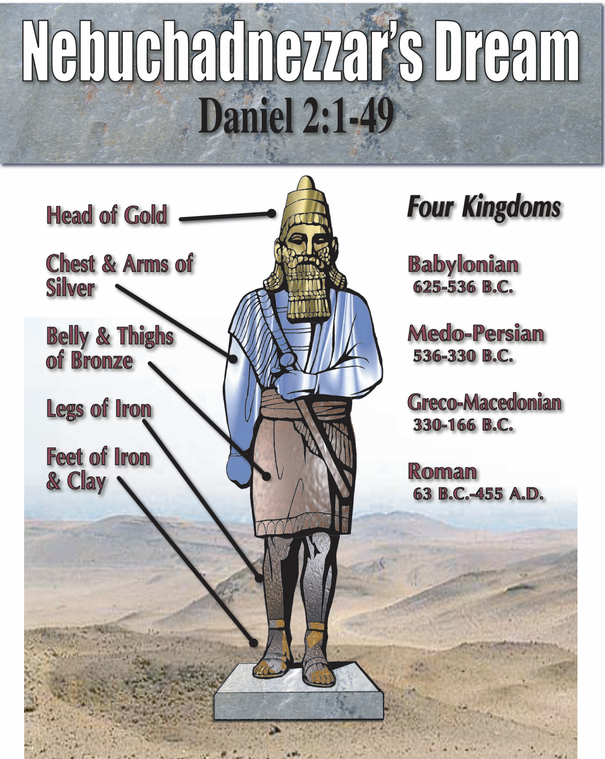
The Kingdom in Prophecy Daniel 2

Slide 55
Daniel 2:44
“And in the days of these kings shall the God of heaven set up a kingdom, which shall never be destroyed: and the kingdom shall not be left to other people, but it shall break in pieces and consume all these kingdoms, and it shall stand for ever.”
In the “days of these kings” = Roman kings
God will set up a kingdom
It will never be destroyed, it is an everlasting kingdom
It will consume all nations, all nations shall flow into it
It will be a peaceable kingdom

Slide 56
The Church In Prophecy
Daniel 2
Isaiah 2:1-4
“The word that Isaiah the son of Amoz saw concerning Judah and Jerusalem. Now it shall come to pass in the latter days That the mountain of the LORD'S house Shall be established on the top of the mountains, And shall be exalted above the hills; And all nations shall flow to it. Many people shall come and say, ‘Come, and let us go up to the mountain of the LORD, To the house of the God of Jacob; He will teach us His ways, And we shall walk in His paths.’ For out of Zion shall go forth the law, And the word of the LORD from Jerusalem. He shall judge between the nations, And rebuke many people; They shall beat their swords into plowshares, And their spears into pruning hooks; Nation shall not lift up sword against nation, Neither shall they learn war anymore.

Slide 57
Isaiah 2:1-4
“Latter days”
Mountain of Lord’s house will be established on top of the mountains
All nations will flow to it
Word of Lord will go forth from Zion
A peaceful kingdom, spread without war

Slide 58
The Church In Prophecy
Daniel 2
Isaiah 2:1-4
Isaiah 9:6
“For unto us a child is born, unto us a son is given: and the government shall be upon his shoulder: and his name shall be called Wonderful, Counsellor, The mighty God, The everlasting Father, The Prince of Peace.”
Birth of son – the mighty God
Government on His shoulders

Slide 59
The Kingdom in Prophecy
Latter Days
Lord’s house established
All nations flow to it
Word of God goes out of Zion
A peaceful kingdom
Kingdom is “at hand” (Matt. 3:1-2)
John the Baptist
Isaiah
700 BC
Daniel
600 BC
Jesus
Kingdom at hand (Matt. 4:17
Kingdom = church (Matt. 16:18)
Come will come with power within lifetime of His audience (Mark 9:1
Power to come when Holy Spirit Comes
In the days of those kings
God will set up a kingdom
It will never be destroyed
It will consume all nations
It will never be destroyed

Slide 60
The Announcement of the Kingdom
John the Baptist: ““Repent, for the kingdom of heaven is at hand” (3:1).
Jesus: “Repent, for the kingdom of heaven is at hand” (4:17).
The “gospel (“good news”) of the kingdom” (4:25; 9:35; 24:14).
“Truly, I say to you, there are some standing here who will not taste death until they see the Son of Man coming in his kingdom” (16:28).

Slide 61
Mark 9:1
“And he said to them, ‘Truly, I say to you, there are some standing here who will not taste death until they see the kingdom of God after it has come with power.’”
The kingdom will come with power.
“So when they had come together, they asked him, ‘Lord, will you at this time restore the kingdom to Israel?’ He said to them, ‘It is not for you to know times or seasons that the Father has fixed by his own authority. But you will receive power when the Holy Spirit has come upon you, and you will be my witnesses in Jerusalem and in all Judea and Samaria, and to the end of the earth’” (Acts 1:8).
Ten days later the Holy Spirit came on the day of Pentecost.

Slide 62
Prophecy
Fulfillment
The Place: Zion/Jerusalem
The Place: Zion/Jerusalem
P
E
N
T
E
C
O
S
T
When: The Last Days/Days of Roman Kings
When: The Last Days/Days of Roman Kings (Acts 2:16-17)
Who: All Nations
Who: All Nations (Acts 2:9-12)
What: Kingdom Established
What: Kingdom/Church Established (Acts 2:47)
A Peaceful Kingdom: Not spread by sword
A Peaceful Kingdom spread by preaching the gospel
Come with Power
Power of Holy Spirit came (Acts 2:1-4)
Acts 2: The Beginning

Slide 63
Church/Kingdom Established
Acts 2:38-47: Those who were obedient were added to the church (1 Cor. 12:13).
John 3:1-5: Those who were born again were added to the kingdom
Philip preached the good news of the kingdom (Acts 8:12).
Paul argued with the Ephesians about the kingdom (Acts 19:8). He preached the kingdom to them (Acts 20:25).
Paul testified about the kingdom in Rome (Acts 28:23) and preached the kingdom there (Acts 28:31).
The saints at Colossae had been translated into the kingdom (Col. 1:13-14).
The saints at Thessalonica had been called into the kingdom (1 Thess. 2:12).
The Hebrews had received a kingdom (Heb. 12:28).
John was in the kingdom (Rev. 1:9)

Slide 64
The Church: The Fulness of God
“. . . far above all principality and power and might and dominion, and every name that is named, not only in this age but also in that which is to come. And He put all things under His feet, and gave Him to be head over all things to the church, which is His body, the fullness of Him who fills all in all” (Eph. 1:21-23).

Slide 65
Jesus Reign as King Over His Kingdom
Began with Jesus’s ascension into heaven (Acts 2:29-36)
During this time, God speaks to mankind through His Son (Heb. 1:2)
At the second coming, the kingdom will be delivered up to God and Jesus’s rule will be over (1 Cor. 15:23-28)

