Slide 1
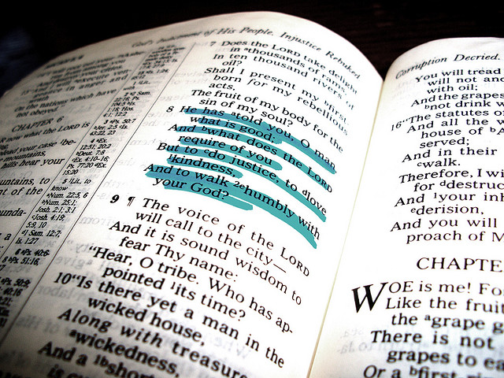
Does the Lord Require Too Much?

Slide 2
1 Kings 12:25-28
Then Jeroboam built Shechem in the hill country of Ephraim and lived there. And he went out from there and built Penuel. And Jeroboam said in his heart, “Now the kingdom will turn back to the house of David. If this people go up to offer sacrifices in the temple of the LORD at Jerusalem, then the heart of this people will turn again to their lord, to Rehoboam king of Judah, and they will kill me and return to Rehoboam king of Judah.” So the king took counsel and made two calves of gold. And he said to the people, “You have gone up to Jerusalem long enough. Behold your gods, O Israel, who brought you up out of the land of Egypt.”

Slide 3
Does the Lord Require Too Much?
Jeroboam used that as a ploy!
Do we use the same excuse today?
Is it too much to serve the Lord in the way He prescribed?
Notes:
Based on sermon by Larry Fain
Preached at West Side, June 19, 2005 AM

Slide 4
Does the Lord Require Too Much?
To Walk by Faith? (2 Cor. 5:6-8; Rom. 10:17)

Slide 5
2 Corinthians 5:6-8
So we are always confident, knowing that while we are at home in the body we are absent from the Lord. 7 For we walk by faith, not by sight. 8 We are confident, yes, well pleased rather to be absent from the body and to be present with the Lord.

Slide 6
Does the Lord Require Too Much?
To Walk by Faith? (2 Cor. 5:6-8; Rom. 10:17)
To Obey His Gospel? (2 Th. 1:7-9; Mk. 16:16)

Slide 7
2 Thessalonians 1:7-9
And to give you who are troubled rest with us when the Lord Jesus is revealed from heaven with His mighty angels, {8} in flaming fire taking vengeance on those who do not know God, and on those who do not obey the gospel of our Lord Jesus Christ. {9} These shall be punished with everlasting destruction from the presence of the Lord and from the glory of His power.

Slide 8
Mark 16:16
He who believes and is baptized will be saved; but he who does not believe will be condemned.

Slide 9
Does the Lord Require Too Much?
To Walk by Faith? (2 Cor. 5:6-8; Rom. 10:17)
To Obey His Gospel? (2 Th. 1:7-9; Mk. 16:16)
To Be Members of One Church? (1 Cor. 12:13, 20; Eph. 4:4)

Slide 10
1 Corinthians 12:13, 20
(13), For by one Spirit we were all baptized into one body; whether Jews or Greeks, whether slaves or free; and have all been made to drink into one Spirit.
(20), But now indeed there are many members, yet one body.

Slide 11
Ephesians 4:4
There is one body and one Spirit, just as you were called in one hope of your calling.

Slide 12
Does the Lord Require Too Much?
To Walk by Faith? (2 Cor. 5:6-8; Rom. 10:17)
To Obey His Gospel? (2 Th. 1:7-9; Mk. 16:16)
To Be Members of One Church? (1 Cor. 12:13, 20; Eph. 4:4)
To Faithfully Worship Him? (John 4:23-24)

Slide 13
John 4:23-24
But the hour is coming, and now is, when the true worshipers will worship the Father in spirit and truth; for the Father is seeking such to worship Him. {24} "God is Spirit, and those who worship Him must worship in spirit and truth."

Slide 14
Does the Lord Require Too Much?
To Walk by Faith? (2 Cor. 5:6-8; Rom. 10:17)
To Obey His Gospel? (2 Th. 1:7-9; Mk. 16:16)
To Be Members of One Church? (1 Cor. 12:13, 20; Eph. 4:4)
To Faithfully Worship Him? (John 4:23-24)
To Live Godly Lives? (Titus 2:11-12; Phi. 2:14-16)

Slide 15
Titus 2:11-12
For the grace of God that brings salvation has appeared to all men, {12} teaching us that, denying ungodliness and worldly lusts, we should live soberly, righteously, and godly in the present age.

Slide 16
Philippians 2:14-16
Do all things without complaining and disputing, {15} that you may become blameless and harmless, children of God without fault in the midst of a crooked and perverse generation, among whom you shine as lights in the world, {16} holding fast the word of life, so that I may rejoice in the day of Christ that I have not run in vain or labored in vain.

Slide 17
Does the Lord Require Too Much?
To Walk by Faith? (2 Cor. 5:6-8; Rom. 10:17)
To Obey His Gospel? (2 Th. 1:7-9; Mk. 16:16)
To Be Members of One Church? (1 Cor. 12:13, 20; Eph. 4:4)
To Faithfully Worship Him? (John 4:23-24)
To Live Godly Lives? (Titus 2:11-12; Phi. 2:14-16)
To Be Faithful Unto Death? (Rev. 2:10; 1 Tim. 4:7-8)

Slide 18
Revelation 2:10
Do not fear any of those things which you are about to suffer. Indeed, the devil is about to throw some of you into prison, that you may be tested, and you will have tribulation ten days. Be faithful until death, and I will give you the crown of life.

Slide 19
1 Timothy 4:7-8
But reject profane and old wives' fables, and exercise yourself toward godliness. {8} For bodily exercise profits a little, but godliness is profitable for all things, having promise of the life that now is and of that which is to come.

Slide 20
Does the Lord Require Too Much?
The wicked King Jeroboam said it was too much to serve God the way he said to do it.
Is it too much for you to do the will of the Father?
"Not everyone who says to Me, 'Lord, Lord,' shall enter the kingdom of heaven, but he who does the will of My Father in heaven. (Matthew 7:21 )

