Slide 1
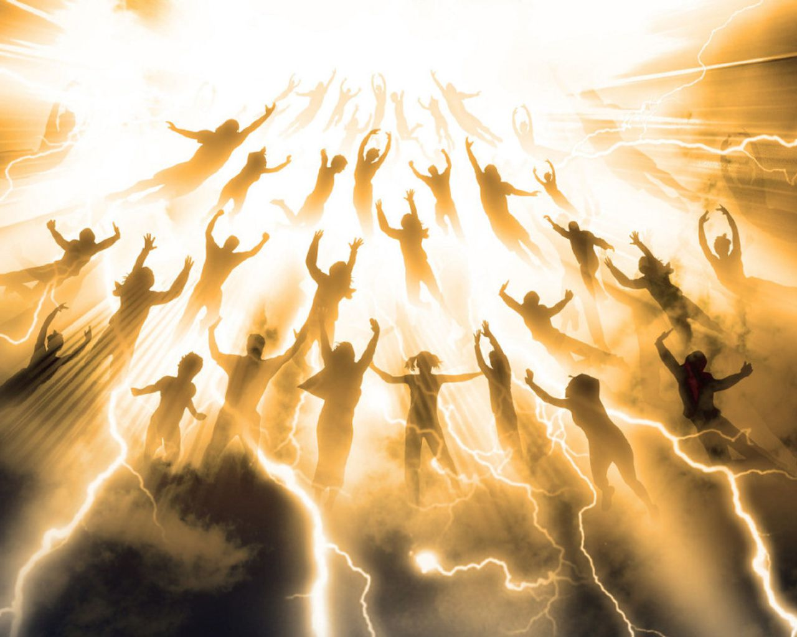
What About The Rapture?

Slide 2
Is the “rapture” a
Biblical doctrine?

Slide 3
Based upon a literal interpretation of Revelation 20:1–6.
is the belief that after a period of severe tribulation of the earth, the Lord Jesus Christ will visibly and bodily return to earth (His Second Coming/Advent or Parousia) and will then rule and reign on the earth for a period of one thousand years (millennium) of peace and prosperity.

Slide 4
What about the Rapture?
14 translations and no “rapture”.
Not even a paraphrase uses the word “rapture”.
If it were a Biblical doctrine wouldn’t God use the word?
Have to look outside the Bible for a definition.

Slide 5
What about the Rapture?
“…ecstatic joy or delight; joyful ecstasy; an utterance or expression of ecstatic delight; the carrying of a person to another place or sphere of existence (www.dictionary.com)
“Rapere” which means to be caught up suddenly; swooped away by a force that cannot be opposed

Slide 6
What about the Rapture?
“By the rapture is meant the sudden and possible secret coming of Christ in the air to catch away from the earth the resurrected bodies of those who have died in the faith and with them the living saints.” (Dr. Robert Strong)

Slide 7
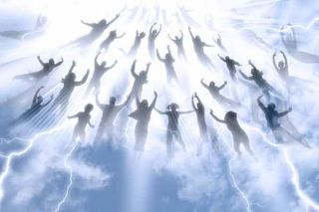
What about the Rapture?

Slide 8
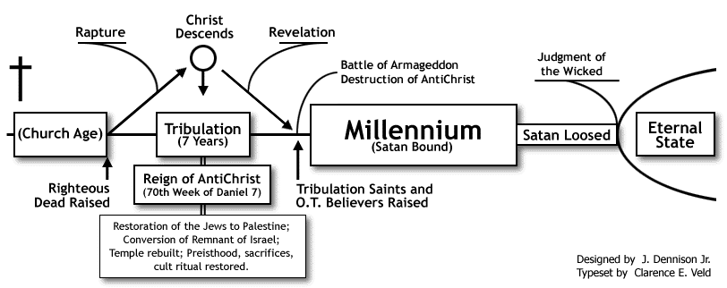
What about the Rapture?

Slide 9
What about the Rapture?
The secret, silent and invisible event where all Christians, both living and dead, will be caught up to heaven to be with Jesus for a period of time before Jesus returns to establish His earthly Kingdom.
The Issue Is NOT Will Christians Be “Caught Up” – But What Will Occur In Conjunction With The Event!

Slide 10
What about the Rapture?
1 Thes. 4:13-18
But we do not want you to be uninformed, brothers, about those who are asleep, that you may not grieve as others do who have no hope. 14 For since we believe that Jesus died and rose again, even so, through Jesus, God will bring with him those who have fallen asleep. 15 For this we declare to you by a word from the Lord, that we who are alive, who are left until the coming of the Lord, will not precede those who have fallen asleep.

Slide 11
What about the Rapture?
1 Thes. 4:13-18
16 For the Lord himself will descend from heaven with a cry of command, with the voice of an archangel, and with the sound of the trumpet of God. And the dead in Christ will rise first. 17 Then we who are alive, who are left, will be caught up together with them in the clouds to meet the Lord in the air, and so we will always be with the Lord. 18 Therefore encourage one another with these words.

Slide 12
What about the Rapture?
1 Thes. 4:13-18
But we do not want you to be uninformed, brothers, about those who are asleep, that you may not grieve as others do who have no hope. 14 For since we believe that Jesus died and rose again, even so, through Jesus, God will bring with him those who have fallen asleep. 15 For this we declare to you by a word from the Lord, that we who are alive, who are left until the coming of the Lord, will not precede those who have fallen asleep.
Some believed those who died before Christ’s return would miss out on blessings

Slide 13
What about the Rapture?
1 Thes. 4:13-18
16 For the Lord himself will descend from heaven with a cry of command, with the voice of an archangel, and with the sound of the trumpet of God. And the dead in Christ will rise first. 17 Then we who are alive, who are left, will be caught up together with them in the clouds to meet the Lord in the air, and so we will always be with the Lord. 18 Therefore encourage one another with these words.
NOT SILENT
NOT SECRET

Slide 14
What about the Rapture?
Revelation 1:7
Behold, he is coming with the clouds, and every eye will see him, even those who pierced him, and all tribes of the earth will wail on account of him. Even so. Amen.
How secret does
“every shall see Him”
appear to be?

Slide 15
What about the Rapture?
1 Corinthians 15:20-26; 51-52
What Christ return brings:
-resurrection of the dead (vs. 21-22)
-the change of those alive (vs. 51-52)
-the end (vs.24)
-the end of all power & authority (vs.24)
-the end of death (vs.25)
Behold! I tell you a mystery. We shall not all sleep, but we shall all be changed, 52 in a moment, in the twinkling of an eye, at the last trumpet. For the trumpet will sound, and the dead will be raised imperishable, and we shall be changed.

Slide 16
What about the Rapture?
Mat. 25:31-46 all nations before Christ at His coming – wicked & righteous.
Wicked on the left & righteous on right.
No room in Mat. 25 for the Rapture, Tribulation, 1,000 yr. reign between resurrection of righteous & wicked.

Slide 17
What about the Rapture?
John 5:28-29
All in tomb will
hear His voice
Do not marvel at this, for an hour is coming when all who are in the tombs will hear his voice 29 and come out, those who have done good to the resurrection of life, and those who have done evil to the resurrection of judgment.

Slide 18
What about the Rapture?
Matthew 24
Rapture theory doesn’t fit the teaching of this chapter.
If they are snatched away then why are they told to flee?
Why, “Pray that your flight will not be in winter or on the Sabbath”?
Nothing to do with the rapture & everything to do with Rome!

Slide 19
What about the Rapture?
There will be NO “Rapture”!
It is a Man-made doctrine!

