Slide 2
Appreciating Each Other
Do we take each other for granted?
What if you had no opportunities to share time with other Christians?
Paul was in jail in Caesarea for two years, although Scripture says he was given “some liberty” (Acts 24:23). His fellowship with other Christians was limited.
Some saints live in conditions where assembling with one another is at best risky. Their lives are threatened by government officials or militant Muslims.

Slide 3
Psalm 133
¹Behold, how good and pleasant it is
when brothers dwell in unity!
²It is like the precious oil on the head,
running down on the beard,
on the beard of Aaron,
running down on the collar of his robes!
³It is like the dew of Hermon,
which falls on the mountains of Zion!
For there the LORD has commanded the blessing,
life forevermore (Psa. 133:1-3).

Slide 4
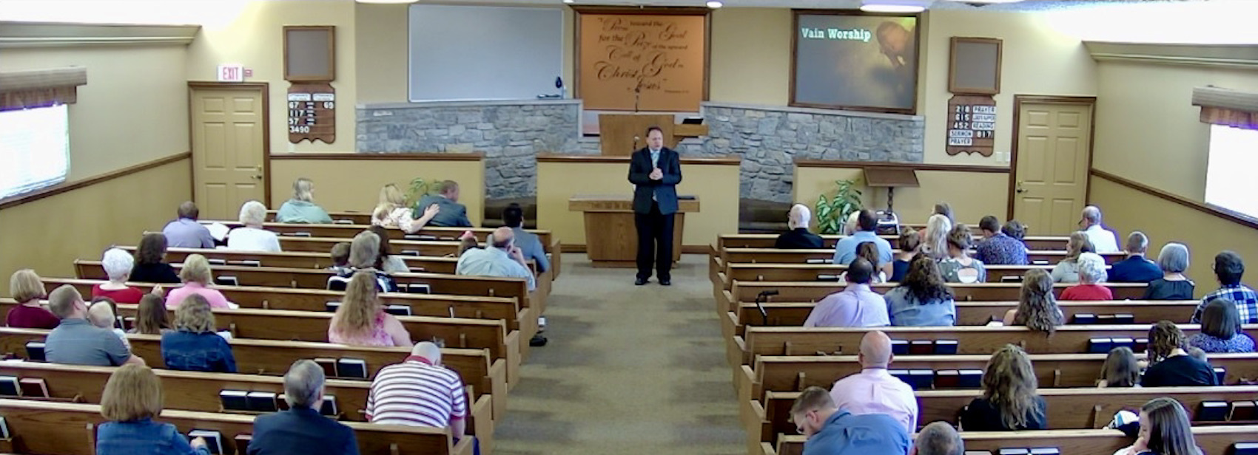
How Blessed We Are

Slide 5
Some Have Not Been So Privileged
Jesus lived under the watchful eyes of Jewish leaders willing to eliminate Him if He became a problem to their leadership.
The saints in Jerusalem were scattered by Jewish persecution (Acts 8:1-4).
We are fortunate never to have experienced such hostility toward our faith.

Slide 6
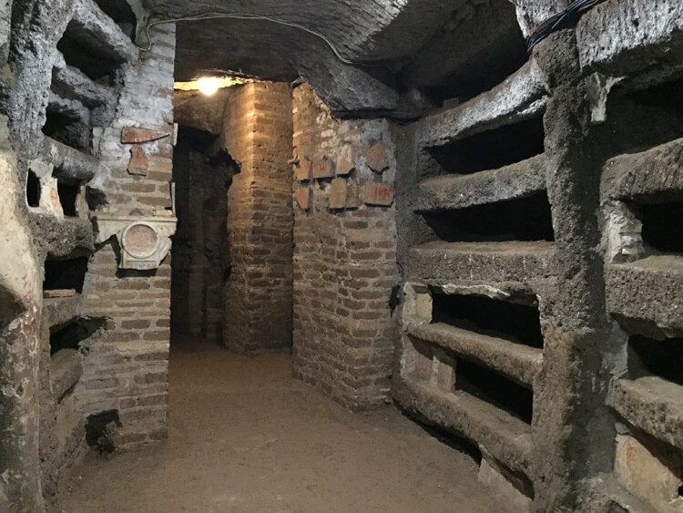
The ancient Romans built these catacombs because they simply didn’t like death—they feared it and didn’t want to think about it. They wanted to push death out onto the margins, even out of sight, so they buried their dead underground.
These catacombs play an interesting role in the history of Christianity. In the first few centuries after Christ, Christianity was at odds with the empire and Christians were marginalized, ostracized, and persecuted. Despite the opposition they faced, they found that they could worship freely in the catacombs. The Romans wouldn’t go down there but would send slaves to dig out the catacombs and bury their dead. So, the Christians were relatively free to worship there.
The Catacombs in Rome

Slide 7
David Missed Worshipping at the Temple
As a deer pants for flowing streams,
so pants my soul for you, O God.
My soul thirsts for God,
for the living God.
When shall I come and appear before God?
My tears have been my food
day and night,
while they say to me all the day long,
“Where is your God?”
These things I remember,
as I pour out my soul:
how I would go with the throng
and lead them in procession to the house of God
with glad shouts and songs of praise,
a multitude keeping festival (Psa. 42:1-4).

Slide 8
Missing the Saints
After being compelled to leave Thessalonica by Jews who opposed him, Paul missed being with the saints there and wrote, “as we pray most earnestly night and day that we may see you face to face and supply what is lacking in your faith?” (1 Thess. 3:10).
While imprisoned at Rome, Paul thought of his spiritual child Timothy and wrote, “As I remember your tears, I long to see you, that I may be filled with joy” (2 Tim. 1:4).
Though John the Apostle was exiled to Patmos, he was “in the Spirit on the Lord’s Day” (Rev. 1:10).
The aged John wished he could be present bodily with the saints whom he missed: “Though I have much to write to you, I would rather not use paper and ink. Instead I hope to come to you and talk face to face, so that our joy may be complete” (2 John 12).

Slide 9
How Blessed We Are to Be Able to Worship God with Other Christians

Slide 10
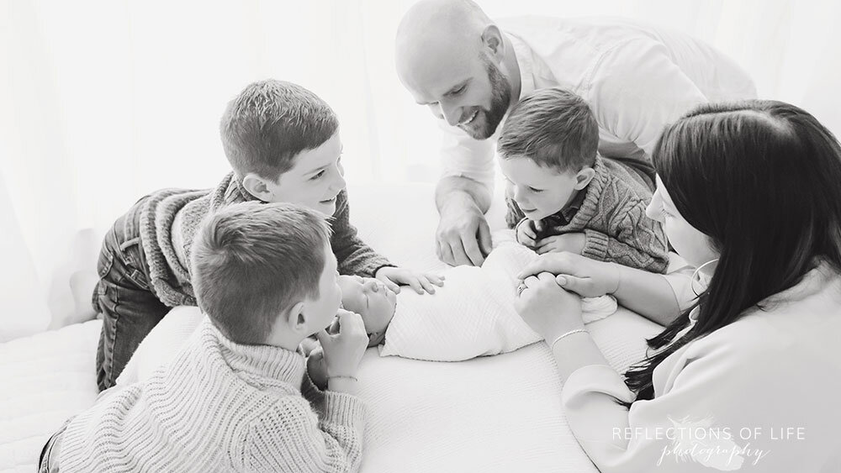
Born into a Family

Slide 11
We Have Newborns Because of Jesus
“But now in Christ Jesus you who once were far off have been brought near by the blood of Christ. For he himself is our peace, who has made us both one and has broken down in his flesh the dividing wall of hostility by abolishing the law of commandments expressed in ordinances, that he might create in himself one new man in place of the two, so making peace, and might reconcile us both to God in one body through the cross, thereby killing the hostility” (Eph. 2:13-16).
Without Christ, we would not know God or become one of His children.

Slide 12
Look Around You
The Willis family from Texas would not know the Ragsdale family in Indiana had not our common allegiance to Jesus brought us together.
The Ervin family from Indiana would never have known Gordon Krentz and Linda Larimore without our common bond in Jesus.
Jesus brings us together this morning and each week.

Slide 13
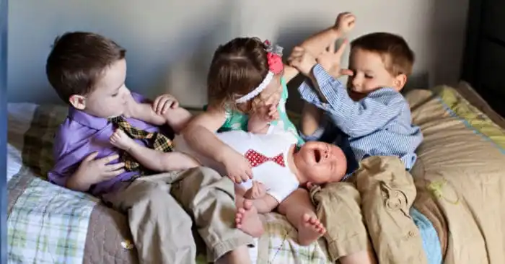
Does Your Family Ever Look Like This?

Slide 14
Sometimes Our Spiritual Family Looks Like This, Too!
We were not born into a physical family without faults.
We cried in the middle of the night because we were hungry.
Sometimes we cried because we wanted attention.
We wet our pants.
We took each other’s toys and screamed when our toys were taken!
It wasn’t pretty!
Our spiritual family can be like this, too!

Slide 15
The Parable of Unforgiving Servant Matthew 18:21-35
The debtor owed his lord 10,000 talents, a sum so large one could never repay it. It represents 20 years of daily wages. He pled that his lord would be patient with him; the lord forgave him the entire debt.
The forgiven debtor had a fellow servant who owed him a debt of 100 denarii, not a small sum. It was equal to 100 day’s wages. The fellow servant pled for patience but the one to whom the debt was due refused to be patient with his fellow servant and had him cast into prison until the debt was paid in full.
His fellow servants saw what had happened and reported it to the lord. “Then his master summoned him and said to him, ‘You wicked servant! I forgave you all that debt because you pleaded with me. And should not you have had mercy on your fellow servant, as I had mercy on you?’ And in anger his master delivered him to the jailers, until he should pay all his debt” (Matt. 18:32-34).

Slide 16
The Point of the Parable
I was received as a Christian in fellowship with Jesus in spite of my past sins and my present imperfections. If any of us had to wait until he had perfected himself in order to join our group, none of us would be here.
Dietrich Bonnhoeffer: “When we received forgiveness instead of judgment, we, too, were made ready to forgive our brethren. What God did to us, we then owed to others. The more we received, the more we were able to give; and the more meager our brotherly love, the less were we living by God’s mercy and love” (Life Together, 25).

Slide 17
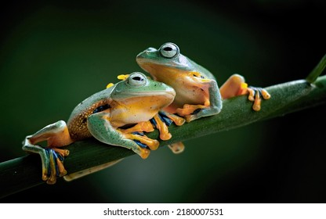
“I toadily love you! Warts and all!”

Slide 18
Love One Another
“Now concerning brotherly love you have no need for anyone to write to you, for you yourselves have been taught by God to love one another, for that indeed is what you are doing to all the brothers throughout Macedonia. But we urge you, brothers, to do this more and more” (1 Thess. 4:9-10).
“Therefore welcome one another as Christ has welcomed you, for the glory of God” (Rom. 15:7).

Slide 19
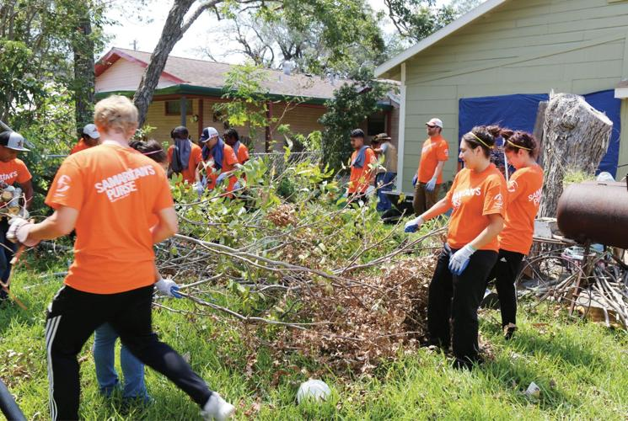
A Community That Sustains Each Other

Slide 20
Unrealistic Ideals
Some people have an idealized picture of what brotherhood in Christ should mean.
It may be a community in which all are perfect people, immune to all the social conflicts that imperfect people have when they do things together.
It may be a picture of a group that does fun things together, such as having soccer, baseball, and basketball teams competing with each other in sports activities. It may be a dreamy picture of idealized association with each other in eating and drinking together as the park.
This is not intended to imply that we never do these kinds of things together, because we do. But these are not the things on which our fellowship with each other is built.

Slide 21
Jesus Binds Us Together!
But, the truth is that our fellowship consists of our common allegiance to Jesus Christ, held together by our common love of His word and commitment to obedience in our lives. Those who become Christians will be around imperfect people growing and maturing in Jesus.
Those saints who met in the catacombs in Rome were not assembled to play baseball in the park. They were meeting in secret to encourage one another by singing psalms, hymns, and spiritual songs together, lifting holy hands to God in prayer for strength to endure the trials that so many of their members experienced, and offering their homage to God and the Lord Jesus.

Slide 22
Greet one another (Rom. 16:16; 1 Cor. 16:20; 2 Cor. 13:12; 1 Pet. 5:14).
Love one another (John 13:34; 15:12, 17; Rom. 13:8; 1 Thess. 4:9; 1 Pet. 1;22; 1 John 3:11, 23; 4:7, 11-12; 2 John 5).
In honor, prefer one another (Rom. 12:10).
Submit one to another (Eph. 5:21).
Don’t judge one another (Rom. 14:13).
Admonish one another (Rom. 15:14; Col. 3:16).
Edify one another (1 Thess. 5:11).
Exhort one another (Heb. 3:13; 10:25).
Provoke one another to love and good works (Heb. 10:24).
Serve one another (Gal. 5:13).
Forbear one another (Eph. 4:2; Col. 3:13).
Forgive one another (Eph. 4:32; Col. 3:13).
Comfort one another (1 Thess. 4:18).
What We Do for Each Other

Slide 23
We Are Not Perfect!
Our Christian brotherhood is not a perfect ideal which we must grow into; it is rather a relationship to one another that Christ created when we both became children of God.
How much like this is our earthly family. Our children are born into a relationship created by the father and mother.
They will grow into loving their brothers and sisters, even though every family experiences those challenges where one sister mistreats her younger brother or both mistreat each other.

Slide 24
Conclusion
“Behold, how good and pleasant it is when brothers dwell in unity!” (Psa. 133:1).

Slide 25
We Are Grateful
To Jesus who brought us together as one body.
To each other for what each contributes to the encouragement we draw from our worship together.
For how each of us sustains the other through life’s peaks and valleys!
We are blessed!

