Slide 1
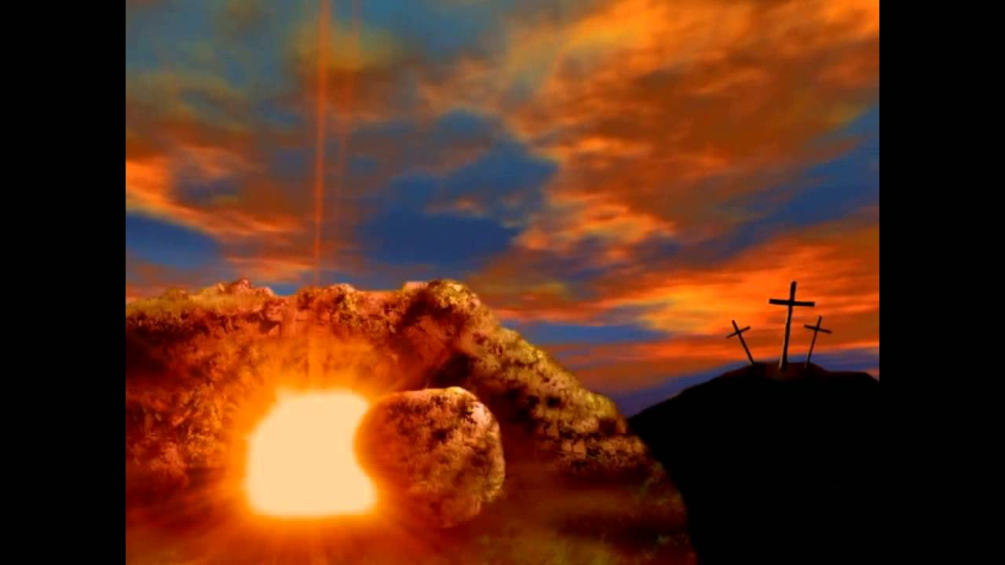
A Resurrected Jesus & What It Means For Me
John 20
Luke 24
Matt. 28
Mark 16

Slide 2
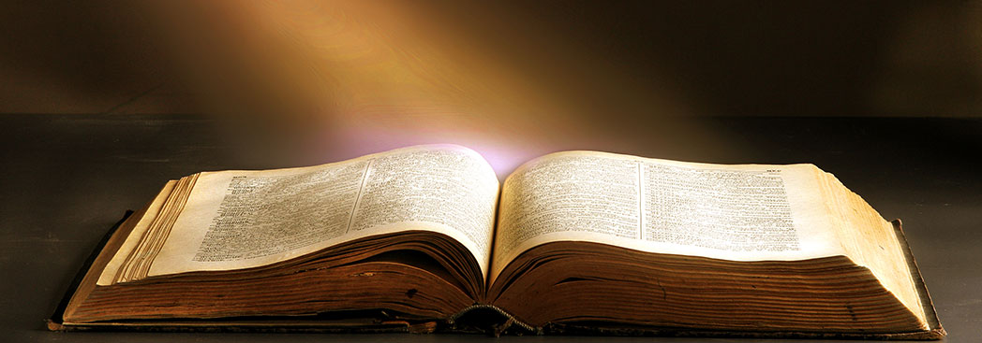
“If a man has committed a crime punishable by death & he is put to death, & you hang him on a tree, 23 his body shall not remain all night on the tree, but you shall bury him the same day, for a hanged man is cursed by God. You shall not defile your land that the Lord your God is giving you for an inheritance.”
Deut. 21:22-23

Slide 3
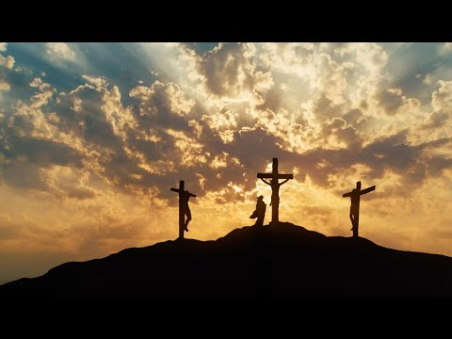
But when they came to Jesus and saw that he was already dead, they did not break his legs. But one of the soldiers pierced his side with a spear, and at once there came out blood and water. He who saw it has borne witness—his testimony is true, and he knows that he is telling the truth—that you also may believe. For these things took place that the Scripture might be fulfilled: “Not one of his bones will be broken.” John 19:33-36

Slide 4
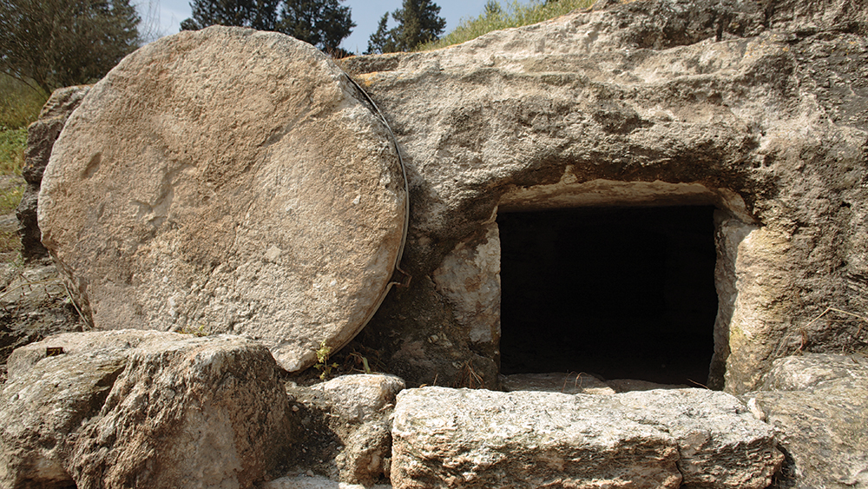

Slide 5
The next day, that is, after the day of Preparation, the chief priests and the Pharisees gathered before Pilate and said, “Sir, we remember how that impostor said, while he was still alive, ‘After three days I will rise.’ Therefore order the tomb to be made secure until the third day, lest his disciples go and steal him away and tell the people, ‘He has risen from the dead,’ and the last fraud will be worse than the first.” Pilate said to them, “You have a guard of soldiers. Go, make it as secure as you can.” So they went and made the tomb secure by sealing the stone and setting a guard.
Matt. 27:62-66

Slide 6
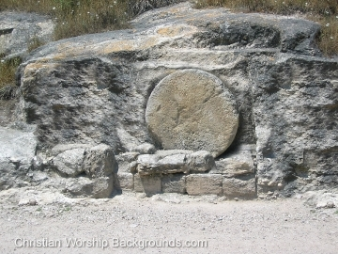
1 Corinthians 15:12-19

Slide 7
All 4 gospels give great details surrounding the resurrection.
“And as the women were terrified & bowed their faces to ground, the men said to them, Why do you seek the living among the dead? He is not here, but has risen. Remember how He told you, while He was still in Galilee,….. Luke 24:5-6

Slide 8
The resurrection of Christ is God’s exclamation point!
“He Is NOT Here”!
“Up from the grave He arose”!
Remember??
He came to life!

Slide 9
The Resurrection of Christ
Single most important event in all human history!
Offers proof of the claims made about & by Jesus!
Rom. 1:4
1 Cor. 15:1-8

Slide 10
Of Christ Means:
I Can Be Saved!
I Have Access To The Father!
I Can Live!
I Have A Story To Tell!
The Resurrection

