Slide 3
How Did His Gift Work Out?
“Thanks to Eugene Lang’s impulsive promise at a grade-school graduation, 90% of the Class of 1981 at East Harlem’s P.S. 121 now has graduated from high school. Half have gone on to Bard, Swarthmore, Barnard and other universities, spurred by the millionaire’s vow to pay the college tuition of each of the 61 students if they got high school diplomas. And around the country, others have copied Lang’s largess” (“Millionaire’s Scholarship Offer Pays Off for Students in Harlem,” https://www.latimes.com/archives/la-xpm-1990-03-25-mn-244-story.html).

Slide 4
Building

Slide 5
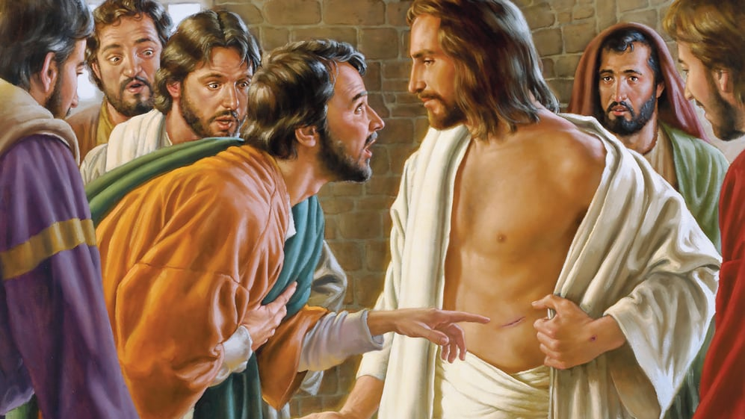
Jesus’s Resurrection and Promise Inspire Hope

Slide 6
The Christian’s Hope
“Blessed be the God and Father of our Lord Jesus Christ! According to his great mercy, he has caused us to be born again to a living hope through the resurrection of Jesus Christ from the dead, to an inheritance that is imperishable, undefiled, and unfading, kept in heaven for you, who by God’s power are being guarded through faith for a salvation ready to be revealed in the last time” (1 Pet. 1:3-5).
Building Hope

Slide 7
The Christian’s Hope
But we do not want you to be uninformed, brothers, about those who are asleep, that you may not grieve as others do who have no hope. For since we believe that Jesus died and rose again, even so, through Jesus, God will bring with him those who have fallen asleep. For this we declare to you by a word from the Lord, that we who are alive, who are left until the coming of the Lord, will not precede those who have fallen asleep. For the Lord himself will descend from heaven with a cry of command, with the voice of an archangel, and with the sound of the trumpet of God. And the dead in Christ will rise first. Then we who are alive, who are left, will be caught up together with them in the clouds to meet the Lord in the air, and so we will always be with the Lord. Therefore encourage one another with these words (1 Thess. 4:13-18).
Building Hope

Slide 8
The Basis for My Hope
Building

Slide 9
The Basis for Hope
“For to this end we both labor and suffer reproach, because we trust in the living God, who is the Savior of all men, especially of those who believe” (1 Tim. 4:10).
“in hope of eternal life, which God, who never lies, promised before the ages began” (Tit. 1:2).
“. . . who through Him believe in God, who raised Him from the dead and gave Him glory, so that your faith and hope are in God” (1 Pet. 1:21).
“Let not your heart be troubled; you believe in God, believe also in Me. In My Father’s house are many mansions; if it were not so, I would have told you. I go to prepare a place for you. And if I go and prepare a place for you, I will come again and receive you to Myself; that where I am, there you may be also” (John 14:1-3).
Building Hope

Slide 10
Not Based on Who We Are
“To them God willed to make known what are the riches of the glory of this mystery among the Gentiles: which is Christ in you, the hope of glory” (Col. 1:27).
“Paul, an apostle of Jesus Christ, by the commandment of God our Savior and the Lord Jesus Christ, our hope” (1 Tim. 1:1).
Building Hope

Slide 11
Grounded in the Resurrection
“Blessed be the God and Father of our Lord Jesus Christ! According to his great mercy, he has caused us to be born again to a living hope through the resurrection of Jesus Christ from the dead, to an inheritance that is imperishable, undefiled, and unfading, kept in heaven for you, who by God’s power are being guarded through faith for a salvation ready to be revealed in the last time” (1 Pet. 1:3-5).

Slide 12
1 Corinthians 15:42-49
So is it with the resurrection of the dead. What is sown is perishable; what is raised is imperishable. It is sown in dishonor; it is raised in glory. It is sown in weakness; it is raised in power. It is sown a natural body; it is raised a spiritual body. If there is a natural body, there is also a spiritual body. Thus it is written, “The first man Adam became a living being”; the last Adam became a life-giving spirit. But it is not the spiritual that is first but the natural, and then the spiritual. The first man was from the earth, a man of dust; the second man is from heaven. As was the man of dust, so also are those who are of the dust, and as is the man of heaven, so also are those who are of heaven. Just as we have borne the image of the man of dust, we shall also bear the image of the man of heaven.

Slide 13
Philippians 3:20-21
“But our citizenship is in heaven, and from it we await a Savior, the Lord Jesus Christ, who will transform our lowly body to be like his glorious body, by the power that enables him even to subject all things to himself.”

Slide 14
My hope does not depend upon my ability to keep God’s law perfectly!
It rests on the shed blood of Jesus Christ and is guaranteed by His resurrection!

Slide 15
What Is My Hope?
Building

Slide 16
Passages Defining Hope
“But when Paul perceived that one part were Sadducees and the other Pharisees, he cried out in the council, ‘Men and brethren, I am a Pharisee, the son of a Pharisee; concerning the hope and resurrection of the dead I am being judged!’” (Acts 23:6).
“I have hope in God, which they themselves also accept, that there will be a resurrection of the dead, both of the just and the unjust” (Acts 24:15).
“. . . who through Him believe in God, who raised Him from the dead and gave Him glory, so that your faith and hope are in God” (1 Pet. 1:21).
Building Hope

Slide 17
“But in fact Christ has been raised from the dead, the firstfruits of those who have fallen asleep. For as by a man came death, by a man has come also the resurrection of the dead. For as in Adam all die, so also in Christ shall all be made alive” (1 Cor. 15:20-22).

Slide 18
Passages Defining Hope
“. . . the eyes of your understanding being enlightened; that you may know what is the hope of His calling, what are the riches of the glory of His inheritance in the saints” (Eph. 1:18).
Building Hope

Slide 19
Passages Defining Hope
“. . . because of the hope which is laid up for you in heaven, of which you heard before in the word of the truth of the gospel” (Col. 1:5).
Building Hope

Slide 20
Passages Defining Hope
“ . . .in hope of eternal life which God, who cannot lie, promised before time began” (Titus 1:2).
“. . . that having been justified by His grace we should become heirs according to the hope of eternal life” (Titus 3:7).
Building Hope

Slide 21
Passages Defining Hope
“There is one body and one Spirit, just as you were called in one hope of your calling” (Eph. 4:4).
“. . . if indeed you continue in the faith, grounded and steadfast, and are not moved away from the hope of the gospel which you heard, which was preached to every creature under heaven, of which I, Paul, became a minister” (Col. 1:23).
Building Hope

Slide 22
Do All Have the Same Hope?
What is the hope of . . .
Premillennialism?
The Jehovah Witnesses (renewed earth)?
Atheism?
The Green Earth people?
The hope of the gospel?
Building Hope

Slide 23
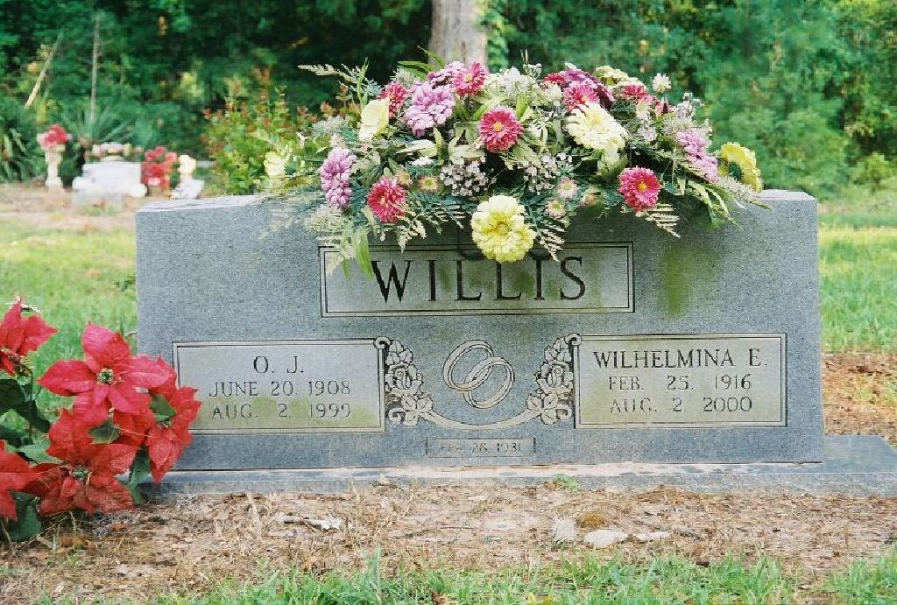

Slide 24
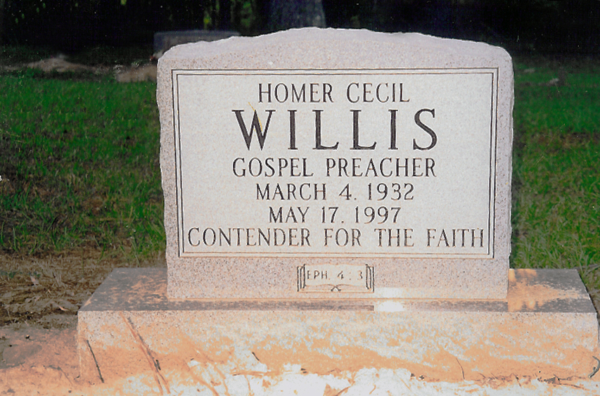
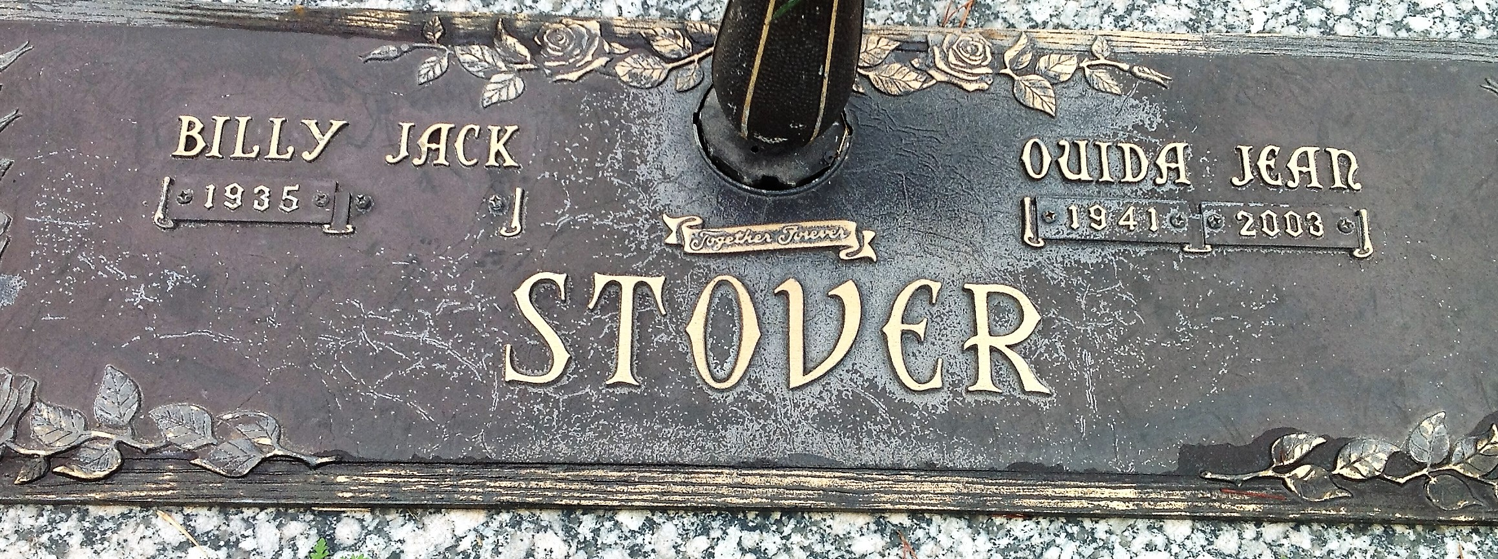

Slide 25
What Hope Does?
Building

Slide 26
Passages on What Hope Does
Enables us to be saved: “For we were saved in this hope, but hope that is seen is not hope; for why does one still hope for what he sees?” (Rom. 8:24).
Causes us to rejoice: “. . . rejoicing in hope, patient in tribulation, continuing steadfastly in prayer” (Rom. 12:12).
Fills us with joy and peace: “Now may the God of hope fill you with all joy and peace in believing, that you may abound in hope by the power of the Holy Spirit” (Rom. 15:13).
Hope enables us to cope!
Building Hope

Slide 27
Passages on What Hope Does
Gives us boldness: “Therefore, since we have such hope, we use great boldness of speech” (2 Cor. 3:12).
Helps us to persevere: “. . . and perseverance, character; and character, hope. Now hope does not disappoint, because the love of God has been poured out in our hearts by the Holy Spirit who was given to us” (Rom. 5:4-5).
“. . . remembering without ceasing your work of faith, labor of love, and patience of hope in our Lord Jesus Christ in the sight of our God and Father” (1 Thess. 1:3).
“Let us hold fast the confession of our hope without wavering, for He who promised is faithful” (Heb. 10:23).
Building Hope

Slide 28
Passages on What Hope Does
Gives us assurance: “And we desire that each one of you show the same diligence to the full assurance of hope until the end” (Heb. 6:11).
Is an anchor for the soul: “that by two immutable things, in which it is impossible for God to lie, we might have strong consolation, who have fled for refuge to lay hold of the hope set before us. This hope we have as an anchor of the soul, both sure and steadfast, and which enters the Presence behind the veil” (Heb. 6:18-19).
Building Hope

Slide 29
Passages on What Hope Does
It is a protective helmet: “But let us who are of the day be sober, putting on the breastplate of faith and love, and as a helmet the hope of salvation” (1 Thess. 5:8).
“And take the helmet of salvation, and the sword of the Spirit, which is the word of God” (Eph. 6:17).
Building Hope

Slide 30
When Will Our Hope Be Fulfilled?
Building

Slide 31
When Will It Happen?
“. . . looking for the blessed hope and glorious appearing of our great God and Savior Jesus Christ” (Tit. 2:13).
“Therefore gird up the loins of your mind, be sober, and rest your hope fully upon the grace that is to be brought to you at the revelation of Jesus Christ” (1 Pet. 1:13).
Building Hope

Slide 32
Without Christ, Without Hope
Building

Slide 33
An Exclusive Hope
“. . . that at that time you were without Christ, being aliens from the commonwealth of Israel and strangers from the covenants of promise, having no hope and without God in the world” (Eph. 2:12).
“But I do not want you to be ignorant, brethren, concerning those who have fallen asleep, lest you sorrow as others who have no hope” (1 Thess. 4:13).
“Jesus said to him, ‘I am the way, the truth, and the life. No one comes to the Father except through Me’” (John 14:6).
Building Hope

Slide 34
A Sad Moment
“As Vice President, George Bush represented the U.S. at the funeral of former Soviet leader Leonid Brezhnev. Bush was deeply moved by a silent protest carried out by Brezhnev’s widow. She stood motionless by the coffin until seconds before it was closed. Then, just as the soldiers touched the lid, Brezhnev’s wife performed an act of great courage and hope, a gesture that must surely rank as one of the most profound acts of civil disobedience ever committed: She reached down and made the sign of the cross on her husband’s chest.
“There in the citadel of secular, atheistic power, the wife of the man who had run it all hoped that her husband was wrong. She hoped that there was another life, and that that life was best represented by Jesus who died on the cross, and that the same Jesus might yet have mercy on her husband” (Gary Thomas, Christianity Today, October 3, 1994, p. 26.
Building Hope

Slide 35
Building
Conclusion

Slide 36
Inspired 61 sixth graders to do well in school!

Slide 37
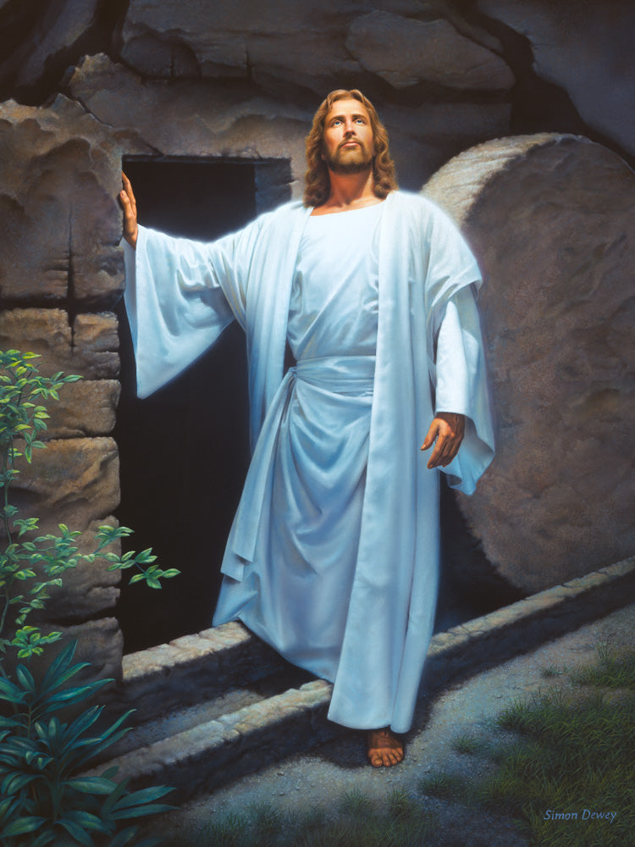
The Resurrection of Jesus gives hope to all of mankind!

Slide 38
Defending Our Living Hope
“But sanctify the Lord God in your hearts, and always be ready to give a defense to everyone who asks you a reason for the hope that is in you, with meekness and fear” (1 Pet. 3:15).
Ours is a living hope. “Blessed be the God and Father of our Lord Jesus Christ, who according to His abundant mercy has begotten us again to a living hope through the resurrection of Jesus Christ from the dead, to an inheritance incorruptible and undefiled and that does not fade away, reserved in heaven for you, who are kept by the power of God through faith for salvation ready to be revealed in the last time” (1 Pet. 1:3-5).
Building Hope

