Slide 2
Facts Admitted by All
The entire world agrees with these basic facts about Jesus (see Gary R. Habermas and Michael R. Licona, The Case for the Resurrection of Jesus, 43-81):
Jesus died by crucifixion during the reign of Tiberius Caesar, while Pontius Pilate was prefect.
On the third day following His death, the tomb was empty.
Jesus’s disciples believed that He rose and appeared to them.
The leading persecutor of the church, Saul of Tarsus, was suddenly changed by what he described as an appearance of the resurrected Jesus.
Jesus’s brother, James, was changed from a skeptic to a believer by Jesus’s appearance to him.
Suddenly, there was a rapidly growing religion called “Christianity” based on their belief that Jesus was raised from the dead.

Slide 3
1 Corinthians 15:12-19
Now if Christ is proclaimed as raised from the dead, how can some of you say that there is no resurrection of the dead? But if there is no resurrection of the dead, then not even Christ has been raised. And if Christ has not been raised, then our preaching is in vain and your faith is in vain. We are even found to be misrepresenting God, because we testified about God that he raised Christ, whom he did not raise if it is true that the dead are not raised. For if the dead are not raised, not even Christ has been raised. And if Christ has not been raised, your faith is futile and you are still in your sins. Then those also who have fallen asleep in Christ have perished. If in Christ we have hope in this life only, we are of all people most to be pitied.

Slide 4
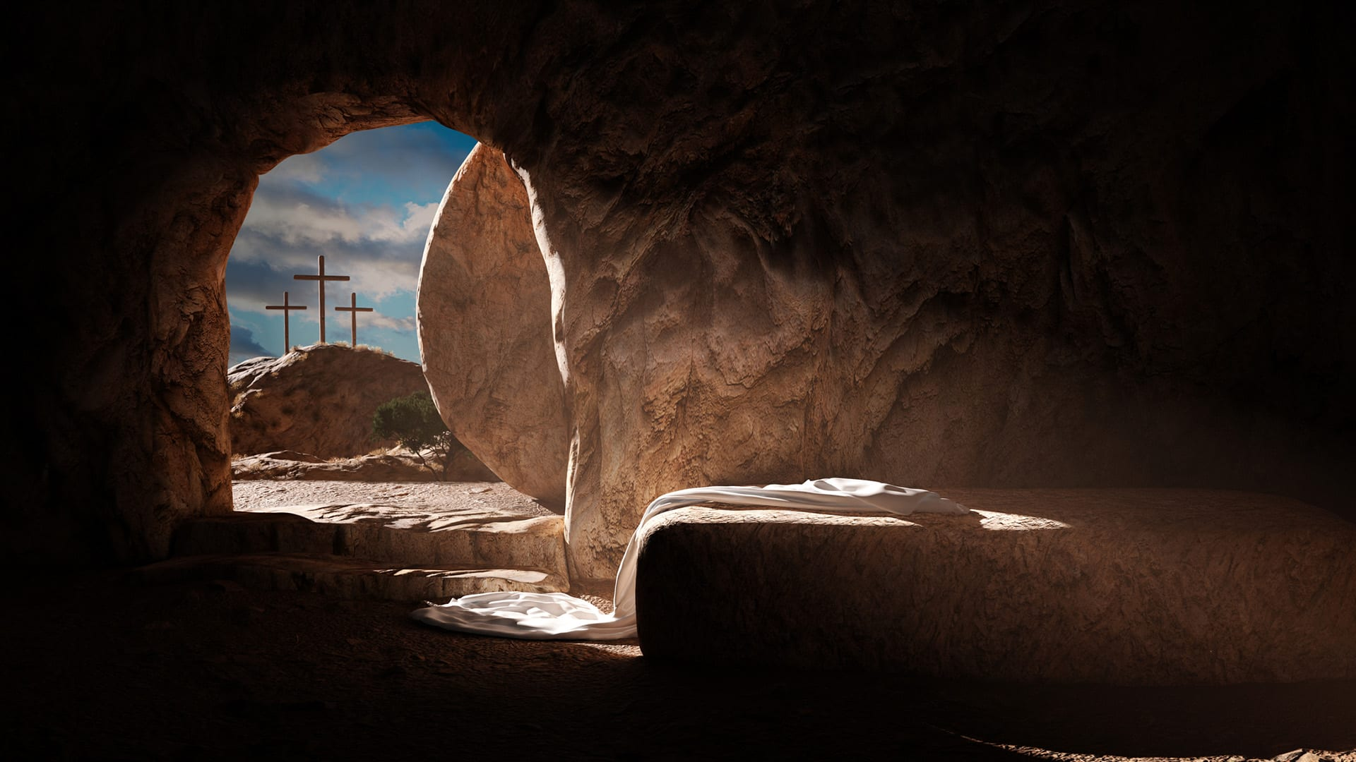
Hard Evidences of the Resurrection

Slide 5
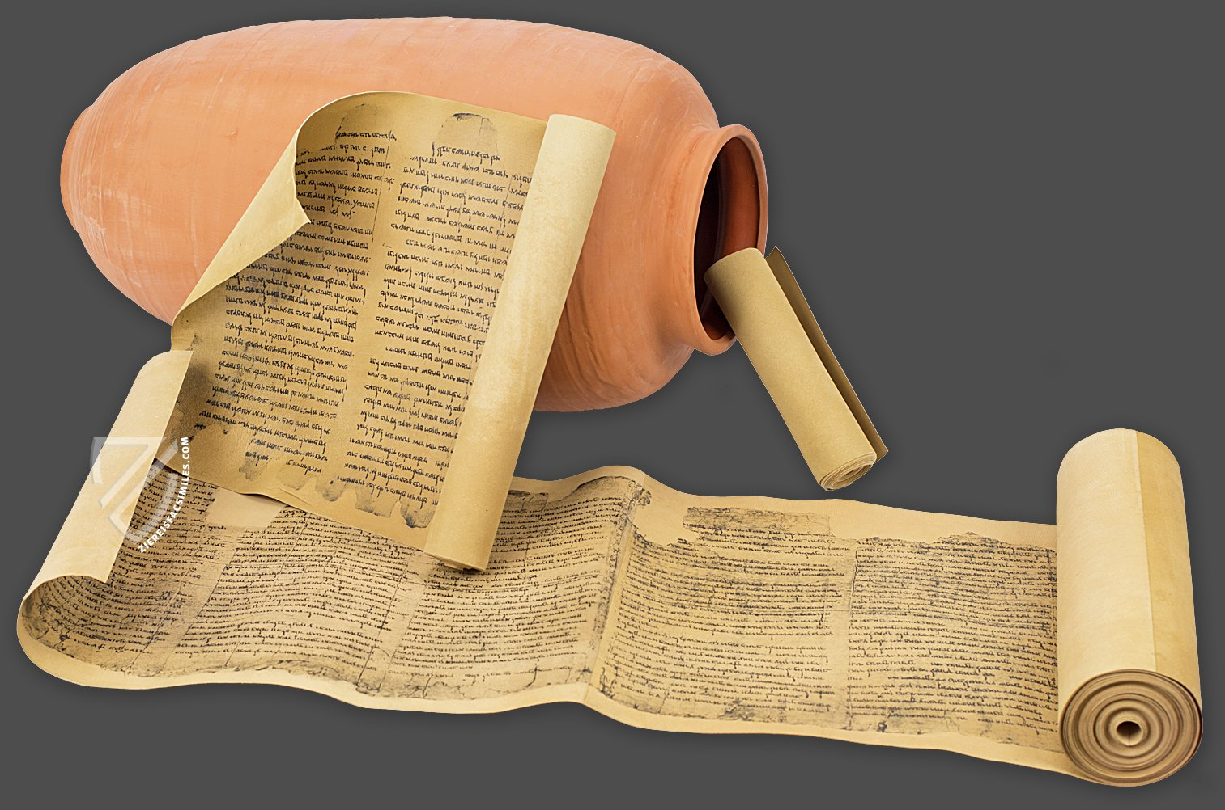
I. The Evidence of Old Testament Prophecy
Facsimile of the Isaiah Scroll found at Qumran near the Dead Sea

Slide 6
A Psalm of David Psalm 16:10 (ca. 1000-960 BC)
“For you will not abandon my soul to Sheol, or let your holy one see corruption.”
This psalm was written by David who reigned about ca. 1002-969 BC.
This psalm is quoted in Acts 2:27-31 and again in 13:35 as predicting the resurrection of the Lord’s Messiah.
The subject of the Psalm is not David himself but “your Holy One.”
Peter said, “Brothers, I may say to you with confidence about the patriarch David that he both died and was buried, and his tomb is with us to this day. Being therefore a prophet, and knowing that God had sworn with an oath to him that he would set one of his descendants on his throne, he foresaw and spoke about the resurrection of the Christ, that he was not abandoned to Hades, nor did his flesh see corruption” (Acts 2:29-31).

Slide 7
Psalm 22: The Psalm of the Cross
“My God, my God, why have you forsaken me?” (22:1).
“All who see me mock me; they make mouths at me; they wag their heads; He trusts in the Lord; let him deliver him; let him rescue him, for he delights in him!” (22:7-8).
“Many bulls encompass me; strong bulls of Bashan surround me; they open wide their mouths at me, like a ravening and roaring lion. I am poured out like water, and all my bones are out of joint; my heart is like wax; it is melted within my breast; my strength is dried up like a potsherd, and my tongue sticks to my jaws; you lay me in the dust of death. For dogs encompass me; a company of evildoers encircles me; they have pierced my hands and feet— I can count all my bones— they stare and gloat over me; they divide my garments among them, and for my clothing they cast lots” (22:12-18).

Slide 8
The Victory
“But you, O Lord, do not be far off! O you my help, come quickly to my aid! Deliver my soul from the sword, my precious life from the power of the dog! Save me from the mouth of the lion!
“You have rescued me from the horns of the wild oxen!
“I will tell of your name to my brothers; in the midst of the congregation I will praise you: You who fear the Lord, praise him! All you offspring of Jacob, glorify him, and stand in awe of him, all you offspring of Israel!” (Psa. 22:19-23).

Slide 9
Isaiah 53 Written ca. 742-700 BC
“He was despised and rejected by men, a man of sorrows and acquainted with grief; and as one from whom men hide their faces he was despised, and we esteemed him not. Surely he has borne our griefs and carried our sorrows; yet we esteemed him stricken, smitten by God, and afflicted. But he was pierced for our transgressions; he was crushed for our iniquities; upon him was the chastisement that brought us peace, and with his wounds we are healed. All we like sheep have gone astray; we have turned—every one—to his own way; and the Lord has laid on him the iniquity of us all” (53:3-6).

Slide 10
Isaiah 53 Written ca. 742-700 BC
He dies: “He was oppressed, and he was afflicted, yet he opened not his mouth; like a lamb that is led to the slaughter, and like a sheep that before its shearers is silent, so he opened not his mouth. By oppression and judgment he was taken away; and as for his generation, who considered that he was cut off out of the land of the living, stricken for the transgression of my people? And they made his grave with the wicked and with a rich man in his death, although he had done no violence, and there was no deceit in his mouth” (53:7-9).
Yet, God prolongs His days: “Yet it was the will of the Lord to crush him; he has put him to grief; when his soul makes an offering for guilt, he shall see his offspring; he shall prolong his days; the will of the Lord shall prosper in his hand” (53:10).

Slide 11
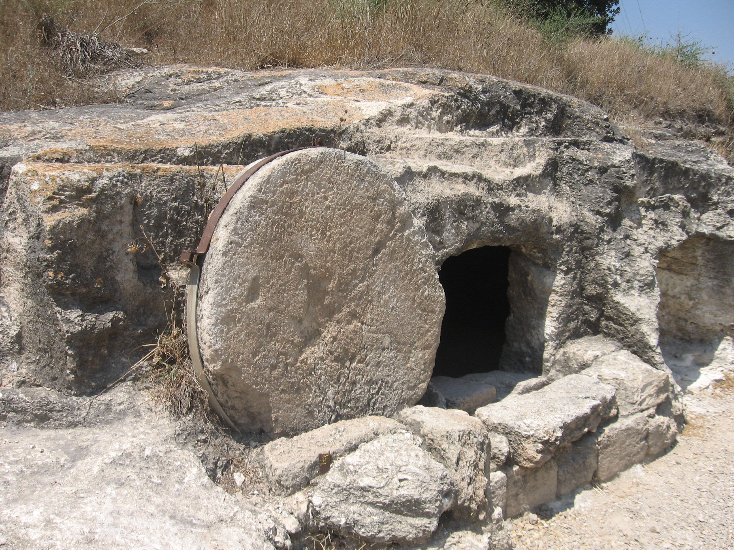
II. The Stone Was Removed
A rolling-stone grave in Galilee

Slide 12
The Burial of Jesus
Jesus was not buried by the Twelve. Two members of the Sanhedrin, Joseph of Arimathea and Nicodemus, requested Jesus’s body and buried it.
A great stone was rolled over the entrance to the tomb: “And Joseph took the body and wrapped it in a clean linen shroud and laid it in his own new tomb, which he had cut in the rock. And he rolled a great stone to the entrance of the tomb and went away” (Matt. 27:59-60).
The Jews asked Pilate to secure the tomb for three days, lest the disciples come and steal the body: “Pilate said to them, ‘You have a guard of soldiers. Go, make it as secure as you can.’ So they went and made the tomb secure by sealing the stone and setting a guard” (Matt. 28:65-66).

Slide 13
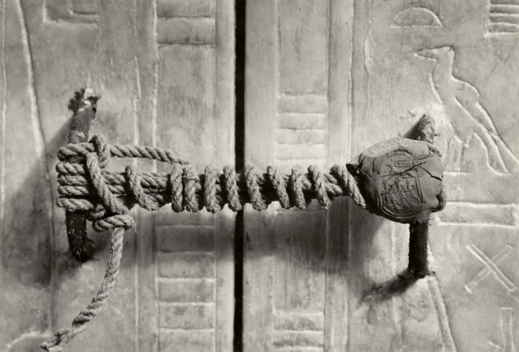
Seal from the tomb of Tutankhamun in Egypt

Slide 14
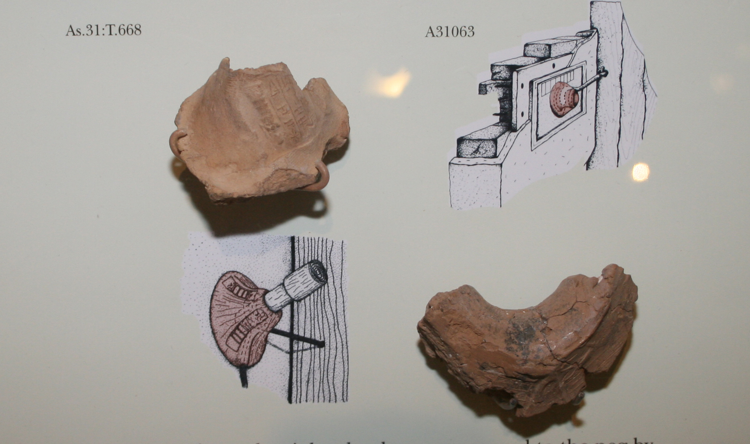
Door Seal Display from Oriental Institute in Chicago, 2008

Slide 15
The Stone Was Rolled Away
“When the Sabbath was past, Mary Magdalene, Mary the mother of James, and Salome bought spices, so that they might go and anoint him. And very early on the first day of the week, when the sun had risen, they went to the tomb. And they were saying to one another, ‘Who will roll away the stone for us from the entrance of the tomb?’” (Mark 16:1-3).
All four evangelists record that the stone was rolled away:
“And looking up, they saw that the stone had been rolled back—it was very large” (Mark 16:4).
“And they found the stone rolled away from the tomb” (Luke 24:2).
“Now on the first day of the week Mary Magdalene came to the tomb early, while it was still dark, and saw that the stone had been taken away from the tomb” (John 20:1).

Slide 16
Who Rolled Away the Stone?
Not the Roman guards
Not the Jewish leaders
Not the disciples
“And behold, there was a great earthquake, for an angel of the Lord descended from heaven and came and rolled back the stone and sat on it” (Matt. 28:2).

Slide 17
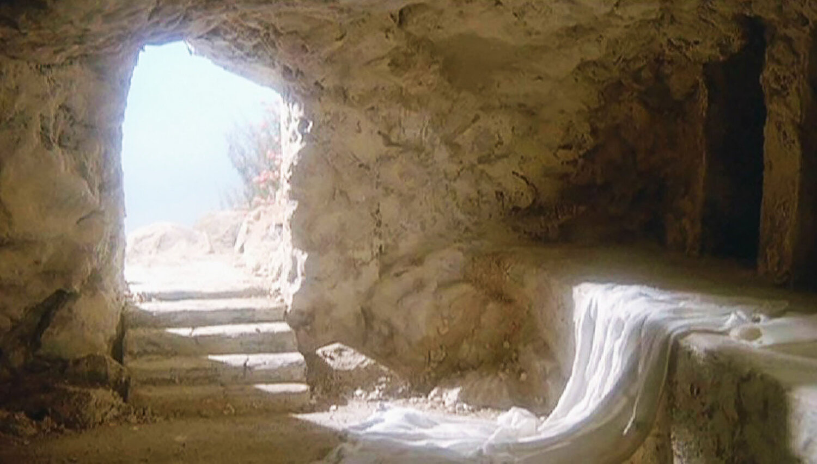
III. The Tomb Was Empty

Slide 18
The Empty Tomb
“While they were going, behold, some of the guard went into the city and told the chief priests all that had taken place. And when they had assembled with the elders and taken counsel, they gave a sufficient sum of money to the soldiers and said, ‘Tell people, “His disciples came by night and stole him away while we were asleep.”’ And if this comes to the governor’s ears, we will satisfy him and keep you out of trouble” (Matt. 28:11-14).
The empty tomb is also confirmed by eyewitnesses:
The women (Mary Magdelene, Mary the mother of James, and Salome, Mark 16:1; Joanna and “the other women with them”, Luke 24:10) who came to anoint the body of Jesus (Matt. 28:1-10).
John and Peter (John 20:2-10).
If the tomb had not been empty, the Jews could have displayed the rotting body of Jesus to prove Jesus had not risen from the dead.

Slide 19
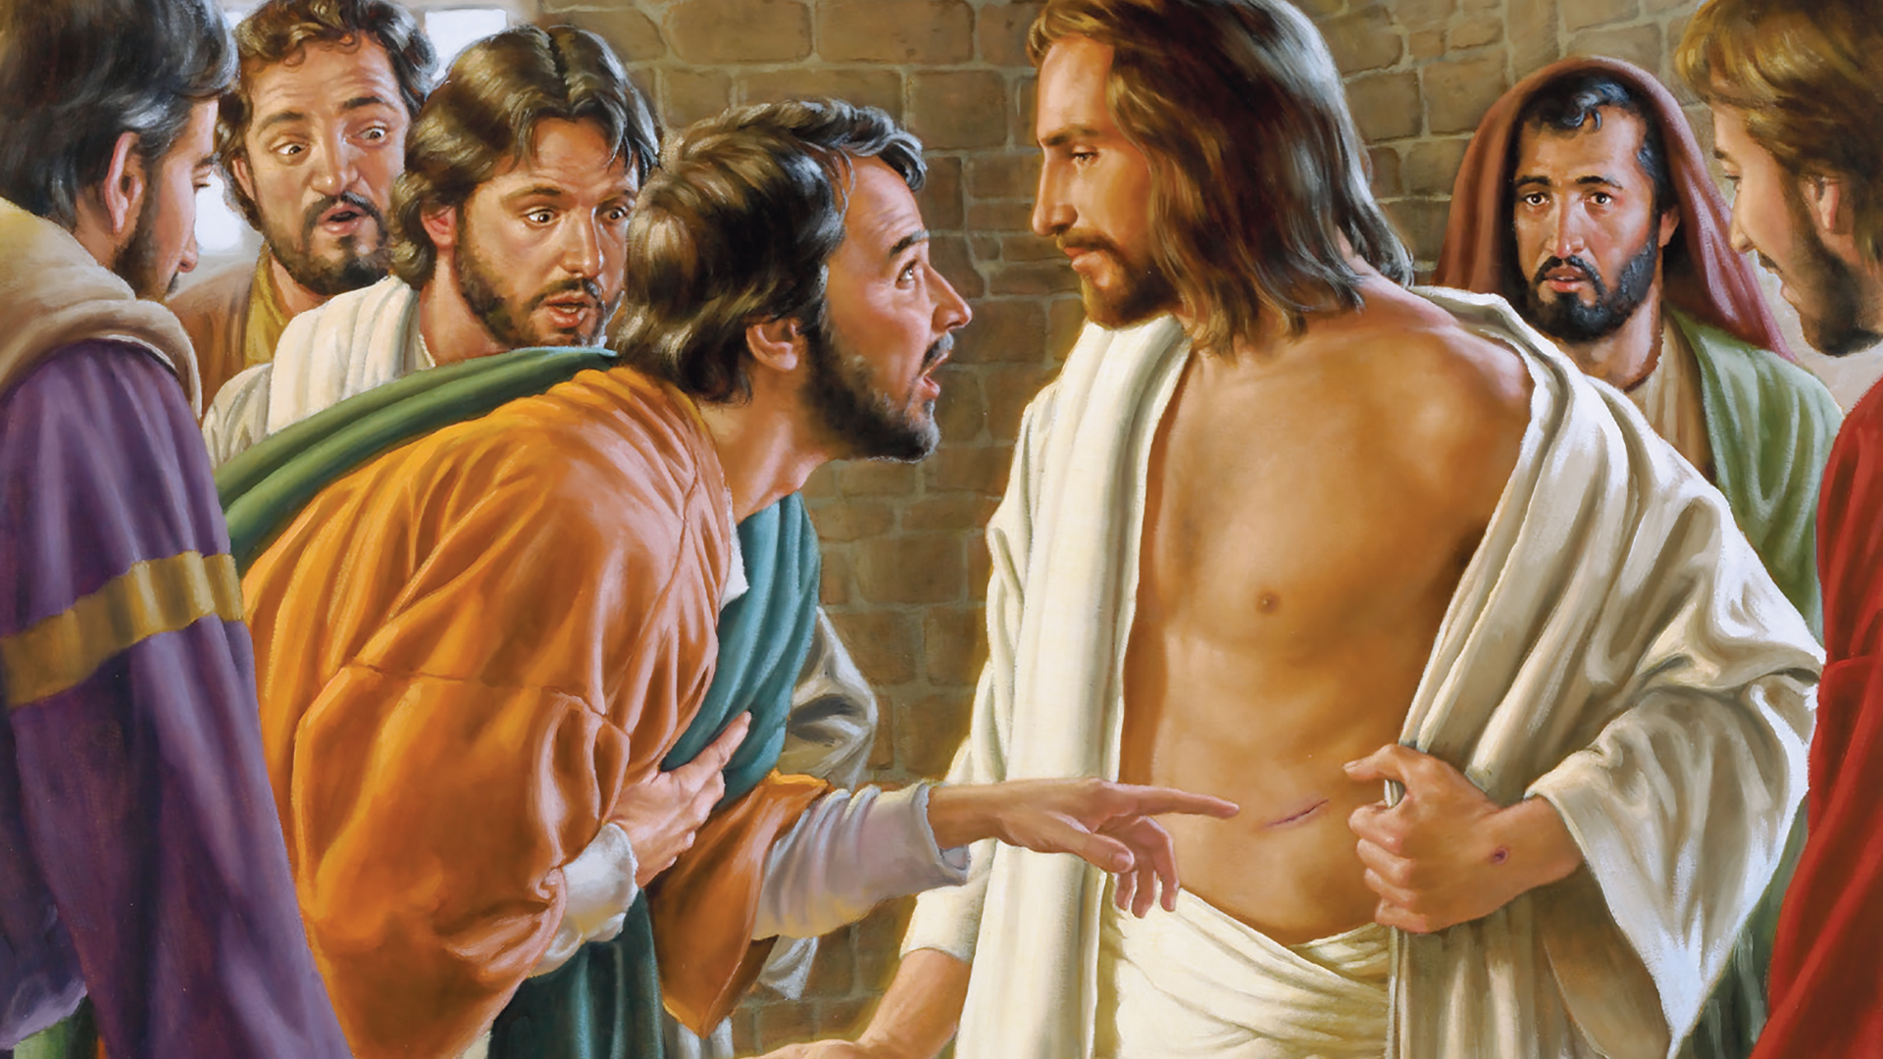
IV. Eyewitnesses Who Saw the Risen Lord

Slide 20
Those Who Saw the Risen Jesus
Mary Magdalene (John 20:11-18). Mary touched Jesus (John 20:17).
Peter (1 Cor. 15:5; Luke 24:34).
To the two walking to Emmaus (Luke 24:13-35). These two men had a long and extended visit with Jesus; they invited him to eat their evening meal together; Jesus said the blessings and then vanished from their sight.
To the Twelve (actually only ten were present; Judas was dead and Thomas was absent) in Jerusalem (Mark 16:14; Luke 24:36-43; John 20:19-25).
Jesus showed them the holes in his hands and his side which the soldier had pierced (Luke 24:39: 20:20).
They handled him to verify that He was not a bodiless spirit.
He ate with them (Luke 24:42-43).
To the Twelve in Jerusalem when Thomas was present (John 20:26-29).
To seven disciples by the Sea of Galilee (John 21:1-24).
Peter, Thomas, Nathanael, James, John, and two other unnamed disciples were present.
They ate breakfast together from food that Jesus had prepared (John 21:9, 13).

Slide 21
Those Who Saw the Risen Jesus
To the Eleven on a mountain in Galilee where He gave the Great Commission (Matt. 28:16-20; Mark 16:15-18).
To more than 500 at one time: “Then he appeared to more than five hundred brothers at one time, most of whom are still alive, though some have fallen asleep” (1 Cor. 15:6).
Jesus appeared to His brother James (1 Cor. 15:7).
At the ascension into heaven (Luke 24:44-53; Acts 1:4-11).
Jesus appeared to Paul (Acts 9:3-7; 22:6-11; 26:12-18; Gal. 1:11-17).

Slide 22
The First Resurrection Appearance to the Twelve
On the evening of that day, the first day of the week, the doors being locked where the disciples were for fear of the Jews, Jesus came and stood among them and said to them, “Peace be with you.” When he had said this, he showed them his hands and his side. Then the disciples were glad when they saw the Lord. Jesus said to them again, “Peace be with you. As the Father has sent me, even so I am sending you.” And when he had said this, he breathed on them and said to them, “Receive the Holy Spirit. If you forgive the sins of any, they are forgiven them; if you withhold forgiveness from any, it is withheld.”

Slide 23
Jesus and Thomas
Now Thomas, one of the twelve, called the Twin, was not with them when Jesus came. So the other disciples told him, “We have seen the Lord.” But he said to them, “Unless I see in his hands the mark of the nails, and place my finger into the mark of the nails, and place my hand into his side, I will never believe.” Eight days later, his disciples were inside again, and Thomas was with them. Although the doors were locked, Jesus came and stood among them and said, “Peace be with you.” Then he said to Thomas, “Put your finger here, and see my hands; and put out your hand, and place it in my side. Do not disbelieve, but believe.” Thomas answered him, “My Lord and my God!” Jesus said to him, “Have you believed because you have seen me? Blessed are those who have not seen and yet have believed.”

Slide 24
1 John 1:1-4
That which was from the beginning, which we have heard, which we have seen with our eyes, which we looked upon and have touched with our hands, concerning the word of life— the life was made manifest, and we have seen it, and testify to it and proclaim to you the eternal life, which was with the Father and was made manifest to us— that which we have seen and heard we proclaim also to you, so that you too may have fellowship with us; and indeed our fellowship is with the Father and with his Son Jesus Christ. And we are writing these things so that our joy may be complete.

Slide 25
The Witnesses
Number of witnesses: Their number is sufficient to prove the facts: 517.
The ability of the witnesses: The witnesses were acquainted with Jesus, so they knew Him.
The agreement of the witnesses:
The cited instances show that they had opportunities to see Him, with others present to verify what they saw.
Their testimony was consistent.

Slide 26
The Witnesses
The honesty and motive of the witnesses:
They were men and women with integrity. They were not unreliable men who would lie for their own benefit, but honest men who told the truth even though it cost them their lives.
The evidence and testimony of Saul of Tarsus, an archenemy of the early Christians, is outstanding evidence.
The testimony of James, the brother of Jesus, who earlier did not believe Jesus was the Christ but after the resurrection became a leader in the church at Jerusalem and a martyr of the faith, is similarly outstanding evidence.

Slide 27
Peter’s Comment About the Witnesses
“And we are witnesses of all that he did both in the country of the Jews and in Jerusalem. They put him to death by hanging him on a tree, but God raised him on the third day and made him to appear, not to all the people but to us who had been chosen by God as witnesses, who ate and drank with him after he rose from the dead” (Acts 10:39-41).

Slide 28
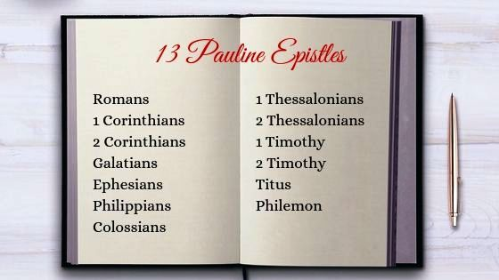
V. The Pauline Letters

Slide 29
The Pauline Letters
Paul’s conversion (ca. AD 36)
Paul’s death (AD 68)
His letters (AD 48-68)
His writings are within 20-40 years of the time of Jesus’s resurrection

Slide 30
The Earliest Letter: Galatians (AD 54-55)
“Paul, an apostle—not from men nor through man, but through Jesus Christ and God the Father, who raised him from the dead—” (1:1).
“For I did not receive it from any man, nor was I taught it, but I received it through a revelation of Jesus Christ. For you have heard of my former life in Judaism, how I persecuted the church of God violently and tried to destroy it. And I was advancing in Judaism beyond many of my own age among my people, so extremely zealous was I for the traditions of my fathers. But when he who had set me apart before I was born, and who called me by his grace, was pleased to reveal his Son to me, in order that I might preach him among the Gentiles, I did not immediately consult with anyone” (1:12-16).
“O foolish Galatians! Who has bewitched you? It was before your eyes that Jesus Christ was publicly portrayed as crucified” (3:2).

Slide 31
1 Corinthians AD 55-56
For I delivered to you as of first importance what I also received: that Christ died for our sins in accordance with the Scriptures, that he was buried, that he was raised on the third day in accordance with the Scriptures, and that he appeared to Cephas, then to the twelve. Then he appeared to more than five hundred brothers at one time, most of whom are still alive, though some have fallen asleep. Then he appeared to James, then to all the apostles. Last of all, as to one untimely born, he appeared also to me (15:3-8).

Slide 32
VI. Pauline Quotations
Scholars identify several passages in Pauline epistles that they believe are either early Christian hymns or early Christian creedal statements.
The Pauline epistles take us back to AD 48 to AD 68.
These songs and creedal statements take us back to an unknown date after the resurrection of Jesus, but before Paul’s letters were written (AD 48-68). Just how early cannot be more exactly known.

Slide 33
Romans 1:1-6
Paul, a servant of Christ Jesus, called to be an apostle, set apart for the gospel of God, which he promised beforehand through his prophets in the holy Scriptures, concerning his Son, who was descended from David according to the flesh and was declared to be the Son of God in power according to the Spirit of holiness by his resurrection from the dead, Jesus Christ our Lord, through whom we have received grace and apostleship to bring about the obedience of faith for the sake of his name among all the nations, including you who are called to belong to Jesus Christ.

Slide 34
1 Corinthians 11:23-26
“For I received from the Lord what I also delivered to you, that the Lord Jesus on the night when he was betrayed took bread, and when he had given thanks, he broke it, and said, ‘This is my body, which is for you. Do this in remembrance of me.’ In the same way also he took the cup, after supper, saying, ‘This cup is the new covenant in my blood. Do this, as often as you drink it, in remembrance of me.’ For as often as you eat this bread and drink the cup, you proclaim the Lord’s death until he comes.”

Slide 35
Philippians 2:5-11
Have this mind among yourselves, which is yours in Christ Jesus, who, though he was in the form of God, did not count equality with God a thing to be grasped, but emptied himself, by taking the form of a servant, being born in the likeness of men. And being found in human form, he humbled himself by becoming obedient to the point of death, even death on a cross. Therefore God has highly exalted him and bestowed on him the name that is above every name, so that at the name of Jesus every knee should bow, in heaven and on earth and under the earth, and every tongue confess that Jesus Christ is Lord, to the glory of God the Father.

Slide 36
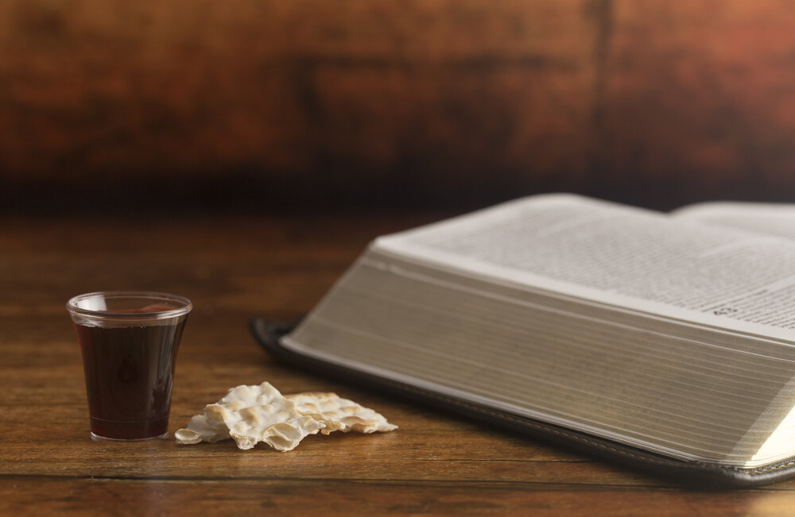
VII. Living Monuments to the Resurrection

Slide 37
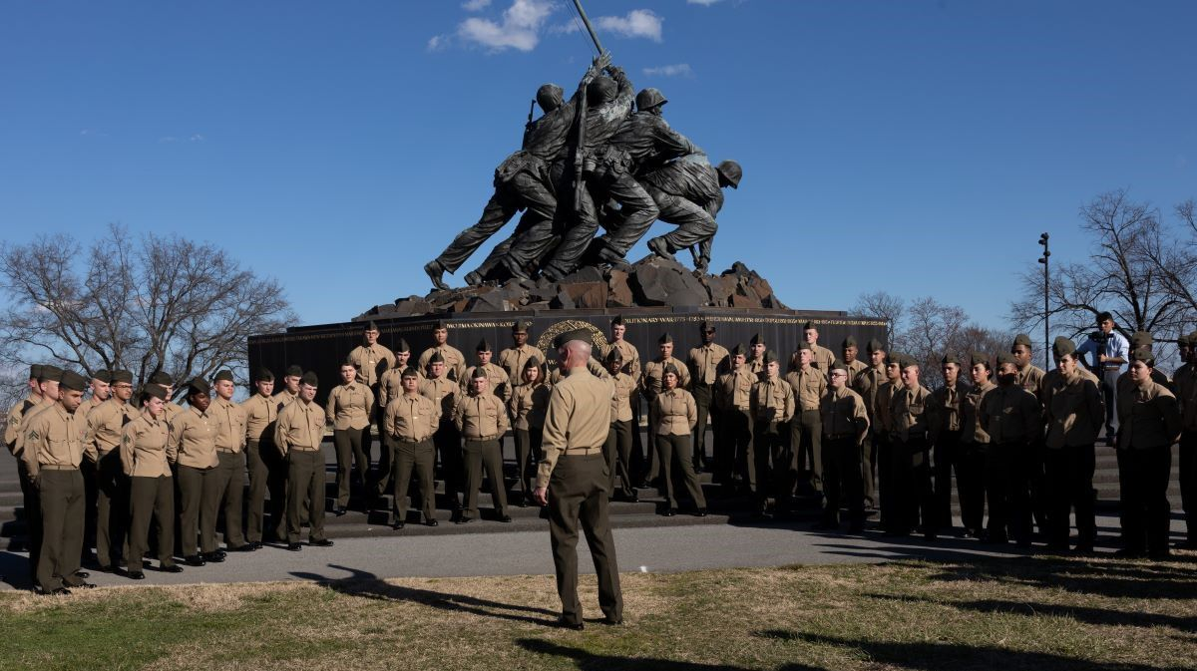
The Battle of Iwo Jima
(19 February – 26 March 1945)

Slide 38
Christian Monuments
A new religion: Christianity.
A different day of worship: The Christian observance of the first day of the week. How does one account for the Christians observing the Lord’s day apart from the resurrection?
The Lord’s supper.
The New Covenant/Testament sealed by the blood of Christ (Matt. 26:28).

Slide 39
Conclusion

Slide 40
The Compelling Evidence
I recognize that believing that someone was raised from the dead and never died again, but ascended into heaven is hard to believe and grasp. It should not be believed unless the preponderance of evidence is so overwhelming that it is the last reasonable alternative.
It is my conviction that this is the case with the evidences for the resurrection. The evidence is so strong and the alternative explanations so weak, that it is more reasonable to believe in the resurrection of Jesus than to deny His resurrection.

