Slide 2
The God Within
Frequently, we have preached lessons to show erroneous beliefs of various denominations.
Some new religions have popped up in America that we have not talked about but, pose serious threat to the Christian religion.

Slide 3
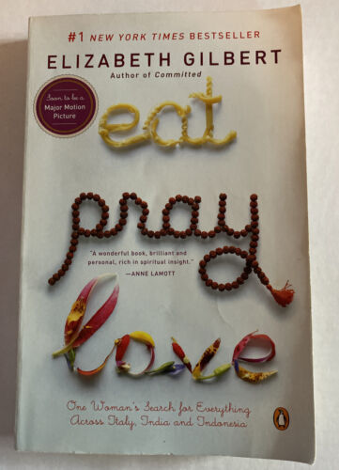
Elizabeth Gilbert (1969-) is an American journalist and author. She is best known for her 2006 memoir, Eat, Pray, Love, which has sold over 12 million copies and has been translated into over 30 languages. The book was also made into a film of the same name in 2010.

Slide 5
Her Personal Story
A dark night for her soul: 3:00 a.m. in her bathroom in Hudson Valley, NY
She fell on her knees in prayer, which she said was a “first for me,” although she had been “some sort of Christian (‘born a Protestant of the White Anglo-Saxon persuasion’), but theologically, she had always been unable to swallow “that one fixed rule of Christianity insisting that Christ is the only path to God” (Douthat, Bad Religion, 211-212).
She called out to God, but a God with open-ended meaning: Whoever might be listening, The Universe, The Great Void, the Force, the Supreme Self, The Whole, The Creator, the Light, The Higher Power

Slide 6
Her Prayer
What she asked God for was a deliverance from her marriage: “I don’t want to be married anymore. I don’t want to be married anymore. I don’t want to live in this big house. I don’t want to have this baby.”

Slide 7
Her God’s Answer
“At long last, someone spoke back. ‘It was not an Old Testament Hollywood Charlton Heston voice,’ Gilbert writes, ‘nor was it a voice telling me I must build a baseball field in my backyard. It was merely my own voice, speaking from within my own self.’ And yet, and yet—‘this was my voice as I had never heard it before. This was my voice, but perfectly wise, calm and compassionate. This was what my voice would sound like if I’d ever experienced love and certainty in my life. How can I describe the warmth of affection in that voice, as it gave me the answer that would forever seal my faith in the divine?’
‘Go back to bed, Liz, the voice told her. So she did. And eventually, fortified by what she describes as more of a “religious conversation” than a “typical Christian conversion experience,” she left the husband and the house and the plans for having kids behind and set out into the unknown” (Douthat, 212).

Slide 8
Her Proof: Two Miracles
He husband signed off to her petition for divorce within an hour of her going through a suggested mental exercise.
Her publisher sent advance money for a trip to Italy, India, and Indonesia which eventually gave birth to her book, Eat, Pray, Love.

Slide 9
Her Religious Quest
Took her to Italy, India, and Indonesia
Resulted in her book, Eat, Pray, Love

Slide 10
Descriptions of Her Religion
There are no right answers.
My religion helps me feel happy (downplaying guilt for sins committed).
Religion is an instrumental means that people use to justify what they want.
My religion makes me feel good and be happy.
You don’t have to be religious to be good.
My religion is personal. Every individual’s religion is different so that it provides what that individual wants.
Religion is about “attaining subjective well-being, being able to resolve problems, and getting along amiably with other people” (Soul Searching, 164).
Referring to this approach to religion as Moralistic, Therapeutic Deism, Christian Smith and Melinda Lundquist Denton said that it “is colonizing many historical religious traditions and, almost without anyone noticing, converting believers in the old faiths to its alternative religious vision of divinely underwritten personal happiness and interpersonal niceness” (Soul Searching, 171).

Slide 12
Isaiah 14:12-21
“How you are fallen from heaven,
O Day Star, son of Dawn!
How you are cut down to the ground,
you who laid the nations low!
You said in your heart,
‘I will ascend to heaven;
above the stars of God
I will set my throne on high;
I will sit on the mount of assembly
in the far reaches of the north;
I will ascend above the heights of the clouds;
I will make myself like the Most High.’
But you are brought down to Sheol,
to the far reaches of the pit.
Those who see you will stare at you
and ponder over you:
‘Is this the man who made the earth tremble,
who shook kingdoms,
who made the world like a desert
and overthrew its cities,
who did not let his prisoners go home?’
All the kings of the nations lie in glory,
each in his own tomb;
but you are cast out, away from your grave,
like a loathed branch,
clothed with the slain, those pierced by the sword,
who go down to the stones of the pit,
like a dead body trampled underfoot.
You will not be joined with them in burial,
because you have destroyed your land,
you have slain your people.
“May the offspring of evildoers
nevermore be named!
Prepare slaughter for his sons
because of the guilt of their fathers,
lest they rise and possess the earth,
and fill the face of the world with cities.”

Slide 13
Despite Claiming to be a Christian Gilbert Did Not Believe the Bible
She had always had trouble with the idea that Jesus is the only way to find eternal life.
“Whoever believes in him is not condemned, but whoever does not believe is condemned already, because he has not believed in the name of the only Son of God” (John 3:18).
“Whoever believes in the Son has eternal life; whoever does not obey the Son shall not see life, but the wrath of God remains on him” (John 3:36).
“I told you that you would die in your sins, for unless you believe that I am he you will die in your sins” (John 8:24).
“I am the way, and the truth, and the life. No one comes to the Father except through me” (John 14:6).

Slide 14
Despite Claiming to Be a Christian She Ignored God’s Word about Marriage
“It was also said, ‘Whoever divorces his wife, let him give her a certificate of divorce.’ But I say to you that everyone who divorces his wife, except on the ground of sexual immorality, makes her commit adultery, and whoever marries a divorced woman commits adultery” (Matt. 5:31-32; 19:9).
“For a married woman is bound by law to her husband while he lives, but if her husband dies she is released from the law of marriage. Accordingly, she will be called an adulteress if she lives with another man while her husband is alive. But if her husband dies, she is free from that law, and if she marries another man she is not an adulteress” (Rom. 7:2-3).
Listening to the God Within, she walked out of her marriage!

Slide 15
Another God
God teaches in both the Old and New Testaments that that “You shall have no other gods before Me” (Exod. 20:3; cf. 1 Cor. 8:4; Eph. 4:6).
Yet, Gilbert began listening to the god within herself!

Slide 16
Led Her to a New Faith
All organized religion offers only partial glimpses of the Divine (God or Inner Light or Being) that all of them pursue, and therefore by their understanding the spiritually adept person must seek to experience God through feeling rather than reason, experience rather than through the study of the Bible, a direct encounter rather than a hand-me-down revelation.
God is everywhere and within everything, but at the same time the best way to encounter the divine is through the god within, the divinity that resides inside your very self and soul.
God’s all-encompassing nature means that sin and death and evil—or what seem like sin and death and evil—will ultimately be reconciled rather than defeated.
Heaven is on earth, “God is right here, right now,” and eternity can be entered at any moment by any person who understands how to let go, let God, and let themselves be washed away in love.

Slide 17
Gilbert’s Own Emotions and Thoughts Are God’s Words
Devotees to the God Within feel free to abandon their daily responsibilities to spouses and children, leaving them to fend for themselves, while they obey the promptings of the God Within.
The God of the Bible teaches spouses and parents to fulfill their marital and parental responsibilities.
From the biblical perspective, the “God Within” is no god at all; the selfish spirit within the person is granting permission to disobey the one true God.
How would one respond to the actions of Jim Jones and David Koresh who followed their god within, killing and abusing many people in the process?
This is the same religious authority as Kevin Costner discovered in Dancing with Wolves and Field of Dreams or George Lucas’s Jedi found in the mystical Force that “surrounds, penetrates us, and binds the galaxy together.”
The God Within movement results in this: “If it feels good, do it!” Far from asking one to put to death the sins of the flesh (Col. 3:5-10), the God Within movements provides salve for your conscious to do whatever you wish.

Slide 18
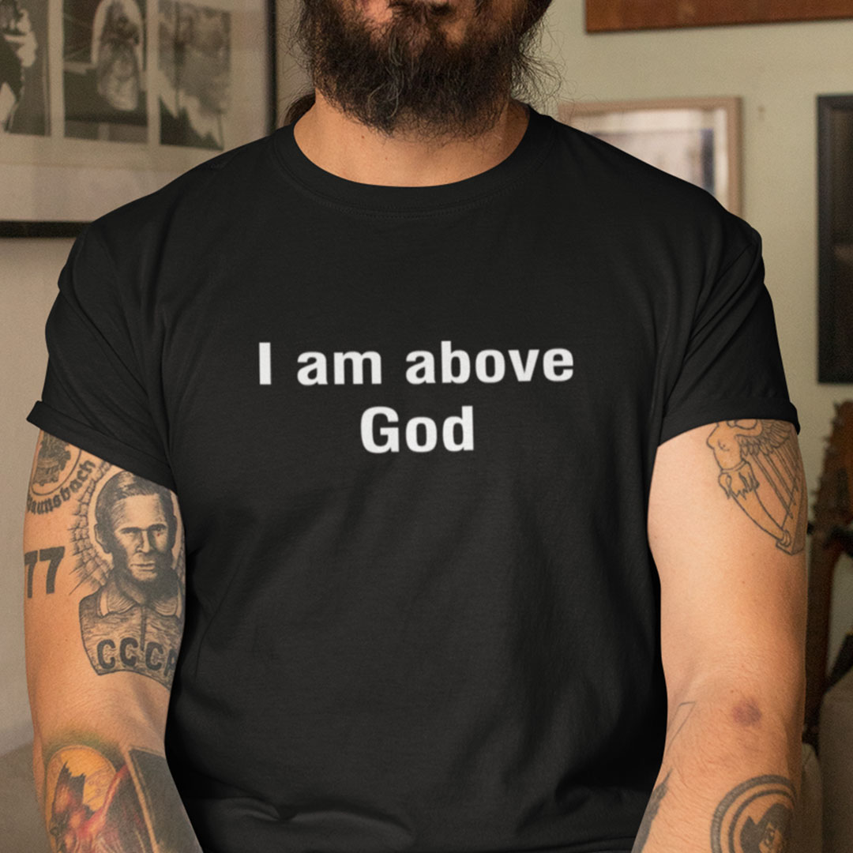
An Assault on God

Slide 19
Its Assault on God
It depersonalizes God and makes Him into an impersonal force.
It makes every person his own god.
This means that there are a little less than 8 billion gods in our world, one for each person.
The idea of “god” has to change:
God allows one person to engage in acts that are sin for another person
God would be unjust for punishing one person and not the other
God would be lying to one or the other of these two persons

Slide 20
It’s Assault on Jesus

Slide 21
Undermining Jesus’s Authority
Gilbert believes that Jesus is not “the way, the truth, and the life” who alone makes access to God possible, despite the clear statements in the Bible to the contrary.
If one person can be saved without Jesus, then all can. If not, why not?
The God Within doctrine is not an innocent mistake; it is an all out assault against faith in God and faith in Jesus.

Slide 22
It Is an Assault on the Bible

Slide 23
An Assault of the Authority of Scripture
There is no hesitancy in saying, “I know the Bible teaches _______, but I don’t believe that.”
The God Within religion ignores those passages warning mankind not to follow his own thoughts and emotions.
“He who trusts in his own heart is a fool” (Prov. 28:26), for “the way of man is not in himself; it is not in man who walks to direct his own steps” (Jer. 10:23).
“There is a way which seems right to a man, but its end is the way of death” (Prov. 14:12).

Slide 24
Listen to Scripture, Not One’s Emotions
Feelings are subjective, they change from person to person and even within the same person. Truth is objective, it remains fixed and does not change, regardless of the person or the year.
The Lord has given to mankind “the Holy Scriptures, which are able to make you wise for salvation” (2 Tim. 3:15).
The knowledge and confidence of salvation can only come from the objective standard of God’s Word. God will judge you by His Word, not by what you feel or experience.
Jesus proclaimed, “. . . the word that I have spoken, the same shall judge him in the last day” (John 12:48).
Instead of the Bible having authority over one’s beliefs and morals, one’s feelings and emotions are that person’s Bible.
You may as well burn your Bible if you are not going to listen to what it says and try to follow it.

Slide 25
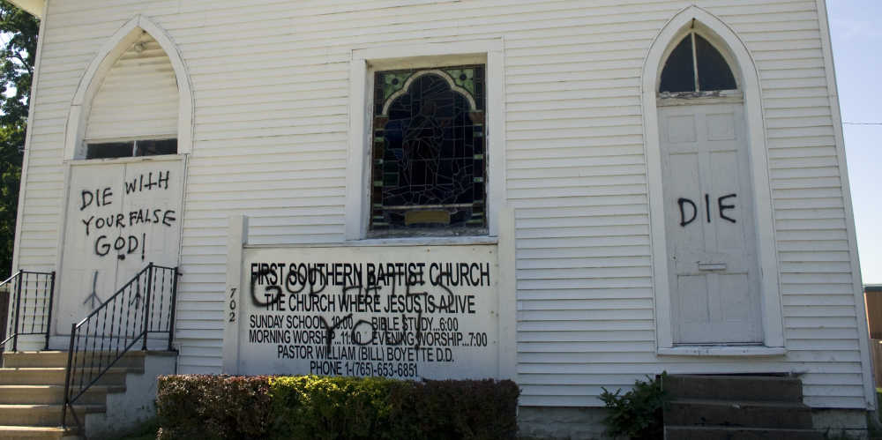
It Is an Assault on the Church

Slide 26
Attacks Against the Church
If a congregation believes and teaches that transgenderism is sinful and homosexual conduct is sinful, someone who follows the leadings of his/her own heart may assault them, as happened in Nashville, TN this last week.
If a congregation believes and teaches that abortion is sinful, they may be attacked.
In the name of everyone following the own leadings of their own heart, there is an intolerance for those who disagree.
When government reaches the belief that there are no universal truths, they will work to stifle those who believe a different truth from what they wish to require. Freedom of religion will end.

Slide 27
There Is One Body
The Scriptures teach that there is “one body” (Eph. 4:4); Christians are expected to have a “common faith” (Jude 3-4).
There can be no common faith if every person has his own personal god who speaks to him through his feelings and emotions.
We might as well close the doors of the church and go home if every person is his own church.

Slide 28
Conclusion

Slide 29
Which God Will Your Serve?
Which God are you serving? Are you serving the God of Scripture or the god within you?
Joshua said long ago what the correct answer is: “Now therefore fear the Lord and serve him in sincerity and in faithfulness. Put away the gods that your fathers served beyond the River and in Egypt, and serve the Lord. And if it is evil in your eyes to serve the Lord, choose this day whom you will serve, whether the gods your fathers served in the region beyond the River, or the gods of the Amorites in whose land you dwell. But as for me and my house, we will serve the Lord” (Josh. 25:14-15).

