Slide 2
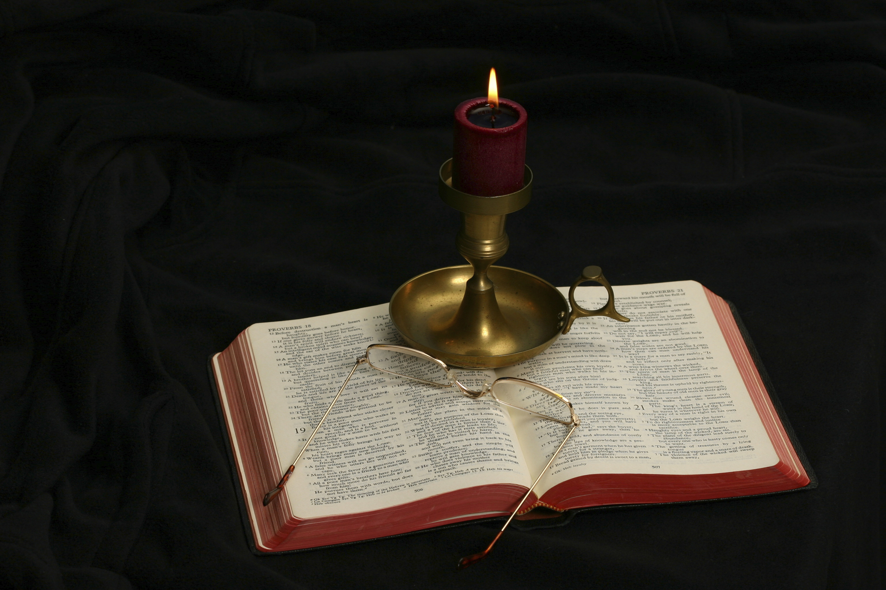
The Gospel of Matthew

Slide 3
The Chronological Order of the Books of the New Testament: The Pauline Epistles
1 Thessalonians 50-51
2 Thessalonians 52
Galatians 50 to 53?
1 Corinthians 57
2 Corinthians 57
Romans 58
His First Prison Epistles
Ephesians 62
Philippians 62
Colossians 62
Philemon 62
His Second Imprisonment
1 Timothy 65
2 Timothy 66
Titus 65

Slide 4
James 50
Hebrews 67
First Peter 67
Second Peter 68
Jude 68
Epistles of John 85
Revelation 96
Luke 63
Acts 64
Mark 66
Matthew 67
John 85
The Chronological Order of the Books of the New Testament: The Other Epistles
Gospels and Acts

Slide 5
The Historical Significance
All of the Pauline Epistles were written between AD 50-65―within 20-35 years of Jesus’s resurrection!
These documents are historical documents, regardless of whether or not one believes them to be inspired of God.
They show us what the earliest Christians believed about Jesus.
There is not enough time between the death, burial and resurrection of Jesus and the earliest Christian writings for myth to have grown up around Jesus.

Slide 6
The Interrelationship of the Synoptics
“Of the three Synoptic Gospels, Mark is the shortest in length. It contains 661 verses; Matthew contains 1,068; Luke contains 1,149. When their content is compared, 97.2 per cent of Mark is paralleled in Matthew and 88.4 per cent is paralled in Luke” (R. H. Stein, “Synoptic Problem,” Dictionary of Jesus and the Gospels, 787).
Matthew and Luke both include material on the birth narrative and the resurrection appearances of Jesus that does not occur in Mark.

Slide 7
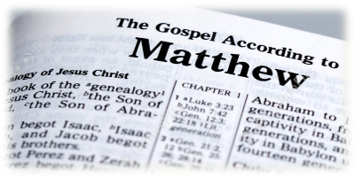
The Author of the Book

Slide 8
About the Book
The phrase “The Gospel According to Matthew” was not written in the autograph (the original document). What appeared at the top of the book was this: “The book of the genealogy of Jesus Christ, the Son of David, the Son of Abraham” (Matt. 1:1).
Some of the existing ancient Greek manuscripts have different a wording in the title.
So why do we think Matthew wrote the book?

Slide 9
The Evidence about Matthew
Eusebius (260/265-339/340) wrote: “Matthew composed his history in the Hebrew dialect, and every one translated it as he was able” (Ecclesiastical History, 3:39).
He was quoting from Irenaeus of Hierapolis in this statement.
Irenaeus (130-200): “These things are attested by Papias, who was John’s hearer and the associate of Polycarp, an ancient writer, who mentions them in the fourth book of his works” (3:39).
Irenaeus quoted his source as Papias (before AD 100)who said: “I shall not hesitate also to put into ordered form for you, along with the interpretations, everything I learned carefully in the past from the elders and noted down carefully, for the truth of which I vouch. For unlike most people I took no pleasure in those who told many different stories, but only in those who taught the truth. Nor did I take pleasure in those who reported their memory of someone else’s commandments, but only in those who reported their memory of the commandments given by the Lord to the faith and proceeding from the Truth itself. And if by chance anyone who had been in attendance on the elders arrived, I made enquiries about the words of the elders—what Andrew or Peter had said, or Philip or Thomas or James or John or Matthew or any other of the Lord’s disciples, and whatever Aristion and John the Elder, the Lord’s disciples, were saying. For I did not think that information from the books would profit me as much as information from a living and surviving voice (3:39).

Slide 10
Matthew’s Authorship
W. D. Davies and D. C. Allison: “There was, as far as we know, no challenge in early Christian times to the Matthean authorship of the First Gospel” (Matthew 1-7, 14).

Slide 11
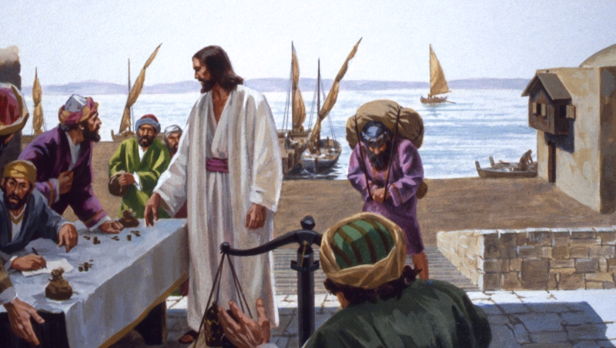
Matthew: The Author

Slide 12
The Call of Matthew
The call of Matthew is recorded in the following Gospels:
Matthew 9:9-13
Mark 2:13-17
Luke 5:27-32
All three of the gospels record the call as occurring immediately after the healing of the paralytic borne of four in the village of Capernaum.

Slide 13
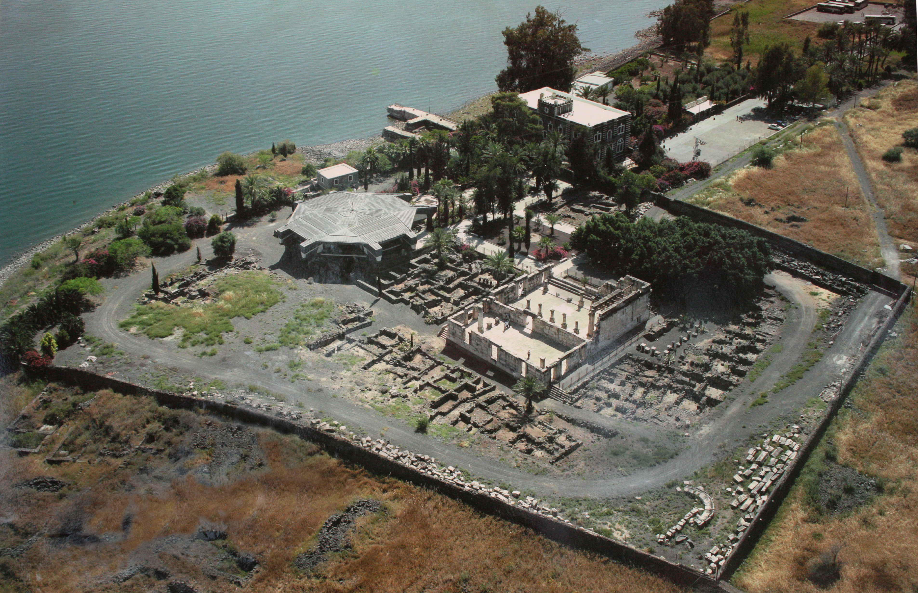
Capernaum

Slide 14
Capernaum
The village of Capernaum was exposed to Jesus.
After Jesus was rejected by Nazareth, He moved His home base to Capernaum (Luke 4:31a) which He called “his own city” (Matt. 9:1; Mark 2:1).
Jesus called Peter, Andrew, James, and John who were fisherman to be His disciples (Matt. 4:18-44; Mark 1:16-20; Luke 5:1-11).
This involved the miraculous draught of fish.
This is followed by a day of miracles at Capernaum:
The man with an unclean spirit (Mark 1:21-34; Luke 4:31-41)
Peter’s mother-in-law was healed (Matt. 8:14; Mark 1:29-30; Luke 4:38-39).
Many others were healed (Matt. 8:15-17; Mark 1:32-34; Luke 4:40-41).
Sometime later, the paralytic borne of four was healed (Matt. 9:1-8; Mark 2:1-12; Luke 5:17-26).

Slide 15
The Call of Matthew
The call of Matthew must be read in the context that the small village of Capernaum is well aware of the miracles Jesus has performed in their village.
Levi/Matthew was a tax collector.
“Direct taxes, that is, taxes on individuals and land, were handled directly by the local government, either the Romans or the tetrarchs, and their clients. Indirect taxes, primarily tolls related to transport of goods, appear to have been farmed out to the highest bidders who contracted to pay a certain sum to the government prior to collection; they and their subordinates then collected as much as they could, since any surplus beyond the contracted amount was profit. Such a system lent itself to corruption, dishonesty, and especially to repression of the poor peasantry who attempted to move their produce to market” (Dennis C. Duling, “Matthew (Disciple),” The Anchor Yale Bible Dictionary, 621).
This led the people to despise the locals responsible for collecting taxes.

Slide 16
Matt. 9:9-13 | Mark 2:13-17 | Luke 5:27-32
As Jesus passed on from there, He saw a man named Matthew sitting at the tax office. And He said to him, “Follow Me.” So he arose and followed Him. Now it happened, as Jesus sat at the table in the house, that behold, many tax collectors and sinners came and sat down with Him and His disciples. And when the Pharisees saw it, they said to His disciples, “Why does your Teacher eat with tax collectors and sinners?” When Jesus heard that, He said to them, “Those who are well have no need of a physician, but those who are sick. But go and learn what this means: ‘I desire mercy and not sacrifice.’ For I did not come to call the righteous, but sinners, to repentance.” | Immediately he arose, took up the bed, and went out in the presence of them all, so that all were amazed and glorified God, saying, “We never saw anything like this!” Then He went out again by the sea; and all the multitude came to Him, and He taught them. As He passed by, He saw Levi the son of Alphaeus sitting at the tax office. And He said to him, “Follow Me.” So he arose and followed Him. Now it happened, as He was dining in Levi’s house, that many tax collectors and sinners also sat together with Jesus and His disciples; for there were many, and they followed Him. And when the scribes and Pharisees saw Him eating with the tax collectors and sinners, they said to His disciples, “How is it that He eats and drinks with tax collectors and sinners?” When Jesus heard it, He said to them, “Those who are well have no need of a physician, but those who are sick. I did not come to call the righteous, but sinners, to repentance.” | After these things He went out and saw a tax collector named Levi, sitting at the tax office. And He said to him, “Follow Me.” So he left all, rose up, and followed Him. Then Levi gave Him a great feast in his own house. And there were a great number of tax collectors and others who sat down with them. And their scribes and the Pharisees complained against His disciples, saying, “Why do You eat and drink with tax collectors and sinners?” Jesus answered and said to them, “Those who are well have no need of a physician, but those who are sick. I have not come to call the righteous, but sinners, to repentance.”

Slide 17
Matt. 9:9-13 | Mark 2:13-17 | Luke 5:27-32
As Jesus passed on from there, He saw a man named Matthew sitting at the tax office. And He said to him, “Follow Me.” So he arose and followed Him. Now it happened, as Jesus sat at the table in the house, that behold, many tax collectors and sinners came and sat down with Him and His disciples. And when the Pharisees saw it, they said to His disciples, “Why does your Teacher eat with tax collectors and sinners?” When Jesus heard that, He said to them, “Those who are well have no need of a physician, but those who are sick. But go and learn what this means: ‘I desire mercy and not sacrifice.’ For I did not come to call the righteous, but sinners, to repentance.” | Immediately he arose, took up the bed, and went out in the presence of them all, so that all were amazed and glorified God, saying, “We never saw anything like this!” Then He went out again by the sea; and all the multitude came to Him, and He taught them. As He passed by, He saw Levi the son of Alphaeus sitting at the tax office. And He said to him, “Follow Me.” So he arose and followed Him. Now it happened, as He was dining in Levi’s house, that many tax collectors and sinners also sat together with Jesus and His disciples; for there were many, and they followed Him. And when the scribes and Pharisees saw Him eating with the tax collectors and sinners, they said to His disciples, “How is it that He eats and drinks with tax collectors and sinners?” When Jesus heard it, He said to them, “Those who are well have no need of a physician, but those who are sick. I did not come to call the righteous, but sinners, to repentance.” | After these things He went out and saw a tax collector named Levi, sitting at the tax office. And He said to him, “Follow Me.” So he left all, rose up, and followed Him. Then Levi gave Him a great feast in his own house. And there were a great number of tax collectors and others who sat down with them. And their scribes and the Pharisees complained against His disciples, saying, “Why do You eat and drink with tax collectors and sinners?” Jesus answered and said to them, “Those who are well have no need of a physician, but those who are sick. I have not come to call the righteous, but sinners, to repentance.”
Like Peter, Matthew had a different Jewish name

Slide 18
Matt. 9:9-13 | Mark 2:13-17 | Luke 5:27-32
As Jesus passed on from there, He saw a man named Matthew sitting at the tax office. And He said to him, “Follow Me.” So he arose and followed Him. Now it happened, as Jesus sat at the table in the house, that behold, many tax collectors and sinners came and sat down with Him and His disciples. And when the Pharisees saw it, they said to His disciples, “Why does your Teacher eat with tax collectors and sinners?” When Jesus heard that, He said to them, “Those who are well have no need of a physician, but those who are sick. But go and learn what this means: ‘I desire mercy and not sacrifice.’ For I did not come to call the righteous, but sinners, to repentance.” | Immediately he arose, took up the bed, and went out in the presence of them all, so that all were amazed and glorified God, saying, “We never saw anything like this!” Then He went out again by the sea; and all the multitude came to Him, and He taught them. As He passed by, He saw Levi the son of Alphaeus sitting at the tax office. And He said to him, “Follow Me.” So he arose and followed Him. Now it happened, as He was dining in Levi’s house, that many tax collectors and sinners also sat together with Jesus and His disciples; for there were many, and they followed Him. And when the scribes and Pharisees saw Him eating with the tax collectors and sinners, they said to His disciples, “How is it that He eats and drinks with tax collectors and sinners?” When Jesus heard it, He said to them, “Those who are well have no need of a physician, but those who are sick. I did not come to call the righteous, but sinners, to repentance.” | After these things He went out and saw a tax collector named Levi, sitting at the tax office. And He said to him, “Follow Me.” So he left all, rose up, and followed Him. Then Levi gave Him a great feast in his own house. And there were a great number of tax collectors and others who sat down with them. And their scribes and the Pharisees complained against His disciples, saying, “Why do You eat and drink with tax collectors and sinners?” Jesus answered and said to them, “Those who are well have no need of a physician, but those who are sick. I have not come to call the righteous, but sinners, to repentance.”
Is the call of Matthew a liability to Jesus’s ministry?
What do you think was the financial status of a tax collector?

Slide 19
Matt. 9:9-13 | Mark 2:13-17 | Luke 5:27-32
As Jesus passed on from there, He saw a man named Matthew sitting at the tax office. And He said to him, “Follow Me.” So he arose and followed Him. Now it happened, as Jesus sat at the table in the house, that behold, many tax collectors and sinners came and sat down with Him and His disciples. And when the Pharisees saw it, they said to His disciples, “Why does your Teacher eat with tax collectors and sinners?” When Jesus heard that, He said to them, “Those who are well have no need of a physician, but those who are sick. But go and learn what this means: ‘I desire mercy and not sacrifice.’ For I did not come to call the righteous, but sinners, to repentance.” | Immediately he arose, took up the bed, and went out in the presence of them all, so that all were amazed and glorified God, saying, “We never saw anything like this!” Then He went out again by the sea; and all the multitude came to Him, and He taught them. As He passed by, He saw Levi the son of Alphaeus sitting at the tax office. And He said to him, “Follow Me.” So he arose and followed Him. Now it happened, as He was dining in Levi’s house, that many tax collectors and sinners also sat together with Jesus and His disciples; for there were many, and they followed Him. And when the scribes and Pharisees saw Him eating with the tax collectors and sinners, they said to His disciples, “How is it that He eats and drinks with tax collectors and sinners?” When Jesus heard it, He said to them, “Those who are well have no need of a physician, but those who are sick. I did not come to call the righteous, but sinners, to repentance.” | After these things He went out and saw a tax collector named Levi, sitting at the tax office. And He said to him, “Follow Me.” So he left all, rose up, and followed Him. Then Levi gave Him a great feast in his own house. And there were a great number of tax collectors and others who sat down with them. And their scribes and the Pharisees complained against His disciples, saying, “Why do You eat and drink with tax collectors and sinners?” Jesus answered and said to them, “Those who are well have no need of a physician, but those who are sick. I have not come to call the righteous, but sinners, to repentance.”
What does Matthew’s response to the call “come follow me” show you about his character?
How does Matthew’s response compare with other people in Capernaum (Matt. 11:23)?

Slide 20
Matt. 9:9-13 | Mark 2:13-17 | Luke 5:27-32
As Jesus passed on from there, He saw a man named Matthew sitting at the tax office. And He said to him, “Follow Me.” So he arose and followed Him. Now it happened, as Jesus sat at the table in the house, that behold, many tax collectors and sinners came and sat down with Him and His disciples. And when the Pharisees saw it, they said to His disciples, “Why does your Teacher eat with tax collectors and sinners?” When Jesus heard that, He said to them, “Those who are well have no need of a physician, but those who are sick. But go and learn what this means: ‘I desire mercy and not sacrifice.’ For I did not come to call the righteous, but sinners, to repentance.” | Immediately he arose, took up the bed, and went out in the presence of them all, so that all were amazed and glorified God, saying, “We never saw anything like this!” Then He went out again by the sea; and all the multitude came to Him, and He taught them. As He passed by, He saw Levi the son of Alphaeus sitting at the tax office. And He said to him, “Follow Me.” So he arose and followed Him. Now it happened, as He was dining in Levi’s house, that many tax collectors and sinners also sat together with Jesus and His disciples; for there were many, and they followed Him. And when the scribes and Pharisees saw Him eating with the tax collectors and sinners, they said to His disciples, “How is it that He eats and drinks with tax collectors and sinners?” When Jesus heard it, He said to them, “Those who are well have no need of a physician, but those who are sick. I did not come to call the righteous, but sinners, to repentance.” | After these things He went out and saw a tax collector named Levi, sitting at the tax office. And He said to him, “Follow Me.” So he left all, rose up, and followed Him. Then Levi gave Him a great feast in his own house. And there were a great number of tax collectors and others who sat down with them. And their scribes and the Pharisees complained against His disciples, saying, “Why do You eat and drink with tax collectors and sinners?” Jesus answered and said to them, “Those who are well have no need of a physician, but those who are sick. I have not come to call the righteous, but sinners, to repentance.”
What do we learn about Matthew from this part of the narrative?
Why did he give this feast?

Slide 21
Matt. 9:9-13 | Mark 2:13-17 | Luke 5:27-32
As Jesus passed on from there, He saw a man named Matthew sitting at the tax office. And He said to him, “Follow Me.” So he arose and followed Him. Now it happened, as Jesus sat at the table in the house, that behold, many tax collectors and sinners came and sat down with Him and His disciples. And when the Pharisees saw it, they said to His disciples, “Why does your Teacher eat with tax collectors and sinners?” When Jesus heard that, He said to them, “Those who are well have no need of a physician, but those who are sick. But go and learn what this means: ‘I desire mercy and not sacrifice.’ For I did not come to call the righteous, but sinners, to repentance.” | Immediately he arose, took up the bed, and went out in the presence of them all, so that all were amazed and glorified God, saying, “We never saw anything like this!” Then He went out again by the sea; and all the multitude came to Him, and He taught them. As He passed by, He saw Levi the son of Alphaeus sitting at the tax office. And He said to him, “Follow Me.” So he arose and followed Him. Now it happened, as He was dining in Levi’s house, that many tax collectors and sinners also sat together with Jesus and His disciples; for there were many, and they followed Him. And when the scribes and Pharisees saw Him eating with the tax collectors and sinners, they said to His disciples, “How is it that He eats and drinks with tax collectors and sinners?” When Jesus heard it, He said to them, “Those who are well have no need of a physician, but those who are sick. I did not come to call the righteous, but sinners, to repentance.” | After these things He went out and saw a tax collector named Levi, sitting at the tax office. And He said to him, “Follow Me.” So he left all, rose up, and followed Him. Then Levi gave Him a great feast in his own house. And there were a great number of tax collectors and others who sat down with them. And their scribes and the Pharisees complained against His disciples, saying, “Why do You eat and drink with tax collectors and sinners?” Jesus answered and said to them, “Those who are well have no need of a physician, but those who are sick. I have not come to call the righteous, but sinners, to repentance.”
What is Jesus saying in His response to the Pharisees’ criticism?

Slide 22
Matt. 9:9-13 | Mark 2:13-17 | Luke 5:27-32
As Jesus passed on from there, He saw a man named Matthew sitting at the tax office. And He said to him, “Follow Me.” So he arose and followed Him. Now it happened, as Jesus sat at the table in the house, that behold, many tax collectors and sinners came and sat down with Him and His disciples. And when the Pharisees saw it, they said to His disciples, “Why does your Teacher eat with tax collectors and sinners?” When Jesus heard that, He said to them, “Those who are well have no need of a physician, but those who are sick. But go and learn what this means: ‘I desire mercy and not sacrifice.’ For I did not come to call the righteous, but sinners, to repentance.” | Immediately he arose, took up the bed, and went out in the presence of them all, so that all were amazed and glorified God, saying, “We never saw anything like this!” Then He went out again by the sea; and all the multitude came to Him, and He taught them. As He passed by, He saw Levi the son of Alphaeus sitting at the tax office. And He said to him, “Follow Me.” So he arose and followed Him. Now it happened, as He was dining in Levi’s house, that many tax collectors and sinners also sat together with Jesus and His disciples; for there were many, and they followed Him. And when the scribes and Pharisees saw Him eating with the tax collectors and sinners, they said to His disciples, “How is it that He eats and drinks with tax collectors and sinners?” When Jesus heard it, He said to them, “Those who are well have no need of a physician, but those who are sick. I did not come to call the righteous, but sinners, to repentance.” | After these things He went out and saw a tax collector named Levi, sitting at the tax office. And He said to him, “Follow Me.” So he left all, rose up, and followed Him. Then Levi gave Him a great feast in his own house. And there were a great number of tax collectors and others who sat down with them. And their scribes and the Pharisees complained against His disciples, saying, “Why do You eat and drink with tax collectors and sinners?” Jesus answered and said to them, “Those who are well have no need of a physician, but those who are sick. I have not come to call the righteous, but sinners, to repentance.”
What does “I desire mercy and not sacrifice” say to the Pharisees who criticized Jesus?
What does “I did not call the righteous, but sinners, to repentance” mean to both the Pharisees and publicans assembled?

Slide 23
The Call of the Twelve Apostles
And when He had called His twelve disciples to Him, He gave them power over unclean spirits, to cast them out, and to heal all kinds of sickness and all kinds of disease. Now the names of the twelve apostles are these: first, Simon, who is called Peter, and Andrew his brother; James the son of Zebedee, and John his brother; Philip and Bartholomew; Thomas and Matthew the tax collector; James the son of Alphaeus, and Lebbaeus, whose surname was Thaddaeus; Simon the Canaanite, and Judas Iscariot, who also betrayed Him (Matt. 10:1-4). | And He went up on the mountain and called to Him those He Himself wanted. And they came to Him. Then He appointed twelve, that they might be with Him and that He might send them out to preach, and to have power to heal sicknesses and to cast out demons: Simon, to whom He gave the name Peter; James the son of Zebedee and John the brother of James, to whom He gave the name Boanerges, that is, "Sons of Thunder"; Andrew, Philip, Bartholomew, Matthew, Thomas, James the son of Alphaeus, Thaddaeus, Simon the Cananite; and Judas Iscariot, who also betrayed Him. And they went into a house (Mark 3:13-19). | Now it came to pass in those days that He went out to the mountain to pray, and continued all night in prayer to God. And when it was day, He called His disciples to Himself; and from them He chose twelve whom He also named apostles: Simon, whom He also named Peter, and Andrew his brother; James and John; Philip and Bartholomew; Matthew and Thomas; James the son of Alphaeus, and Simon called the Zealot; Judas the son of James, and Judas Iscariot who also became a traitor (Luke 6:12-16).

Slide 24
Matthew as an Eyewitness
What qualifications must an eyewitness possess in order to give testimony?
To have seen the action about which he gives testimony
Have the ability to verify what he gives testimony to
Honesty
The number of witnesses strengthen one’s testimony
Their agreement (undesigned coincidence)
Conformity to human experience

Slide 25
Matthew’s Qualifications
His leaving everything to follow Jesus testifies to his integrity (honesty)
Traveling with Jesus, he had ample opportunity to witness and examine Jesus’s miracles
No special qualifications are needed to testify to the blind seeing, the deaf hearing, the dead being raised
As a Jew, he knew the opinions, ceremonies, and customs of his people. His gospel shows his familiarity with the Old Testament.

Slide 26
A Unique Qualification
Simon Greenleaf: “And if men of that day were, as in Truth they appear to have been, as much disposed as those of the present time, to evade the payment of public taxes and duties, and to elude, by all possible means, the vigilance of the revenue officers, Matthew must have been familiar with a great variety of forms of fraud, imposture, cunning, and deception, and must have become habitually distrustful, scrutinizing, and cautious; and, of course, much less likely to have been deceived in regard to many of the facts in our Lord’s ministry. . .” (The Testimony of the Evangelists, 14, 15).

Slide 27
Dating Matthew’s Gospel
There is not enough evidence to prove the date decisively.
My reasoning:
Luke finished Acts with Paul still in prison. The most likely reason not to mention the outcome of Paul’s imprisonment was that it had not been decided when Luke finished Acts. Paul was martyred in ca. AD 67 or 68 by Nero (37-68). My ESV Bible says Luke was written in the early 60s.
Mark was written before as shown by Luke’s use of Mark.
All of the three synoptic gospels speak prophetically of the fall of Jerusalem, not in the past tense.
My conclusion is that Matthew was probably the third gospel written and that it was completed ca. AD 67. The introductory note in my ESV Bible says that Matthew was written in the 50s or 60s.
Those who deny that prophecy can occur place all of the synoptics after the fall of Jerusalem in AD 70 and usually date the book in the late 80’s.

Slide 28
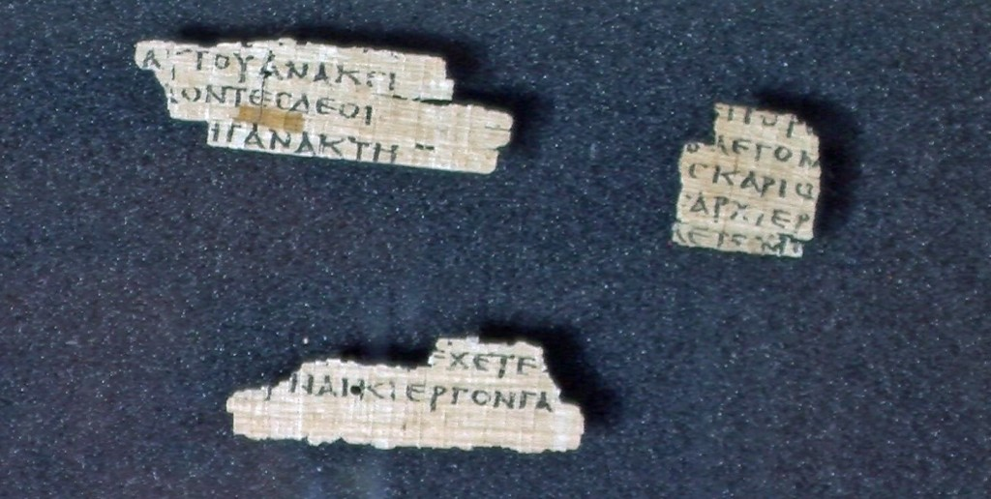
The Magdalen Papyrus
Also known as P⁶⁴ the Magdalen Papyrus was purchased in Luxor, Egypt in 1901 and donated to Magdalen College, Oxford, from which it got its name.
It only contains Matt. 26:23 and 31.
Carsten Peter Thiede dated the fragment to somewhere between AD 37-70, but the majority of scholars date the fragment to AD 200.
If Thiede is correct, Matthew would have been written earlier than I suggested.

Slide 29
Title of the Book
“The book of the genealogy of Jesus Christ, the Son of David, the Son of Abraham” (Matt. 1:1).
The phrase “the book of the geneseōs (the genitive form of genesis) of” appears ten times in Genesis (2:4; 6:9; 10:1; 11:10, 27; 25:12, 19; 36:1, 9; 37:2). The phrase introduces the life of one of the patriarchs, not only his genealogical record.
Matthew is using the phrase in the same way as does Genesis. It is not only a reference to the genealogy of Jesus in 1:2-17, but a title for the entire book.
And, one cannot avoid the implication that this is a new beginning.

Slide 30
The Subject of the New Genesis
Jesus.
Christ. The word appears only 17 times in the KJV and NKJV versions.
By comparison, Paul uses the word 68 times in Romans and 376 times in his 14 letters (Romans through Philemon).
Son of David recalls the Davidic promises (2 Sam. 7:7-14; Psa. 89:3-4,33; 132:11; Isa. 11:1, 10; Jer. 23:5).
Son of Abraham recalls the promises made to Abraham (Gen. 12:3; 18:18-19; 22:18; 26:4-5; Luke 1:32, 69; Acts 2:30-36).

Slide 31
Purpose of the Book
Davies and Allison: “Clearly Matthew’s opening two chapters are intended to demonstrate the Jesus (through his father: 1:16) qualifies as the royal Messiah, the Davidic king (21:9, 15)” (157).
The point is this: Jesus is the fulfillment and culmination of all of the prophecies to bless all families of the earth through the seed of Abraham.
The idea is not that the Old Testament plan of God did not work so He has come up with another idea.
Rather, Jesus is the final fulfillment of God’s plan from eternity.

Slide 32
That It Might Be Fulfilled
One should be alert to those passages in Matthew that read “that it might be fulfilled. . .”
The phrase occurs sixteen times in Matthew’s gospel: 1:22; 2:15, 17, 23; 3:15; 4:14; 5:18; 8:17; 12:17; 13:14; 13:35; 21:2; 26:54, 56; 27:9, 35.
Some of the uses of “fulfilled” are not specific prophecies about a future event, but a use of the word that carries more nearly the meaning that one event is virtually like another (for example, comparing the mourning of Rachel over her descendants being taken into exile to the slaughter of the infants at Bethlehem, 2:17), the complete fulfillment of all things foretold in the Law and prophets (3:15; 5:17; 26:54), or simply to be full (such as a fisherman’s net, 13:48) or “to fill up” (“the measure of your fathers,” 23:32).
This leaves twelve other uses—1:22; 2:15, 23; 3:15; 4:14; 8:17; 12:17; 13:35, 48; 21:4; 26:56; 27:9—in which Matthew argues that the event that transpired in the life of Jesus was the fulfillment of Old Testament prophecy.

Slide 33
Matthean Peculiarities
Matthew has been called the “Old Testament Gospel.” Numerous references and quotations are drawn from the Old Testament, using both the Hebrew Old Testament and the Greek Septuagint. Jewish terminology is used such as “kingdom of heaven,” “kingdom of God,” and “Son of David.”
There are fifteen parables and twenty miracles in Matthew. Ten of these parables and three miracles are unique to the book.
Great addresses are contained in large blocks of teaching: Sermon on the Mount (chap. 5-7), address to the Twelve (chap. 10), parables of the kingdom (chap. 13), denunciation of the scribes and Pharisees (chap. 23), and the Olivet discourse (chaps. 24-25).
The word ekklesia (church) is used twice (16:18; 18:17). Matthew is the only gospel account to make reference to the church.
References to Gentiles are made such as the wise men “from the east” (2:1-12), the centurion in Capernaum (8:5-13), the woman of Canaan (15:21-28), and the command to make disciples of “all the nations” (28:19). The gospel of Matthew may have had a Jewish audience, but it was universal in outlook (Marc Gibson, BTB Matthew, 6).

