Slide 2
The Gospel of Matthew
Chapter 1

Slide 3
Outline of the Chapter 1
The genealogy of Jesus (1:2-17)
Joseph’s acceptance of Mary’s child (1:28-25)

Slide 4
The Genealogy of Jesus (1:2-17)

Slide 5
From Abraham to David | David to the Babylonian Captivity | From Babylonian Captivity to Christ
Abraham | Solomon | Shealtiel
Isaac | Rehoboam | Zerubbabel
Jacob | Abijah | Abiud
Judah | Asa | Eliakim
Perez (and Zerah) by Tamar | Jehoshaphat | Azor
Hezron | Joram | Zadok
Ram | Uzziah | Achim
Amminadab | Jotham | Eliud
Nahshon | Ahaz | Eleazar
Salmon | Hezekiah | Matthan
Boaz by Rahab | Manasseh | Jacob
Obed by Ruth | Amon | Joseph
Jesse | Josiah | Jesus
David by wife of Uriah | Jeconiah and his brothers

Slide 6
From Abraham to David | David to the Babylonian Captivity | From Babylonian Captivity to Christ
Abraham | Solomon | Shealtiel
Isaac | Rehoboam | Zerubbabel
Jacob | Abijah | Abiud
Judah | Asa | Eliakim
Perez (and Zerah) by Tamar | Jehoshaphat | Azor
Hezron | Joram | Zadok
Ram | Uzziah | Achim
Amminadab | Jotham | Eliud
Nahshon | Ahaz | Eleazar
Salmon | Hezekiah | Matthan
Boaz by Rahab | Manasseh | Jacob
Obed by Ruth | Amon | Joseph
Jesse | Josiah | Jesus
David by wife of Uriah | Jeconiah and his brothers
The births of both Isaac and Jesus were miraculous.

Slide 7
Characteristics of the Genealogy
The structure: Three groups of 14 names each
Genealogies:
Horizontal: to emphasize bounds of relationships (kinship)
Vertical: to emphasize position and authority
The genealogy has evidences of telescoping
Three generations are omitted between Uzziah and Jotham (Ahaziah, Jehoash, Amaziah) and “Johoiachin and his brethren” includes Jehoahaz, Jehoiakim, and Zedekiah

Slide 8
Different from Luke’s Genealogy
Luke traces Jesus’s genealogy all the way back to Adam
Luke’s birth narrative focuses on Mary rather than Joseph and the differences between the two genealogies is thought to be that Luke traces the genealogy of Jesus through Mary and Matthew traces it through Joseph.
The two genealogies separate at David, with Luke following David’s son Nathan (3:31) and Matthew following Solomon (1:6) (Gibson, 7).
Luke’s genealogy demonstrates that Mary also was a descendant of David.

Slide 9
The Four Women in the Genealogy
The genealogy mentions four women:
Tamar
Rahab
Ruth
Wife of Uriah (Bathsheba)
Some have tried to show that all four were guilty of immoral acts, but this stumbles over Ruth.
It is more likely that all four were foreign women and points towards God’s interest in saving the Gentiles.

Slide 10
Joseph, the Father of Jesus
When a father accepts a son as his own, the child is considered a legal descendant.
Think about adoption in modern society.
The Misnah says, “If one says: ‘This is my son,’ he is believed, [to cause him to inherit and to exempt his (own) wife from yibum (levirate marriage)]” (Bava Batra 8:6).
Joseph accepts the child as his own.

Slide 11
The Significance of the Genealogy
The genealogy connects the birth of Jesus to the promises given to Abraham that through his seed all families of the earth would be blessed (Gen. 12:1-3; 18:18) and to David that his descendants would sit on the throne of David forever (2 Sam. 7:12-14).
“Throughout Israel’s history these promises often seemed to be in jeopardy, as at the Babylonian captivity. But God remained faithful, despite appearances; and his faithfulness becomes fully and finally manifested in the birth of Jesus, the flower of Judaism and telos of salvation-history, in which the promises to Abraham and David find their yes” (Davies and Allison, 187).

Slide 12
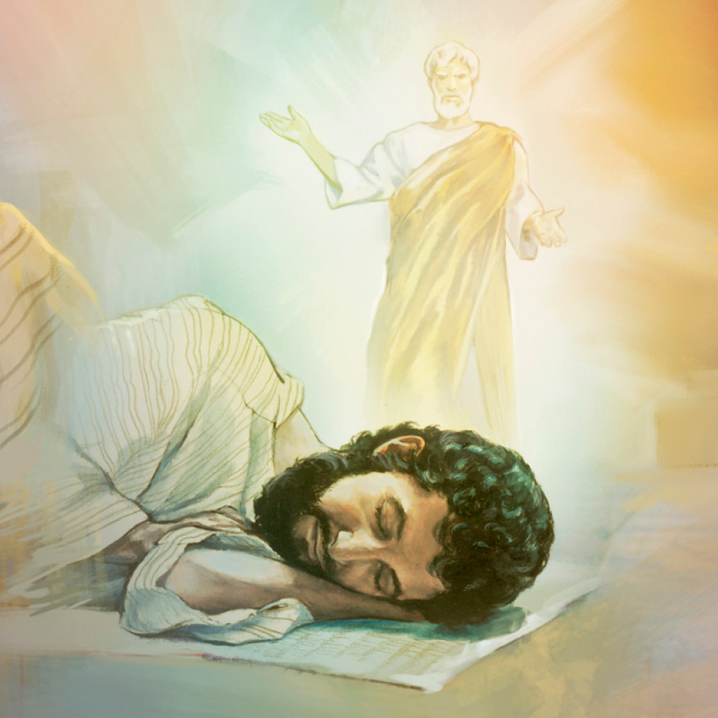
Born of a Virgin and Adopted by Joseph (1:18-25)

Slide 13
Matthew 1:18-25
Now the birth of Jesus Christ was as follows: After His mother Mary was betrothed to Joseph, before they came together, she was found with child of the Holy Spirit. Then Joseph her husband, being a just man, and not wanting to make her a public example, was minded to put her away secretly. But while he thought about these things, behold, an angel of the Lord appeared to him in a dream, saying, “Joseph, son of David, do not be afraid to take to you Mary your wife, for that which is conceived in her is of the Holy Spirit. And she will bring forth a Son, and you shall call His name JESUS, for He will save His people from their sins.” So all this was done that it might be fulfilled which was spoken by the Lord through the prophet, saying: “Behold, the virgin shall be with child, and bear a Son, and they shall call His name Immanuel,” which is translated, “God with us.” Then Joseph, being aroused from sleep, did as the angel of the Lord commanded him and took to him his wife, and did not know her till she had brought forth her firstborn Son. And he called His name JESUS.

Slide 14
Pregnant Outside of Wedlock
Now the birth of Jesus Christ was as follows: After His mother Mary was betrothed to Joseph, before they came together, she was found with child of the Holy Spirit (1:18).
Bethrothed (mnēsteuō): “become engaged” (BDAG, 656).
Sometimes bethrothal happened at a very young age (12 to 12.5 years).
“But about a year typically passed before the woman moved from her parent’s house to her husband’s house. . . . During that time although the marriage was not consummated, the woman was ‘wife’” (Davies and Allison, 199).
Divorce was necessary to terminate the bethrothal.
Came together (sunerchomai): “come together in a sexual context” (BDAG, 970).
Mary’s predicament: “If a young woman who is a virgin is betrothed to a husband, and a man finds her in the city and lies with her, then you shall bring them both out to the gate of that city, and you shall stone them to death with stones, the young woman because she did not cry out in the city, and the man because he humbled his neighbor’s wife; so you shall put away the evil from among you” (Deut. 22:23-24).
Matthew is careful not to criticize Mary: “she was found with child of the Holy Spirit.”

Slide 15
Joseph’s Character (1:19)
Then Joseph her husband, being a just man, and not wanting to make her a public example, was minded to put her away secretly (1:19).
Joseph is just (dikaios): “upright, just, fair, equitable” (BDAG, 246). Luke 1:6 uses the same word to describe Zacharias and Elizabeth.
To make her a public example (paradeigmatizō): “to cause someone to suffer public disgrace or shame—‘to disgrace in public, put to shame’” (Louw-Nida, 1:130).
To put her away (apoluō): “to dissolve a marriage relationship, to divorce” (BDAG, 118).
Obviously, a divorce becomes known in a community.

Slide 16
Joseph’s Options
To bring formal charges against Mary to determine whether she had a consensual relationship or one against her will
To draw up a formal bill of divorce himself without a trial and have it signed by two or three witnesses (Deut. 24:1; Gittim 9.4, 8).

Slide 17
Matthew 1:20-21
But while he thought about these things, behold, an angel of the Lord appeared to him in a dream, saying, “Joseph, son of David, do not be afraid to take to you Mary your wife, for that which is conceived in her is of the Holy Spirit. And she will bring forth a Son, and you shall call His name JESUS, for He will save His people from their sins.”
Matthew provides information about God’s revelation to Joseph.
God was protecting Mary as well as reassuring Joseph of Mary’s fidelity.
Providing revelation through dreams was common in Genesis and Daniel, but only here and in Matt. 2:12, 13, 19, 22; 27:19 in the NT.
Joseph, son of David, acknowledges Joseph’s lineage.
To take a wife (paralabein . . . tēn gunaika) “of one’s wife: take (her) into one’s home” (BDAG, 767).

Slide 18
The Virgin Birth
For that which is conceived in her is of the Holy Spirit.
Luke wrote: “Then Mary said to the angel, ‘How can this be, since I do not know a man?’ And the angel answered and said to her, ‘The Holy Spirit will come upon you, and the power of the Highest will overshadow you; therefore, also, that Holy One who is to be born will be called the Son of God’” (Luke 1:34-35).
Both Matthew and Luke affirm the virgin birth of Jesus.

Slide 19
His Name Is Jesus
And she will bring forth a Son, and you shall call His name JESUS, for He will save His people from their sins.”
There is a play on words between Jesus and “to save.”
The Hebrew word for Jesus is Jeshua‘ (the Old Testament name is translated “Joshua”). The word means “to save” or “to deliver.”
The full name is “Hoshea” – Yahweh is salvation (cf. Num. 13:16)
The deliverance which Jesus was to bring was salvation from sins, not salvation from Roman oppressors.

Slide 20
Matthew 1:22-23
So all this was done that it might be fulfilled which was spoken by the Lord through the prophet, saying: “Behold, the virgin shall be with child, and bear a Son, and they shall call His name Immanuel,” which is translated, “God with us.”
This is the first of the “that it might be fulfilled” arguments, designed to show that Jesus is the Messiah because He fulfilled Old Testament prophecies.
This passage is quoted from Isaiah 7:14.
A copy of the book of Isaiah exists which pre-dates Jesus’s birth by 200 years. Isaiah was not written after the fact.

Slide 21
Isaiah 7:14
“Therefore the Lord Himself will give you a sign: Behold, the virgin shall conceive and bear a Son, and shall call His name Immanuel.”
Ahaz, the king of Judah, had rejected a sign offered to him by Isaiah.
Isaiah responds by giving the house of David a sign.
A virgin shall conceive.
She shall bear a son.
His name will be “Immanuel,” which mean “God with us.”

Slide 22
Matthew 1:24-25
Then Joseph, being aroused from sleep, did as the angel of the Lord commanded him and took to him his wife, and did not know her till she had brought forth her firstborn Son. And he called His name JESUS.
The effect of the angel’s appearance was to convince Joseph to take Mary as his wife and to name the child Jesus.
One notices the obedience of Joseph (cf. the obedience of Mary, Luke 1:38). Jesus was raised by godly parents who put obedience to the word of God above their personal desires.
Can you imagine Joseph explaining to others why he married a woman carrying a child that was not his own?
“Her firstborn son” presupposes that Mary had other children (Matt. 13:55).

