Slide 2
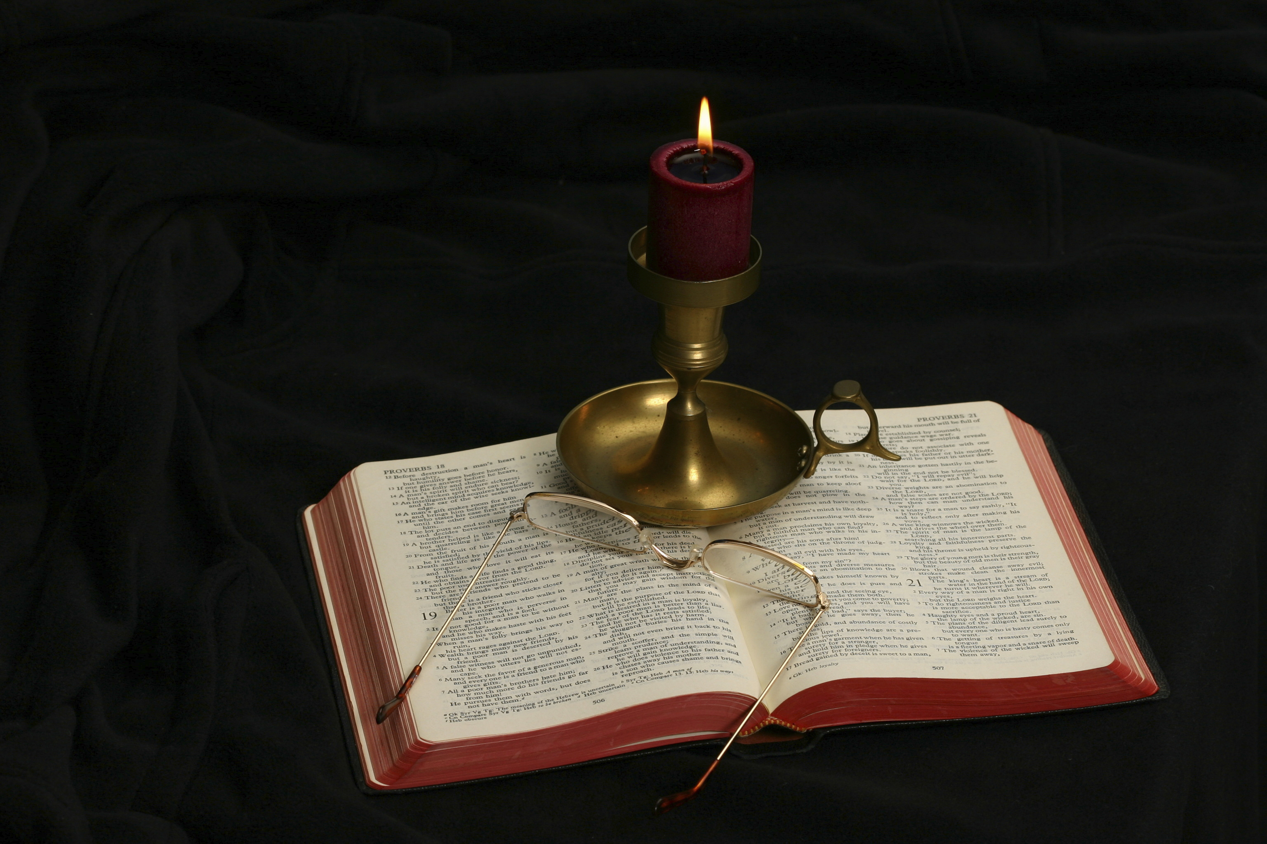
The Gospel of Matthew
Chapter 2

Slide 3
Outline of the Chapter
The visit of the wise men from the east (2:1-12)
The Messiah’s flight and return (2:13-23)
The chapter can also be outlined by geography:
Jerusalem (2:1-8)
Bethlehem (2:9-13)
Egypt (2:14-21)
Nazareth (2:22-23)

Slide 4
Things in Luke Omitted in Matthew
Jesus was circumcised when He was eight days old (Luke 2:21).
He was presented in the Temple when He was forty days old, when the days for Elizabeth’s purification following childbirth had come (Lev. 12:1-5).
When Jesus was presented in the Temple, Simeon prophesied over Him (Luke 2:25-40).

Slide 5
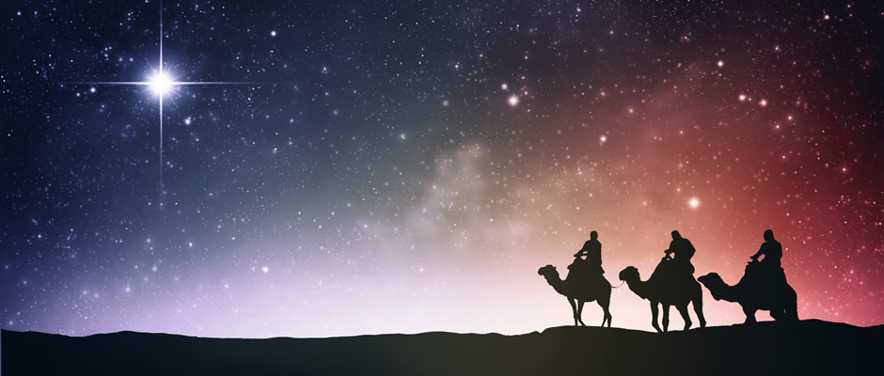
The Visit of the Wise Men (2:1-12)

Slide 6
Matthew 2:1
Now after Jesus was born in Bethlehem of Judea in the days of Herod the king, behold, wise men from the East came to Jerusalem. . .
This text anchors the Jesus narrative geographically and chronologically.
Matthew makes no explanation for Mary and Joseph being in Bethlehem; he only relates that the birth of Jesus had already occurred there when the incident he relates occurred.
Luke relates what caused Mary and Joseph to be in Bethlehem (the taxation) and the narrative of the birth of the child.
“Has not the Scripture said that the Christ comes from the seed of David and from the town of Bethlehem, where David was?” (John 7:42).

Slide 7
In the Days of Herod the Great
Herod (ca. 70-4 BC) was “the king who, by arrangement with Rome, ruled Jewish Palestine from 37 B.C.E. to 4 B.C.E. According to the NT (Matt 2:1–19; cf. Luke 1:5)” (L. I. Levine, “Herod the Great [Person],” The Anchor Yale Bible Dictionary, 3:161).
The year of the death of Herod is the latest date that can be given to the birth of Jesus. Based on the age of the infants that were slain at Bethlehem, the likelihood is that Jesus was born 7-4 BC.
When the Gregorian calendar was introduced in 1582, it accepted that Jesus’s birth marked the change BC to AD set by Dionysius Exiguus in 525 AD.

Slide 8
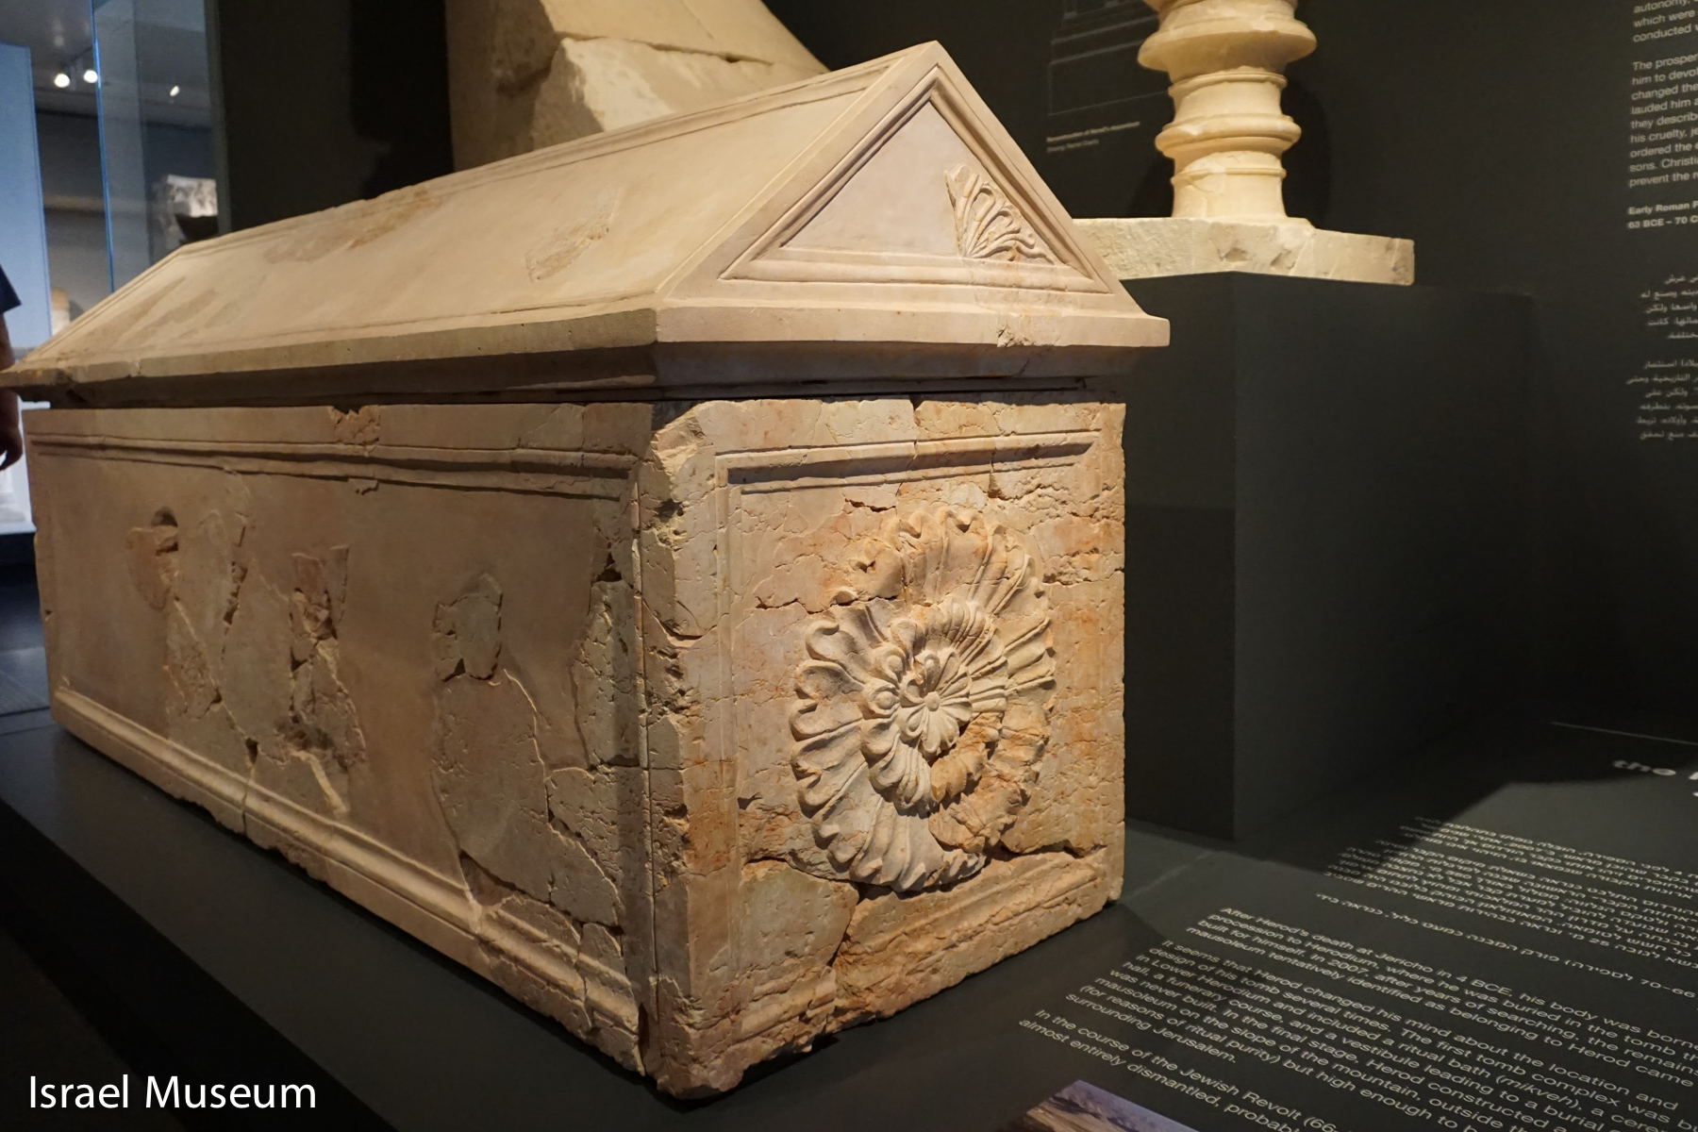
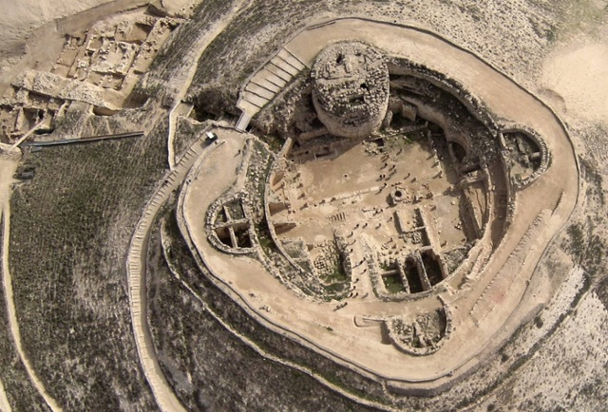
Herod’s Sarcophagus
Herodium

Slide 9
Herod’s Fear of Assassination
Elimination of Political Enemies: Hyrcanus II, former ruler installed by Pompey
When he became ruler of the kingdom, “he slew all the members of this Sanhedrin, and Hyrcanus himself” (Josephus, Antiquities 14.9.4).
Herod was an Idumean; to secure his throne, he married into the Hasmonean family. He married Mariamne (bethrothed at 12 and married at 17 to Herod who was 32) and had five children through her.
Herod set out to eliminate the Hasmonean family.

Slide 10
Herod’s Brutal Personality
He had his son Aristobulus (aged 17) drowned by some of his men at their mother’s (Alexandra) pool at Jericho
Accused his wife Mariamne of adultery when one of Herod’s servants confided a secret to her. The secret was that if Herod was killed, Mariamne was to be slain.
Later, he had Mariamne killed on the charge of attempting to poison Herod; she was 28.
The evidence leads one to believe that Herod had an emotional collapse after murdering his wife.
He murdered his brother-in-law Kostobar for conspiracy
He charged his sons Alexander and Aristobulus with treason and had them put to death
He charged his son Antipater (heir to his throne) with treason and put him to death
He ordered that one out of every prominent family be slain at his death so that they would mourn his passing, although that was not carried out (Josephus, Antiquities, 17.6.6; 17.8.2)
Augustus Caesar is reported to have said, “Better is it to be Herod’s pig (hus) than his son (huios).”

Slide 11
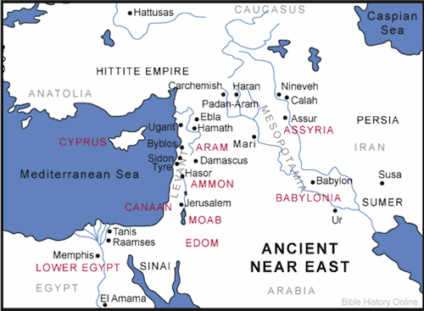
There is no information to determine from where in the East the wise men came.

Slide 12
Wise Men from the East
The words wise men are translated from the Greek word magoi.
The word is defined as “a (Persian . . . , then also Babylonian) wise man and priest, who was expert in astrology, interpretation of dreams and various other occult arts” (BAGD, 608).
The word appears three times in this chapter (2:1, 7, 16) and then two times in Acts 13:6, 8 to describe Elymas, Bar Jesus. There the word is translated “sorcerer” (KJV, NKJV) or “magician” (RSV).
The text is not giving an endorsement to the pagan religions that were practiced in those regions.
The Bible does not tell us that the wise men were kings, nor that there were just three of them.
Why is the narrative of the visit of the wise men given?

Slide 13
Prophecies about the Gentiles
“And in that day there shall be a Root of Jesse, Who shall stand as a banner to the people; For the Gentiles shall seek Him, And His resting place shall be glorious” (Isa. 11:10).
“Behold! My Servant whom I uphold, My Elect One in whom My soul delights! I have put My Spirit upon Him; He will bring forth justice to the Gentiles” (Isa. 42:1).
“I, the Lord, have called You in righteousness, And will hold Your hand; I will keep You and give You as a covenant to the people, As a light to the Gentiles” (Isa. 42:6).
“Go therefore and make disciples of all the nations, baptizing them in the name of the Father and of the Son and of the Holy Spirit” (Matt. 28:19).

Slide 14
Matthew 2:2
. . .saying, “Where is He who has been born King of the Jews? For we have seen His star in the East and have come to worship Him.”
What news do the wise men bring?
There is no way possible for the wise men to have arrived in Jerusalem on the same night as Jesus was born, if the star appeared at His birth.
What did the magi see?
Men have identified this with Halley’s Comet or another comet visible at the time, an alignment of planets, such as Jupiter, Saturn, and Venus that took place early in 7 BC, or a supernova.
There is no natural explanation of a miracle.
Through whatever means, these wise men concluded that the star represented the “King of the Jews.”

Slide 15
His Star
The star reminds the reader of the prophecy of Balaam, the prophet from Pethor, near the Euphrates in central Syria (Anchor Bible Dictionary, 5:288).
Balaam foretold the following: “I see Him, but not now; I behold Him, but not near; A Star shall come out of Jacob; A Scepter shall rise out of Israel, And batter the brow of Moab, And destroy all the sons of tumult” (Num. 24:17).
This a messianic prophecy from a “prophet” from the East.
Contemporary people at Qumran understood it to be speaking of the Messiah (CD 7.18-26).

Slide 16
Why Did the Wise Men Travel So Far?
What was their purpose in traveling from the East to Jerusalem?
Who can be worshipped? What did they believe about the new king?
What difference do you notice between Herod’s reaction to the news and these magi?
The phrase “king of the Jews” appears four times in Matthew:
Here at 2:2
Three times during Jesus’s trial:
Pilate asked Jesus, “Are you King of the Jews?” (27:11).
The soldiers mocked Jesus saying, “Hail, King of the Jews” (27:29)
On the inscription written on the cross: “Jesus the King of the Jews” (27:37)
In every case it is spoken by a Gentile!

Slide 17
Matthew 2:3
When Herod the king heard this, he was troubled, and all Jerusalem with him.
Why was Herod affected the way he was?
Why was “all Jerusalem troubled . . . with him”?
How would you expect Jerusalem to act upon receiving knowledge that the “King of the Jews” had been born?

Slide 18
Matthew 2:4
And when he had gathered all the chief priests and scribes of the people together, he inquired of them where the Christ was to be born.
Who are the chief priests and scribes?
Why are they selected to learn this information?

Slide 19
Matthew 2:5-6
So they said to him, “In Bethlehem of Judea, for thus it is written by the prophet: ‘But you, Bethlehem, in the land of Judah, Are not the least among the rulers of Judah; For out of you shall come a Ruler Who will shepherd My people Israel.’”
The chief priests and scribes cite Micah 5:2 to provide an answer to this question.
“Has not the Scripture said that the Christ comes from the seed of David and from the town of Bethlehem, where David was?” (John 7:42).

Slide 20
Micah 5:1-3
Now gather yourself in troops, O daughter of troops; He has laid siege against us; They will strike the judge of Israel with a rod on the cheek. “But you, Bethlehem Ephrathah, Though you are little among the thousands of Judah, Yet out of you shall come forth to Me The One to be Ruler in Israel, Whose goings forth are from of old, From everlasting.” Therefore He shall give them up, Until the time that she who is in labor has given birth; Then the remnant of His brethren Shall return to the children of Israel.
What do you learn about the Messiah from this passage?
Where would one expect the Messiah to be born?
Cf. Abraham Lincoln’s birthplace (memorial in Hodgensville, KY)
What does one learn about the coming “Ruler in Israel”?

Slide 21
Matthew 2:5-6
So they said to him, “In Bethlehem of Judea, for thus it is written by the prophet: ‘But you, Bethlehem, in the land of Judah, Are not the least among the rulers of Judah; For out of you shall come a Ruler Who will shepherd My people Israel.’”
The chief priests and scribes cite Micah 5:2 to provide an answer to this question.
What does their citing of this passage show about the first century understanding of Micah 5:2?
The quotation that the chief priests and scribes give to Herod is not entirely from Micah 5:2.
“Also, in time past, when Saul was king over us, you were the one who led Israel out and brought them in; and the Lord said to you, ‘You shall shepherd My people Israel, and be ruler over Israel’” (2 Sam. 5:2).
Jesus, not Herod, is the one who should be leading Israel!
What kind of ruler were the people wanting in the first century?

Slide 22
Matthew 2:7-8
Then Herod, when he had secretly called the wise men, determined from them what time the star appeared. And he sent them to Bethlehem and said, “Go and search carefully for the young Child, and when you have found Him, bring back word to me, that I may come and worship Him also.”
Determined (akriboō): “make detailed inquiry about something, ascertain precisely, exactly” (BDAG, 39).
Why does Herod want to know when the star appeared?
Why does Herod meet with the wise men secretly to get this information?
What does Herod give as the reason for why he wants to know when he was born?

Slide 23
Matthew 2:9-10
When they heard the king, they departed; and behold, the star which they had seen in the East went before them, till it came and stood over where the young Child was. When they saw the star, they rejoiced with exceedingly great joy.
The scene shifts from Jerusalem to Bethlehem

Slide 24
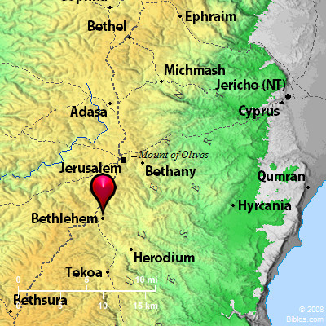
Distance traveled: Less than six miles

Slide 25
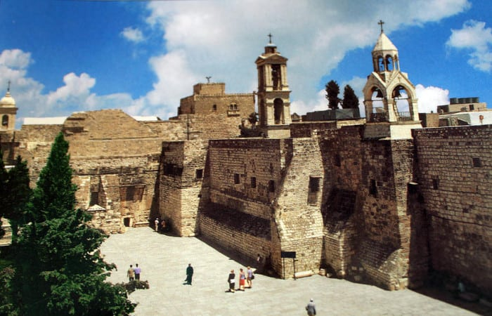

Slide 26
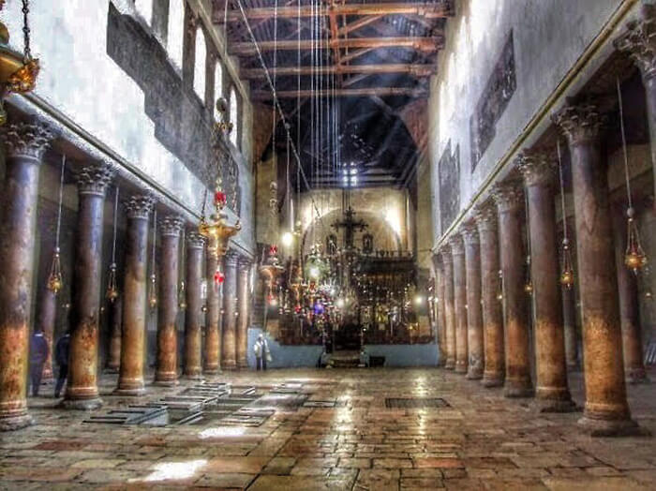

Slide 27
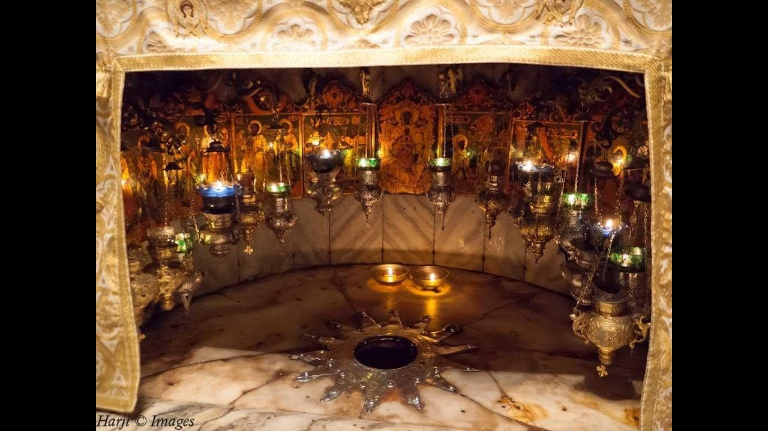

Slide 28
Matthew 2:9-10
When they heard the king, they departed; and behold, the star which they had seen in the East went before them, till it came and stood over where the young Child was. When they saw the star, they rejoiced with exceedingly great joy.
The star is directing the path of the wise men as they travel.
“The wise men go by themselves to find the new-born king. The Jewish scribes, if they know where he is, are not interested in going” (Davies and Allison, I:245).
“It came and stood over where the young Child was” gives evidence that this was no ordinary star in the heavens.
We cannot explain a miracle by natural means.
Why did the wise men rejoice to see the star again?

Slide 29
Matthew 2:11
And when they had come into the house, they saw the young Child with Mary His mother, and fell down and worshiped Him. And when they had opened their treasures, they presented gifts to Him: gold, frankincense, and myrrh.
Where were Mary and Joseph staying on the night of Jesus’s birth?
Where are they at the arrival of the wise men?
What is significant about the wise men offering worship to Jesus?
Matthew 4:10: “You shall worship the Lord your God, and Him only you shall serve.”
Psalm of Solomon (an intestamental book writing about the Messiah): “So that nations shall come from the ends of the earth to see his glory, Bearing as gifts her children who have fainted on the way – To see the glory of the Lord, wherewith God has glorified her.”
Why do men conclude that there were “three wise men”? Why is that an illegitimate conclusion?

Slide 30
Matthew 2:12
Then, being divinely warned in a dream that they should not return to Herod, they departed for their own country another way.
Divinely warned (chrēmatizō): “impart a divine message, make known a divine injunction/warning” (BDAG).
Why did the Lord not want the wise men to return to Herod?

Slide 31
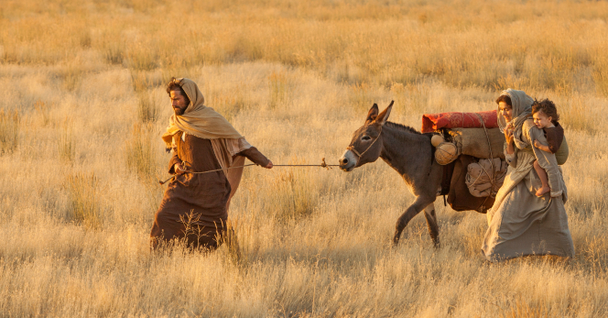
The Messiah’s Flight and Return (2:13-23)

Slide 32
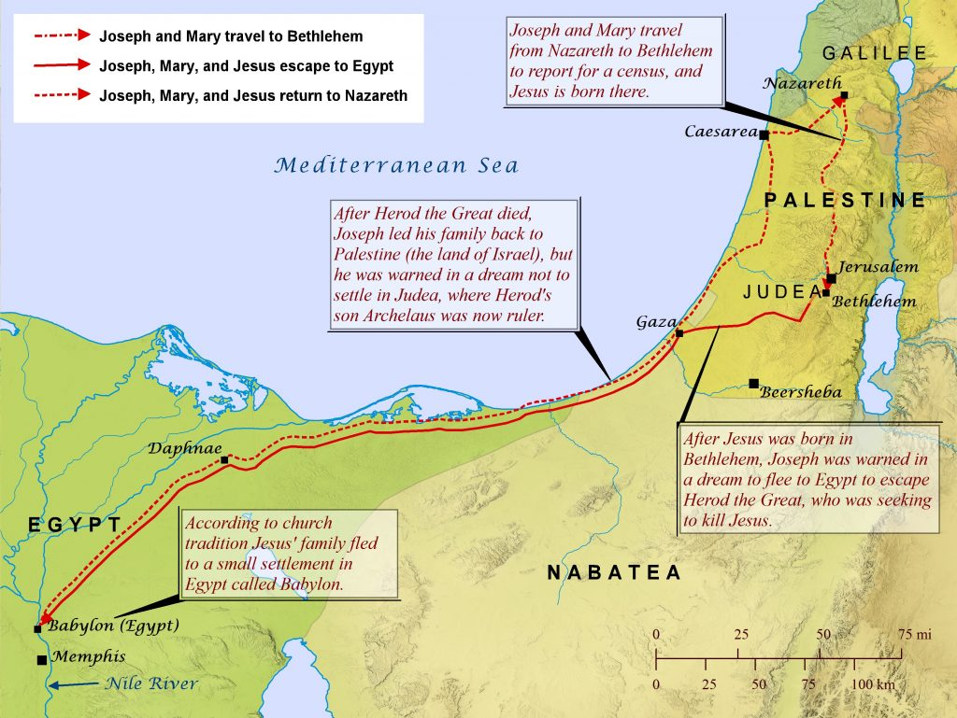

Slide 33
Drastic Change
Verses 1-12 have shown the messiah being worshipped, with rich gifts being provided by wise men from the East.
Verses 13-23 show the messiah’s life being threatened by the king of His own people, a desperate flight in the middle of the night to save His life, living as an alien in a foreign land, and then returning to one’s homeland.

Slide 34
Matthew 2:13
Now when they had departed, behold, an angel of the Lord appeared to Joseph in a dream, saying, “Arise, take the young Child and His mother, flee to Egypt, and stay there until I bring you word; for Herod will seek the young Child to destroy Him.”
The wise men return to the East.
The Angel of the Lord appeared to Joseph in a dream (cf. 1:20).
Dreams as a means for communicating God’s divine will were more common in the OT.
How was Joseph able to escape Herod the Great’s plan for killing Jesus?
Why did Herod want to kill this baby?
How long was Joseph to stay in Egypt?

Slide 35
Matthew 2:14
When he arose, he took the young Child and His mother by night and departed for Egypt.
How long did Joseph wait before deciding to do as God commanded him?
Why did he leave Bethlehem during the night?
Compare Jeroboam’s flight to escape the threats of King Solomon: “Solomon therefore sought to kill Jeroboam. But Jeroboam arose and fled to Egypt, to Shishak king of Egypt, and was in Egypt until the death of Solomon” (1 Kings 11:40).

Slide 36
Matthew 2:15
. . . and was there until the death of Herod, that it might be fulfilled which was spoken by the Lord through the prophet, saying, “Out of Egypt I called My Son.”
Herod the Great ruled over Judea from 37–4 BC.
This is the second of the “that it might be fulfilled” prophecies.
The passage quoted by Matthew is Hosea 11:1—“When Israel was a child, I loved him, And out of Egypt I called My son.”
Matthew was aware that Hosea was speaking of Israel as God’s Son.
In this passage, Matthew is showing that the Exodus, the grand miracle of Israel’s redemption from Egyptian bondage and the occasion for the institution of the Passover feast, was a type of the redemption Jesus would bring.
But the typology of the Exodus goes deeper.

Slide 37
The Lives of the Patriarchs Foreshadow Israel’s History
Abram | Israel
Abram went to Egypt because of famine | Israel moved to Egypt because of famine
Abram prospered there | Israel prospered there
Abram’s situation changed when Pharaoh discovered that Sarai was Abram’s wife | Israel’s situation changed from shepherds for the crown to a state of bondage
God plagued Pharaoh and his house | God sent plagues on Egypt
Abram was driven out of Egypt | Israel was sent out of Egypt
Abram went out a rich man | Israel “borrowed” from Egypt and left rich (Exod. 3:22; 11:2)

Slide 38
Israel’s History Foreshadows the Messiah
Israel | The Messiah (Christ)
Moses’ could not return to Egypt until Pharaoh died (Exod. 4:19) | Jesus had to go to Egypt until Herod the Great died
Pharaoh felt threatened by the multiplication of Hebrew male infants | Herod felt threatened by the Christ child
Pharaoh threatened to kill all of the male babies (Exod. 1:15-22) | Herod the Great threatened to kill the Christ child
The deliverance from Egypt involved the sacrifice of the Passover Lamb (Exod. 12) | Deliverance from spiritual bondage requires the sacrifice of Christ our Passover (1 Cor. 5:7)

Slide 39
My Son
This is the first time in Matthew’s gospel that Jesus is identified as God’s Son.
“Son of God” can be used in a metaphorical sense for any of God’s adopted children (Gal. 3:26, 27; Rom. 8:16-17; 2 Cor. 6:18).
Matthew uses “Son of God” in a different sense with reference to Jesus; it is sometimes used as the equivalent of the Messiah (Matt. 4:3, 6; 8:29; 14:33; 16:16; 26:63; 27:40, 43, 54) and sometimes to express Jesus’s unique relationship with the Father as Deity (Mark 3:11; 5:7; 15:39; Luke 1:32, 35; Luke 4:3, 9; 8:28; 22:69, 70; John 1:18, 34; 3:18; etc.).

Slide 40
Matthew 2:16
Then Herod, when he saw that he was deceived by the wise men, was exceedingly angry; and he sent forth and put to death all the male children who were in Bethlehem and in all its districts, from two years old and under, according to the time which he had determined from the wise men.
Notice this is a second reference to Herod’s anger (see 2:3).
“Bethlehem and its districts” would include the countryside near the small village.
Why did Herod put to death all of the children under two years old?

Slide 41
Matthew 2:17-18
Then was fulfilled what was spoken by Jeremiah the prophet, saying: “A voice was heard in Ramah, Lamentation, weeping, and great mourning, Rachel weeping for her children, Refusing to be comforted, Because they are no more.”
This is the third of the “that it might be fulfilled” references.
It is obvious in Jeremiah 31 that the prophet is speaking of the sorrow experienced by Israel when her sons and daughters were taken into Babylonian captivity, and I am confident that Matthew was well aware of that, being the student of the Old Testament that he was.

Slide 42
Why Mention Rachel?
This is the only wife of a patriarch mentioned in Matthew.
Rachel was the favorite wife of Jacob.
She died giving birth to Benjamin and was buried somewhere on the journey from Bethel to Bethlehem (Gen. 35:19; 48:7).
In Jeremiah’s own time, the Babylonians assembled Israel’s sons at Ramah, prior to taking them into Babylonian captivity in 586 BC.
The word to Jeremiah came from the Lord after Nebuzaradan the captain of the guard had released him from Ramah. Nebuzaradan had bound the prophet in chains along with others who were to be carried away captive from Judah to Babylon (Jer. 40:1).

Slide 43
Rachel Weeping
In his words of comfort to Israel, Jeremiah wrote,
“Then shall the virgin rejoice in the dance, And the young men and the old, together; For I will turn their mourning to joy, Will comfort them, And make them rejoice rather than sorrow. I will satiate the soul of the priests with abundance, And My people shall be satisfied with My goodness, says the Lord.” Thus says the Lord: “A voice was heard in Ramah, Lamentation and bitter weeping, Rachel weeping for her children, Refusing to be comforted for her children, Because they are no more.” Thus says the Lord: “Refrain your voice from weeping, And your eyes from tears; For your work shall be rewarded, says the Lord, And they shall come back from the land of the enemy. There is hope in your future, says the Lord, That your children shall come back to their own border” (Jer. 31:13-17).

Slide 44
Jeremiah’s Messianic Context
That the comfort described has a messianic context is evident from just a few verses later in Jeremiah:
“Behold, the days are coming, says the Lord, when I will make a new covenant with the house of Israel and with the house of Judah― not according to the covenant that I made with their fathers in the day that I took them by the hand to lead them out of the land of Egypt, My covenant which they broke, though I was a husband to them, says the Lord. But this is the covenant that I will make with the house of Israel after those days, says the Lord : I will put My law in their minds, and write it on their hearts; and I will be their God, and they shall be My people. No more shall every man teach his neighbor, and every man his brother, saying, ‘Know the Lord,’ for they all shall know Me, from the least of them to the greatest of them, says the Lord. For I will forgive their iniquity, and their sin I will remember no more” (Jer. 31:31-34).
This is quoted in Hebrews 8:8-12; 10:16-17.

Slide 45
Matthew 2:19-20
But when Herod was dead, behold, an angel of the Lord appeared in a dream to Joseph in Egypt, saying, “Arise, take the young Child and His mother, and go to the land of Israel, for those who sought the young Child’s life are dead.”
Joseph receives his third divinely inspired dream (Matt. 1:20; 2:13).
What is the message and purpose of this dream?

Slide 46
Moses and Jesus
Moses
Jesus
And the Lord said
to Moses in Midian,
“Go, return to Egypt; for all the men who sought your life are dead.”
Then Moses took his wife and his sons and set them on a donkey, and he returned to the land of Egypt (Exod. 4:19-20).
But when Herod was dead, behold, an angel of the Lord appeared in a dream
to Joseph in Egypt,
saying, “Arise, take the young Child and His mother, and go to the land of Israel, for those who sought the young Child’s life are dead.”
Then he arose, took the young Child and His mother, and came into the land of Israel (Matt. 2:19-21)

Slide 47
Matthew 2:21
Then he arose, took the young Child and His mother, and came into the land of Israel.
What does Joseph’s reaction to the dream show about Joseph’s character?
How has Joseph’s life been affected by God’s commandments to him?
What would have happened if Joseph had said, “Lord, I am just an ordinary carpenter trying to provide for my family. All of this moving from one place to another is preventing me from establishing my carpentry business. I have to settle down and get on with my life”?

Slide 48
Matthew 2:22
But when he heard that Archelaus was reigning over Judea instead of his father Herod, he was afraid to go there. And being warned by God in a dream, he turned aside into the region of Galilee.
Another dream (number 4)!
What is God doing in this dream?
Read Psalm 121.

Slide 49
Archelaus
Upon the death of Herod the Great, several of his relatives were vying for power. Herod the Great had named Archelaus as his successor.
Archelaus behaved so improperly that a state of unrest developed. Archelaus and his calvary put a stop to it by killing 3000 Jews in the Temple precincts.
The Jews petitioned Augustus not to allow Archelaus to become king. Eventually, he was appointed Ethnarch (higher than Tetrarch, but lower than king) over Judaea, Samaria, and Idumea with the promise that, if he ruled wisely, he could be appointed king at a later date.
He ruled ten years, from 4 BC to AD 6, at which time accusations were made against him and Caesar Augustus removed him from power and put the area under procurators (the office held by Pontius Pilate).

Slide 50
Matthew 2:23
And he came and dwelt in a city called Nazareth, that it might be fulfilled which was spoken by the prophets, “He shall be called a Nazarene.”
This is the fourth of the “that it might be fulfilled” prophecies.
It is not cited as being attributed to one prophet; rather it “was spoken by the prophets.”
The problem is that there is no place in the Hebrew Bible were this prophecy appears.

Slide 51
Usual Explanations
Jesus was a person of holiness (Hebrew word nazar), much like Samson (Judg. 13:2-7) and Samuel (1 Sam. 1-2).
Jesus was from the root (Hebrew word, neşer) of David, calling to mind passages such as Isa. 11:1, where the Scriptures refer to the messiah would be of the “stem” or “root” of Jesse. Jeremiah predicted the Messiah as a “branch” of David (Jer. 23:5).

Slide 52
A More Likely Explanation
“The most straightforward explanation would seem to be derivation from the name of a town, Nazareth. . . . This would fit in with the common Jewish custom of distinguish individuals according to the place from which they come (as in Mk 15:21 and 43), and it is Matthew’s assumption” (Davies and Allison, I:281).
This obvious explanation floundered because there was no evidence of the Hebrew name Nazareth being transliterated into Greek by Nazōraios. So scholars tended to reject this passage as saying what it so obviously meant, Jesus was called a Nazōraios because he was from Nazareth.
The Dead Sea Scroll 1QIsaª is now being cited as giving grammatical evidence that would provide support to this use of Nazōraios to refer to someone from Nazareth.
The word Nazōraios appears in 13 verses in the NT, all of which use Nazōraios as the place of Jesus residence (Matt. 2:23; 26:71; Luke 18:37; John 18:5, 7; 19:19; Acts 2:22; 3:6; 4:10; 6:14; 22:8; 24:5; 26:9).

Slide 53
Where Is the Prophecy?
If the straightforward meaning of the prophecy is correct, where is the prophecy that foretold Jesus would be known as one from Nazareth?
Nazareth does not appear in the Old Testament.
No specific prophecy is quoted by Matthew.
The passage which I think is most likely is Isaiah 9:1-2, cited by Matthew in 4:14-16.
“Nevertheless the gloom will not be upon her who is distressed, As when at first He lightly esteemed The land of Zebulun and the land of Naphtali, And afterward more heavily oppressed her, By the way of the sea, beyond the Jordan, In Galilee of the Gentiles. The people who walked in darkness Have seen a great light; Those who dwelt in the land of the shadow of death, Upon them a light has shined.”
Nazareth is in Galilee (Matt. 21:11; Mark 1:9; Luke 1:26, 39).
This passage foretold that the Messiah’s work would be concentrated in Galilee.
The village of Nazareth only began to be settled in the seventh century BC.
To be a Nazarene had the meaning of “a citizen of an obscure and unimportant town.”

