Slide 2
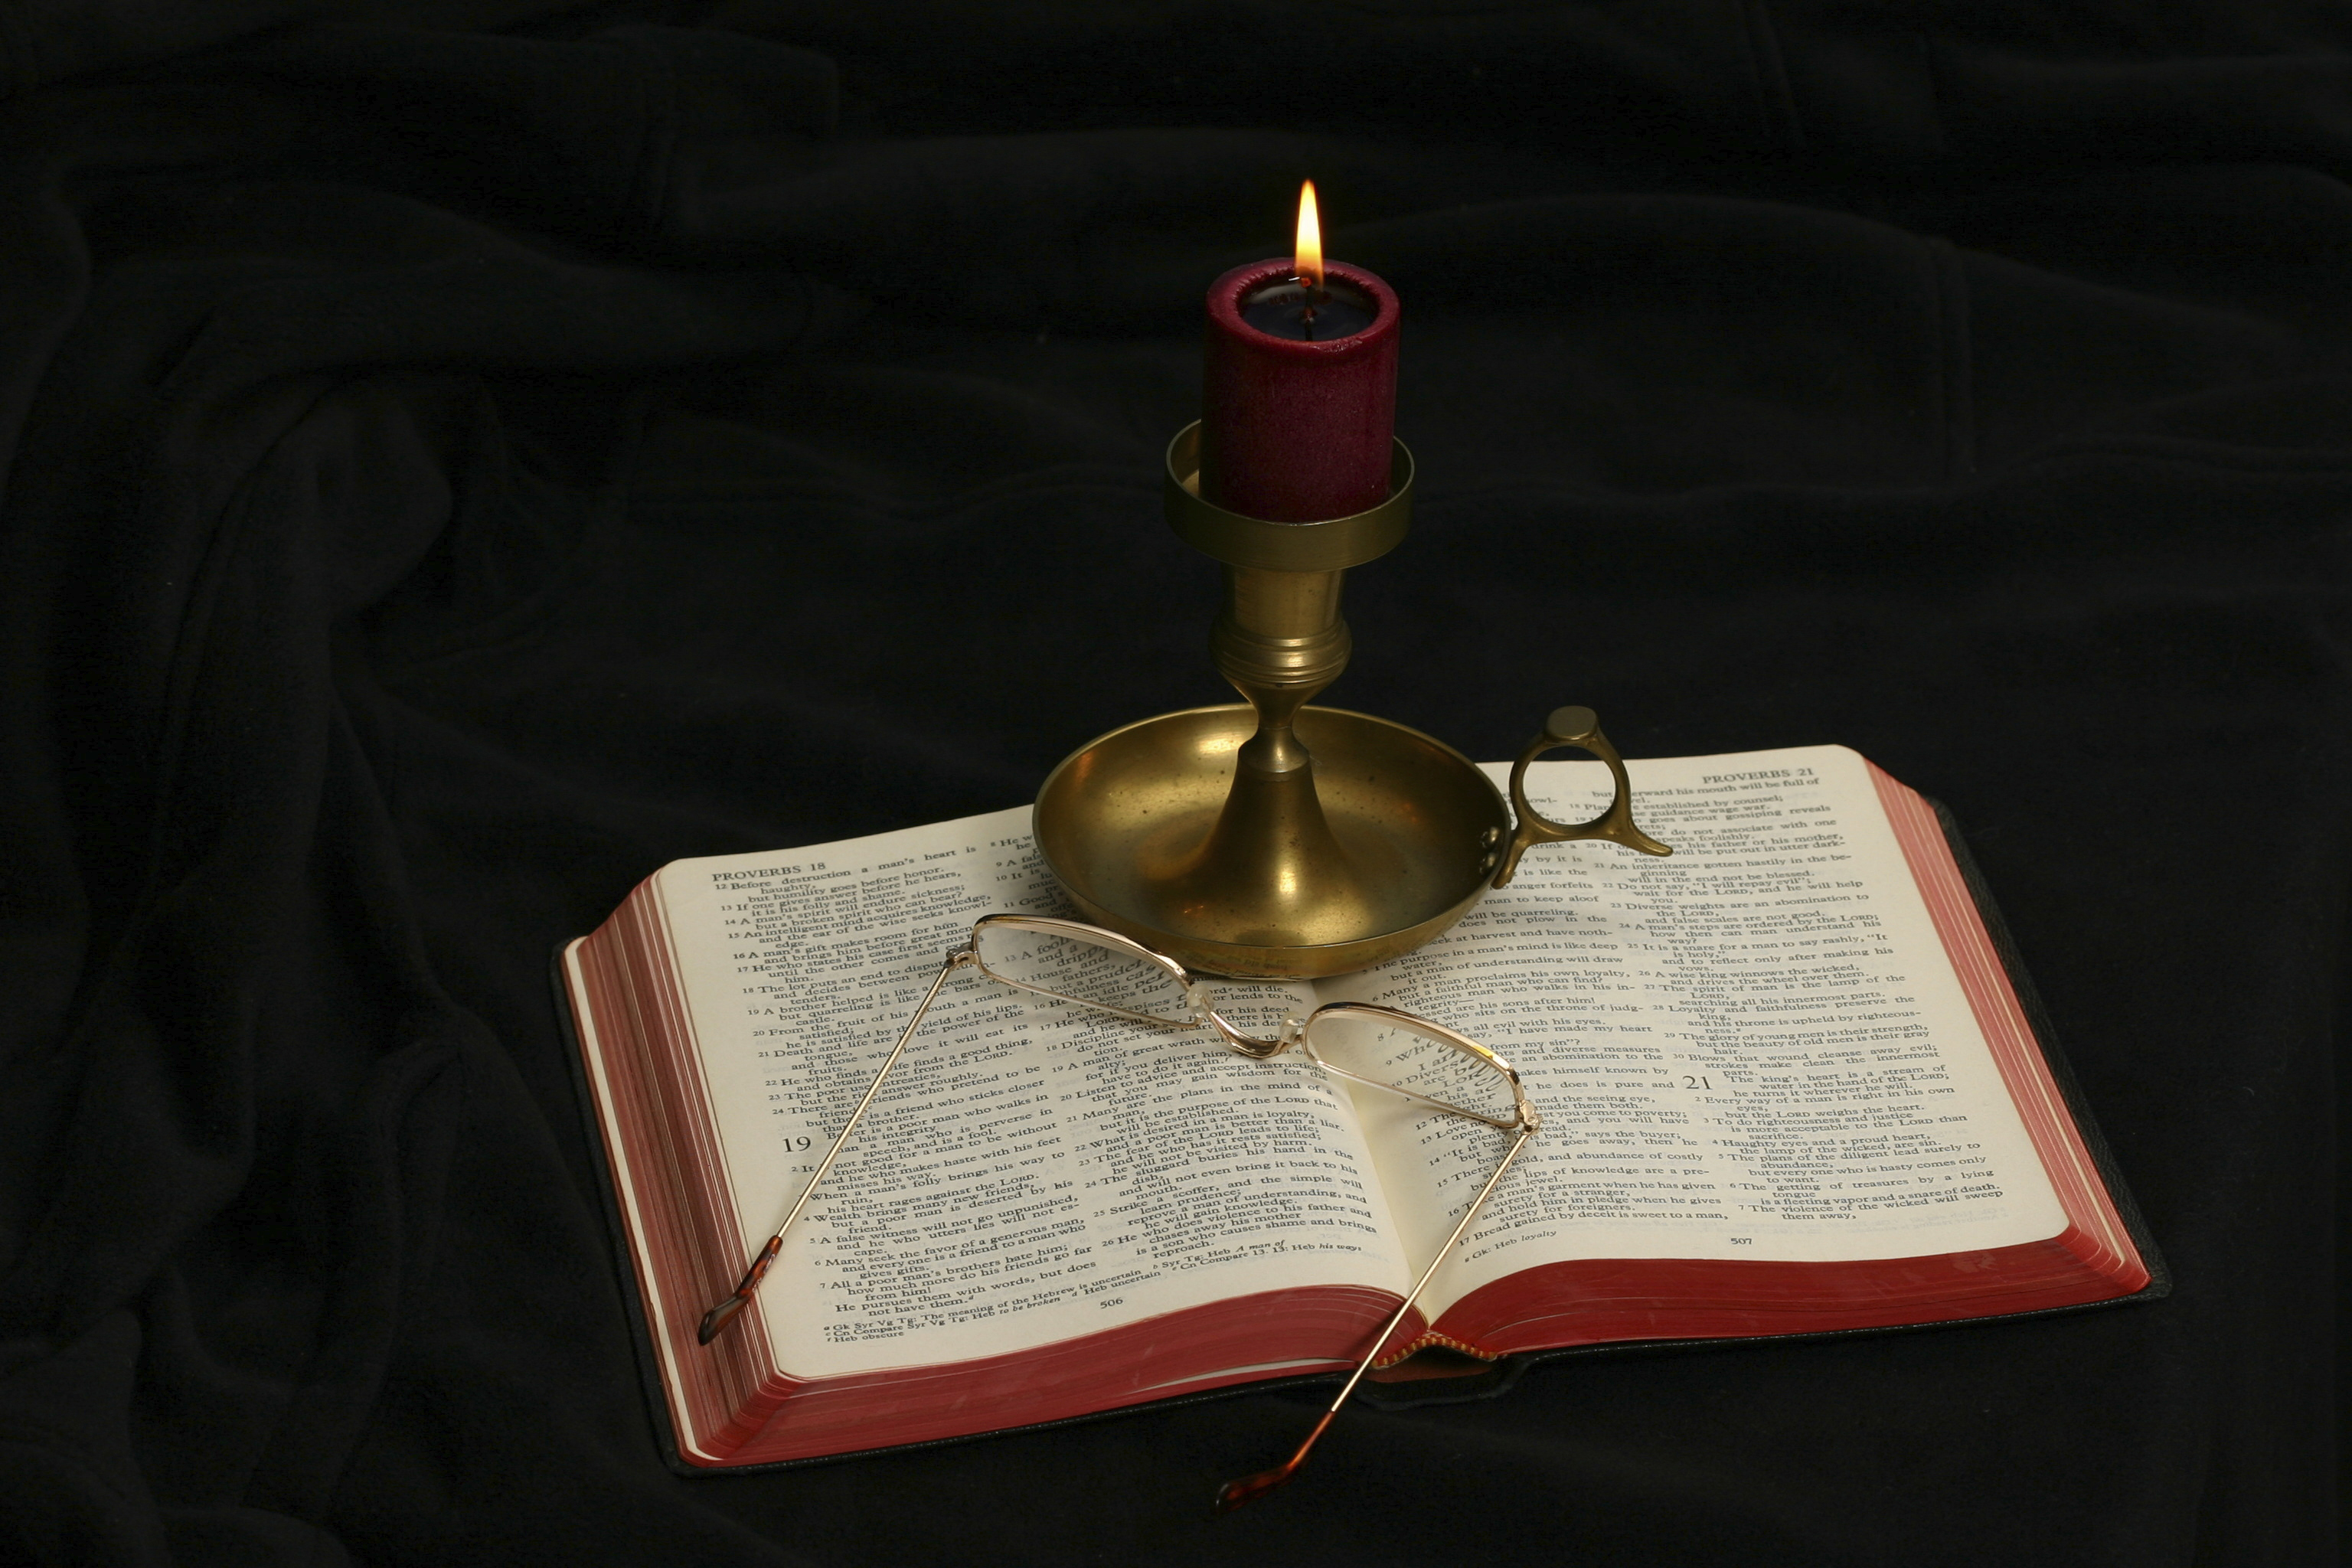
The Gospel of Matthew
Chapter 4

Slide 3
Outline of the Chapter
The temptation of Jesus (4:1-11)
The return to Galilee (4:12-17)
The calling of four disciples (4:18-22)
Introduction to the Sermon on the Mount (4:23-25)

Slide 4
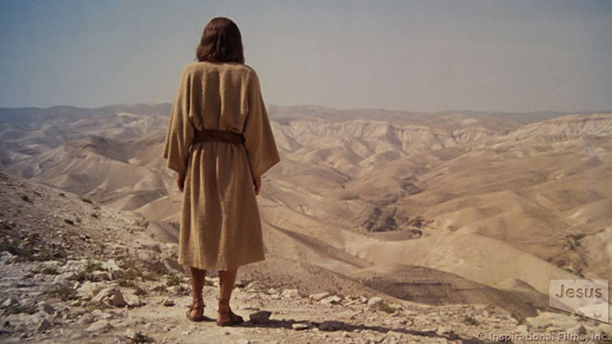
The Temptation Scene (4:1-11)

Slide 5
Jesus’s Temptation
Reminds one of the scene in the Garden of Eden when the first Adam was tempted and sinned. The second Adam is tempted without sin.
Reminds one of Israel’s wandering the wilderness.

Slide 6
Deuteronomy 8:1-5
Every commandment which I command you today you must be careful to observe, that you may live and multiply, and go in and possess the land of which the Lord swore to your fathers. And you shall remember that the Lord your God led you all the way these forty years in the wilderness, to humble you and test you, to know what was in your heart, whether you would keep His commandments or not. So He humbled you, allowed you to hunger, and fed you with manna which you did not know nor did your fathers know, that He might make you know that man shall not live by bread alone; but man lives by every word that proceeds from the mouth of the Lord. Your garments did not wear out on you, nor did your foot swell these forty years. You should know in your heart that as a man chastens his son, so the Lord your God chastens you.

Slide 7
Jesus’s Temptation
Reminds one of the scene in the Garden of Eden when the first Adam was tempted and sinned. The second Adam is tempted without sin.
Reminds one of Israel’s wandering the wilderness.
Temptations have a spatial progression:
Desert
Pinnacle of Temple
High mountain
Jesus quotes from Deuteronomy in His replies to Satan (8:3; 6:16; 6:13).

Slide 8
Matthew 4:1-2
Then Jesus was led up by the Spirit into the wilderness to be tempted by the devil. And when He had fasted forty days and forty nights, afterward He was hungry.
Just as God led Israel out of Egypt into the desert where they were tempted for forty years, Jesus is led out by the Spirit into the wilderness to be tempted for 40 days and nights.
Jesus submitted to the Spirit’s leadership.
Jesus was tempted (peirazō), just as are we (James 1:2, 12-15)
“For we do not have a High Priest who cannot sympathize with our weaknesses, but was in all points tempted as we are, yet without sin” (Heb. 4:15).
Some minimize the incarnation by teaching the impeccability of Jesus, that He was unable to be tempted. If He was unable to sin, He was not like me!
The humanity of Jesus is seen in Him being “hungry.”

Slide 9
The Devil
Devil (diabolos): “one who engages in slander; in our literature as a title of the principal transcendent evil being the adversary/devil” (BDAG, 426). He is also known as . . .
The Serpent (ophis, Gen. 3:1; Rev. 12:9)
Satan: adversary, the enemy (Rev. 12:9); “the enemy of God and all of those who belong to God” (BDAG, 915)

Slide 10
Matthew 4:3 The First Temptation
Now when the tempter came to Him, he said, “If You are the Son of God, command that these stones become bread.”
The Tempter describes the purpose of the Devil. Whereas the Devil “tempts” (“to entice to improper behavior, tempt”), God “tests” (“put people to the test”) (BDAG, 792-793).
“And you shall remember that the Lord your God led you all the way these forty years in the wilderness, to humble you and test you, to know what was in your heart, whether you would keep His commandments or not” (Deut. 8:2).
The “if you are the Son of God” calls to mind the words of God at the baptism of Jesus (3:17).
The Devil acknowledges the miraculous power of Jesus: “command that these stones become bread.”

Slide 11
Matthew 4:4
But He answered and said, “It is written, ‘Man shall not live by bread alone, but by every word that proceeds from the mouth of God.’”
Jesus depended upon God’s word.
“Your word I have hidden in my heart, That I might not sin against You!” (Psa. 119:11).
He quoted from Scripture to resist sin’s temptation: “So He humbled you, allowed you to hunger, and fed you with manna which you did not know nor did your fathers know, that He might make you know that man shall not live by bread alone; but man lives by every word that proceeds from the mouth of the Lord” (Deut. 8:3).
The temptation is to persuade Jesus to quit trusting in God!

Slide 12
Matthew 4:5-6 The Second Temptation
Then the devil took Him up into the holy city, set Him on the pinnacle of the temple, and said to Him, “If You are the Son of God, throw Yourself down. For it is written: ‘He shall give His angels charge over you,’ and, ‘In their hands they shall bear you up, Lest you dash your foot against a stone.’”
The order of the second and third temptations is reversed in Luke.
The second temptation occurs in the holy city, Jerusalem.

Slide 13
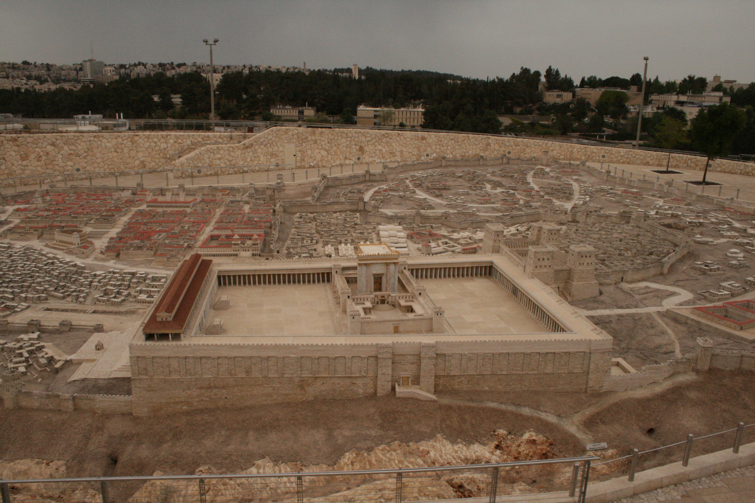

Slide 14
The Devil’s Use of Scripture
“For He shall give His angels charge over you, To keep you in all your ways. In their hands they shall bear you up, Lest you dash your foot against a stone” (Psa. 91:11-12).
The Devil leaves a critical portion of the text: “to keep you in all your ways.”
What does this temptation tell us about the proper use of Scripture?
Would God protect me if I were to jump off the Sears Tower in Chicago?
John Nolland: “the divine purpose for Jesus, as for certain others, is that they should be preserved through death, not from death” (The Gospel of Matthew: A Commentary on the Greek Text, New International Greek Testament Commentary, 165).
Even though the location has changed to the Temple, there is no evidence that others were present to witness this second temptation.

Slide 15
Matthew 4:7
Jesus said to him, “It is written again, ‘You shall not tempt the Lord your God.’”
Jesus replies again by quoting Scripture, this time Deuteronomy 6:16.
Tempt (ekpeirazō): certainly this word is not used of persuading God to commit a sin; it rather implies, to see if God will honor His word.
What does Jesus’s reply teach us about the use of Scripture?
Eusebius writes that James the brother of Jesus was “thrown from a wing of the temple, and beaten to death with a club” (Ecclesiastical History, xxiii, p. 76).

Slide 16
Matthew 4:8-9 The Third Temptation
Again, the devil took Him up on an exceedingly high mountain, and showed Him all the kingdoms of the world and their glory. And he said to Him, “All these things I will give You if You will fall down and worship me.”
The scene changes to an exceedingly high (unnamed) mountain.
John Nolland: “Matthew may be thinking in terms of direct Satan worship, but he may also envision a more indirect form of Satan worship: if Jesus was to take as his goal to possess ‘all the kingdoms of the world and their glory’, then he would need ‘to pursue his task in the ways of the world …, to gain glory for himself in this world by compromise with the forces that control it … and to become indebted to Satan in the manner that every successful man of the world is’” (The Gospel of Matthew: A Commentary on the Greek Text, New International Greek Testament Commentary, 166).

Slide 17
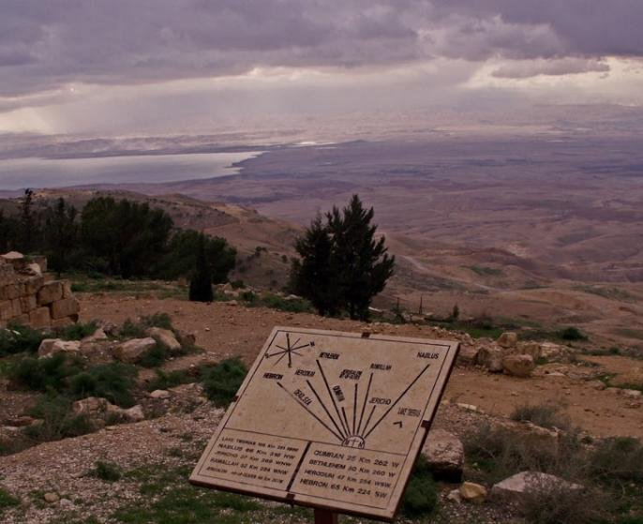
Since the mountain is unnamed, I chose a view from the top of Mt. Nebo, from which Moses looked into the promised land.

Slide 18
The Temptation
What is the temptation Jesus faced in the third temptation?
What did Jesus get as result of enduring the cross?
“Therefore God also has highly exalted Him and given Him the name which is above every name, that at the name of Jesus every knee should bow, of those in heaven, and of those on earth, and of those under the earth, and that every tongue should confess that Jesus Christ is Lord, to the glory of God the Father” (Phil. 2:9-11).
“. . .which He worked in Christ when He raised Him from the dead and seated Him at His right hand in the heavenly places, far above all principality and power and might and dominion, and every name that is named, not only in this age but also in that which is to come. And He put all things under His feet, and gave Him to be head over all things to the church, which is His body, the fullness of Him who fills all in all” (Eph. 1:20-23).

Slide 19
Matthew 4:10
Then Jesus said to him, “Away with you, Satan! For it is written, ‘You shall worship the Lord your God, and Him only you shall serve.’”
Cf. away with you (hupagō) here and in Matthew 16:23— “But He turned and said to Peter, ‘Get behind (hupagō) Me, Satan! You are an offense to Me, for you are not mindful of the things of God, but the things of men.’ ”
What is common to both of these situations? What were both Satan and Peter trying to do?
Jesus quoted Deuteronomy 6:13 in His reply: “You shall fear the Lord your God and serve Him, and shall take oaths in His name.”

Slide 20
From the Mountain Top
It is probably significant to tie this mountain top temptation to the scene we read at the end of Matthew’s gospel:
“Then the eleven disciples went away into Galilee, to the mountain which Jesus had appointed for them. When they saw Him, they worshiped Him; but some doubted. And Jesus came and spoke to them, saying, ‘All authority has been given to Me in heaven and on earth’” (Matt. 28:16-18).
Davies and Allison: “In both places Jesus is choosing the path of duty; the end ordained by the Father is to be achieved by the manner ordained by the Father, namely, the cross. And any opposition to this is satanic. To reject the way of the cross is to be on the side of the Devil” (Commentary on Matthew, 1:372).

Slide 21
Satan’s Offer
Descriptions of Satan:
God of this world (2 Cor. 4:4)
Ruler of this world (John 12:31; 14:30; 16:11)
In Luke’s account: “All this authority I will give You, and their glory; for this has been delivered unto me; and I give it to whomsoever I wish” (Luke 4:6).
“We know that we are of God, and the whole world lies under the sway of the wicked one” (1 John 5:19).
Does Satan correctly represent his own power or is he lying to Jesus like he lied to Eve?

Slide 22
An Important Truth
Being “led by the Spirit” (Matt. 4:1; Gal. 5:18) and “filled with the Spirit” (Eph. 5:18) do not prevent one from being tempted by the Devil!

Slide 23
Matthew 4:11
Then the devil left Him, and behold, angels came and ministered to Him.
“Therefore submit to God. Resist the devil and he will flee from you. (James 4:7).
Jesus provides us an example in resisting the Devil.
What does the “angels came and ministered to Him” show?
Jesus had trusted His Father in heaven—and all of His needs were met!

Slide 24
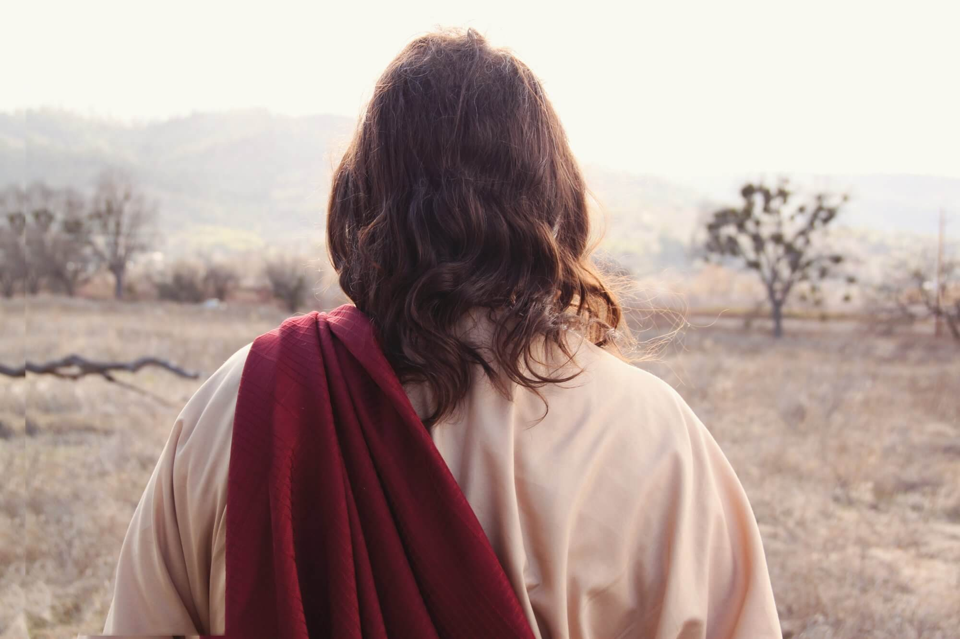
The Return to Galilee Matt. 4:12-17

Slide 25
Matthew 4:12-17
Now when Jesus heard that John had been put in prison, He departed to Galilee. And leaving Nazareth, He came and dwelt in Capernaum, which is by the sea, in the regions of Zebulun and Naphtali, that it might be fulfilled which was spoken by Isaiah the prophet, saying: “The land of Zebulun and the land of Naphtali, By the way of the sea, beyond the Jordan, Galilee of the Gentiles: The people who sat in darkness have seen a great light, And upon those who sat in the region and shadow of death Light has dawned.” From that time Jesus began to preach and to say, “Repent, for the kingdom of heaven is at hand.”

Slide 26
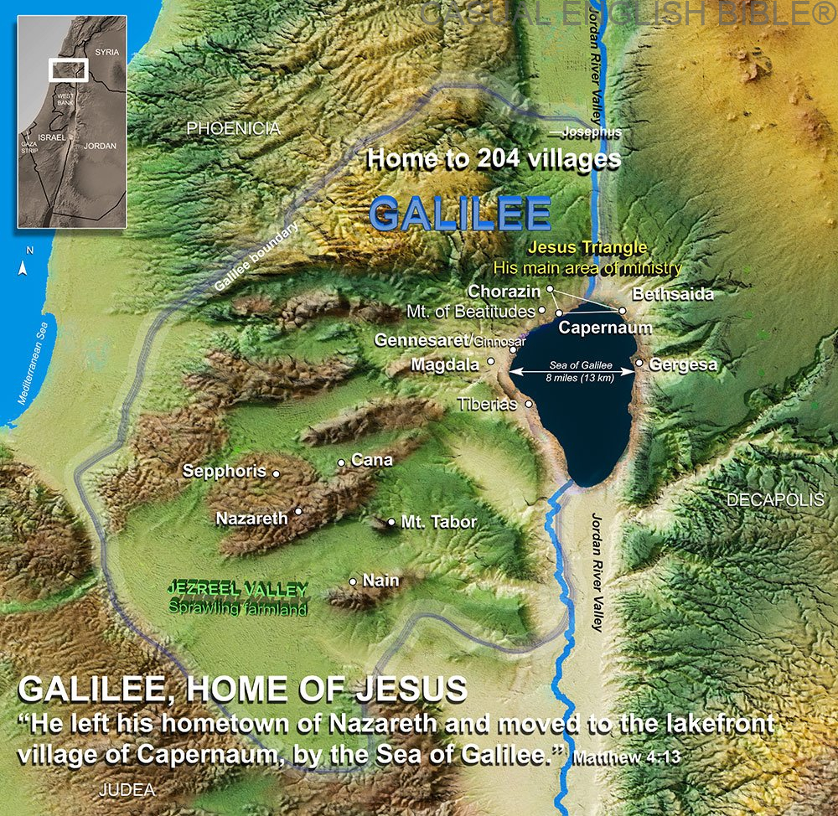

Slide 27
Matthew 4:12
Now when Jesus heard that John had been put in prison, He departed to Galilee.
Cf. the other synoptics:
“Now after John was put in prison, Jesus came to Galilee, preaching the gospel of the kingdom of God” (Mark 1:14).
“But Herod the tetrarch, being rebuked by him concerning Herodias, his brother Philip's wife, and for all the evils which Herod had done, also added this, above all, that he shut John up in prison” (Luke 3:19-20).
The beginning of Jesus’s public ministry commenced after the imprisonment of John.
John’s arrest created a vacuum of leadership. In the vacancy of John’s absence, Jesus stepped forward to lead a people prepared for Him.

Slide 28
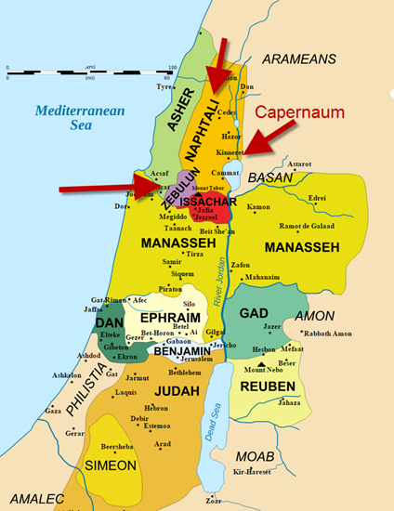
Matthew 4:13
And leaving Nazareth, He came and dwelt in Capernaum, which is by the sea, in the regions of Zebulun and Naphtali.
The map show an overlay of the ancient tribal divisions, though the first century divisions of the land had Judaea, Samaria, and Galilee as its divisions.

Slide 29
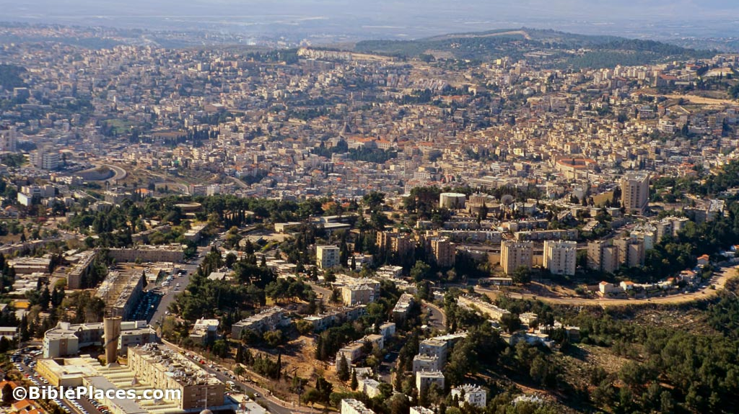
Nazareth in the 21st Century

Slide 30
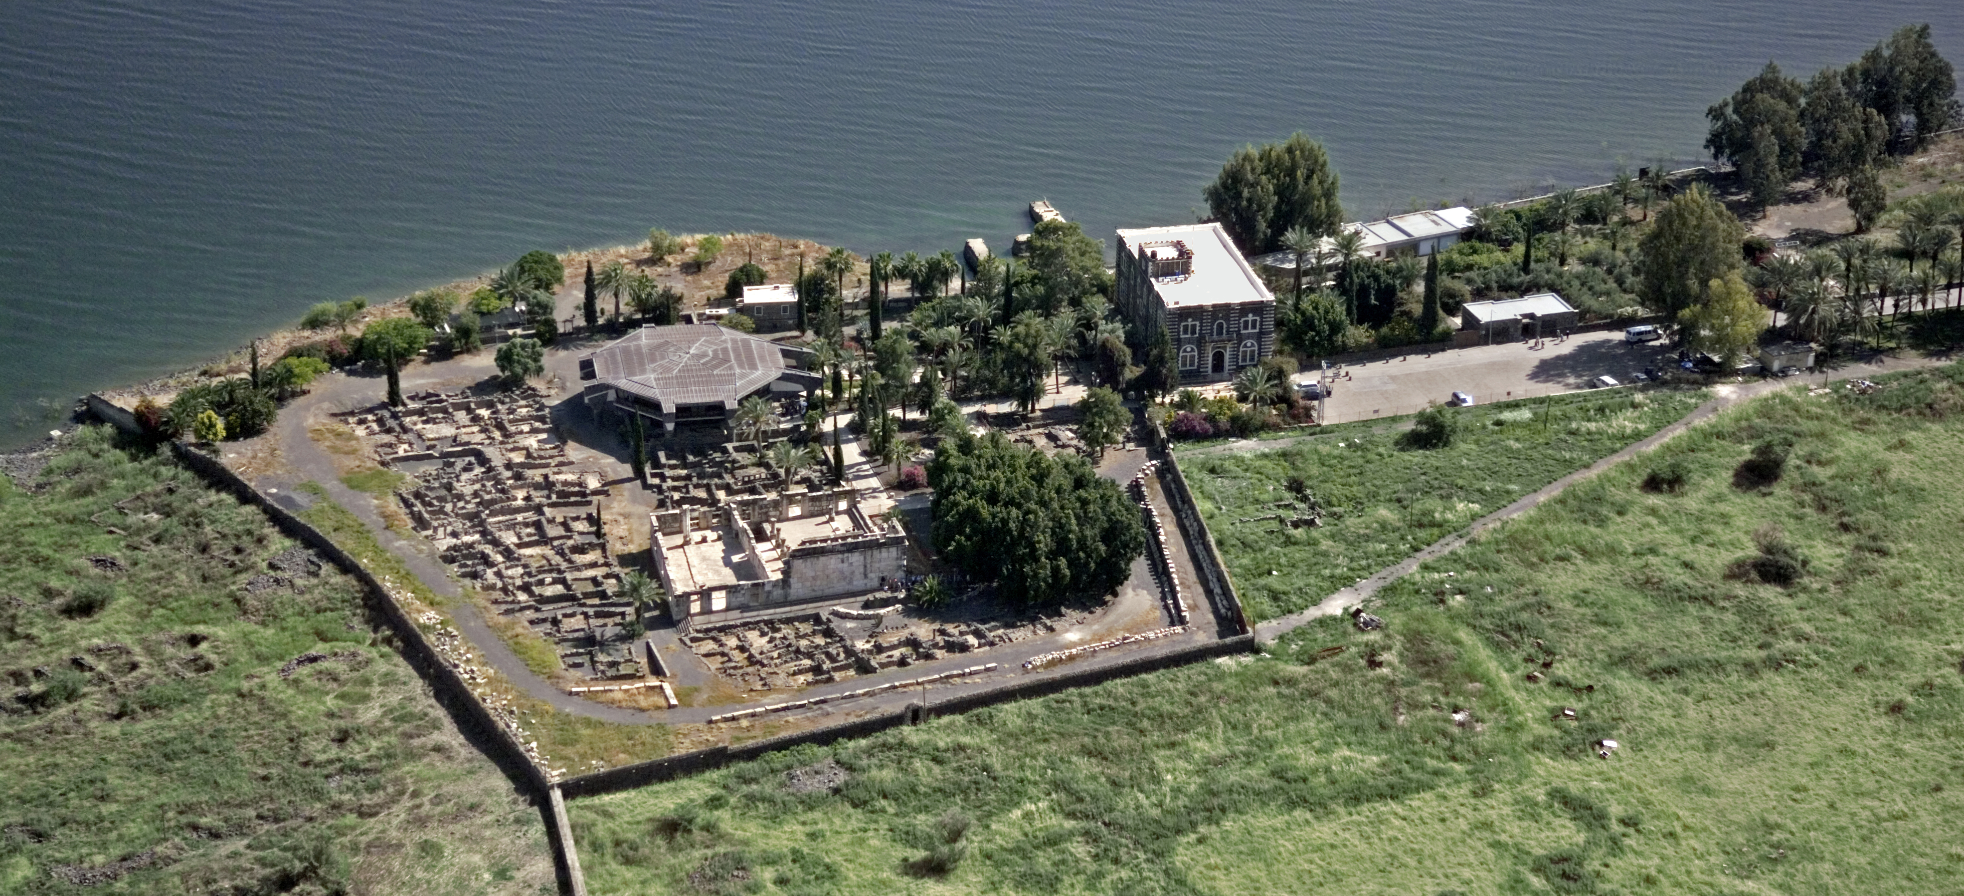
Capernaum
(Hebrew: kĕpar naḥum, the village of Nahum, the prophet)

Slide 31
Capernaum
The modern Tell Hum (Hum recalling Nahum)
Located on the northwest shore of the Sea of Galilee
Two things to remember:
It was a place for fishermen
It was near a trade route that ran between Damascus and Ptolemais (Acco).
A centurion was stationed there, whose servant Jesus healed (Matt. 8:5-13)
Matthew’s tax office was located there (Matt. 9:9-13)
Matthew shows his familiarity with Palestinian geography by stating the Capernaum is from the tribal division of Naphtali.

Slide 32
Matthew 4:14-16
. . . that it might be fulfilled which was spoken by Isaiah the prophet, saying: “The land of Zebulun and the land of Naphtali, By the way of the sea, beyond the Jordan, Galilee of the Gentiles: The people who sat in darkness have seen a great light, And upon those who sat in the region and shadow of death Light has dawned.”
This is the fifth time we have had “that it might be fulfilled” prophecies cited.
The quotation is taken from Isaiah 9:1-2, a messianic context.
Isaiah 9:1-2 is also alluded to in Luke 1:79—“To give light to those who sit in darkness and the shadow of death, To guide our feet into the way of peace.”

Slide 33
Isaiah 9:1-7
Nevertheless the gloom will not be upon her who is distressed, As when at first He lightly esteemed The land of Zebulun and the land of Naphtali, And afterward more heavily oppressed her, By the way of the sea, beyond the Jordan, In Galilee of the Gentiles. The people who walked in darkness Have seen a great light; Those who dwelt in the land of the shadow of death, Upon them a light has shined. You have multiplied the nation And increased its joy; They rejoice before You According to the joy of harvest, As men rejoice when they divide the spoil. For You have broken the yoke of his burden And the staff of his shoulder, The rod of his oppressor, As in the day of Midian. For every warrior's sandal from the noisy battle, And garments rolled in blood, Will be used for burning and fuel of fire. For unto us a Child is born, Unto us a Son is given; And the government will be upon His shoulder. And His name will be called Wonderful, Counselor, Mighty God, Everlasting Father, Prince of Peace. Of the increase of His government and peace There will be no end, Upon the throne of David and over His kingdom, To order it and establish it with judgment and justice From that time forward, even forever. The zeal of the LORD of hosts will perform this.

Slide 34
Isaiah’s Prophecy
During the period of the fall of Israel (722 BC), the cities in Zebulun and Naphtali were among the first to be affected by the Assyrian invasion.
Isaiah’s prophecy encourages them by foretelling that when God’s mercy and grace sends His Messiah, they were be among the first to see the light of His revelation and glory.
Significantly, the text refers to “Galilee of the Gentiles” providing a way for Matthew to insert the theme that the Messiah’s message is applicable to Gentiles as well as Jews at this early stage in his narrative of Jesus’s ministry.

Slide 35
Galilee
We previously have noted that Jesus was born in the insignificant city of Bethlehem and reared in Nazareth.
Nazareth had a poor reputation: “Philip found Nathanael and said to him, ‘We have found Him of whom Moses in the law, and also the prophets, wrote—Jesus of Nazareth, the son of Joseph’. And Nathanael said to him, ‘Can anything good come out of Nazareth?’ Philip said to him, ‘Come and see’” (John 1:45).
Galilee’s reputation was not so good either.
“Others said, ‘This is the Christ.’ But some said, ‘Will the Christ come out of Galilee?’” (John 7:41).
“They answered and said to him, ‘Are you also from Galilee? Search and look, for no prophet has arisen out of Galilee’” (John 7:52).
Isaiah’s quotation states that Galilee was “sitting in darkness.”
Matthew’s citation of Isaiah’s prophecy might have been aimed at objections made against Jesus because He was from Galilee.

Slide 36
Matthew 4:17
From that time Jesus began to preach and to say, “Repent, for the kingdom of heaven is at hand.”
Jesus preaches the same message as John the Baptist had been preaching (Matt. 3:2).
This would have been very appealing to those attracted to John the Baptist.
With the preaching of Jesus, a light begins to shine in the darkness of Galilee.
Like His forerunner, Jesus also called on men to repent.
The kingdom of heaven is “at hand” (eggizō).
The tense of the verb is perfect which “implies a past action and affirms an existing result” (Ernst de Witt Burton, Syntax of the Moods and Tenses in New Testament Greek, 37).
The sense is that with the birth of Jesus, events had already begun to transpire that would result in the establishment of the Kingdom of Heaven. With both the preaching of John the Baptist and then of Jesus, this event was progressing.

Slide 37
Davies and Allison
“When Jesus announces that the kingdom of God has come and is coming, this means that the last act has begun but not yet reached its climax; the last things have come and will come” (1:390).

Slide 38
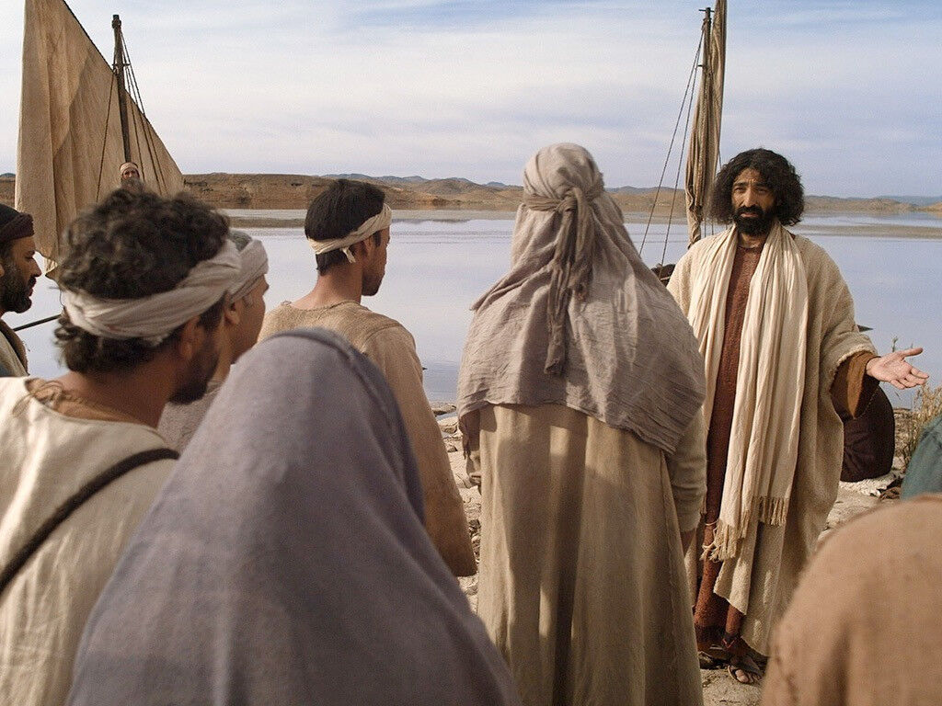
The Calling of Four Disciples (4:18-22)

Slide 39
Matthew 4:18-22
And Jesus, walking by the Sea of Galilee, saw two brothers, Simon called Peter, and Andrew his brother, casting a net into the sea; for they were fishermen. Then He said to them, “Follow Me, and I will make you fishers of men.” They immediately left their nets and followed Him. Going on from there, He saw two other brothers, James the son of Zebedee, and John his brother, in the boat with Zebedee their father, mending their nets. He called them, and immediately they left the boat and their father, and followed Him.

Slide 40
The Placement of This Material
There is little disagreement among the synoptic gospels about where this material goes.
The ministry of John the Baptist (Matt. 3:1-12; Mark 1:1-8; Luke 3:1-20)
The baptism of Jesus (Matt. 3:13-17; Mark 1:9-11; Luke 3:21-23a)
The temptation of Jesus (Matt. 4:1-11; Mark 1:12-13; Luke 4:1-13)

Slide 41
Integrating John’s Gospel
Following the prologue to John’s gospel are these events:
John’s testimony before the priests and Levites (1:19-28)
John’s declaration that Jesus is the Lamb of God (1:29-34)
John introduces Andrew, John, and Peter to Jesus (1:35-42)
Jesus calls Philip and Nathanael (1:43-51)
Water to wine (2:1-11)
Jesus moves to Capernaum (2:12)
Jesus cleanses the Temple at Passover (2:13-22)
Jesus’s discourse with Nicodemus (2:23-3:21)
Jesus baptizing in Judea (3:22-24)
John’s testimony to Christ at Aenon (3:25-36)
Jesus’s departure from Judea (4:1-3)
Jesus’s discourse with the woman at the well (4:4-26)
The gospel in Sychar (4:27-42)
Beginning of the Galilean ministry (4:43-45; Matt. 4:12-17; Mark 1:14-15; John 4:43-45)
The Nobleman’s son healed from a distance (4:46-54)
The call of the four (Matt. 4:18-22; Mark 1:16-20; Luke 5:1-11)

Slide 42
Matthew 4:18-20
And Jesus, walking by the Sea of Galilee, saw two brothers, Simon called Peter, and Andrew his brother, casting a net into the sea; for they were fishermen. Then He said to them, “Follow Me, and I will make you fishers of men.” They immediately left their nets and followed Him.
Previous exposure to Jesus makes these disciples’ immediate response to Jesus’s call easier to understand
The scene occurs on the banks of the Sea of Galilee

Slide 43
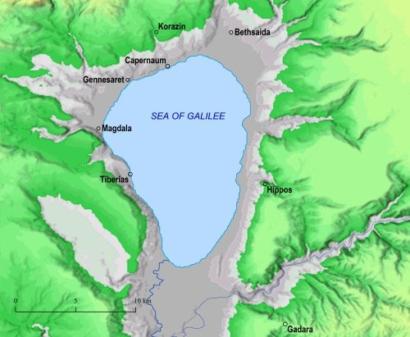
Seven Miles
Thirteen Miles

Slide 44
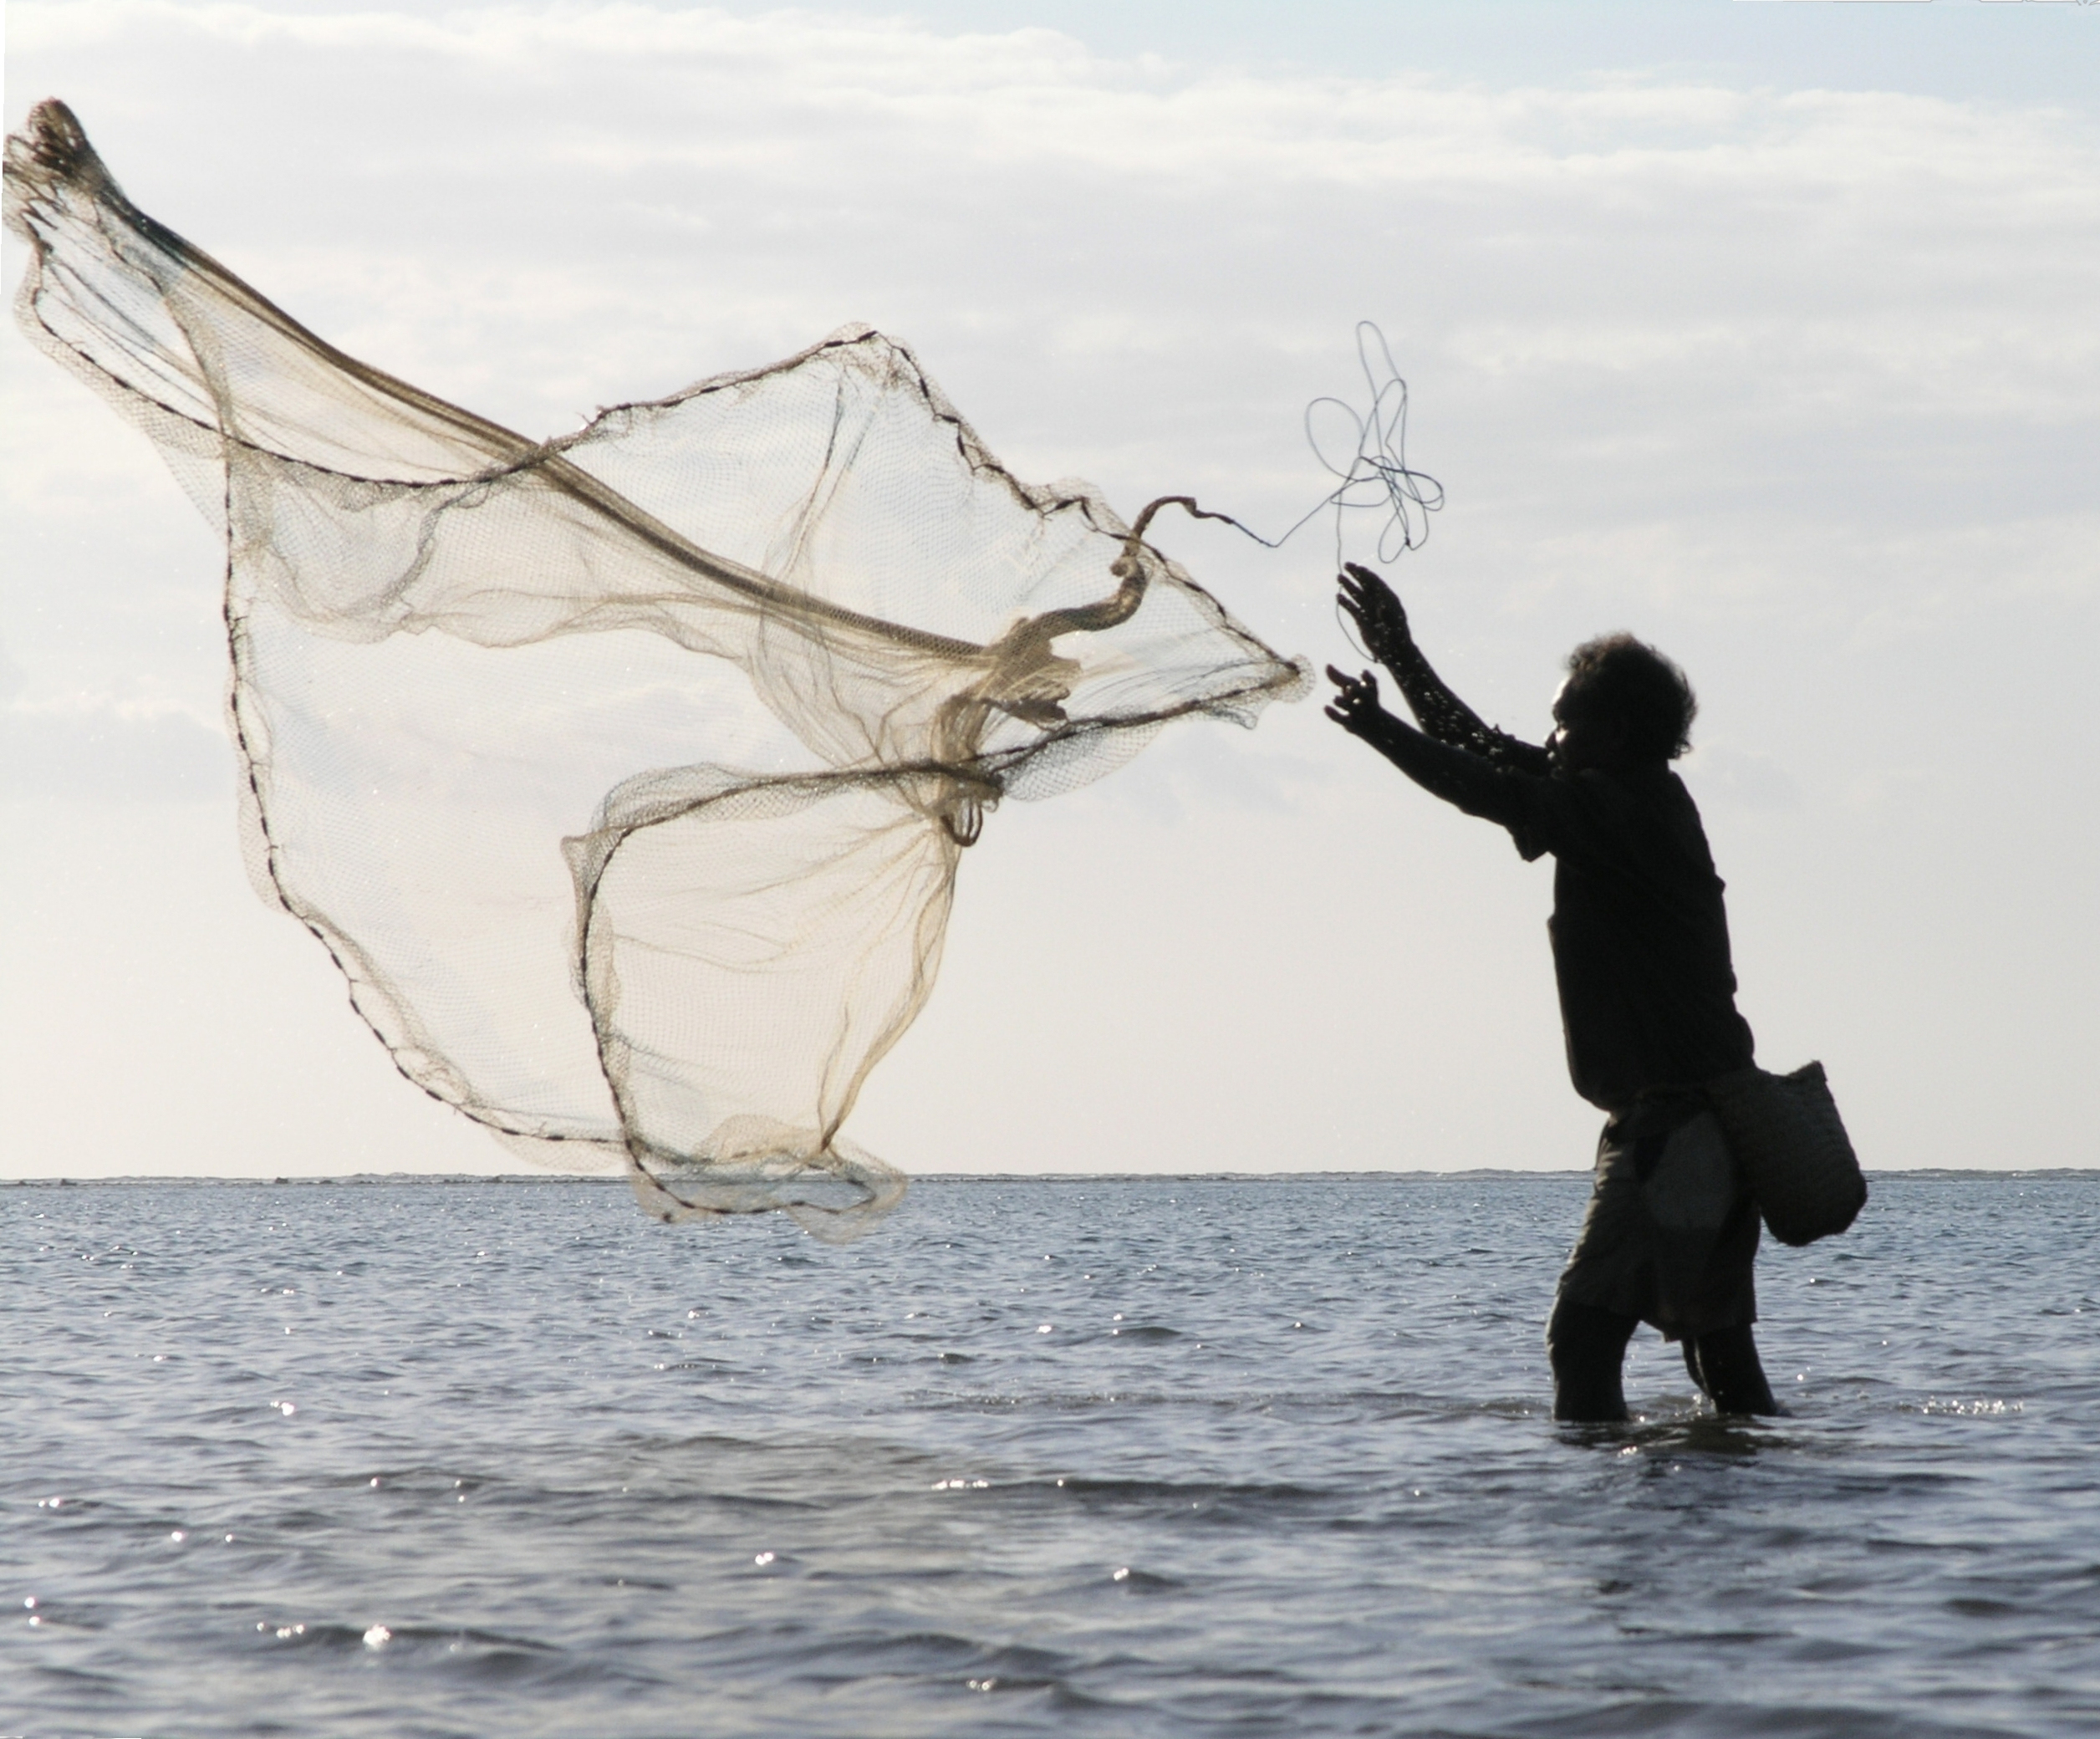
The amphiblēstron is a circular casting net used in fishing.
Using a casting net

Slide 45
Capernaum
(Hebrew: kĕpar naḥum, the village of Nahum, the prophet)

Slide 46
Understanding the Account
What relationship did Andrew have to Peter?
What evidences contribute to Peter and Andrew and James and John having previous contact with Jesus?
Who chose whom? Did Peter and Andrew chose Jesus or did Jesus choose Peter and Andrew?
“You did not choose Me, but I chose you and appointed you that you should go and bear fruit, and that your fruit should remain, that whatever you ask the Father in My name He may give you” (John 15:16).
What did Jesus command Peter and Andrew to do?
What change in occupation does following Jesus involve?
What was their reaction to the command?

Slide 47
Matthew 4:21-22
Going on from there, He saw two other brothers, James the son of Zebedee, and John his brother, in the boat with Zebedee their father, mending their nets. He called them, and immediately they left the boat and their father, and followed Him.
A second set of brothers: James and John.
They were working with their father.
The word mending (katartizō) means “restore to a former condition. . . Nets (by cleaning, mending, folding together)” (BDAG, 526)
Why would they leave their father and follow Jesus?

Slide 48
Parallels with Elijah’s Call of Elisha
So he departed from there, and found Elisha the son of Shaphat, who was plowing with twelve yoke of oxen before him, and he was with the twelfth. Then Elijah passed by him and threw his mantle on him. And he left the oxen and ran after Elijah, and said, “Please let me kiss my father and my mother, and then I will follow you.” And he said to him, “Go back again, for what have I done to you?” So Elisha turned back from him, and took a yoke of oxen and slaughtered them and boiled their flesh, using the oxen's equipment, and gave it to the people, and they ate. Then he arose and followed Elijah, and became his servant.

Slide 49
A Prophetic Call
The Bible records the Lord calling the following prophets:
Michaiah (1 Kings 22:19-22)
Isaiah (ch. 6)
Jeremiah (1:1-10)
Ezekiel (3:1-15)
Davies and Allison: “Jesus’ words, which contain no why, are not invitation. They are unconditional demand. (Hengel, Charismatic Leader, p. 17, claims that in the OT it is ultimately God himself who issues the prophetic call [1 Kings 11:31ff.; 19:15-21; 1 Sm. 16:1ff.] while in the NT the authority resides with Messiah Jesus.”) (I:397).

Slide 50
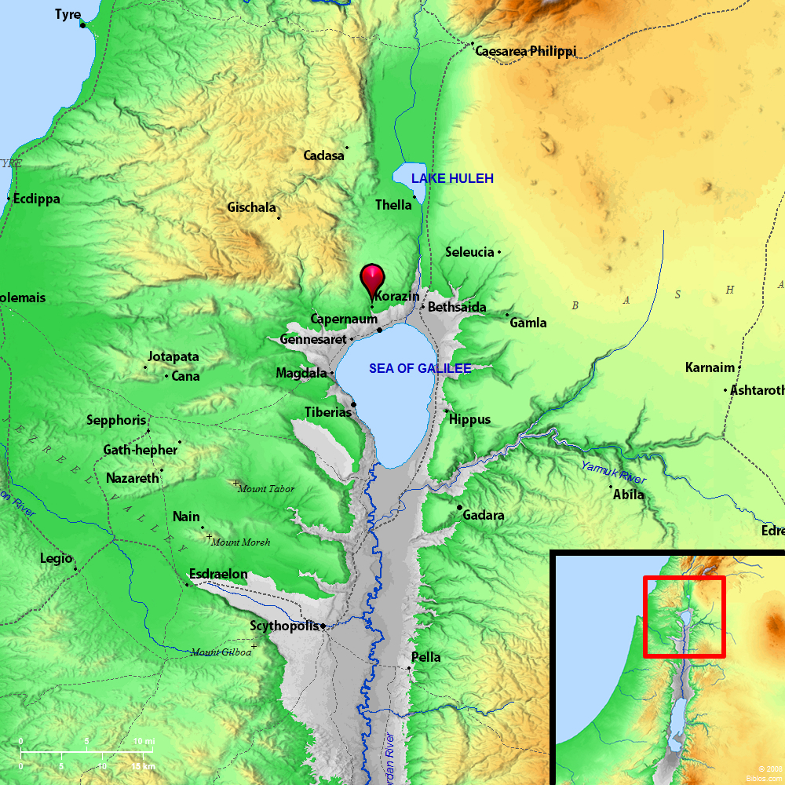
Early Galilean Ministry Matt. 4:23-25

Slide 51
Matthew 4:23-25
And Jesus went about all Galilee, teaching in their synagogues, preaching the gospel of the kingdom, and healing all kinds of sickness and all kinds of disease among the people. Then His fame went throughout all Syria; and they brought to Him all sick people who were afflicted with various diseases and torments, and those who were demon-possessed, epileptics, and paralytics; and He healed them. Great multitudes followed Him—from Galilee, and from Decapolis, Jerusalem, Judea, and beyond the Jordan.

Slide 52
Matthew’s Style
He uses summary statements throughout the book to mark divisions within the book (cf. 9:35–10:1; 13:1-3; 18:1-3; 24:3-4; etc.)
And Jesus went about all Galilee, teaching in their synagogues, preaching the gospel of the kingdom, and healing all kinds of sickness and all kinds of disease among the people (Matt. 4:23).
The summary statement describes Jesus teaching in various synagogues through Galilee.
The places: in the synagogues
The message: the gospel of the kingdom
The verification: miracles of healing, including all kinds of sicknesses (nosos) and “all kinds of disease” (malakian: condition of bodily weakness, debility, weakness, sickness, BDAG, 613).

Slide 53
Matthew 4:24
Then His fame went throughout all Syria; and they brought to Him all sick people who were afflicted with various diseases and torments, and those who were demon-possessed, epileptics, and paralytics; and He healed them.
Syria: used here of a Roman province with its capital in Antioch

Slide 54
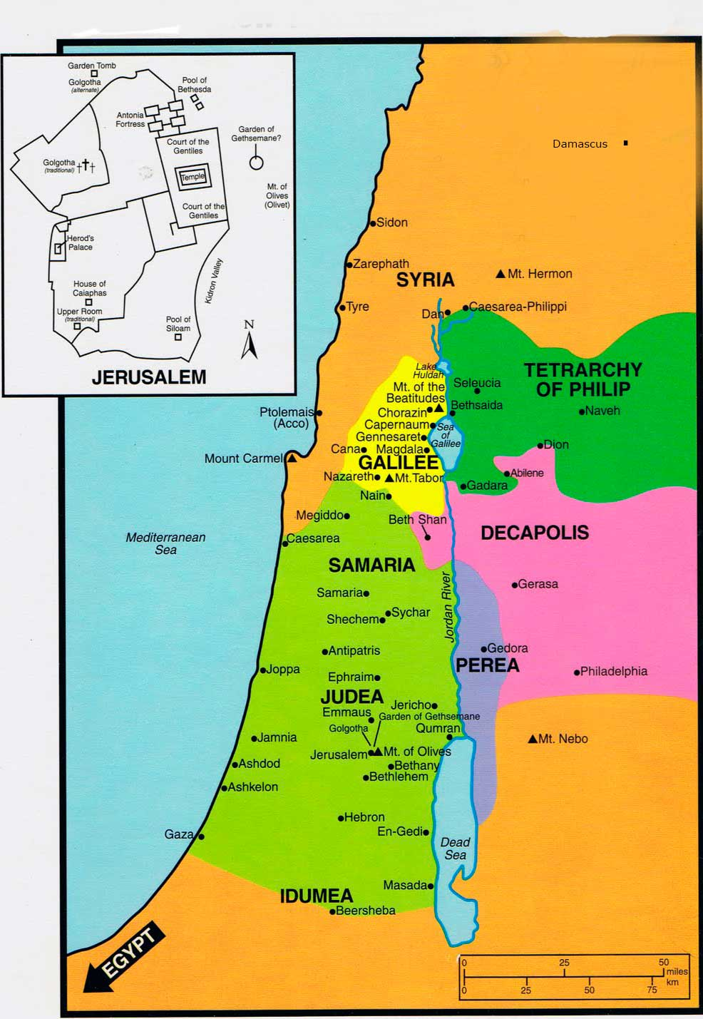
Then His fame went throughout all Syria; and they brought to Him all sick people who were afflicted with various diseases and torments, and those who were demon-possessed, epileptics, and paralytics; and He healed them (Matt. 4:24).
Syria, in the first century, referred to a province in the Roman empire that included all of Palestine (cf. Luke 2:2, where Cyrenius, governor of Syria, administered the census that required Joseph and Mary to travel to Bethlehem).

Slide 55
The Appealing Prophet
Grew in fame
Attracted those who had sick loved ones, with many different diseases
Torments (basanos): Used once in this text and two times (Luke 16:23, 28) of the torments of Hades. It is used of “severe pain caused by something oppressive, severe pain, torment” (BDAG, 168).
Demon possessed (daimonizomai): appears in 13 verses, all in the gospels, to describe those who are “possessed by a hostile spirit” (BDAG, 210).
Epiletics (selēniazomai): literally, “to be moonstruck” (cf. “lunatic,” from “lunar”) and then “to experience epileptic seizures, be an epileptic” (BDAG, 919).
Paralytics (paralutikos): “a lame person, paralytic” (BDAG, 768).
Jesus healed them, not made them feel better or taught them hope to cope with pain, but completely healed them!

Slide 56
Matthew 5:25
Great multitudes followed Him—from Galilee, and from Decapolis, Jerusalem, Judea, and beyond the Jordan.

Slide 57
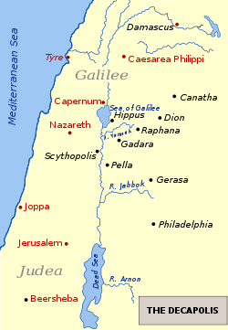
The “ten cities” of the Decapolis are in black.

Slide 58
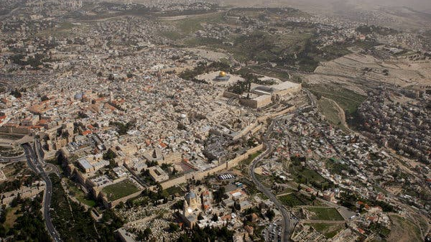
Aerial of Jerusalem

Slide 59
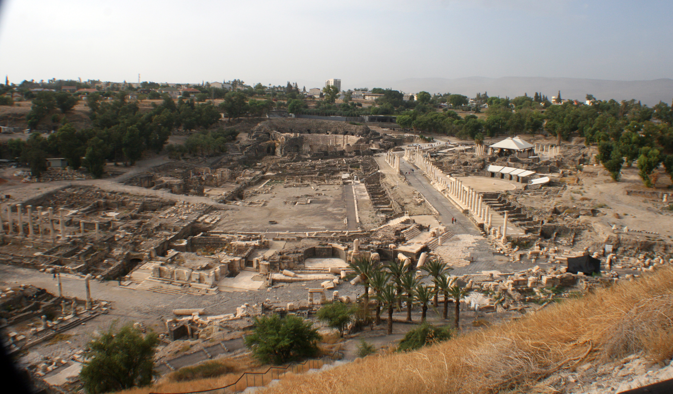
Beth-shean in Israel

Slide 60
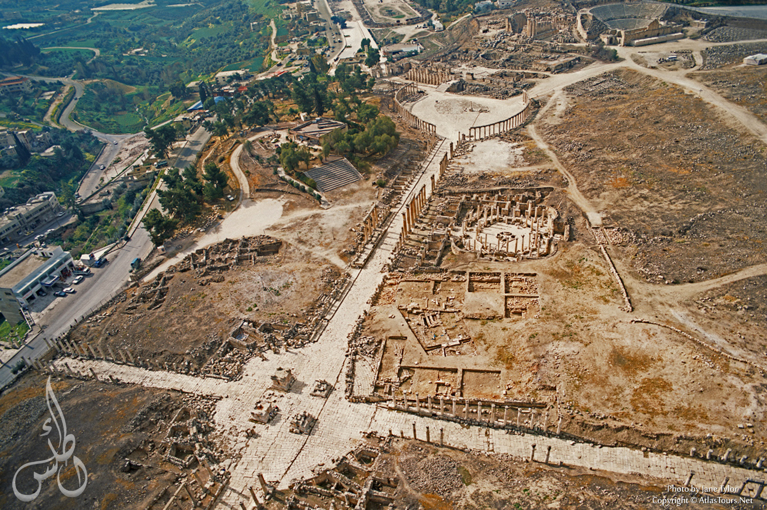
Gerash in Jordan

