Slide 2
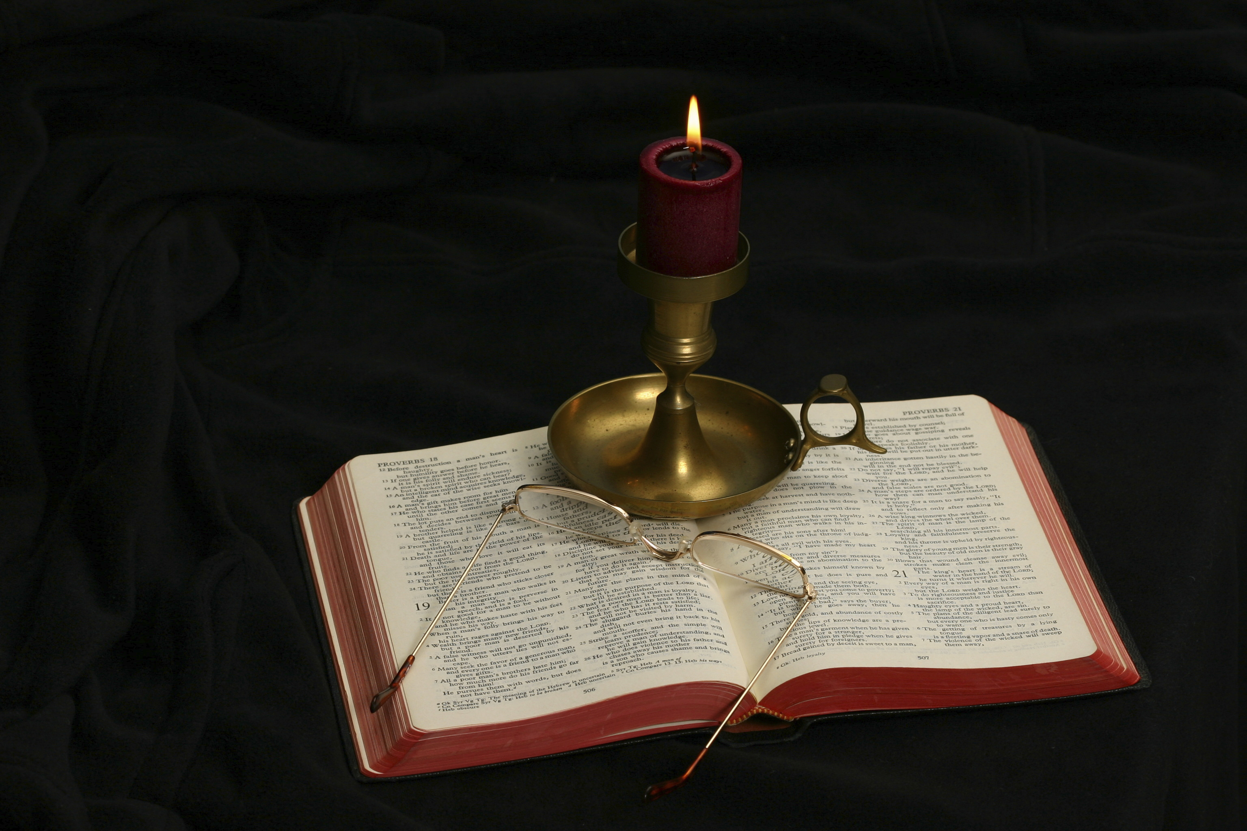
The Gospel of Matthew
Chapter 5

Slide 3
Five Sermons in Matthew
The Sermon on the Mount (5:1‐7:28)
Discourse on Mission and Martyrdom (9:36‐10:42)
Teaching on the Kingdom of Heaven (13:1-52)
Discourse on Church Administration (17:22‐18:35)
Discourse on Eschatology and Farewell Address (23:1‐25:46)

Slide 4
Introduction to the Sermon on the Mount (Matt. 5:1-2)
Church of the Beatitudes

Slide 5
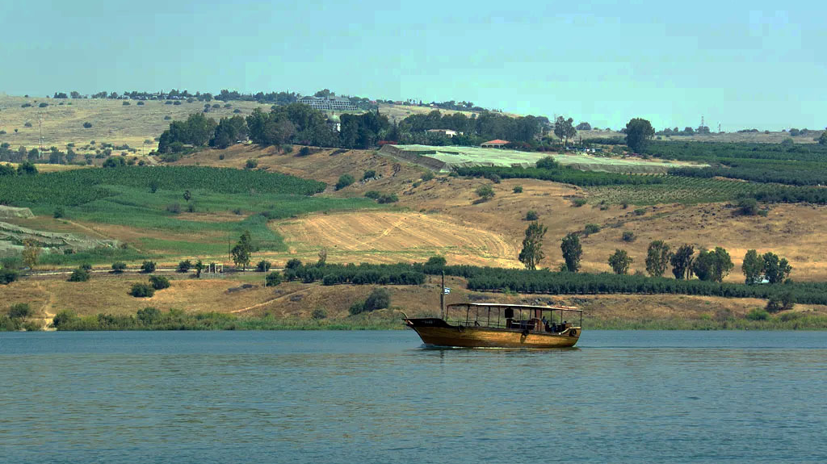
Church of the Beatitudes from the Sea of Galilee

Slide 6
Matthew 5:1-2
And seeing the multitudes, He went up on a mountain, and when He was seated His disciples came to Him. Then He opened His mouth and taught them, saying. . .
This is a continuation of 4:23-25.
The crowd is drawn from those bringing their sick being healed (4:24-25).
Other crowds were drawn at the Feeding of the 5000 and 4000
The location is not certainly known. The tourist site has been built in a place that might fit.
“He went up on a mountain” recalls Moses’ going up into a mountain at Mt. Sinai.

Slide 7
General Introductory Points
The Sermon on the Mount is probably a compilation of many of Jesus’s main preaching points.
The differences in between Matthew Sermon on the Mount and Luke’s Sermon on the Plain (Luke 6:20-49) are probably to be explained by comparing it to a preacher delivering the same sermon to different audiences.
The sermon is a demonstration to the recently called disciples in how to “fish for men.”

Slide 8
Outline of Matthew 5
Introductory information (5:1-2)
The Sermon
The Beatitudes (5:1-12)
Salt and Light (5:13-16)
Jesus’s Attitude toward the Old Testament (5:17-20)
Six antitheses (5:21-48)

Slide 9
]
The Beatitudes
3 | Blessed are the poor in spirit | For theirs is the kingdom of heaven
4 | Blessed are those who mourn | For they shall be comforted
5 | Blessed are the meek | For they shall inherit the earth
6 | Blessed are those who hunger and thirst for righteousness | For they shall be filled
7 | Blessed are the merciful | For they shall obtain mercy
8 | Blessed are the pure in heart | For they shall see God
9 | Blessed are the peacemakers | For they shall be called sons of God
10 | Blessed are those who are persecuted for righteousness’ sake | For theirs is the kingdom of heaven
11-12 | Blessed are you when they revile and persecute you, and say all kinds of evil against you falsely for My sake. | Rejoice and be exceedingly glad, for great is your reward in heaven, for so they persecuted the prophets who were before you.

Slide 10
The Influence of Isaiah 61
Isaiah 61:1-3
Matthew 5:3-12
“The Spirit of the Lord God is upon Me, Because the Lord has anointed Me To preach good tidings to the poor; He has sent Me to heal the brokenhearted, To proclaim liberty to the captives, And the opening of the prison to those who are bound; To proclaim the acceptable year of the Lord, And the day of vengeance of our God; To comfort all who mourn, To console those who mourn in Zion, To give them beauty for ashes, The oil of joy for mourning, The garment of praise for the spirit of heaviness; That they may be called trees of righteousness, The planting of the Lord, that He may be glorified.”
Blessed are the poor in spirit, For theirs is the kingdom of heaven. Blessed are those who mourn, For they shall be comforted. Blessed are the meek, For they shall inherit the earth. Blessed are those who hunger and thirst for righteousness, For they shall be filled. Blessed are the merciful, For they shall obtain mercy. Blessed are the pure in heart, For they shall see God. Blessed are the peacemakers, For they shall be called sons of God. Blessed are those who are persecuted for righteousness’ sake, For theirs is the kingdom of heaven. Blessed are you when they revile and persecute you, and say all kinds of evil against you falsely for My sake. Rejoice and be exceedingly glad, for great is your reward in heaven, for so they persecuted the prophets who were before you. (Mat

Slide 11
Key Word
Blessed (makarios): “pertaining to being especially favored, blessed, fortunate, happy, privileged. . . a. of humans privileged recipient of divine favor” (BDAG, 611).
Cf. Psalm 1:1-2—“Blessed is the man Who walks not in the counsel of the ungodly, Nor stands in the path of sinners, Nor sits in the seat of the scornful; But his delight is in the law of the Lord, And in His law he meditates day and night.”
The sense is this: These dispositions of heart and conduct toward others and toward God will lead to eternal blessings in heaven and the happiest life on earth!

Slide 12
First Beatitude
“Blessed are the poor in spirit, For theirs is the kingdom of heaven” (5:3).
Poor in spirit: “lacking in spiritual worth” (BDAG, 896).
Contrast John’s words to the church at Laodicea : “Because you say, ‘I am rich, have become wealthy, and have need of nothing’—and do not know that you are wretched, miserable, poor, blind, and naked—” (Rev. 3:17).
The language of poverty is the language of neediness.
The significance is the recognition of one’s sinfulness and need of divine grace (Isa. 6:5—“Woe is me, for I am undone! Because I am a man of unclean lips, And I dwell in the midst of a people of unclean lips; For my eyes have seen the King, The Lord of hosts.”)
Those who are not poor in spirit can never have membership in the kingdom!
“Kingdom of heaven” in this context refers to the state of eternal blessedness.

Slide 13
Second Beatitude
Blessed are those who mourn, For they shall be comforted (5:4).
Mourn (pentheō) means “to experience sadness as the result of some condition or circumstances, be sad, grieve, mourn,” but the mourning in this context is “sorrow for sins one has committed” (BDAG, 795).
The sense is not the sadness one feels with reference to the rampant wickedness in our society, but refers to the sadness one should feel for his own sins. One without this feeling toward his sin will never find divine comfort.
“Be afflicted, and mourn, and weep: let your laughter be turned to mourning, and your joy to heaviness” (James 4:9, KJV).
There is an attitude toward sin that does not grieve over sin, but brags about it and resolves to repeat it as often as he can.
Shall be comforted (future passive of parakaleō) in a divine passive, in that sense that God is the one comforting the mourning sinner.

Slide 14
Third Beatitude
Blessed are the meek, For they shall inherit the earth (5:5).
Meek (praǘs): “Meekness is not synonymous with weakness or timidity. Praus (or praos), the word Jesus uses here, was used by Xenophon in reference to a horse that was well-controlled (The Art of Horsemanship 3.12). The meek soul yields his will to the bridle of God’s will exercising restraint and self-control. Aristotle said of the adjective form praotēs, that “Meekness is the virtue of the high-spirited by which one is hard to be moved to become angry” (Virtues and Vices 1250a.2, Pope)” (Kyle Pope, Matthew: Truth Commentaries, 127).
“But the meek shall inherit the earth, And shall delight themselves in the abundance of peace” (Psa. 37:11).

Slide 15
Inherit the Earth
Alan Hugh M‘Neile: “The metaphor of inheritance . . . was primarily derived from the occupation of Canaan by the Israelites who had been oppressed in Egypt. . . . The Psalmist . . . uses it of ultimate prosperity in this life, and triumph over the wicked, which are described in the remainder of the Psalm” (The Gospel According to St. Matthew, 51).

Slide 16
Meek, Not Weak
Sometimes we think that those who are most wealthy and generally prosperous are those who are arrogant, selfishly ambitious, willing to trod on the rights of others to get what they want.
Early in Jacob’s life, he displayed some of these sinful attitudes in making sure that he would inherit the birthright and, in the process, abused his brother Esau, making him an enemy who wanted to kill him.
Jacob had to learn to trust and rely upon God in order to receive the Abrahamic blessing (including inheriting the land of Canaan).
Yielding one’s self to the bridle of God’s word requires a different approach to life to what most people think is necessary for success.

Slide 17
Fourth Beatitude
Blessed are those who hunger and thirst for righteousness, For they shall be filled (5:6).
Both “hunger” and “thirst” are used in the sense of “have a strong desire to attain some goal” (BDAG, 792, 253).
Righteousness appears five times in the Sermon on the Mount (5:6, 10, 20; 6:1, 33) and two times elsewhere (3:15; 21:32). In all of them, the meaning is “the right conduct which God requires.”
Just a few verses later, in v. 10, it is used of something characteristic of Jesus’s disciples for which they are being persecuted.

Slide 18
Shall Be Filled
The work translated filled (chortazō) means “be satisfied.”
Davies and Allison observed, “The meek are not given meekness. The pure in heart are not given purity. The peacemakers are not given peace. It is therefore far from obvious that those who hunger and thirst for righteousness gain righteousness” (1:452-453).
Those who think they have attained righteousness through their own works are condemned in the parable of the Pharisee and the tax collector (Luke 18:9-14).
The sense of this text is this: “The one who hungers for both aspects of righteousness (that is the desire to be right with God and to do right before God, mw) will be satisfied” (Kyle Pope, 129).

Slide 19
Satisfied and Gratified
Solomon speaks about all earthly quests for happiness and concludes:
“‘Vanity of vanities,’ says the Preacher; ‘Vanity of vanities, all is vanity’” (Eccl. 1:2).
“Then I looked on all the works that my hands had done And on the labor in which I had toiled; And indeed all was vanity and grasping for the wind. There was no profit under the sun” (Eccl. 2:11).
Think of those who have found that what they chased for all of their lives (under the sun) was vanity and in their disappointment took their own lives.
By contrast, Paul wrote, “exercise yourself toward godliness. For bodily exercise profits a little, but godliness is profitable for all things, having promise of the life that now is and of that which is to come” (1 Tim. 4:7-8).
Devotion to service to God will not leave you disappointed!

Slide 20
Beatitudes 5-7
Beatitudes 1-4 emphasized one’s relationship to God, as one spiritually poor, mourning over his sins, meekness (yielding to God’s divine word), and hungering and thirsting after righteousness.
Beatitudes 5-7 addresses dealing with the needs of those whom we encounter:
Showing mercy
Having a clean heart
Being a peacemaker

Slide 21
The Fifth Beatitude
Blessed are the merciful, For they shall obtain mercy (5:7).
What is mercy?
Merciful (eleēmōn): “pertaining to being concerned about people in need, merciful, sympathetic, compassionate” (BDAG, 316).
There is a tendency not to show mercy:
To our enemies, judging instead that at the moment they need mercy, we should step with a good kick or slap implying, “We thank God that you now are getting what you deserve.”
To those homeless and poor, justifying our lack of help by saying, “We don’t want to be enablers,” “you are reaping the effects of your bad choices,” etc.
We want mercy for ourselves, but justice for those who harm or hurt us.
The Scriptures teach mankind to be merciful one to another.

Slide 22
Showing Mercy Makes One Godlike
“And the Lord passed before him and proclaimed, ‘The Lord, the Lord God, merciful and gracious, longsuffering, and abounding in goodness and truth, keeping mercy for thousands, forgiving iniquity and transgression and sin, by no means clearing the guilty, visiting the iniquity of the fathers upon the children and the children’s children to the third and the fourth generation’” (Exod. 34:6-7).
God said of the “mercy seat” in the Tabernacle: “And there I will meet with you, and I will speak with you from above the mercy seat, from between the two cherubim which are on the ark of the Testimony, about everything which I will give you in commandment to the children of Israel” (Exod. 25:22).
“The Lord is longsuffering and abundant in mercy, forgiving iniquity and transgression; but He by no means clears the guilty, visiting the iniquity of the fathers on the children to the third and fourth generation” (Num. 14:18).

Slide 23
God’s People Show Mercy
“He has shown you, O man, what is good; And what does the Lord require of you But to do justly, To love mercy, And to walk humbly with your God?” (Mic. 6:8).
“For I desire mercy and not sacrifice, And the knowledge of God more than burnt offerings” (Hos. 6:6; Matt. 9:13; 12:7).
“And Saul said, ‘Blessed are you (David) of the Lord, for you have compassion on me’” (1 Sam. 23:21).
“He will spare the poor and needy, And will save the souls of the needy” (Psa. 72:13).
“He who despises his neighbor sins; But he who has mercy on the poor, happy is he” (Prov. 14:21).

Slide 24
They Shall Obtain Mercy
On earth.
God will forgive them of their sins: “For if you forgive men their trespasses, your heavenly Father will also forgive you. But if you do not forgive men their trespasses, neither will your Father forgive your trespasses” (Matt. 6:14-15; 18:21-35, the Parable of Two Servants).
Their fellow men will treat them with the same kindness they received from them.
“Whoever shuts his ears to the cry of the poor Will also cry himself and not be heard” (Prov. 21:13).
Forgiving the penitent brother: “so that, on the contrary, you ought rather to forgive and comfort him, lest perhaps such a one be swallowed up with too much sorrow. Therefore I urge you to reaffirm your love to him” (2 Cor. 2:7-8).
Eternal mercy.
“For judgment is without mercy to the one who has shown no mercy. Mercy triumphs over judgment” (James 2:13).

Slide 25
The Sixth Beatitude
Blessed are the pure in heart, For they shall see God (Matt. 5:8).
What does it mean to be pure in heart?
Pure (katharos): “pertaining to being free from moral guilt, pure, free from sin” (BDAG, 489).
Heart (kardia): “as the center of the whole inner life, with its thinking, feeling, and volition” (BDAG, 508).
Is it possible to have a pure heart?
“Woe to you, scribes and Pharisees, hypocrites! For you cleanse the outside of the cup and dish, but inside they are full of extortion and self-indulgence. Blind Pharisee, first cleanse the inside of the cup and dish, that the outside of them may be clean also” (Matt. 23:25-26).
Leon Morris: “This beatitude thus leads us to purity at the very center of our being. This is no truism. Jesus later said, ‘out of the heart proceed evil thoughts, murders, adulteries, fornications, thefts, false witness, blasphemies’ (15:19). The heart is not the place where we naturally expect purity, but Jesus demands purity right there. To be pure in heart is to be pure throughout (cf. Ps. 24:4)” (The Gospel according to Matthew, 100).

Slide 26
Sinful Man in the Presence of God
Isaiah: “So I said: ‘Woe is me, for I am undone! Because I am a man of unclean lips, And I dwell in the midst of a people of unclean lips; For my eyes have seen the King, The Lord of hosts’” (Isa. 6:5).
Peter: “When Simon Peter saw it, he fell down at Jesus’ knees, saying, ‘Depart from me, for I am a sinful man, O Lord!’” (Luke 5:8).

Slide 27
Shall See God
“As for me, I will see Your face in righteousness; I shall be satisfied when I awake in Your likeness” (Psa. 17:15).
“For I know that my Redeemer lives, And He shall stand at last on the earth; And after my skin is destroyed, this I know, That in my flesh I shall see God” (Job 19:25-26).
“Beloved, now we are children of God; and it has not yet been revealed what we shall be, but we know that when He is revealed, we shall be like Him, for we shall see Him as He is” (1 John 3:2).

Slide 28
The Seventh Beatitude
Blessed are the peacemakers, For they shall be called sons of God (Matt. 5:9).
What is a peacemaker?
The word eirēnopoios (peacemaker) means “pertaining to endeavor to reconcile person who has disagreements, making peace” (BDAG, 288). What is envisaged is not particularly intervention of a third party but rather peace-seeking ways of handling one’s own situation (Nolland, 205). Other passages on the subject of “peace-making”:
Cf. James 3:17—“easy to be entreated” (KJV), “willing to yield” (NKJV), “open to reason” (RSV). Eupeithēs means “pertaining to being easily persuaded, with the implication of being open to reason or willing to listen” (Louw-Nida, 33.305).
Cf. Rom. 1:31—“implacable” (KJV), “unforgiving” (NKJV), “heartless” (RSV). The word aspondos is defined as “pertaining to being unwilling to be reconciled to others—‘irreconcilable, unwilling to be at peace with others” (Louw-Nida, 40.7); “admitting of no truce, implacable” (LS, 260).
“Seek peace and pursue it” (Psa. 34:14).

Slide 29
A Peacemaker
Leon Morris: “There is a quality of peaceableness, a disinclination to engage in disputes, that is admirable, but Jesus is talking about more than that. He refers not to peace-keepers but to peace-makers, people who end hostilities and bring the quarrelsome together. Argyle points out that these are ‘not appeasers, but those who actively overcome evil with good.’ A person may be known as one who ends hostilities throughout his whole sphere of life, whether that sphere be great or small” (The Gospel according to Matthew, 100–101).

Slide 30
“Sons of God”
Leon Morris: “There is something godlike in bringing peace to people and people to peace. There is, of course, a sense in which all believers are members of the family of God, whether they are distinguished as makers of peace or not. But those who make peace are fulfilling what membership in the family really means, and this is something to which all the members of the family must aspire” (ibid., 101).

Slide 31
The Eighth Beatitude
Blessed are those who are persecuted for righteousness’ sake, For theirs is the kingdom of heaven (Matt. 5:10).
What does it mean to be persecuted?
The word persecute (diōkō) means “to harass someone, especially because of beliefs, persecute” (BDAG, 254). Matthew uses this word six times (5:10, 11, 12, 44; 10:23; 23:34). The word does not appear in Mark and appears in Luke (3 times) and John (3 times in 2 verses).
Jesus foresees the time when His disciples will experience persecution, unfortunately at the hand of one’s Jewish kinsmen.
The reason for persecution is for righteousness’ sake. In Matthew, the word is used of conduct that is consistent with a right standing before God.

Slide 32
For Righteousness’ Sake
There is no promise of blessing for being persecuted because of one’s political beliefs (marching on the White House, opposing other political stances).
“Therefore I exhort first of all that supplications, prayers, intercessions, and giving of thanks be made for all men, for kings and all who are in authority, that we may lead a quiet and peaceable life in all godliness and reverence” (1 Tim. 2:1-2).
“And seek the peace of the city where I have caused you to be carried away captive, and pray to the Lord for it; for in its peace you will have peace” (Jer. 29:7).

Slide 33
The Ninth Beatitude
Blessed are you when they revile and persecute you, and say all kinds of evil against you falsely for My sake. Rejoice and be exceedingly glad, for great is your reward in heaven, for so they persecuted the prophets who were before you (Matt. 5:11-12).
This beatitude is an expansion of the one before. What is added?
The word revile (oneidizō) also appears in 11:20 and 27:44 (of what the mockers did to Jesus). It means “to find fault in a way that demeans the other, reproach, revile, mock, heap insults upon as a way of shaming” (BDAG, 710).
Who among us would expect the Lord to call being reviled and persecuted a blessing?

Slide 34
“Falsely”
“say all kinds of evil against you falsely. . . .”
Are we blessed if these evil things said about us are true?
The word “falsely” is omitted in a few important texts, so you might have a note in your Bible indicating this.
Peter wrote, “But let none of you suffer as a murderer, a thief, an evildoer, or as a busybody in other people’s matters. Yet if anyone suffers as a Christian, let him not be ashamed, but let him glorify God in this matter” (1 Pet. 4:15-16).
If what the enemy said against us is true, it would be no evil to say it.
In v. 11, on account of me is parallel to for righteousness’ sake in v. 10.

Slide 35
How to React to Persecution
Rejoice and be exceedingly glad, for great is your reward in heaven, for so they persecuted the prophets who were before you (Matt. 5:12).
How is one able to do what this commandment teaches?
John Nolland: “Verbal abuse, persecution, and defamation easily make one feel a failure and readily label one a failure in the eyes of others. The text provides another perspective by appealing to a set of instances on which there was common agreement that suffering did not have such significance, but quite the opposite” (The Gospel of Matthew: A Commentary on the Greek Text, 210).
It requires a Christian worldview to view persecutions in this manner.

Slide 36
Accept the Different Perspective
Rejoice in that day and leap for joy! For indeed your reward is great in heaven, For in like manner their fathers did to the prophets (Luke 6:23).
So they departed from the presence of the council, rejoicing that they were counted worthy to suffer shame for His name (Acts 5:41).
And not only that, but we also glory in tribulations, knowing that tribulation produces perseverance (Rom. 5:3).
My brethren, count it all joy when you fall into various trials” (James 1:2).
. . . who are kept by the power of God through faith for salvation ready to be revealed in the last time. In this you greatly rejoice, though now for a little while, if need be, you have been grieved by various trials (1 Pet. 1:5-6).
. . . but rejoice to the extent that you partake of Christ’s sufferings, that when His glory is revealed, you may also be glad with exceeding joy (1 Pet. 4:13).

Slide 37
Look at Jesus’s Disciples
Poor in spirit
Mourning for sin
Meek (submitting to the will of the Father)
Hungering and thirsting after righteousness
Merciful
Pure in heart
Peacemakers
Suffering for the kingdom of heaven’s sake
Do these sound like characteristics of soldiers for an army? This is one of the proofs that Jesus was never a revolutionary leader!

Slide 38
Contrary to Our Culture
Craig Blomberg: “The upshot of the Beatitudes is a complete inversion of the attitude popularly known in our culture as ‘machismo.’ In fact, this attitude is not limited to a particular culture but characterizes humanity’s self-centered, self-arrogating pride which invariably seeks personal security and survival above the good of others. We are enabled to invert these natural, worldly values only when we recognize that God will in turn invert our marginalized status and grant eternal compensation” (Matthew: The New American Commentary, 101–102).

Slide 39
What Is Heaven Going to Be Like
Being a citizen in God’s kingdom
Being comforted
Like inheriting the earth (abundant blessings)
Being satisfied
Receiving God’s mercy
Seeing God
Being God’s son
Having heaven as a reward

Slide 40
Salt and Light (5:13-16)

Slide 41
Matthew 5:13-16
“You are the salt of the earth; but if the salt loses its flavor, how shall it be seasoned? It is then good for nothing but to be thrown out and trampled underfoot by men. You are the light of the world. A city that is set on a hill cannot be hidden. Nor do they light a lamp and put it under a basket, but on a lampstand, and it gives light to all who are in the house. Let your light so shine before men, that they may see your good works and glorify your Father in heaven.”

Slide 42
Matthew 5:13
“You are the salt of the earth; but if the salt loses its flavor, how shall it be seasoned? It is then good for nothing but to be thrown out and trampled underfoot by men.”
Leon Morris: Jesus has spoken of the blessedness of being Jesus’s disciple; now He turns to their responsibility (104).
What is the significance of Christians being compared to salt?
Davies and Allison list eleven uses of salt in the ancient world (1:472-473).
Blomberg adds that being a food preservative was its most basic function and then adds: “Jesus thus calls his disciples to arrest corruption and prevent moral decay in their world” (102).
“How shall it be seasoned” also alludes to using salt to enhance taste.
Of the earth gives their influence a wide application.
It is not God’s will that Christians withdraw from the world behind cloistered walls into monasteries and convents.
It is God’s will that we influence for good the communities and cultures in which we live.

Slide 43
If the Salt Shall Lose Its Flavor
Pure sodium chloride does not lose its flavor, but the impurities in the salts of the first century caused salt to lose its flavor. In that case it had no good purpose.
Enemies sometimes poured salt on ground in order to make it unproductive (Deut. 29:23; Judg. 9:45), such as occurs when one disposes of the water from homemade ice cream on one’s grass.
The implied parallel is that of a Christian whose conduct makes them worthless as agents for moral change and redemption.

Slide 44
Good for Nothing
What makes salt good for nothing?
Blomberg: “Christianity may make its peace with the world and avoid persecution, but it is thereby rendered impotent to fulfill its divinely ordained role. It will thus ultimately be rejected by by those with whom it has sought compromise” (102).
Think of those liberal denominations which defend abortion, approve of homosexuality, want to make it a crime to interfere with a teenager becoming transgender!
They are worthless so far as the promotion of moral purity and the cause of Jesus is concerned!

Slide 45
Matthew 5:14
“You are the light of the world. A city that is set on a hill cannot be hidden.”
What is the point of the comparison?

Slide 46
Light of the World
“A city set on a hill cannot be hidden” implies the impossibility of concealing one’s righteous influence. Christians stand out in the midst of a wicked world like a city on the top of a hill!
What does “you are the light of the world” imply about the world?
What does “you are the light of the world” imply about Christians?
You are the “light of the world” implies that Christians by their wholesome conduct influence the world for good.
This demands association and contact with the world.
This demands interaction with the moral discussions of our day and moral rebukes of the different kinds of wickedness in our society.
Jesus wants us to bring light to the darkness of the world.
What does “world” say about the size of the task before us?

Slide 47
Matthew 5:15
“Nor do they light a lamp and put it under a basket, but on a lampstand, and it gives light to all who are in the house.”
What is this comparison saying about our action as Christians?
The purpose for lighting a lamp is to give light. Putting it under a basket defeats the purpose for lighting a lamp.
A lamp is lit to put it on a lampstand in order to provide as much light as possible.
How might we hide our light?
The very purpose of being Jesus’s disciple is to give light to others.
Giving light is inherent to being a disciple of Christ; it is not optional.
The challenge is to live out one’s life in public consistently with one’s commitment to Christ.

Slide 48
How might we be guilty of doing what Jesus instructs us not to do?

Slide 49
Matthew 5:16
“Let your light so shine before men, that they may see your good works and glorify your Father in heaven.”
Jesus make His application in v. 16. What does it mean?
It is the will of God that Christian illuminate the darkness of the age in which they live to bring others to Christ.
They do this by the good works that they do for others! See the example of Dorcas in Acts 9:36-39.
What Jesus teaches in this verse is not intended to contradict His condemnation of the Pharisees who did their works to be seen by men (Matt. 23:5).
The Pharisees wanted to glorify themselves rather than to glorify their heavenly Father.

Slide 50
“Glorify Your Father in Heaven”
This is the first time this phrase appears in Matthew.
It occurs 44 times (only John’s gospel uses it more frequently).
Leon Morris: “We are so accustomed to referring to God as ‘the Father’ that we do not stop to reflect that this is a revolutionary way of thinking of ‘the high and lofty One who inhabits eternity, whose name is Holy’ (Isa. 57:15). Jesus altered forever the way we think of God” (The Gospel according to Matthew, 106).
The phrase makes one think of having an intimate relationship with the Almighty God comparable to that between a child and his father!

Slide 51
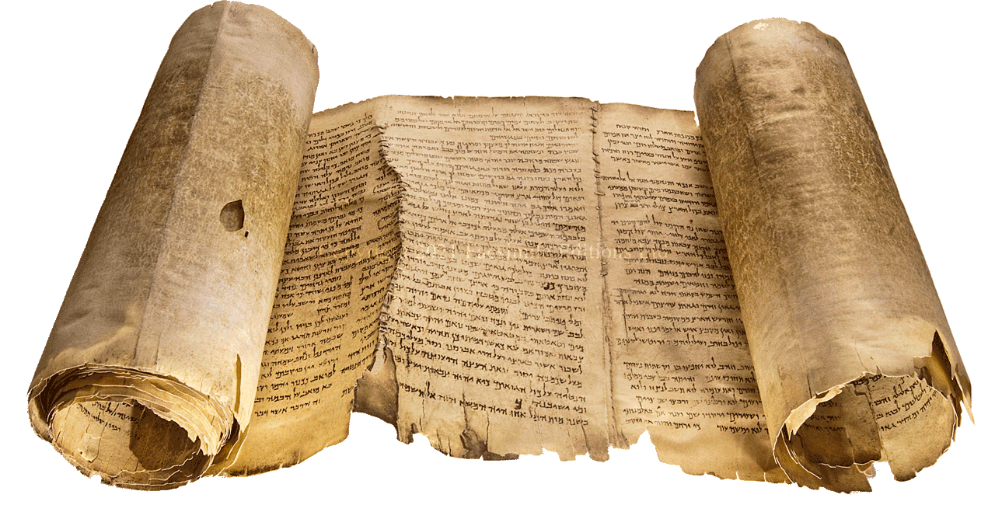
Jesus’s Attitude to the OT Matthew 5:17-20

Slide 52
Matthew 5:17-20
“Do not think that I came to destroy the Law or the Prophets. I did not come to destroy but to fulfill. For assuredly, I say to you, till heaven and earth pass away, one jot or one tittle will by no means pass from the law till all is fulfilled. Whoever therefore breaks one of the least of these commandments, and teaches men so, shall be called least in the kingdom of heaven; but whoever does and teaches them, he shall be called great in the kingdom of heaven. For I say to you, that unless your righteousness exceeds the righteousness of the scribes and Pharisees, you will by no means enter the kingdom of heaven.”

Slide 53
Jesus Was Charged with Undermining the Law
Evidences of Jewish opposition:
Questions about fasting (Matt. 9:14-17; Mark 2:18-22; Luke 5:33-39)
Plucking grain on the Sabbath (Matt. 12:1-8; Mark 2:23-28; Luke 6:1-5)
Healing on the Sabbath (Matt. 12:9-14; Mark 3:1-6; Luke 6:6-11)
He does not keep the Sabbath (John 9:16)
Eating with unwashen hands (Matt. 15:1-20; Mark 7:1-23)
Paying the Temple-tax (Matt. 17:24-27)
Charge that Jesus intended to destroy the Temple (Matt. 26:61)

Slide 54
Jewish Opposition to Christians
Initially, Jewish leaders were grieved that the Disciples preached the resurrection of the dead through Jesus (Acts 4:2).
Leaders hoped that this preaching would die a natural death, so they followed the advice of Gamaliel (Acts 5:33-40).

Slide 55
Charges Against the Church
Stephen: “Then they secretly induced men to say, ‘We have heard him speak blasphemous words against Moses and God.’ And they stirred up the people, the elders, and the scribes; and they came upon him, seized him, and brought him to the council. They also set up false witnesses who said, ‘This man does not cease to speak blasphemous words against this holy place and the law; for we have heard him say that this Jesus of Nazareth will destroy this place and change the customs which Moses delivered to us’” (Acts 6:11-14).

Slide 56
Persecution
Saul’s opposition was to the preaching of Christ (Acts 8:1-3; 9:1-14).
The opposition soon rose to the level of casting Christians out of the synagogue (John 9:22; 12:42; 15:20; 16:2) and persecuting them (Matt. 10:17; 24:9; Mark 13:9; Luke 21:12).
The Jewish defense was that Jesus was a false teacher, a heretic— “This fellow does not cast out demons except by Beelzebub, the ruler of the demons” (Matt. 12:24).
Matthew 5:17-20 is designed to show that Jesus did not oppose the Law and prophets. Rather, He was the fulfillment of the Law and prophets!

Slide 57
Matthew 5:17
“Do not think that I came to destroy the Law or the Prophets. I did not come to destroy but to fulfill.”
What does “do not think” mean in this context?
Think (nomizō): “to form an idea about something, but with some suggestion of tentativeness or refraining from a definitive statement” (BDAG, 675).
John Nolland’s translation: “Do not make the judgment [when you find me critical of what you have heard it was said to the people of old] that I came to annul the Law or the Prophets; I came not to annul but to fulfil” (215).
His parenthetical insertion makes the point that Jesus is answering criticism that arose against Him.

Slide 58
Jesus and Scripture
Jesus firmly disclaims any intention of doing away with any part of the Bible.
Jesus respected the words of Scripture, as His frequent references to the Old Testament demonstrate.
R. T. France: “Jesus is bringing that to which the Old Testament looked forward; his teaching will transcend the Old Testament revelation, but, far from abolishing it, is itself its intended culmination” (Matthew: An Introduction and Commentary, 120).

Slide 59
To Destroy
Kataluō means “to end the effect or validity of something, put an end to. . . . To cause to be no longer in force, abolish, annul, make invalid” (BDAG, 522).
Think of Jesus’s relationship to the law in the sense of an engagement followed by a wedding. The wedding does not nullify or make void the engagement but fulfills the promise of marriage.
Jesus did not nullify the Old Testament promises and prophecies, but fulfilled them.
Jesus did not release men from obligation to divine law, but brought the Law to its promised end.
Fulfilment can only confirm the Torah’s truth, not cast double upon it.

Slide 60
Galatians, Romans, & Hebrews
“What purpose then does the law serve? It was added because of transgressions, till the Seed should come to whom the promise was made; and it was appointed through angels by the hand of a mediator” (Gal. 3:19).
“But before faith came, we were kept under guard by the law, kept for the faith which would afterward be revealed. Therefore the law was our tutor to bring us to Christ, that we might be justified by faith. But after faith has come, we are no longer under a tutor” (Gal. 3:23-25).
“For Christ is the end of the law for righteousness to everyone who believes” (Rom. 10:4).
“For the priesthood being changed, of necessity there is also a change of the law” (Heb. 7:12).

Slide 61
“I Came”
Leon Morris: “I came is a significant expression; it is not one that a person would normally use of himself. It will have a meaning like ‘came into the world,’ ‘came from God’ and points to a consciousness of mission” (The Gospel according to Matthew, 107).

Slide 62
Matthew 5:18
“For assuredly, I say to you, till heaven and earth pass away, one jot or one tittle will by no means pass from the law till all is fulfilled.”
What is the purpose of this statement by Jesus?
For assuredly (“verily,” amēn) introduces one of the 31 “verily” passages, where Jesus solemnly emphasizes and affirms the certainty of what He says on His own authority (I say unto you).
The purpose of the saying is to affirm the permanent validity of Scripture.
Pass away (parerchomai) means “to come to an end and so no longer be there, pass away, disappear. . . Pass away in the sense of lose force, become invalid” (BDAG, 776).

Slide 63
One Jot and One Tittle
The Greek word jot (iota is the Greek letter which is equivalent to the English “i”). However, it is referring to the smallest letter of the Hebrew alphabet, the yod (י). There are 66,420 yods in the OT and not one of them will pass away.
The word tittle (keraia) means “horn, then anything that projects like a horn, projection, hook” (BDAG, 540). It is the small projections on letters that distinguish them from each other (ה, ח).
The idea is this: not one little bit of God’s word will pass away for God will oversee the preservation of the text of Scripture.
“‘All flesh is as grass, And all the glory of man as the flower of the grass. The grass withers, And its flower falls away, But the word of the Lord endures forever.’ Now this is the word which by the gospel was preached to you” (1 Pet. 1:24-25).

Slide 64
Till Heaven and Earth Pass
The point of Jesus’s statement is that God’s word is more durable than the heavens and earth.
The Scriptures foretell the destruction of the heaven and earth (Job 14:12; Psa. 102:25-26; Isa. 34:4; 51:6; Matt. 24:35; Mark 13:31; Luke 21:33; 1 John 2:17; Rev. 20:11; 2 Pet. 3:5-10).
“Heaven and earth will pass away, but My words will by no means pass away” (Matt. 24:35).
“He who rejects Me, and does not receive My words, has that which judges him—the word that I have spoken will judge him in the last day” (John 12:48).

Slide 65
Till All Things Are Fulfilled
The phrase is literally “until all has taken place (=is past)” (BDAG, 197).
Leon Morris: “None of it will pass away, Jesus says, until all has taken place. The divine purpose in Scripture will be fully worked out” (The Gospel according to Matthew, 110).
God’s purpose will be accomplished!
Craig Blomberg: “With the coming of Christ, many aspects of the law are brought to complete fruition (e.g., the need for sacrifices, on which see Hebrews). In other instances certain requirements of the law endure until Christ’s coming again (e.g., classically, love of neighbor and God). In short, Christian application of the Old Testament must always take into account both the continuities and the discontinuities with the New Testament” (Matthew, 104).

Slide 66
“It Is Finished”
“So when Jesus had received the sour wine, He said, ‘It is finished!’ And bowing His head, He gave up His spirit” (John 19:30).
When Jesus had finished all that was promised and prophesied under the Law and prophets, He pronounced its completion.
“. . . having wiped out the handwriting of requirements that was against us, which was contrary to us. And He has taken it out of the way, having nailed it to the cross” (Col. 2:14).

Slide 67
Matthew 5:19
“Whoever therefore breaks one of the least of these commandments, and teaches men so, shall be called least in the kingdom of heaven; but whoever does and teaches them, he shall be called great in the kingdom of heaven.”
What is the purpose of this verse?
It is to show Jesus’s endorsement and support for every Old Testament commandment.
He did not break or teach others that it was right to ignore anything that God had commanded!
If Jesus did not break or teach others to break any of God’s commandments, that should be what we do as well!
The word least is for rhetorical effect and contrasts with great in the latter part of the verse.
Kingdom of heaven has been previously discussed.

Slide 68
Least/Great Commandments
“Teacher, which is the great commandment in the law?” (Matt. 22:36).
“Woe to you, scribes and Pharisees, hypocrites! For you pay tithe of mint and anise and cummin, and have neglected the weightier matters of the law: justice and mercy and faith. These you ought to have done, without leaving the others undone” (Matt. 23:23).
“For whoever shall keep the whole law, and yet stumble in one point, he is guilty of all. For He who said, ‘Do not commit adultery,’ also said, ‘Do not murder.’ Now if you do not commit adultery, but you do murder, you have become a transgressor of the law” (James 2:10-11).
Nothing less than commitment to keep all of God’s commandments is acceptable to God.

Slide 69
Matthew 5:20
“For I say to you, that unless your righteousness exceeds the righteousness of the scribes and Pharisees, you will by no means enter the kingdom of heaven.”
What does Jesus see wrong with the righteousness of the scribes and Pharisees?
This verse transitions Jesus to the next part of the Sermon on the Mount, in which are the “you have heard”/“but I say unto you” contrasts.
Not every person is a citizen in the kingdom of heaven, nor can they be unless that meet the conditions for entrance into God’s kingdom.
From one point of view, the Pharisees meticulously kept the externals of the Law of Moses (cleanliness, observing the Sabbath, fasting, tithing, giving alms to the poor, etc.).
Yet, Jesus identified something was wrong with their righteousness!

Slide 70
Characteristic Problems in the Righteousness of the Pharisees in Matthew
Here is how the Pharisees are presented in Matthew’s gospel:
A generation of vipers (3:7)
Those who refused to associate with sinners (Matt. 9:11)
Those who felt superior because of their keeping the law (Matt. 9:14)
Those who condemned Jesus for healing on the Sabbath but thought nothing about planning murder on the Sabbath (Matt. 12:10-14)
Elevating their traditions above the word of God (Matt. 15:1-6)
Asked Jesus hard questions to trap Him (Matt. 19:3)
Repeatedly described as hypocrites (Matt. 23:13, 14, 15, 23, 25, 27, 29)
Plotted the death of the innocent Jesus (Matt. 27:62)
These are problems reflecting the integrity of their character.

Slide 71
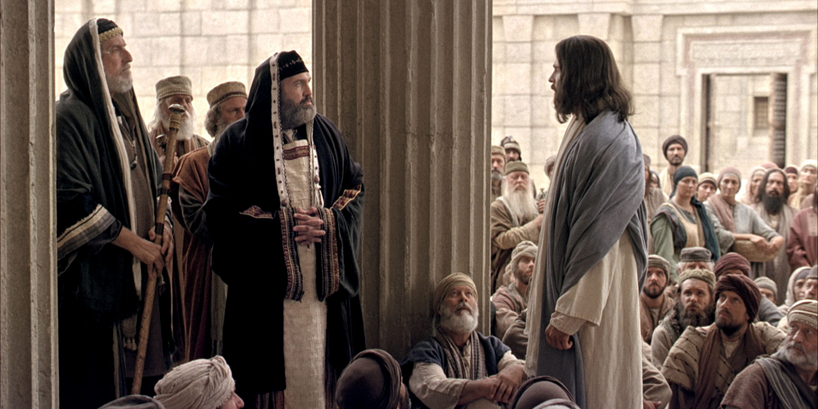
A Superior Kind of Righteousness

Slide 72
Six Antitheses
On murder (5:21-26)
On adultery (5:27-30)
On divorce (5:31-32)
On oaths (5:33-37)
On retaliation (5:38-42)
On loving enemies (5:43-48)

Slide 73
1. On Murder (Matt. 5:21-26)
“You have heard that it was said to those of old, ‘You shall not murder, and whoever murders will be in danger of the judgment.’ But I say to you that whoever is angry with his brother without a cause shall be in danger of the judgment. And whoever says to his brother, ‘Raca!’ shall be in danger of the council. But whoever says, ‘You fool!’ shall be in danger of hell fire. Therefore if you bring your gift to the altar, and there remember that your brother has something against you, leave your gift there before the altar, and go your way. First be reconciled to your brother, and then come and offer your gift. Agree with your adversary quickly, while you are on the way with him, lest your adversary deliver you to the judge, the judge hand you over to the officer, and you be thrown into prison. Assuredly, I say to you, you will by no means get out of there till you have paid the last penny.”

Slide 74
Matthew 5:21
“You have heard that it was said to those of old, ‘You shall not murder, and whoever murders will be in danger of the judgment.’”
The commandment cited by Jesus is “Thou shalt not kill” (Exod. 20:13).
The commanded “thou shalt not kill” is correctly interpreted as “You shall not murder.”
Craig Blomberg: “‘Murder’ is the correct rendering since the underlying Hebrew (ratsach, sometimes translated “kill”) did not include killing in self-defense, wars ordered by Yahweh, capital punishment following due process of law, or accidental manslaughter” (Matthew: New American Commentary, 106).
The one who commits murder is subject to the penalty of death: “ He who strikes a man so that he dies shall surely be put to death” (Exod. 21:12).
Judgment is referring to a local court (BDAG, 569).

Slide 75
Matthew 5:22
“But I say to you that whoever is angry with his brother without a cause shall be in danger of the judgment. And whoever says to his brother, ‘Raca!’ shall be in danger of the council. But whoever says, ‘You fool!’ shall be in danger of hell fire.”
But I say unto you implies the deity of Christ.
Nolland: “Taken alone, this is nothing more than a piece of emphatic assertion. Its juxtaposition with the speaking of God is striking and implies the claim to a distinct capacity to speak the demand of God into the present situation” (The Gospel of Matthew: A Commentary on the Greek Text, 229-230).

Slide 76
The Offenses
Angry with one’s brother.
“Without a cause”: “It does not seem likely that copyists would have omitted the word εἰκῇ (without a cause) after αὐτοῦ if it had been original. Although the reading with εἰκῇ is widespread from the second century onwards, it is much more likely that the word was added by copyists in order to soften Jesus’ extreme demand” (Roger L. Omanson and Bruce Manning Metzger, A Textual Guide to the Greek New Testament, 6).
Raca: “a term of abuse/put-down relating to lack of intelligence, numskull, fool (in effect verbal bullying)” (BDAG, 903).
Fool: “foolish, stupid” (BDAG, 663).
What are some modern terms we use to insult and bully people that fall into the same category as these terms?

Slide 77
The Places of Judgment
Judgment: the local courts (BDAG, 569). The synagogues had their own local courts (cf. 2 Cor. 11:24; Matt. 10:17; 23:34).
The council (Sanhedrin): there were both local councils and a national council (Matt. 10:17; 12:14; Mark 13:9).
Gehenna: the place of eternal damnation (see BDAG, 191).

Slide 78
Gradations?
Leon Morris: “Then we might see a gradation of offense, from being angry, to calling the brother stupid, to calling him a rebel, coupled with a gradation of punishment, first that of the local council, then the Sanhedrin, and finally the judgment of God. This distinction has its attractions, but it falls short of being demonstrated” (The Gospel according to Matthew, 115).

Slide 79
The Significance of What Jesus Said
He did not reject anything the Law of Moses said about murder.
He correctly identified that murder comes from a heart that is . . .
Full of anger toward that a person
Murders are frequently committed in the heat of anger!
Has degenerated into belittling and demeaning speech toward him
Having these attitudes of heart, like lust is to adultery, is murder in one’s heart

Slide 80
Matthew 5:23-24
“Therefore if you bring your gift to the altar, and there remember that your brother has something against you, leave your gift there before the altar, and go your way. First be reconciled to your brother, and then come and offer your gift” (Matt. 5:23-24).
What does this verse require of worshippers?
Jesus describes a situation in which a worshipper knows that he has offended a brother/sister, but has made no effort to seek his forgiveness and to be reconciled to one another.
Jesus instructs the brother who has sinned against another to put reconciliation with his brother before his worship.
The message is that how one treats his fellow man affects whether or not his worship is accepted by God.

Slide 81
The Importance of Reconciliation
These verses teach us that we cannot worship properly when we act in such a way as to cause animosity from others or we hold animosity in our hearts toward them.
This passage reminds one of the Beatitude and is an example of what being a peacemaker means: “Blessed are the peacemakers, For they shall be called sons of God” (Matt. 5:9).
Leon Morris: “The interruption of so solemn an act emphasizes the overriding importance of reconciliation. First has a time reference: ‘in the first place, before doing anything else.’ It is important that the worshiper get his priorities right, and the first thing to do is to effect reconciliation” (116).
There is a message here about the peace and harmony that should exist in the local church, but it expands to include our relationships with those outside of the assembly.

Slide 82
Romans 12:18
“If it is possible, as much as depends on you, live peaceably with all men.”
Some men are unable to be reconciled.
“But the wisdom that is from above is first pure, then peaceable, gentle, willing to yield, full of mercy and good fruits, without partiality and without hypocrisy” (James 3:17).
The Greek word eupeithēs means “pertaining to being easily persuaded, with the implication of being open to reason or willing to listen—‘one who is easily persuaded, open to reason” (Johannes P. Louw and Eugene Albert Nida, Greek-English Lexicon of the New Testament: Based on Semantic Domains, 422).

Slide 83
Matthew 5:25-26
“Agree with your adversary quickly, while you are on the way with him, lest your adversary deliver you to the judge, the judge hand you over to the officer, and you be thrown into prison. Assuredly, I say to you, you will by no means get out of there till you have paid the last penny.”
Jesus pictures two adversaries headed toward court to have their differences decided by the judge meeting each other on the way to court.
The party having conducted himself wrongfully is advised/instructed to take advantage of that opportunity to come to a peaceful agreement with adversary. Otherwise, he delivered into prison and will not be released until the last penny is paid.

Slide 84
Defining Terms
Agree with (eunoeō): “be well disposed, make friends . . . Make friends quickly with your opponent=settle the case with your plaintiff” (BDAG, 409).
Adversary (antidikos): “one who brings a charge in a lawsuit” (BDAG, 88).
Penny (kodrantēs): the smallest Roman coin; 1/64 of a denarius, which is the daily wage of a common laborer. In a labor market where the minimum wage is $15 an hour ($120 a day), the amount would be $1.87.

Slide 85
The Application
The first illustration presumes that the matter was settled and the man returned to offer his sacrifice; the second illustration presumes nothing is done to effect reconciliation and the offender is cast into prison until full payment has been made due to his financial liability.
The one case ends with the approval of God in the acceptance of the sacrifice and the latter case in the punitive judgment of God.

Slide 86
2. On Adultery (Matt. 5:27-30)
“You have heard that it was said to those of old, ‘You shall not commit adultery.’ But I say to you that whoever looks at a woman to lust for her has already committed adultery with her in his heart. If your right eye causes you to sin, pluck it out and cast it from you; for it is more profitable for you that one of your members perish, than for your whole body to be cast into hell. And if your right hand causes you to sin, cut it off and cast it from you; for it is more profitable for you that one of your members perish, than for your whole body to be cast into hell.”

Slide 87
Matthew 5:27
“You have heard that it was said to those of old, ‘You shall not commit adultery.’”
Does Jesus correctly represent the Old Testament teaching?
The seventh of the Ten Commandments: “You shall not commit adultery” (Exod. 20:14; cf. Deut. 5:18).
What is adultery and how is it different from fornication?
What makes “adultery” such a grievous sin that it is included with the Ten Commandments?

Slide 88
Matthew 5:28
“But I say to you that whoever looks at a woman to lust for her has already committed adultery with her in his heart.”
Was Jesus treading new ground in what He taught?
“You shall not covet your neighbor’s house; you shall not covet your neighbor’s wife, nor his male servant, nor his female servant, nor his ox, nor his donkey, nor anything that is your neighbor’s” (Exod. 20:17).
“If my heart has been enticed by a woman, Or if I have lurked at my neighbor’s door. . .” (Job 31:9).
“So is he who goes in to his neighbor’s wife; Whoever touches her shall not be innocent” (Prov. 6:29).
“They were like well-fed lusty stallions; Every one neighed after his neighbor’s wife” (Jer. 5:8).
The sin lies not in the entrance of a thought (which cannot be controlled), but in letting it incite passion.

Slide 89
The Problem of Sexual Temptation
Pornography
Strip bars
Filthy TV and movies
The swimming pools and beaches
This is not just a modern problem:
The Qumran material condemns “lecherous eyes” (1QS 1:6), “not follow after the thoughts of a guilty inclination and lascivious eyes” (CD 2:16), and “his eyes have not drawn them to licentiousness” (1QpHab 5:7).
Jubilee 20:4—“let them not commit fornication with her after their eyes and their heart.”

Slide 90
The Plague of Adultery in the Church
Craig Blomberg: “Adultery among Christians today is a scandal, yet it almost never occurs without precipitation. Christians must recognize those thoughts and actions which, long before any overt sexual sin, make the possibility of giving in to temptation more likely, and they must take dramatic action to avoid them”(Matthew: The New American Commentary, 109).

Slide 91
Proverbs
Look at the things a woman can do to incite and manifest lust:
Her words:
“To deliver you from the immoral woman, From the seductress who flatters with her words” (Prov. 2:16).
“For the lips of an immoral woman drip honey, And her mouth is smoother than oil” (Prov. 5:3).
Her beauty: “Lust not after her beauty in thine heart” (Prov. 6:25).
Women can put the “attire of a harlot” (Prov. 7:10).
He eyes: “Neither let her take thee with her eyelids” (Prov. 6:25).
Her kisses: “So she caught him and kissed him; With an impudent face she said to him” (Prov. 7:13).

Slide 92
Proverbs 7:6-23
For at the window of my house I looked through my lattice,
And saw among the simple, I perceived among the youths,
A young man devoid of understanding,
Passing along the street near her corner;
And he took the path to her house
In the twilight, in the evening,
In the black and dark night.
And there a woman met him,
With the attire of a harlot, and a crafty heart.
She was loud and rebellious,
Her feet would not stay at home.
At times she was outside, at times in the open square,
Lurking at every corner.
So she caught him and kissed him;
With an impudent face she said to him:
“I have peace offerings with me;
Today I have paid my vows.
So I came out to meet you,
Diligently to seek your face,
And I have found you.
I have spread my bed with tapestry,
Colored coverings of Egyptian linen.
I have perfumed my bed
With myrrh, aloes, and cinnamon.
Come, let us take our fill of love until morning;
Let us delight ourselves with love.
For my husband is not at home;
He has gone on a long journey;
He has taken a bag of money with him,
And will come home on the appointed day.”
With her enticing speech she caused him to yield,
With her flattering lips she seduced him.
Immediately he went after her,
As an ox goes to the slaughter,
Or as a fool to the correction of the stocks,
Till an arrow struck his liver.
As a bird hastens to the snare,
He did not know it would cost his life.

Slide 93
Sexual Lust
Sinful anger against a person = murder in one’s heart
Sinful lust after another = adultery in one’s heart

Slide 94
Matthew 5:29-30
“If your right eye causes you to sin, pluck it out and cast it from you; for it is more profitable for you that one of your members perish, than for your whole body to be cast into hell. And if your right hand causes you to sin, cut it off and cast it from you; for it is more profitable for you that one of your members perish, than for your whole body to be cast into hell.”
The eye is probably mentioned because it is the instrument through which one looks to lust.
Since the majority of people are right oriented, the right eye and right hand are mentioned, being more important for right oriented people than the left would be.

Slide 95
What Is the Message?
Would plucking out the right eye and cutting off the right hand prevent sexual lust?
So, what is the message?
One must be willing to make any sacrifice to avoid sin!
If you are looking at pornography on your computer, get rid of your computer.
If you are watching movies that are creating sinful lust, unsubscribe to Netflex, HBO, or any other service you must.
If you have a person at work making advances that are tempting you, look for another job!
Make any sacrifice necessary in order to stay faithful to the Lord!
“But I discipline my body and bring it into subjection, lest, when I have preached to others, I myself should become disqualified” (1 Cor. 9:27).

Slide 96
3. On Adultery and Remarriage
“Furthermore it has been said, ‘Whoever divorces his wife, let him give her a certificate of divorce.’ But I say to you that whoever divorces his wife for any reason except sexual immorality causes her to commit adultery; and whoever marries a woman who is divorced commits adultery” (Matt. 5:31-32).

Slide 97
Matthew 5:31
“Furthermore it has been said, ‘Whoever divorces his wife, let him give her a certificate of divorce.’”
What is the thrust of the Mosaic Law in Deut. 24:1-4?
“When a man takes a wife and marries her, and it happens that she finds no favor in his eyes because he has found some uncleanness in her, and he writes her a certificate of divorce, puts it in her hand, and sends her out of his house, when she has departed from his house, and goes and becomes another man’s wife, if the latter husband detests her and writes her a certificate of divorce, puts it in her hand, and sends her out of his house, or if the latter husband dies who took her as his wife, then her former husband who divorced her must not take her back to be his wife after she has been defiled; for that is an abomination before the Lord, and you shall not bring sin on the land which the Lord your God is giving you as an inheritance” (Deut. 24:1-4).
Leon Morris: “The bill of divorce was a protection for the woman; a capricious husband could not drive her from his home and afterward claim that she was still his wife. He must give her the document that set out her right to marry someone else” (The Gospel according to Matthew, 120).

Slide 98
Two Prevailing Views about Divorce
The school of Shammai: This group took a conservative understanding of “some indecency” (Deut. 24:1), saying that it was only allowed in cases of adultery.
This interpretation runs into the problem that adultery was to be punished by death, not divorce. The text refers to some act short of adultery.
The school of Hillel: This group allowed a much wider range of interpretation, and permitted a man to divorce his wife if she spoiled his dinner (Mishnah Giṭ. 9.10); R. Akiba allowed divorce “Even if he found another fairer than she.”
This view is as liberal as American “no fault divorce.”
Against such a background Jesus calls on people to appreciate the true meaning and solemnity of marriage.

Slide 99
Matthew 5:32
“But I say to you that whoever divorces his wife for any reason except sexual immorality causes her to commit adultery; and whoever marries a woman who is divorced commits adultery.”
What difference do you see between Jesus and the two factions of Jews?
Jesus forbids divorces that Deuteronomy 24 allowed and permits remarriage following a divorce only in cases of sexual immorality, in which case only the innocent person is allowed to remarry.
What two new teachings does Jesus about divorce?
A person who divorces his/her mate for some reason other than sexual immorality and then remarries commits adultery.
Should the person who has been divorced for some reason other than sexual immorality remarry, that person is guilty of adultery.

Slide 100
4. On Oaths (5:33-37)
“Again you have heard that it was said to those of old, ‘You shall not swear falsely, but shall perform your oaths to the Lord.’ But I say to you, do not swear at all: neither by heaven, for it is God’s throne; nor by the earth, for it is His footstool; nor by Jerusalem, for it is the city of the great King. Nor shall you swear by your head, because you cannot make one hair white or black. But let your ‘Yes’ be ‘Yes,’ and your ‘No,’ ‘No.’ For whatever is more than these is from the evil one.”
Written before Matthew’s gospel, James’s reference to Jesus’s teaching shows that this teaching was very early in Christianity: “But above all, my brethren, do not swear, either by heaven or by earth or with any other oath. But let your ‘Yes,’ be ‘Yes,’ and your ‘No,’ ‘No,’ lest you fall into judgment” (James 5:12).

Slide 101
Bible Teaching on Oaths
The Lord Himself swears (Deut. 31:7; Gen. 22:16-18; Luke 1:73; Acts 2:29-32; Psa. 110:4; Heb. 7:17-28) and takes oaths (Gen. 26:3).
Oaths taken in Yahweh’s name were acceptable (Deut. 6:13; 10:20) and sometimes commanded (Num. 5:19ff).
Oaths taken in God’s name but not kept profaned the name of Yahweh (Lev. 19:12; Exod. 20:7).
Jesus Himself was put under oath during His trial (Matt. 26:63f.).
Paul called God as His witness one some occasions (1 Thess. 2:5; 2 Cor. 1:23; Gal. 1:20; Phil. 1:8; Rom. 1:9).
Perjuring oneself is sinful (1 Tim. 1:10).

Slide 102
Summary of OT Teaching
“And you shall not swear by My name falsely, nor shall you profane the name of your God: I am the Lord” (Lev. 19:12).
“If a man makes a vow to the Lord, or swears an oath to bind himself by some agreement, he shall not break his word; he shall do according to all that proceeds out of his mouth” (Num. 30:2).

Slide 103
Matthew 5:33
“Again you have heard that it was said to those of old, ‘You shall not swear falsely, but shall perform your oaths to the Lord.’”
The Old Testament held men responsible to fulfill the vows and oaths that they take, as shown in a previous chart.

Slide 104
Matthew 5:34-36
“But I say to you, do not swear at all: neither by heaven, for it is God’s throne; nor by the earth, for it is His footstool; nor by Jerusalem, for it is the city of the great King. Nor shall you swear by your head, because you cannot make one hair white or black.”

Slide 105
First Century Jewish Practices
“Woe to you, blind guides, who say, ‘Whoever swears by the temple, it is nothing; but whoever swears by the gold of the temple, he is obliged to perform it.’ Fools and blind! For which is greater, the gold or the temple that sanctifies the gold? And, ‘Whoever swears by the altar, it is nothing; but whoever swears by the gift that is on it, he is obliged to perform it.’ Fools and blind! For which is greater, the gift or the altar that sanctifies the gift? Therefore he who swears by the altar, swears by it and by all things on it. He who swears by the temple, swears by it and by Him who dwells in it. And he who swears by heaven, swears by the throne of God and by Him who sits on it” (Matt. 23:16-22).
Several tractates in the Mishnah regulate Jewish oaths.

Slide 106
A Rejection of Jewish Casuistry
Jesus is rejecting the silly games by which the scribes and Pharisees manufactured an approved way of lying!
Leon Morris: “The Jews held that unless the name of God was specifically mentioned the oath was not binding; there were lengthy discussions about when an oath is or is not binding, and people would sometimes swear by heaven or earth or a similar oath and later claim that they were not bound by that oath because God was not mentioned” (The Gospel according to Matthew, 124).

Slide 107
Matthew 5:37
“But let your ‘Yes’ be ‘Yes,’ and your ‘No,’ ‘No.’ For whatever is more than these is from the evil one.”
Jesus’s solution was simple: Always tell the truth!
Even when one tries to always tell the truth, sometimes he needs to modify his answer by “my perception is. . . .” There is a great deal of human subjectivity in what we perceive another to have done or said.
Can you think of an example of where you have only heard part of a conversation that you lacked context to fully understand what was going on?

Slide 108
5. On Retaliation (5:38-42)
“You have heard that it was said, ‘An eye for an eye and a tooth for a tooth.’ But I tell you not to resist an evil person. But whoever slaps you on your right cheek, turn the other to him also. If anyone wants to sue you and take away your tunic, let him have your cloak also. And whoever compels you to go one mile, go with him two. Give to him who asks you, and from him who wants to borrow from you do not turn away.”

Slide 109
Matthew 5:38
“You have heard that it was said, ‘An eye for an eye and a tooth for a tooth.’”
“If men fight, and hurt a woman with child, so that she gives birth prematurely, yet no harm follows, he shall surely be punished accordingly as the woman’s husband imposes on him; and he shall pay as the judges determine. But if any harm follows, then you shall give life for life, eye for eye, tooth for tooth, hand for hand, foot for foot, burn for burn, wound for wound, stripe for stripe” (Exod. 21:22-25).
“Your eye shall not pity: life shall be for life, eye for eye, tooth for tooth, hand for hand, foot for foot” (Deut. 19:21).
Cf. also Leviticus 24:17-23

Slide 110
The Purpose of the Civil Law
R. T. France: “Its intention was not to sanction revenge, but to prevent the excesses of the blood-feud by stating that the legal punishment must not exceed the crime. By the time of Jesus physical penalties had generally been replaced by financial damages. What Jesus is opposing here is not therefore brutality, or even physical retaliation, but the principle of insisting on even legitimate retribution” (Matthew: An Introduction and Commentary, 130).
Craig L. Blomberg: “This law originally prohibited the formal exaction of an overly severe punishment that did not fit a crime as well as informal, self-appointed vigilante action. Now Jesus teaches the principle that Christian kindness should transcend even straightforward tit-for-tat retribution” (Matthew, 113).
The Hatfield-McCoy feud in West Virginia demonstrates the need for limiting punishments.
What does this law say about the limits of compensatory damages?

Slide 111
Matthew 5:39
“But I tell you not to resist an evil person. But whoever slaps you on your right cheek, turn the other to him also.”
What principle does Jesus present for His disciples in the first sentence?
Why is this not a fitting principle for police and judges to follow in their professional jobs?
If it were followed, we would have evil triumphing throughout the cities, states, and nation.
What, then, is Jesus forbidding?
What is a “slap on your right cheek”?
What two options are available when someone slaps your cheek?
What then is Jesus teaching?

Slide 112
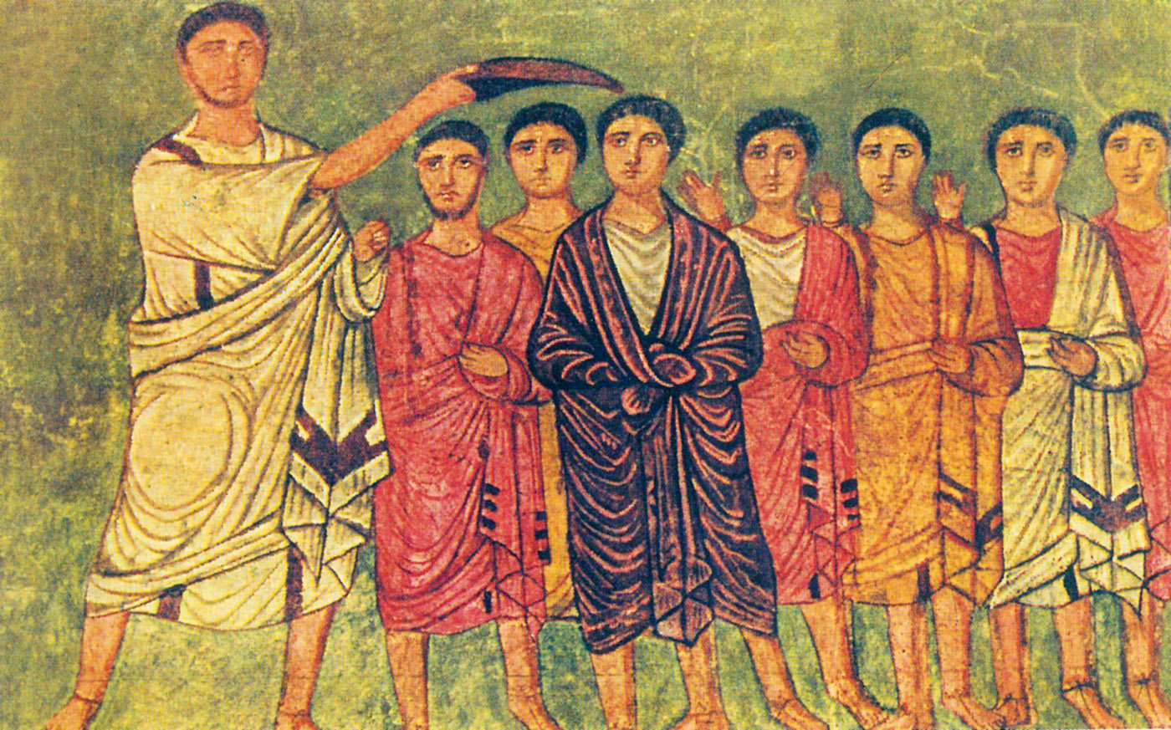
Matthew 5:40
“If anyone wants to sue you and take away your tunic, let him have your cloak also.”
Duro-Europos synagogue paintings (3rd century AD), note the tunic and cloaks

Slide 113
The Two Garments
The tunic (chitōna): The robe-like garment worn next to the skin under the outer garments
The cloak (himation): The outer-garment, often used to protect oneself from the weather
If one literally did what Jesus commanded, what would his condition be?
If the passage is not to be literally applied, what is it teaching?

Slide 114
1 Corinthians 6:1-8
“Dare any of you, having a matter against another, go to law before the unrighteous, and not before the saints? Do you not know that the saints will judge the world? And if the world will be judged by you, are you unworthy to judge the smallest matters? Do you not know that we shall judge angels? How much more, things that pertain to this life? If then you have judgments concerning things pertaining to this life, do you appoint those who are least esteemed by the church to judge? I say this to your shame. Is it so, that there is not a wise man among you, not even one, who will be able to judge between his brethren? But brother goes to law against brother, and that before unbelievers! Now therefore, it is already an utter failure for you that you go to law against one another. Why do you not rather accept wrong? Why do you not rather let yourselves be cheated? No, you yourselves do wrong and cheat, and you do these things to your brethren!”

Slide 115
Matthew 5:41
“And whoever compels you to go one mile, go with him two.”
Compels (aggareuō): “press into service, and so force, compel” (BDAG, 7).
Think of Simon of Cyrene: “Now as they came out, they found a man of Cyrene, Simon by name. Him they compelled to bear His cross” (Matt. 27:32).
Being forced into service by a Roman soldier was “fiercely resented” by Jews of the first century AD (France, Matthew: An Introduction and Commentary, 132).
What is the point of Jesus’s commandment?

Slide 116
Matthew 5:42
“Give to him who asks you, and from him who wants to borrow from you do not turn away.”
What would happen if this were literally applied to every person in society?
To a person personally?
To the banking system?
To lend to neighbors who never return what they “borrow”?

Slide 117
So, What Is Jesus Teaching?
He severely rebukes the taking of personal vengeance—an eye for an eye (5:38).
He severely condemns the tit-for-tat reaction to insults (5:39).
He condemns the “standing up for your rights” at all times approach to life (5:40).
He commands the “go the second mile” approach to human relationships.
Does that leave one vulnerable?
He commands a generous spirit toward those poor who genuinely need our help, without approving professional begging (2 Thess. 3:10).

Slide 118
6. On Loving One’s Enemies (5:43-48)
“You have heard that it was said, ‘You shall love your neighbor and hate your enemy.’ But I say to you, love your enemies, bless those who curse you, do good to those who hate you, and pray for those who spitefully use you and persecute you, that you may be sons of your Father in heaven; for He makes His sun rise on the evil and on the good, and sends rain on the just and on the unjust. For if you love those who love you, what reward have you? Do not even the tax collectors do the same? And if you greet your brethren only, what do you do more than others? Do not even the tax collectors do so? Therefore you shall be perfect, just as your Father in heaven is perfect.

Slide 119
Matthew 5:43
“You have heard that it was said, ‘You shall love your neighbor and hate your enemy.’”
Leviticus 19:18—“You shall not take vengeance, nor bear any grudge against the children of your people, but you shall love your neighbor as yourself: I am the Lord.”
Jesus made application of this verse in other texts:
The Good Samaritan (Luke 10:25-37)
The first and second greatest commandments (Matt. 22:36-40)
“Hate your enemy” does not appear in the Old Testament and must be understood as a jibe at contemporary Jewish attitudes.
The lawyer in the Parable of the Good Samaritan wanted to limit who was one’s neighbor.
The Qumran Essenes said that the “sons of light were ‘to hate . . . All the sons of darkness, each according to his guilt at the time of God’s vengeance’ (1 QS 1:10-11)” (Commentary on Matthew, I:549-550).

Slide 120
Matthew 5:44
“But I say to you, love your enemies, bless those who curse you, do good to those who hate you, and pray for those who spitefully use you and persecute you, . . .”
Jesus calls us to a higher standard. We are to love, bless, do good to, and pray for our enemies, those who curse us, those who hate us, and those who spitefully use us and persecute us.
Peter remembered this about Jesus: “who, when He was reviled, did not revile in return; when He suffered, He did not threaten, but committed Himself to Him who judges righteously” (1 Pet. 2:23).
Crail L. Blomberg: “The true test of genuine Christianity is how believers treat those whom they are naturally inclined to hate or who mistreat or persecute them” (Matthew, 114–115).

Slide 121
Matthew 5:45
“. . . that you may be sons of your Father in heaven; for He makes His sun rise on the evil and on the good, and sends rain on the just and on the unjust.”
Be (ginomai) means this: “γένησθε might be understood as ‘become’ (so GNB); disciples are not to be content with what they are but to ‘become’ increasingly God’s children. It is not only that they act in love to show what they are now (Zahn); that is true, but they also go on to become what they are not yet. This does not mean that they qualify for membership in the family by their deeds, but rather that they continually progress in the service of God. Cf. Bruner, ‘that we might really be in act what we have been made in fact—sons and daughters of the Father’ (p. 221)” (Leon Morris, The Gospel according to Matthew, 131).
The character of the Father that we are to emulate is His showing grace and favor to both the evil and the good.

Slide 122
Matthew 5:46-47
“For if you love those who love you, what reward have you? Do not even the tax collectors do the same? And if you greet your brethren only, what do you do more than others? Do not even the tax collectors do so?”
Tax collectors were usually held in contempt by Jewish people.
Doing good to those who have done good to you is only reciprocating and repaying.
Jesus calls His disciples to a higher standard—loving and greeting those who hate and mistreat us.
Who gave us the right not to love and not to speak to those who are our enemies? Are these not a way of showing contempt toward our enemies?

Slide 123
Matthew 5:48
“Therefore you shall be perfect, just as your Father in heaven is perfect.”
The point is not that man can be sinless, like God’s nature, but that we are ever growing to become like God.
We should show perfect (fully mature) love like God does.

