Slide 1
The Parable of the Lost Sheep Matthew 18:10-14
“See that you do not despise one of these little ones. For I tell you that in heaven their angels always see the face of my Father who is in heaven. What do you think? If a man has a hundred sheep, and one of them has gone astray, does he not leave the ninety-nine on the mountains and go in search of the one that went astray? And if he finds it, truly, I say to you, he rejoices over it more than over the ninety-nine that never went astray. So it is not the will of my Father who is in heaven that one of these little ones should perish.”

Slide 2
Matthew 10:10
“See that you do not despise one of these little ones. For I tell you that in heaven their angels always see the face of my Father who is in heaven.”
Who are intended by “these little ones”?
Despise (kataphroneō): “to look down on someone or something with contempt or aversion, with implication that one considers the object of little value, look down on, despise, scorn, treat with contempt” (BDAG, 529).
How does this church treat those “little ones” (weak Christians)? Do we look down upon them?
Do we follow the instructions of vv. 12-17 to save them when they wander away?

Slide 3
Matthew 10:10
“See that you do not despise one of these little ones. For I tell you that in heaven their angels always see the face of my Father who is in heaven.”
What is the second sentence in this verse saying?
“See the face of my Father” = have access to the Father
“Are they not all ministering spirits sent out to serve for the sake of those who are to inherit salvation?” (Heb. 1:14).

Slide 4
Guardian Angels?
The thought of guardian angels stems from Psa. 34:7; 91:11. It resulted in Jewish belief in guardian angels for each person.
Read Psalms 91 and 34.
It is impossible for us to know whether or not each individual is protected by his own personal angel; what is more likely is that God uses His angels to provide the protection God commands them to provide.
Jesus is aware of any act that is done to one of His disciples, even the weakest one (Matt. 25:31-45; Acts 9:4).

Slide 5
(Matthew 18:11)
(“For the Son of Man came to save the lost.”)
“The words ‘For the Son of Man came (to seek and) to save the lost’ are absent from the earliest manuscripts representing several textual types (Alexandrian, Egyptian, Antiochian) and are taken from Luke 19:10. These words were apparently added in order to provide a connection between v. 10 and vv. 12–14” (Roger L. Omanson and Bruce Manning Metzger, A Textual Guide to the Greek New Testament: An Adaptation of Bruce M. Metzger’s Textual Commentary for the Needs of Translators, 29).
The texts supporting the reading are #579 (dated 13th century) and #892 (9th century).

Slide 6
Matthew 18:12
“What do you think? If a man has a hundred sheep, and one of them has gone astray, does he not leave the ninety-nine on the mountains and go in search of the one that went astray?”
Would it be wise for a shepherd to leave 99 sheep to themselves in seach of 1?
It is assumed that the good shepherd would provide for the care of the 99 just as much as he would the 1.

Slide 7
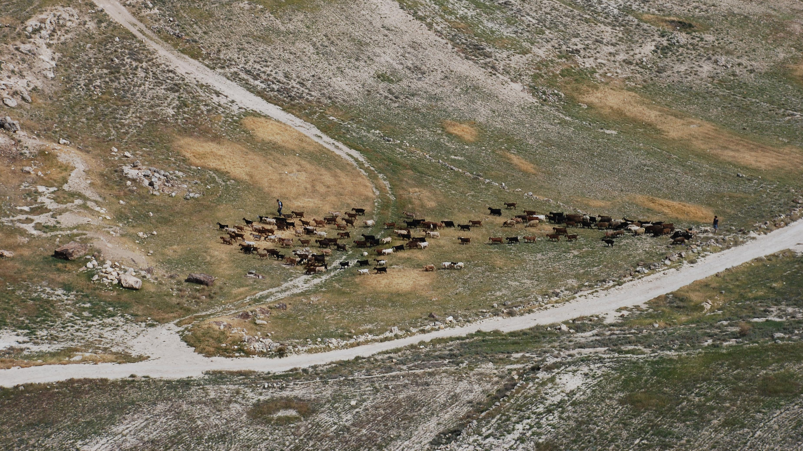
Note the Two Shepherds

Slide 8
Matthew 18:12
“What do you think? If a man has a hundred sheep, and one of them has gone astray, does he not leave the ninety-nine on the mountains and go in search of the one that went astray?”
Would it be wise for a shepherd to leave 99 sheep to themselves in seach of 1?
It is assumed that the good shepherd would provide for the care of the 99 just as much as he would the 1.
What is being stressed in this example?
Does the shepherd love this one sheep more than 99 others?

Slide 9
Matthew 18:13
“And if he finds it, truly, I say to you, he rejoices over it more than over the ninety-nine that never went astray.”
What is the significance of “if he finds it”?
Why does the shepherd rejoice move over the 1 than the 99?
Think of a mother who has four children and one becomes ill and is taken in the hospital. How does she feel when the sick one recovers? Does she rejoice over it more than over the three who were not ill?

Slide 10
Matthew 18:14
“So it is not the will of my Father who is in heaven that one of these little ones should perish.”
What is this verse saying?
Lessons:
God does not want a single one to perish. 2 Peter 3:9
Reclaiming such people should lead to joyous celebration.
We need to be more like our Father in our attitude toward the erring.
The faithfulness of the majority may never excuse us for ignoring anyone who still remains distant from God (Craig Blomberg, Matthew, The New American, 277).

Slide 11
If Your Brother Sins Against You Matthew 18:15-17
“If your brother sins against you, go and tell him his fault, between you and him alone. If he listens to you, you have gained your brother. But if he does not listen, take one or two others along with you, that every charge may be established by the evidence of two or three witnesses. If he refuses to listen to them, tell it to the church. And if he refuses to listen even to the church, let him be to you as a Gentile and a tax collector.

Slide 12
When Brethren Offend
What Do I Do?
Jesus says go & tell HIM!
Don’t slander or take revenge.
If it works I have gained my brother.
We are to work together. Eph. 4:11-16
Matthew 18:15-17

Slide 13
Matthew 5:22-24
"But I say to you that whoever is angry with his brother without a cause shall be in danger of the judgment. And whoever says to his brother, 'Raca!' shall be in danger of the council. But whoever says, 'You fool!' shall be in danger of hell fire. 23 "Therefore if you bring your gift to the altar, and there remember that your brother has something against you, 24 "leave your gift there before the altar, and go your way. First be reconciled to your brother, and then come and offer your gift.

Slide 14
When Brethren Offend
What Do I Do?
Reconciliation takes precedence!
Jesus identifies three steps to be taken:
-postpone worship
-make peace
-resume worship
Matthew 6:14-15
Matthew 18:15-17

Slide 15
When Brethren Offend
What If That Doesn’t Work?
Jesus knew that some might not be humble in spirit.
Take 1 or 2 back with you.
Jesus leaves open the possibility that the brother or sister will not listen.
Matthew 18:15-17

Slide 16
When Brethren Offend
What Next?
Jesus said to bring it before the church.
Jesus knew that some might have stubborn spirits.
If not reconciled in private it must be taken public.
Matthew 18:15-17

Slide 17
When Brethren Offend
What Next?
If complaint is frivolous then the one making it should be rebuked.
If complaint just then they must rebuke the offender & call them to repentance.
Matthew 18:15-17

Slide 18
When Brethren Offend
What Next?
If they will not hear the church?
“let them be unto thee as a heathen man & a publican.”
Those who bring reproach must be disciplined!
Matthew 18:15-17

Slide 19
Matthew 18:18-20
"Assuredly, I say to you, whatever you bind on earth will be bound in heaven, and whatever you loose on earth will be loosed in heaven. 19 "Again I say to you that if two of you agree on earth concerning anything that they ask, it will be done for them by My Father in heaven. 20 "For where two or three are gathered together in My name, I am there in the midst of them."

