Slide 1
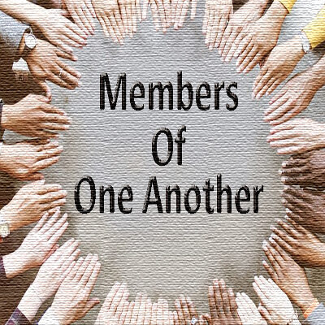

Slide 4
Therefore, having put away falsehood, let each one of you speak the truth with his neighbor, for we are members one of another.
Ephesians 4:25

Slide 6
And all who believed were together and had all things in common. And they were selling their possessions and belongings and distributing the proceeds to all, as any had need. And day by day, attending the temple together and breaking bread in their homes, they received their food with glad and generous hearts, praising God and having favor with all the people. And the Lord added to their number day by day those who were being saved. Acts 2:44-47

Slide 7
Called to be Saints together. 1 Cor. 1:2
Glorify God with one voice. Rom. 15:6
4x’s to the Corinthians to come together to eat the Lord’s Supper. 1 Cor. 11:17-34
Ephesians made alive together with Christ. Eph. 2:5
Joined & built together. Eph. 2:21-22
Colossians to be knit together. Col. 2:2

Slide 10
Do nothing from selfish ambition or conceit, but in humility count others more significant than yourselves. Let each of you look not only to his own interests, but also to the interests of others. Have this mind among yourselves, which is yours in Christ Jesus, who, though he was in the form of God, did not count equality with God a thing to be grasped, but emptied himself, by taking the form of a servant, being born in the likeness of men. Philippians 2:3-7

Slide 11
Romans 12:3-5

