Slide 2
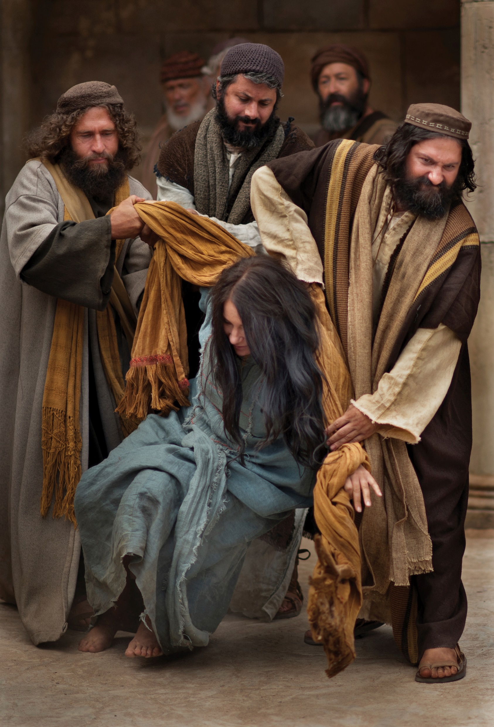
The Woman Caught in Adultery
John 8:1-11

Slide 3
The Woman’s Sin: Adultery
One of the Ten Commandments: “You shall not commit adultery” (Exod. 20:14).
A promiscuous society may wink its eye at this sin, but not God. Adultery is a sin that will send one’s soul to hell.
“But God came to Abimelech in a dream by night and said to him, ‘Behold, you are a dead man because of the woman whom you have taken, for she is a man’s wife’” (Gen. 20:3).
“Let marriage be held in honor among all, and let the marriage bed be undefiled, for God will judge the sexually immoral and adulterous” (Heb. 13:4).
Adultery is included in the sinful conduct listed in 1 Corinthians 6:9-10.
Whatever interpretation we may make of John 8:1-11 cannot be in conflict with these truths.

Slide 4
Caught in the Acts
What an embarrassing situation for her.
In addition to being caught in the act of adultery, she now is publicly exposed in the Temple!
Many are exposed as being guilty of fornication and/or adultery, being caught in the act, becoming pregnant outside of wedlock, or exposed in some other way.
This passage reminds us of this truth: “be sure your sins will find you out” (Num. 32:23).

Slide 5
I Won’t Be Caught!
No doubt this woman was like most other adulterers who think they can commit the sin without being caught.
“Beware lest there be among you a man or woman or clan or tribe whose heart is turning away today from the LORD our God to go and serve the gods of those nations. Beware lest there be among you a root bearing poisonous and bitter fruit, one who, when he hears the words of this sworn covenant, blesses himself in his heart, saying, ‘I shall be safe, though I walk in the stubbornness of my heart.’ This will lead to the sweeping away of moist and dry alike. The LORD will not be willing to forgive him, but rather the anger of the LORD and his jealousy will smoke against that man, and the curses written in this book will settle upon him, and the LORD will blot out his name from under heaven” (cf. Deut. 29:18-20).

Slide 6
Adultery Has Serious Consequences
This woman was committing a sin which could cost her life.
The sin would destroy her marriage, alienate her from her children, disgrace her parents, brothers and sisters, and bring public humiliation before the whole community.
This sin could bring physical diseases.
The sin would lead her into hell, unless she repented and received the Lord’s forgiveness.

Slide 7
The Sin of Her Accusers
John 8:1-11

Slide 8
Their Motive: To Trap Jesus
The Scriptures plainly state that the Jews brought the woman to Jesus in order to tempt Him (v. 6). The “sinner” whom these Jews wanted to see punished was Jesus, not the woman taken in adultery!
“The fact that this woman is brought to Jesus personally, rather than being presented for formal charges to the Sanhedrin where she might be judged, is evidence of a scheme cooked up by the scribes and Pharisees as a test for the Teacher” (Dan King, The Book of John: Truth Commentaries, 160).
Had their only interest been the enforcement of the Law of Moses, they would have carried out the judicial proceedings to execute both the man and woman.
The man was not brought with the woman.
There would have been no need to bring her to Jesus.

Slide 9
Both Adulterers Should Be Punished
“If a man commits adultery with the wife of his neighbor, both the adulterer and the adulteress shall surely be put to death” (Lev. 20:10).
“If a man is found lying with the wife of another man, both of them shall die, the man who lay with the woman, and the woman. So you shall purge the evil from Israel” (Deut. 22:22).

Slide 10
The Sinful Woman Was Only A Pawn
The accusers used the sinful woman.
They had no compassion, moral indignation against her sin, or concern for her as a person.
They were interested in one purpose: to find an occasion to bring charges against Jesus that they might kill Him.
The Scriptures state the Jew’s desire to kill Jesus.
“After this Jesus went about in Galilee. He would not go about in Judea, because the Jews were seeking to kill him” (John 7:1).
“‘Has not Moses given you the law? Yet none of you keeps the law. Why do you seek to kill me?’ The crowd answered, ‘You have a demon! Who is seeking to kill you?’” (John 7:19-20).
“Some of the people of Jerusalem therefore said, ‘Is not this the man whom they seek to kill?’” (John 7:25).
“So they picked up stones to throw at him, but Jesus hid himself and went out of the temple” (John 8:59).

Slide 11
A Two-Tiered Justice System
While they manifest a sanctimonious righteousness at having found this woman guilty of adultery—caught in the very act—they themselves were guilty of injustice, having a two-tiered justice system (one for the man, another for the woman) and both were “caught in the very act.”
Isn’t that what is usually practiced in America’s treatment of prostitution?
Jesus was as opposed to unequal application of justice as to adultery!
When we confront sinners with their sin, we must be careful to be sure our motives are clean and convey a sincere concern for their soul.

Slide 12
Between a Rock & A Hard Place
If Jesus said, “Put her to death!”
The Roman government prohibited the Jewish state from prosecuting capital offense cases (John 18:31; 19:7).
Jesus would have risked Roman prosecution.
If Jesus said, “Do not put her to death!”
Jesus would not be willing to do what the Law of Moses commanded.
He would be minimizing her sin.

Slide 13
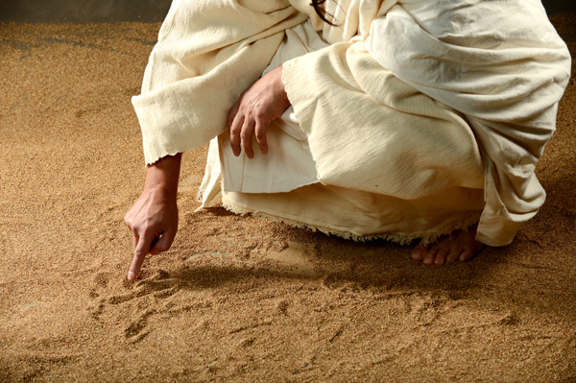
Jesus’s Response

Slide 14
What Jesus Did
The Lord’s reaction was to stoop down and with His finger write on the ground, as though He did not hear them (8:6).
Jesus seemed to be ignoring their question.
He calmly deliberated what He should say in answer to their temptation.
What He wrote is not revealed, but it seems to have contributed to the effect produced, whatever it was.

Slide 15
The Problem Jesus Faced
How to join mercy with law.
He did not want to minimize the sin committed by the woman.
He could not approve her conduct.
How to expose the sinfulness of the woman’s accusers.
How to save both the woman and her accusers. Jesus’s mission was to save the souls of men—both the woman and her accusers.
This story manifests Jesus’s remarkable compassion and mercy in redeeming sinful men and women.
Jesus never forgot that even the guiltiest person has an immortal soul created in the image of God.

Slide 16
His Response
“He that is without sin among you, let him first cast a stone at her” (8:7).
The passage is misunderstood if it is interpreted to say that judicial punishment cannot be administered except by sinless men.
Such an interpretation would undermine the judicial system of every country and at every level.

Slide 17
What the Law of Moses Required
Such an interpretation would place Jesus in conflict with the Law of Moses which mandated that the eyewitnesses be the first to inflict punishment, inasmuch as their testimony is what convicted the guilty.
“On the evidence of two witnesses or of three witnesses the one who is to die shall be put to death; a person shall not be put to death on the evidence of one witness. The hand of the witnesses shall be first against him to put him to death, and afterward the hand of all the people. So you shall purge the evil from your midst” (Deut. 17:6-7; cf. 13:9-11).
The guilt of a false witness was two-fold:
Lying.
Murder!

Slide 18
Once More He Bent Down and Wrote on the Ground
“In this instance, Christ tells them to ‘get on with it.’ He will have nothing to do with it, as he signifies by stooping down and again writing upon the ground. It is back in their hands. If they proceed with the execution, then they will appear self-righteous and ruthless, and the responsibility before the Romans for an unauthorized execution will fall upon their shoulders. Now he had them upon the horns of a dilemma!” (King, 162).
Jesus was not acting as a legal judge at all.
He was working to bring sinful men to repentance. Both the accusers and the woman needed repentance.

Slide 19
Look at Your Own Sin
The Lord’s purpose was to lead the woman’s accusers to focus their eyes on their own sins rather than on the sins of the adulterous woman.
By Jesus’s reply, the accusers were forced to admit that they too were guilty of sin (cf. Rom. 3:23).
The accusers were called upon to judge themselves instead of the woman.
Jesus wakened their consciousness of their own sins.
To their credit, the accusers silently dropped the case and walked away (8:9). Jesus’s words had convicted their consciences.
We do not know the lasting effect of Jesus’s words on these Jewish men.
Some may have been honest enough to have recognized that all men have sinned and fallen short of the glory of God and later turned to Jesus for forgiveness. We do not know!

Slide 20
Their Plan Was Thwarted
Had their purpose sincerely been to enforce the Law of Moses, they would have taken the woman to the proper authorities for the administration of justice.
When they saw that their intended use of the woman was over, they walked away, without concern for healing her soul and bringing her into the grace of God.
They were not interested in justice, preserving marriage commitments and punishing unfaithfulness; they were interested in discrediting Jesus.
When they saw that He had bested them, one by one they walked away disappointed and frustrated!

Slide 21
Where Are Your Accusers?
“Neither do I condemn thee” (8:11) is not to be understood to mean:
I do not hold you responsible for your sin.
I approve your conduct.
The 21st century distorted understanding of “Judge not lest you be judged” was not what Jesus applied. He was not saying, “A person’s view of adultery is only his personal opinion. One should not bind his moral opinions on others!”
What the statement emphasizes is this: “For God did not send his Son into the world to condemn the world, but in order that the world might be saved through him” (John 3:17).

Slide 22
Go and Sin No More!
“Go and sin no more” is a moral rebuke of what the woman had been caught doing.
Jesus specifically implies that her adultery was sin!
“Sin no more” was the Lord’s commandment for the woman to repent and cease the practice of her sins.
The Lord commanded the woman to live righteously, even in the face of the consequences of her sin.

Slide 23
Sin Has Its Consequences
She might have to face the situation of being put away as a guilty fornicator and left with the alternative to live alone.
She might feel bitterness from knowing that a different standard of morality was applied to her than to the man who committed adultery with her.
She would face the disdain of a society that condemned adultery, instead of society in which sexual immorality is winked at as one’s personal choice.
Regardless of the consequences of her sin, Jesus called her to a life of holiness!

Slide 24
Look at Jesus
He knows the hearts of all men (2:24-25).
He knew the hearts of the woman’s accusers just as well as He knew the woman’s sin.
His convicts all sinners of ungodliness.
He masterfully turned the situation on the accusers to highlight their sin.
He had compassion on the sinful woman.
He extended divine grace in exhorting her to “sin no more.”
He demanded righteous living: “sin no more!”

Slide 25
Conclusion

Slide 26
Apply What We Learn
There is no one here who has not stood in exactly the same predicament as this woman: openly exposed before God and, on some occasions, men as a sinner.
Let us take courage from Jesus’s saving her life that He likewise wishes for each of us to be saved, regardless of what horrible sins we have committed.

