Slide 2
Maturing to Adulthood
Sometimes young folks think that Christ is for little kids and old folks, not for maturing young adults.
Some young people are venturing in the fields of Satan, sowing their wild oats.
Some are testing their own newly discovered independence, pushing against the fences of established norms and standards of righteousness.
Some will choose to turn away from the Lord, never to obey His word.
Most youths will eventually grow into adulthood and adopt most of the same standards as did their parents.

Slide 3
Should Youths Be Encouraged to Become Christians?
Sometimes people act as if you cannot obey the gospel until you reach the age of majority and minimize encouraging their children to obey the gospel during their youth.
That would be no problem were it the fact that our children are incapable of committing sin before they reach the age of majority.
Both the Bible and our own experience show that our children can and do sin before reaching legal majority:
“. . . for the imagination of man’s heart is evil from his youth” (Gen. 8:21).
“Remember not the sins of my youth” (Psa. 25:7).
Inasmuch as there is only one way to obtain forgiveness of sins, one either bears the guilt of his sin until he reaches majority or he is capable of repenting of his sins and obeying the gospel.
Should one be unable to obey the gospel before majority and he would be unfortunate enough to die before he reaches majority, he would be lost without Christ.

Slide 4
In the Days of Youth
Youth is the time when one is in his father’s house, before leaving to assume adult responsibilities (Lev. 10:14; 22:12-13; Num. 30:3, 16).
David was a youth when he met and defeated Goliath (1 Sam. 17:42, 55).
Obadiah, who ministered to Elijah, said that he had “feared the Lord from his youth” (1 Kings 18:12).
“. . . Thou art my trust from my youth” (Psa. 71:5).
Jesus calls for young people to obey His word, the same as He does for older people.
He called the rich, young ruler (Matt. 19:16-22, esp. v. 20).
The Lord commands young people to “remember their Creator in the days of their youth” (Eccl. 12:1).
Timothy began preaching in his youth (1 Tim. 4:12).

Slide 5
Jesus Calls You During Your Youth

Slide 6
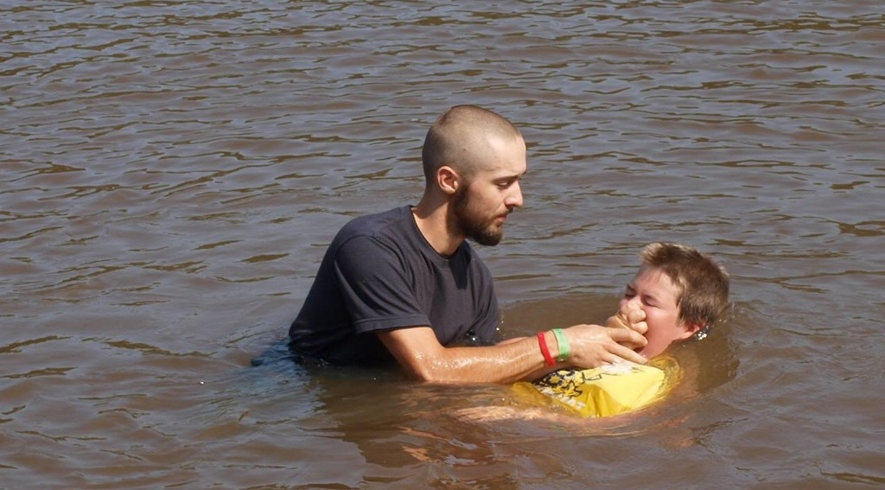
I. The Call to Become a Christian

Slide 7
Morally Responsible
Children are born morally pure, not tainted by sin (Matt. 18:3; Ezek. 18:20).
The doctrine of inherited depravity, which led to infant sprinkling, is not taught in the Bible.
Children enter the kingdom of Satan, not by birth, but by sin.
When a child reaches the “age of accountability,” he sins and falls under the guilt of sin (Rom. 3:23; 6:23; 2 Cor. 5:14).
Those who are guilty of sin are lost, in need of a Savior (Matt. 1:21; Lk. 19:10).
When one is old enough to recognize his need for salvation, he is old enough to obey the gospel.

Slide 8
Young People Need the Gospel
Our young people have the same need for the gospel as do our older people: the need for salvation from sin.
We judge our young people poorly when we conclude that the appeal of the gospel cannot touch their hearts. We insult them when we imply that they must be reached with baseball, hot dogs, and Coke because they will not respond to the love of God.
The young people of our day are just like the young people of every age before us. They will respond to the Lord’s love when they have it taught to and lived before them (2 Tim. 3:14-15).

Slide 9
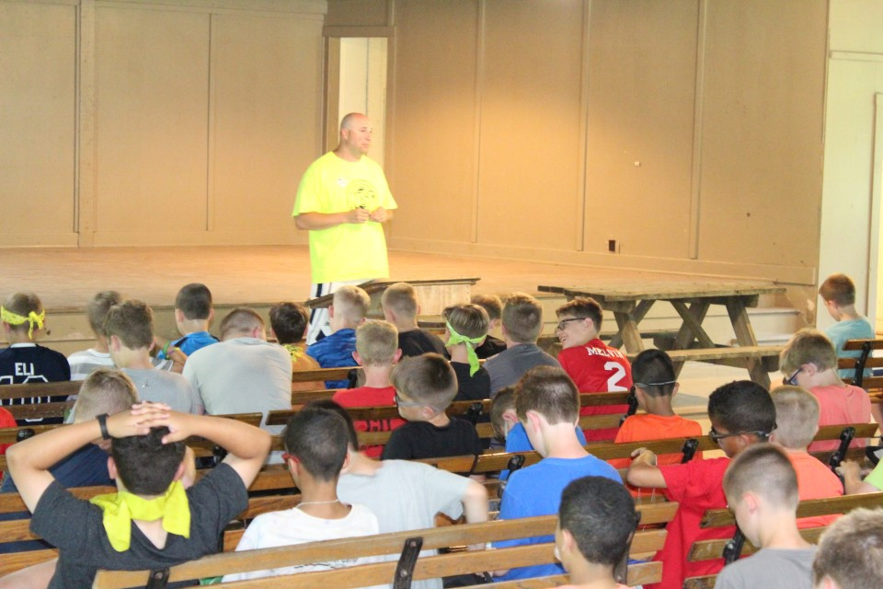
II. The Call to Live a Righteous Life

Slide 10
1 Timothy 4:12
“Let no man despise thy youth; but be thou an example of the believers, in word, in conversation, in charity, in spirit, in faith, in purity.”
An example “of” the believers: so live that you show others what a believer should be like.
In word. Young people’s speech should be wholesome (Eph. 4:29; 5:4) and truthful (Eph. 4:25).
In conversation (manner of living). Young people are taught to put away the sins of the flesh and walk in the Spirit (Gal. 5:19-23).
In charity (love). This refers to love toward one’s fellowman (cf. 1 Cor. 13:4-9 for its attributes).
In spirit. This points to the zeal for spiritual things, being “full of the Spirit” (Eph. 5:18).
In faith. This points to these possible means: (a) In personal faith in God; (b) In faithfulness, integrity.
In purity, both in heart and in life.

Slide 11
Use Your Youth for Christ
“Rejoice, O young man, in your youth, And let your heart cheer you in the days of your youth; Walk in the ways of your heart, And in the sight of your eyes; But know that for all these God will bring you into judgment. Therefore remove sorrow from your heart, And put away evil from your flesh, For childhood and youth are vanity. Remember now your Creator in the days of your youth, Before the difficult days come, And the years draw near when you say, ‘I have no pleasure in them’” (Eccl. 11:9-12:1).

Slide 12
Why You Should Remember God in Your Youth
To participate in sin will develop tastes for forbidden things which ensnare, entrap and hold you in sin. At whatever time in your life you decide to obey the gospel, your road will be harder because of these tastes for the forbidden.
You never know how long you have to live (Jas. 4:13). “The young die too!”
Young people have an enthusiasm, zeal and strength for the Lord’s service which they will not have at a later time in life. This “strength of youth” needs to be devoted to the Lord’s service.

Slide 13
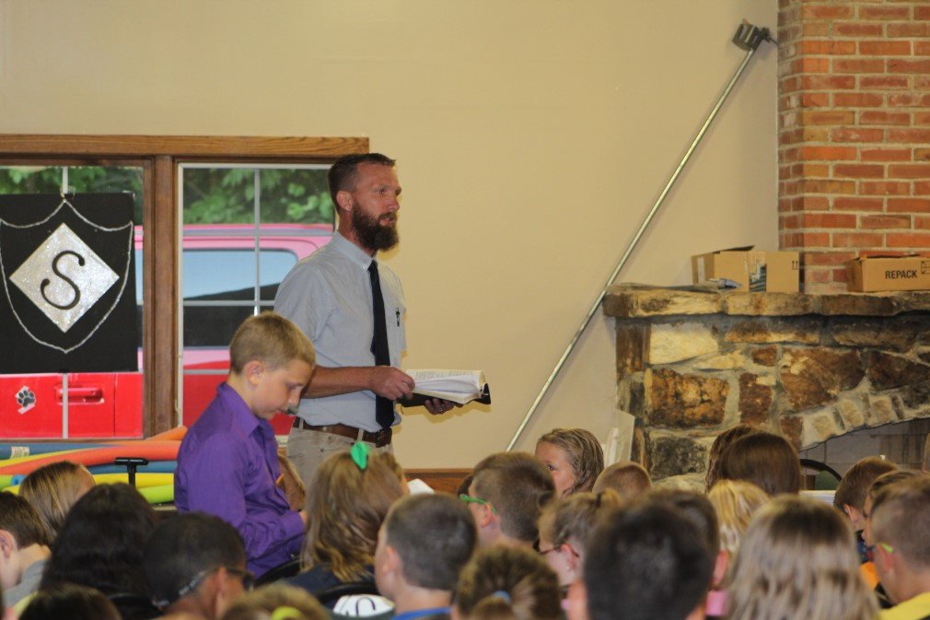
Exemplary Youth

Slide 14
Great Examples of Youth Serving God
Joseph at 17 years old (Gen. 37:2):
Persevered in service to God in horrible circumstances.
Refused the sensual lusts of the flesh (Gen. 39).
As a young lady without children, Ruth was devoted to duty (Ruth 1:16-17).
As a child, Samuel had a heart ready to hear and obey the Lord’s word: “Speak, Lord, for Your servant hears” (1 Sam. 3:9).
David fought the giant Goliath, the enemy of the Lord and righteousness (1 Sam. 17).
Daniel refused the king’s dainties at great personal risk (Dan. 1:8-21).

Slide 15
Conclusion
“Let no man despise thy youth; but be thou an example of the believers, in word, in conversation, in charity, in spirit, in faith, in purity” (1 Tim. 4:12).

Slide 16
Now It’s Your Turn
We who are old had our turn at being young. Many of us succeeded and have lived our lives to God’s glory.
Now it is your turn.
Choose to become a Christian.
Take it seriously when you do and do not play the hypocrite!
We pray for you every day.
May God bless each one of you!

