Slide 2
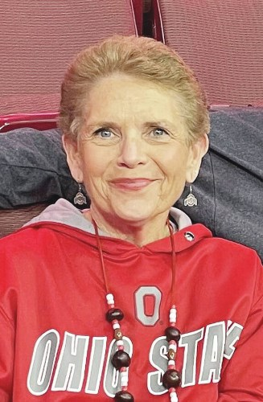
Diane Lynn Smith
1956-2023

Slide 3
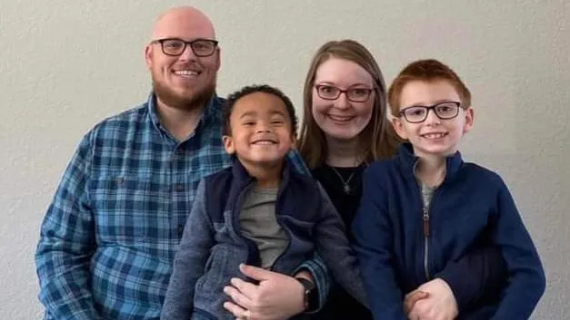
Sean Patrick Cavender
1987-2023
Wife: Kristin
Sons: Xander and Zeke

Slide 4
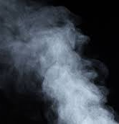
The Frailty of Life
“Come now, you who say, ‘Today or tomorrow we will go into such and such a town and spend a year there and trade and make a profit’— yet you do not know what tomorrow will bring. What is your life? For you are a mist that appears for a little time and then vanishes” (James 4:13-14).

Slide 5
The Lord Told Us: “You Shall Die!”

Slide 6
In the Garden of Eden
In giving Adam instructions not to eat of the tree of the knowledge of good and evil, God said, “You may surely eat of every tree of the garden, but of the tree of the knowledge of good and evil you shall not eat, for in the day that you eat of it you shall surely die” (Gen. 2:16-17).
After Eve and Adam violated the Lord’s commandment, God’s judgment for mankind was pronounced: “Because you have listened to the voice of your wife and have eaten of the tree of which I commanded you, ‘You shall not eat of it,’ cursed is the ground because of you; in pain you shall eat of it all the days of your life; thorns and thistles it shall bring forth for you; and you shall eat the plants of the field. By the sweat of your face you shall eat bread, till you return to the ground, for out of it you were taken; for you are dust, and to dust you shall return” (Gen. 3:17-19).

Slide 7
In Adam All Died
Paul wrote, “Therefore, just as sin came into the world through one man, and death through sin, and so death spread to all men because all sinned” (Rom. 5:12).
Man knows that so long as life continues on this earth, death is a certainty.
The genealogies in Genesis 5 have a consistent form: X lived Y years and begat Z. After X begat Z, he lived YY years and had sons and daughters. So all the days of X were YY years; and he died” (5:5, 8, 11, 14, 17, 20, 27, 31).
A similar pattern is followed in Genesis 11.

Slide 8
Death Comes to All of Mankind

Slide 9
It Always Comes to the Elderly
Isaac said to Esau, his son: “Behold, I am old; I do not know the day of my death” (Gen. 27:2).
Psalm 90

Slide 10
The Context of the Psalm 90
The only Psalm in the Psalter written by Moses.
The context of the psalm is the passing away of the generation who did not have enough faith to listen to the spies sent out to spy out the land of Canaan.
Ten spies said the Israelites could not conquer Canaan; Joshua and Caleb exhorted Israel to trust in the Lord.
The people followed the ten spies’ advice.

Slide 11
Numbers 14:26-30
“And the LORD spoke to Moses and to Aaron, saying, ‘How long shall this wicked congregation grumble against me? I have heard the grumblings of the people of Israel, which they grumble against me. Say to them, “As I live, declares the LORD, what you have said in my hearing I will do to you: your dead bodies shall fall in this wilderness, and of all your number, listed in the census from twenty years old and upward, who have grumbled against me, not one shall come into the land where I swore that I would make you dwell, except Caleb the son of Jephunneh and Joshua the son of Nun. But your little ones, who you said would become a prey, I will bring in, and they shall know the land that you have rejected”’” (Num. 14:26-30).

Slide 12
Psalm 90
Having witnessed the passing of that generation over a period of forty years, Moses wrote:
“For all our days pass away under your wrath;
we bring our years to an end like a sigh.
The years of our life are seventy,
or even by reason of strength eighty;
yet their span is but toil and trouble;
they are soon gone, and we fly away” (Psa. 90:9-10).

Slide 13
Death Is Not Unexpected for the Elderly
When death comes in these circumstances, there is still mourning, but it is not unexpected.
Moses wrote of the death of Abraham saying, “Abraham breathed his last and died in a good old age, an old man and full of years, and was gathered to his people” (Gen. 25:8).
Similar statements are made of Isaac (Gen. 35:29) and Joseph (Gen. 50:26).

Slide 14
Death Sometimes Comes Prematurely
Many have had the painful experience of losing a child:
David lost his baby born from the illicit relationship with Bathsheba (2 Sam. 12:12-23).
Elisha promised the barren Shunammite woman that she would have a child and it came to pass. One day while working in the field with his father, the child said, “Oh, my head, my head!” and died at noon (2 Kings 4:18-20). In her grief, the woman ran to Elisha who raised him from the dead.
In the gospel narratives, we have the record of premature deaths:
The son of the widow of Nain (Luke 7:11-15).
The daughter of Jairus (Mark 5:21-43).

Slide 15
Death During the Prime of Life
When David heard that his rebellious son Absalom had been killed in the civil war, he lamented his death: “And the king was deeply moved and went up to the chamber over the gate and wept. And as he went, he said, ‘O my son Absalom, my son, my son Absalom! Would I had died instead of you, O Absalom, my son, my son!’” (2 Sam. 18:33).
Job spoke of the different situations in which one dies saying, “Will any teach God knowledge, seeing that he judges those who are on high? One dies in his full vigor, being wholly at ease and secure, his pails full of milk and the marrow of his bones moist. Another dies in bitterness of soul, never having tasted of prosperity. They lie down alike in the dust, and the worms cover them” (Job 21:22-26).

Slide 16
The Frailty of Life
“Come now, you who say, ‘Today or tomorrow we will go into such and such a town and spend a year there and trade and make a profit’— yet you do not know what tomorrow will bring. What is your life? For you are a mist that appears for a little time and then vanishes” (James 4:13-14).

Slide 17
Reminders from the Book of Job
“My days are swifter than a weaver’s shuttle and come to their end without hope” (Job 7:6).
“For we are but of yesterday and know nothing, for our days on earth are a shadow” (Job 8:9).
“My days are swifter than a runner; they flee away; they see no good. They go by like skiffs of reed, like an eagle swooping on the prey” (Job 9:25-26).
“Are not my days few? Then cease, and leave me alone, that I may find a little cheer before I go—and I shall not return— to the land of darkness and deep shadow” (Job. 10:20-21).
“Man who is born of a woman is few of days and full of trouble. He comes out like a flower and withers; he flees like a shadow and continues not” (Job. 14:1-2).

Slide 18
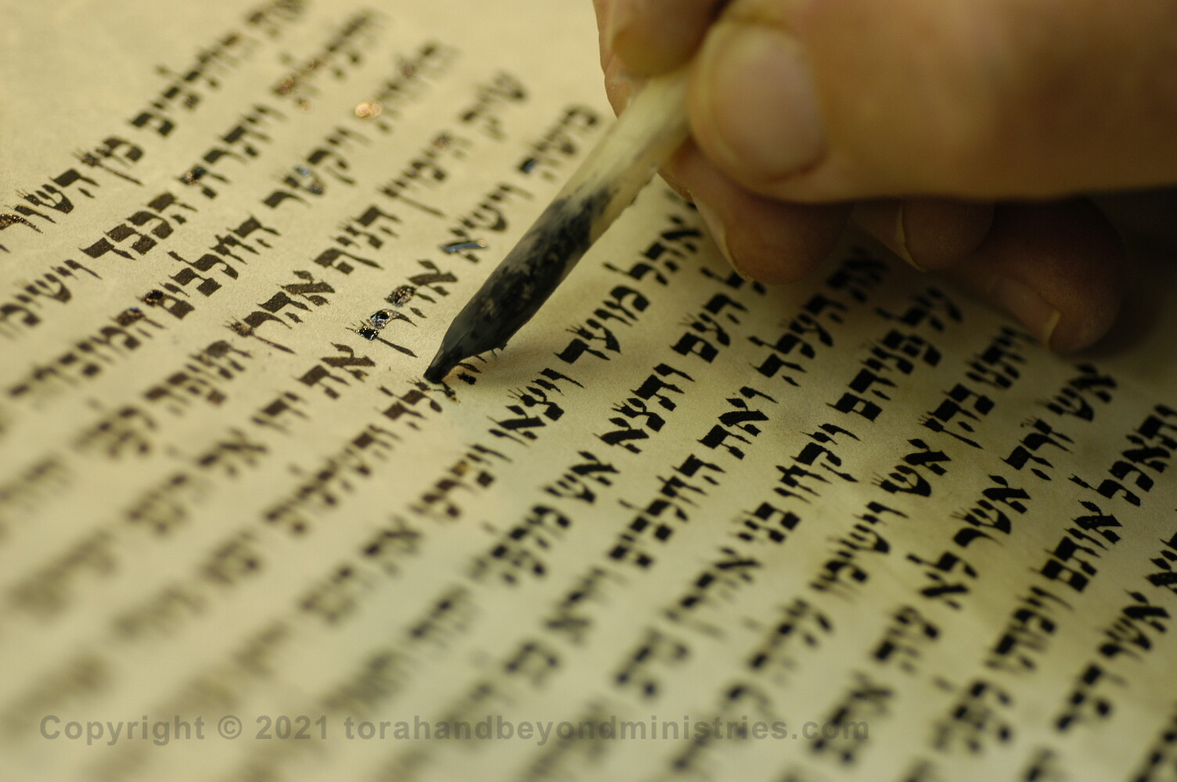
Psalm 39:4–6:
⁴ “O LORD, make me know my end
and what is the measure of my days;
let me know how fleeting I am!
⁵ Behold, you have made my days a few handbreadths,
and my lifetime is as nothing before you.
Surely all mankind stands as a mere breath! Selah
⁶ Surely a man goes about as a shadow!
Surely for nothing they are in turmoil;
man heaps up wealth and does not know who will gather!

Slide 19
Psalm 49:10–12:
¹⁰ “For he sees that even the wise die;
the fool and the stupid alike must perish
and leave their wealth to others.
¹¹ Their graves are their homes forever,
their dwelling places to all generations,
though they called lands by their own names.
¹² Man in his pomp will not remain;
he is like the beasts that perish” (Psa. 49:10-12).

Slide 20
Psalm 78:39
“He remembered that they were but flesh,
a wind that passes and comes not again.”
Psalm 89:47-48
“Remember how short my time is!
For what vanity you have created all the children of man!
What man can live and never see death?
Who can deliver his soul from the power of Sheol? Selah.”
Psalm 102:11
“My days are like an evening shadow;
I wither away like grass.”

Slide 21
Psalm 103:14–16:
¹⁴ “For he knows our frame;
he remembers that we are dust.
¹⁵ As for man, his days are like grass;
he flourishes like a flower of the field;
¹⁶ for the wind passes over it, and it is gone,
and its place knows it no more.”
Psalm 144:3–4
³ “O LORD, what is man that you regard him,
or the son of man that you think of him?
⁴ Man is like a breath;
his days are like a passing shadow.”

Slide 22
Isaiah 38:12
My dwelling is plucked up and removed from me
like a shepherd’s tent;
like a weaver I have rolled up my life;
he cuts me off from the loom;
from day to night you bring me to an end.
Isaiah 40:6-8
⁶ “A voice says, ‘Cry!’
And I said, ‘What shall I cry?’
All flesh is grass,
and all its beauty is like the flower of the field.
⁷ The grass withers, the flower fades
when the breath of the LORD blows on it;
surely the people are grass.
⁸ The grass withers, the flower fades,
but the word of our God will stand forever”

Slide 23
Peter Foresaw His Impending Death
“I think it right, as long as I am in this body, to stir you up by way of reminder, since I know that the putting off of my body will be soon, as our Lord Jesus Christ made clear to me” (2 Pet. 1:13-14).

Slide 24
Conclusion

Slide 25
Remember Your Frailty
When David was fleeing from King Saul, he said about his life that “there is but a step between me and death” (1 Sam. 20:3).
Toward the end of his life, he said, “For we are strangers before you and sojourners, as all our fathers were. Our days on the earth are like a shadow, and there is no abiding” (1 Chron. 29:15).
After listening to Paul preach to him of righteousness, self-control and the coming judgment, Felix foolishly put off obeying the gospel saying, “Go away for the present. When I get an opportunity I will summon you” (Acts 24:25).

Slide 26
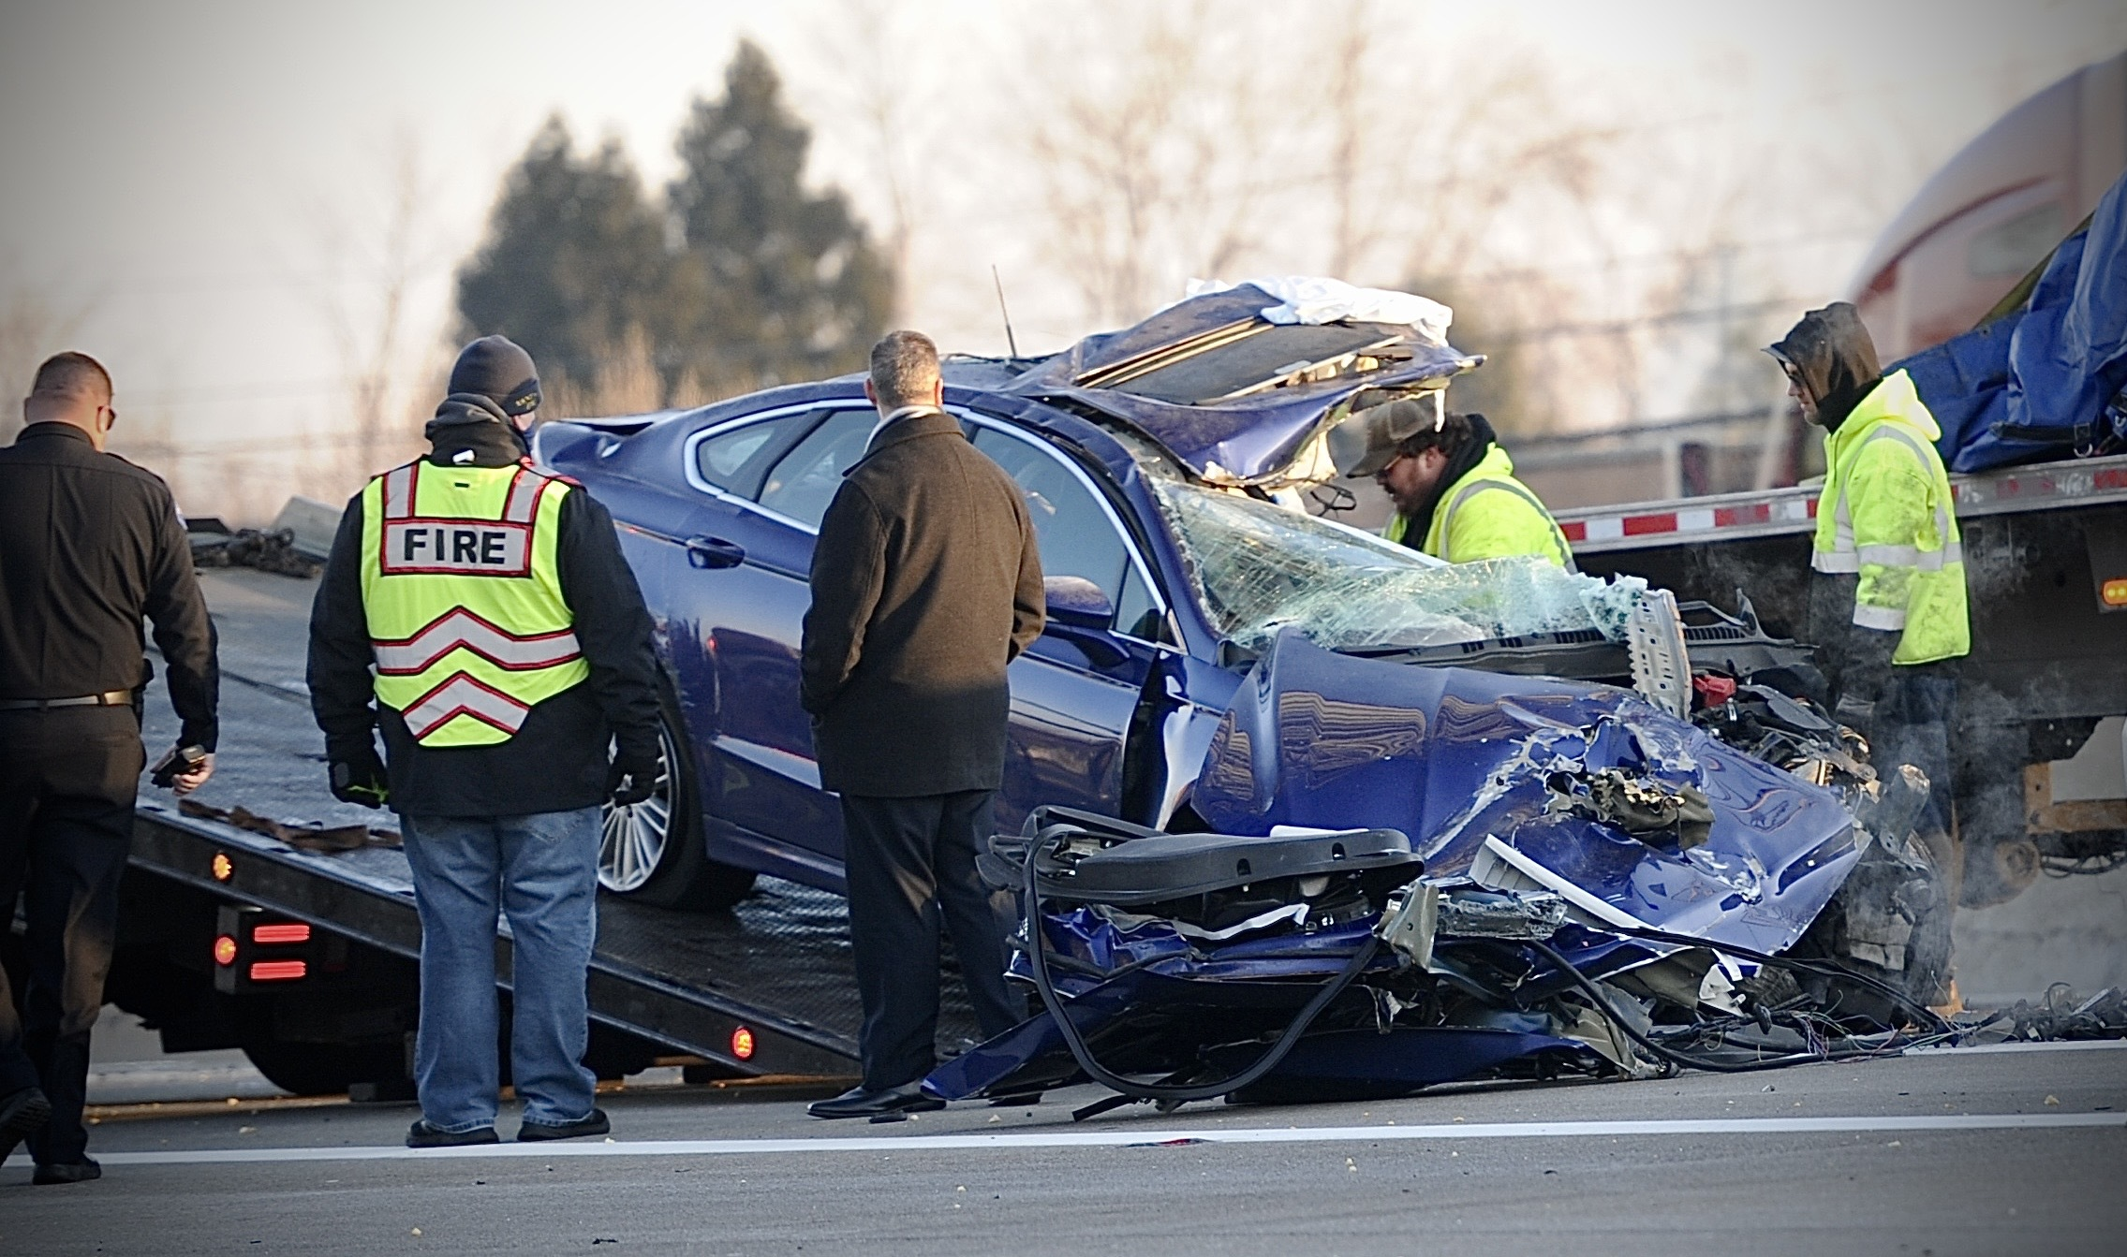
Would You Be Ready?

