Slide 2
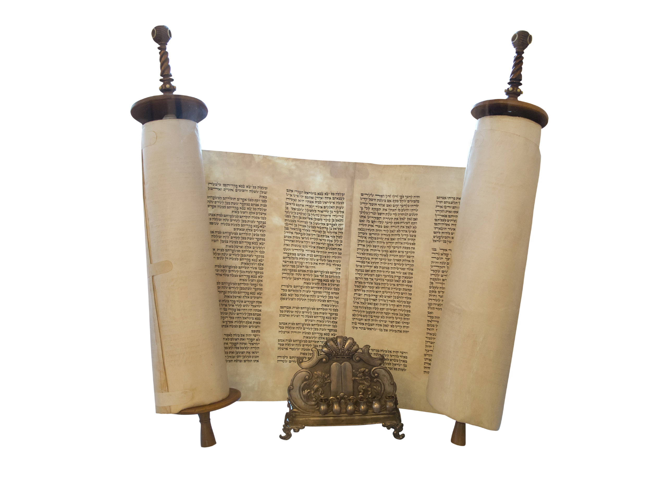
Psalm 119
“Your word is a lamp to my feet and a light to my path” (119:105).

Slide 3
The Structure of the Psalm
It is an acrostic psalm, based on the 22 letters of the Hebrew alphabet. Each letter of the alphabet has 8 verses (8 x 22 = 176), each verse begins with the letter of the alphabet it is using.
“A” has 8 verses beginning with the letter “a.”
“B” has 8 verses beginning with the letter “b.”
. . . .
“Z” has 8 verses beginning with the letter “z.”
Almost every verse refers to the word of the Lord.

Slide 4
Psalm 119 Considers the Word of God,
Like a Jeweler Looks at the Many Facets of a Diamond

Slide 5
Nine Terms for the Word of the Lord
Law (tôrāh, 25x).
Testimonies (‘ëdûth, 23x).
Precepts (piqqûdîm, 21x).
Statutes (chōq, 21).
Commandments (mitswāh, 22x).
Judgments (KJV), rules (mišpāt, 23).
Word (dābār, 23x).
Promise or Word (’imrāh, 19x).
Ways (derek, 13x).

Slide 6
Psalm 119
Your word is a lamp to my feet and a light to my path (119:105).
א Aleph

Slide 7
Psalm 119: Aleph 119:1-8
Blessed are those whose way is blameless,
who walk in the law of the LORD!
Blessed are those who keep his testimonies,
who seek him with their whole heart,
who also do no wrong,
but walk in his ways!
You have commanded your precepts
to be kept diligently.
Oh that my ways may be steadfast
in keeping your statutes!
Then I shall not be put to shame,
having my eyes fixed on all your commandments.
I will praise you with an upright heart,
when I learn your righteous rules.
I will keep your statutes;
do not utterly forsake me!

Slide 8
“Blessed are those whose way is blameless, who walk in the law of the LORD!” (119:1).
Blessed (‘ašrë): “happy, blessed is he who. . .” (followed by a noun telling what someone is or does) (HALOT, 100).
Those who are blessed are described in two clauses:
“Those whose way is blameless.”
Blameless (tāmîm): when used of sheep, it means “without fault, free of blemish”; when used of God, it means “perfect”; with reference to humans, it means “impeccable” (free from fault or blame) (HALOT, 1749).
Way (derek): “way, road”; it is used metaphorically of one’s “manner, custom, behavior” (HALOT, 232).

Slide 9
Who Walk in the Law of the Lord
Walk is tied to the idea of way in the preceding clause (“whose way is blameless”; metaphorically, the word hālak means “to walk, behave” (HALOT, 247).
Law (tôrāh): The word has a range of meanings beginning with “direction, instruction” (based on yārah, to teach).
What gives this instruction validity and worthiness is that it is “of the LORD.”
There were many gods, each with his own law and worshiped in neighboring villages around the Hebrews in the days of David.
The Israelites’ God was the LORD (Yahweh), the one and only true God.

Slide 10
What Is Our Attitude Toward Bible Instruction?
When someone expresses disappointment, regret, etc. for obedience to the word of the LORD, it reflects on his heart. Think of these statements:
Do we have to go to Kings Island? Young people would not say that, but I would. I am not interested in standing in long lines, walking all day through a carnival, being thrown around in rides, etc. What does this lack of desire say about me?
Do we have to go listen to another sermon from Mike or Greg? What does your lack of desire say about you?

Slide 11
“Blessed are those who keep his testimonies, who seek him with their whole heart. . .” (119:2).
Blessed is repeated in the second verse.
It is said of those with two attributes:
Who keep His testimonies
Who seek Him with their whole heart

Slide 12
Who keep His Testimonies
Keep (nātsar): “to observe, comply with” (HALOT, 718).
God’s word is a treasure to be kept.
There is a doctrinal keeping of His testimonies, and we should be ready to die in their defense.
There is a practical keeping of it when we apply it in our lives.
If we will keep the Lord’s testimonies, they will keep us! Here are some of the ways:
In the right doctrinal convictions.
Peace in your spirit.
Holy in life.
Hopeful in expectation.
We cannot fight a good fight or finish our course unless we keep the faith.

Slide 13
Who Seek Him with Their Whole Heart
Seek (dāraš): “to seek with care, care for” (HALOT, 233). What we are seeking for is God and His will. We are not merely learning the meaning of a book.
We are not to seek Him God merely for the sake of having a knowledge of His word, but as the means of knowing God so that we may have a relationship with Him.
If His word is precious to us, how much more must God Himself be!
With their whole heart requires a total effort, total commitment.
Half-hearted effort will never please the Lord.
“Whole heart” has the sense of one’s whole being!

Slide 14
“Blessed are . . . . . .who also do no wrong, but walk in his ways!” (119:3).
This verse is a continuation of the thought expressed in v. 2. The Aleph appears in the conjunction “also” (’ăph), joining it to verse 2.
Here are two more descriptions of those who are blessed:
Who . . . do no wrong.”
Do (pā‘al): “to commit, practice” (HALOT, 950).
Wrong (‘awlāh): “badness, malice, injustice” (HALOT, 798).
No man, other than the Lord Jesus, can claim to have completely avoided evil, but evil is not our common practice. Evil is unexpected from the person described by the psalmist.
Those who are blessed are those who have overcome the lusts of the flesh to such a degree that they have a reputation for living righteously.
“But walk in his ways.” This repeats the idea of 119:1 (“who walk in the law of the LORD”). The “ways” of this verse are equated with “the law of the Lord.”
The surest way to abstain from evil is to be fully occupied in doing good.

Slide 15
“You have commanded your precepts to be kept diligently” (119:4).
Command (tsāwāh): “to give an order, command. . . to command, instruct, order” (HALOT, 1010-1011).
The LORD did not give suggestions, but commandments.
Precepts (piqqûdîm): “instructions, procedures” (HALOT, 959). Instructions imply details to be followed.
Keep (šāmar): the word has a wide range of meaning, but is used in this context to mean “to do something carefully” (HALOT, 1583).
The verb is modified by the adverb mĕ’ōd which strengths the concept described, hence “keep diligently.”
Some give to God a careless service, a sort of hit or miss obedience, but the Lord has not commanded such service, nor will He accept it.

Slide 16
Observations
Charles H. Spurgeon: “Those who are diligent in business rise up early and sit up late, and deny themselves much of comfort and repose. They are not soon tired, or if they are they persevere even with aching brow and weary eyes. So should we serve the Lord” (143).
God’s precepts require careful obedience (remember Nadab and Abihu, and Uzzah).
There is no use in traveling fast if you are not on the right road!
God has not commanded us to be diligent in making precepts, but in keeping them!

Slide 17
“Oh that my ways may be steadfast in keeping your statutes!” (119:5).
Oh that (‘achălay): “oh! If only” (HALOT, 34).
Be steadfast (kûn): “to be steadfast, be sure” (HALOT, 464).
Ways (derek): “way = manner, custom, behaviour” (HALOT, 232).
The personal pronoun “my” brings this home to oneself. David was not so much concerned about what others may do as he was about himself.
Keep (see v. 4).
Statutes (chōq): “law, regulation. . . prescription, rule” (HALOT, 347).
Charles H. Spurgeon: “This verse is a sigh of regret because the Psalmist feels that he has not kept the precepts diligently, it is a cry of weakness appealing for help to one who can aid, it is a request of bewilderment from one who has lost his way and would fain be directed in it, and it is a petition of faith from one who loves God and trusts in him for grace” (The Treasury of David, 144).

Slide 18
“Then I shall not be put to shame, having my eyes fixed on all your commandments” (119:6).
Then (‘āz): a temporal adverb (HALOT, 26). This ties the verse to the things expressed in v. 5.
Put to shame (bûš): “to be ashamed, be put to shame because of. . .” (HALOT, 116).
Having my eyes fixed on (Hiphil of nābat): “to look, in a particular direction, . . . to be attentive” (HALOT, 661).
Commandments (mitswāh): “command, commandments” (HALOT, 622).
Notice the modifying words: “all your commandments.” Both modifiers are important.
Your: The commandments come from God.
Our respect for God will lead us to keep all of them, not only the ones we like or agree with.
Partial obedience leaves one liable for those commandments he willfully chooses not to obey!

Slide 19
Shame
Sin brings shame! Think of the change sin brought to Adam and Eve.
Charles H. Spurgeon: “To a poor sinner who is buried in despair, it may seem a very unlikely thing that he should ever be delivered from shame. He blushes, and is confounded, and feels that he can never lift up his face again. Let him read these words: ‘Then shall I not be ashamed.’ David is not dreaming, nor picturing an impossible case. Be assured, dear friend, that the Holy Spirit can renew in you the image of God, so that you shall yet look up without fear” (ibid., 145).
“There is nothing to be ashamed of in a holy life; a man may be ashamed of his pride, ashamed of his wealth, ashamed of his own children, but he will never be ashamed of having in all things regarded the will of the Lord his God” (ibid., 145).

Slide 20
“I will praise you with an upright heart, when I learn your righteous rules” (119:7).
Praise (Hiphil of yādāh): “to praise God” (HALOT, 389). The first person singular makes it personal to David.
Upright (yōšer): “straightness, honesty; uprightness” (HALOT, 450).
Even under the Old Testament the seed of God’s word had to be planted in a good and honest heart.
Heart is used of all of one’s being.
Learn (lāmad): “to learn” (HALOT, 531).
Rules (mišpāt): “decision, judgement. . . given by God” (HALOT, 651).
The rules are modified by the word righteous (tsedek): “equity, what is right” (HALOT, 1005).

Slide 21
Praising God
He who prays for holiness (v. 6) will one day praise God for his happiness!
The praise is addressed to the LORD, the only true God.
The section began with an acknowledgment of the blessings that were upon those who walk in the law of the LORD, who keep His testimonies, who seek Him with their whole heart, who do no wrong, but walk in His ways. The blessings received and felt lead to spontaneous praise to God.
As I come to this stage in my life, I find myself commenting to others about how blessed I have been. Counting one’s blessings leads him to praise God.

Slide 22
Learned Your Righteous Rules
Learning implies that one is not born knowing the righteous rules of God.
He needs a mother and dad who will teach them to him.
Mothers and dads also have teachers who instruct one in the rules of God.
Learning the rules requires:
Being present when the teacher instructs.
Being mentally present, not just physically sitting on a pew, when the teacher instructs.
Additional study outside of the assembly.
Imbibing the principles in one’s own heart and life.
Establishing those principles by repeated application in one’s life so that they become second nature.

Slide 23
“I will keep your statutes; do not utterly forsake me!” (119:8).
Statutes (choq): “law, regulation, prescription, rule” (HALOT, 346).
This is modified by the important pronoun your, referring to the LORD; these are not the statutes of men, but of God.
Keep (šāmar): “to hold on to, devote oneself to” (HALOT, 1584). I makes it personal to me.
Forsake (‘āzab): “to abandon a wife, husband, divorce. . . God forsakes men and men forsake God” (HALOT, 806-807).
The adverb mĕ’ōd intensifies “forsake,” making it utterly forsake.

Slide 24
David’s Resolve
The resolution of the psalmist to obey God’s laws, rules.
The praise of v. 7 leads to a solid resolution in v. 8.
The prayer that God will not utterly forsake him.
Charles H. Spurgeon: “Feeling his own incapacity he trembles lest he should be left to himself, and this fear is increased by the horror which he has of falling into sin” (145).
Note the combination: resolution and dependency.
“We meet with those who to all appearance humbly pray, but there is no force of character, no decision in them, and consequently the pleading of the closet is not embodied in the life: on the other hand, we meet with abundance of resolve attended with an entire absence of dependence upon God, and this makes as poor a character as the former. The Lord grant us to have such a blending of excellences that we may be ‘perfect and entire, wanting nothing’” (Spurgeon, 145-146).

Slide 25
God Respects One’s Decision
Sometimes a person turns his back to God, resists every effort to appeal to him to repent, and hardens his heart.
God will not force Himself upon anyone, so He reacts to the decision made by the sinner.
He leaves him to himself!
Note the Father’s conduct in the Parable of the Prodigal Son (Luke 15), especially what He did not do—force Himself on His Son.

Slide 26
Conclusion

Slide 27
Take Away
May you and I learn to appreciate our dependence upon the word of God.
May it lead us, as it did for David, to an appreciation of how blessed we are, to praise to God, and to resolve to keep His word.

