Slide 2
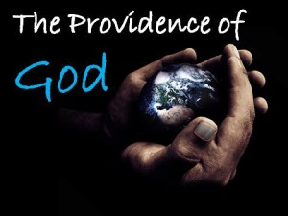
God’s continuing activity in relation to the ongoing world.
The age of miracles have ceased. Heb. 2:3-4
God hears & answers prayer.
God …”can do exceedingly abundantly beyond all that we ask or think.” Eph. 3:20
God is …”over all, through all, & in all.” Eph. 4:6

Slide 3
In The Affairs Of Men
In The OT:
Joseph – Gen. 39:21
Esther – Esther 4:14
King of Persia – Isa. 44:28
He does so today!
We are told to pray for civil rulers. 1 Tim. 2:1-3
God cares for mankind. He is in control.
He provides for His children. Matt. 6:33

Slide 4
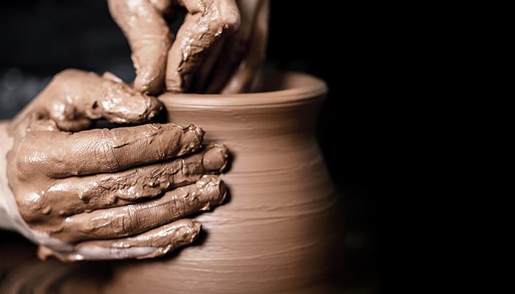
God Works
In Us!

Slide 5
For this reason I bow my knees before the Father, from whom every family in heaven and on earth is named, that according to the riches of his glory he may grant you to be strengthened with power through his Spirit in your inner being, so that Christ may dwell in your hearts through faith—that you, being rooted and grounded in love, may have strength to comprehend with all the saints what is the breadth and length and height and depth, and to know the love of Christ that surpasses knowledge, that you may be filled with all the fullness of God. Now to him who is able to do far more abundantly than all that we ask or think, according to the power at work within us, to him be glory in the church and in Christ Jesus throughout all generations, forever and ever. Amen. Eph. 3:14-21

Slide 6
For this reason I bow my knees before the Father, from whom every family in heaven and on earth is named, that according to the riches of his glory he may grant you to be strengthened with power through his Spirit in your inner being, so that Christ may dwell in your hearts through faith—that you, being rooted and grounded in love, may have strength to comprehend with all the saints what is the breadth and length and height and depth, and to know the love of Christ that surpasses knowledge, that you may be filled with all the fullness of God. Now to him who is able to do far more abundantly than all that we ask or think, according to the power at work within us, to him be glory in the church and in Christ Jesus throughout all generations, forever and ever. Amen. Eph. 3:14-21

Slide 7
And so, from the day we heard, we have not ceased to pray for you, asking that you may be filled with the knowledge of his will in all spiritual wisdom and understanding, so as to walk in a manner worthy of the Lord, fully pleasing to him: bearing fruit in every good work and increasing in the knowledge of God; being strengthened with all power, according to his glorious might, for all endurance and patience with joy; Col. 1:9-11
God Works
In Us!

Slide 8
God Works In Us!
Therefore, my beloved, as you have always obeyed, so now, not only as in my presence but much more in my absence, work out your own salvation with fear and trembling, for it is God who works in you, both to will and to work for his good pleasure. Phil. 2:12-13

Slide 9
How Does God Work In Our Life?
Through the gospel. Acts 2:37; 39
And on the Sabbath day we went outside the gate to the riverside, where we supposed there was a place of prayer, and we sat down and spoke to the women who had come together. One who heard us was a woman named Lydia, from the city of Thyatira, a seller of purple goods, who was a worshiper of God. The Lord opened her heart to pay attention to what was said by Paul. And after she was baptized, and her household as well, she urged us, saying, “If you have judged me to be faithful to the Lord, come to my house and stay.” And she prevailed upon us. Acts 16:13-15

Slide 10
How Does God Work In Our Life?
Through the gospel. Acts 2:37; 39
But we ought always to give thanks to God for you, brothers beloved by the Lord, because God chose you as the firstfruits to be saved, through sanctification by the Spirit and belief in the truth. To this he called you through our gospel, so that you may obtain the glory of our Lord Jesus Christ. 2 Thess. 2:13-14

Slide 11
How Does God Work In Our Life?
Through the gospel. Acts 2:37; 39
Through Others. Eph. 4:11-13
Through prayer. John 14:13-14

Slide 12
Can Men Do God’s Work in Their Life?
We Can and We Must!
Do not work for the food that perishes, but for the food that endures to eternal life, which the Son of Man will give to you. For on him God the Father has set his seal.” Then they said to him, “What must we do, to be doing the works of God?” Jesus answered them, “This is the work of God, that you believe in him whom he has sent.” John 6:27-29

Slide 13
God Works In Us!
Therefore, my beloved, as you have always obeyed, so now, not only as in my presence but much more in my absence, work out your own salvation with fear and trembling, for it is God who works in you, both to will and to work for his good pleasure. Phil. 2:12:13

Slide 14
What should we learn concerning the providence of God in our life?
Learn to trust God! Matt. 6:30-32
Remember to pray! James 5:13-18
God can only work in our life if we allow Him to.
When we live by faith, God is working in us to produce His good pleasure within us.

