Slide 2
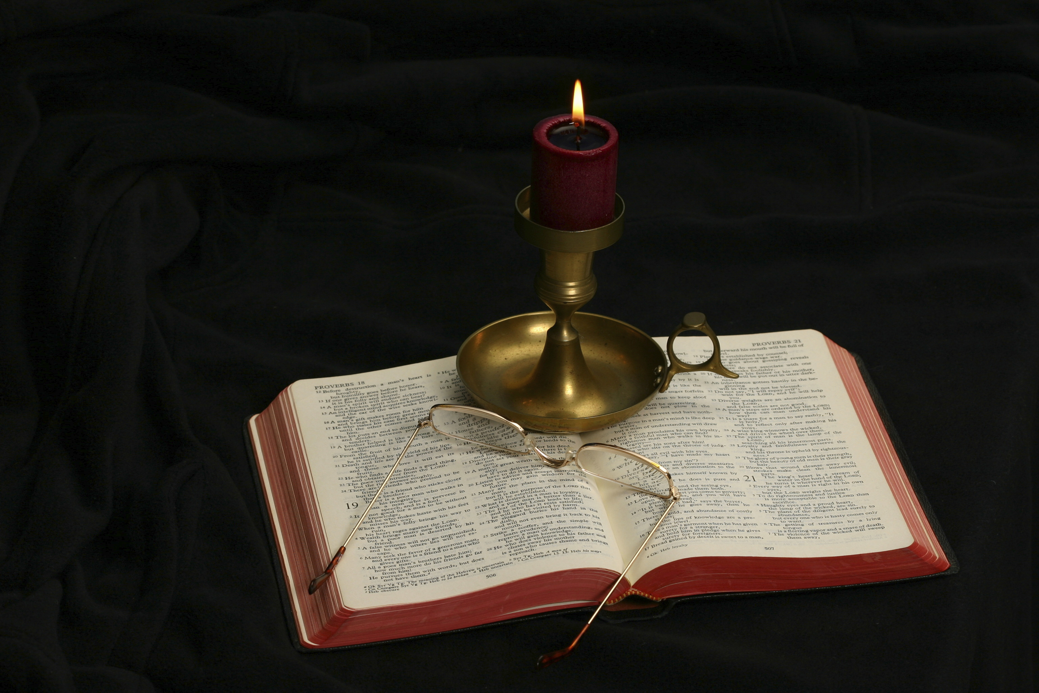
The Gospel of Matthew
Chapter 20

Slide 3
Outline of the Chapter
Parable of the Generous Master of the House (19:30‐20:16)
Jesus Foretold His Death a Third Time (20:17-19)
A Mother’s Request (20:20-23)
The Disciples’ Reaction (20:24-28)
Jesus Heals Two Blind Men (20:29-34)

Slide 4
Parable of the Generous Master of the House Matthew 19:30‐20:16
Scenes in the parable:
The hiring of workers (20:1-7)
The paying of the workers (20:8-15)
Commentary (20:16)

Slide 5
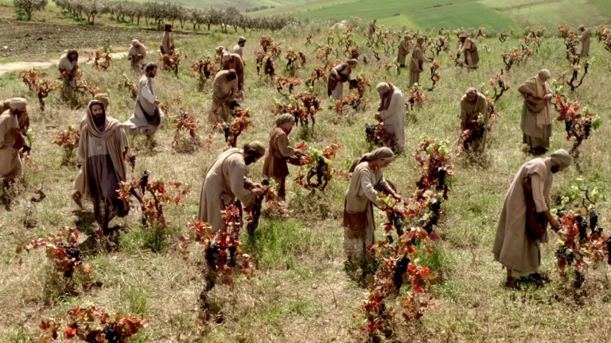
Laborers in a Vineyard

Slide 6
Parable of the Generous Master of the House Scene 1: Matthew 19:30-20:7
But many who are first will be last, and the last first. “For the kingdom of heaven is like a master of a house who went out early in the morning to hire laborers for his vineyard. After agreeing with the laborers for a denarius a day, he sent them into his vineyard. And going out about the third hour he saw others standing idle in the marketplace, and to them he said, ‘You go into the vineyard too, and whatever is right I will give you.’ So they went. Going out again about the sixth hour and the ninth hour, he did the same. And about the eleventh hour he went out and found others standing. And he said to them, ‘Why do you stand here idle all day?’ They said to him, ‘Because no one has hired us.’ He said to them, ‘You go into the vineyard too.’

Slide 7
Parable of the Generous Master Matt. 19:31-20:16 |  | Parable of the Prodigal Son Luke 15:11-32
Generous employer |  | Generous father
Workers hired late | Workers hired early | Prodigal son | Other son
Unexpected generosity of master towards workers hired late |  | Unexpected generosity of father toward prodigal son
The workers first hired, resentful, complain of injustice |  | The other son, resentful, complains of injustice
The employer justifies his extravagant generosity |  | The father justifies his extravagant generosity
Chart based on material from Davies and Allison, Matthew 19-28, 3:69

Slide 8
Overview of the Parable
Who is the leading character?
Who are represented by the day workers?
What distinction is made between the day workers?
Who is represented by the master of the house?
What stands out as the most unusual point in the parable?

Slide 9
Matthew 19:30
But many who are first will be last, and the last first.
Chapter divisions were added to the NT Greek text in 1550 by Robert Estienne (pronounced ā-tē-in)(also known as Robertus Stephanus in Latin and Robert Stephens). In this case, his chapter division is unfortunate.
The same sentence is repeated at the beginning and end of the Parable of the Generous Employer (20:1-16). It forms an inclusio around the parable that binds it together and ties it to the preceding context.
This indicates that Matthew intends the parable to underline the point he has just made.
It looks back to the rich young ruler, who may have thought of himself as “first” but because of his love of money ended up “last,” as well as to the Twelve who had left everything to follow Jesus who end up being first.
In Luke 13:28-30, the same sentence is quoted with application to the Jewish people.

Slide 10
Matthew 20:1
“For the kingdom of heaven is like a master of a house who went out early in the morning to hire laborers for his vineyard.”
Master of a house (oikodespotēs): master of the house, householder (BDAG, 695).
To whom would the master ordinarily answer?
Hire (misthoō): “hire, engage for oneself” (BDAG, 654).
How does one look upon his salary? Is it a gift?
Laborers (ergatēs): “one who is engaged in work, worker, laborer” (BDAG, 390).
The work day was usually from sunrise to sunset (12 hours).

Slide 11
Matthew 20:2
“After agreeing with the laborers for a denarius a day, he sent them into his vineyard.”
Agreeing (sumphōneō): “to have come to an agreement about something, be of one mind, agree, with focus on specific result of negotiations” (BDAG, 961).
What is the significance of “agreeing” upon a salary?
A denarius per day was the common wage in the first century AD for a day laborer.
Laborers is used for temporary day laborers, not those workers who work as regular employees but like migrant farm hands who help to harvest crops.

Slide 12
Matthew 20:3-7
“And going out about the third hour he saw others standing idle in the marketplace, and to them he said, ‘You go into the vineyard too, and whatever is right I will give you.’ So they went. Going out again about the sixth hour and the ninth hour, he did the same. And about the eleventh hour he went out and found others standing. And he said to them, ‘Why do you stand here idle all day?’ They said to him, ‘Because no one has hired us.’ He said to them, ‘You go into the vineyard too.’”
These employees were hired at 9:00 am, 12:00 pm, 3:00 pm, and 5 pm.
Why were these men still lingering at the marketplace at these hours?
Idle (argos) means “unemployed, idle” (BDAG, 128) and not “lazy.”
What was their likely plight at the eleventh hour?
What does the master’s repeated returns to the marketplace to find workers indicate?

Slide 13
Urgency in Harvesting Grapes
Harvesting period for grapes, generally starts 30-70 days after fruit set, by the time berries change color from green to yellow (for white varieties), or red-purple (for red varieties). During this stage, we normally have an increase in sugars and a decrease in acids inside the fruits.
For this reason, during the final maturity stage, from veraison (change of color of the grape) to color change, producers perform daily weather monitoring together with a grape examination, so as to prevent possible infection or damage.
Most producers use Portable Refractometers that measure the sugar content of the grapes, in order to decide if the crop is ready for harvest or not. These Portable Devices determine the Degrees Brix. Degrees Brix (or just Brix) is a measure of sugar content. 1 degree Brix is equal to 1g Sucrose in 100g of Solution. Brix method is universally used for determining fruit maturity, potential alcohol yield for wine varieties, and sugar content. In general, wine grape varieties are harvested at 12-24 degrees Brix, while table grape varieties are normally harvested at 12-20 degrees Brix.
https://wikifarmer.com/grape-harvesting-when-and-how-to-harvest-vineyard/#:~:text=Harvesting%20period%20for%20grapes%2C%20generally,in%20acids%20inside%20the%20fruits.

Slide 14
Wage Agreement
What was the wage agreement between the master of the house and those hired after 6:00 am?
What was the wage agreement between the master of the house and those hired later during the day?
Right (dikaios) “denotes that which is obligatory in view of certain requirements of justice, right, fair, equitable” (BDAG, 247).

Slide 15
Don’t Forget the Context
Look what had happened in chapter 19:
The rich young man came seeking eternal life, but turned away from the opportunity to follow Jesus (19:16-22).
Peter had just asked Jesus, “See, we have left everything and followed you. What then will we have?” (19:27).

Slide 16
Parable of the Generous Master of the House Scene 2: Matthew 19:30-20:8-15
And when evening came, the owner of the vineyard said to his foreman, ‘Call the laborers and pay them their wages, beginning with the last, up to the first.’ And when those hired about the eleventh hour came, each of them received a denarius. Now when those hired first came, they thought they would receive more, but each of them also received a denarius. And on receiving it they grumbled at the master of the house, saying, ‘These last worked only one hour, and you have made them equal to us who have borne the burden of the day and the scorching heat.’ But he replied to one of them, ‘Friend, I am doing you no wrong. Did you not agree with me for a denarius? Take what belongs to you and go. I choose to give to this last worker as I give to you. Am I not allowed to do what I choose with what belongs to me? Or do you begrudge my generosity?’

Slide 17
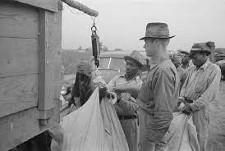
Cotton pickers weighed each bag of cotton so that they could be paid at the end of the day.

Slide 18
Matthew 20:8
“And when evening came, the owner of the vineyard said to his foreman, ‘Call the laborers and pay them their wages, beginning with the last, up to the first.’”
When I was young, my siblings and I picked cotton for area growers. We participated in a scene exactly like the one described.
Owner (kurios): refers to the master of the house.
Foreman (epitropos): “manager, foreman, steward” (BDAG, 385).
Payment of poor day laborers was to be made at the end of the day (Lev. 19:13; Deut. 24:14-15).
The owner orders that payment be made for those who were hired last to be the first paid.
This statement connects to 19:30; 20:16.
It appears that the owner’s intention was that the one hired first would see what happened to those hired later.

Slide 19
Matthew 20:9-10
“And when those hired about the eleventh hour came, each of them received a denarius. Now when those hired first came, they thought they would receive more, but each of them also received a denarius.”
Those hired in the eleventh hour were elated with what they received—much more than they expected.
Sometimes we see examples of such generosity:
“SCRANTON, P.A. -- A waitress in Scranton, Pennsylvania is thankful after a generous customer gives her a massive tip. Mariana Lambert was working a shift at Alfredo's Pizza Café when a man came in and ordered his meal totaling just over $13 but left her with the tip of $3,000” (https://abc11.com/tips-for-jesus-3-grand-tip-waitress-13-dollar-meal/12052210/).
Those hired in the first hour felt wronged, because of the generosity shown to those hired in the eleventh hour.

Slide 20
First and Last
In the context, the parable points back to Peter’s question, “See, we have left everything and followed you. What then will we have?” (19:27).
Those hired last represents all others who labored in the kingdom, giving their best to their employer. They will receive what is just, the same as the apostles.
Luke uses Jesus’s statement in the context of the Gentiles entering the kingdom.
“In that place there will be weeping and gnashing of teeth, when you see Abraham and Isaac and Jacob and all the prophets in the kingdom of God but you yourselves cast out. And people will come from east and west, and from north and south, and recline at table in the kingdom of God. And behold, some are last who will be first, and some are first who will be last” (Luke 13:28-30).

Slide 21
Matthew 20:11-12
“And on receiving it they grumbled at the master of the house, saying, ‘These last worked only one hour, and you have made them equal to us who have borne the burden of the day and the scorching heat.’”
Grumbled (gonguzō): “to express oneself in low tones of disapprobation, grumble, murmur” (BDAG, 204). The word is an onomatopoeia word (like meow, boom, roar, etc.).
Those working twelve hours complained that they had borne the burden of the day and scorching heat.
In Beth Shemesh, average high temperatures are 88-85˚ in August-September, during grape harvest season.
Had the master of the house been unfair? Had he violated his agreed upon wage?

Slide 22
R. T. France
“‘It is frightening to realize that our identification with the first workers, and hence with the opponents of Jesus, reveals how loveless and unmerciful we basically are. We may be more “under law” in our thinking and less “under grace” than we realize. God is good and compassionate far beyond his children’s understanding!’ (Stein, p. 128)” (Matthew: An Introduction and Commentary, 293).

Slide 23
Matthew 20:13
“But he replied to one of them, ‘Friend, I am doing you no wrong. Did you not agree with me for a denarius?’”
Friend (hetairos): “Hetaire (‘friend’) in v. 13 is a distancing form of address and suggests a mild reproach (cf. 22:12; 26:50)” (Craig L. Blomberg, Matthew, 304). It is used of Judas Iscariot, when he came to betray Jesus (Matt. 26:50).
Wrong (adikeō): from the same word group as “whatever is right” (v. 4, dikaion); “to act in an unjust manner, do wrong . . . treat someone unjustly” (BDAG, 20).
The master defended himself: We had a contract and both parties fulfilled their side of the contract.
The discontentment of these workers is due to envy or resentment, not to injustice.

Slide 24
Matthew 20:14-15
“Take what belongs to you and go. I choose to give to this last worker as I give to you. Am I not allowed to do what I choose with what belongs to me? Or do you begrudge my generosity?”
There is a degree of curtness in the master’s response to those hired early in the day.
I choose (thelō): a free-will act. The owner acknowledges that those hired later in the day had not earned what they got.
To give (didōmi): an act of generosity.
Begrudge my generosity is more literally “Or is your eye evil because I am good?” (NKJV). Jesus spoke of an “evil eye” earlier (6:23). The only thing these men begrudged was that they were not the recipient of the master’s generosity!

Slide 25
Matthew 20:16
“So the last will be first, and the first last.”
The closing statement takes one back to 19:30, tying all of this together as a teaching related to one’s attitude toward his service to God: “What shall we have?”
“For many are called, but few chosen” (KJV, NKJV).
The words πολλοὶ γάρ εἰσιν κλητοί, ὀλίγοι δὲ ἐκλεκτοί (for many are called but few chosen) have probably been added at the end of this verse by copyists who remembered another parable which has these words at the end (see 22:14). It is possible, but less likely, that these additional words are original and were accidentally omitted by a copyist whose eye jumped from the end of the word ἔσχατοι (last, mw) to the end of the word ἐκλεκτοί” (Roger L. Omanson and Bruce Manning Metzger, A Textual Guide to the Greek New Testament: An Adaptation of Bruce M. Metzger’s Textual Commentary for the Needs of Translators, 34).

Slide 26
Jesus Foretold His Death a Third Time Matthew 20:17-19
And as Jesus was going up to Jerusalem, he took the twelve disciples aside, and on the way he said to them, “See, we are going up to Jerusalem. And the Son of Man will be delivered over to the chief priests and scribes, and they will condemn him to death and deliver him over to the Gentiles to be mocked and flogged and crucified, and he will be raised on the third day.”

Slide 27
Jesus’s Four Predictions of His Death
Matthew 16:21 | Matthew 17:9-12 | Matthew 17:22-23 | Matthew 20:17-19
From that time Jesus began to show his disciples that he must go to Jerusalem and suffer many things from the elders and chief priests and scribes, and be killed, and on the third day be raised. | And as they were coming down the mountain, Jesus commanded them, “Tell no one the vision, until the Son of Man is raised from the dead.” And the disciples asked him, “Then why do the scribes say that first Elijah must come?” He answered, “Elijah does come, and he will restore all things. But I tell you that Elijah has already come, and they did not recognize him, but did to him whatever they pleased. So also the Son of Man will certainly suffer at their hands.” | As they were gathering in Galilee, Jesus said to them, “The Son of Man is about to be delivered into the hands of men, and they will kill him, and he will be raised on the third day.” And they were greatly distressed. | And as Jesus was going up to Jerusalem, he took the twelve disciples aside, and on the way he said to them, “See, we are going up to Jerusalem. And the Son of Man will be delivered over to the chief priests and scribes, and they will condemn him to death and deliver him over to the Gentiles to be mocked and flogged and crucified, and he will be raised on the third day.”

Slide 28
Pertinent Points
Jerusalem is mentioned two times.
He will be condemned to death.
Involves being delivered to the Gentiles (first mentioned).
Method of death: crucifixion.
“Suffer many things” becomes “mocked and flogged.”
Jesus knew exactly what He was walking into when He journeyed to Jerusalem!

Slide 29
The Details
Going up to Jerusalem: from Galilee to Jerusalem was both physically going up and spiritually going up.
The route will take them to Jericho, Bethphage, and finally Jerusalem.
Took the Disciples aside (kat’ idian):
There must have been others traveling with Jesus and the Twelve, so He took them aside to tell them what was forthcoming.
“And they were on the road, going up to Jerusalem, and Jesus was walking ahead of them. And they were amazed, and those who followed were afraid. And taking the twelve again, he began to tell them what was to happen to him” (Mark 10:32).
See: The Greek word idou is frequently translated “Behold!” or “Look!”

Slide 30
More Details
Chief priests: “The pl. is used in the NT and in Joseph. (Schürer II 233, 25; 235, 34) to denote members of the Sanhedrin who belonged to highpriestly families: ruling high priests, those who had been deposed, and adult male members of the most prominent priestly families” (BDAG, 139).
Scribes: “experts in the Law of Moses” (BDAG, 206).
Jesus would be condemned to death by order of the Sanhedrin!
The Gentiles: The Jews were not allowed to execute their own criminals (John 18:31).
The torment and execution:
Mocking (empaizō): “to subject to ridicule, make fun of, mock” (BDAG, 323). What is the significance of this? Mark adds that they would spit on Jesus (10:34).
Flogging (mastigoō): “to beat with a whip or lash, whip, flog, scourge” (BDAG, 620).
Crucifixion: This was the form of death usually reserved for slaves, criminals, and other despised people (a Roman citizen could not be crucified).

Slide 31
Resurrection
All four of the accounts in Matthew mention that Jesus will be raised.
Jesus implicitly trusted in the Father to raise Him from the dead.
Note that Mark’s “after three days” (10:34) is “on the third day” (Matt. 20:19; Luke 18:34), showing their equivalence in meaning.

Slide 32
A Mother’s Request Matthew 20:20-23
Then the mother of the sons of Zebedee came up to him with her sons, and kneeling before him she asked him for something. And he said to her, “What do you want?” She said to him, “Say that these two sons of mine are to sit, one at your right hand and one at your left, in your kingdom.” Jesus answered, “You do not know what you are asking. Are you able to drink the cup that I am to drink?” They said to him, “We are able.” He said to them, “You will drink my cup, but to sit at my right hand and at my left is not mine to grant, but it is for those for whom it has been prepared by my Father.”

Slide 33
Mark 10:35-40
“And James and John, the sons of Zebedee, came up to him and said to him, ‘Teacher, we want you to do for us whatever we ask of you.’ And he said to them, ‘What do you want me to do for you?’ And they said to him, ‘Grant us to sit, one at your right hand and one at your left, in your glory.’ And they said to him, ‘Grant us to sit, one at your right hand and one at your left, in your glory.’ Jesus said to them, ‘You do not know what you are asking. Are you able to drink the cup that I drink, or to be baptized with the baptism with which I am baptized?’ And they said to him, ‘We are able.’ And Jesus said to them, ‘The cup that I drink you will drink, and with the baptism with which I am baptized, you will be baptized, but to sit at my right hand or at my left is not mine to grant, but it is for those for whom it has been prepared.’”

Slide 34
Preliminary Thoughts
How does this incident fit with what has been recorded in 20:17-19?
Think of the sequence of events:
Rebuke about not allowing children to see Jesus.
The rich young ruler who turned away from Jesus because he was unwilling to part with his possessions.
Jesus’s comment about how hard it will be for the rich to enter the kingdom.
Peter’s question: “What then will we have?”
The parable of the generous master of the house.
Now the mother’s concern for her two sons.
There is nothing said about what will happen in Jerusalem.
The disciples are still interested in “what’s in it for me?”

Slide 35
Matthew 20:20
“Then the mother of the sons of Zebedee came up to him with her sons, and kneeling before him she asked him for something.”
The mother of James and John, the sons of Zebedee, was journeying to Jerusalem with the group of disciples (27:56).
It is hard to determine whether the request originated with the mother or with James and John. A good argument can be made for either one.
Notice the respectful, even reverent, posture she assumes when making the request.
Mark’s account has the request made by the sons and much more bluntly: “And James and John, the sons of Zebedee, came up to him and said to him, ‘Teacher, we want you to do for us whatever we ask of you’” (10:35).
They are asking Jesus to sign a blank check!

Slide 36
Matthew 20:21
“And he said to her, ‘What do you want?’ She said to him, ‘Say that these two sons of mine are to sit, one at your right hand and one at your left, in your kingdom.’”
She is asking for the first and second highest positions in the kingdom to be given to her two sons.
For the significance of “right hand,” see Psalm 110:1—“The LORD says to my Lord: “Sit at my right hand, until I make your enemies your footstool.”
It is evident that, in the mind of the mother, Jesus has not yet established His kingdom.
Luke 19:11 indicates that they expected the kingdom soon to be established: “As they heard these things, he proceeded to tell a parable, because he was near to Jerusalem, and because they supposed that the kingdom of God was to appear immediately.”
What is wrong with this request?

Slide 37
The Right and the Left Hand
The right and the left hand refers to the request that the two sons wanted when Jesus came in His kingdom.
Significantly, Jesus had just finished foretelling that He was going to be crucified in the city of Jerusalem, where they were anticipating that He would inaugurate His kingdom.
The only ones on the right and left hands of Jesus in Jerusalem were the two thieves (Matt. 27:38)!

Slide 38
Matthew 20:22
“Jesus answered, ‘You do not know what you are asking. Are you able to drink the cup that I am to drink?’ They said to him, ‘We are able.’”
What is the significance of “You do not know what you are asking”?
Do you think we ever make the same mistake in our prayers?
What is wrong with the brothers’ reply, “we are able”?
What does Jesus mean by “the cup that I am to drink”?
“And going a little farther he fell on his face and prayed, saying, ‘My Father, if it be possible, let this cup pass from me; nevertheless, not as I will, but as you will’” (Matt. 26:39; cf. Mark 14:36; Luke 22:42; John 18:11).
What became of James and John?

Slide 39
Matthew 20:23
“He said to them, ‘You will drink my cup, but to sit at my right hand and at my left is not mine to grant, but it is for those for whom it has been prepared by my Father.’”
Note that Jesus Himself is subordinate to the will of the Father.
Those who were to sit on the right and left hand of Jesus would be decided by the Father, and given to those for whom it had already been prepared.
Note the intimacy between Jesus and “My Father.” Though He had already spoken about his impending suffering, Jesus still speaks of His relationship with God in such intimate terms. He faced His sufferings with trust in His loving Father.

Slide 40
The Disciples’ Reaction Matthew 20:24-28
And when the ten heard it, they were indignant at the two brothers. But Jesus called them to him and said, “You know that the rulers of the Gentiles lord it over them, and their great ones exercise authority over them. It shall not be so among you. But whoever would be great among you must be your servant, and whoever would be first among you must be your slave, even as the Son of Man came not to be served but to serve, and to give his life as a ransom for many.”

Slide 41
Matthew 20:24
“And when the ten heard it, they were indignant at the two brothers.”
Indignant (aganakteō): “be indignant against what is assumed to be wrong, be aroused, indignant, angry” (BDAG, 5).
Why were the ten indignant at the two brothers?
Why does self-assertion evoke such reactions?

Slide 42
Matthew 20:25-26
“But Jesus called them to him and said, ‘You know that the rulers of the Gentiles lord it over them, and their great ones exercise authority over them. It shall not be so among you. But whoever would be great among you must be your servant. . . .’”
Lord it over (katakurieuō): “to have mastery, be master, lord it (over), rule τινός of, over someone or something” (BDAG, 519).
Exercise authority over (katexousiazō): “exercise authority, perhaps tyrannize τινός over someone, of the mighty ones of the earth” (BDAG, 531).
Jesus is not saying that putting someone in such positions is always sinful (think of the military, business, etc.). Rather, He is saying that this is not how it will be in His kingdom.
True greatness is not in lording it over others, but in serving others!

Slide 43
Servant Leadership
“Wanting to be first” reminds one of v. 21 and 19:30 and 20:16.
How does one become a “leader” in the Lord’s kingdom?
What does becoming a leader mean on a practical level?
What does “minister” mean in today’s religious culture?
What is the difference in today’s modern usage and the biblical sense?

Slide 44
Matthew 20:27
“. . . and whoever would be first among you must be your slave. . . .”
First (protos): The word can be used of the “first in a sequence,” in time, in order, etc. Here it is used “pertaining to prominence, first, foremost, most important, most prominent” (BDAG, 893).
Slave (doulos): “one who is solely committed to another, slave, subject. . . Slaves are duty-bound only to their owners or masters” (BDAG, 260).
What position did slaves hold in the first century?
What kinds of jobs were typically given to ordinary slaves?

Slide 45
Matthew 20:28
“. . . even as the Son of Man came not to be served but to serve, and to give his life as a ransom for many.”
Jesus: an example of Servant Leadership! Note the contrast:
“Not to be served.”
“But to serve.”
The Son of Man “the Human One [Son of Man] came to carry out an assignment not to benefit himself but others [by giving his life in ransom]” (BDAG, 229).
Ransom (lutron): “price of release, ransom (esp. also the ransom money for the manumission of slaves)” (BDAG, 605).
“Ransom” is one of several images used to describe the atonement.

Slide 46
The Ransom Metaphor
“The phrase to give his life as a ransom for many is one of the clearest statements in the New Testament of the saving effect of Jesus’ death. Lytron (‘ransom’) and the preposition anti (‘for’, literally ‘instead of’) point clearly to the idea of his ‘taking our place’, as the payment of an equivalent sum of money procures the release of the captive (or, in the Old Testament, the ‘redemption’ of what was dedicated to God: see Lev. 27 for relevant legislation). There is of course no exact analogy between Jesus’ death and such ransom-language, so that the passage does not require us to ask to whom payment is made, or how the ‘equivalent’ is calculated. The point is that a ‘payment’ was needed to achieve the ‘release’ of many, and that Jesus’ death provides it” (R. T. France, Matthew: An Introduction and Commentary, Tyndale New Testament, 296–297).

Slide 47
Jesus Heals Two Blind Men Matthew 20:29-34
And as they went out of Jericho, a great crowd followed him. And behold, there were two blind men sitting by the roadside, and when they heard that Jesus was passing by, they cried out, “Lord, have mercy on us, Son of David!” The crowd rebuked them, telling them to be silent, but they cried out all the more, “Lord, have mercy on us, Son of David!” And stopping, Jesus called them and said, “What do you want me to do for you?” They said to him, “Lord, let our eyes be opened.” And Jesus in pity touched their eyes, and immediately they recovered their sight and followed him.

Slide 48
Matthew 20:29
“And as they went out of Jericho, a great crowd followed him.”
Mark writes “went out” but Luke writes “go in” to Jericho.
“As he drew near to Jericho, a blind man was sitting by the roadside begging” (Luke 18:35).

Slide 49
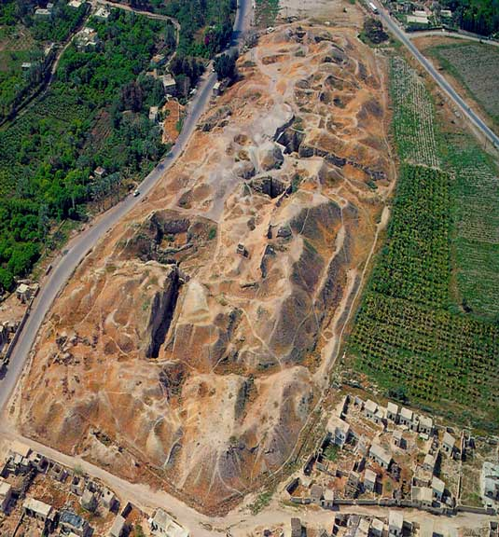
Tel for Old Testament Jericho
Known as
Tel-es-Sultan

Slide 50
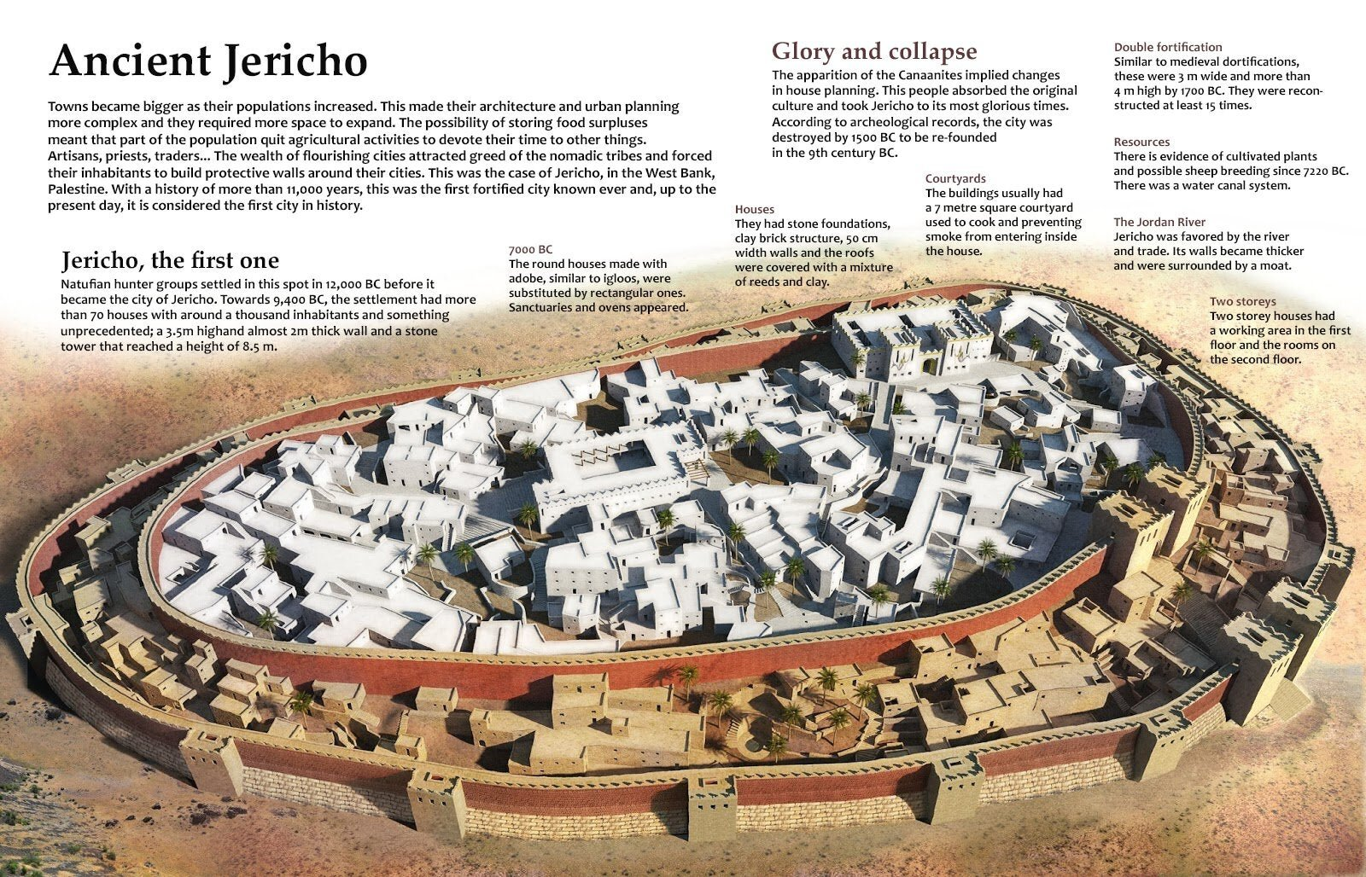
https://www.thearchaeologist.org/blog/ancient-jericho-the-first-walled-city-in-history

Slide 51
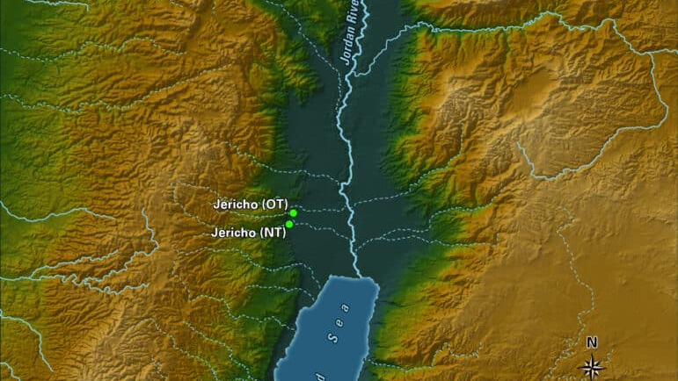
NT Jericho
Located about 1 mile south of OT Jericho
Herod the Great built a winter place and ornamental gardens there
A large cistern and traces of an aqueduct which brought water down from Wadi Qelt have been exposed.

Slide 52
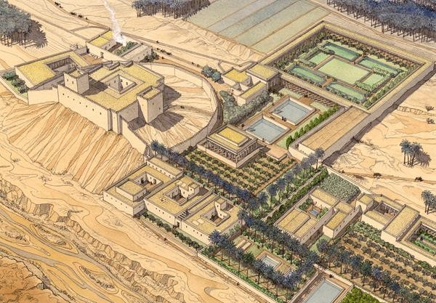
Known as Tulul Abu el-‘Alayiq
Artist’s Drawing of Herod the Great’s Winter Palace at Jericho
https://www.baslibrary.org/sites/default/files/styles/xlarge/public/bsba440607001l.jpg?itok=kUtjpvTM

Slide 53
Matthew 20:29
“And as they went out of Jericho, a great crowd followed him.”
Mark writes “went out” but Luke writes “go in” to Jericho.
“As he drew near to Jericho, a blind man was sitting by the roadside begging” (Luke 18:35).
Leon Morris (The Gospel According to Matthew, 514) and Kyle Pope (The Book of Matthew, 686-687) conjectures that the incident occurred between OT Jericho and NT Jericho. Kyle Pope argues the following.
Matthew, who is writing from the Jewish perspective, mentions that Jesus was departing from OT Jericho.
Luke, writing from the Gentile perspective, says that they were approaching the Herodian city of Jericho.
The great crowd going to Jerusalem would have been natural; they were going to observe the Passover, as the Law commanded.

Slide 54
Matthew 20:30
And behold, there were two blind men sitting by the roadside, and when they heard that Jesus was passing by, they cried out, “Lord, have mercy on us, Son of David!”
What is the significance of “behold”?
Matthew has “two blind men,” whereas both Luke and Mark have one blind man; Mark gives the name of the beggar, Bartimaeus (the son of Timaeus) perhaps because he was known in the Christian community.
Both Mark and Luke say Bartimaeus was a beggar (Mark 10:46; Luke 18:35).
What motivated the beggars to cry out for help?
How do the blind men address Jesus?
What is the significance of each title?
Why did Jesus not tell them “do not call me ‘Son of David’ (Christ)”?
What is “mercy”?
The Greek word eleeō means “to be greatly concerned about someone in need, have compassion/mercy/pity . . . on or for someone” (BDAG, 315).

Slide 55
Matthew 20:31
“The crowd rebuked them, telling them to be silent, but they cried out all the more, ‘Lord, have mercy on us, Son of David!’”
The crowd going up to Jerusalem with Jesus rebuked the two blind men.
Rebuked (epitimao): “to express strong disapproval of someone, rebuke, reprove, censure also speak seriously, warn in order to prevent an action or bring one to an end” (BDAG, 384).
What was motivating the crowd to tell the beggars to be silent?
Why did the blind men ignore the crowd?

Slide 56
Matthew 20:32
“And stopping, Jesus called them and said, ‘What do you want me to do for you?’”
Why did Jesus react differently than the crowd reacted to the beggars?
Why did Jesus not ignore the blind men?
Why did He ask what they wanted from Him?

Slide 57
Matthew 20:33
“They said to him, ‘Lord, let our eyes be opened.’”
Mark includes the following: “And Jesus stopped and said, ‘Call him.’ And they called the blind man, saying to him, ‘Take heart. Get up; he is calling you.’ And throwing off his cloak, he sprang up and came to Jesus” (10:49-50).
What request did the two blind men have of Jesus?
What did not they not request from Him?

Slide 58
Matthew 20:34
And Jesus in pity touched their eyes, and immediately they recovered their sight and followed him.
What motivated Jesus to heal the blind man?
Why did Jesus touch their eyes?
What effect did Jesus’s touch have on the blind men?

Slide 59
The Journey Nears Its End
Matthew 19:1-20:34 is a section in Matthew’s gospel.
Teaching about divorce (19:1-12)
Let the children come to Me (19:13-15)
The rich young ruler (19:16-22)
Conversation with disciples about wealth (19:23-30)
Laborers in the Vineyard (20:1-16)
Jesus foretells His death for a third time (20:17-19)
Mother’s request for her two sons (20:20-28)
Healing two blind men at Jericho (20:29-34)
Jesus’s visit with Zacchaeus (Luke 19:1-10)
Jerusalem is the next stop!

