Slide 1
Mechanical Instruments

Slide 2
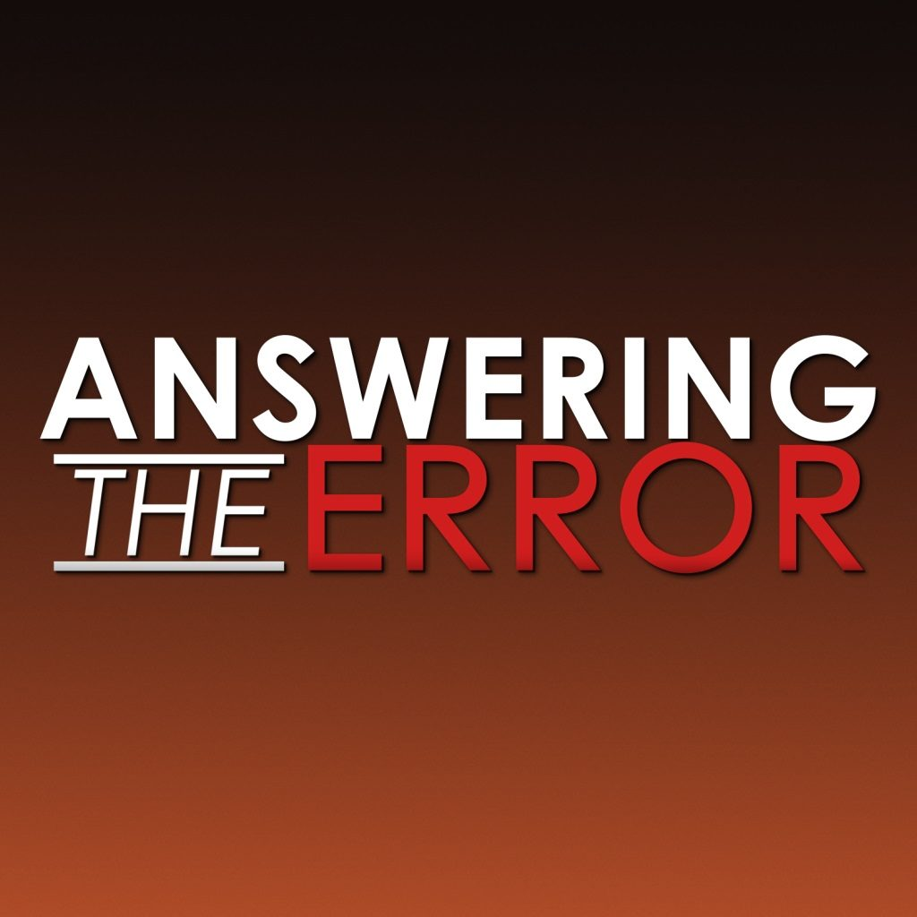
Mechanical Instruments
1. Instruments in heaven makes it acceptable in the church.
Instruments are mentioned in Revelation. 5:8-9 ; 14:2-3; 15:2-3
If this were true then we would also have angels, golden bowls of incense, a throne,……..
Rules of the OT differ from NT so the rules of heaven differ from the present.
Revelation 1:1
Harps are symbolic of praise.

Slide 3
Mechanical Instruments
2. Definition of psallo includes playing.
Thayer page 675 (Psallo) – to vibrate by touching, to twang, to play a stringed instrument, to sing to the music of the harp.
Eph. 5:19
Same page! – In the NT Psallo means: “to sing a hymn, to celebrate the praise of God in song, one who has it in his heart to sing a song”.
“make melody” - Psallontes

Slide 4
Mechanical Instruments
3. Instruments are just an aid to the singing.
Aid or Addition?
Books?
Lights?
Seats?
Pitch pipe?
Psalm 150
What happens when an instrument is supplied?

Slide 5
THE VOICE OF VARIOUS RELIGIOUS SOURCES...
CATHOLIC - "... the first Christians were of too spiritual a fiber to substitute lifeless instruments for or to use them to accompany the human voice." -- CATHOLIC ENCYCLOPEDIA
GREEK ORTHODOX - "The execution of Byzantine church music by instruments, or even the accompaniment of sacred chanting by instruments was ruled out by the Eastern Fathers as being incompatible with the pure, solemn, spiritual character of the religion of Christ." -- Constantine Cavarnos, BYSANTINE SACRED MUSIC

Slide 6
THE VOICE OF VARIOUS RELIGIOUS SOURCES...
PRESBYTERIAN - "Musical instruments in celebrating the praises of God would be no more suitable than the burning of incense, the lighting up of lamps, the restoration of the other shadows of the law. The Papists, therefore, have foolishly borrowed this, as well as many other things, from the Jews. Men who are fond of outward pomp may delight in that noise; but the simplicity which God recommends to us by the apostle is far more pleasing to Him." - JOHN CALVIN, Commentary on the Book of Psalms, Vol. I, p. 539

Slide 7
THE VOICE OF VARIOUS RELIGIOUS SOURCES...
METHODIST - "I have no objection to instruments of music, in our chapels, provided they are neither heard nor seen." - JOHN WESLEY (founder)
METHODIST - "Music as a science, I esteem and admire: but instruments of music in the house of God I abominate and abhor. This is the abuse of music; and here I register my protest against all such corruptions in the worship of the Author of Christianity." - ADAM CLARKE (commentator)
LUTHERAN - "Martin Luther called the organ an 'ensign of Baal'." - MCCLINTOCK & STRONG'S ENCYCLOPEDIA
BAPTIST - "I would as soon attempt to pray to God with machinery as to sing to Him with machinery." - CHARLES H.SPURGEON

Slide 8
Why did they object?
Recognized the use of instruments was a carry-over from the Jewish worship.
Recognized it was out of harmony with the SPIRITUAL nature of NT worship.
Recognized that it rightfully belonged in the OL with its “shadows” & not the TRUE worship of the NT.

Slide 9
Justifications Offered For The Use Of Instruments
“It’s always been a tradition in our church.”
“I don’t see anything wrong with it.”
“I like it in my worship to God.”
“It is found in the OT.”
“It doesn’t say not to.”

