Slide 2
A Character Study
We learn from the examples set before us.
The prophet wrote, “And the word of the LORD came to me: ‘Son of man, when a land sins against me by acting faithlessly, and I stretch out my hand against it and break its supply of bread and send famine upon it, and cut off from it man and beast, even if these three men, Noah, Daniel, and Job, were in it, they would deliver but their own lives by their righteousness, declares the Lord GOD’” (Ezek. 3:12-14; cf. vv. 19-20).
Noah is a good example for a character study.

Slide 3
Noah Was Faithful to God in a Wicked World

Slide 4
The World in Which Noah Lived
Marriage had degenerated to the point that man entered a relationship with a woman on the basis of her appearance: “When man began to multiply on the face of the land and daughters were born to them, the sons of God saw that the daughters of man were attractive. And they took as their wives any they chose” (Gen. 6:1-2).
“The LORD saw that the wickedness of man was great in the earth, and that every intention of the thoughts of his heart was only evil continually” (Gen. 6:5).
A man may not be what he thinks he is, but whatever he thinks, he is!
There was no redeeming value left in the antediluvian people.

Slide 5
The Lord’s Assessment
“Now the earth was corrupt in God’s sight, and the earth was filled with violence” (Gen. 6:11).
“And God saw the earth, and behold, it was corrupt, for all flesh had corrupted their way on the earth” (Gen. 6:12).
What a sordid picture of a world!

Slide 6
Noah’s Character
“Noah was a righteous man, blameless in his generation. Noah walked with God” (Gen. 6:9).
A righteous man (Gen. 6:9).
Blameless in his times (Gen. 6:9).
Noah walked with God (Gen. 6:9).

Slide 7
The Test of Blending with the Crowd
Noah knew how to be different.
Noah realized that God’s people are different from the rest of the world.
Do we realize the same?
“For the time that is past suffices for doing what the Gentiles want to do, living in sensuality, passions, drunkenness, orgies, drinking parties, and lawless idolatry. With respect to this they are surprised when you do not join them in the same flood of debauchery, and they malign you” (cf. 1 Pet. 4:3, 4).
By the word “mixer,” we describe a person who can blend-in with any crowd. A “mixer” sacrifices principles of righteousness to blend-in with the crowd. We say that he is a chameleon.

Slide 8
The Danger of Evil Companions
Noah must have known how easily “bad company ruins good morals” (1 Cor. 15:33) and have avoided their influence.
Everyone has to realize that he must make decisions to stand for truth, even if they are unpopular decisions.
Compare Paul’s decision to become a Christian:
“But when he who had set me apart before I was born, and who called me by his grace, was pleased to reveal his Son to me, in order that I might preach him among the Gentiles, I did not immediately consult with anyone; nor did I go up to Jerusalem to those who were apostles before me, but I went away into Arabia, and returned again to Damascus” (Gal. 1:15-17).

Slide 9
The First-Century Greco-Roman World
“They were filled with all manner of unrighteousness, evil, covetousness, malice. They are full of envy, murder, strife, deceit, maliciousness. They are gossips, slanderers, haters of God, insolent, haughty, boastful, inventors of evil, disobedient to parents, foolish, faithless, heartless, ruthless. Though they know God’s righteous decree that those who practice such things deserve to die, they not only do them but give approval to those who practice them” (Rom. 1:28-32).

Slide 10
The First-Century Greco-Roman World
“Or do you not know that the unrighteous will not inherit the kingdom of God? Do not be deceived: neither the sexually immoral, nor idolaters, nor adulterers, nor men who practice homosexuality, nor thieves, nor the greedy, nor drunkards, nor revilers, nor swindlers will inherit the kingdom of God. And such were some of you. But you were washed, you were sanctified, you were justified in the name of the Lord Jesus Christ and by the Spirit of our God” (1 Cor. 6:9-11).

Slide 11
The First-Century Greco-Roman World
“Now the works of the flesh are evident: sexual immorality, impurity, sensuality, idolatry, sorcery, enmity, strife, jealousy, fits of anger, rivalries, dissensions, divisions, envy, drunkenness, orgies, and things like these. I warn you, as I warned you before, that those who do such things will not inherit the kingdom of God” (Gal. 5:19-21).

Slide 12
Christianity Was Born in a Wicked World
The church at Pergamum served God in a place described as “where Satan dwells” (Rev. 2:12,13).
The apostles served in Jerusalem amidst persecution (Acts 8).
Therefore, I conclude that one cannot be excused from service to God on the basis of the wickedness of the world around him.

Slide 13
Noah Persevered

Slide 14
He Did Not Let the Hard Times Cause Him to Quit
Peter described Noah as a “herald (KJV: preacher) of righteousness” (2 Pet. 2:5).
Through Noah, God preached to the wicked spirits in prison:
“For Christ also suffered once for sins, the righteous for the unrighteous, that he might bring us to God, being put to death in the flesh but made alive in the spirit, in which he went and proclaimed to the spirits in prison, because they formerly did not obey, when God’s patience waited in the days of Noah, while the ark was being prepared, in which a few, that is, eight persons, were brought safely through water” (1 Pet. 3:19-20).
“Concerning this salvation, the prophets who prophesied about the grace that was to be yours searched and inquired carefully, inquiring what person or time the Spirit of Christ in them was indicating when he predicted the sufferings of Christ and the subsequent glories” (1 Pet. 1:10-11).
From this passage, one concludes that during the time Noah was building the ark until the flood arrived—120 years, Noah preached to the people of his day.

Slide 15
The Striving of God’s Spirit
During this period, God’s Spirit strove with men to call them to repentance: “Then the LORD said, ‘My Spirit shall not abide in (KJV & NKJV have “strive with”) man forever, for he is flesh: his days shall be 120 years’” (Gen. 6:3).
“Or do you presume on the riches of his kindness and forbearance and patience, not knowing that God’s kindness is meant to lead you to repentance?” (Rom. 2:4).
No doubt, Noah had to endure the mockery characteristic of the wicked who refuse to accept God’s word.

Slide 16
Noah’s Ministry
From a human standpoint, Noah’s ministry was a failure.
The world did not change.
No one accepted his call to repentance.
Only his immediate family was saved! (This is more than many men are able to do!)
Yet, in all of this, Noah’s faith remained strong. For this reason, God said this about Noah, “. . . for you alone I have seen to be righteous before me in this generation” (7:1).

Slide 17
Noah Obeyed God

Slide 18
Noah’s Life’s Work
Build an ark: The commandment was formidable.
To build an ark 450' x 75' x 45’ (Gen. 6:15).
Three flours (Gen. 6:16).
33,750 square feet per floor (total square feet: 101,250)
1,518,750 cubic feet
To build rooms in the ark (6:14) and decks (6:16).
To put pitch inside and out (6:14).
To prepare food for the survival of both his family and the animals on the ark (6:21).

Slide 19
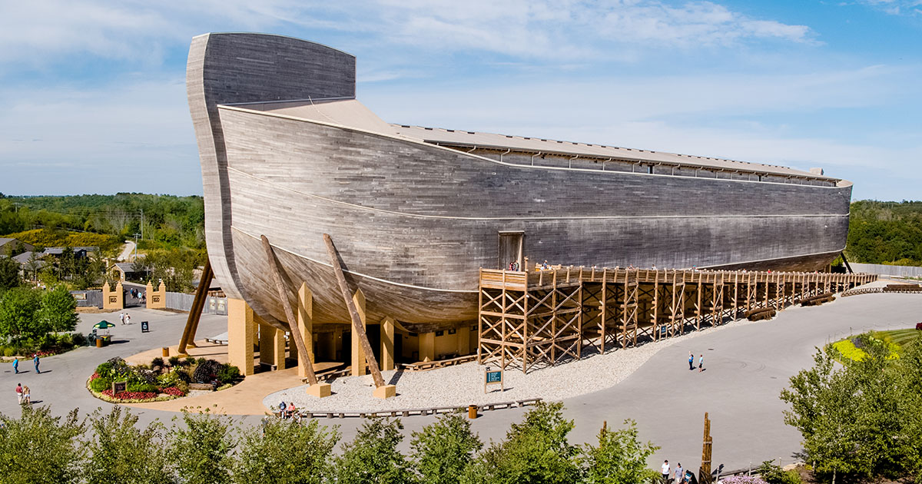
The Ark Encounter
Williamstown, KY

Slide 20
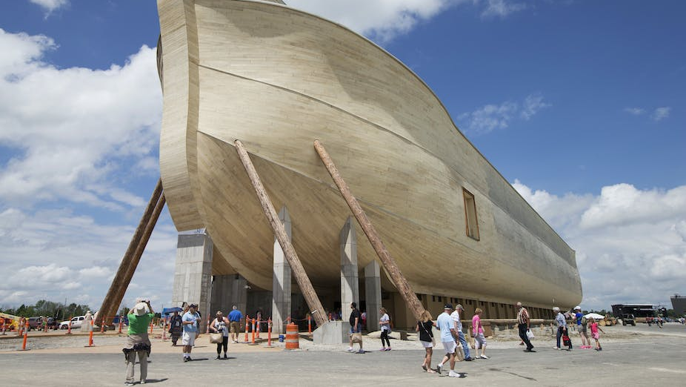

Slide 21
Noah Obeyed God’s Commandments
At the command to build the ark: “Noah did this; he did all that God commanded him” (Gen. 6:22).
At the announcement that they should enter the ark in a week: “And Noah did all that the LORD had commanded him” (Gen. 7:5).
At the entering of the ark: “Of clean animals, and of animals that are not clean, and of birds, and of everything that creeps on the ground, two and two, male and female, went into the ark with Noah, as God had commanded Noah” (Gen. 7:8-9).
At the closing of the door of the ark: “And those that entered, male and female of all flesh, went in as God had commanded him. And the LORD shut him in” (Gen. 7:16).

Slide 22
By Faith
“And without faith it is impossible to please him, for whoever would draw near to God must believe that he exists and that he rewards those who seek him” (Heb. 11:6).
“By faith Noah, being warned by God concerning events as yet unseen, in reverent fear constructed an ark for the saving of his household. By this he condemned the world and became an heir of the righteousness that comes by faith” (Heb. 11:7).

Slide 23
Noah Worshiped God

Slide 24
Noah Worshiped God
Not only is his worship implied in the description of Noah before the flood as being righteous, blameless in his generation, and walking with God, it is also specifically stated after the flood.
“Then Noah built an altar to the LORD and took some of every clean animal and some of every clean bird and offered burnt offerings on the altar” (Gen. 8:20).
Despite the ordeal of the flood and the confinement of the ark, Noah still worshiped God.
In light of the alternatives, he had a lot for which to give thanks.
If anything, Noah’s fervency in service was probably increased by his experience.

Slide 25
Noah Was Just a Man

Slide 26
The Man Noah
In our study of the characteristics of Noah so far, we are apt to picture Noah as a “Superman clothed as Clark Kent.” To puncture that image, let us not forget that Noah was only a man.
His sin after the flood adequately demonstrates this point: “Noah began to be a man of the soil, and he planted a vineyard. He drank of the wine and became drunk and lay uncovered in his tent” (Gen. 9:20-21).
Notice that one has the tendency to let his guard down after success.
Though the flood destroyed sinful mankind, it did not destroy sin! Noah was as subject to temptation after the flood as he was before it.
Righteous as he was, let us not forget that Noah was a man with the same temptations as the rest of us face!

Slide 27
Conclusion

Slide 28
Take Aways
If I had lived in Noah’s days, would I have found favor in the eyes of the Lord?
Am I a righteous man?
Am I blameless in the sight of the Lord?
Do I walk with God?
Compare yourself to this man of faith.
Learn from his example of faith!

