Slide 1
26 days ago
was one of the
HAPPIEST
and SADDEST
days of my life

Slide 2
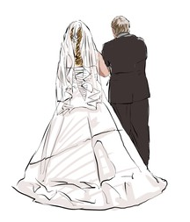
26 days ago
I was Blessed
to walk my
daughter
down the aisle

Slide 3
Two
Hours
Earlier

Slide 4
Our daughter’s wedding day
Was a GIFT from GOD

Slide 5
Moments like these remind us of
The
Divine
Gift of
OUR CHILDREN

Slide 6
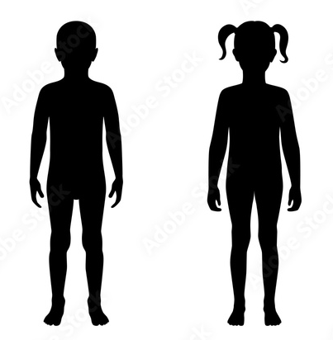
Our Children’s MINDS
Our Children’s BODIES
Our Children’s QUESTIONS
Our Children’s SOULS

Slide 7
Our Children’s MINDS
A Biblical response
to modern education

Slide 8
Satan’s Attack:
Man-Centered Education
2. God’s Defense:
God-Centered Education
Our Children’s
MINDS
3. Our Response:
6 Action Steps

Slide 9
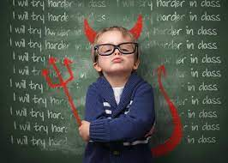
Our Children’s MINDS
Satan’s Attack: Man-Centered Education
Removes God
Silences Dissention
Discredits Religion
Displaces Parents

Slide 10
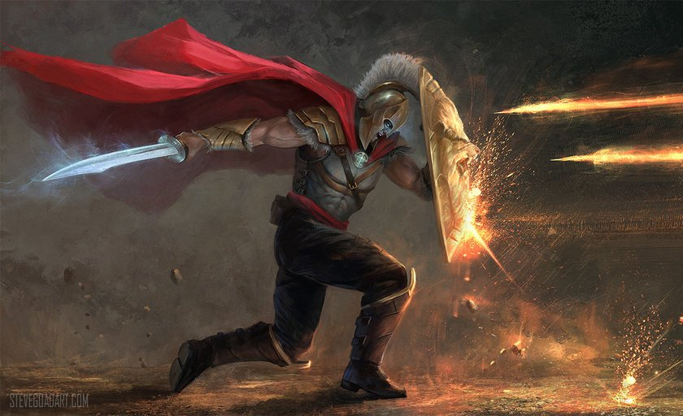
Our Children’s MINDS
God’s Defense: God-Centered Education
Obeys Scripture
Exposes Folly
Glorifies God
Equips Youth
Inspires Learning
Unites Families

Slide 11
Our Children’s MINDS
Our Response: 6 Action Steps
Teach Triumphantly
Teach Intentionally
Teach Scientifically
Teach Theo-centrically
Teach Domestically
Teach Intelligently

Slide 12
Satan’s Attack:
Man-Centered Education
2. God’s Defense:
God-Centered Education
Our Children’s
MINDS
3. Our Response:
6 Action Steps

