Slide 1
(Deut. 6:20)

Slide 2
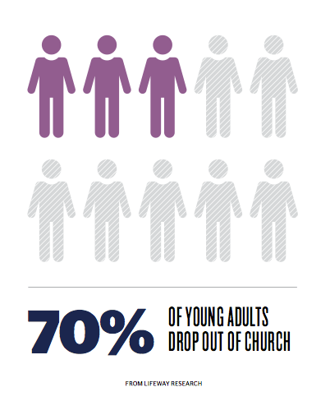
Unfortunately,
this story
is not unique

Slide 3
Why?

Slide 4
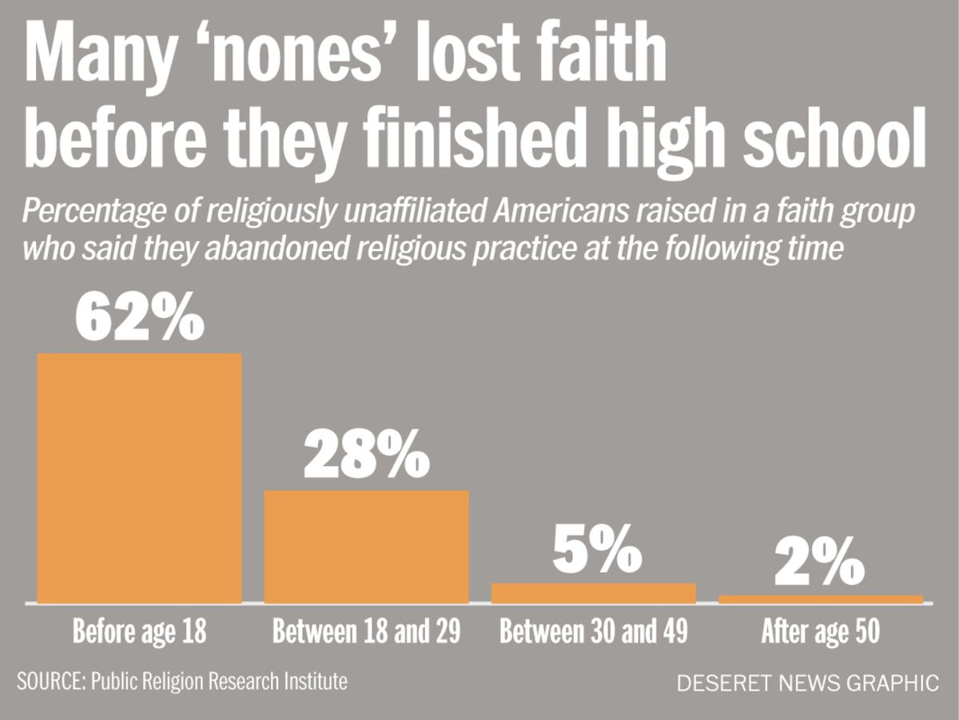
(Deut. 6:20)
When?

Slide 5
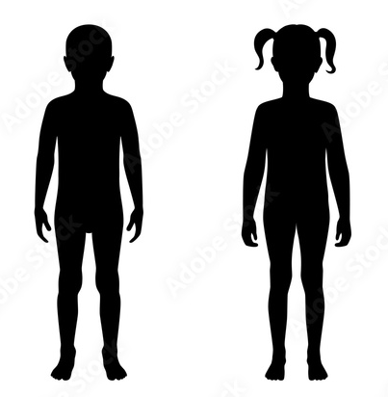
Our Children’s MINDS
Our Children’s BODIES
Our Children’s QUESTIONS
Our Children’s SOULS

Slide 6
Our Children’s QUESTIONS
“When your son asks…”
(Deut. 6:20)

Slide 7
When
Children
Ask
WELCOME the questions
ANSWER the questions

Slide 8
WELCOME Questions
God Anticipated
that Children will ask
Questions
Deut. 6:20 Josh 4:6
Josh 4:21 Exod 12:24f

Slide 9
When your children ask
Advantageous Time
80% of people make
decision to follow Christ
in their early teens
4-14
Window

Slide 10
When your children ask
Dangerous
Time
62% lose their
faith before finishing
high school

Slide 11
Action Steps to Encourage
Children’s questions
- Repetitive behavior feasts, worship Exod. 12:24f
- Visual reminders memorials Josh. 4:6
- Faithful living hope within 1 Pet. 3:15f
- Genuine relationship daily walk, talk Deut. 6:5f
- Faithful teaching regular instruction Deut. 6:20

Slide 12
WELCOME Questions
God Welcomes
Our Questions
Isa. 1:18 Phil. 4:8 Jer. 29:13
Matt. 5:7-8 Acts 17:11

Slide 13
WELCOME Questions
Failing to do so is
eternally FATAL
Faithfulness of the next generation
depends on them ASKING questions
depends on HOW we answer

Slide 14
When
Children
Ask
WELCOME the questions
ANSWER the questions

Slide 15
When Children Ask
Answer the Questions
Answer with
GOD

Slide 16
When Children Ask
Answer the Questions
Answer with
HISTORY

Slide 17
When Children Ask
Answer the Questions
Answer with the
WORD

Slide 18
When Children Ask
Answer the Questions
Answer with
HUMILITY

Slide 19
Action Steps required to
ANSWER children’s questions effectively
-Humility admit you may not have all the answers
Isa. 55:8-9; 2 Tim. 2:24-25
-Study be willing to find the answers
Acts 17:11; 2 Tim. 2:15
-Faith God has the answers
2 Tim. 3:16
-Care enough to spend time finding answers
Deut. 6:5f; Eph. 6:1-4

Slide 20
When
Children
Ask
WELCOME the questions
ANSWER the questions

Slide 21
(Deut. 6:20)

Slide 22
Most
important
question

