Slide 2
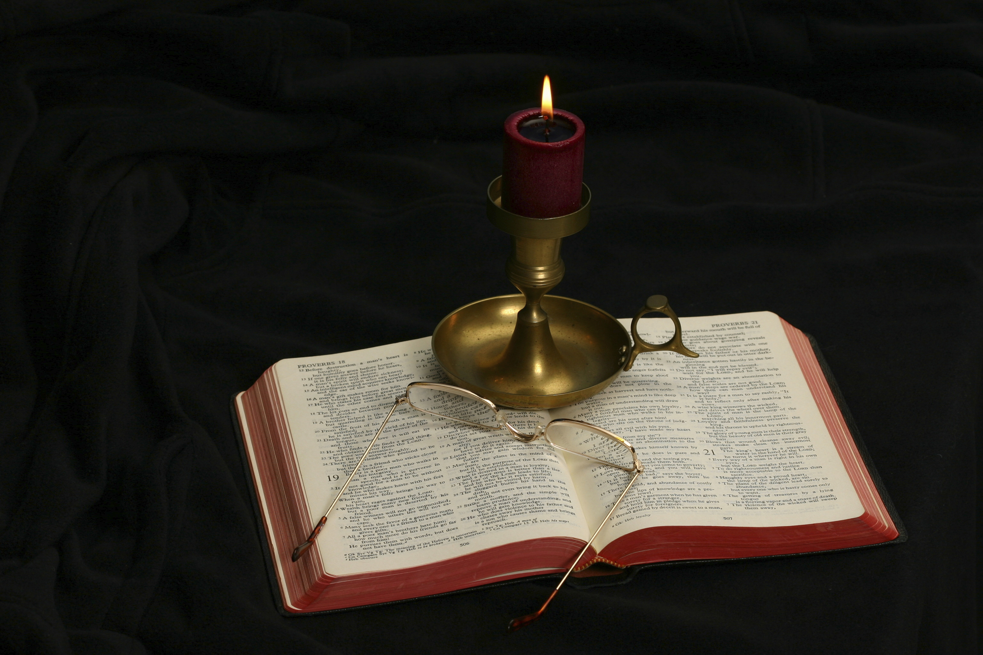
The Gospel of Matthew
Chapter 6

Slide 3
Continuation of the Sermon
Jesus has been discussing the righteousness necessary to be pleasing to God, which He began in the six antitheses of chapter 5.
Chapter 6 continues this subject in 6:1-18 by focusing on one’s relationship with God in the following areas:
Almsgiving (6:1-4)
Prayer (6:5-15)
Verses 5-8 are organized in the same pattern with what is say about almsgiving and fasting.
Verses 9-15 is an expansion consisting of the Lord’s model prayer
Fasting (6:16-18)
Verses 6:19-34 focus on God and Mammon

Slide 4
What and Why
Being religious and doing good are good, so long as the “why” is correct.
Correct actions with improper motives do not please God.
God is watching as to whether we do what we do to elicit praise from mankind or to glorify Him.
Most of corporate giving is designed to send the message to the company’s customer base that they are benefactors, aligned with the latest and most popular politically correct positions.
Almsgiving to be seen by men brings glory to the almsgiver whereas that which is done in service to God gives glory to God, whether or not anyone else ever knows what one has done.

Slide 5
1. Almsgiving (6:1-4)
“Take heed that you do not do your charitable deeds before men, to be seen by them. Otherwise you have no reward from your Father in heaven. Therefore, when you do a charitable deed, do not sound a trumpet before you as the hypocrites do in the synagogues and in the streets, that they may have glory from men. Assuredly, I say to you, they have their reward. But when you do a charitable deed, do not let your left hand know what your right hand is doing, that your charitable deed may be in secret; and your Father who sees in secret will Himself reward you openly” (Matt. 6:1-4).

Slide 6
Matthew 6:1
“Take heed that you do not do your charitable deeds before men, to be seen by them. Otherwise you have no reward from your Father in heaven.”
Charitable deeds (eleēmosunē): “kind deed, then specifically alms, charitable giving” (BDAG, 249).
These are commanded in Scripture (Deut. 15:11).
Take heed (prosechō): “to be in a state of alert, be concerned about, care for, take care” (BDAG, 880).
Why does one need to “take heed” of this, so long as the poor are helped?
Allison and Davies: “Human nature being what it is, the temptation to make a good show of oneself to impress others has been ever present in every religion. . . .” (Commentary on Matthew, I:576).
There is no reward in heaven for doing good to be seen of men—whether that good is almsgiving, praying, or preaching!

Slide 7
Matthew 6:2
“Therefore, when you do a charitable deed, do not sound a trumpet before you as the hypocrites do in the synagogues and in the streets, that they may have glory from men. Assuredly, I say to you, they have their reward.”
Sound a trumpet (salpizō): “to publicize something with fanfare, to trumpet” (BDAG). It is probably to be taken metaphorically in this verse. There is no literal use of trumpets in connection with almsgiving that is clearly attested (France, 136; Morris, 137; Nolland, 275).
We use the same phrase: “To toot your own horn!”
What do corporations do to “sound a trumpet” about their giving?
“Store X donates x% of our sales to _______________.” Why do I need to know that? What is it saying?
We usually inscribe the generosity of the wealthy on stone monuments.

Slide 8
Hupocrites
The word hupokritēs appears 17 times in the NT, 13 of those in Matthew.
It means “one who pretends to be other than he really is—‘hypocrite, pretender, one who acts hypocritically’” (Louw-Nida, 88.228).
R. T. France: “The Greek word means originally an ‘actor’, and here that sense is not far from the surface: they are performing to an audience” (Matthew: An Introduction and Commentary, 136).
Leon Morris: “The word was used for actors who, of course, play a part and whose words are spoken for effect and not in order to convey the truth. These hypocrites were people who acted a concern for the poor whereas their real concern was to establish a reputation for piety” (The Gospel according to Matthew, 137).

Slide 9
Paid in Full
“They have their reward.”
The word apechō means “to receive in full what is due, to be paid in full, receive in full.” It is a commercial technical term meaning “provide a receipt for a sum paid in full” (BDAG, 102).
R. T. France: “The aim of such play-acting is that they may be praised by men, and in that praise it finds its full reward (misthos, literally ‘wages’, that which has been earned). Have (apechō) is a commercial term for receipt in full, and therefore implies there is no more to look forward to” (Matthew: An Introduction and Commentary, 136).
Leon Morris: “. . . it is the praise and not the helping of the needy in which they are primarily interested” (op. cit., 137).
They sought the praise of men; they received the praise of men; there is nothing more to come!
The teaching of being paid in full is emphasized by “assuredly” or “verily.”

Slide 10
Matthew 6:3-4
“But when you do a charitable deed, do not let your left hand know what your right hand is doing, that your charitable deed may be in secret; and your Father who sees in secret will Himself reward you openly.”
“Do not let your left hand know what your right had is doing” is physically impossible. It is an hyperbole for “with utmost secrecy.”
What does secrecy in almsgiving do for the recipient?
What does secrecy in almsgiving do for the giver?
What is the point being taught in v. 4?

Slide 11
2. Prayer (6:5-8)
“And when you pray, you shall not be like the hypocrites. For they love to pray standing in the synagogues and on the corners of the streets, that they may be seen by men. Assuredly, I say to you, they have their reward. But you, when you pray, go into your room, and when you have shut your door, pray to your Father who is in the secret place; and your Father who sees in secret will reward you openly. And when you pray, do not use vain repetitions as the heathen do. For they think that they will be heard for their many words. Therefore do not be like them. For your Father knows the things you have need of before you ask Him.”

Slide 12
Prayer: Overview
What is prayer?
What does one presuppose when he prays?
How is prayer related to one’s own relationship with God?
Explanation: How can we feel close to any person with whom we rarely speak?
Of what do you speak to God in your prayers?

Slide 13
Matthew 6:5
And when you pray, you shall not be like the hypocrites. For they love to pray standing in the synagogues and on the corners of the streets, that they may be seen by men. Assuredly, I say to you, they have their reward.
What temptations accompany public prayer?
What made the prayers that Jesus criticized hypocritical?
What is Jesus saying about public prayer? Did He ever pray in public? See John 17.
What is the point of “they have their reward”?

Slide 14
Matthew 6:6
But you, when you pray, go into your room, and when you have shut your door, pray to your Father who is in the secret place; and your Father who sees in secret will reward you openly.
Isaiah wrote: “Come, my people, enter your chambers, And shut your doors behind you; Hide yourself, as it were, for a little moment, Until the indignation is past” (Isa. 26:20).
What is the advantage of private prayer?
Who is involved in private prayer?
Leon Morris: “The secret place will exclude other people but not God; he is there, in the secret place” (The Gospel according to Matthew, 141).

Slide 15
Matthew 6:7
“And when you pray, do not use vain repetitions as the heathen do. For they think that they will be heard for their many words.”
Vain repetitions (battalogeō): “to speak in a way that images the kind of speech pattern of one who stammers, use the same words again and again” (BDAG, 172); Liddell & Scott, “talk aimlessly” (311).
What is the difference between repetitions and vain repetitions?
It is ironic that the “Lord’s prayer” is so frequently used as standardized prayer to be repeated verbatim, rather than as a model for us to learn how to pray.
How would you describe saying the rosary? “Hail Mary, Full of Grace, The Lord is with thee. Blessed art thou among women, and blessed is the fruit of thy womb, Jesus. Holy Mary, Mother of God, pray for us sinners now, and at the hour of our death. Amen.”

Slide 16
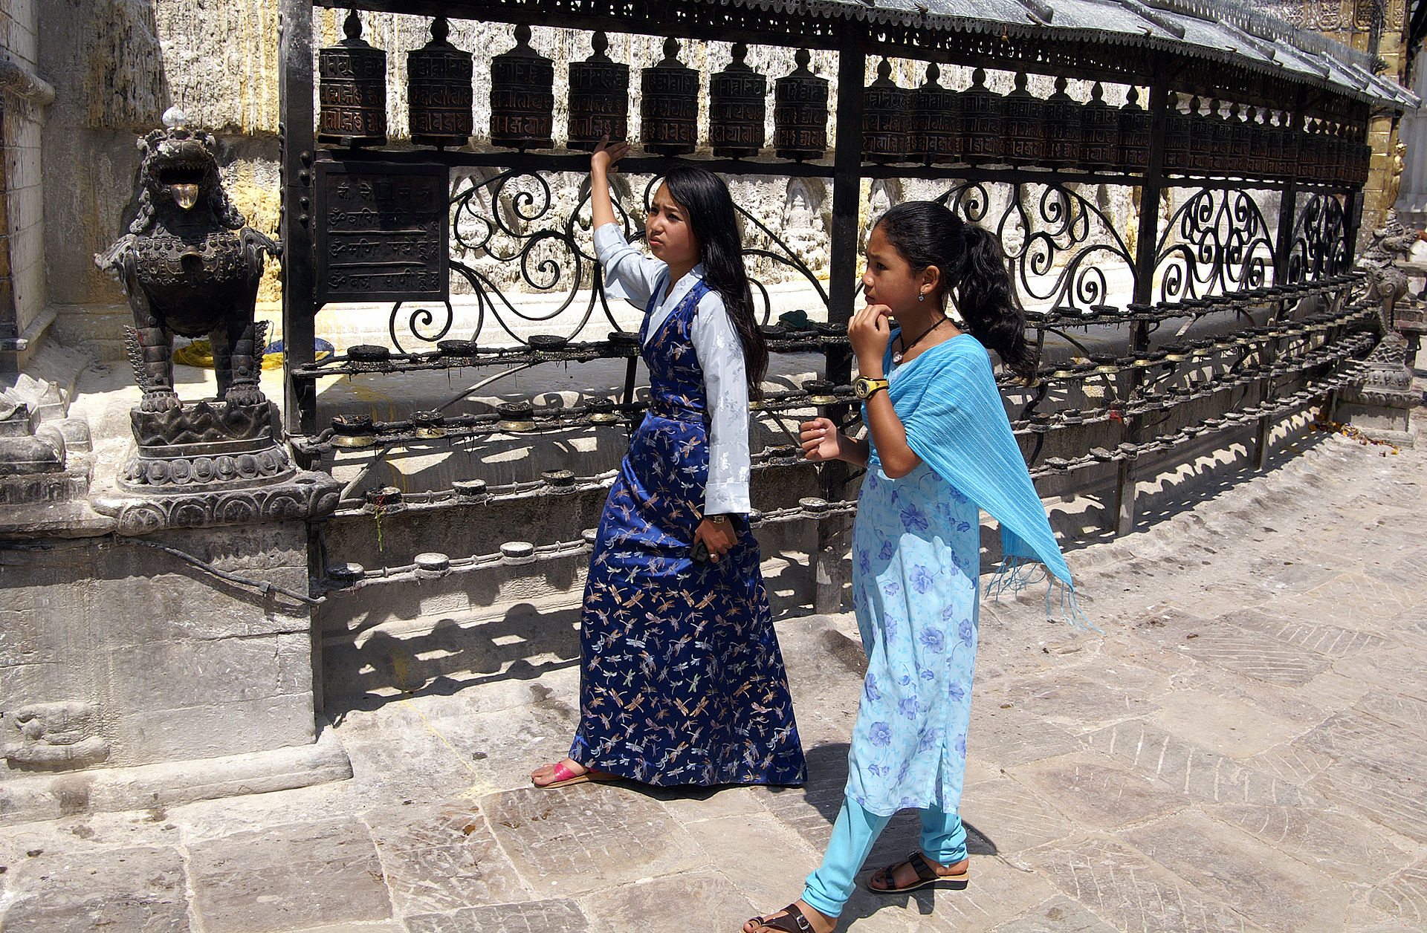
Buddhism Accepts Prayer Wheels
The original uploader was Pjottermans at English Wikipedia. - Transferred from en.wikipedia to Commons., CC BY-SA 2.5, https://commons.wikimedia.org/w/index.php?curid=32527826

Slide 17
Dangers of Repetitions
It is easy for us to allow our prayers to become vain repetitions full of familiar clichés, easily repeated without thinking about their meanings.
Can you think of a few “church of Christ” clichés?
If God does not want vain repetitions, what does He want our prayers to be?
What warning is given in “for they think that they will be heard for their many words”?

Slide 18
Davies and Allison on Prayer
“So prayer, the purpose of which is not to exercise the tongue, does not inform or remind God of anything; it is instead worship, and it serves to cleanse the mind, purify the heart, and align one’s will with God’s will (cf. 6:10); it recalls to the suppliant who God is and what his purposes are. Compare Chrysostom, Hom. on Mt. 19:5: ‘Wherefore must we pray? Not to instruct Him, but to prevail with Him; to be made intimate with Him, by continuance in supplication; to be humbled; to be reminded of thy sins’” (Commentary on Matthew, 1:590).

Slide 19
Matthew 6:8
“Therefore do not be like them. For your Father knows the things you have need of before you ask Him.”
John Noland: “God is way ahead of you; he is already fully aware of your needs (and deeply committed to caring for you in respect of them). The reference to God as ‘your Father’ sets prayer into the context of God’s existing paternal commitment. Jewish piety was well aware of the omniscience of God, but it did not often play as comforting a role as here” (The Gospel of Matthew: A Commentary on the Greek Text, 285).
Leon Morris: “Before they (i.e., His children) offer any prayer, he knows exactly what their need is. They pray, not to inform the Father on matters of which he is ignorant, but to worship him” (The Gospel according to Matthew, 142).
“It shall come to pass That before they call, I will answer; And while they are still speaking, I will hear” (Isa. 65:24).

Slide 20
The Lord’s Prayer
“In this manner, therefore, pray:
Our Father in heaven,
Hallowed be Your name.
Your kingdom come.
Your will be done
On earth as it is in heaven.
Give us this day our daily bread.
And forgive us our debts,
As we forgive our debtors.
And do not lead us into temptation,
But deliver us from the evil one.
For Yours is the kingdom and the power and the glory forever. Amen” (Matt. 6:9-13).
Number of words: 66 (not counting the five introductory words)

Slide 21
The Lord’s Prayer?
“The Lord’s Prayer” more nearly fits what Jesus prayed in John 17 and in the Garden of Gethsemane (Matt. 26:39, 42).
This might be more appropriately labeled “The Lord’s Model Prayer.”
Matthew 6:7 demonstrates that Jesus did not intend for this prayer to be used as memorized words that His disciples mechanically repeat.
The differences in wording between Luke’s account of the prayer (Luke 11:2-4) and Matthew’s indicates that in Jesus’s preaching on prayer, He did not use precisely the same words each time He taught on the subject, anymore than I use the same exact words should I preach the same sermon in two places.
Rather, they give us an example of the kinds of things for which we should pray in our own devotional life.
This is also confirmed by “In this manner, therefore, pray.”

Slide 22
1. Our Father in Heaven
The word “Father” is an intimate term for God, implying His relationship with His spiritual children.
We should think of God as accessible as the most loving parent.
Until one has made a decision to become a child of God, he has no basis for addressing God as his Father.
Jesus spoke to the Jews rather bluntly: “But now you seek to kill Me, a Man who has told you the truth which I heard from God. Abraham did not do this. You do the deeds of your father.” “Then they said to Him, ‘We were not born of fornication; we have one Father—God.’ Jesus said to them, ‘If God were your Father, you would love Me, for I proceeded forth and came from God; nor have I come of Myself, but He sent Me’” (John 8:40-42).
Do non-Christians have the relationship presupposed when one addresses God as “our Father in heaven”?
It is only through the work of Jesus that we can approach God as “Our Father.”
The addition of “in heaven” emphasizes His infinite greatness.

Slide 23
2. Hallowed Be Your Name
Hallowed (hagiazō): “to treat as holy, reverence” (BDAG, 10); “to feel reverence for or to honor as holy—‘to hallow, to regard as holy, to honor as holy’” (Louw-Nida, 88.27).
“You shall not take the name of the Lord your God in vain, for the Lord will not hold him guiltless who takes His name in vain” (Exod. 20:7).
R. T. France: “the synagogue prayer known as the Qaddish: ‘Exalted and hallowed be his great name in the world which he created according to his will. May he let his kingdom rule in your lifetime … speedily and soon’” (Matthew: An Introduction and Commentary, 138).
“Hallowed be Your name” is a petition we ask of God. It should be our prayer that God’s name be held in reverence in our homes and throughout our society.

Slide 24
3. Your Kingdom Come
This passage must be placed in the context of Matthew’s gospel:
John the Baptist preached, “Repent, for the kingdom of heaven is at hand!” (Matt. 3:2).
Matthew adds, “From that time Jesus began to preach and to say, ‘Repent, for the kingdom of heaven is at hand’” (Matt. 4:17).
The preaching that the kingdom was near was “good news” (Matt. 4:23; 9:35).
The Twelve were sent out to preach that the kingdom was at hand (Matt. 10:7).
The Son of man would come in his kingdom within their lifetime (Matt. 16:28).

Slide 25
Kingdom Coming Is the Church
“And I also say to you that you are Peter, and on this rock I will build My church, and the gates of Hades shall not prevail against it. And I will give you the keys of the kingdom of heaven, and whatever you bind on earth will be bound in heaven, and whatever you loose on earth will be loosed in heaven” (Matt. 16:18-19).

Slide 26
The Kingdom Was Established on Pentecost
Philip preached to the Samaritans the kingdom of God (Acts 8:12).
Paul preached the things concerning the kingdom to the Jews in Ephesus (Acts 19:8).
“. . . giving thanks to the Father who has qualified us to be partakers of the inheritance of the saints in the light. He has delivered us from the power of darkness and conveyed us into the kingdom of the Son of His love, in whom we have redemption through His blood, the forgiveness of sins” (Col. 1:12-14).
One born of water and the Spirit could become a citizen of the kingdom (John 3:3, 5).
John was “in the kingdom” (Rev. 1:9).
To the Hebrews, the author wrote: “Therefore, since we are receiving a kingdom which cannot be shaken, let us have grace, by which we may serve God acceptably with reverence and godly fear” (Heb. 12:28).

Slide 27
God’s Kingdom Has Come
The word “kingdom” is used of both the earthly kingdom of Christ (the church) and the heavenly kingdom which is received when Jesus’s second coming occurs (Matt. 5:3, 10, 20; 7:21; 8:11-12; 25:34; 2 Pet. 1:11).
It would be inappropriate for one to pray for the earthly kingdom/ church to come since it has already been in existence for two millennium.
Like the promise that Israel would inherit Canaan, the promise of the establishment of God’s kingdom/church was a subject of divine prophecy which men anxiously anticipated with the coming of the Messiah.
It would be appropriate to pray for the church which already has come to prosper and grow.
It is appropriate to pray for the eternal kingdom to come: “If anyone does not love the Lord Jesus Christ, let him be accursed. O Lord, come!” (1 Cor. 16:22).

Slide 28
4. Your Will Be Done
The prayer that God’s will be done in one’s own life is one of the most stringent prayers one can pray:
“Your will be done on earth” translates into “Your will be done in my own life.” What God wants takes precedence over what I want to do!
“He went a little farther and fell on His face, and prayed, saying, ‘O My Father, if it is possible, let this cup pass from Me; nevertheless, not as I will, but as You will’” (Matt. 26:39).
I saw this principle of commitment to the will of God lived out before my own eyes as a child when one of my favorite cousins unexpectedly came to visit us at 3 pm on Sunday. We had to leave for church at 5:15 pm for evening worship. I still remember what Mom said, “Here is the pantry, so you feel free to cook anything in there that you want. It is time for us to go to church for Sunday evening services. We will see you when we get back.” They proceeded to load the family in the car and leave my cousins by themselves in the house while we went to church!

Slide 29
Learning to Submit to God’s Will
It should be one’s constant prayer that God’s will be done.
One’s personal plans and desires should be subordinated to the will of God.
“Instead you ought to say, ‘If the Lord wills, we shall live and do this or that’” (James 4:15).
“. . .but took leave of them, saying, ‘I must by all means keep this coming feast in Jerusalem; but I will return again to you, God willing.’ And he sailed from Ephesus” (Acts 18:21).
“But I will come to you shortly, if the Lord wills, and I will know, not the word of those who are puffed up, but the power” (1 Cor. 4:19).
“For I do not wish to see you now on the way; but I hope to stay a while with you, if the Lord permits” (1 Cor. 16:7).
“And this we will do if God permits” (Heb. 6:3).

Slide 30
Praying and Doing
How can I pray that the Lord’s will be done on earth as it is in heaven, and put my desires before what the Lord commands me to do?
“But seek first the kingdom of God and His righteousness, and all these things shall be added to you” (Matt. 6:33).
“Now it happened as they journeyed on the road, that someone said to Him, ‘Lord, I will follow You wherever You go.’ And Jesus said to him, ‘Foxes have holes and birds of the air have nests, but the Son of Man has nowhere to lay His head.’ Then He said to another, ‘Follow Me.’ But he said, ‘Lord, let me first go and bury my father.’ Jesus said to him, ‘Let the dead bury their own dead, but you go and preach the kingdom of God.’ And another also said, ‘Lord, I will follow You, but let me first go and bid them farewell who are at my house.’ But Jesus said to him, ‘No one, having put his hand to the plow, and looking back, is fit for the kingdom of God’” (Luke 9:57-62).
“If anyone comes to Me and does not hate his father and mother, wife and children, brothers and sisters, yes, and his own life also, he cannot be My disciple” (Luke 14:26).
Where does God will that I should be when the church assembles?

Slide 31
5. On Earth As It Is In Heaven
Heaven is presented in Scripture as the place where God’s will is uncontested, and humbly executed by His obedience attendants.
Our prayer should be that God’s will be done on earth in the same way.
Jonah found God’s will for his life distasteful, so instead of heading to Nineveh, he fled to Tarshish.
In the belly of a large fish, he determined that doing God’s will was best.
After God ordered the fish to vomit him out on dry land, Jonah went and preached to Nineveh, as God intended: “Yet forty days, and Nineveh shall be overthrown.”
But Jonah’s will was not submissive to God’s will. When Nineveh repented and God relented on His determination to punish them, Jonah went outside the city to watch what God would do to the city. He was angry that God did not punish Nineveh.

Slide 32
Are We Like Jonah?
Ananias was sent to teach Saul of Tarsus what to do for salvation: “So the Lord said to him, ‘Arise and go to the street called Straight, and inquire at the house of Judas for one called Saul of Tarsus, for behold, he is praying’” (Acts 9:11).
“Then Ananias answered, ‘Lord, I have heard from many about this man, how much harm he has done to Your saints in Jerusalem’” (Acts 9:13).
One can never persuade others to put God’s will as his top priority in their lives, so long as he does not make it first in his own life!

Slide 33
When Christ is the center of one’s life, all of life is balanced!
The Church
Home
Christ
Community
Recreation
Work

Slide 34
When “you” are the center of life, life becomes unbalanced and Christ and His church are rooted out!
The Church
Home
Community
You
Recreation
Work

Slide 35
6. Give Us This Day Our Daily Bread
This is one of three petitions for which the disciples ought to pray.
Bread is used in this context for the material things that we need for our well being, including food, clothing, and shelter.
John Nolland: “The need for daily bread likely stands for all the recurring basic (material?) needs of humanity” (The Gospel of Matthew: A Commentary on the Greek Text, 290).
Daily (epiousion): Three possible meanings have been suggested:
Necessary for our existence
For the current day
For the following (next) day (BDAG, 376).

Slide 36
God’s Provisions of Manna
The prayer may be based on the Lord’s provision of manna to sustain the Israelites in the wilderness.
“So when the children of Israel saw it, they said to one another, ‘What is it?’ For they did not know what it was. And Moses said to them, ‘This is the bread which the Lord has given you to eat. This is the thing which the Lord has commanded: “Let every man gather it according to each one’s need, one omer for each person, according to the number of persons; let every man take for those who are in his tent.”’ Then the children of Israel did so and gathered, some more, some less. So when they measured it by omers, he who gathered much had nothing left over, and he who gathered little had no lack. Every man had gathered according to each one’s need. And Moses said, ‘Let no one leave any of it till morning’” (Exod. 16:15-19).

Slide 37
The Lesson from the Manna
“So He humbled you, allowed you to hunger, and fed you with manna which you did not know nor did your fathers know, that He might make you know that man shall not live by bread alone; but man lives by every word that proceeds from the mouth of the Lord” (Deut. 8:3).
Leon Morris: “The prayer encourages a continuing dependence on God; it does not countenance a situation in which the disciple asks God for a supply for a lengthy period, after which prayer he can go on for some time in forgetfulness of God. He depends on God constantly, and this dependence is expressed in this prayer” (The Gospel according to Matthew, 147).

Slide 38
Think of How Dependent We Are
God controls nature (sunshine, rain, violent storms, etc.)
God controls the nations (warfare, our civil liberties, etc.)
The nations in turn control economic policies which enable prosperity or cause inflation, depression, companies moving to more prosperous economies and leaving employment disasters, etc.
Rejection of God leads to moral decay, depravity, and violence, which we as individuals are helpless to change
Considering our utter dependence upon God should motivate us to pray more fervently

Slide 39
7. Forgive Us Our Debts
Debt (opeilēma): “that which is owed in a financial sense, debt, one’s due; obligation in a moral sense, debt=sin” (BDAG, 743).
Forgive (aphiēmi): the word has a broad usage of dismissing one from one’s presence, letting go or sending away, including divorcing a wife. In this context it bears the meaning of “to release from legal or moral obligation or consequence, cancel, remit, pardon . . . forgive sin” (BDAG, 156).
Our prayer for the Lord to forgive our sins, acknowledges sinfulness, and dependency upon the grace and mercy of the Lord for our own forgiveness.

Slide 40
Luke 18:9-14
“Also He spoke this parable to some who trusted in themselves that they were righteous, and despised others: ‘Two men went up to the temple to pray, one a Pharisee and the other a tax collector. The Pharisee stood and prayed thus with himself, “God, I thank You that I am not like other men—extortioners, unjust, adulterers, or even as this tax collector. I fast twice a week; I give tithes of all that I possess.” And the tax collector, standing afar off, would not so much as raise his eyes to heaven, but beat his breast, saying, “God, be merciful to me a sinner!” I tell you, this man went down to his house justified rather than the other; for everyone who exalts himself will be humbled, and he who humbles himself will be exalted.’”

Slide 41
As We Forgive Others
This portion of the prayer for forgiveness reminds the sinner of his own responsibility to be God-like in forgiving others of their sins.
Jesus gave a parable in Matthew 18:21-35, in which He again compared sin to a debt, to show that one’s own forgiveness is dependent upon his willingness to forgive those who sin against him.
One unwilling to forgive those who sin against him jeopardizes his own forgiveness.
One must be willing to forgive the debtor, even if the debt can never be repaid, as is one’s own predicament before God.
One must be careful not to have an attitude toward those who sin against him that says, “I will never forgive you!”

Slide 42
The Christian’s Obligation
Be active in seeking forgiveness of those against whom we have sinned: “Therefore if you bring your gift to the altar, and there remember that your brother has something against you, leave your gift there before the altar, and go your way. First be reconciled to your brother, and then come and offer your gift” (Matt. 5:23-24).
Be active in seeking reconciliation with those who have sinned against you: “Moreover if your brother sins against you, go and tell him his fault between you and him alone. If he hears you, you have gained your brother. But if he will not hear, take with you one or two more, that ‘by the mouth of two or three witnesses every word may be established.’ And if he refuses to hear them, tell it to the church. But if he refuses even to hear the church, let him be to you like a heathen and a tax collector” (Matt. 18:15-17).
Not everyone who is confronted with his sin will show a penitent heart.
With reference to the impenitent, we must not allow our hearts to brood over these offenses and allow it to be poisoned with bitterness, taking vengeance, or show other sinful attitudes. This is the time to “let go” and “let God” handle the matter.

Slide 43
8. Lead Us Not Into Temptation
Lead (eispherō): “to cause someone to enter into a certain event or condition, bring in” (BDAG, 295).
Matthew has already recorded the temptations of Jesus, introduced by this verse: “Then Jesus was led up by the Spirit into the wilderness to be tempted by the devil” (4:1).
It is not God’s will that men sin and James tells us that God does not “tempt” anyone: “Let no one say when he is tempted, ‘I am tempted by God’; for God cannot be tempted by evil, nor does He Himself tempt anyone. But each one is tempted when he is drawn away by his own desires and enticed. Then, when desire has conceived, it gives birth to sin; and sin, when it is full-grown, brings forth death” (James 1:13-15).
God allows men to be tested, such as Job, but He does not tempt anyone to sin.
“. . . then the Lord knows how to deliver the godly out of temptations and to reserve the unjust under punishment for the day of judgment” (2 Pet. 2:9)

Slide 44
God’s Care for His Own
“No temptation has overtaken you except such as is common to man; but God is faithful, who will not allow you to be tempted beyond what you are able, but with the temptation will also make the way of escape, that you may be able to bear it” (1 Cor. 10:13).
“Now to Him who is able to keep you from stumbling, And to present you faultless Before the presence of His glory with exceeding joy” (Jude 24).
“Therefore let those who suffer according to the will of God commit their souls to Him in doing good, as to a faithful Creator” (1 Pet. 4:19).

Slide 45
Psalm 121
I will lift up my eyes to the hills—
From whence comes my help?
My help comes from the Lord,
Who made heaven and earth.
He will not allow your foot to be moved;
He who keeps you will not slumber.
Behold, He who keeps Israel
Shall neither slumber nor sleep.
The Lord is your keeper;
The Lord is your shade at your right hand.
The sun shall not strike you by day,
Nor the moon by night.
The Lord shall preserve you from all evil;
He shall preserve your soul.
The Lord shall preserve your going out and your coming in
From this time forth, and even forevermore.

Slide 46
Temptation
The word peirasmos means “an attempt to make one do something wrong, temptation, enticement to sin; . . . to entice to improper behavior, tempt” (BDAG, 793).
There are places one can go, things one can do, and people with whom one can be that one knows will provide an inducement to sin.
There are times when temptations appear without one seeking them out: “Then it happened one evening that David arose from his bed and walked on the roof of the king's house. And from the roof he saw a woman bathing, and the woman was very beautiful to behold” (2 Sam. 11:2).
The prayer is that God’s providence will direct our lives so that we are not placed in those circumstances. How can one pray this prayer and intentionally put himself into circumstances where he knows he will be tempted?

Slide 47
9. Deliver Us from the Evil One
The Greek construction tou ponērou can be translated either “evil” or “the evil one” (Satan).
Either translation stresses the vulnerability of the disciples to sin and their consequent dependence upon God for avoiding sin.
Because the Holy Spirit led Jesus into the wilderness to be tempted by the devil and God does not tempt anyone with evil, some understand the prayer to be “don’t let us succumb to temptation” or “don’t abandon us to temptation” (Blomberg, 120).
Craig Blomberg: “If we are praying for rescue from the devil, he is more likely tempting than testing us (cf. under 4:1). God tests us in order to prove us and bring us to maturity (Jas 1:2–4; 1 Pet 1:6–9). Such tests should not be feared, nor should we pray for God to withhold them” (Matthew, 120).

Slide 48
Prayer for Deliverance from Evil
There are many kinds of evil from which we need protection.
I pray for protection from temptations to sin which jeopardize my soul, as described in previous charts. However, . . .
Were I living in Kyiv, Ukraine today, I would be praying for God to protect my family from the evils of the war that is going on
Were I being tested for cancer, I would be praying for God to deliver me from that dreaded disease
Were I in the middle of an earthquake, I would be praying for God to deliver me
Were I caught in the crossfire of street violence, I would be praying for God to deliver me

Slide 49
Doxology
For Yours is the kingdom and the power and the glory forever. Amen.
Roger L. Omanson and Bruce Manning Metzger: “Early and important manuscripts of the Alexandrian, Western, and other types of text, as well as commentaries on the Lord’s Prayer by early Church Fathers, end the Lord’s Prayer with the word πονηροῦ in v. 13. Copyists added several different endings in order to adapt the Prayer for use in worship in the early church. Additions include the following: (a) “for yours is the kingdom, and the power, and the glory forever. Amen” (so Seg); (b) “for yours is the kingdom and the glory forever. Amen”; and (c) “for yours is the kingdom and the power and the glory of the Father and of the Son and of the Holy Spirit forever. Amen” (A Textual Guide to the Greek New Testament: An Adaptation of Bruce M. Metzger’s Textual Commentary for the Needs of Translators, 8).
If it is an addition, it was a very early one as shown by the fact that the Didache (The Teaching), written late in the first century or early second century, includes it.

Slide 50
The Doxology
Acknowledges that to God. . .
Belongs the kingdom
Belongs the power (Lord God Almighty)
Belongs the glory (that which He has and should receive from all creation)
Amen: “attests the praise of God in response to a doxology” (TDNT, 1:336). It asserts “that which is sure and valid.”

Slide 51
Matthew 6:14-15
“For if you forgive men their trespasses, your heavenly Father will also forgive you. But if you do not forgive men their trespasses, neither will your Father forgive your trespasses.”
These verses are a repeat of what was said in the Lord’s model prayer (v. 12).
Leon Morris: “Jesus is saying that to fail to forgive others is to demonstrate that one has not felt the saving touch of God” (The Gospel according to Matthew, 149).
Note Jesus’s use of your heavenly Father . . . your Father.
Sin is here called a paraptōma, “in imagery of one making a false step so as to lose footing: a violation of moral standards, offense, wrongdoing, sin” (BDAG, 770).

Slide 52
3. Fasting (6:16-18)
“Moreover, when you fast, do not be like the hypocrites, with a sad countenance. For they disfigure their faces that they may appear to men to be fasting. Assuredly, I say to you, they have their reward. But you, when you fast, anoint your head and wash your face, so that you do not appear to men to be fasting, but to your Father who is in the secret place; and your Father who sees in secret will reward you openly.”

Slide 53
Fasting
Have you ever fasted as an act of religious devotion?
How often?
How well does fasting fit the American religious culture?

Slide 54
Old Testament Fasting
Only one day of fasting was commanded by the Law: on the day of atonement, a once a year event.
“This shall be a statute forever for you: In the seventh month, on the tenth day of the month, you shall afflict your souls, and do no work at all, whether a native of your own country or a stranger who dwells among you” (Lev. 16:29).
“It is a sabbath of solemn rest for you, and you shall afflict your souls. It is a statute forever” (Lev. 16:31).
“Also the tenth day of this seventh month shall be the Day of Atonement. It shall be a holy convocation for you; you shall afflict your souls, and offer an offering made by fire to the Lord” (Lev. 23:27).
“It shall be to you a sabbath of solemn rest, and you shall afflict your souls; on the ninth day of the month at evening, from evening to evening, you shall celebrate your sabbath” (Lev. 23:32).
“‘On the tenth day of this seventh month you shall have a holy convocation. You shall afflict your souls; you shall not do any work” (Num. 29:7).

Slide 55
Spontaneous Fasting
Saul commanded his troops to fast in a battle against the Philistines (1 Sam. 14:24).
David fasted in hopes that the Lord would change His mind and allow to live the baby to whom Bathsheba had given birth as a result of their adultery (2 Sam. 12:16).
During the post-exilic period, the number of fasts increased (Ezra 8:21-23; Neh. 9:1; Esth. 4:16).
By New Testament times, the Pharisees were fasting two days a week (Mondays and Thursdays) (Luke 18:12).

Slide 56
Jesus and Fasting
Jesus fasted forty days during His temptation (Matt. 4:2).
Jesus’s practice differed from that of both the Pharisees and the disciples of John the Baptist (Mark 2:18-22).
“. . . that Jesus distances himself here from the pious practice of fasting, which was as widely esteemed in 1st-century Judaism as it continued to be in early Christianity, is highly distinctive” (John Muddiman, “Fast, Fasting,” The Anchor Yale Bible Dictionary, 2:776).

Slide 57
Fasting in the Early Church
Fasting was sometimes associated with fervent prayer (Acts 10:30-31; 13:2-3; 14:23).
On several occasions when “fasting” is mentioned in the NT, it is poorly supported in the manuscripts that exist (e.g., Acts 10:30-31; 1 Cor. 7:5).
“The Church in the NT period did not reject the pious Jewish practice of fasting. But it had not yet formalized its own discipline, considering it a matter of individual conscience” (John Muddiman, “Fast, Fasting,” The Anchor Yale Bible Dictionary, 2:775).
To my trained eye (☺), it appears obvious that fasting is not regularly practiced by many twenty-first century Christians in America!

Slide 58
Matthew 6:16
“Moreover, when you fast, do not be like the hypocrites, with a sad countenance. For they disfigure their faces that they may appear to men to be fasting. Assuredly, I say to you, they have their reward.”
Disfigure (aphanizō): “1. to cause something to disappear. . . . 2. to cause to become unrecognizable through change in appearance, render invisible/unrecognizable” (BDAG, 154); “to cause something to be unattractive or unsightly—‘to make unsightly, to disfigure, to make ugly.’ ἀφανίζουσιν γὰρ τὰ πρόσωπα αὐτῶν ‘for they make their faces unsightly’” (Johannes P. Louw and Eugene Albert Nida, Greek-English Lexicon of the New Testament: Based on Semantic Domains, 695).
The idea is that one should not draw attention to himself to advertise his deep spirituality.

Slide 59
Matthew 6:17-18
“But you, when you fast, anoint your head and wash your face, so that you do not appear to men to be fasting, but to your Father who is in the secret place; and your Father who sees in secret will reward you openly.”
Jesus’s concern is that one not practice his religion for the purpose of being seen of men, advertising to others how religious he is.
Leon Morris: “They were more interested in appearing to fast than in the actual fasting itself. Such people, Jesus says, have their reward (i.e., they have received in full all the reward they are going to get” (The Gospel according to Matthew, 150).
A distinction between the Jewish and any religious practice of Christians is demanded in prayer, almsgiving, and fasting—it must not be done for the purpose of being seen of men!

Slide 60
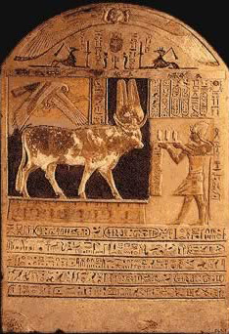
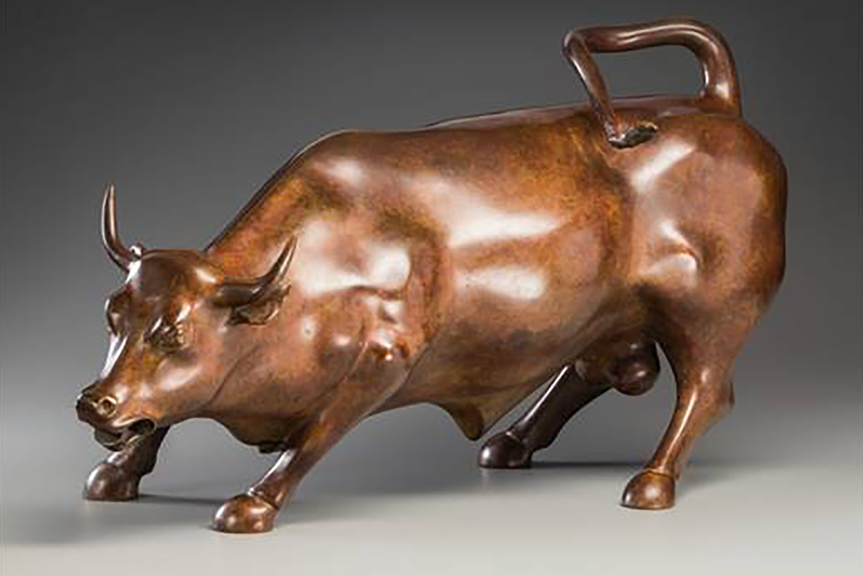
God and Mammon (6:19-34)
Egyptian worship of the Apis Bull
The Bull That Some Americans Worship: The Wall Street Bull

Slide 61
Matthew 6:19-34
Davies and Allison suggests dividing this section into the following four paragraphs:
6:19-21—Do not store up earthly treasures
6:22-23—Be generous
6:24—Serve God, not mammon
6:25-34—Do not be anxious

Slide 62
1. Do Not Store Up Earthly Treasures (6:19-21)
“Do not lay up for yourselves treasures on earth, where moth and rust destroy and where thieves break in and steal; but lay up for yourselves treasures in heaven, where neither moth nor rust destroys and where thieves do not break in and steal. For where your treasure is, there your heart will be also.”

Slide 63
Matthew 6:19
“Do not lay up for yourselves treasures on earth, where moth and rust destroy and where thieves break in and steal. . . .”
Treasure (thēsauros): the word is used first of “a place where something is kept for safekeeping, repository” and then of “that which is stored up, treasure” (BDAG, 456).
Lay up . . . treasures (thēsaurizō): “to keep some material thing safe by storing it, lay up, store up, gather, save something” (BDAG, 456).
Jesus calls attention to what people prize above all else. What one puts first in his life is what he treasures!
What two reasons does Jesus give for why one should not lay up treasures on earth?

Slide 64
James 5:2-3
“Your riches are corrupted, and your garments are moth-eaten. Your gold and silver are corroded, and their corrosion will be a witness against you and will eat your flesh like fire. You have heaped up treasure in the last days.”
James 5:2-3 is probably based on James hearing Jesus say these are very similar words.

Slide 65
Matthew 6:20
“. . . but lay up for yourselves treasures in heaven, where neither moth nor rust destroys and where thieves do not break in and steal.”
Craig Blomberg: “Spiritual treasure should be defined as broadly as possible—as everything that believers can take with them beyond the grave—e.g., holiness of character, obedience to all of God’s commandments, souls won for Christ, and disciples nurtured in the faith. In this context, however, storing up treasures focuses particularly on the compassionate use of material resources to meet others’ physical and spiritual needs, in keeping with the priorities of God’s kingdom (vv. 25–34; cf. Luke 16:8–13)” (Matthew, 123).
“Treasures in heaven” is contrasted also with “they have been paid in full” in vv. 1-18. Treasures in heaven are riches that will last forever!
The true value of any treasure (property) is “Location! Location! Location!”

Slide 66
Matthew 6:21
“For where your treasure is, there your heart will be also.”
What is Jesus saying in this verse?
Davies and Allison: “A heart or mind directed towards heaven, and therefore acting in accordance with heaven’s will, shall find its reward in heaven (cf. 5:8). In this way, one’s treasure tells the tale of one’s heart” (Commentary on Matthew, 1:632).
Leon Morris: “Jesus points out that the place we choose for our treasures tells something about ourselves. He does not describe treasure in any way, but clearly it means here that which one prizes most, that which one values above all else. The place where we choose to store up what we value most shows what our values are deep down” (The Gospel according to Matthew, 153).

Slide 67
2. Be Generous (6:22-23)
“The lamp of the body is the eye. If therefore your eye is good, your whole body will be full of light. But if your eye is bad, your whole body will be full of darkness. If therefore the light that is in you is darkness, how great is that darkness!”

Slide 68
The “Evil Eye”
“Beware lest there be a wicked thought in your heart, saying, ‘The seventh year, the year of release, is at hand,’ and your eye be evil against your poor brother and you give him nothing, and he cry out to the Lord against you, and it become sin among you” (Deut. 15:9).
“He who has a generous eye will be blessed, For he gives of his bread to the poor” (Prov. 22:9).
“A man with an evil eye hastens after riches, And does not consider that poverty will come upon him” (Prov. 28:22).
“‘Is it not lawful for me to do what I wish with my own things? Or is your eye evil because I am good?’” (Matt. 20:15).

Slide 69
Matthew 6:22
“The lamp of the body is the eye. If therefore your eye is good, your whole body will be full of light.”
Good (haplous): “pertaining to being motivated by singleness of purpose so as to be open and above-board, single, without guile, sincere, straightforward, i.e. without a hidden agenda” (BDAG, 104).
The “good” eye contrasts with the “evil eye” (6:23).
Remember verses 1-4, where Jesus condemned giving to be seen of men!
What is Jesus saying in this verse?

Slide 70
Matthew 6:23
“But if your eye is bad, your whole body will be full of darkness. If therefore the light that is in you is darkness, how great is that darkness!”
Bad (ponēros): the root meaning of this word is “to being morally or socially worthless, wicked, evil, bad, base, worthless, visious, degenerate.” It can be used to describe “being in an unhealthy condition physically” to describe a part of the body that is sick, in this case the eye (BDAG, 851-852).
What is Jesus saying in this verse?
R. T. France: “The body here represents the whole person, and if the idea of the lamp was of that which enables the body to find its way, the thought is of a purposeful life, directed towards its true goal. The alternative is a life in the dark, like a blind man, because the ‘evil eye’ of selfish materialism gives no light to show the way” (Matthew: An Introduction and Commentary, 143).

Slide 71
3. Serve God, Not Mammon (6:24)
“No one can serve two masters; for either he will hate the one and love the other, or else he will be loyal to the one and despise the other. You cannot serve God and mammon.”
What makes it impossible to serve two masters at the same time?
It is impossible to give first allegiance to two separate masters!
What happened when a slave wanted to go fishing, but the master wanted him to pick cotton?
Service to God is not a part-time affair! His will must always take precedence over our own.
Craig Blomberg: “We try so hard to create heaven on earth and to throw in Christianity when convenient as another small addition to the so-called good life. Jesus proclaims that unless we are willing to serve him wholeheartedly in every area of life, but particularly with our material resources, we cannot claim to be serving him at all (cf. under 8:18–22)” (Matthew, 124).

Slide 72
4. Do Not Be Anxious (6:25-34)
“Therefore I say to you, do not worry about your life, what you will eat or what you will drink; nor about your body, what you will put on. Is not life more than food and the body more than clothing? Look at the birds of the air, for they neither sow nor reap nor gather into barns; yet your heavenly Father feeds them. Are you not of more value than they? Which of you by worrying can add one cubit to his stature? So why do you worry about clothing? Consider the lilies of the field, how they grow: they neither toil nor spin; and yet I say to you that even Solomon in all his glory was not arrayed like one of these. Now if God so clothes the grass of the field, which today is, and tomorrow is thrown into the oven, will He not much more clothe you, O you of little faith? Therefore do not worry, saying, ‘What shall we eat?’ or ‘What shall we drink?’ or ‘What shall we wear?’ For after all these things the Gentiles seek. For your heavenly Father knows that you need all these things. But seek first the kingdom of God and His righteousness, and all these things shall be added to you. Therefore do not worry about tomorrow, for tomorrow will worry about its own things. Sufficient for the day is its own trouble.”

Slide 73
Matthew 6:25
“Therefore I say to you, do not worry about your life, what you will eat or what you will drink; nor about your body, what you will put on. Is not life more than food and the body more than clothing?”
Therefore (oun): Do not ignore the link between vv. 19-24 and vv. 25-34. The point is that anxiety over the necessities of life is incompatible with life in the kingdom of God.
Leon Morris: “Jesus underlines the pointlessness of anxiety and the sound reasons for trusting the heavenly Father. There is more to life than food and clothing, so one’s attention should not be concentrated on them but should be focused elsewhere. As we read his words we must remember that he lived in a society where shortage of food was much more common than in modern Western states (despite the problems in their slum areas). Even so he sees the Father as active throughout his creation, caring even for birds and flowers; there is accordingly no reason for those who call him ‘Father’ to be anxious. God will surely meet all their real needs. Worry is pointless; trust is well based” (The Gospel according to Matthew, 156–157).

Slide 74
Matthew 6:25
“Therefore I say to you, do not worry about your life, what you will eat or what you will drink; nor about your body, what you will put on. Is not life more than food and the body more than clothing?”
Do not worry (merimnaō): the word appears 19 times in the NT, 7 times in Matthew (6:25, 37, 38, 31, 34 [2x]; 10:19) and 5 times in Luke (4 of them in the parallel verses to this passage). The word means “to be apprehensive, having anxiety, be anxious, be (unduly) concerned” (BDAG, 632).
Jesus is not teaching a person not to give thought and make provision for one’s physical needs.
“Go to the ant, you sluggard! Consider her ways and be wise, Which, having no captain, Overseer or ruler, Provides her supplies in the summer, And gathers her food in the harvest” (Prov. 6:6-8).
It is wise to make reasonable financial planning for one’s needs.

Slide 75
Anxiety
There are many things over which none of us has any control.
How will inflation affect my retirement savings? Will we have enough to provide for ourselves so that we will not be a burden to our children?
Will the Chinese, North Koreans, Iranians, and Russians form a coalition to invade the United States?
Will the housing market collapse and cause a depression?
Will there be enough rain for the grain crops to produce?
For first century people international politics were not as important as “what shall we eat?”, “what will you drink?”, and “what will we wear?”
We are so blessed in America that few of us even think about these essential daily needs.

Slide 76
Our Concerns
Statistics show that both those who live on the cusp of survival and those who live in fancy houses show anxiety.
One can understand why those who are concerned about the necessities of life worry.
However, the rich worry as well—about keeping the standards of living to which they have become accustomed.
Jesus replied to anxieties over food, clothing, and shelter, the very most basic needs for survival by saying, “Is not life more than food and the body more than clothing?”
Even the poorest would agree that life is more than these.
What is the significance of “I say to you” in Jesus’s lesson (6:25)?

Slide 77
Matthew 6:26
“Look at the birds of the air, for they neither sow nor reap nor gather into barns; yet your heavenly Father feeds them. Are you not of more value than they?”
Look (emblepō): “to give serious thought to something, look at, consider” (BDAG, 322-323).
What need does God provide for the birds of the field?
What does “they neither sow nor reap” mean in this context?
What should one learn about God from Jesus’s use of the birds of the air?
What is the significance of “your heavenly Father”?
What argument is Jesus making in this verse?
John Nolland: “Anxiety is wrong because it represents a failure to trust God as provider” (The Gospel of Matthew, 310).

Slide 78
Matthew 6:27
“Which of you by worrying can add one cubit to his stature?”
The word “cubit” is a unit of measure of about 18-21 inches in length.
Stature (hēlikian): “the period of time that one’s life continues, age, time of life, a. generally of time that is past”; the word is also used of “bodily stature” (BDAG, 435).
To add 18 inches to one’s height, is an extremely large amount; in this context, a “cubit” is obviously referring to a small amount.
Some think that adding 18 inches is an hyperbole—intentional exaggeration to make a point (cf. a camel going through the eye of a needle).
Sometimes a distance measurement is used for time: “Indeed, You have made my days as handbreadths, And my age is as nothing before You; Certainly every man at his best state is but vapor” (Psa. 39:5).
What is Jesus saying in this verse? Is He concerned about one’s height or length of life?
The point is simple: What does one accomplish by worrying?

Slide 79
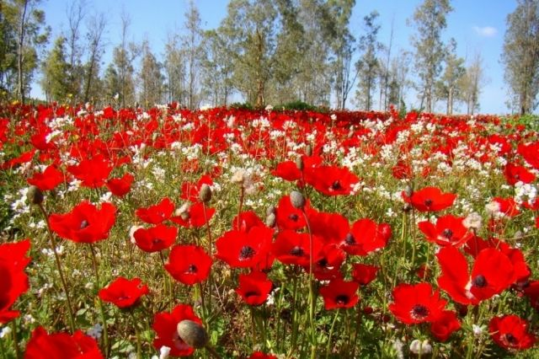
Matthew 6:28
“So why do you worry about clothing? Consider the lilies of the field, how they grow: they neither toil nor spin. . . .”

Slide 80
Lilies of the Field
The word lily (krinon) is not definite enough to specify which flower: “In this connection the principal opinions include the autumn crocus, Turk’s cap lily, anemone, or gladiolus, but the data do not permit certainty. Perh. Jesus had no definite flower in mind, but was thinking of all the wonderful blooms that adorn the fields of Galilee. As an extremely beautiful flower (as Theodor. Prodr. 6, 296 H.) it is mentioned Mt 6:28; Lk 12:27” (BDAG, 567).
The point is that the wild flowers do even less to provide for themselves than do the birds who flutter about to gather their own food and feed their nestlings. But the flowers do nothing!
The argument is from the less to the greater: If God provides for the wild flowers of the field which blossom throughout the year, how much more will He provide for those who are created in His own image?

Slide 81
“Consider”
The Greek word katamanthanō only occurs here in the New Testament and means “observe (well), notice, learn something” (BDAG, 522).
What are we to learn from considering the lilies of the field?

Slide 82
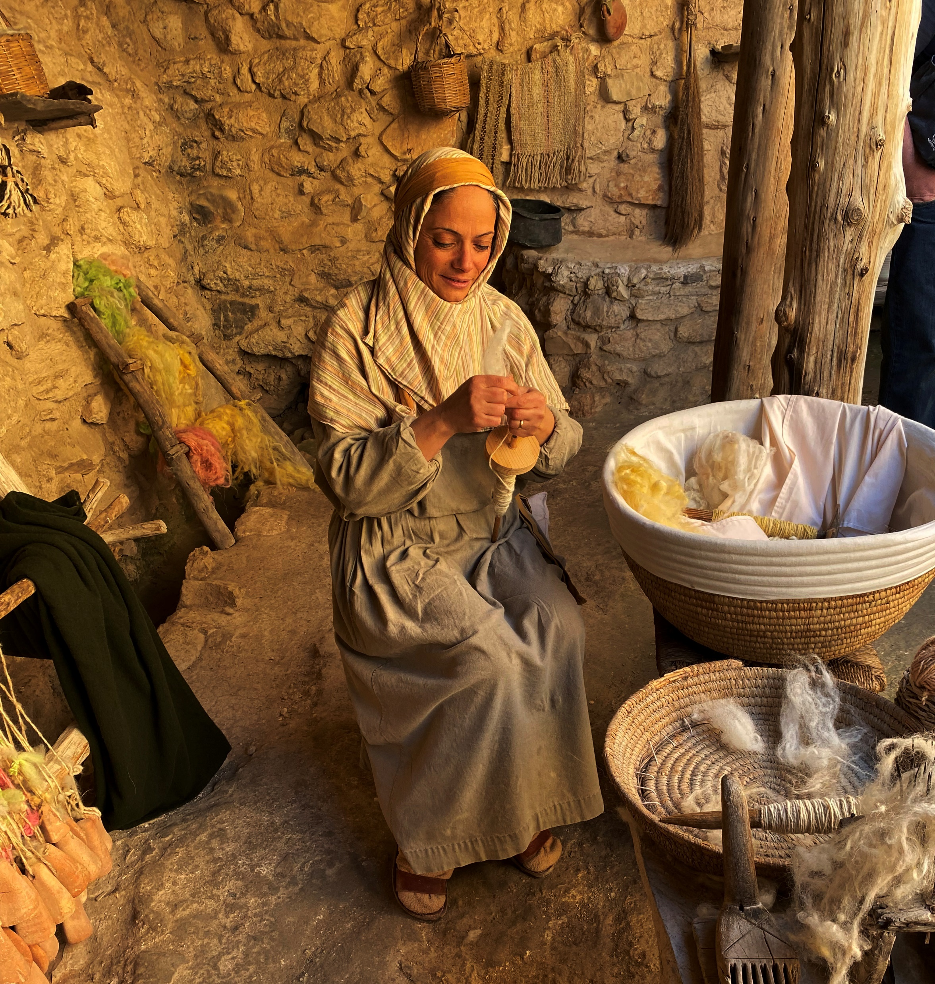
Those who produce fabrics must grow the plants (toil), spin the fibers into thread, use dyes to make them into different colored threads, and then weave them into pieces of cloth that can be sewn into beautiful garments.

Slide 83
Matthew 6:29
“. . .and yet I say to you that even Solomon in all his glory was not arrayed like one of these.” Why mention Solomon?
Prince William and his wife Kate Middleton

Slide 84
Matthew 6:30
“Now if God so clothes the grass of the field, which today is, and tomorrow is thrown into the oven, will He not much more clothe you, O you of little faith?”
Verse 30 makes the point of the argument: God provides for the wild vegetation that adorns His creation and will also provide for the clothing of those created in His own image.
This forbids anxiety about our own clothing!
What is the point of “which today is, and tomorrow is thrown into the oven”? Cf. vv. 11, 34!
What is the point of “grass of the field” vs. “you”?

Slide 85
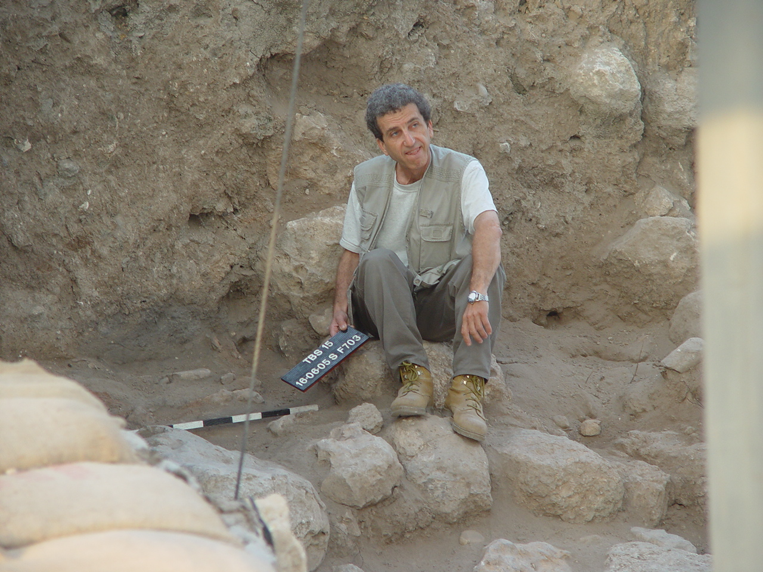
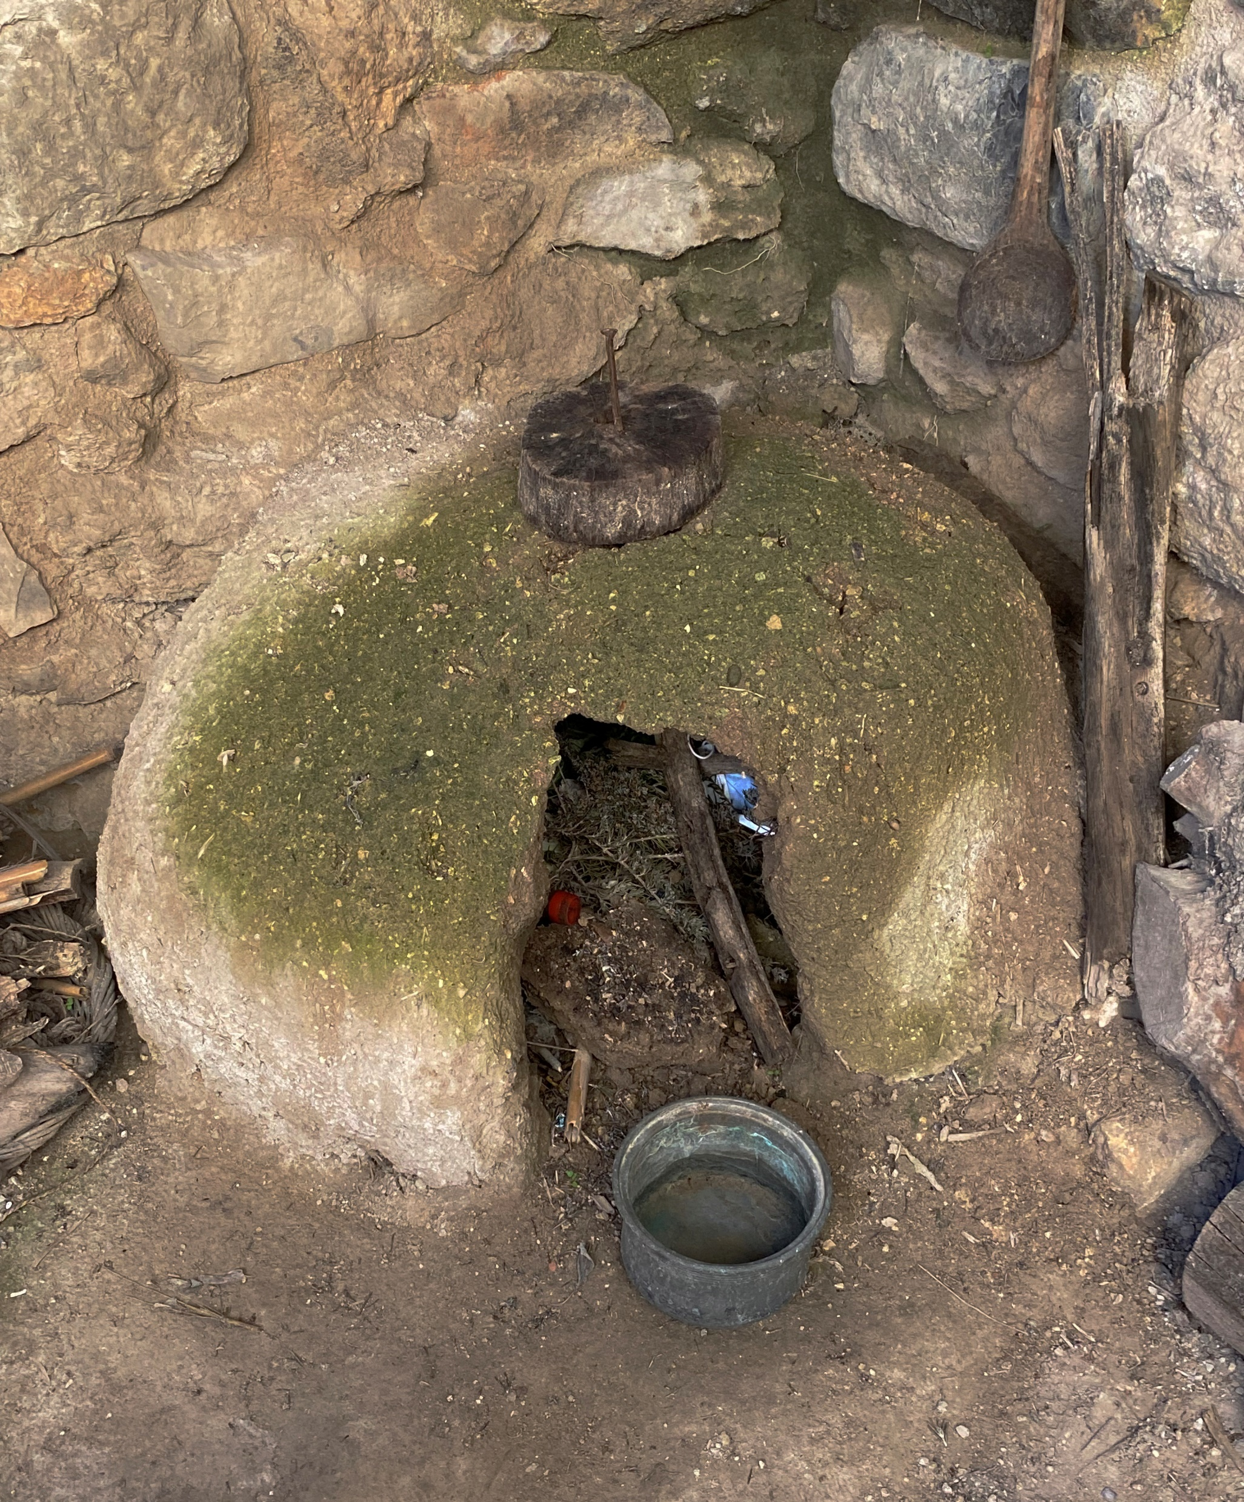
Ancient oven (Heb. taboon) Dead grass was used as fuel for an oven (Gr. klibanos).

Slide 86
“O, You of Little Faith”
Before calming the stormy sea: “But He said to them, ‘Why are you fearful, O you of little faith?’ Then He arose and rebuked the winds and the sea, and there was a great calm” (Matt. 8:26).
To Peter when he began to sink in the water walking toward Jesus: “And immediately Jesus stretched out His hand and caught him, and said to him, ‘O you of little faith, why did you doubt?’” (Matt. 14:31).
To the disciples before the feeding of the 4000: “But Jesus, being aware of it, said to them, ‘O you of little faith, why do you reason among yourselves because you have brought no bread?’” (Matt. 16:8).
Before healing the epileptic boy after His disciples had failed: “So Jesus said to them, ‘Because of your unbelief; for assuredly, I say to you, if you have faith as a mustard seed, you will say to this mountain, “Move from here to there,” and it will move; and nothing will be impossible for you’” (Matt. 17:20).
In these passages, is Jesus speaking to disciples or outsiders?

Slide 87
Worry
Worry does not accomplish anything. It may cause us to die early but it will not cause us to live longer!
Craig L. Blomberg: “If the logic of his argument be granted, then worry can only result from a lack of genuine belief in God’s goodness and mercy. R. Mounce says, ‘Worry is practical atheism and an affront to God.’ Anxiety characterized pagan religions, which were dominated by fears of a capricious and despotic deity who constantly had to be appeased. In its modern, irreligious garb, pagan anxiety displays a great preoccupation with physical exercise and diet without a corresponding concern for spiritual growth and nutrition” (Matthew, The New American Commentary, 126).

Slide 88
Matthew 6:31-32
“Therefore do not worry, saying, ‘What shall we eat?’ or ‘What shall we drink?’ or ‘What shall we wear?’ For after all these things the Gentiles seek. For your heavenly Father knows that you need all these things.”
Therefore: Since God takes care of the lower orders of creation, how much more will He care for those created in His image.
Do not worry is in the imperative mood. What is the significance of this?
What three things did He command that we not worry about?
Why is fretting and worrying more appropriate for the Gentiles?
Why should Christians not worry about these things?

Slide 89
Why Gentiles Worry
Leon Morris: “Such people cannot claim to be members of the heavenly family, and it is not surprising, accordingly, that they should be anxious and ask questions like these. As they see it, they must seek the supply of these necessities by their own efforts and out of their own resources. Anxiety is natural for them. But worry should not characterize God’s children. The second for goes on to introduce the reason the disciples should not ask such questions. They have a heavenly Father, and that Father knows all their needs. Since God knows them all, there is not the slightest reason for anxiety” (The Gospel according to Matthew, 161).
What did Jesus say about those things which we desire beyond our needs?

Slide 90
Matthew 6:33
“But seek first the kingdom of God and His righteousness, and all these things shall be added to you.”
This is a positive statement of one’s obligation (vs. “do not worry”).
What is the significance of the word “first” in this verse?
Leon Morris: “The kingdom is not one of many competing aims for the disciples, but that which comes first of all!” (161).
What life decisions does seeking first the kingdom of God affect?
What is God’s righteousness?
As in Matt. 5:6, 10, 20, “righteousness” means “the kind of life which God requires in the present age” (France, 146).
What is included in “all these things” that will be added to you?

Slide 91
Matthew 6:34
“Therefore do not worry about tomorrow, for tomorrow will worry about its own things. Sufficient for the day is its own trouble.”
What is Jesus saying in this verse?
Leon Morris: “Tomorrow will be anxious about itself does not mean that, while we must not worry today, tomorrow we may do so. It is a forceful way of saying that worry must always be deferred. Tomorrow’s worry is only in the sense ‘tomorrow never comes’; if worry is confined to tomorrow we are free, for it is always today. And Jesus finishes this part of his subject with the reminder that each day has sufficient trouble to keep us occupied; there is no point in anticipating tomorrow’s quota of trouble today. ‘Today’s trouble is enough for today’ (NRSV). This, of course, is a counsel that defeats worry. We are rarely anxious for today; it is the future that bothers us. If we restrict our concern to today, we defeat anxiety. The plain statement that there is trouble each day, however, is important. A shallow thinker might gather from the previous words about trust that the believer will have a smooth path through life. That is not what Jesus is saying. All people have trouble, believers among them. But he is making it clear that there is all the difference in the world between facing the problems we will certainly meet with firm faith in our heavenly Father and facing them with anxiety” (162-163).

