Slide 2
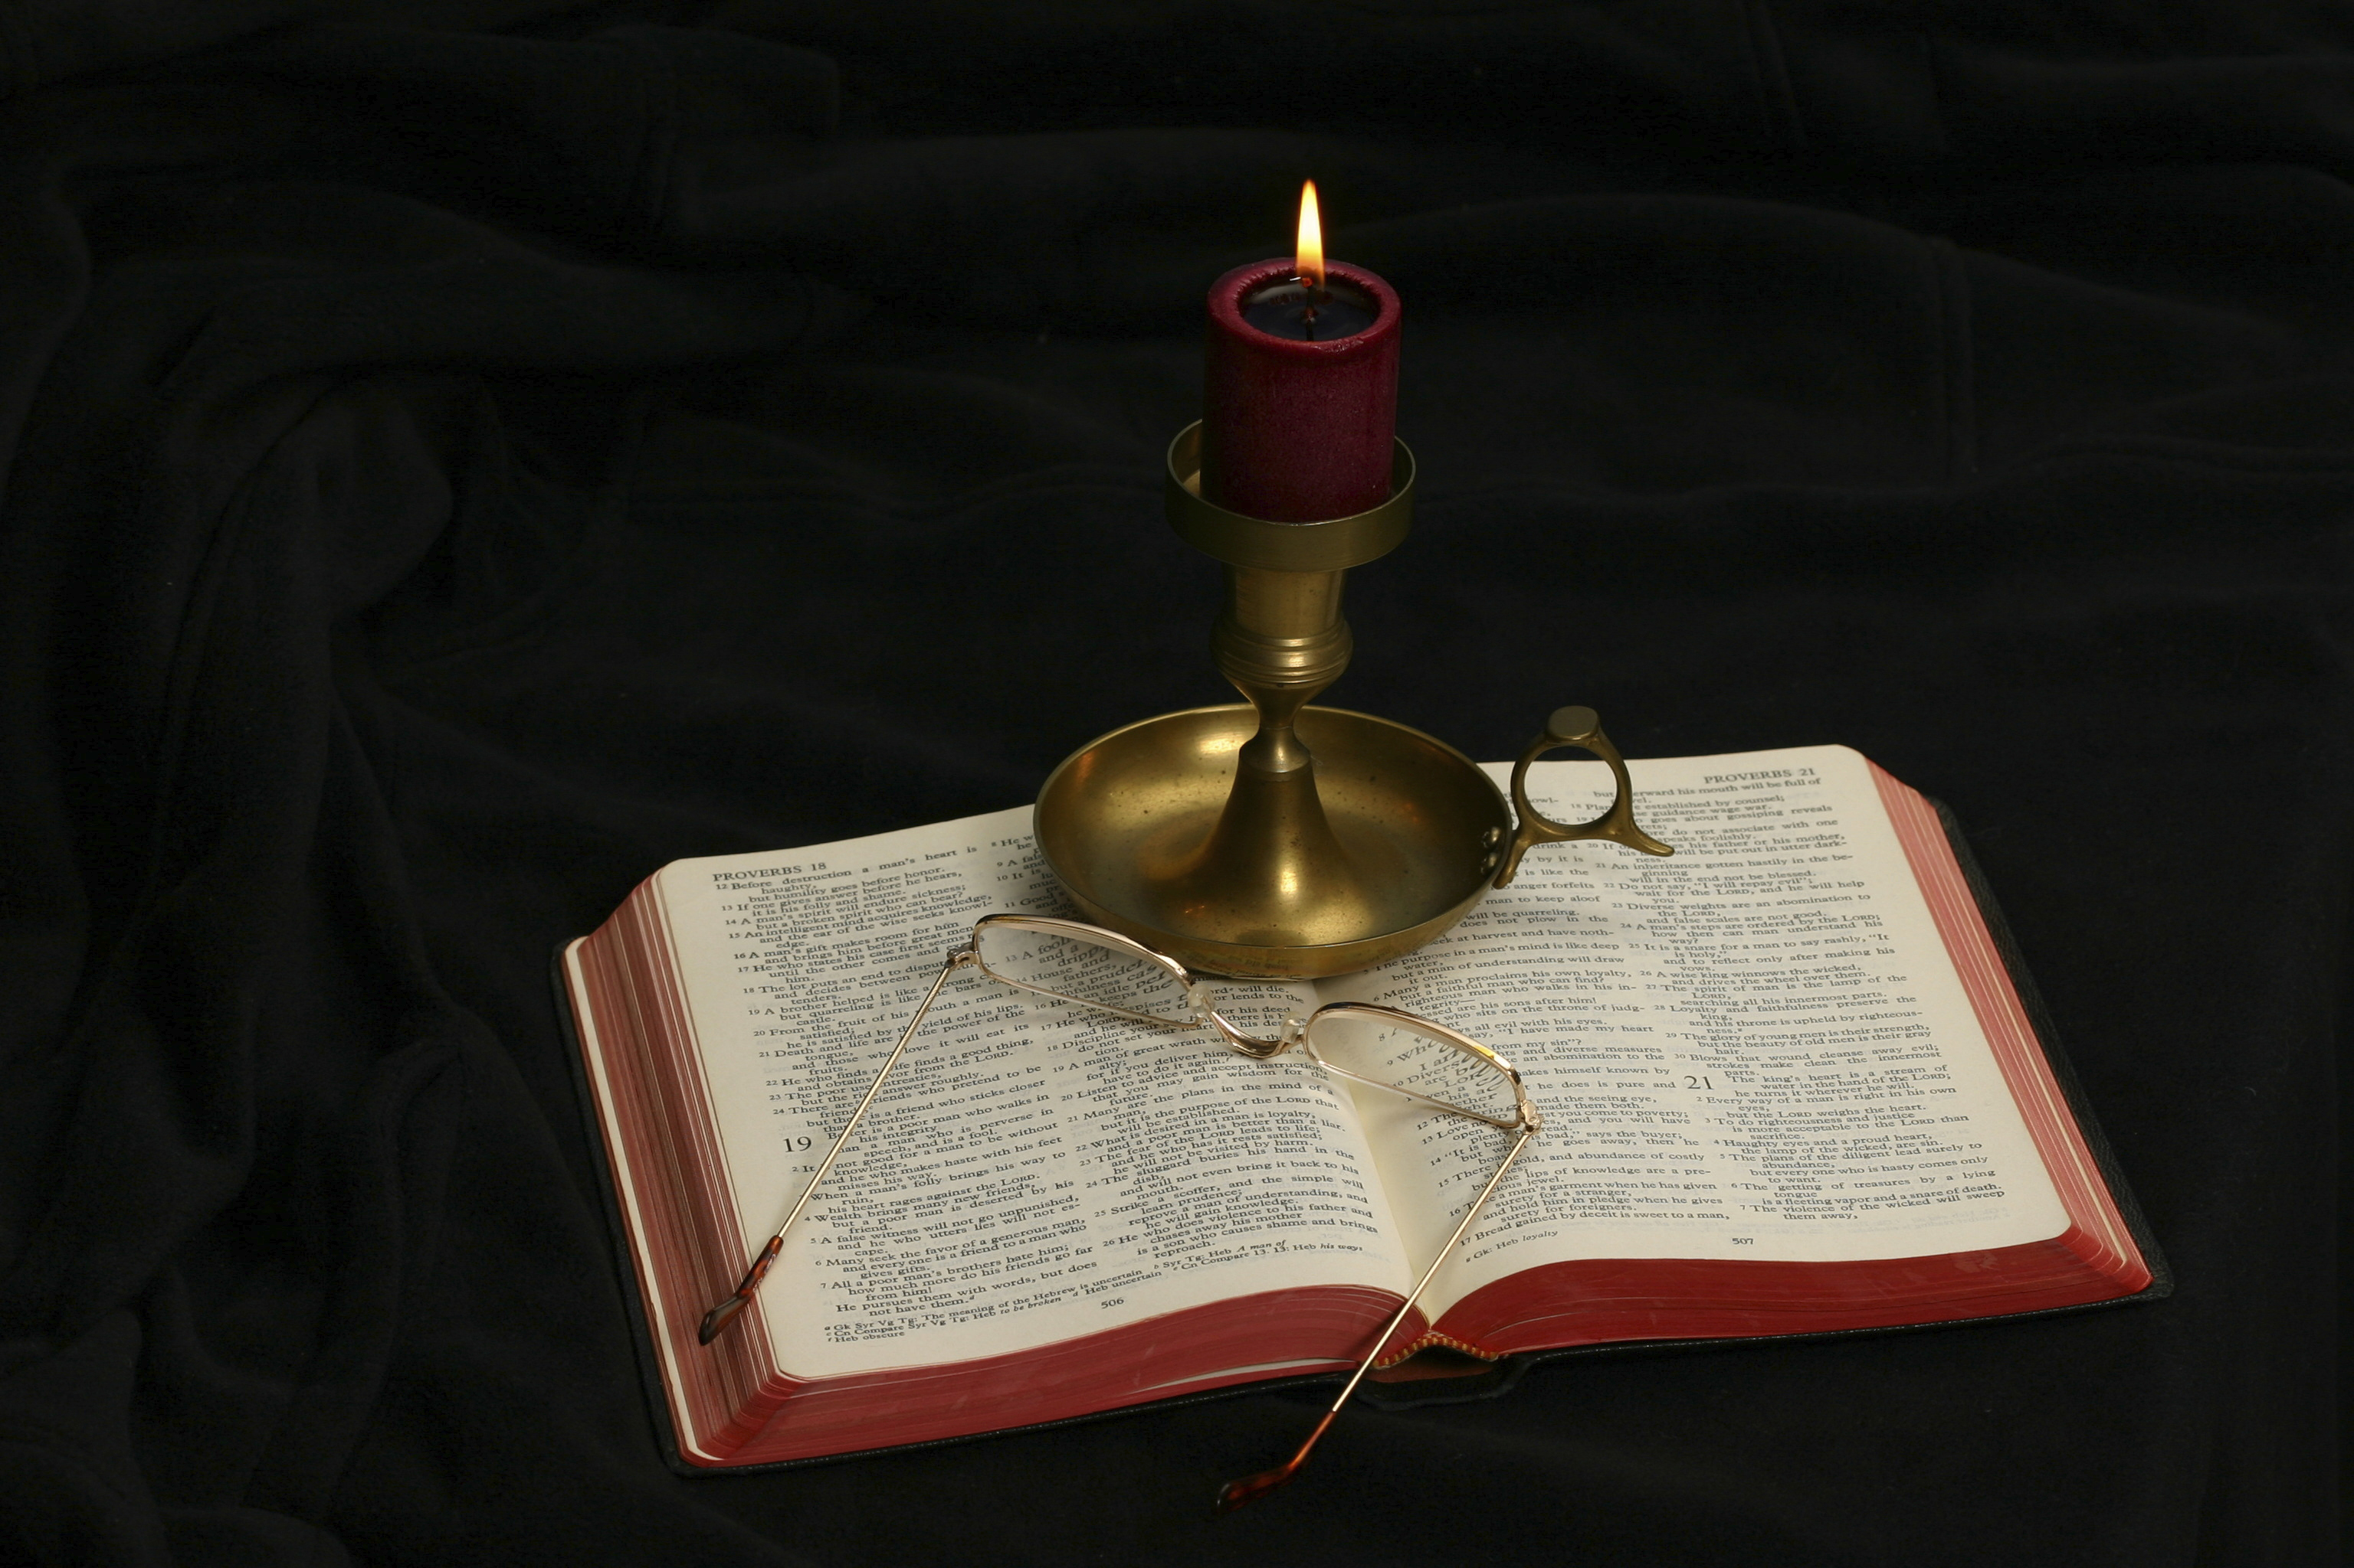
The Gospel of Matthew
Chapter 7

Slide 3
Outline of the Chapter
The Treatment of One’s Neighbor (7:1-12)
Do not judge (7:1-2)
The splinter and the log (7:3-5)
Pearls before swine (7:6)
Seek and you shall find (7:7-11)
The Golden Rule (7:12)
True and False Discipleship (7:13-27)
The narrow versus the wide gate/road (7:13-14)
True and false disciples (7:15-23)
Building on a rock (7:24-27)
Conclusion (7:28-29)

Slide 4
Matthew 7:1-6
“Judge not, that you be not judged. For with what judgment you judge, you will be judged; and with the measure you use, it will be measured back to you. And why do you look at the speck in your brother’s eye, but do not consider the plank in your own eye? Or how can you say to your brother, ‘Let me remove the speck from your eye; and look, a plank is in your own eye? Hypocrite! First remove the plank from your own eye, and then you will see clearly to remove the speck from your brother’s eye. Do not give what is holy to the dogs; nor cast your pearls before swine, lest they trample them under their feet, and turn and tear you in pieces.”

Slide 5
Tying the Section Together
Craig L. Blomberg: “Verses 1–6 seem to be united by the theme of how believers treat each other, specifically in judging or not judging one another, while vv. 7–11 illustrate how God treats his people. Verse 12 rounds out this section and probably summarizes the body of the sermon as a whole, with its classic statement of ideal interpersonal behavior” (Matthew, The New American Commentary, 127).
Leon Morris: “Jesus is not, of course, forbidding all judgments (cf. ‘judge righteous judgment,’ John 7:24, and the judgments required in this very chapter); he is warning against the hasty condemnations that are so easy to make, and so characteristic of the human race” (The Gospel according to Matthew, 164).

Slide 6
1. Do Not Judge (7:1-2)
“Judge not, that you be not judged. For with what judgment you judge, you will be judged; and with the measure you use, it will be measured back to you.”

Slide 7
Matthew 7:1
“Judge not, that you be not judged.”
How is passage being used in today’s society?
What conclusions would follow were this interpretation correct?
Could a person serve as a judge in court?
What judgments would be required to apply Matthew 7:6—“Do not cast your pearls before swine?”
Why can no one consistently apply the idea that all judgments of another are invalid?
List some examples where those who most frequently quote this passage to condemn anyone teaching that a socially accepted conduct is displeasing to God are guilty of violating their own rule?
What kinds of judgment is Jesus condemning in this verse?

Slide 8
Matthew 7:2
“For with what judgment you judge, you will be judged; and with the measure you use, it will be measured back to you.”
What reason does Jesus give for not judging others in this verse?
What is wrong with using one measure to judge you and a different measure to judge me?
“With the measure you use, it will be measured back to you” is a figure used for buying and selling things based on their weight (see Lev. 19:35-36; Deut. 25:13-16; Prov. 11:1; 16:1; 20:10; Ezek. 45:9-10; Amos 8:4-6). Both the buyer and seller should weigh their goods by the same standards.
Why is measuring using different standards dishonest and hypocritical?
Do you wish to be judged with the same measure and harshness that you use when speaking of others?
Does this verse teach that if one uses a “nothing is sin” measure for judging others, God will use that same judgment on him?

Slide 9
Why Is Lady Justice Blindfolded?

Slide 10
2. The Splinter and the Log (7:3-5)
“And why do you look at the speck in your brother’s eye, but do not consider the plank in your own eye? Or how can you say to your brother, ‘Let me remove the speck from your eye’; and look, a plank is in your own eye? Hypocrite! First remove the plank from your own eye, and then you will see clearly to remove the speck from your brother’s eye” (Matt. 7:3-5).

Slide 11
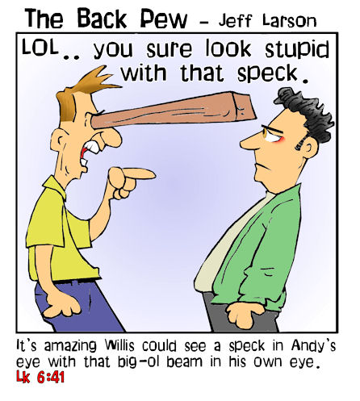
Matthew 7:3
“And why do you look at the speck in your brother’s eye, but do not consider the plank in your own eye? Or how can you say to your brother, ‘Let me remove the speck from your eye’; and look, a plank is in your own eye?”
Speck (karphos): “a small piece of straw, chaff, or wood, to denote something quite insignificant” (BDAG, 510).
Plank (dokon): “a piece of heavy timber such as a beam used in roof construction or to bar a door, beam of wood” (BDAG, 256).

Slide 12
Matthew 7:3-4
These verses are an example of Jesus using humor to make His point. In this case, He uses hyperbole (exaggerated statements or claims not meant to be taken literally) to make the point that one should first clean up his own life before trying to correct others.
The fact is that a “speck” in one’s eye is irritating to the point that all of us would want it removed from our eye. However, the last person we would want to try to remove it is someone with a log in his own eye!
What does this tell us about judging others?
How serious a problem is it to criticize others when we have more serious shortcomings in our own life?

Slide 13
A Splinter and Log Example
“Then the Lord sent Nathan to David. And he came to him, and said to him: ‘There were two men in one city, one rich and the other poor. The rich man had exceedingly many flocks and herds. But the poor man had nothing, except one little ewe lamb which he had bought and nourished; and it grew up together with him and with his children. It ate of his own food and drank from his own cup and lay in his bosom; and it was like a daughter to him. And a traveler came to the rich man, who refused to take from his own flock and from his own herd to prepare one for the wayfaring man who had come to him; but he took the poor man’s lamb and prepared it for the man who had come to him.’ So David’s anger was greatly aroused against the man, and he said to Nathan, ‘As the Lord lives, the man who has done this shall surely die! And he shall restore fourfold for the lamb, because he did this thing and because he had no pity.’ Then Nathan said to David, ‘You are the man! Thus says the Lord God of Israel: “I anointed you king over Israel, and I delivered you from the hand of Saul. I gave you your master's house and your master’s wives into your keeping, and gave you the house of Israel and Judah. And if that had been too little, I also would have given you much more! 'Why have you despised the commandment of the Lord, to do evil in His sight? You have killed Uriah the Hittite with the sword; you have taken his wife to be your wife, and have killed him with the sword of the people of Ammon”’” (2 Sam. 12:1-9).

Slide 14
Matthew 7:5
“Hypocrite! First remove the plank from your own eye, and then you will see clearly to remove the speck from your brother’s eye.”
Why is the person with a plank in his eye called a “hypocrite”?
What is this verse teaching about judging others?
Leon Morris: “The meaning is not that in every case the person passing judgment is a worse sinner than the one he criticizes. It is rather that what he finds wrong in his brother is a very small matter compared with the sin God sees in him. . . .Jesus is using a humorous method of bringing out the contrast between our excellence in picking up the faults of others and our myopia in discerning our own” (The Gospel according to Matthew, 166).
Jesus does not condemn all judging. In v. 1 Jesus rebukes looking on others in order to condemn; in v. 5, one who has removed the plank in his own eye is able to see clearly (diablepō) in order to help, to remove the speck in his brother’s eye.

Slide 15
3. Pearls Before Swine
“Do not give what is holy to the dogs; nor cast your pearls before swine, lest they trample them under their feet, and turn and tear you in pieces” (Matt. 7:6).
The arrangement has a-b-b-a format. Dogs “tear you in pieces” and pigs “trample . . . under their feet.”
“What is holy” most likely refers to things that are sacred (such as portions of sacrificial animals or shewbread; in application, it is the gospel) and “pearls” refers to something that is precious or valuable.
How is this verse related to the context (Matt. 7:1-5)? What judgments does this verse require?
What lessons should one learn about evangelism from this verse?

Slide 16
Guidance from the Limited Commission
“Now whatever city or town you enter, inquire who in it is worthy, and stay there till you go out. And when you go into a household, greet it. If the household is worthy, let your peace come upon it. But if it is not worthy, let your peace return to you. And whoever will not receive you nor hear your words, when you depart from that house or city, shake off the dust from your feet. Assuredly, I say to you, it will be more tolerable for the land of Sodom and Gomorrah in the day of judgment than for that city! Behold, I send you out as sheep in the midst of wolves. Therefore be wise as serpents and harmless as doves. But beware of men, for they will deliver you up to councils and scourge you in their synagogues” (Matt. 10:11-17).
This is pretty good commentary on Matthew 7:6.

Slide 17
4. Seek and You Will Find (7:7-11)

Slide 18
Matthew 7:7-11
“Ask, and it will be given to you; seek, and you will find; knock, and it will be opened to you. For everyone who asks receives, and he who seeks finds, and to him who knocks it will be opened. Or what man is there among you who, if his son asks for bread, will give him a stone? Or if he asks for a fish, will he give him a serpent? If you then, being evil, know how to give good gifts to your children, how much more will your Father who is in heaven give good things to those who ask Him!”

Slide 19
Matthew 7:7-8
“Ask, and it will be given to you; seek, and you will find; knock, and it will be opened to you. For everyone who asks receives, and he who seeks finds, and to him who knocks it will be opened.”
The text spoke of prayer in 6:5-15 and returns to prayer in 7:7-11. The text also links “seek” with “seek ye first the kingdom of heaven….”
The verbs “ask,” “seek,” and “knock” are present tense imperatives with the significance of persistence—“keep on asking, seeking, knocking.”
What is involved in “ask,” “seek,” and “knock”?
How does one know that Jesus is not promising us that prayer is a signed blank check?
What then is the promise of these verse 8?

Slide 20
Matthew 7:9-10
“Or what man is there among you who, if his son asks for bread, will give him a stone? Or if he asks for a fish, will he give him a serpent?”
These verses are not an absolute affirmation that no man will abuse his children, for the fact is that some men do abuse them.
What is the reason that a man will give the child the requested bread and fish?

Slide 21
Matthew 7:11
“If you then, being evil, know how to give good gifts to your children, how much more will your Father who is in heaven give good things to those who ask Him!”
Why is there a contrast between morally flawed men and “your Father who is in heaven”? What is the argument Jesus is making?
What is included/excluded by “good things”?
When our requests from God are not aligned with what is best for us, what would we want our Heavenly Father to do?

Slide 22
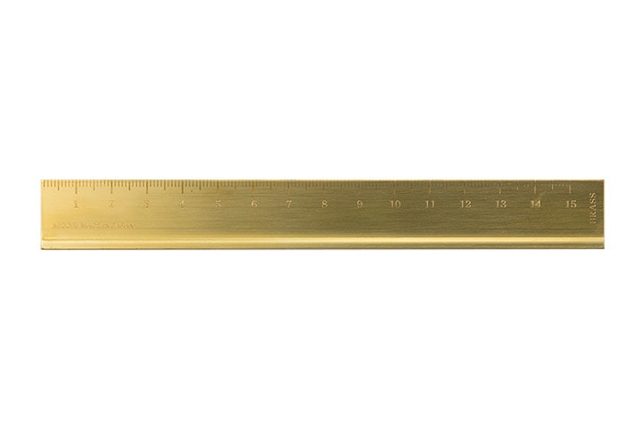
5. The Golden Rule (7:12)
The Golden Rule
Davies and Allison describe Matthew 7:12 as the “climax, the entire central core of the sermon on the mount” (I: 685).

Slide 23
Matthew 7:12
“Therefore, whatever you want men to do to you, do also to them, for this is the Law and the Prophets.”
The negative form of this rule already existed in Jesus’s day: “What you hate, do not do to anyone” (Tobit 4:15 and other religions; see Davies and Allison 1:686-687 for many other examples). It states that one should not do to others what he himself dislikes.
Leon Morris: “The great Hillel, when invited to teach a certain heathen the whole Torah while he stood on one leg, replied: ‘What is hateful to you, do not to your neighbour: that is the whole Torah, while the rest is the commentary thereof’ (Shab. 31a)” (The Gospel according to Matthew, The Pillar New Testament Commentary, 1992).
What is the difference in Jesus’s teaching and the negative teach?
Craig L. Blomberg: “As Mounce explains: ‘In its negative form, the Golden Rule could be satisfied by doing nothing. The positive form moves us to action on behalf of others’” (Matthew, The New American Commentary, 131).

Slide 24
This Is the Law and Prophets
Cf. Matthew 22:40—“On these two commandments (love of God and love of one’s neighbor) hang all the Law and the Prophets.”
Tie this statement back to Matthew 5:17— “Do not think that I came to destroy the Law or the Prophets. I did not come to destroy but to fulfill.”
The Golden Rule specifically includes one’s treatment toward one’s enemies (remember Matt. 5:43-48).
R. T. France: “The specific ethical teaching of the Sermon on the Mount therefore comes to its climax in this verse. So links the verse not with the immediately preceding verses but with the whole teaching of the Sermon so far, as it relates to our attitude towards other men, and the rule which follows presents in a nutshell the ‘greater righteousness’, the distinctive behaviour and attitude expected of the disciple” (Matthew: An Introduction and Commentary, Tyndale New Testament Commentaries, 149).

Slide 25
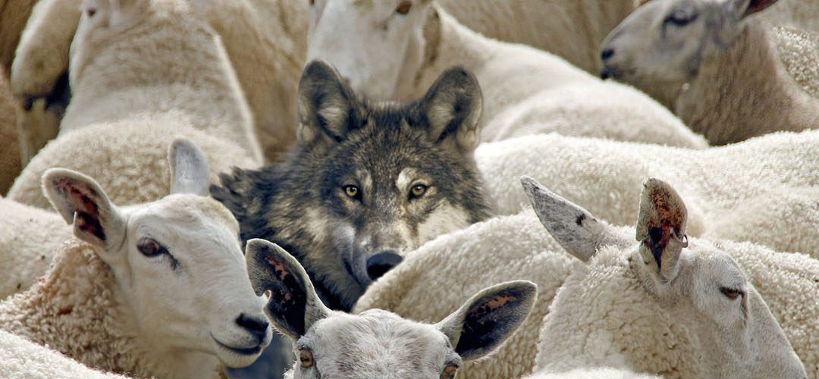
True and False Disciples (7:13-27)

Slide 26
Outline of the Section
True and False Discipleship (7:13-27)
The narrow versus the wide gate/road (7:13-14)
True and false disciples (7:15-23)
Building on a rock (7:24-27)

Slide 27
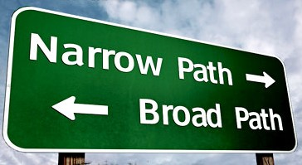
The Narrow versus the Wide Gate/Road (7:13-14)

Slide 28
Stringent Words
Leon Morris quoted Bruner: “‘Jesus began his sermon with unqualified tenderness, embracing in the Blessings those who felt least embraceable. He concludes with unqualified toughness, warning us that his sermon is not an intellectual option, a set of suggestions we may take or leave, one philosophy among several others, but that it is the exclusive way to life’ (Bruner, p. 282)” (The Gospel according to Matthew, The Pillar New Testament, 173).

Slide 29
Matthew 7:13-14
“Enter by the narrow gate; for wide is the gate and broad is the way that leads to destruction, and there are many who go in by it. Because narrow is the gate and difficult is the way which leads to life, and there are few who find it.”
The narrow gate and difficult way
Stenos in reference to dimension “narrow” (BDAG, 942).
Thlibō means “to be constricted or narrow, press together, make narrow”; “a narrow, confined road and therefore a source of trouble or difficulty to those using it” (BDAG, 457).
The broad way and wide gate
Platus “pertains to great extent from side to side, broad, wide” (BDAG, 823).
Euruchōros “pertains to having amply room, broad, spacious, roomy” (BDAG, 412).
Jesus makes it clear that are only two ways set before all of mankind and that one has the power to choose which one he will take!

Slide 30
A Common Jewish Theme
Moses: “"See, I have set before you today life and good, death and evil,. . . . I call heaven and earth as witnesses today against you, that I have set before you life and death, blessing and cursing; therefore choose life, that both you and your descendants may live” (Deut. 30:19).
Jeremiah: “Now you shall say to this people, ‘Thus says the Lord: “Behold, I set before you the way of life and the way of death”’” (Jer. 21:8).
David: “For the Lord knows the way of the righteous, But the way of the ungodly shall perish” (Psa. 1:6).

Slide 31
The Two Destinies
The wide gate and broad way: Destruction
Apōleia is “the destruction that one experiences, annihilation both complete and in process, ruin; . . . Especially of eternal destruction as punishment for the wicked, Mt. 7:13” (BDAG, 127).
We should not limit the destruction of the broad way to eternal damnation; it leads also to ruinous consequences in this life.
The narrow gate and difficult way: Life
Zōē is “the opposite of death. . . Is used of life in the blessed period of final consummation. . . In the coming age eternal life” (BDAG, 430).
We should not limit the joys of life to eternal life. Paul said that godliness “is profitable for all things, having promise of the life that now is and of that which is to come” (1 Tim. 4:8).

Slide 32
The Travelers
The wide gate and broad way: many
The narrow gate and difficult way: few
The command to enter implies effort to find it and travel it.
Leon Morris: “A narrow gate must be sought out: it is not as easily perceived as is a broad one. For is a causal conjunction; the implication is that something of an effort must be made to enter the narrow gate” (Ibid., 174).

Slide 33
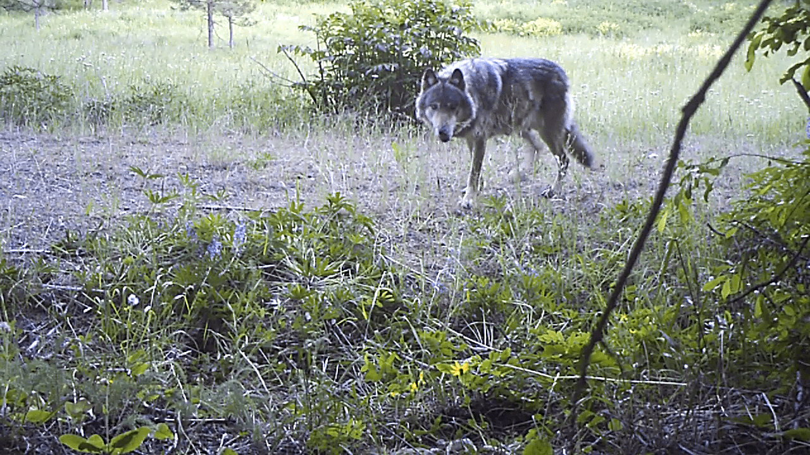
True and False Disciples (7:15-20)

Slide 34
Matthew 7:15-20
“Beware of false prophets, who come to you in sheep’s clothing, but inwardly they are ravenous wolves. You will know them by their fruits. Do men gather grapes from thornbushes or figs from thistles? Even so, every good tree bears good fruit, but a bad tree bears bad fruit. A good tree cannot bear bad fruit, nor can a bad tree bear good fruit. Every tree that does not bear good fruit is cut down and thrown into the fire. Therefore by their fruits you will know them.”

Slide 35
Matthew 7:15
“Beware of false prophets, who come to you in sheep’s clothing, but inwardly they are ravenous wolves.”
How can one harmonize the instructions of 7:15 with 7:1-2?
What are the implications of the command to “beware”?
Beware (prosechō): “to be in a state of alert, be concerned about, care for, take care” (BDAG, 879).
What danger does the wolf pose to the flock?
Ravenous (harpax): “rapacious (living on prey, Webster), ravenous” (BDAG, 134).
What is a “false prophet”?
False prophet (pseudoprophētēs): “one who falsely claims to be a prophet of God or who prophesies falsely, false/bogus prophet” (BDAG, 1097).
Are false prophets always dishonest and intentionally lying?
Can a false prophet be sincere, but sincerely wrong?

Slide 36
Jeremiah & the False Prophets
“Thus says the Lord of hosts: ‘Do not listen to the words of the prophets who prophesy to you. They make you worthless; They speak a vision of their own heart, Not from the mouth of the Lord’” (Jer. 23:16).
“They continually say to those who despise Me, ‘The Lord has said, “You shall have peace”’; And to everyone who walks according to the dictates of his own heart, they say, ‘No evil shall come upon you’” (Jer. 23:17).
“I have not sent these prophets, yet they ran. I have not spoken to them, yet they prophesied” (Jer. 23:21).
“I have heard what the prophets have said who prophesy lies in My name, saying, ‘I have dreamed, I have dreamed!’” (Jer. 23:25).
“‘Behold, I am against those who prophesy false dreams,’ says the Lord, ‘and tell them, and cause My people to err by their lies and by their recklessness. Yet I did not send them or command them; therefore they shall not profit this people at all,’ says the Lord. ‘So when these people or the prophet or the priest ask you, saying, “What is the oracle of the Lord?” you shall then say to them, “What oracle?” I will even forsake you,’ says the Lord” (Jer. 23:32-33).

Slide 37
Isaiah 8:19-20
“And when they say to you, ‘Seek those who are mediums and wizards, who whisper and mutter,’ should not a people seek their God? Should they seek the dead on behalf of the living? To the law and to the testimony! If they do not speak according to this word, it is because there is no light in them.”

Slide 38
1 John 4:1-3
“Beloved, do not believe every spirit, but test the spirits, whether they are of God; because many false prophets have gone out into the world. By this you know the Spirit of God: Every spirit that confesses that Jesus Christ has come in the flesh is of God, and every spirit that does not confess that Jesus Christ has come in the flesh is not of God. And this is the spirit of the Antichrist, which you have heard was coming, and is now already in the world.”

Slide 39
Matthew 7:16-20
“You will know them by their fruits. Do men gather grapes from thornbushes or figs from thistles? Even so, every good tree bears good fruit, but a bad tree bears bad fruit. A good tree cannot bear bad fruit, nor can a bad tree bear good fruit. Every tree that does not bear good fruit is cut down and thrown into the fire. Therefore by their fruits you will know them.”
How does Jesus instruct that one may determine whether or not a given man is a faithful or false prophet? Does testing his fruit include what he teaches and preaches or is it limited to his character?
What would be necessary to identify a false prophet if his honesty and sincerity are the test?
List some fruits of a man that should be tested.

Slide 40
Matthew 7:21-23
“Not everyone who says to Me, ‘Lord, Lord,’ shall enter the kingdom of heaven, but he who does the will of My Father in heaven. Many will say to Me in that day, ‘Lord, Lord, have we not prophesied in Your name, cast out demons in Your name, and done many wonders in Your name?’ And then I will declare to them, ‘I never knew you; depart from Me, you who practice lawlessness!’”
Who is in the role as Judge?
What were some of the things these false prophets were doing that made them look like sheep?
Where they Christians or non-Christians?
What made them ravenous wolves?

Slide 41
Lawlessness
The word anomia is made of the word nomos (law) and the privative a (alpha). The root idea is being without the law or acting outside of what the law authorizes.
BDAG defines the word to mean “state or condition of being disposed to what is lawless, lawlessness, opposite of dikaiosunē (righteousness). . . . The product of a lawless disposition, a lawless deed” (BDAG, 85).
It can be a rebellious, unauthorized, or a transgressive act.
Those who step outside the restraints of God’s law open a gate that leads to every kind of sinful act.
An act of “lawlessness” is put in opposition to “he who does the will of My Father in heaven” (v. 21).

Slide 42
Opposites
In one’s opinion of himself vs. God’s opinion:
One’s own opinion of himself:
Recognize the Lordship of Jesus
Prophesying in the Lord’s name
Casting out demons in Jesus’s name
Doing many good works in Jesus’s name
In God’s opinion:
“I never knew you”
You practice lawlessness
In destiny:
“Shall enter the kingdom of heaven” (v. 21)
“Depart from me” (v. 23)

Slide 43
Building on a Rock

Slide 44
Matthew 7:24-27
“Therefore whoever hears these sayings of Mine, and does them, I will liken him to a wise man who built his house on the rock: and the rain descended, the floods came, and the winds blew and beat on that house; and it did not fall, for it was founded on the rock. But everyone who hears these sayings of Mine, and does not do them, will be like a foolish man who built his house on the sand: and the rain descended, the floods came, and the winds blew and beat on that house; and it fell. And great was its fall.”

Slide 45
Further Teaching on False Teachers
The subject matter has not changed from v. 13.
Jesus is still warning against the danger of the two gates, two ways, and two destinies. The wolves (false prophets) in sheep’s clothing were those lawless men who claimed to be followers of Jesus but were guilty of lawlessness.
In this parable, the foolish builder who built on the sand is the same person who enters the wide gate and walks on the broad way, the same person who calls Jesus “Lord, Lord” and protests that he prophesies, casts out devils, and does many miracles in Jesus’s name. Despite these protests, such men are workers who “practice lawlessness.”

Slide 46
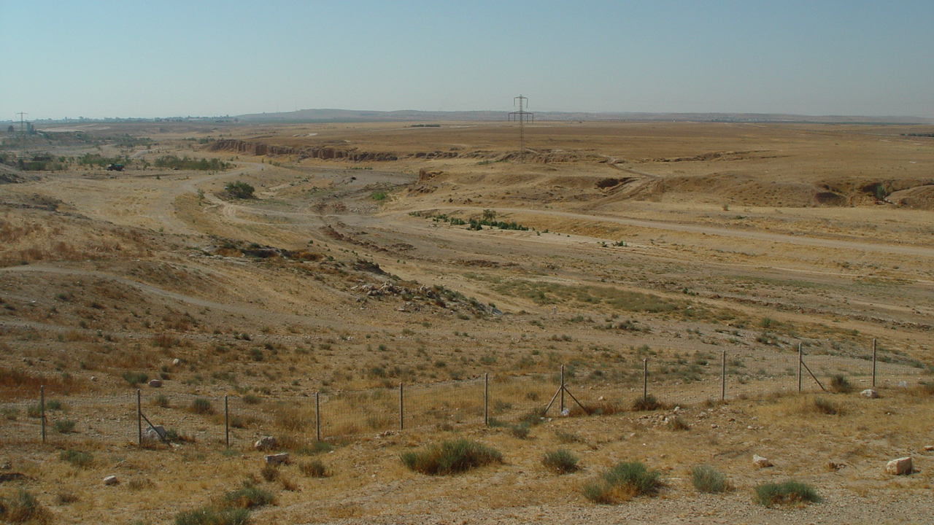
Where Would You Build Your House?
Wadi near Beersheba

Slide 47
Matthew 7:24-27
What is meant by building one’s house on a rock (petra)?
How does one go about building his house on a rock?
What is represented by building one’s house on sand?
How does one go about building his house on sand?
What is represented by the rain, floods (river), and winds that beat upon the house?
What is the difference in the storms for the two builders?
Why do they have a different effect?
Why is one builder wise and the other foolish?

Slide 48
What Is Your Foundation Like?
The word for “it was founded” (themelioō) appears also in these verses:
“But may the God of all grace, who called us to His eternal glory by Christ Jesus, after you have suffered a while, perfect, establish, strengthen, and settle you” (1 Pet. 5:10).
“. . .that Christ may dwell in your hearts through faith; that you, being rooted and grounded in love” (Eph. 3:17).
“. . . if indeed you continue in the faith, grounded and steadfast, and are not moved away from the hope of the gospel which you heard, which was preached to every creature under heaven, of which I, Paul, became a minister” (Col. 1:23).

Slide 49
Matthew 7:28-29
“And so it was, when Jesus had ended these sayings, that the people were astonished at His teaching, for He taught them as one having authority, and not as the scribes.”

Slide 50
From the Mishnah: Berachoth 1:2
From when does one recite Shema in the morning? From when a person can distinguish between sky-blue [tekhelet] and white. Rabbi Eliezer says: From when one can distinguish between sky-blue and leek-green. And one must finish reciting Shema until the end of the period when you rise, i.e., sunrise, when the sun begins to shine. Rabbi Yehoshua says: One may recite the morning Shema until three hours of the day, which this is still considered when you rise, as that is the habit of kings to rise from their sleep at three hours of the day. While there is a set time frame for the recitation of Shema, one who recites Shema from that time onward loses nothing. Although he does not fulfill the mitzva of reciting of Shema at its appointed time, he is nevertheless considered like one who reads the Torah, and is rewarded accordingly.

Slide 51
Jesus Taught As One Who Had Authority
“I say unto you” (5:18, 20, 22, 28, 32, 34, 39, 44; 6:2, 5, 16, 25, 29)—thirteen times in 15 verses in the Sermon on the Mount.
Jesus did not need to quote some highly respected rabbi to prove what He had to say. He taught with the authority of the Son of God who came down from heaven!
This amazed and astonished the crowd who heard Him preach.
It was totally unlike the scribes (grammateis: “specialists in the law of Moses: experts in the law, scholars versed in the law, scribes,” BDAG, 206).

