Slide 2
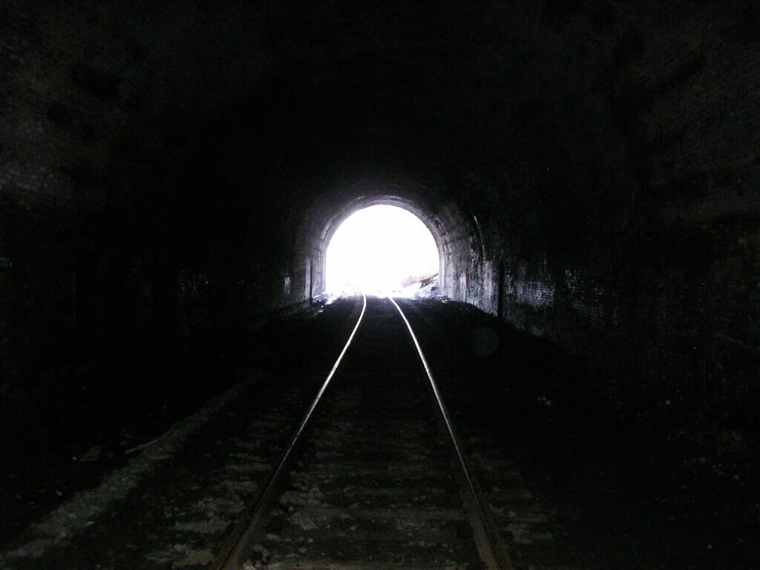
Hope

Slide 3
Flippant Uses of Hope
It can be used to express a mere wish.
I hope Dad will stop at McDonald’s on the way home from church.
I hope that we have a good crowd on Sunday morning.
I hope the Colts have a winning season this year.
Sometimes our use of hope expresses one’s ambitions: “I hope to become a lawyer.”
Sometimes it expresses our plans: “I hope to retire next year.”
Sometimes it expresses concern about past events: “I hope he mailed that contract that was laying on his desk.”
Because it is used in such common ways, sometimes with little significance, we may forget how important a word hope is in the Scriptures.

Slide 4
What Is Hope?
The Greek word elpis is defined as following: “the looking forward to something with some reason for confidence respecting fulfillment, hope, expectation” (BDAG, 319).
Bible hope is not a mere wish, a remote possibility, or a maybe.
It is a happily anticipated and certain expectation based on the promises of God.
The Christian hope is expressed by Paul: “because of the hope which is laid up for you in heaven, of which you heard before in the word of the truth of the gospel” (Col. 1:5).

Slide 5
Do You Believe You Are Going to Heaven?
“Well, I hope I will.” This answer may only be expressing one’s wish, without any basis in reality of whether or not it is likely to be true. After all, who would dare answer, “No, I hope to go to hell!”
Another may answer, “Yes, I truly expect to go to heaven.”
Christians who have been saved by grace have a reasonable expectation of eternal life and should not be reluctant to express it: We “have fled for refuge to lay hold of the hope set before us. This hope is an anchor of the soul, both sure and steadfast” (Heb. 6:18-19).
We are able to give “a defense to everyone who asks you a reason for the hope that is in you, with meekness and (reverential) fear” (1 Pet. 3:15).
Someone may ask, “Do you really think you are good enough to go to heaven?” Our reply should be, “No, of course I am not good enough, but my hope is not based on my goodness, but on the grace of God, the blood of Jesus, and the promises of the Bible.”

Slide 6
Not Self-Confidence
Hope is not self-confidence, but confidence in God and His promises.
“. . . in hope of eternal life which God, who cannot lie, promised before time began” (Tit. 1:2).
“. . . by which have been given to us exceedingly great and precious promises, that through these you may be partakers of the divine nature, having escaped the corruption that is in the world through lust” (2 Pet. 1:4).
“And this is the promise that He has promised us—eternal life” (1 John 2:25).

Slide 7
I. Our Hope Is Grounded in God’s Ability and Dependability
Hope

Slide 8
Taking God at His Word
We accept as true the facts that are declared in His word. The historical evidences give us reason to believe the promises given in the Bible.
We have hope because of the reliability of God’s word. “For all the promises of God in Him are Yes, and in Him Amen, to the glory of God through us” (2 Cor. 1:20). God is able to keep His promises.
For example, God promised Abraham that he would have a son.
“But Sarah was barren; she had no child” (Gen. 11:30).
Abraham was 75 years old when God made this promise to him and Sarah was ten years younger, 65 years old (Gen. 12:4; 17:17). Twenty-five years passed before Isaac was born when Abraham was 100 years old and Sarah was 90.
“He did not waver at the promise of God through unbelief, but was strengthened in faith, giving glory to God” (Rom. 4:20).

Slide 9
God Keeps His Word
God kept his promise that Abraham’s descendants would go into Egypt and serve as slaves in that land for 400 years before God would bring them out of Egypt by the hand of Moses:
“Then He said to Abram: ‘Know certainly that your descendants will be strangers in a land that is not theirs, and will serve them, and they will afflict them four hundred years. And also the nation whom they serve I will judge; afterward they shall come out with great possessions. Now as for you, you shall go to your fathers in peace; you shall be buried at a good old age. But in the fourth generation they shall return here, for the iniquity of the Amorites is not yet complete’” (Gen. 15:13-16).

Slide 10
God Keeps His Word
God kept His promises to Abraham in making a great nation come from his descendants. Israel went into Egypt as 70 people (Gen. 46:27) and came out of Egypt with 603,550 men (without counting women and children, Num. 1:46).
They were delivered by miraculous works of God:
The signs God gave to Moses (rod to a serpent to a rod, Exod. 4:3-4; leprous hand Exod. 4:6-7).
The ten plagues on Egypt: (a) Water to blood, (b) Frogs, (c) Lice, (d) Flies, (e) Murrain of the cattle, (f) Boils, (g) Hail, (h) Locusts, (i) Darkness, (j) Death of the Firstborn.
Destruction of Egypt’s army at the miraculous crossing of the Red Sea (Exod. 14).

Slide 11
God Keeps His Word
The conquest of Canaan happened just as God promised.
Joshua could say that God’s word was dependable: “So the Lord gave to Israel all the land of which He had sworn to give to their fathers, and they took possession of it and dwelt in it. The Lord gave them rest all around, according to all that He had sworn to their fathers. And not a man of all their enemies stood against them; the Lord delivered all their enemies into their hand. Not a word failed of any good thing which the Lord had spoken to the house of Israel. All came to pass” (Joshua 21:43-45).
Solomon expressed the reliability of God’s promises 480 years later: “Blessed be the Lord, who has given rest to His people Israel, according to all that He promised. There has not failed one word of all His good promise, which He promised through His servant Moses” (1 Kings 8:56).

Slide 12
God Is Able
“Now to Him who is able to do exceedingly abundantly above all that we ask or think, according to the power that works in us” (Eph. 3:20).
“For this reason I also suffer these things; nevertheless I am not ashamed, for I know whom I have believed and am persuaded that He is able to keep what I have committed to Him until that Day” (2 Tim. 1:12).

Slide 13
God Is Reliable
“God is not a man, that He should lie, Nor a son of man, that He should repent. Has He said, and will He not do? Or has He spoken, and will He not make it good?” (Num. 23:19).
“Thus God, determining to show more abundantly to the heirs of promise the immutability of His counsel, confirmed it by an oath, that by two immutable things, in which it is impossible for God to lie, we might have strong consolation, who have fled for refuge to lay hold of the hope set before us” (Heb. 6:17-18).

Slide 14
II. Our Hope Is Grounded in Reality
Hope

Slide 15
Not Imagined
We are not to assume that our hope is made real by our believing that it is real. What God declares is real whether or not we believe it!
The patriarchs lived their lives based on God’s promises and were not disappointed.
“Now faith is the substance of things hoped for, the evidence of things not seen” (Heb. 11:1).
The author of Hebrews recalls the faith of the patriarchs. They lived the way they lived, worshiped the way their worshiped, built what they built, went where they went, and endured what they endured because they lived by faith!
“We do not look at the things which are seen, but at the things which are not seen. For the things which are seen are temporary, but the things which are not seen are eternal” (2 Cor. 4:18).

Slide 16
Reasonable Faith—Confident Hope
“And since we have the same spirit of faith, according to what is written, ‘I believed and therefore I spoke,’ we also believe and therefore speak, knowing that He who raised up the Lord Jesus will also raise us up with Jesus, and will present us with you. For all things are for your sakes, that grace, having spread through the many, may cause thanksgiving to abound to the glory of God. Therefore we do not lose heart. Even though our outward man is perishing, yet the inward man is being renewed day by day. For our light affliction, which is but for a moment, is working for us a far more exceeding and eternal weight of glory, while we do not look at the things which are seen, but at the things which are not seen. For the things which are seen are temporary, but the things which are not seen are eternal. For we know that if our earthly house, this tent, is destroyed, we have a building from God, a house not made with hands, eternal in the heavens” (2 Cor. 4:13–5:1).

Slide 17
Reasonable Faith—Confident Hope
“For this reason I also suffer these things; nevertheless I am not ashamed, for I know whom I have believed and am persuaded that He is able to keep what I have committed to Him until that Day” (2 Tim. 1:12).
“Beloved, now we are children of God; and it has not yet been revealed what we shall be, but we know that when He is revealed, we shall be like Him, for we shall see Him as He is” (1 John 3:2).

Slide 18
III. Some Live and Die Without Hope!

Slide 19
Without Jesus, Without Hope!
“. . . that at that time you were without Christ, being aliens from the commonwealth of Israel and strangers from the covenants of promise, having no hope and without God in the world” (Eph. 2:12).
“But I do not want you to be ignorant, brethren, concerning those who have fallen asleep, lest you sorrow as others who have no hope” (1 Thess. 4:13).
The Scriptures clearly affirm that those outside of Christ are without hope of eternal life in heaven.
“Then Jesus said to them again, ‘I am going away, and you will seek Me, and will die in your sin. Where I go you cannot come. . . . Therefore I said to you that you will die in your sins; for if you do not believe that I am He, you will die in your sins” (John 8:21, 24).
“Jesus said to him, ‘I am the way, the truth, and the life. No one comes to the Father except through Me’” (John 14:6).

Slide 20
Don’t Be Deceived!
A sizeable portion of American citizens have embraced secularism (another word for atheism) and accept the consequences of unbelief—that the grave is the end of their existence.
They embrace mortality and advocate their right to have doctor assisted euthanasia when the pains of life become unbearable or not worth continuing.
Unfortunately, their children may reach that same conclusion in their teenaged years based on peer rejection. In their frustration and anger, some may choose to go out in a blaze of glory—going into an elementary school with an automatic weapon and killing a score of others before the police can take him out.

Slide 21
Unbelief Does Not Make It So!
But, the sad fact is this: believing that there is nothing beyond this life does not make it so.
The word of God, the God who cannot lie and therefore whose word is absolutely reliable, tells us that life continues beyond the grave and for those without Jesus, it is an horribly eternal place of suffering—hell “where their worm does not die and the fires are never quenched” (Mark 9:43-44, 45-46, 48).
“It is a fearful thing to fall into the hands of the living God” (Heb. 10:31).

Slide 22
How Reliable Are Your Witnesses?
The only basis for believing in this secular view of life is the fallible words of short-lived men.
Even our most credible scientists have always been proven wrong!
If you doubt that this is so, ask yourself if you would want to have the best doctor of the nineteenth century, a doctor with an impeccable reputation, to perform an operation on you should you find yourself in need of surgery.
You know of the remarkable advances of medicine in the last 150 years and would prefer to have your veterinarian do surgery on you than a doctor of the nineteenth century.
The fact is, if this world continues for another 150 years, what is known with such certainty today will be as old school in the twenty-second century as that of the nineteenth century is for the early twenty-first century.

Slide 23
The Only Reliable Witness: Jesus
There is only one person who has lived on this earth who has the information to speak authoritatively about life after death:
Jesus lived from the beginning with God
Jesus is God,
Jesus experienced death and came back to this life

Slide 25
IV. Hope Sustains One’s Life
Hope

Slide 26
Hopeless Secularism
Secular atheism may provide one with some temporary sense of alleviation from the guilt of a dissolute life lived during good times.
But it cannot sustain a person who must walk through the valley of the shadow of death (Psa. 23:4).
Hope enables us to eagerly wait with perseverance: “For we were saved in this hope, but hope that is seen is not hope; for why does one still hope for what he sees? But if we hope for what we do not see, we eagerly wait for it with perseverance” (Rom. 8:24-25).

Slide 27
Christian Hope Sustained Paul
Look at Paul’s mental state on two occasions when he faced the possibility and later the certainty of death:
“For to me, to live is Christ, and to die is gain. But if I live on in the flesh, this will mean fruit from my labor; yet what I shall choose I cannot tell. For I am hard pressed between the two, having a desire to depart and be with Christ, which is far better. Nevertheless to remain in the flesh is more needful for you” (Phil. 1:21-24).
“For I am already being poured out as a drink offering, and the time of my departure is at hand. I have fought the good fight, I have finished the race, I have kept the faith. Finally, there is laid up for me the crown of righteousness, which the Lord, the righteous Judge, will give to me on that Day, and not to me only but also to all who have loved His appearing” (2 Tim. 4:6-8).

Slide 28
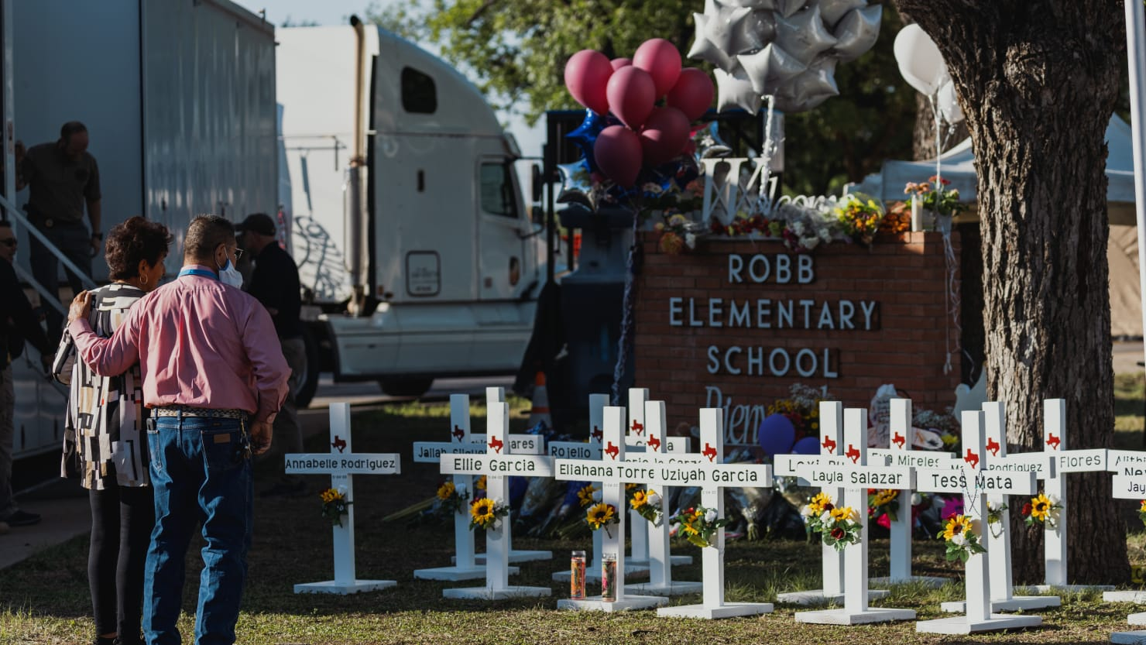
How Can a Secular Atheist Comfort
Those Mourning in Texas?

Slide 29
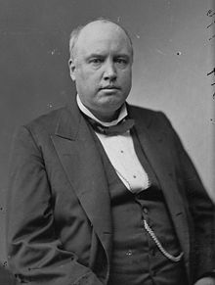
Ingersoll wrote this at the death of his brother:
Life is a narrow vale between the cold and barren peaks of two eternities. We strive in vain to look beyond the heights. We cry aloud, and the only answer is the echo of our wailing cry. From the voiceless lips of the unreplying dead there comes no word; but in the night of death hope sees a star and listening love can hear the rustle of a wing.
He who sleeps here, when dying, mistaking the approach of death for the return of health, whispered with his latest breath, ‘I am better now.’ Let us believe, in spite of doubts and dogmas, of fears and tears, that these dear words are true of all the countless dead.
(https://www.goodreads.com/quotes/961082-robert-s-eulogy-at-his-brother-ebon-c-ingersoll-s-grave-even).
Robert Ingersoll (1833-1899)
“The great agnostic”

Slide 30
The Sadness of Hopelessness!
David R. Pharr tells of a sad experience he had in his work as a preacher: “I was called to a home where a son had just been killed in a horrific accident. As far as I knew there was little or no religion of any kind. When the father met me at the door, he had a glass of whiskey in his hand and said, ‘Preacher, I apologize for this; it’s all I’ve got”” (“Hope for the Journey of Life,” Spiritual Sword 52:2 (January 2021), 45).
Paul said to those Christians who had lost loved ones: “But I do not want you to be ignorant, brethren, concerning those who have fallen asleep, lest you sorrow as others who have no hope” (1 Thess. 4:13).

Slide 31
The Blessing of Hope
Hope enables us to endure the tribulations of life:
“Therefore, having been justified by faith, we have peace with God through our Lord Jesus Christ, through whom also we have access by faith into this grace in which we stand, and rejoice in hope of the glory of God. And not only that, but we also glory in tribulations, knowing that tribulation produces perseverance; and perseverance, character; and character, hope. Now hope does not disappoint, because the love of God has been poured out in our hearts by the Holy Spirit who was given to us” (Rom. 5:1-5).
It can take you through the trials and struggles of every period of your life—the early years of life in a broken home, the struggles of a difficult marriage, illness, grief, and even persecution.
It assures you that there is something beyond this life that gives you the ability to rise above your afflictions and to say, “For our light affliction, which is but for a moment, is working for us a far more exceeding and eternal weight of glory” (2 Cor. 4:17).

Slide 32
Hope

Slide 33
The Grave Is Not the End
The fact is that there is no conclusion to the journey of life, because life does not end at the grave.
The “last mile of the way” does not lead to dead end street! For the Christian, life ends something like this:
“The days of our lives are seventy years; And if by reason of strength they are eighty years, Yet their boast is only labor and sorrow; For it is soon cut off, and we fly away” (Psa. 90:10).
“So it was that the beggar died, and was carried by the angels to Abraham’s bosom” (Luke 16:22).
“We are confident, yes, well pleased rather to be absent from the body and to be present with the Lord” (2 Cor. 5:8).

Slide 34
Inexplicable!
There is more glory and good in what lies ahead for the children of God than mortal tongue or pen can describe:
“Beloved, now we are children of God; and it has not yet been revealed what we shall be, but we know that when He is revealed, we shall be like Him, for we shall see Him as He is” (1 John 3:2).
“Now may our Lord Jesus Christ Himself, and our God and Father, who has loved us and given us everlasting consolation and good hope by grace, comfort your hearts and establish you in every good word and work” (2 Thess. 2:16-17).

