Slide 2
Evangelizing in a Wicked World

Slide 3
A Wicked World Is the Only Kind
In introducing this lesson, I must admit that a wicked world is the only kind of world that has ever existed. The world is made up of sinners, and not even the “Leave It to Beaver” world depicted in the TV shows of the 1950s was a righteous world.
Having acknowledged that, we still must face the facts that the early twenty-first century in the United States is morally more perverted than was the world of the 1950s.
So, let’s address what is obvious before us: How do we evangelize this wicked age?
If you had been Ananias, would you have gone to teach Saul of Tarsus? Have we accepted the idea, “It won’t do any good to try”?

Slide 4
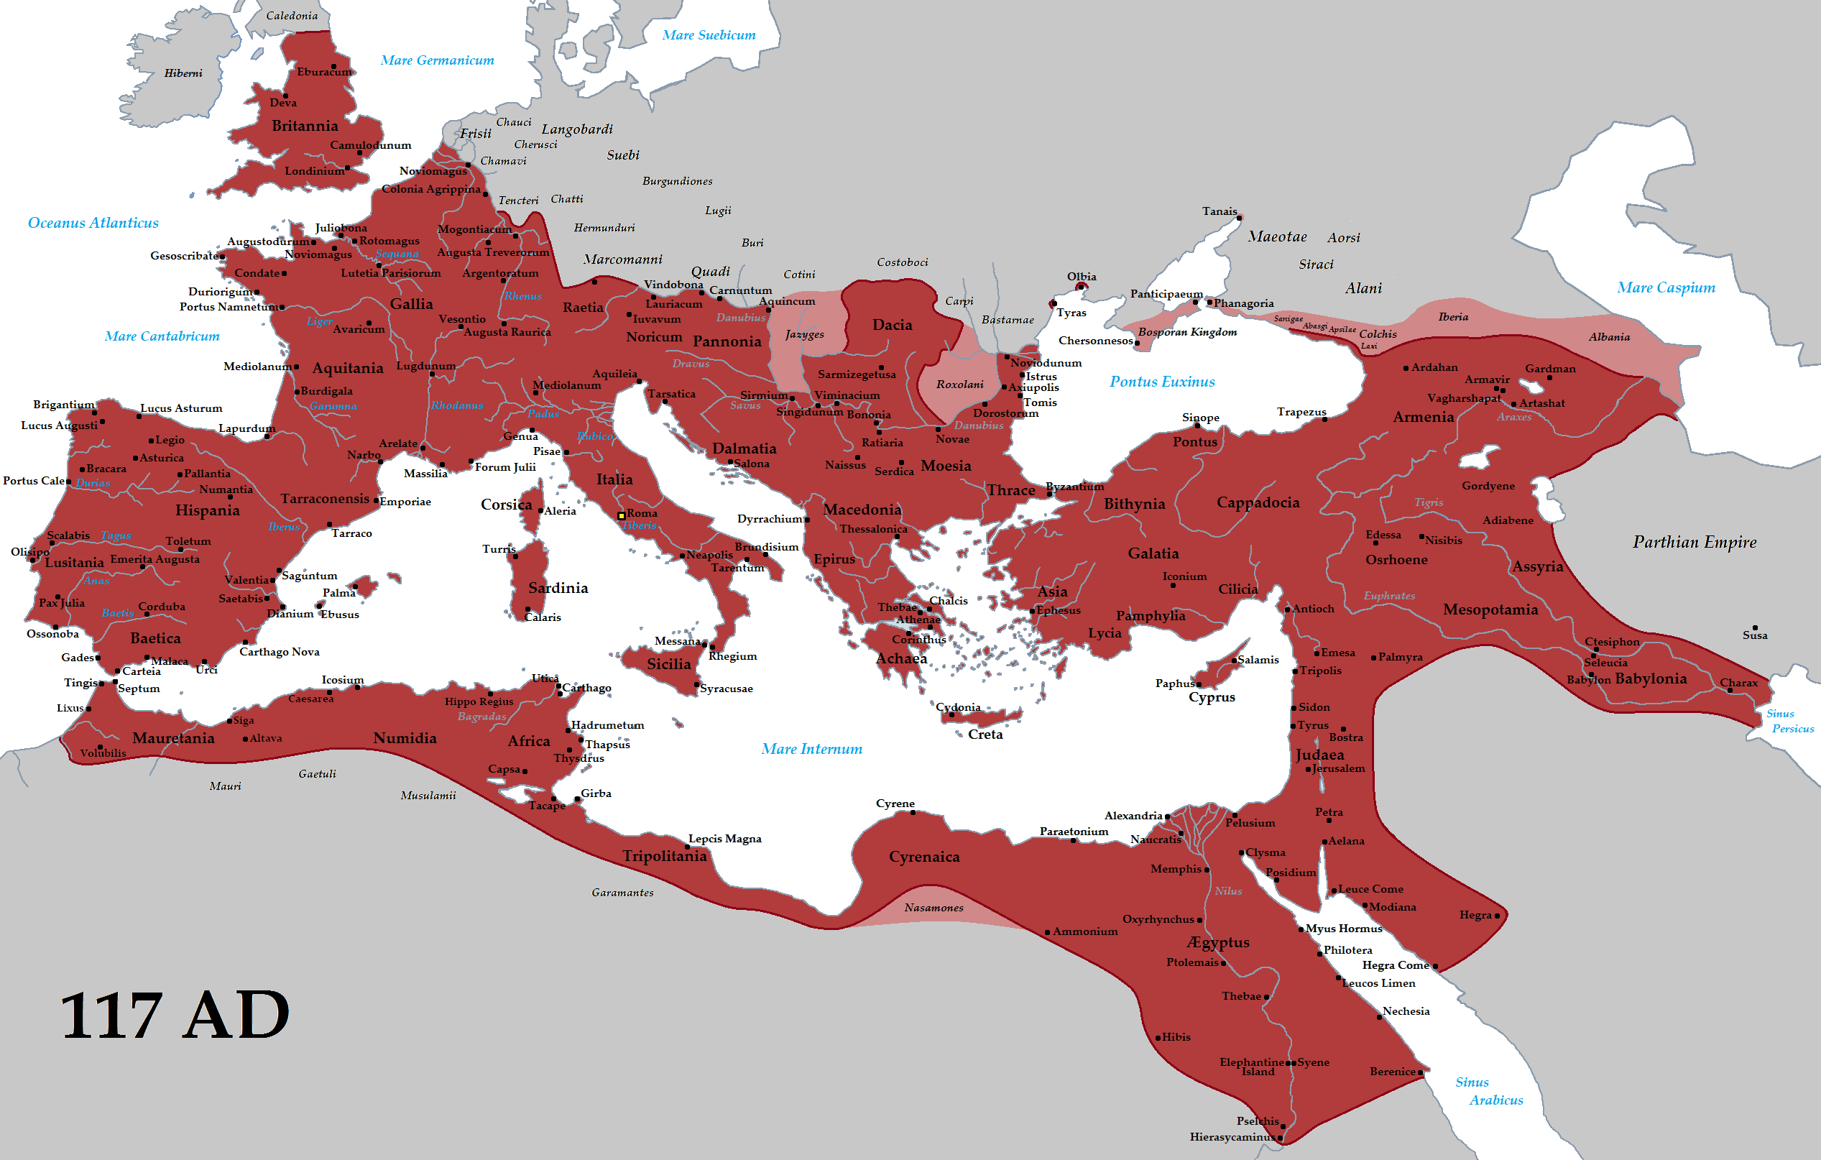
The Greco-Roman World of AD 117

Slide 5
Romans 1:18-21
A willful rejection of what one can know about God:
“For the wrath of God is revealed from heaven against all ungodliness and unrighteousness of men, who suppress the truth in unrighteousness, because what may be known of God is manifest in them, for God has shown it to them. For since the creation of the world His invisible attributes are clearly seen, being understood by the things that are made, even His eternal power and Godhead, so that they are without excuse, because, although they knew God, they did not glorify Him as God, nor were thankful, but became futile in their thoughts, and their foolish hearts were darkened” (Rom. 1:18-21).

Slide 6
Romans 1:22-23
A world that professed itself to be wise had become fools:
“Professing to be wise, they became fools, and changed the glory of the incorruptible God into an image made like corruptible man—and birds and four-footed animals and creeping things” (Rom. 1:22-23).
Instead of the Bible world view, the Greco-Roman world had a pagan view of the world.

Slide 7
Romans 1:22-25, 26-27
A world given up to immorality: “Therefore God also gave them up to uncleanness, in the lusts of their hearts, to dishonor their bodies among themselves, who exchanged the truth of God for the lie, and worshiped and served the creature rather than the Creator, who is blessed forever. Amen” (Rom. 1:22-25).
A world given up to sexual perversion: “For this reason God gave them up to vile passions. For even their women exchanged the natural use for what is against nature. Likewise also the men, leaving the natural use of the woman, burned in their lust for one another, men with men committing what is shameful, and receiving in themselves the penalty of their error which was due” (Rom. 1:26-27).

Slide 8
Romans 1:28-32
A world given up to every form of moral degeneracy:
“And even as they did not like to retain God in their knowledge, God gave them over to a debased mind, to do those things which are not fitting; being filled with all unrighteousness, sexual immorality, wickedness, covetousness, maliciousness; full of envy, murder, strife, deceit, evil-mindedness; they are whisperers, backbiters, haters of God, violent, proud, boasters, inventors of evil things, disobedient to parents, undiscerning, untrustworthy, unloving, unforgiving, unmerciful; who, knowing the righteous judgment of God, that those who practice such things are deserving of death, not only do the same but also approve of those who practice them” (Rom. 1:28-32).

Slide 9
Corinth: The Las Vegas of First Century
“Also, located on the Acrocorinth, was a temple to Aphrodite which housed one thousand sacred prostitutes, which naturally attracted ‘worshippers’ from all over Greece. So profligate did Corinth become that the phrase “to live like a Corinthian”(to korinthiazesthai) meant to live a life of drunken and immoral debauchery. Because of the immorality common to the city, the church which was established there was destined to encounter a variety of moral problems. Perhaps Paul’s description of Gentile degeneration which appears in Romans 1:28-32 was inspired by what he saw while he stayed in Corinth; we do know that he wrote Romans while he was in that city (Rom. 15:26; 16:1)” (Mike Willis, A Commentary on First Corinthians, ii).

Slide 10
Nero (AD 54-48): A Corrupt Ruler
Seutonius: “Besides abusing freeborn boys and seducing married women, he debauched the vestal virgin Rubria. The freedwoman Acte he all but made his lawful wife, after bribing some ex-consuls to perjure themselves by swearing that she was of royal birth. He castrated the boy Sporus and actually tried to make a woman of him; and he married him with all the usual ceremonies, including a dowry and a bridal veil, took him to his house attended by a great throng, and treated him as his wife. And the witty jest that someone made is still current, that it would have been well for the world if Nero’s father Domitius had had that kind of wife. This Sporus, decked out with the finery of the empresses and riding in a litter, he took with him to the assizes and marts of Greece, and later at Rome through the Street of the Images, fondly kissing him from time to time. That he even desired illicit relations with his own mother, and was kept from it by her enemies, who feared that such a help might give the reckless and insolent woman too great influence, was notorious, especially after he added to his concubines a courtesan who was said to look very like Agrippina. Even before that, so they say, whenever he rode in a litter with his mother, he had incestuous relations with her, which were betrayed by the stains on his clothing” (The Twelve Caesars, “Nero,” 28).

Slide 11
Jeremiah’s World in Jerusalem (587 BC)
“Thus says the Lord: ‘Stand in the ways and see, And ask for the old paths, where the good way is, And walk in it; Then you will find rest for your souls. But they said, ‘We will not walk in it’” (Jer. 6:16).
“Now therefore, speak to the men of Judah and to the inhabitants of Jerusalem, saying, ‘Thus says the Lord: “Behold, I am fashioning a disaster and devising a plan against you. Return now every one from his evil way, and make your ways and your doings good.”’ And they said, ‘That is hopeless! So we will walk according to our own plans, and we will every one obey the dictates of his evil heart’” (Jer. 18:11-12).

Slide 12
Ezekiel’s World in Babylon (587 BC)
“And He said to me: ‘Son of man, I am sending you to the children of Israel, to a rebellious nation that has rebelled against Me; they and their fathers have transgressed against Me to this very day. For they are impudent and stubborn children. I am sending you to them, and you shall say to them, “Thus says the Lord God.” As for them, whether they hear or whether they refuse—for they are a rebellious house—yet they will know that a prophet has been among them’” (Ezek. 2:3-5).

Slide 13
Ezekiel’s World in Babylon (587 BC)
“Then He said to me: ‘Son of man, go to the house of Israel and speak with My words to them. For you are not sent to a people of unfamiliar speech and of hard language, but to the house of Israel, not to many people of unfamiliar speech and of hard language, whose words you cannot understand. Surely, had I sent you to them, they would have listened to you. But the house of Israel will not listen to you, because they will not listen to Me; for all the house of Israel are impudent and hard-hearted. Behold, I have made your face strong against their faces, and your forehead strong against their foreheads. Like adamant stone, harder than flint, I have made your forehead; do not be afraid of them, nor be dismayed at their looks, though they are a rebellious house’” (Ezek. 3:4-9).

Slide 14
Preaching in a Wicked World
The darkness has to get so hopeless before wicked man will turn from his painful, sinful ways.
The gospel was born in a wicked society.

Slide 15
Only the Gospel
“For I am not ashamed of the gospel of Christ, for it is the power of God to salvation for everyone who believes, for the Jew first and also for the Greek” (Rom. 1:16).

Slide 16
All of Mankind Are Guilty of Sin
The gospel acknowledges the sinfulness of all humanity (Rom. 3:10-19), including both Jew and Gentile: “for all have sinned and fall short of the glory of God” (Rom. 3:23).
The most righteous among us and the most wicked stand before God’s judgment seat with the same sentence, “Guilty!”
There is no room for feelings of superiority over others who are also sinful.

Slide 17
The Gospel Is Man’s Only Hope
“For I am not ashamed of the gospel of Christ, for it is the power of God to salvation for everyone who believes, for the Jew first and also for the Greek” (Rom. 1:16).
“For the message of the cross is foolishness to those who are perishing, but to us who are being saved it is the power of God. . . . For since, in the wisdom of God, the world through wisdom did not know God, it pleased God through the foolishness of the message preached to save those who believe” (1 Cor. 1:18, 21).

Slide 18
Diluting and Polluting the Gospel
In the bleak and rapidly spreading secularism in America, some evangelists compromise with the world in hope of luring some to the gospel.
The liberal churches compromise on worldliness:
Acceptance of immodest dress and lascivious conduct
Expectation that our children will have sex outside of the bonds of wedlock
Living together outside the bonds of marriage
Acceptance of abortion
Acceptance of divorce and remarriage for any reason
Acceptance of homosexuality and homosexual marriages
The message is a “come as you are, stay as you are” gospel
Significantly, the most liberal denominations among us are the ones who are losing the most members and having the most churches to close their doors.

Slide 19
Luring with Entertainment
Even evangelical churches are trying to reach the lost with social attractions.
Protestants have lured people with special musical performances appealing to the young, specifically rock gospel music.
Special speakers in the entertainment and political world are invited to speak to draw a crowd.
Frequently, the churches are embarrassed when they learn of ungodly conduct from those half-converted speakers who are wanting to attractive votes to their political ambitions.

Slide 20
21st Century Approach to Evangelism
David Kinnaman: “The unpopular parts of Christian teaching are omitted or deemphasized. They hijack the image of Jesus by portraying him as an open-minded, big-hearted, and never-offend-anyone moral teacher. That is an entirely wrong idea of Jesus” (UnChristian, 33).
Francis Chan: “If we genuinely believed that the Word of God was this powerful, what would we do? We would read these words and expect them to have a life of their own. We certainly wouldn’t put so much emphasis on different preachers and their ability to ‘make the Scriptures come alive’!” (Letters to the Church, 57).

Slide 21
Some Are Waking Up
Francis Chan, one of the successful mega-church leaders, walked away from the mega-church concept and wrote a book entitled Letters to the Church.
He quoted Alan Hirsch who was trying to build a mega-church in Australia, “If you have to use marketing and the lures of entertainment to attract people, then you will have to keep them there on the [same] principle because that is what people buy in to. . . .Win them with entertainment, and you have to keep them there by entertaining them.”
Because the addictive nature of entertainment, it takes more to produce the same effect, “We end up creating a whip for our own backs” (51).

Slide 22
Making the Church A Social Club
Special services are provided:
Day care centers
Pre-school through six-grade schools
Fellowship halls for a pitch-in supper were soon expanded into soccer fields, gymnasiums, and other facilities to create a cheap alternative to exclusive golf clubs
One church planned its services around the Super Bowl, with a 20-minute service at half-time!

Slide 23
Judge Them by Their Fruits
David Kinnaman, president of the Barna Group:
“When asked to identify their activities over the last thirty days, born-again believers were just as likely to bet or gamble, to visit a pornographic website, to take something that did not belong to them, to consult a medium or psychic, to physically fight or abuse someone, to have consumed enough alcohol to be legally drunk, to have used an illegal, nonprescription drug, to have said something to someone that was not true, to have gotten back at someone for something he or she did, and to have said mean things behind another person’s back” (David Kinnaman, UnChristian, 47).

Slide 24
Paul’s Evangelism Techniques
Paul did not avoid confronting the non-Christian philosophy of the first century and his example for how to do is instructive:
“And I, brethren, when I came to you, did not come with excellence of speech or of wisdom declaring to you the testimony of God. For I determined not to know anything among you except Jesus Christ and Him crucified. I was with you in weakness, in fear, and in much trembling. And my speech and my preaching were not with persuasive words of human wisdom, but in demonstration of the Spirit and of power, that your faith should not be in the wisdom of men but in the power of God” (1 Cor. 2:1-5).

Slide 25
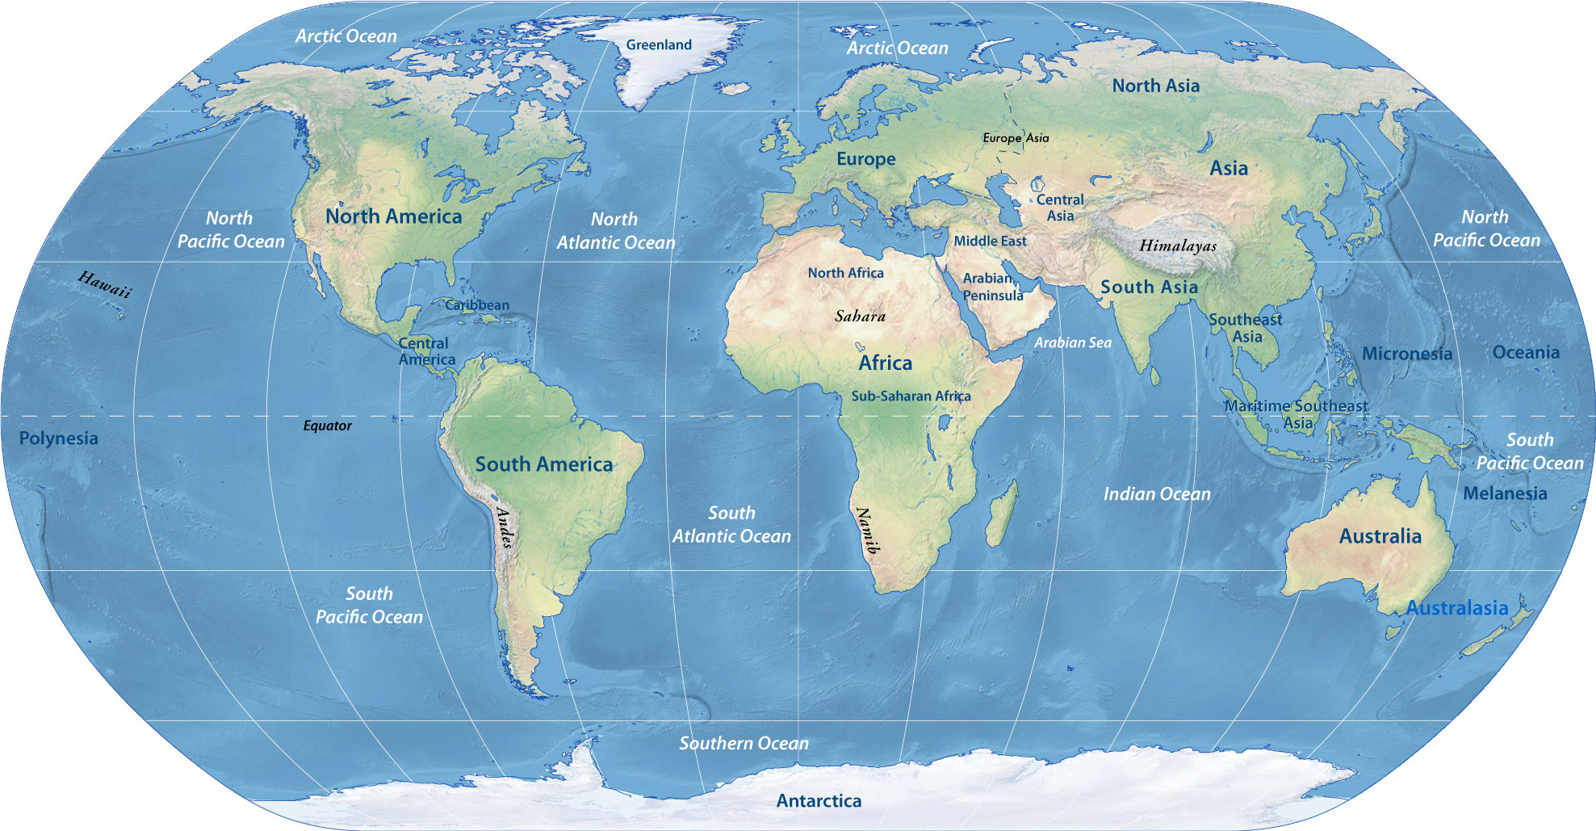
A World of Opportunities

Slide 26
The Great Commission
“And Jesus came and spoke to them, saying, ‘All authority has been given to Me in heaven and on earth. Go therefore and make disciples of all the nations, baptizing them in the name of the Father and of the Son and of the Holy Spirit, teaching them to observe all things that I have commanded you; and lo, I am with you always, even to the end of the age’” (Matt. 28:18-20).
“And He said to them, ‘Go into all the world and preach the gospel to every creature. He who believes and is baptized will be saved; but he who does not believe will be condemned’” (Mark 16:15-16).

Slide 27
Driven by Darkness
The darkness of the wicked world caused people to turn away from wickedness.
Cornelius, a Roman centurion: “There was a certain man in Caesarea called Cornelius, a centurion of what was called the Italian Regiment, a devout man and one who feared God with all his household, who gave alms generously to the people, and prayed to God always” (Acts 10:1-2).
The Philippian jailor: “Sirs, what must I do to be saved?” (Acts 16:30).
The great gospel invitation is still appreciated: “Come to Me, all you who labor and are heavy laden, and I will give you rest. Take My yoke upon you and learn from Me, for I am gentle and lowly in heart, and you will find rest for your souls. For My yoke is easy and My burden is light” (Matt. 11:28-30).

Slide 28
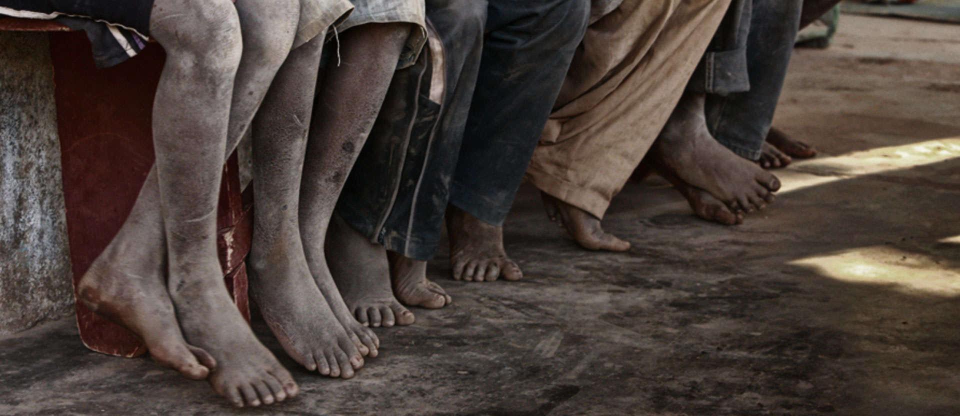
How Will We View Our Opportunities to Teach the Gospel to a World Lost in the Darkness of Wickedness?
Salesman 1:
“There is no hope for us to market our shoes here. The people do not wear shoes.”
Salesman 2:
“This is going to be a wonderful market. No one has any shoes!” ”

Slide 29
Realistic Expectations

Slide 31
Look for the Right Soil
Jesus taught His disciples to walk away from poor soils and look for another place to plant the seed.
“And whoever will not receive you nor hear your words, when you depart from that house or city, shake off the dust from your feet. Assuredly, I say to you, it will be more tolerable for the land of Sodom and Gomorrah in the day of judgment than for that city!” (Matt. 10:14-15).
“But whatever city you enter, and they do not receive you, go out into its streets and say, ‘The very dust of your city which clings to us we wipe off against you. Nevertheless know this, that the kingdom of God has come near you’” (Luke 10:10-11).
“But they shook off the dust from their feet against them (Antioch of Pisidia), and came to Iconium” (Acts 13:51).
He did not encourage or teach His disciples to change and adapt His message to accommodate the sinful desires of the people: “For since, in the wisdom of God, the world through wisdom did not know God, it pleased God through the foolishness of the message preached to save those who believe” (1 Cor. 1:21).

Slide 32
The Soil in America
The soil has changed in America—more and more of the soil is becoming wayside, stony, and thorny ground.
The gospel is bearing precious little fruit in the United States, Canada, and Europe.
The gospel is bearing abundance of fruit in such places as the Philippines, India, South America and South Korea.
Let us not judge the gospel to be impotent because of the ground in which it is planted!

Slide 33
Bless the Sowers
We are not limiting sowers to preachers.
We ask the Lord to bless those who invite their friends and neighbors to come to worship, whether or not anyone of them ever comes.
We ask the Lord to bless those who have taught their children and other relatives whether or not they ever choose to obey the gospel.
Remember that we are sowers! We are not appointed to keep count of the harvest results.

Slide 34
Conclusion

Slide 35
Evangelizing in a Wicked World

Slide 36
Will You Accept the Challenge?
Will to invite one of your neighbors, friends, a person at Walmart, or whomever, to come to worship with you this week?
Will you pray for the Lord to open a door for you and me to teach someone the gospel?

