Slide 2
Jesus Taught Many Religious People
Nicodemus was a ruler among the Jews (John 3:1)
The rich young ruler (Matt. 19:16-22)
He taught in the synagogue at Nazareth (Luke 4:16-30)

Slide 3
Jesus Reached Out to Those Entrapped in Sin
The woman who was caught in the very act of adultery and brought to see if Jesus would approve the Law’s command that she be stoned to death (John 8:1-12).
The Samaritan woman who had been married five times and was living with someone who was not her husband (John 4:18).
The sinful woman who anointed Jesus at the house of Simon (Luke 7:36-50).
It is instructive to witness how Jesus treated those who were attracted to Jesus’s message of salvation.

Slide 4
The Sinful Woman Who Anointed Jesus’s Feet
Luke 7:36-50

Slide 5
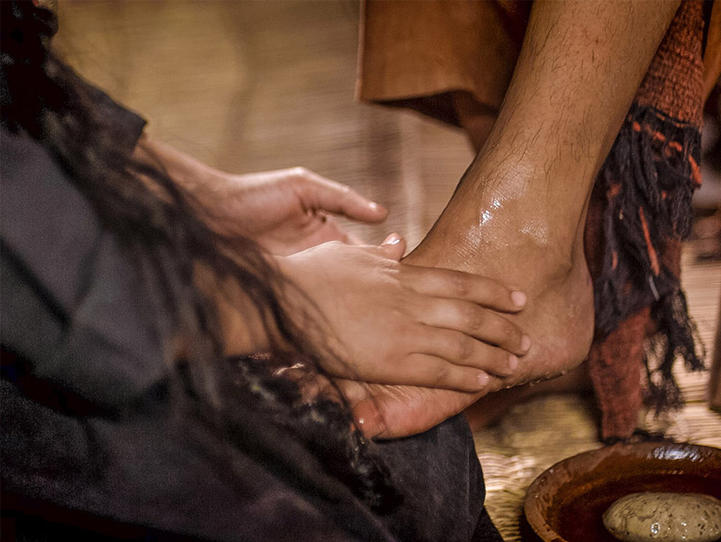
A Sinful Woman Anoints Jesus’s Feet
Luke 7:36-50

Slide 6
Setting the Context
The context of Luke’s gospel follows an incident in Nain where Jesus had raised a widow’s dead son (Luke 7:11-17).
Luke places this narrative in the context of John the Baptist having sent messengers his disciples to inquire if Jesus was truly the Messiah (Luke 7:19-28).
In concluding his comments about John the Baptist, Jesus said, “‘For I say to you, among those born of women there is not a greater prophet than John the Baptist; but he who is least in the kingdom of God is greater than he.’ And when all the people heard Him, even the tax collectors justified God, having been baptized with the baptism of John. But the Pharisees and lawyers rejected the will of God for themselves, not having been baptized by him” (Luke 7:28-30).
Sinners and tax collectors were commonly grouped together as the vilest among first century Jews (Matt. 5:46; 9:10; 11:19; 18:17; 21:31-32).

Slide 7
An Invitation to Dinner
The narrative relates that a Pharisee invited Jesus to join him for dinner, along with others.
This incident should not be confused with the incident in the last week of Jesus’s life, more than a year later.
People sometimes tie them together because in both cases, the house is that of a man named Simon (Luke 7:40; Matt. 26:6). However, since Simon was a very popular name in the first century AD, that is insufficient reason to conclude that the two Simon’s were the same person.
The two incidents emphasize totally different messages: “In Luke it is concerned with love and forgiveness, in the others with selling the unguent and giving to the poor” (Leon Morris, Luke: An Introduction and Commentary, Tyndale New Testament Commentaries, 165). There is no reason to think that the woman in the latter event was a vile sinner; she was Mary, the sister to Lazarus (John 12:1-3).
Jesus had dined earlier with Matthew (Levi), a publican who became one of Jesus’s disciples (Matt. 5:29).

Slide 8
A Sinful Woman
The woman who approached Jesus to anoint him is described as a “sinner.”
The word “sinner” actually describes all of humanity who has reached the age to make moral choices (Rom. 3:23).
However, it is also used to describe someone who had a bad reputation in the community. It emphasizes that she is an outsider—“irreligious, unobservant people, outsiders of those who did not observe the Law in detail and therefore were shunned by observers of traditional precepts” (BDAG, 51).

Slide 9
Who Was She?
The commentaries draw their own conclusions from this:
Leon Morris: “probably means a prostitute” (166).
Robert H. Stein: “This woman could have been a sinner because of her occupation. Tax collectors, tanners, camel drivers, custom collectors, among others were considered ceremonially impure because of their occupations and could be labeled ‘sinners.’ In this instance, however, this woman’s sinfulness involved moral not ceremonial matters” (Luke, The New American Commentary, 236).
I. Howard Marshall: “Probably a prostitute is meant” (The Gospel of Luke: A Commentary on the Greek Text, New International Greek Testament Commentary, 308).
Colly Caldwell: “Some have supposed that she was a prostitute, an immoral adulteress, but her sins are not specified in the text” (Luke: Truth Commentaries, 449).
What is clear is that she had a bad reputation in town for being a sinner, whatever might have been the reason for that.

Slide 10
An Uninvited Guest
By American standards, what the woman did appears to be intruding on the privacy of the guests.
She was uninvited to the feast. However, “A meal such as the one that Jesus was attending was not private. People could come in and watch what went on. At the same time a prostitute would not have been very welcome in Simon’s house, so it took courage to come” (Morris, 166).
The guests in the house commonly reclined at the table, that is, they lay on their left side with their feet extended away from the table, and reached for their food with their right hand.

Slide 11
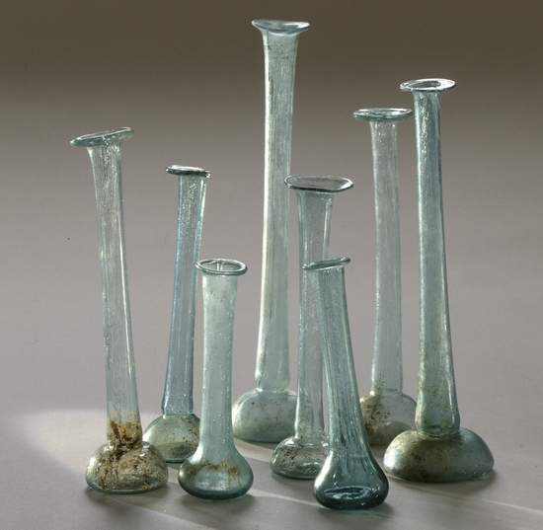
What She Did Was Shocking
She had brought an alabaster flask of ointment. If it was in an alabaster flask, this would indicate that the ointment was probably expensive.
The smell of the perfume most likely would have filled the room.
She anointed, not the head of Jesus, but His feet.
She washed Jesus’s feet with her tears and dried them with the hairs of her head.

Slide 12
Picture the Scene
“The woman was thus able to approach Jesus’ feet without difficulty. She may have intended to anoint them (or the head), but her emotions got the better of her and her tears fell on his feet. She promptly wiped them with her hair, a significant action, for Jewish ladies did not unbind their hair in public. Clearly she was completely oblivious of public opinion in the grip of her deep emotion. This will explain also her kissing of the feet. . . . Finally she anointed Jesus’ feet with the unguent. Normally this would have been poured on the head. To use it on the feet is probably a mark of humility” (Leon Morris, 166-167).

Slide 13
Who Was She?
“It is a fair conjecture that Jesus had turned this woman from her sinful ways and that all this was the expression of her love and gratitude. It is not clear whether she had met Jesus. She may simply have been among the crowds who listened to his teaching and had been so convicted that her life had been changed. Or she may have had unrecorded contacts with Jesus. We do not know” (Morris, 167).

Slide 14
Jesus vs. Simon
Our interest is in seeing how Jesus viewed this woman.
Jesus: Jesus allowed the woman to come near Him and to express her deeply felt emotions toward Him.
Simon: “Now when the Pharisee who had invited Him saw this, he spoke to himself, saying, ‘This man, if He were a prophet, would know who and what manner of woman this is who is touching Him, for she is a sinner’” (Luke 7:39).
Simon would not have reached out to touch her or to allow the woman to touch him.
He was repulsed by what he saw Jesus allowing.

Slide 15
Gospel Blessings Available to All

Slide 16
Will You Come?
“And the Spirit and the bride say, ‘Come!’ And let him who hears say, ‘Come!’ And let him who thirsts come. Whoever desires, let him take the water of life freely” (Rev. 22:17).
“Come to Me, all you who labor and are heavy laden, and I will give you rest. Take My yoke upon you and learn from Me, for I am gentle and lowly in heart, and you will find rest for your souls. For My yoke is easy and My burden is light” (Matt. 11:28-30).

Slide 17
The Land of Beginning Again
If you have found that the sinful life is a dark place, that the consequences of sin are so painful that you have decided to turn away from them, and wish to make a fresh start, the gospel invitation is extended to you.
You can be born again: “Jesus answered and said to him, ‘Most assuredly, I say to you, unless one is born again, he cannot see the kingdom of God’” (John 3:3).
Louisa Fletcher wrote a poem entitled “The Land of Beginning Again,” with an inclusio in which the last verse repeats the first verse:
I wish that there were some wonderful place
Called the land of Beginning Again,
Where all our mistakes and all our heartaches
And all of our poor selfish grief
Could be dropped like a shabby old coat at the door,
And never put on again.

Slide 18
1 Timothy 1:12-16
“And I thank Christ Jesus our Lord who has enabled me, because He counted me faithful, putting me into the ministry, although I was formerly a blasphemer, a persecutor, and an insolent man; but I obtained mercy because I did it ignorantly in unbelief. And the grace of our Lord was exceedingly abundant, with faith and love which are in Christ Jesus. This is a faithful saying and worthy of all acceptance, that Christ Jesus came into the world to save sinners, of whom I am chief. However, for this reason I obtained mercy, that in me first Jesus Christ might show all longsuffering, as a pattern to those who are going to believe on Him for everlasting life” (1 Tim. 1:12-16).

Slide 19
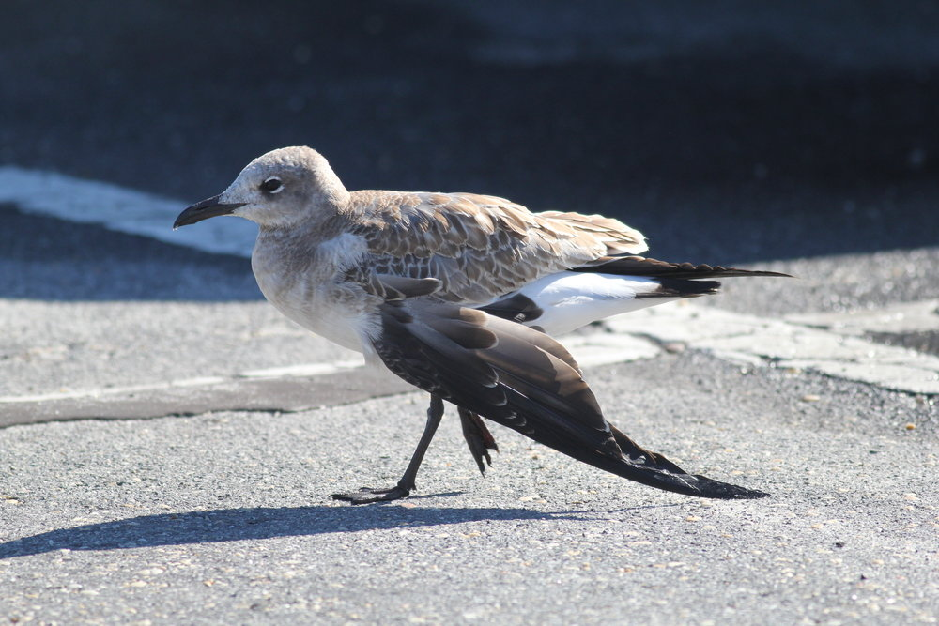
Mended and Whole
By Donald Alexander
O how great the salvation in Jesus,
That the prophets of old testified!
Even angels desire its revealing.
Praise and glory to Christ crucified.
As a lamb that was led to the slaughter,
Not a threat, not a word did You say.
Help me, Lord, when my heart fills with anger.
Your example I will not betray.
I’ve been saved by Your Word that is living
To a love that is fervently pure;
Precious blood from Your cross brings redemption
With a hope that is living and sure.
Chorus
You were threatened for me;
You were slandered for me;
Ev’ry thorn, ev’ry nail, ev’ry tear was for me.
Sweet the thought that my soul may be mended and whole
By my Lord who was broken for me.

Slide 20
Not Cheap Grace

Slide 21
1. It requires faith in the deity of Jesus
Simon had reasoned: “Now when the Pharisee who had invited Him saw this, he spoke to himself, saying, ‘This man, if He were a prophet, would know who and what manner of woman this is who is touching Him, for she is a sinner’” (Luke 7:39).
Jesus shows Simon that He knew who the woman was by replying to the inward thoughts of Simon’s heart.
Jesus was Immanuel, “God with us” (Matt. 1:23).

Slide 22
2. Jesus demands repentance
“. . . unless you repent you will all likewise perish” (Luke 13:3).
Repentance is that change of one’s mind toward sin.
One must decide, “I will no longer be lord over my own life. I will yield myself to the Lordship of Jesus”: “But why do you call Me ‘Lord, Lord,’ and do not do the things which I say?” (Luke 6:46).
As a child, I understood the ramifications of repentance: If I was doing something that Jesus commanded me not to do, I had to quit doing it; if I was not doing something He wanted me to do, I had to start doing it.
It affects our speech
It affects our sexual conduct
It affects our honesty
It affects our conduct in business
It touches every part of our existence

Slide 23
3. Confession of faith in Jesus
Jesus said, “Therefore whoever confesses Me before men, him I will also confess before My Father who is in heaven” (Matt. 10:32).

Slide 24
4. Baptism in water for remission of one’s sins
“And He said to them, ‘Go into all the world and preach the gospel to every creature. He who believes and is baptized will be saved; but he who does not believe will be condemned’” (Mark 16:15-16).
“Then Peter said to them, ‘Repent, and let every one of you be baptized in the name of Jesus Christ for the remission of sins; and you shall receive the gift of the Holy Spirit’” (Acts 2:38).

Slide 25
Become a Living Sacrifice
The remainder of one’s life then is to become a spiritual sacrifice to Jesus: “I beseech you therefore, brethren, by the mercies of God, that you present your bodies a living sacrifice, holy, acceptable to God, which is your reasonable service. And do not be conformed to this world, but be transformed by the renewing of your mind, that you may prove what is that good and acceptable and perfect will of God” (Rom. 12:1-2).
If Jesus is who we confess Him to be, He knows better than we do, how life should be lived. So, we yield our will to His will.
We sincerely pray, “Thy will be done in earth, as it is in heaven” (Matt. 6:10).

Slide 26
Do you want to do whatever you want to do, live in disobedience to God, and receive the eternal consequences of your rebellion against God?
Do you wish to have your sins cleansed by the blood of Jesus, devote your life to His service, and raise your children according to His commandments?

Slide 27
Conclusion

Slide 28
Bring Christ Your Broken Life
Thomas O. Chisholm
Bring Christ your broken life, so marred by sin;
He will create anew, make whole again.
Your empty wasted years, He will restore.
And your iniquity, remember no more.
Bring him your every care, if great or small,
Whatever troubles you, O bring it all!
Bring him the haunting fears, the nameless dread,
Thy heart he will relieve, and lift up thy head.
Blest Savior of us all, almighty friend!
His presence shall be ours unto the end.
Without him life would be how dark how drear!
But with Him morning breaks and heaven is near!

Slide 29
It’s Up to You
“I have set before you life and death, blessing and cursing: therefore choose life, that both thou and thy seed may live” (Deut. 30:19).

